Slide 1
“I never really saw that well after cataract surgery...”
Rick Blodi
February 14th, 2020

Slide 2
Patient Presentation
CC
Decreased vision in right eye
HPI
75 yo M presents with decreased vision OD over past several months to years.
Had cataract surgery a few years ago in Florida but vision did not improve
Noticed that his right eye did not move much and was bulging forward

Slide 3
History (Hx)
Past Ocular Hx: Intermediate AMD OU, Pseudophakia OU, DM without ocular complications, Asteroid Hyalosis OD,
Past Medical Hx: HTN, DM, hypercholesterolemia, OSA, Asthma
Fam Hx: Cancer (unknown), mother
Meds: Janumet, Lantus, Losartan, Gemfibrozil, Sertraline, Finasteride, omeprazole, singulair, albuterol
Allergies: Ciprofloxacin
Social Hx: Former smoker, Denies alcohol
ROS: unremarkable

Slide 4
External Exam
 | OD |  | OS
BCDVA | 20/400 |  | 20/30
Pupils | 4→3mm | No rAPD | 4→3mm
IOP | 13 mmHg |  | 11 mmHg
EOM | -3 in all cardinal directions |  | full
CVF | full |  | full
103
23
18
Hertel

Slide 5
EOMs

Slide 6
Anterior Segment Exam
SLE | OD |  | OS
External/Lids | Proptosis |  | WNL
Conj/Sclera | Mild chemosis |  | White and quiet
Cornea | Clear, arcus senilis |  | Clear, arcus senilis
Ant Chamber | Deep and quiet |  | Deep and quiet
Iris | Flat |  | Flat
Lens | Centered PCIOL |  | Centered PCIOL

Slide 7
External Photo

Slide 8
Posterior Segment Exam
Fundus | OD |  | OS
Optic Nerve | Pink and sharp |  | Pink and sharp
Macula | Few intermediate drusen |  | Few intermediate drusen
Vessels | WNL |  | WNL
Periphery | WNL |  | WNL

Slide 9
Assessment
75 yo M with long-standing, progressive and painless decreased VA and proptosis OD
Differential Diagnosis
Thyroid Eye Disease
Orbital inflammatory pseudotumor
Lacrimal gland tumor
Orbital tumor
Cavernous hemangioma
Pleomorphic adenoma
Adenoid cystic carcinoma
Orbital lymphoma
Solitary fibrous tumor
Metastatic
Orbital varix
Orbital cellulitis

Slide 10
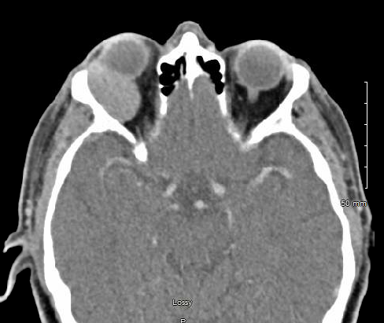
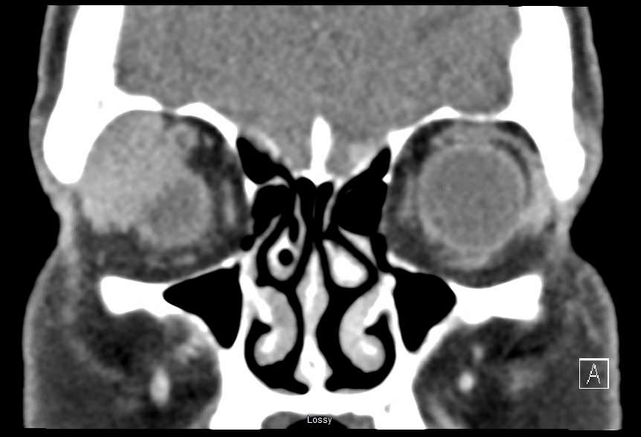
Plan
Obtain CT Orbits W Contrast
Right Orbitotomy with bone flap for mass biopsy and debulking
Notes:
2 x 3.4 x 2.5 cm homogeneous mass along the posterior superior lateral margin of the right globe centered at the lacrimal gland and upper surface of the lateral rectus muscle.

Slide 11
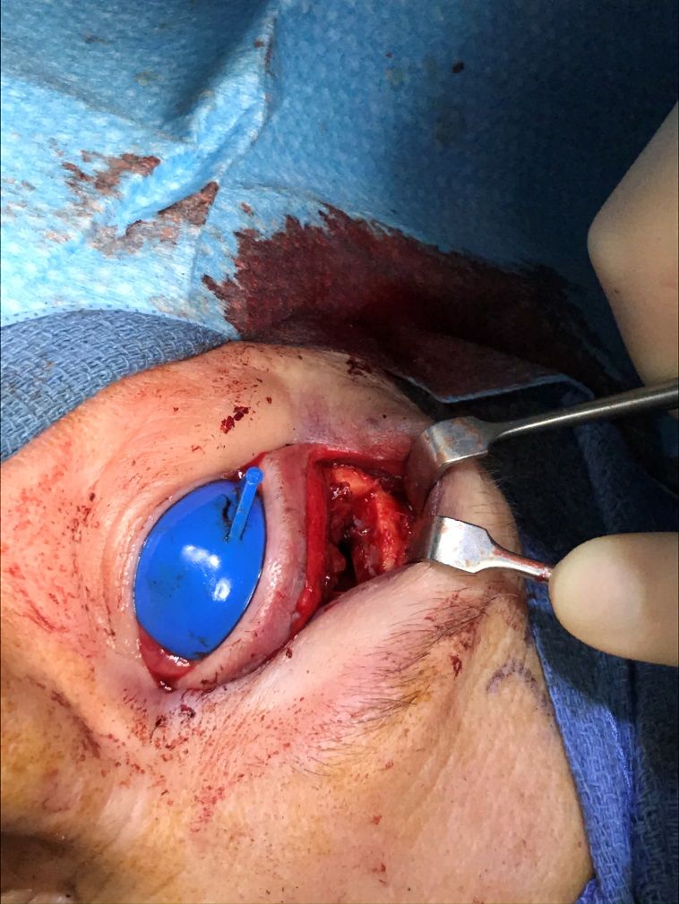
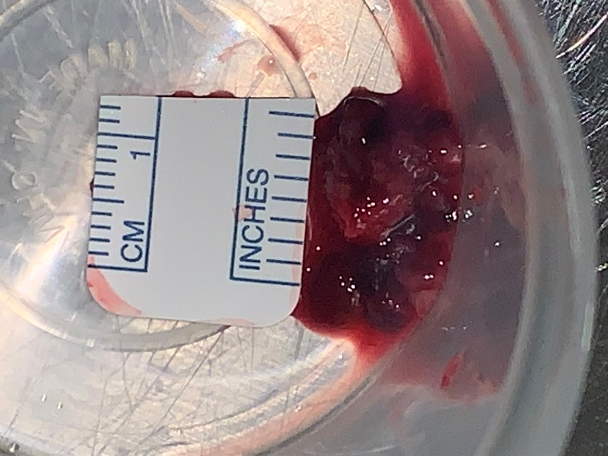
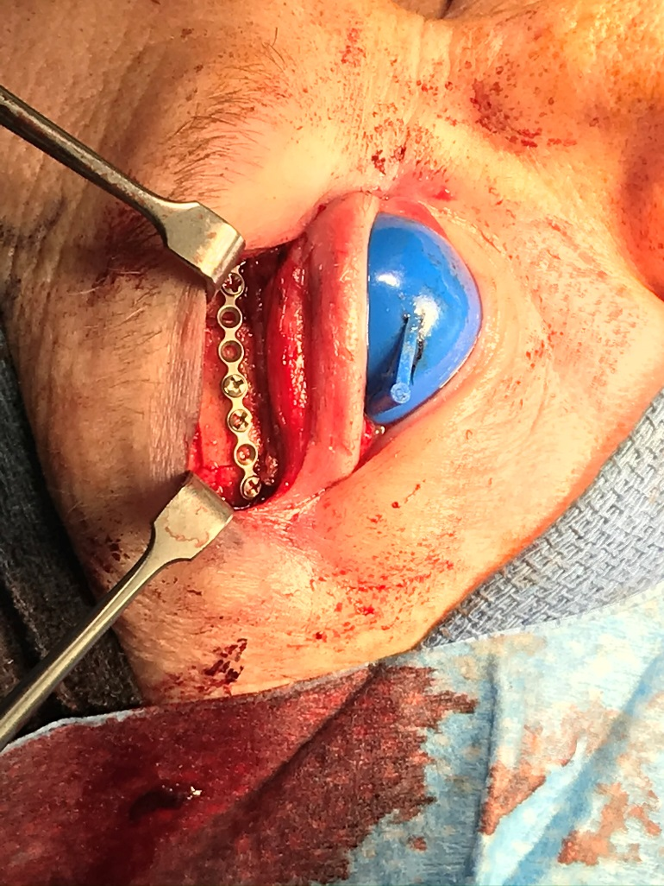
Surgical Photos

Slide 12
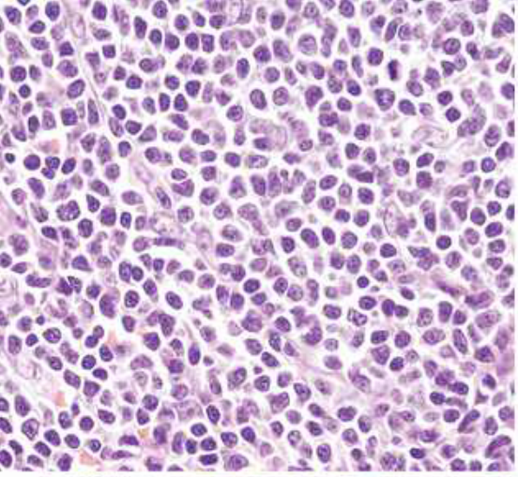
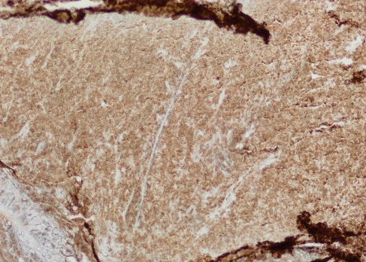
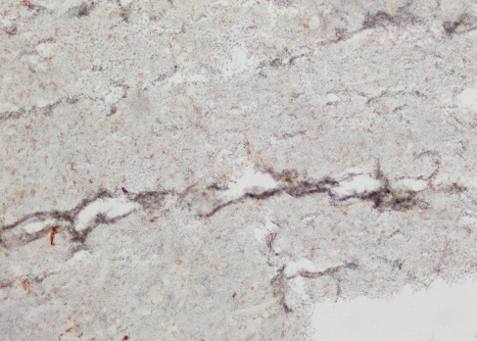
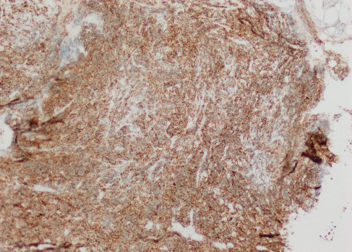
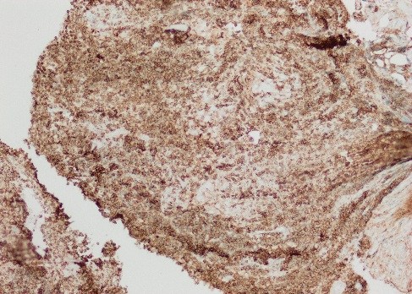
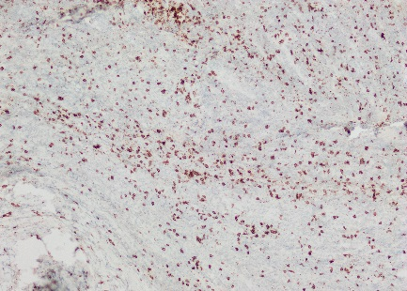
Pathology and Diagnosis
BCL2+
CD10-
Orbital Mantle Cell Lymphoma
CD5+
CD20+
H&E
CD3-
Also Ki-67+. Flow cytometry pending
Notes:
H&E: small to medium size lymphoid cells with irregular nuclear contours, condensed chromatin, inconspicuous nucleoli and scant cytoplasm

Slide 13
Orbital Lymphoma
Orbital Mantle Cell Lymphoma
Mantle Cell Lymphoma

Slide 14
Orbital Lymphoma
Orbital Mantle Cell Lymphoma
Mantle Cell Lymphoma

Slide 15
Orbital Lymphoproliferative Lesions
Most are of B-cell origin, usually MALT type (Mucosa-associated lymphoid tissue)
Good prognosis
Others: follicular, large B-cell, and mantle cell
CD19, CD20 positive
T-cell lymphomas are rare, aggressive
CD3, CD4, CD8 positive
Vast majority are highly radiosensitive
Incidence is increasing

Slide 16
Classification of Orbital Lymphoma
No lymph nodes in orbit → difficult to classify
Revised European-American Lymphoma (REAL) Classification – 4 most common orbital lymphomas:
MALT lymphoma (40-60%)
Chronic Lymphocytic Lymphoma (CLL)
Follicular Center Lymphoma
High-grade lymphomas
Notes:
Classification is an on-going and controversial process

Slide 17
Systemic Involvement of Orbital Lymphoma
Knowles and Jakobiec: tumor location, not histopathology, is most important factor in determining systemic involvement
Conjunctiva: 20%
Orbit: 35%
Eyelid: 67%
Frederick Jakobiec
Notes:
At Mass Eye and Ear… Harvard Medical School

Slide 18
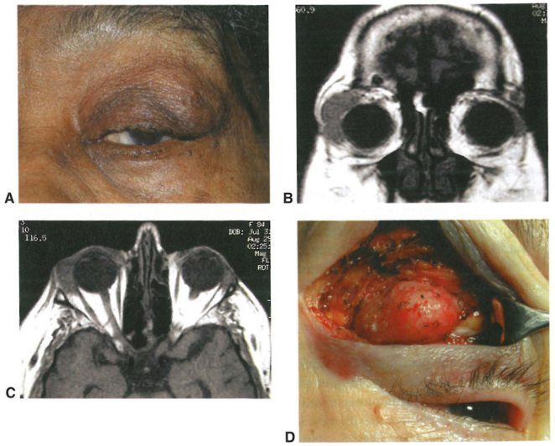
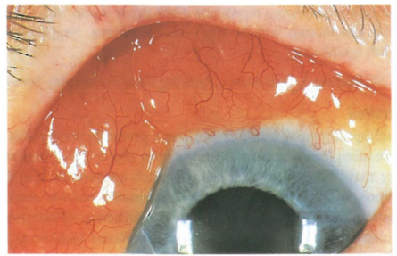
Clinical Presentation of Orbital Lymphoma
Gradual, painless proptosis
Often anterior in orbit or beneath conjunctiva
Mold to surrounding orbital structures
Notes:
A, Right upper eyelid ptosis and fullness with palpable mass beneath orbital rim.
B, Coronal MRI demonstrating right lacrimal gland enlargement with infiltration of anterior
orbital tissues.
C, Axial MRI showing characteristic molding of lesion to adjacent structures.
D, lncisional biopsy of the abnormal infiltration of lacrimal gland reveals orbital lymphoma.
Subconjunctival lymphoma. Note classic salmon-patch appearance of lesion.

Slide 19
Biopsy of Orbital Lymphoma
Discussion in advance with pathologist
Avoid prolonged exposure in air
Wrap in saline-moistened gauze and transport on ice
Avoid crush artifact
Fresh tissue → flow cytometry
Gene rearrangement studies
and immunohistochemistry
on fixed tissue

Slide 20
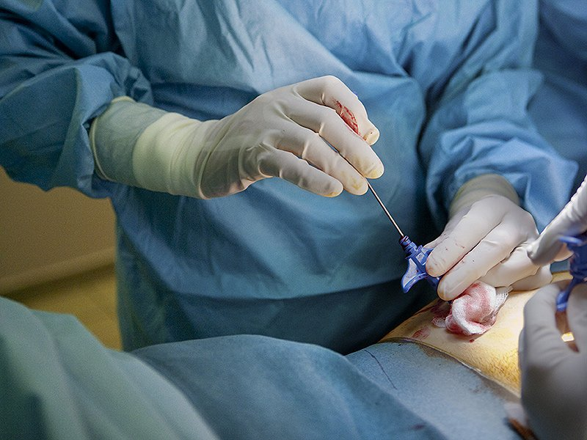
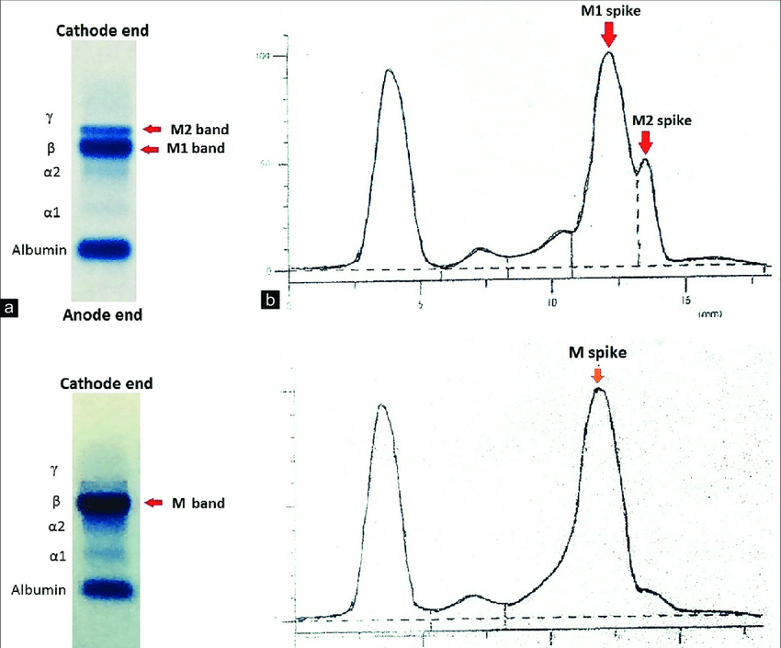
Orbital Lymphoma Management
Exam by an oncologist
CBC
Serum protein electrophoresis
Imaging of neck, thorax, and abdomen – repeated every 6 mos for at least 2 years
Bone marrow biopsy
If localized: radiotherapy
2000-3000 cGy
If systemic: controversial
Chemotherapy (R-CHOP)
Bone Marrow Biopsy
Serum protein electrophoresis
Notes:
Because the various lymphoproliferative lesions show great overlap in terms of clinical behavior, all patients with hypercellular lymphoid lesions (whether monoclonal or polyclonal) should be examined by an oncologist. Depending on the histologic type of the lesion, the examination may include a general physical examination, a complete blood count, a bone marrow biopsy, a liver and spleen scan, a chest radiograph, and serum immunoprotein electrophoresis. The oncologist may also recommend CT of the thorax and abdomen to check for mediastinal and retroperitoneal lymph node involvement. The patient should be reexamined periodically because systemic lymphoma may occur many years after the presentation of an isolated orbital lymphoid neoplasm.
Although systemic corticosteroids are useful in nonspecific orbital inflammation, they are not recommended in the treatment of lymphoproliferative lesions. Radiotherapy is the treatment of choice for patients with localized ocular adnexal lymphoproliferative disease. A dose of 2000- 3000 cGy is typically administered. This regimen achieves local control in virtually all cases and, if the lesion is isolated, may prevent systemic spread. A surgical cure usually cannot be achieved because of the infiltrative nature of lymphoid tumors.
The treatment of low-grade lymphoid lesions that have already undergone systemic dissemination is somewhat controversial because indolent lymphomas are generally refractory to chemotherapy and are associated with long-term survival, even if untreated. Many oncologists take a watchful waiting approach and treat only symptomatic disease. Lymphomas that are more aggressive require radiation, aggressive chemotherapy, or both; up to one-third of these lesions can be cured.

Slide 21
Mantle Cell Lymphoma
Orbital Lymphoma
Orbital Mantle Cell Lymphoma

Slide 22
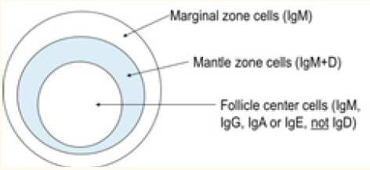
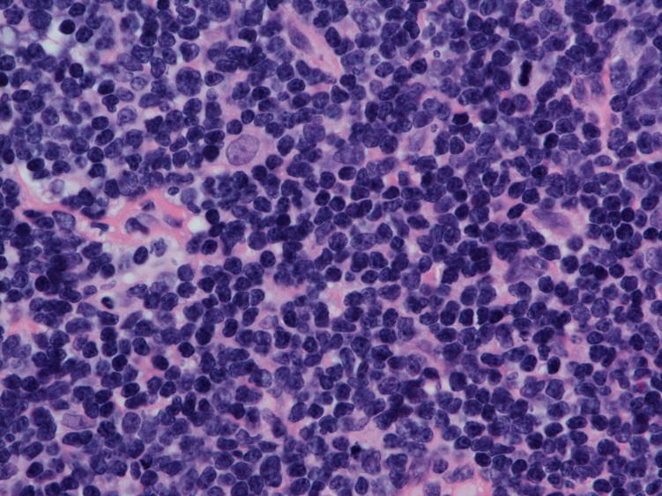
Mantle Cell Lymphoma
Rare non-Hodgkin’s B-cell originating in mantle zone
CD5+, CD20+, cyclin D1, Ki-67
Older males, B-symptoms, enlarged lymph nodes or spleen
Bone marrow and GI tract
No proven treatment standard
Chemotherapy, immune based therapy, radioimmunotherapy and biologic agents
5-year survival rate: 50%
Notes:
cyclin D1, a cell cycle gene, that contributes to the abnormal proliferation of the malignant cells.
Ki-67, a protein associated with cellular proliferation
CHOP therapy (cyclophosphamide, hydroxydaunorubicin, oncovin (vincristine), prednisone. R-CHOP… R = rituximab
antibodies known to be clinically significant in lymphoma: Bcl-2 , Bcl-6, CD3, CD5, CD10, CD20, CD23, and CD79a; cyclin D-1; and MIB-1, an antibody used to establish the presence of Ki-67, a protein associated with cellular proliferation.

Slide 23
Orbital Mantle Cell Lymphoma
Orbital Lymphoma
Mantle Cell Lymphoma

Slide 24
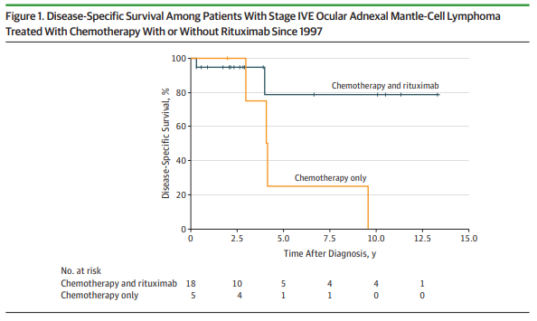
Orbital Mantle Cell Lymphoma
2-7% of Non-Hodgkins Lymphoma
Older men, Bilateral (47%), disseminated (62%)
Aggressive: 5-yr survival rate 38%
Rituximab (R-CHOP) improves survival
Notes:
CHOP therapy (cyclophosphamide, hydroxydaunorubicin, oncovin (vincristine), prednisone. R-CHOP… R = rituximab

Slide 25
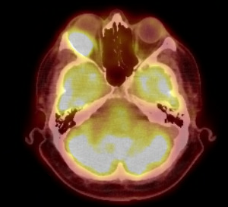
Patient Outcome
PET scan
No other abnormal metabolic activity
Bone marrow biopsy
Normocellular, no evidence of malignant lymphoma
Bloodwork (CBC)
WBC 139.85 → 7.1
Treatment
RCHOP, maintenance Rituxan
Radiotherapy
PET scan
Notes:
In the right orbit, superior laterally is an approximately. 2 to 2.5 cm mass causing proptosis of the right globe. This mass is hypermetabolic having an SUV of 8.7. No other definite abnormal metabolic activity is seen in the neck, chest, abdomen, pelvis. There is presumed physiologic activity seen in the GI and GU tracts.

Slide 26
Conclusions – Orbital Mantle Zone Lymphoma
Rare non-Hodgkin’s B-cell lymphoma originating in mantle zone
Presents as gradual, painless proptosis
Aggressive
Affects older men
Rituximab in addition to CHOP improves outcomes
BCL2+
CD20+
CD5+

Slide 27
References
Harris NL: Extranodal lymphoid infiltrates and mucosa-associated lymphoid tissue (MALT). A unifying concept [editorial]. Am J Surg Pathol 15:879–884, 1991.
Knowles DM, Jakobiec FA: Orbital lymphoid neoplasms: Clinical, pathologic and immunohistochemical characteristics. In Jakobiec FA (ed): Ocular and Adnexal Immunohistochemical Characteristics. Birmingham, AL, Aesculapius Publishing, 1978, pp 806–838.
Knowles DM, Jakobiec FA: Orbital lymphoid neoplasms: A clinicopathologic study of 60 cases. Cancer 46:576–589, 1980.
Knowles DM, Jakobiec FA: Ocular adnexal lymphoid neoplasms: Clinical, histopathologic, electron microscopic, and immunologic characteristics. Hum Pathol 13:148–162, 1982.
A revised European-American classification of lymphoid neoplasms: a proposal from the International Lymphoma Study Group. Blood. 1994. Harris et al.
BCSC Ophthalmic Pathology and Intraocular Tumors
BCSC Orbit, Eyelids, and Lacrimal System
Knudson et al. Clinicopathological Features of Ocular Adnexal Mantle-Cell Lymphoma in an International Multicenter Cohort, JAMA Ophthalmol. 2017;135(12):1367-1374
Medicosis lymphoma videos

Slide 28
Thank you!
Dr. Nunery - clinic
Dr. Compton - surgery
Dr. Tomasko - surgery
Dr. Elpers – surgical photos
Dr. Andrea Breaux - pathology

