Slide 1
Grand Rounds The Great Imitator
Patrick Burchell, PGY-3
January 11, 2019

Slide 2
Patient Presentation
CC
Sudden decreased vision in left eye
HPI
26 yo AAM presents with a 1 week history of sudden decreased vision in his left eye. Noticed upon awakening. Non-progressive. Associated “flickering” in periphery. No recent illness.

Slide 3
History (Hx)
Past Ocular Hx: Denied
Past Medical Hx: Denied
Fam Hx: Denied
Meds: None
Allergies: NKDA
Social Hx: Everyday smoker, denied illicits
ROS: +Headache

Slide 4
External Exam
 | OD |  | OS
VA sc | 20/20 |  | 20/60-2
Refraction |  |  | No improvement
Pupils | 4→3mm |  | 4→3mm
IOP | 16 mmHg |  | 15 mmHg
EOM | full |  | full
CVF | full |  | full

Slide 5
Anterior Segment Exam
PLE or SLE | OD |  | OS
External/Lids | WNL |  | WNL
Conj/Sclera | WNL |  | WNL
Cornea | Clear |  | Clear
Ant Chamber | Deep and quiet |  | Deep and quiet
Iris | WNL |  | WNL
Lens | Congenital Cataract (lamellar) |  | Congenital Cataract (lamellar)

Slide 6
Posterior Segment Exam
Fundus | OD |  | OS
Optic Nerve | Elevation nasally, hyperemic |  | Elevation nasally, hyperemic
Vitreous | Pigment cells in anterior vitreous |  | Pigment cells in anterior vitreous
Macula | WNL |  | Intraretinal creamy dots, blunted foveal reflex
Vessels | Normal caliber |  | Normal caliber
Periphery | White without pressure nasal to disc |  | Few white dots along arcade

Slide 7
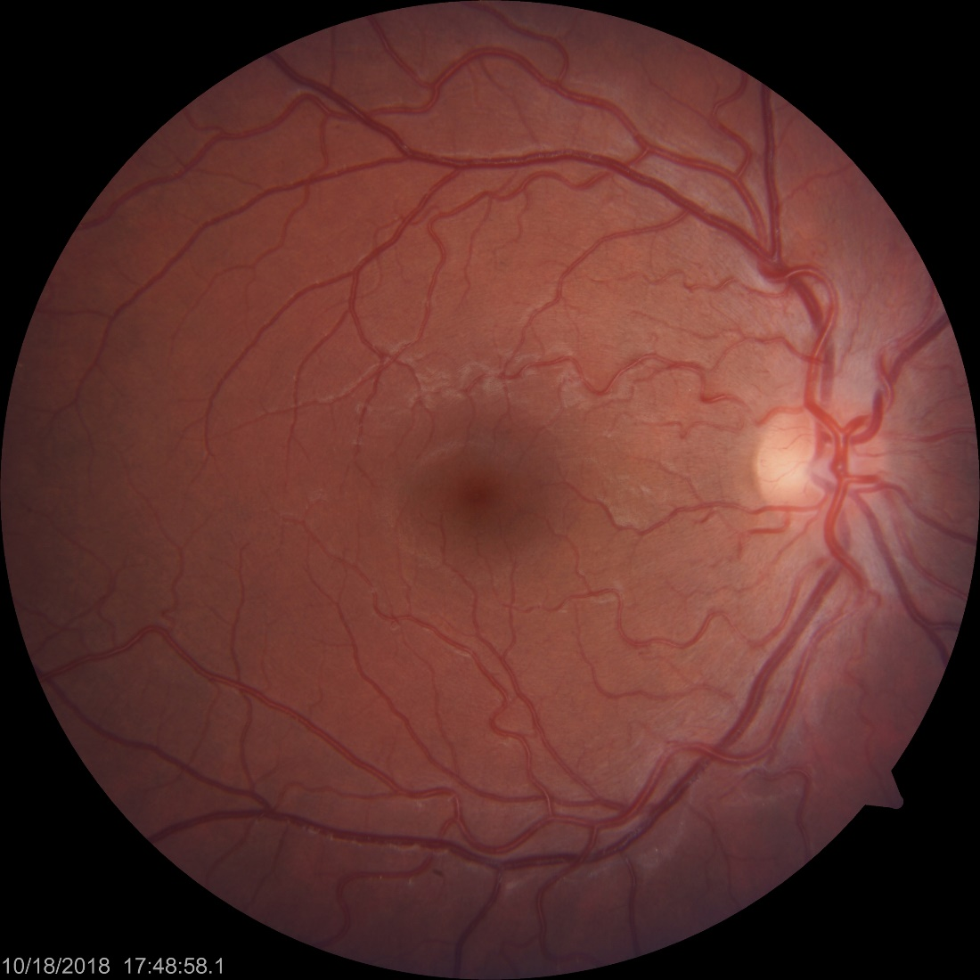
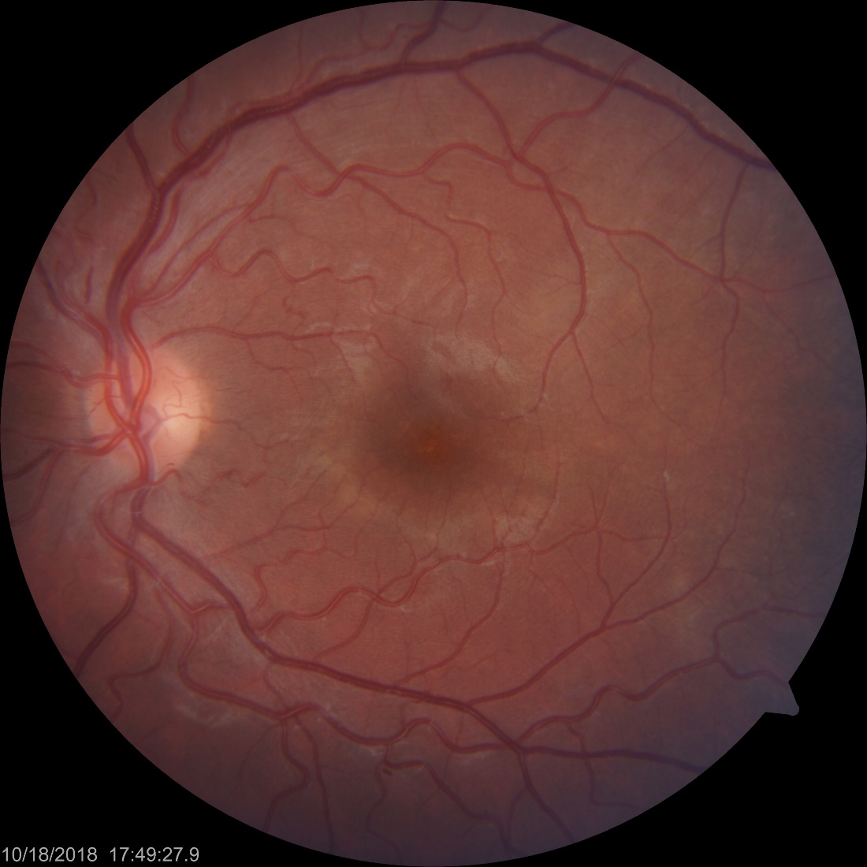
Color Fundus Photos
OD
OS
Notes:
- Small, deep punctate yellow dots in the central macula with a deep yellow discoloration making a ring around the fovea and extending superotemporally

Slide 8
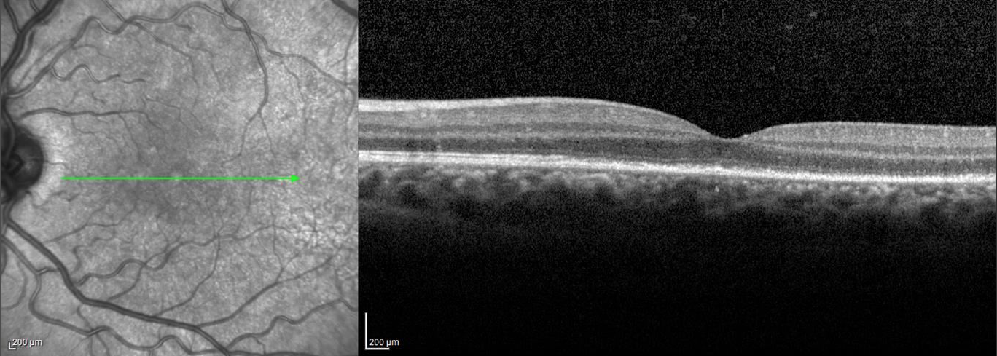
SD-OCT
OD
OS
Notes:
The OCT of the right eye appeared normal
In the left eye there was no macular edema, no subretinal fluid, but there was loss and disruption of the IS/OS and some hyperreflective nodularity of the RPE and punctate hyperreflectivity in the choroid

Slide 9
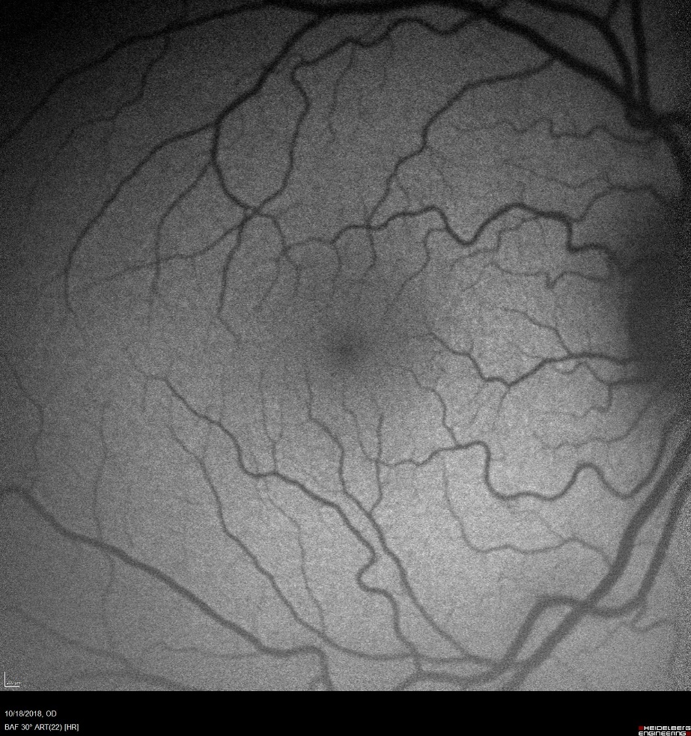
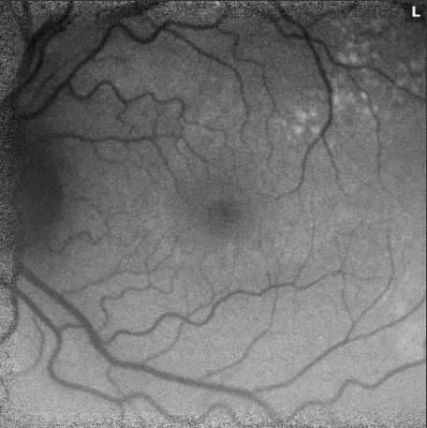
FAF 12/5
OD
OS

Slide 10
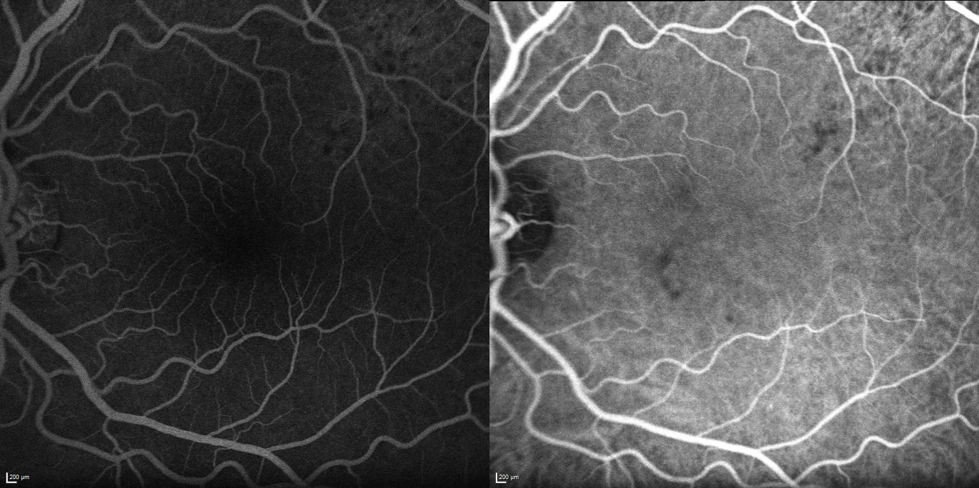
FA/ICG OS
56.52
1.19.12
Notes:
- On FA/ICG there was early hypofuoresence without leakage or staining in the late phases

Slide 11
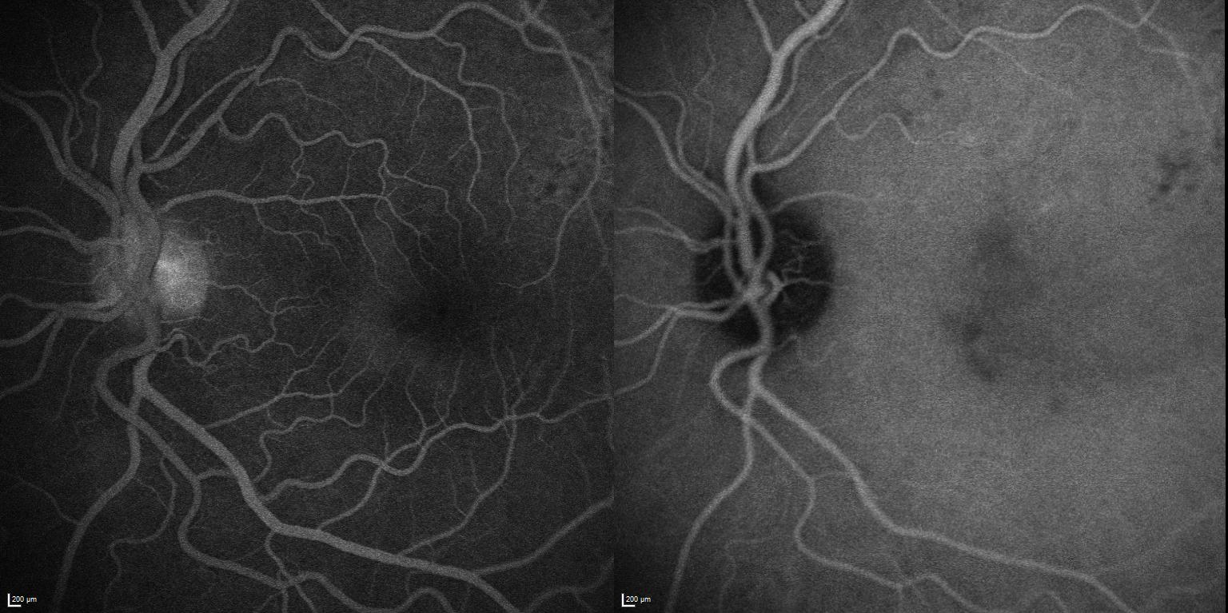
FA/ICG OS
2.04.95
5.27.54

Slide 12
Assessment
26 yo AAM with a multifocal choroiditis OS
Differential Diagnosis
Syphilis
Sarcoidosis
Tuberculosis
White dot syndrome
Idiopathic
CBC, CXR, ACE, RPR, TP-PA, Quantiferon, HIV, HSV, CMV
Notes:
Our assessment is a 26 yo AAF with a multifocal choroiditis of the left eye
Differential for multifocal choroidits includes
Syphilis
Sarcoidosis however patient not having any breathing difficulties
Tuberculosis – denied any night sweats
White dot syndrome due to the intraretinal lesions seen along the superotemperal arcade
Idiopathic

Slide 13
Course
Pt was lost to follow up for 2 months but returned after an acute decrease in vision OD
Stated that vision had improved OS
Did not obtain lab work

Slide 14
Exam
 | OD |  | OS
VA sc | 20/100; PHNI |  | 20/40-2; PH 20/25-2
Pupils | 4→3mm |  | 4→3mm
IOP | 7 mmHg |  | 12 mmHg
AC | 1+ cell |  | quiet

Slide 15
Posterior Segment Exam
Fundus | OD |  | OS
Optic Nerve | Elevation nasally, hyperemic |  | Elevation nasally, hyperemic
Vitreous | Pigment cells in anterior vitreous |  | Pigment cells in anterior vitreous
Macula | 3 dot heme surrounding fovea, blunted foveal reflex |  | Intraretinal creamy dots, blunted foveal reflex
Vessels | Normal caliber |  | Normal caliber
Periphery | White without pressure nasal to disc |  | Few white dots along arcade

Slide 16
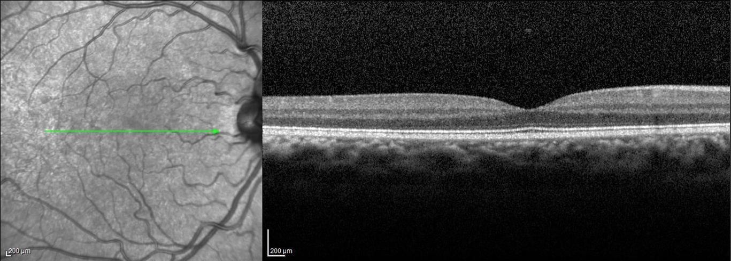
SD- OCT
OD 10/18
OD12/5

Slide 17
SD-OCT
OS 10/18
OS 12/5

Slide 18
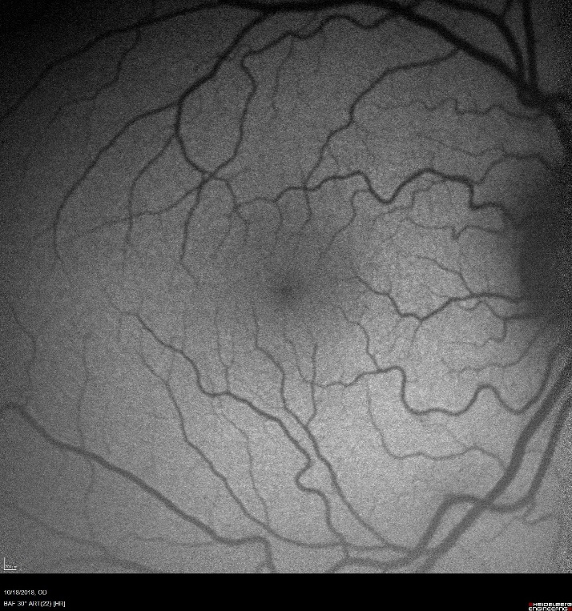
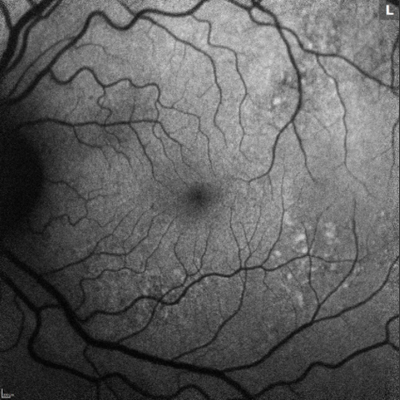
FAF
10/18
12/05

Slide 19
Plan
Pt left clinic prior to full workup
Later called with progression of vision loss and obtained lab studies
Outpatient Lab Results
RPR+, titer 1:512, TP-PA+
HIV+
CMV IgG+, IgM-
EBV IgG+, IgM-
HSV IgG+, IgM-
Normal CXR
Notes:
Rapid Plasma Reagin
Treponema pallidum Antibody particle agglutination is a confirmation of antibodies to treponemal organisms
CD4 count was 334

Slide 20
Hospital Course
Pt was instructed to go to the ED, where he was admitted for treatment
Started on IV Penicillin G 24 million units
Neurosyphilis dosing
Lumbar Puncture
VDRL-, no pleocytosis, normal protein & glucose, Cryptococcus –
Discharged on IV Penicillin G X 2 weeks
Notes:
- Pt had an unrevealing lumbar puncture

Slide 21
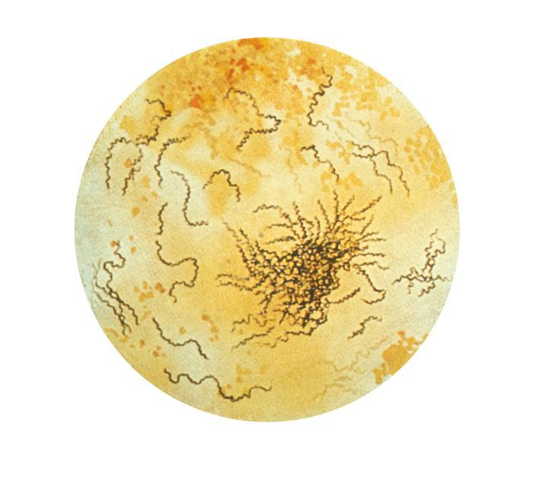
Syphilis
Multisystem, chronic bacterial infection caused by spirochete Treponema pallidum
Transmission
Transplacental (After 10th week)
Sexual (Most common)
Incidence 9.7/100.000
Men who have sex with men (MSM)
African Americans
https://labtestsonline.org/tests/syphilis-tests
Notes:
- The incidence has increased each year since 2000
- Incidence rate is 5 times greater in African Americans than non-Hispanic whites

Slide 22
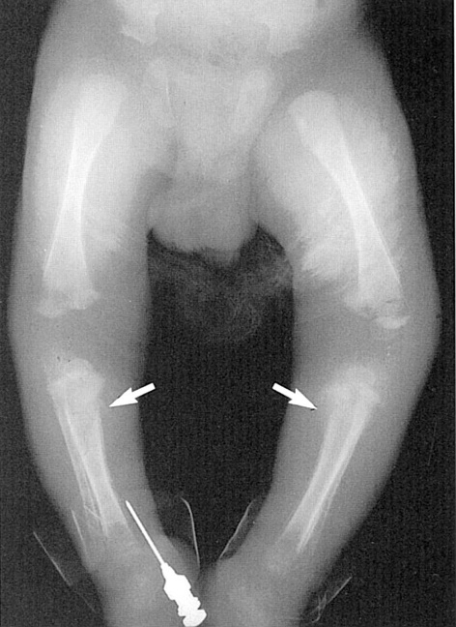
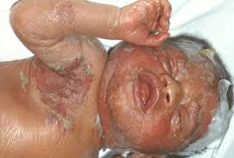
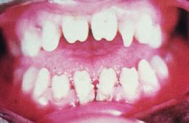
Congenital Syphilis
Hepatosplenomegaly, desquamating rash, bone abnormalities, Hutchinson teeth, Mulberry molars, deafness (CN VIII), cardiac abnormalities, ocular signs
Notes:
Syphilis is known as the great masquerade due to its multiple systemic manifestations mimicking many systemic inflammatory disorders
Congenital signs include hepatospenomegaly, Hutchinson teeth, Mulberry molars, deafness due to involvement of CNVIII, cardiac abnormalities, and many ocular signs which will be discussed later
Acquired consists of 3 stages
Primary noted by a painless chancre at the site of inoculation which resolves spontaneously without treatment in 12 weeks
Secondary – occurs 6-8 weeks later, heralded by the appearance of lymphadenopathy and a generalized maculopapular rash on the palms and soles
Teriary – can range from 1 year to decades and is evidenced by gummas, neurological, and cardiac involvement

Slide 23
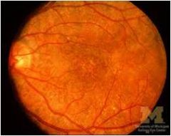
Congenital Syphilis
Ocular Findings
Panuveitis
Salt & Pepper fundus
Multifocal chorio-retinitis
Retinal Vasculitis
Optic Neuritis
Argyll-Robertson pupil
Interstitial Keratitis
Hutchinson Triad
Notes:
Hutchinson trid – interstitial keratitis, malformed teeth, deafness

Slide 24
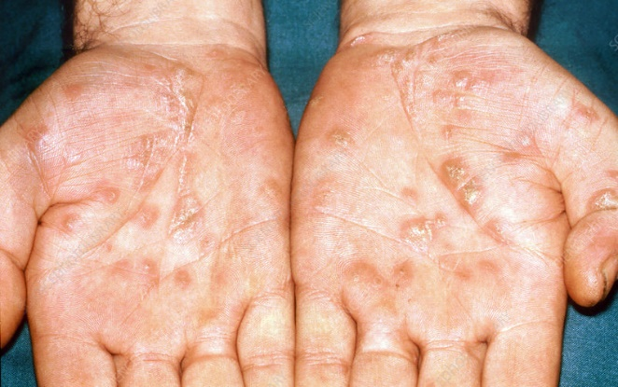
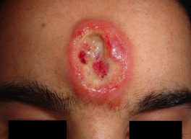
Acquired Syphilis
Primary – painless chancre
Secondary – lymphadenopathy, rash on palms/soles
Tertiary – gummas, neurological/cardiac involvement
Ocular involvement at any stage

Slide 25
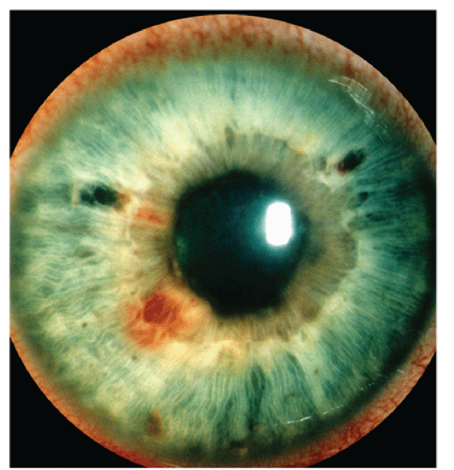
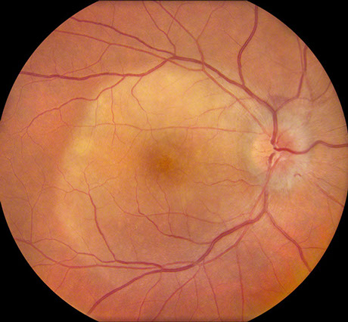
Acquired Syphilis
Ocular involvement 5 - 8% of cases
Usually secondary & tertiary stages
Great Masquerader
Can involve all structures including pupillomotor pathways and optic nerve
Posterior uveitis most common
Multifocal chorioretinitis
Iris Roseola
Posterior Placoid Chorioretinitis
Notes:
- Posterior placoid chorioretinitis is unusual but pathognomonic for secondary syphilis

Slide 26
Workup and treatment
Serologic testing
Non-treponemal (RPR, VDRL) + Treponemal (TP-PA)
Include HIV
Lumbar puncture
Ocular syphilis = Neurosyphilis
IV Penicillin G 18-24 million units per day for 10-14 days
IM Procaine penicillin 2.4 million units daily + probenecid 500 mg QID for 10-14 days
Notes:
TP-PA is Treponema pallidum particle agglutination test has best combination of sensitivity and specificity, Fluorescent treponemal antibody FTA-ABS is no longer recommended
Jarisch-Herxheimer reaction
Fever, chills/rigors, hypotension, headache, tachycardia, hyperventilation, vasodilation with flushing, myalgias, exacerbation of skin lesions and anxiety. Sepsis-like clinical picture. Reaction to endotoxin-like products released by the death of harmful microorganisms in response to antibiotic therapy. Self-limiting. Not life threatening. Symptomatic management.

Slide 27
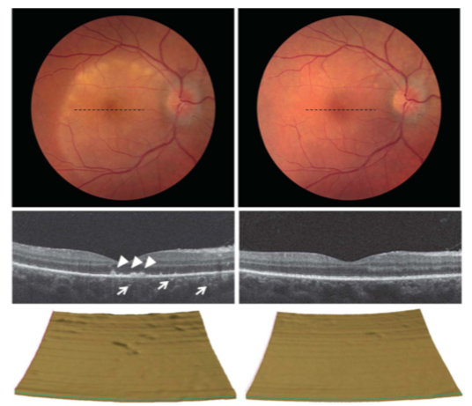
Notes:
- Described typical OCT findings of loss of IS/OS junction, areas of irregular elevation of the RPE, and areas of punctate hyperfluoresence in the underlying choroid in patients with placoid chorioretinopathy which resolved after treatment with penicillin

Slide 28
Conclusions
Syphilis should always be on your differential
With prompt diagnosis it is curable with penicillin!
Ocular syphilis = neurosyphilis
Commonly coinfected with HIV

Slide 29
Thank You
Dr. Wang
Dr. Fleissig
Dr. Piri

Slide 30
References
BCSC Section 9, Intraocular Inflammation and Uveitis
Wells J, Wood C, Sukthankar A, Jones NP. Ocular syphilis: the re-establishment of an old disease. Eye (2018) 32: 99-103.
Lapere S, Mustak H, Steffen J. Clinical Manifestations and Cerebrospinal Fluid Status in Ocular Syphilis. Ocular Immunology and Inflammation (2018) 00: 1-5.
Pichi F, Ciardella AP, Cunningham ET, et al. Spectral domain optical coherence tomography findings in patients with acute syphilitic posterior placoid chorioretinopathy. Retina (2014): 34; 373-384.
Davis J. Ocular Syphilis. Ocular Manifestations of Systemic Disease (2014) 25; 513-518.
Lima LH, Costa de Andrade G, et al. Multimodal imaging analyses of hyperreflective dot-like lesions in acute syphilitic posterior placoid chorioretinopathy. Journal of Ophthalmic Inflammation and Infection (2017) 7: 1-6.

