Slide 1
MYSTERY OF BILATERAL HSV CONJUNCTIVITIS
GRAND ROUNDS
Niloofar Piri MD
August 24th 2018

Slide 2
Patient Presentation
CC
Ophthalmology service was consulted to evaluate a patient for possible corneal and intraocular involvement due to HSV conjunctivitis
HPI
44 yo WM without previous medical history was transferred from outside hospital to ULH with possible diagnosis of HSV esophagitis and HSV conjunctivitis for further management after 2 weeks of admission. Ophthalmology was consulted because of bilateral ocular involvement , severe conjunctival injection and crusted lesions on the lids and possible HSV infection

Slide 3
Of note he started to have fever, chills, and flu like symptoms 2 weeks prior to presentation , received Tamiflu and two different antibiotics with minimal improvement, he started to devlop oral lesions, painful swallowing, skin lesions and was admitted to the hospital with extensive work up including
x2 EGD demonstrating esophageal ulceration which was negative for HSV PCR x2
x2 HIV test ( negative )

Slide 4
Extensive immunologic and infectious work up
Finally transfer to UofL
With third set of extensive pending work up including another HIV test ordered!

Slide 5
History (Hx)
Past Ocular Hx: negative
Past Medical Hx: negative
Meds: none
Before admission :Healthy

Slide 6
Repeat Hx

Slide 8
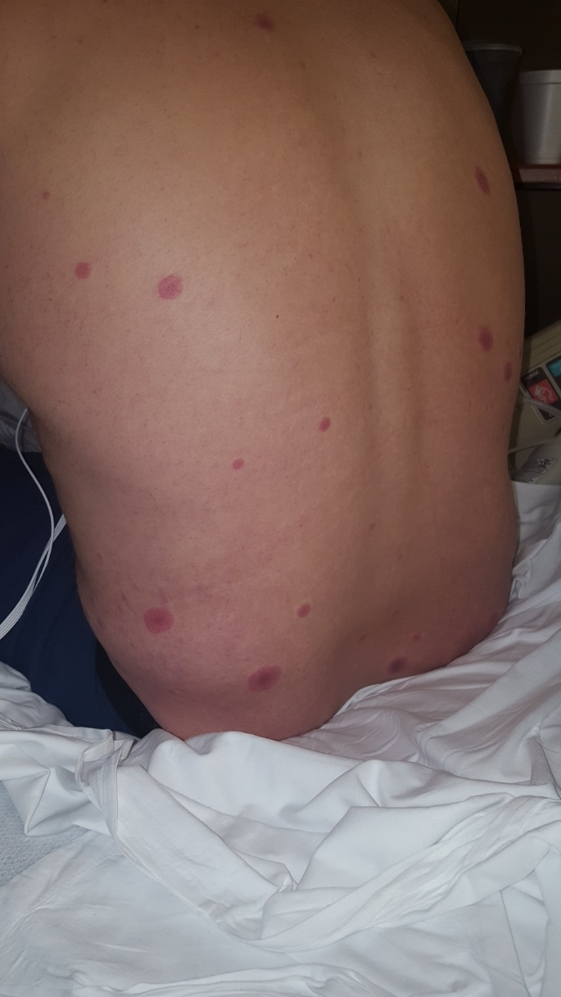

Slide 10
External Exam
 | OD |  | OS
VA cc N | 20/20- |  | 20/20
Pupils | 3→1 mm |  | 3→1 mm
IOP | 10 mmHg |  | 11 mmHg
EOM | full |  | full

Slide 11
Anterior Segment Exam
PLE | OD | OS
External/Lids | Edema wit crusting on the lid margins , | Edema wit crusting on the lid margins ,
Conj/Sclera | Severe mucopurulent conjunctivitis, no Symblepharon and no eyelid margin ulceration | Severe mucopurulent conjunctivitis, no Symblepharon, no eyelid margin ulceration
Cornea | Clear | Clear
Ant Chamber | Formed | Formed
Iris | Wnl | Wnl
Lens | Clear | Clear

Slide 12
Assessment
44 yo WM with no previous medical hx, admitted or 2 weeks with extensive infectious and immunologic work up, has classic Steven-Johnson- Syndrome

Slide 13
Plan: Stop all IV antibiotics, transfer to burn unit for supportive management and electrolyte replacement
Aggressive lubrication with preservative free artificial tears and ointment and topical Erythromycin as prophylaxis

Slide 14
He was discharged after a week, but re-admitted due to HAP ( Hospital Aquired Pneumonia)!
After 6 weeks, he was discharged and did not develop serious ocular complications, although he will need life-long ophthalmic care

Slide 15
Discussion
Stevens-Johnson syndrome (SJS) and toxic epidermal necrolysis (TEN) are the most severe in the spectrum of immunologically mediated adverse drug reactions (IM-ADRs) that are considered to be primarily T-cell mediated
They result from presentation of MHC class –I restricted antigens, leading to infiltration of skin with cytotoxic T cells and NK cells.

Slide 16
SJS and TEN are thought to be the same disease across a spectrum of severity defined by the percentage of skin detachment related to the body surface area comprising
SJS (<10%),
SJS/TEN overlap (10%-30%),
TEN (>30%)

Slide 17
Incidence: 1-5 per million cases per year

Slide 18
Approximately 80% of TEN and 50-80% of SJS cases are thought to be drug induced.
The conjunctiva and oropharynx are the tissues most frequently involved.
More than 100 drugs have been found, most commonly sulfonamides, anticonvulsants, NSAIDs, and allopurinol.

Slide 19
Over the last 10 to 15 years, there have been significant advances in our understanding of the immunogenomics of IM-ADRs

Slide 20
There are several strong associations from Southeast Asia between HLA class I alleles and drug-associated SJS/TEN including
HLA-B*15:02 and carbamazepine SJS/TEN
And HLA-B*58:01 and allopurinol SJS/TEN.

Slide 21
This has led to successful HLA-B*15:02 screening programs in Taiwan, Singapore, and other parts of Southeast Asia and has almost eliminated carbamazepine-associated SJS/TEN.

Slide 22
Despite this progress there are still a large number of clinical and research gaps.

Slide 23
A few highlights of these gaps include the lack of
(1) lack of an evidence based approach to guide therapeutic interventions above aggressive supportive care in acute SJS/TEN,
(2) predictive biomarkers for early diagnosis and prognosis,
(3) genetic predictors for most drugs that cause SJS/TEN, and
(4) an explanation for why only a small proportion (<10%) of those carrying an HLA risk allele will develop SJS/TEN following drug exposure

Slide 24
Ocular involvement
There is incomplete correlation between the severity of SJS/ TEN illness and ocular complications and the degree of ocular involvement in SJS/TEN is highly variable

Slide 25
In the United States alone, only 66% of burn intensive care units routinely consult ophthalmology on patients with SJS/TEN during their hospital stay!

Slide 26
The primary ocular finding is mucopurulent conjunctivitis and episcleritis
Conj and corneal epithelial sloughing and necrosis with severe inflammation and scarring may develop

Slide 28
Long- term ocular complications result from ocular surface cicatrization, resulting in conj shrinkage, keratinizations of the eyelid margins, Trichiasis, and tear deficiency.

Slide 31
SJS/TEN: Phase of disease | Exam finding
Acute | Ocular surface/eyelid margin epithelial defect Pseudomembrane formation
Chronic | Posterior eyelid margin keratinization Trichiasis/distichiasis Tear deficiency Persistent epithelial defect

Slide 32
The single best predictor of chronic corneal complications is acute eyelid margin involvement.
Acute eyelid margin de-epithelialization and ulceration leads to eventual eyelid margin keratinization, which causes corneal disease through various mechanisms

Slide 33
Management
Acute stage
Chronic stage

Slide 34
Management of acute stage is similar to that of extensive thermal burns; patients are often treated in burn units at major tertiary care centers.
Immediate discontinuation of the offending agent has been associated with reduced mortality and improved outcome.

Slide 35
Systemic therapy is mainly supportive and is aimed at managing dehydration and superinfection.
No consensus on systemic therapy including IVIG or steroids

Slide 36
Mainstay of acute ocular therapy includes aggressive lubrication with preservative free artificial tears and ointments
Topical antibiotics are used as prophylaxis
peeling of pseudomembranes and membranes are recommended
Symblepharon lysis is controversial

Slide 37
Significant long-term benefit has been demonstrated with early amniotic membrane transplant over the entire ocular surface, including the lid margins, in severe cases of ocular surface involvement.

Slide 38
Gary N. Foulks, MD, emeritus professor of ophthalmology at the University of Louisville, co-authored the first paper on using cryopreserved amniotic membrane in the acute phase of SJS.
John T1, Foulks GN, et al .Amniotic membrane in the surgical management of acute toxic epidermal necrolysis. Ophthalmology 2002;109:351–360.

Slide 39
The Ocular Surface Volume 14, Issue 2, April 2016, Pages 168-188

Slide 40
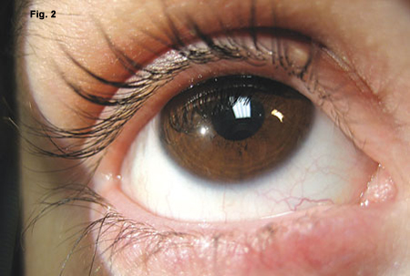
Marianne Doran, Amniotic Membrane for Acute Stevens-Johnson Syndrome. Eyenet magazine 2008

Slide 41
Grade | Grade defined | Management
0 | No ocular involvement | AT 4x/day
1 | Conjunctival hyperemia | Moxi 3x/day Pred 6x/day FML 6x/day AT every hour as feasible
2 | Ocular surface/eyelid margin epithelial defect or pseudomembrane formation | Use above therapies, plus consider AMT
3 | Ocular surface/eyelid margin epithelial defect and pseudomembrane formation | Use above therapies, plus consider AMT
Am J Ophthalmol, 160 (2015), pp. 228-237

Slide 42
Conclusions
Accurate history of present illness is the most important step before evaluating patients
It’s important always to think of simple things that can be a diagnostic challenge.

Slide 43
References
SJS/TEN 2017: Building Multidisciplinary Networks to Drive Science and Translation
Ergen EN, et al. Foundations of a North American SJS/TEN Research Network: results of a web-based survey of dermatologists and surgeons. Presented at: American Burn Association (ABA) 49th Annual Meeting; March 20-24, 2017; Boston, MA.
White KD, et al. Evolving models of the immunopathogenesis of T cell-mediated drug allergy: the role of host, pathogens, and drug response. J Allergy Clin Immunol 2015;136:219-34. quiz 35.
C. Sotozono, et al. Predictive factors associated with acute ocular involvement in Stevens-Johnson syndrome and toxic epidermal necrolysis Am J Ophthalmol, 160 (2015), pp. 228-237
The Ocular Surface Volume 14, Issue 2, April 2016, Pages 168-188

