Slide 1
Grand Rounds The Masquerade Spot
Sidharth Puri MD, PGY3
March 30, 2018

Slide 2
Patient Presentation
CC
Annual follow up
HPI
56 yo female with history of Rosai-Dorfman disease who presents for annual follow up for suspicious choroidal lesions OU (first discovered ~10 years ago). No change in vision

Slide 3
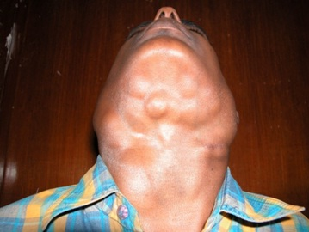
Rosai-Dorfman Disease
Sinus histiocytosis with massive lymphadenopathy
Numerous histiocytes in lymph nodes and throughout body
Unknown cause
Treatment- observe, surgery, radiation, or chemotherapy

Slide 4
History (Hx)
Past Ocular Hx- Choroidal Lesions OU
Past Medical Hx- Rosai Dorfman, Thyroid Disease, Seizures, Anemia
Past Surgical Hx- Tonsillectomy, Fibroidectomy
Fam Hx- Diabetes, AMD
Meds- Tegretol, Keppra, Synthroid, Multivitamin
Allergies- Penicillin, Formaldehyde
Social Hx- Former Smoker
**Underwent chemotherapy for intra-abdominal histiocytic lesions in past**

Slide 5
Review of Systems
No headache, nausea/vomiting, blurry vision, eye pain, fever, weight loss, night sweats
Occasional floaters in left eye

Slide 6
Physical Exam
 | OD |  | OS
VA (cc) | 20/30 |  | 20/20
BCVA | -0.50+1.00x19 (20/20) |  | -1.00+0.50x174 (20/20)
Pupils | 4→3mm | No rAPD | 4→3mm
IOP | 17 mmHg |  | 18 mmHg
EOM | full |  | full
CVF | full |  | full

Slide 7
Physical Exam
SLE | OD |  | OS
External/Lids | Wnl |  | Wnl
Conj/Sclera | White and Quiet |  | White and Quiet
Cornea | Clear |  | Clear
Ant Chamber | Deep and Quiet |  | Deep and Quiet
Iris | Flat |  | Flat
Lens | 1+ NS |  | 1+ NS
Vitreous | Clear |  | Clear

Slide 8
Physical Exam
Fundus | OD |  | OS
Optic Nerve | Pink and Sharp |  | Pink and Sharp
Macula | Yellow-White Mass with Mild Elevation, No Hemorrhage |  | Yellow-White Mass with Mild Elevation, No Hemorrhage
Vessels | Normal Caliber |  | Normal Caliber
Periphery | Flat and Attached 360 |  | Flat and Attached 360

Slide 9
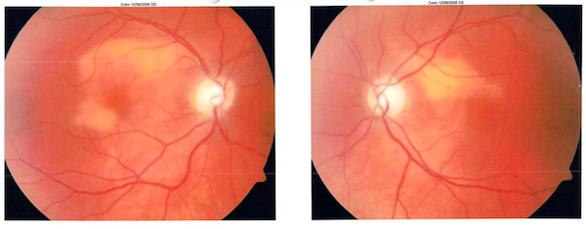
2008

Slide 10
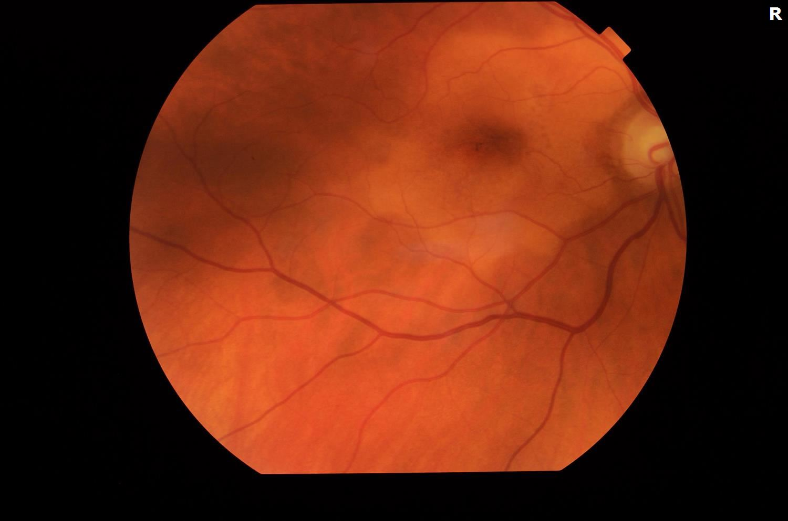
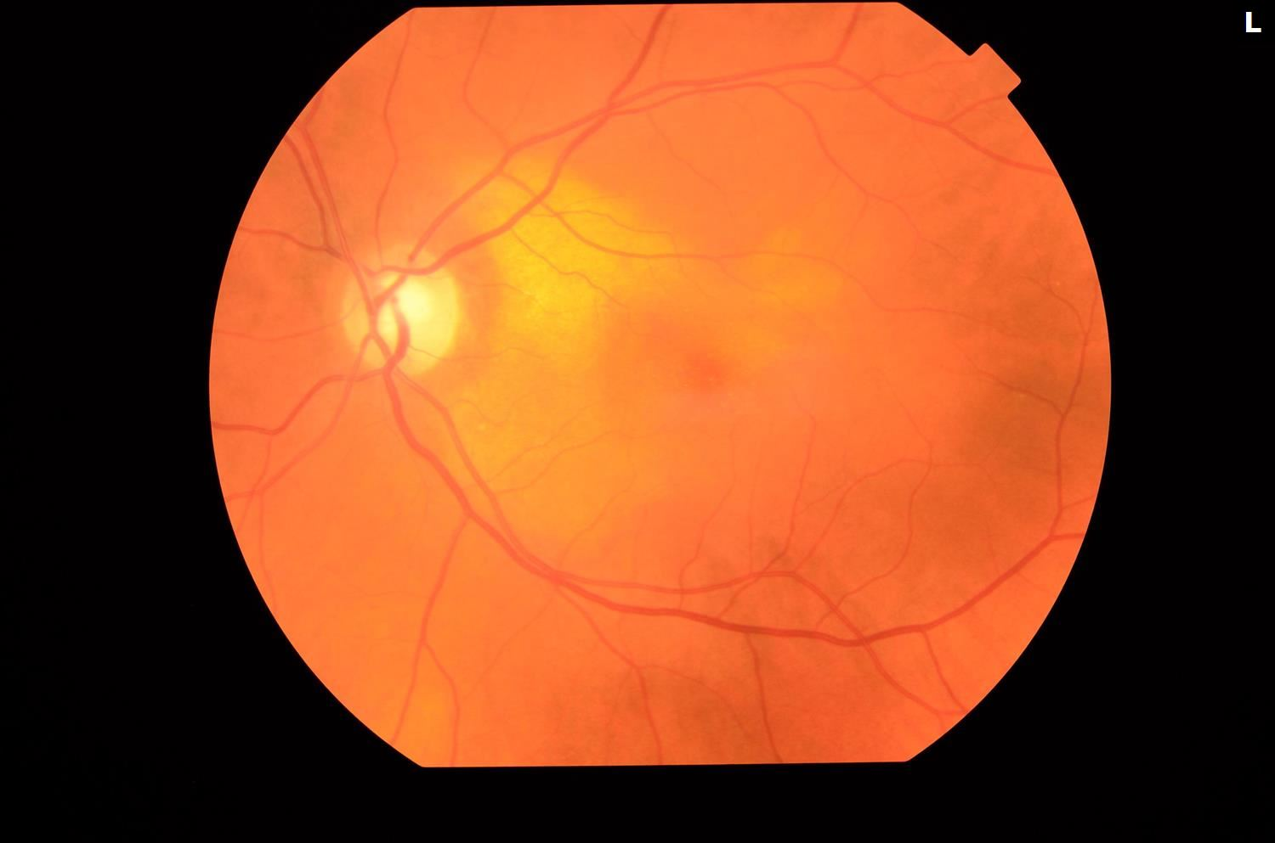
2018

Slide 11
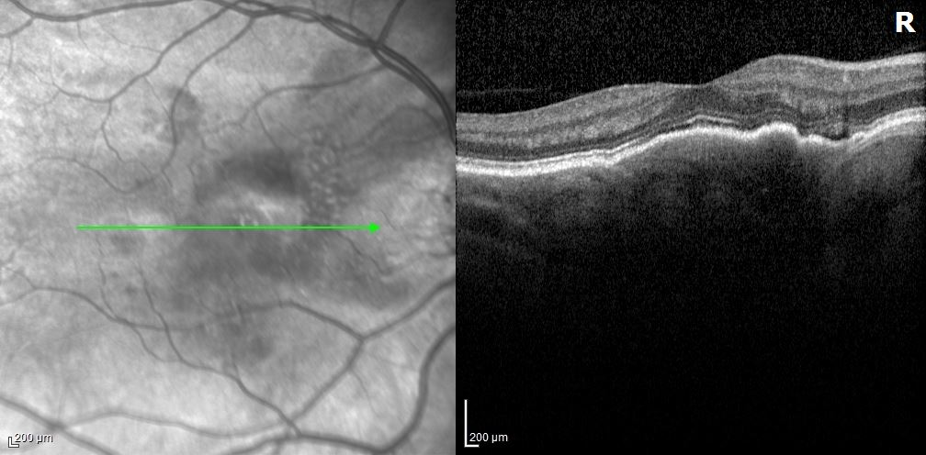
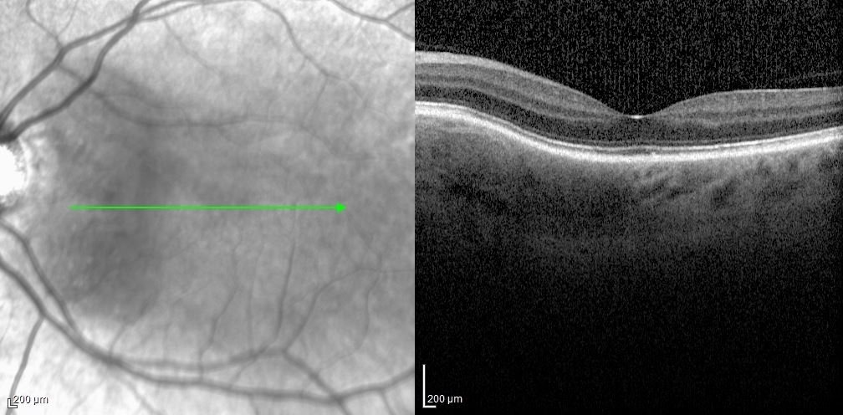
OCT

Slide 12
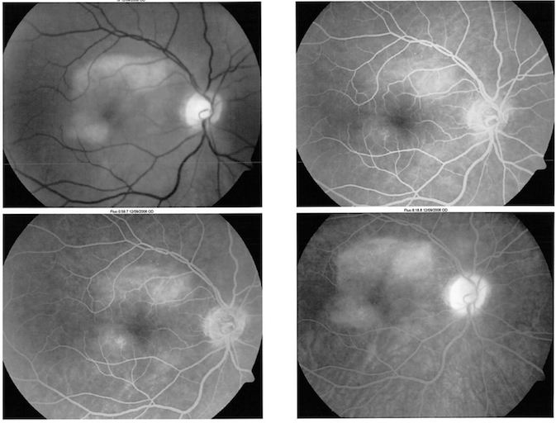
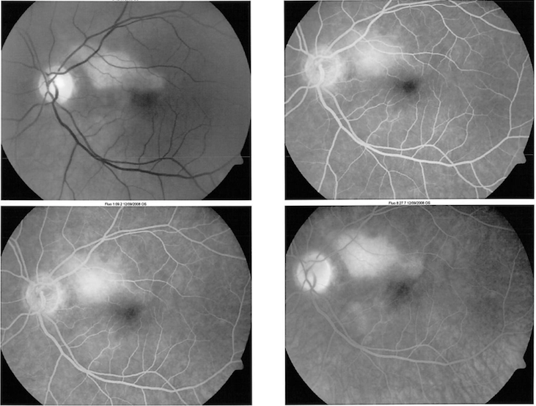
FA

Slide 13
Assessment
56 yo female with hx of Rosai–Dorfman disease with stable intraocular choroidal lesions OU.
Differential Diagnosis
Choroidal Histiocytic Lesion
Amelanotic Choroidal Melanoma/Nevus
Metastasis
Choroidal Osteoma

Slide 14
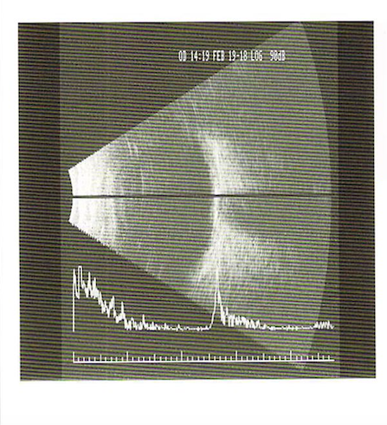
B Scan

Slide 15
Choroidal Osteoma
Benign ossifying tumor
Mature bone replacing choroid
Rare condition with unknown frequency
Women, unilateral 80% cases
Etiology is unknown
Some sporadic cases related to trauma, Stargardt’s disease, intraocular inflammation, and Histiocytosis X

Slide 16
Pathophysiology
Deep, orange-yellow lesion
Peripapillary lesion with well-defined geographic or scalloped borders
Depigmentation of overlaying RPE
Limited tumor growth
41-64% of cases grew. Slow growth (0.37mm/year)

Slide 17
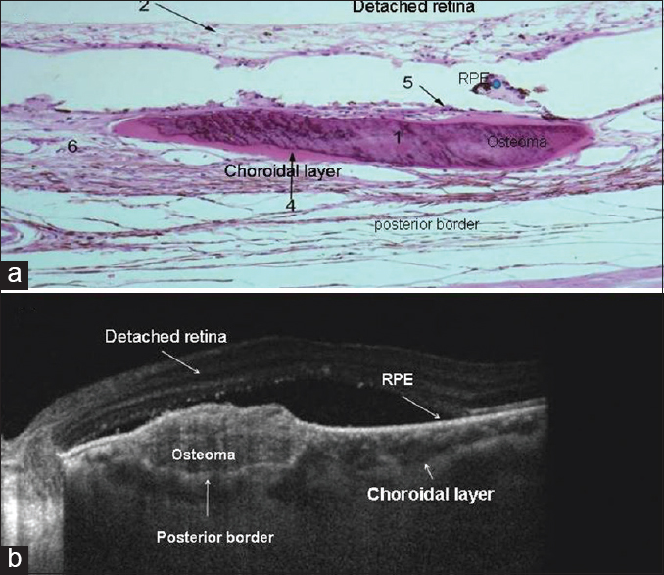

Slide 18
Diagnosis
Ultrasound imaging (A or B scan)
A scan with high intensity echo spike
B scan with elevated choroidal mass
FA
Early patchy hyperfluorescent choroidal filling with late diffuse staining
Can show CNV
OCT
Variable hyper and hyporeflective areas. Subretinal fluid, CNV

Slide 19
Choroidal Osteoma
CNV is very common
Overlaying heme or irregular surface increase risk of CNV
Subretinal fluid and serous RD can occur
Serous RD common in absence of CNV

Slide 20
Prognosis
Factors influencing prognosis:
Tumor location
Non-foveal involvement - 80% had VA >20/40
Foveal involvement - 45% had VA >20/40
Decalcification status
Can be induced by laser treatment
RPE atrophy
CNV
Persistent subretinal fluid or heme

Slide 21
Treatment
Osteoma with CNV
Anti-VEGF (Bevacizumab and Ranibizumab)
PDT and TTT with some success
Limited success with argon laser photocoagulation and surgical removal
Osteoma with Serous RD (no CNV)
TTT, Bevacizumab have shown improvement

Slide 22
Discussion
Choroidal osteomas are rare, benign ossifying tumors
Very slow growing lesions with characteristic ultrasound imaging findings
Vision loss can occur due to RPE atrophy, serous RD, and most commonly CNV
Anti-VEGF has shown promise for treating complications of osteomas

Slide 23
References
Alameddine, R. M., Mansour, A. M., & Kahtani, E. (2014). Review of Choroidal Osteomas. Middle East African Journal of Ophthalmology, 21(3), 244–250.
Shields CL, Shields JA, Augsburger JJ. Choroidal osteoma. Surv Ophthalmol. 1988;33:17–27.

