Slide 1
Night and Day
Julia Elpers, MD
March 30th, 2018

Slide 2
Patient Presentation
CC
Left eye swelling, pain, headaches and blurred vision x 4 days
HPI
14 yo AAF with 4 days of 7/10 left eye pain, especially with movement, blurred vision, swelling and headaches. Received migraine cocktail 2 days prior in ED, but eyelid swelling progressed. No recent trauma or infection, but did have cavity filled 10 days prior.
Two similar episodes in the past of left eyelid swelling and proptosis, deemed preseptal cellulitis vs conjunctivitis, improved with topical and oral antibiotics

Slide 3
History
Past Ocular Hx OS preseptal cellulitis vs
conjunctivitis x 2
Past Medical Hx None
Fam Hx Sickle Cell Disease (sister)
Sickle Cell Trait (mother)
Meds Naproxen, Acetominophen
Allergies None
Social Hx (-) tobacco, alcohol, illicits
RoS (+) poor sleep due to pain
(-) fevers, weight loss, fatigue

Slide 4
Physical Exam
 | OD | OS
VAscN | 20/20 | 20/30+2
Pupils | 3→2mm, no RAPD | 3→2mm, no RAPD
IOP | 09 mmHg | 09 mmHg
EOM | full | full, mild pain
CVF | full | full

Slide 5
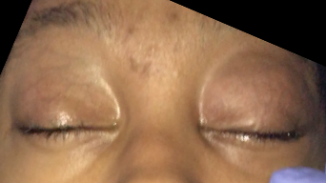
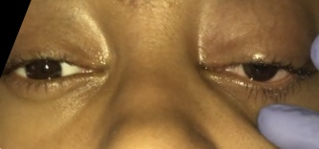
Physical Exam
PLE | OD | OS
Ext/Lids | Normal | Mild proptosis Mild LUL swelling, erythema 1mm ptosis
C/S | White and quiet | Trace diffuse injection, Trace temporal chemosis
K | Clear | Clear
AC | Deep and quiet | Deep and quiet
Iris | Flat | Flat
Lens | Clear | Clear
Vit | Clear | Clear

Slide 6
Physical Exam
Fundus | OD | OS
Optic Nerve | Did not dilate to monitor for APD | Pink and sharp
Macula |  | Good foveal reflex
Vessels |  | Normal caliber
Periphery |  | Retina attached 360˚

Slide 7
Emergency Dept. Workup
CBC, CMP
No abnormalities
CRP
slightly elevated at 1.0 (<1.0mg/dL)
CT Orbits with Contrast
No fat stranding, no abscess
MRI and MRV Brain
No abnormalities including mass lesion or venous thrombus.

Slide 8
Assessment & Plan
14 yo AAF with 4 day history of left eyelid swelling, pain with motility, proptosis, blurred vision and headache.
Differential Diagnosis
Inflammatory
Infectious: preseptal vs. orbital cellulitis
Noninfectious: orbital pseudotumor (*2 prior episodes)
Neoplasm
Lymphangioma
admitted for preseptal vs early orbital cellulitis
IV Vancomycin, Ceftriaxone, and pain control.
Follow daily
Normal Imaging

Slide 9
Hospital Day 2
Pain improved (1/10). Still endorses blurred vision.
 | OD | OS
VAscN | 20/20 | 20/400 –PH-> NI
Pupils | 3→2mm, no RAPD | Pharm dilated, no RAPD
IOP | 11 mmHg | 07 mmHg
EOM | full | Full, mild pain
CVF | full | full
Color | 11/11 | 0/11
Red Desat. | 100% | 50% (looked orange)

Slide 10
Hospital Day 2
PLE | OD | OS
Ext/Lids | Normal | Mild proptosis Mild LUL swelling, erythema 1mm ptosis
C/S | White and quiet | Trace diffuse injection, Trace temporal chemosis
K | Clear | Clear
AC | Deep and quiet | Deep and quiet
Iris | Flat | Flat
Lens | Clear | Clear
Vit | Clear | Clear

Slide 11
Hospital Day 2
Fundus | OD | OS
Optic Nerve | Pink and sharp | Optic disc edema sup, inf, nasal
Macula | Good foveal reflex | Horizontal folds
Vessels | Normal caliber | Tortuous with dilated veins
Periphery | Retina attached 360˚ | Whitening of retina along arcades inf > sup, retinal edema with scattered folds. Large inferotemporal exudative detachment

Slide 12
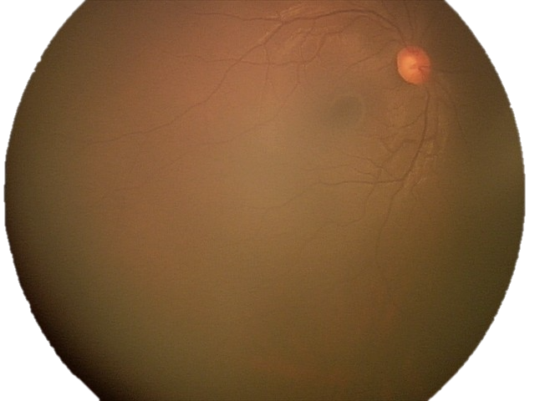

Slide 13
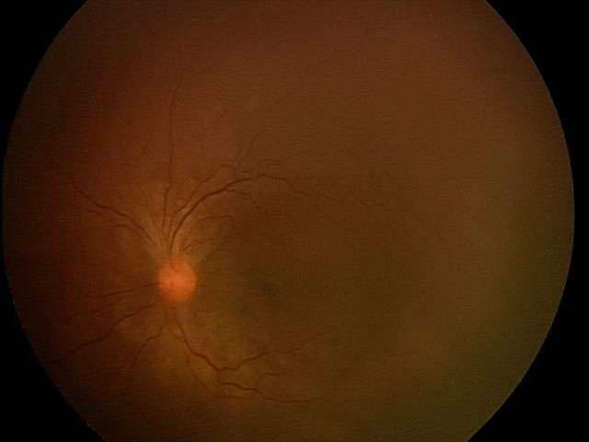

Slide 14
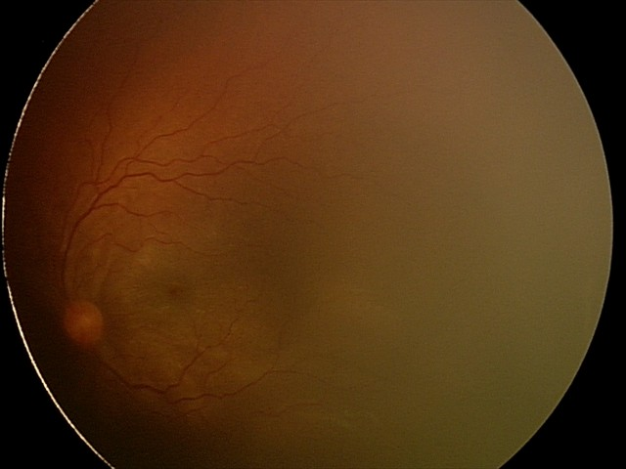

Slide 15
OD
Trace sub-tenon’s fluid

Slide 16
OD
Trace sub-tenon’s fluid
Sub-retinal fluid

Slide 17
OS
Thickened Choroid
Peri-neural fluid
T
Sign
Sub-tenon’s fluid

Slide 18
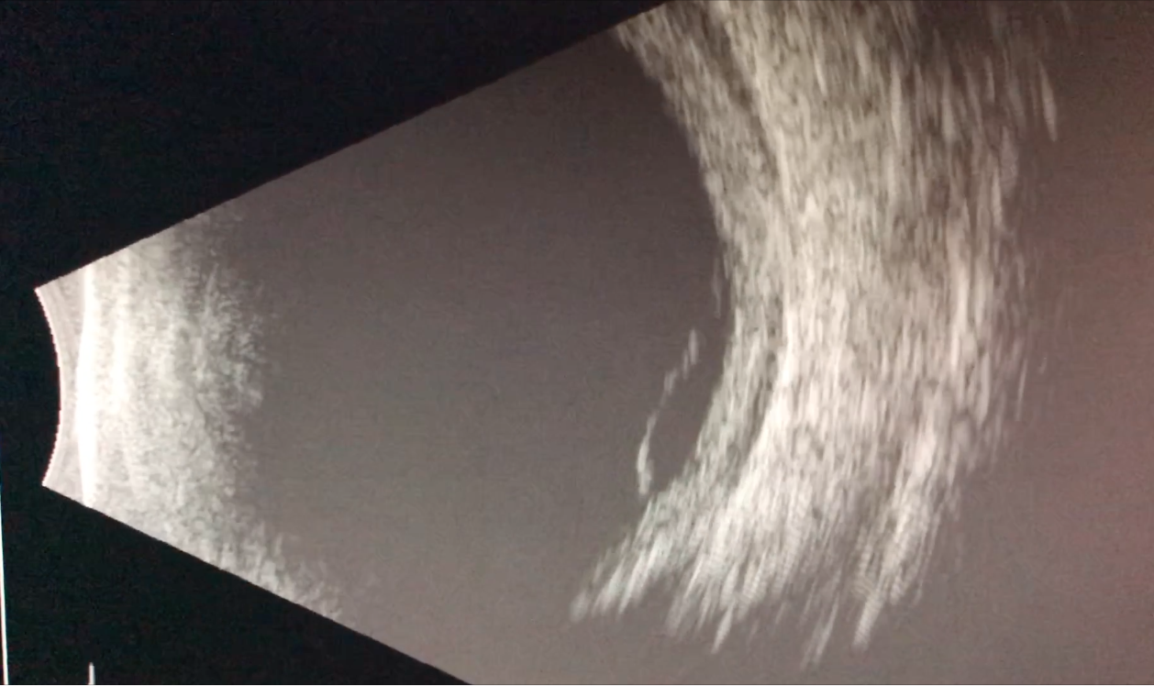
OS
Thickened
Choroid
Sub-retinal fluid
Sub-tenon’s fluid

Slide 19
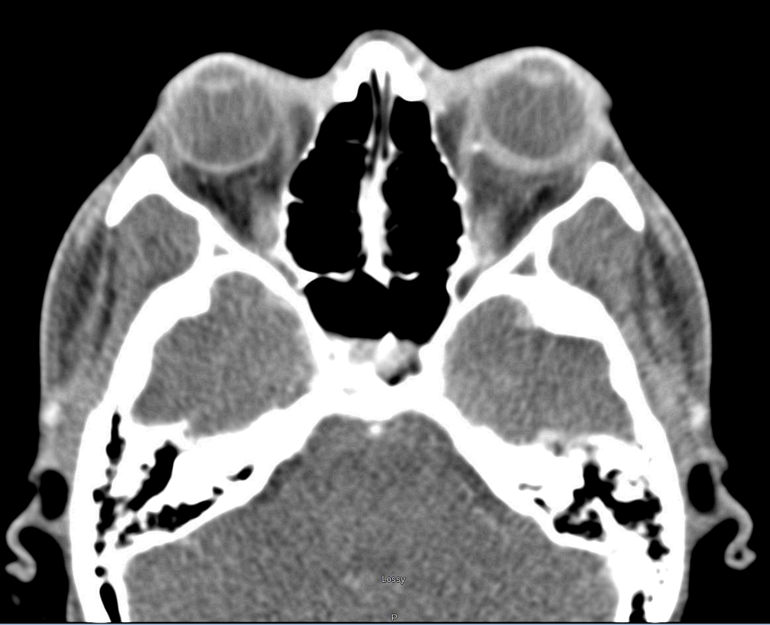
Hospital Day 2
CT Orbits with Contrast
No fat stranding, no abscess
MRI and MRV Brain
No abnormalities including mass lesion or venous thrombus.
Attending Over-Read:
“mild thickening and increased enhancement along the posterior margin of the left globe”
CT Orbits w Contrast
Notes:
CT: On CT, the posterior sclera is thickened and may enhance with contrast agents. Sub-Tenon’s edema may appear as a thin crescent of lucency between the sclera and Tenon’s capsule.
MRI: diffuse posterior scleritis, the sclera is thickened on T1-weighted images and is isoin- tense to slightly hyperintense with respect to vitreous. On T2-weighted images, the sclera is hypointense. There is moderate to marked inhomogeneous enhancement with gadolin- ium. A retinal detachment appears as a crescent-shaped area that is hyperintense on both T1- and T2-weighted images

Slide 20
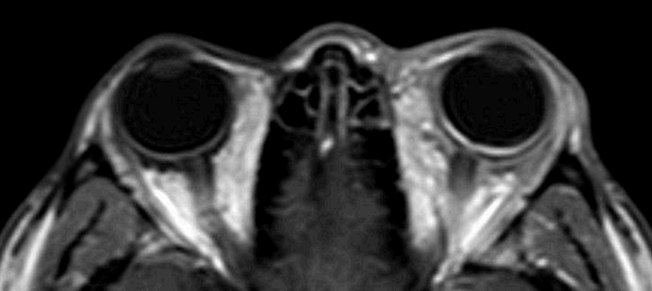
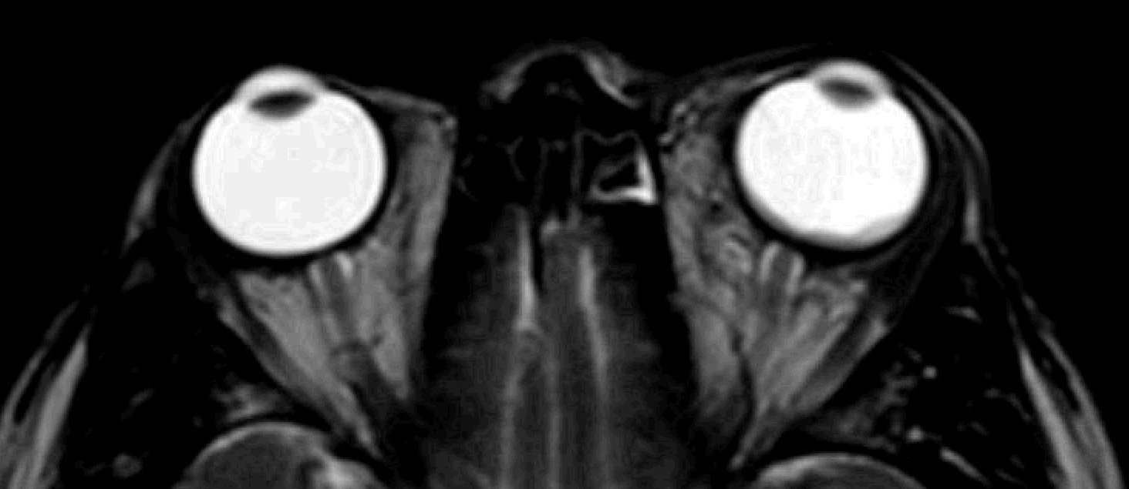
Hospital Day 2
MRI w Contrast
Retina + choroid
T1
CT Orbits with Contrast
No fat stranding, no abscess
MRI and MRV Brain
No abnormalities including mass lesion or venous thrombus.
Sclera
T2
Retina + choroid
Sclera
Attending Over-Read:
“Mild contour irregularity, thickening and increased enhancement is visualized along the margin of the posterior left globe. Subtle proptosis”
Notes:
CT: On CT, the posterior sclera is thickened and may enhance with contrast agents. Sub-Tenon’s edema may appear as a thin crescent of lucency between the sclera and Tenon’s capsule.
MRI: diffuse posterior scleritis, the sclera is thickened on T1-weighted images and is isoin- tense to slightly hyperintense with respect to vitreous. On T2-weighted images, the sclera is hypointense. There is moderate to marked inhomogeneous enhancement with gadolin- ium. A retinal detachment appears as a crescent-shaped area that is hyperintense on both T1- and T2-weighted images

Slide 21
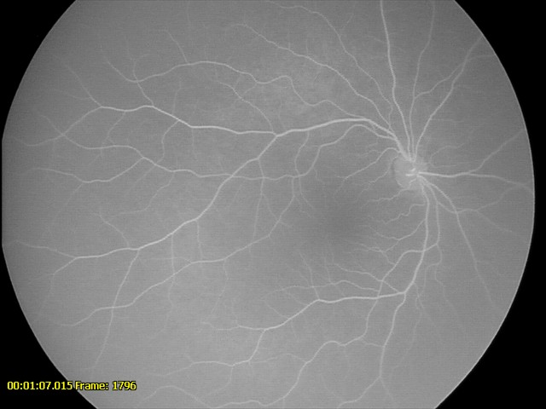
Workup
Exam under anesthesia with Fluorescein Angiography
OD
normal

Slide 22
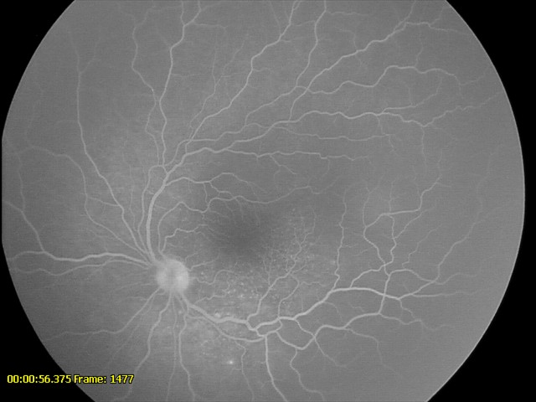
OS
disc leakage
chorioretinal leakage along inferotemporal arcade

Slide 23
Assessment
14 yo AAF with 4 day history of left eyelid swelling, pain with EOM, proptosis, blurred vision and headache, now with 20/400 vision, optic disc edema, retinal folds, serous retinal detachment, thickened sclera and suprachoroidal fluid...
Consistent with a diagnosis of Posterior Scleritis

Slide 24
Plan
Infectious and inflammatory workup:
Lyme, Syphilis, TB, Sarcoid (ACE, CXR), ANA, c-ANCA, p-ANCA, RF, toxoplasma, Sjogren, IgG4, Lupus, antiphospholipid antibody, HLA B51
1 G methylprednisolone q24H x 3 days
Rheumatology Consult
Notes:
ANA screen includes – dsDNA,Sm,RNP,SmRNP,SS-A,SS-B,Scl-70,Centromere B, Chromatin, Jo-1, Ribosomal P
Syphilis was total Antibody.

Slide 25
Follow Up
Vision improved to 20/100 by Day 3 of IV steroids
Discharged on:
25mg prednisone PO BID
1000mg mycophenolate mofetil BID

Slide 26
Posterior Scleritis
6 cases per 10,000
2-12% of all scleritis cases
Most common in females
Average age 45-49 yo
65% unilateral
30-50% associated with systemic disease
More likely in >50 yo

Slide 27
Posterior Scleritis
Presentation
Moderate-severe deep, boring pain
Classically awakes from sleep
Pain with motility +/- restriction
Proptosis
Vision: normal to NLP
With or without injection
Optic disc edema
Exudative retinal detachment
Choroidal effusions

Slide 28
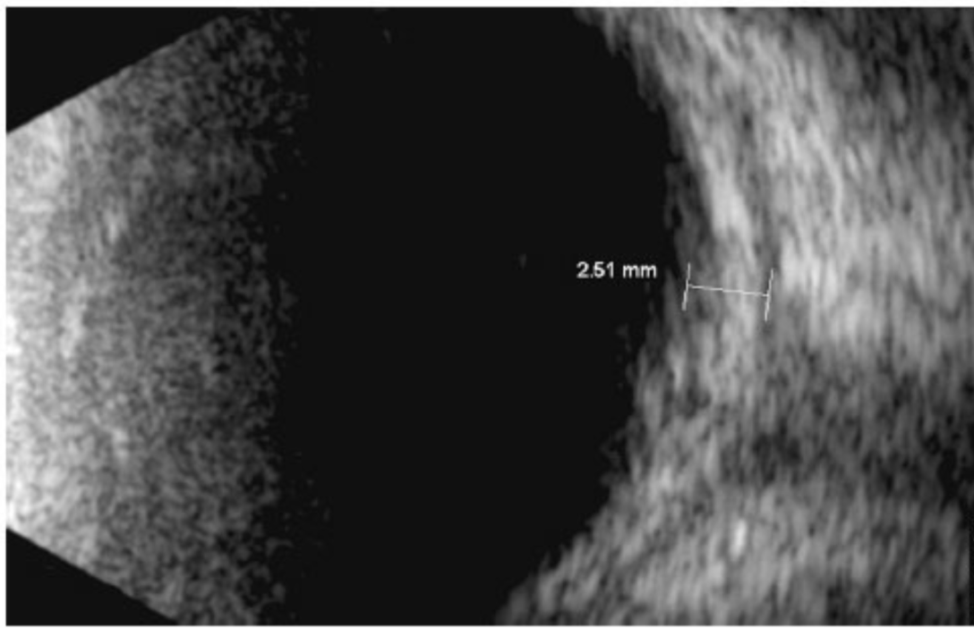
Posterior Scleritis
Workup
B Scan is gold standard
T-sign
thickened choroid
OCT
increased thickness choroid, often subretinal fluid
FA
no characteristic signs, but can help distinguish from central serous retinopathy
CT or MRI
may show scleral thickening and enhancement

Slide 29
Posterior Scleritis
Workup for Systemic Disease
Must rule out infection!
TB, Syphilis, Lyme
Rheumatoid
Lupus
Sarcoid
Granulomatosis with polyangiitis
Polyarthritis nodosa
Thyroid disease
And many others...
Consult Rheumatology

Slide 30
Posterior Scleritis
Treatment (usually Systemic)
NSAIDs
Corticosteroids
Immunomodulatory therapy
Antimetabolites
Biologics

Slide 31
Retrospective Case Series of 13 patients (20 eyes) + Review of Literature
The patients:
all Chinese
5-16 yo, median age 11.5
8 female, 5 male
Visual Acuity:
20/30 median presenting vision
Signs:
100% positive T-sign on B scan
95% had optic disc swelling
85% retinal striae
75% concurrent anterior uvietis
Systemic Disease:
0%
Treatment:
1 resolved with NSAIDs
12 received corticosteroids
11 required immunomodulatory therapy
Outcomes:
20/20 median vision at 1 year
Anterior scleritis 18% peds vs 81% adults
10 of 13 patients had initial diagnosis other than scleritis.
→ Diagnosis is often delayed
Disc edema 95% peds vs 18-45% adults
Poor VA 7% peds vs 30% adults

Slide 32
Follow Up – Day 6
OS:
VA scD 20/70
Post Seg
Optic Disc Edema
Macular Folds

Slide 33
Follow Up – Day 6
OS:
VA scD 20/70
Post Seg
Optic Disc Edema
Macular Folds

Slide 34
Follow Up – Week 3
OS:
VA scD 20/25+3
Post Seg - Disc Edema resolved,
trace fibrosis
- Macular Folds improved
- trace ERM

Slide 35
Follow Up – Week 3
All labs resulted negative:
Lyme, Syphilis, TB, Sarcoid (ACE, CXR), ANA, c-ANCA, p-ANCA, RF, toxoplasma, Sjogren, IgG4, Lupus, antiphospholipid antibody, HLA B51
Plan:
Continue mycophenolate mofetil 100mg BID
Taper steroids
f/u with Rheumatology

Slide 36
Conclusions
Rare, but often misdiagnosed
B Scan!
Must rule out infection
Workup for systemic disease
Majority of pts require long term immunotherapy

Slide 37
References
Cheung,CM, Chee,SP. Posterior Scleritis in Children: Clinical Features and Treatment. Ophthalmology 2012;119:59–65.
Rifkin,LM. Posterior Scleritis: A Diagnostic Challenge. Review of Ophthalmology 2018.
Lavric, A, Gonzalez-Lopez, JJ, Majumber, PD, et al. Posterior Scleritis: Analysis of Epidemiology, Clinical Factors, and Risk of Recurrence in a Cohort of 114 Patients. Ocul Immunol Inflamm 2016;24:1: 6-15.
Watson PG, Hayreh SS. Scleritis and episcleritis. Br J Ophthalmol 1976;60:163–91.
BCSC Section 8 External Disease and Cornea.

