Slide 1
Grand Rounds A Unique Intra-Orbital Foreign Body
Niloofar Piri MD
Jan 19th 2018

Slide 2
Patient Presentation
CC
Ophthalmology service was consulted to evaluate a patient for possible intra-ocular foreign body
HPI
87 yo WF presented to the ER after she was partially run over by a truck twice, sustained multiple trauma including skull and facial trauma, and extensive scalp lacerations. Facial bones CT scan showed left intra-orbital foreign body and per radiology intra-ocular FB could not be ruled out. Ophtho was consulted to evaluate.

Slide 3
History (Hx)
Past Ocular Hx: Scleral buckling OS for RRD in 1990s with moderate low vision at baseline
Past Medical Hx: Hypertension, Hyperlipidemia, Hypothyroidism
Meds: Aspirin, Amlodipine, Levothyroxine, Escitalopram
Before admission :Totally independent, was able to drive, performing ADL

Slide 4
External Exam
 | OD |  | OS
VA cc N | 20/20- |  | 20/60
Pupils | 3→1 mm | Left RAPD 2+ | 3→2 mm
IOP | 10 mmHg |  | 11 mmHg
EOM | full |  | -1 abduction -1 supraduction

Slide 5
Anterior Segment Exam
PLE | OD | OS
External/Lids | Wnl | Upper lid hematoma, lower lid ecchymosis Deep small laceration above eyebrow
Conj/Sclera | Wnl | Superior SCH
Cornea | Clear | Clear
Ant Chamber | Formed | Formed
Iris | Wnl | Wnl
Lens | PC IOL | PC IOL

Slide 6
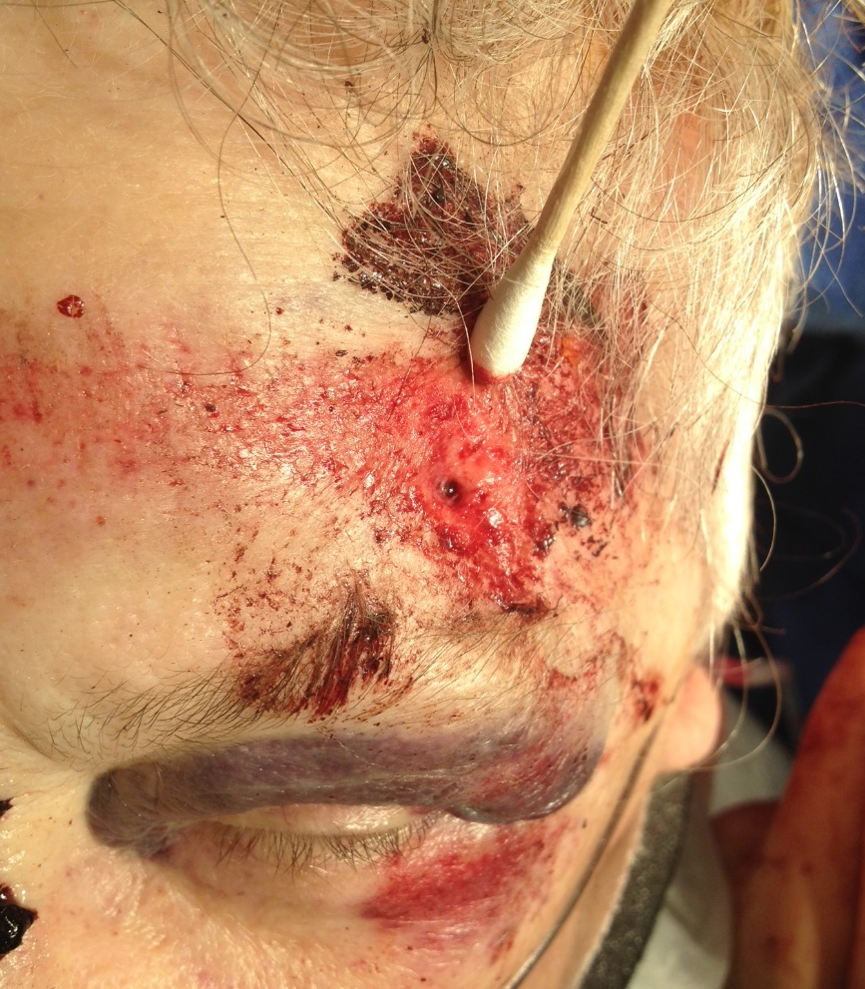
External Photos

Slide 7
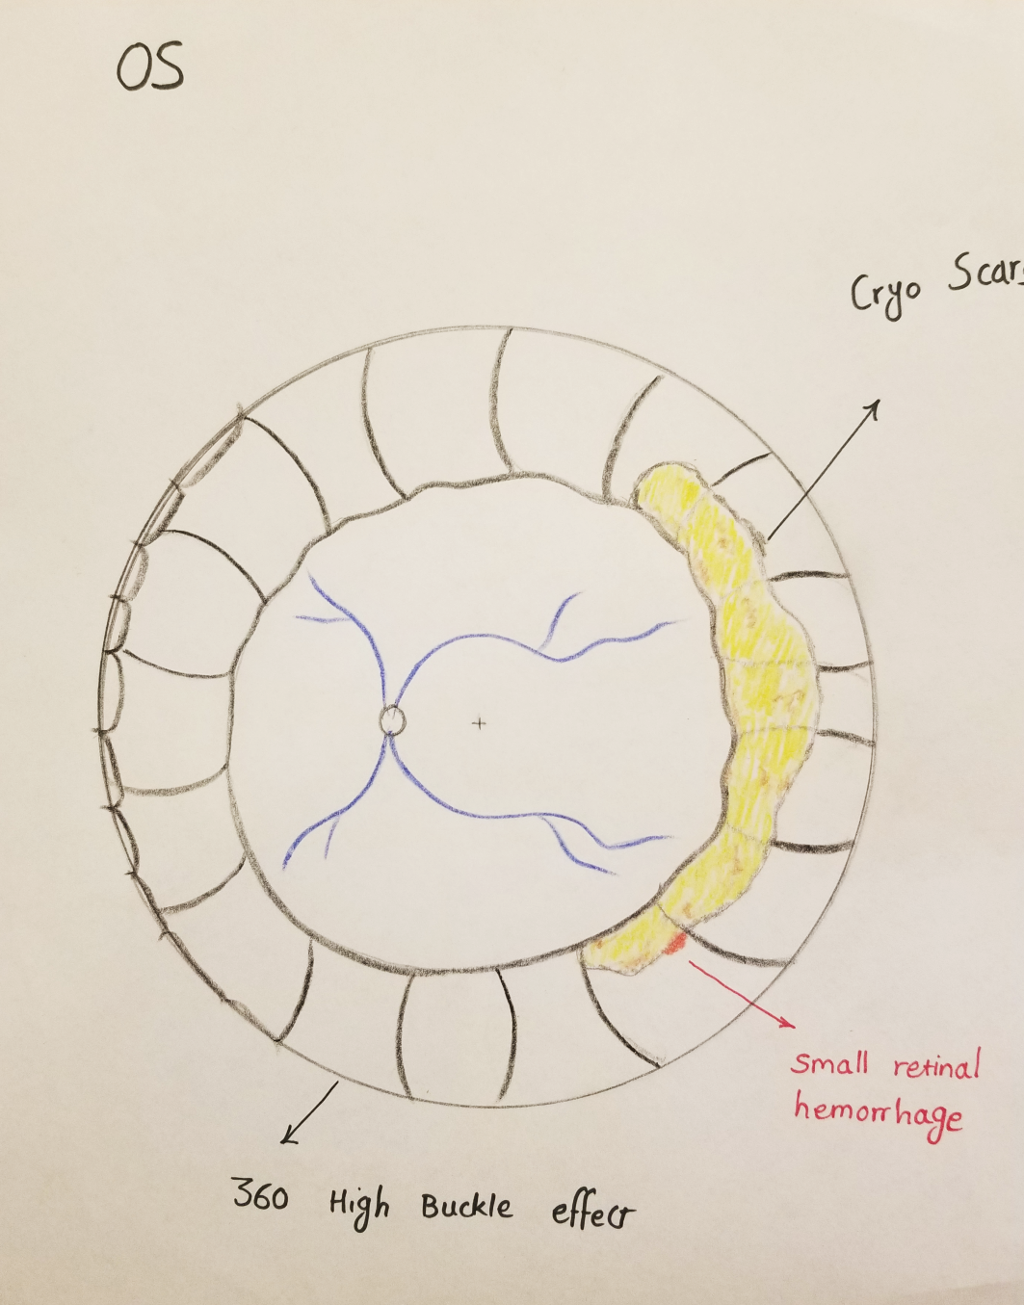
Posterior segment drawing

Slide 8
CT Scan

Slide 16
Assessment
87 yo WF with Large irregular metallic intra-orbital foreign body, s/p Car vs. pedestrian struck.

Slide 17
Plan: Surgical exploration and foreign body removal OS

Slide 18
Op Report
Superior orbitotomy through upper lid crease
Opening of septum
Exploring and irrigation without seeing FB
Intra-op skull Xray

Slide 20
Placed lid speculum, 120̊ superior peritomy, isolating SR muscle with Jameson hook
and …

Slide 22
Contacted primary surgeon’s office next day after surgery:
Nonmagnetic metallic clips superonasally to secure scleral buckle in place!

Slide 23
Discussion
Decades ago, the free ends of encircling elements were secured with small metallic clips, which have been replaced by small silicone sleeves (Watzke Sleeves).
These clips were composed of tantalum.

Slide 24
Tantalum is a metallic element with an atomic number of 73 and atomic weight of 180.9.
It is quite ductile and malleable and can therefore be repeatedly bent without breaking.
This property is important because it prevents weakening of the metal and breakage of the clips when manipulated surgically

Slide 25
From FDA Website

Slide 28
Tantalum is completely non-reactive and does not irritate tissues
Tantalum clips cause streak artifacts when the eye and orbit are studied by CT scan and the artifact is greater than with stainless steel.
MR compatible as it is non magnetic

Slide 31
Conclusions
Although Tantalum surgical clips that was used in the past to secure scleral buckle is almost obsoleted in practice, still might be used in some places.
Keep it in mind in patients who have had scleral buckling long time ago.
It’s important always to think of simple things that can be a diagnostic challenge.

Slide 32
Acknowledgement
Dr. Jeremy Clark
Dr. Austin Gerber

Slide 33
References
Michaels Retinal detachment (Book 1997).
Scheapens Retinal detachment and allied diseases ( Book 1983).
Bakshandeh H, et al. Metallic clips used for scleral buckling: ex vivo evaluation of ferromagnetism at 1.5 T. J Magn Reson Imaging. 1993 May-Jun;3(3):559.
Rosas JAA, et al. Incidental CT findings in acute orbital disease. EPOS 2011
Reiter M, et al. Postoperative imaging of orbital contents. Radiographics. 2015 Jan-Feb;35(1):221-34

