Slide 1
Grand Rounds
Jinghua Chen, MD, PhD
October 21, 2016

Slide 2
History
CC: 29 yo young male complained of sudden blurred vision in right eye.
HPI: This is a 29 yo young male from Peru who came to US two months ago to study. Two nights ago he stayed very late to study for an exam. He noticed that he could only see periphery with right eye, central vision was very blurry.

Slide 3
Past Medical History
POH: Refractive error OU
PMH: Right knee joint pain
Allergy: NKDA
FH: None contributory
Medication: None

Slide 4
Exam
OD OS
BCVA: 20/30+2 20/30+1
+4.75+1.50X090 +4.00+2.25X085
Pupils: 4→2 4 →2
IOP: 15 16
EOM: Full OU
CVF: Central scotoma OD>OS
Anterior segment: normal
Vitreous: 0.5 cells in anterior vitreous

Slide 5
Initial Exam
Notes:
Multiple choroidal yellow lesion, 200-300um, mainly posterior pole

Slide 6
AF Foundus Photo
Notes:
Hyper auto fluoresin

Slide 7
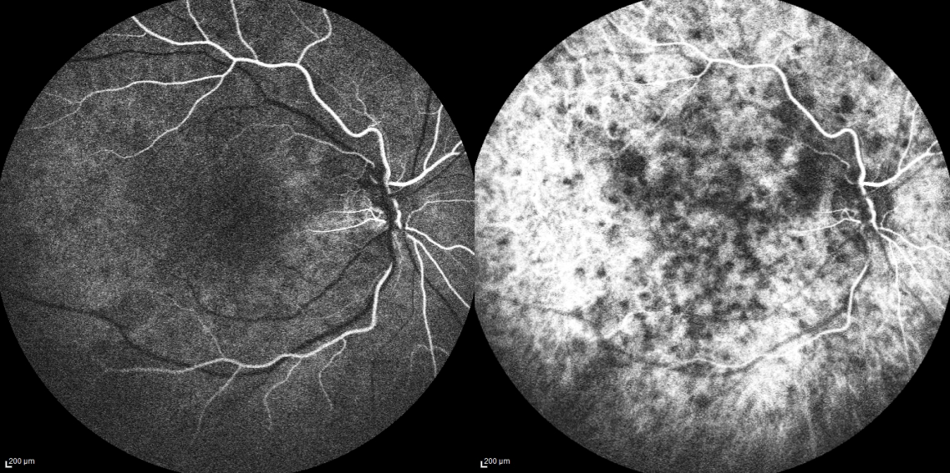
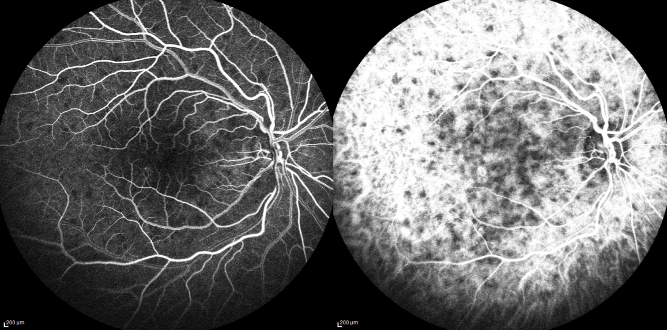
FA and ICG OD
16’’
20’’
Notes:
Both hypofluoresein, more on ICG means multifocal on choroid in posterior pole as well as outside archade

Slide 8
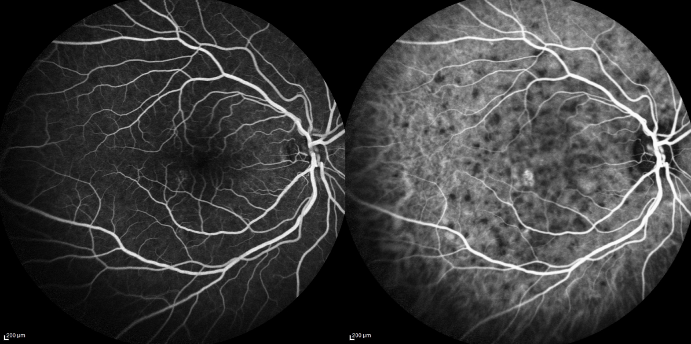
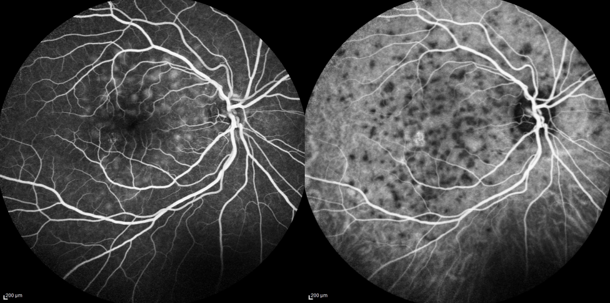
FA and ICG OD
60’’
2’35’’
Notes:
On FA hyper and ICG remain hypo, choroidal capillary occlusion

Slide 9
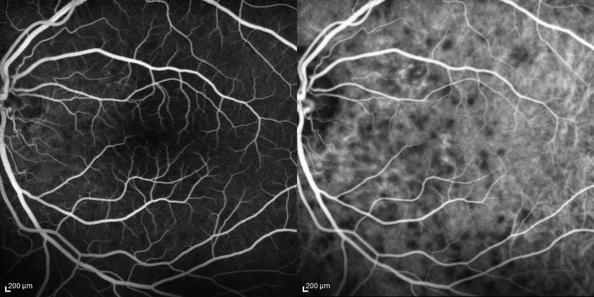
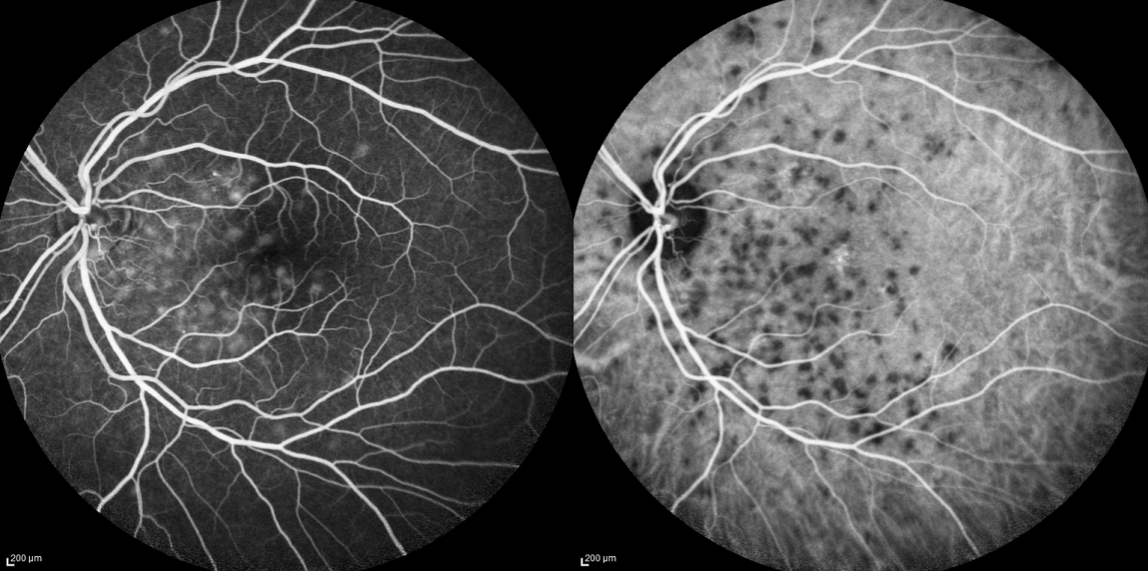
FA and ICG OS
43’’
2’50’’
Notes:
Maybe leaking from choroidal blood vessels

Slide 10
OCT
Notes:
subRPE,introretinal and neurosensory

Slide 11
What Could It Be?
Multiple evanescent white dot syndrome (MEWDS)
Differential diagnosis of white dot syndrome
Multifocal choroiditis without pan uveitis
Acute posterior multifocal placoid pigment epitheliopathy (APMPPE)
Punctate inner choroidopathy (PIC)
Birdshot chorioretinopathy
Acta Ophthalmol. Scand. 2000: 78: 348–353
Notes:
Syphilis, Lyme disease, Sarcoidosis, Tuberculosis, Toxoplasmosis, Lymphoma
Pic not outside

Slide 12
What Now?
No insurance
Oral Prednisone (20 mg po tid) x 3 days
To return in 1 week for follow up.
If symptoms don't resolve- medical work up
Chest imaging
Serological testing
Notes:
in an effort to identify any systemic autoimmune or infectious etiology
Patient social economic-no TB, syphilis

Slide 13
Two Weeks Later Vision 20/20 OD and 20/30 OS

Slide 14
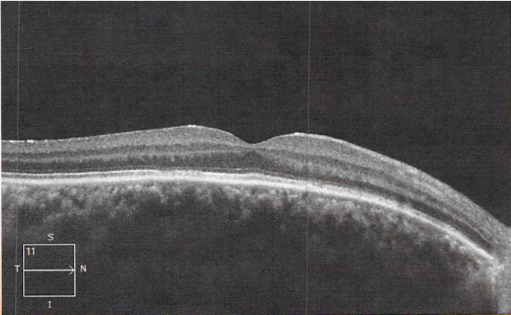
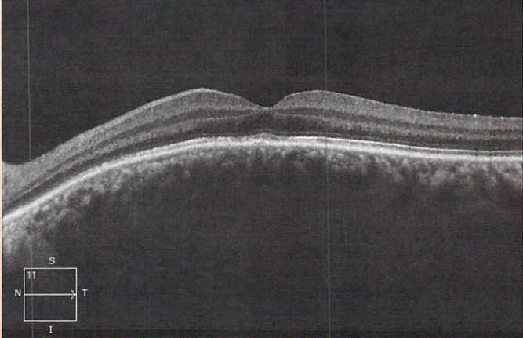
OCT
Notes:
ELLIPIZOID ZONE, OS under forvea and right eye

Slide 15
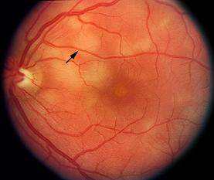
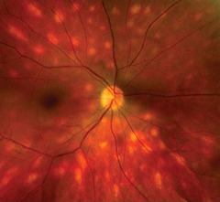
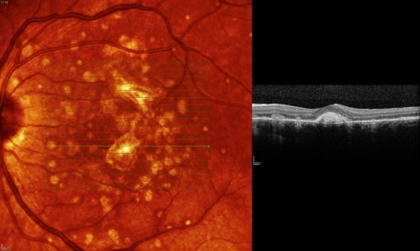
White Dot Syndromes (WDS)
Multiple evanescent white dot syndrome
Multifocal choroiditis and panuveitis ( MCP )
Acute posterior multifocal placoid pigment epitheliopathy (APMPPE)
Birdshot chorioretinopathy
Punctate inner choroidopathy (PIC)
Notes:
a collection of diseases characterized by localized, circumscribed whitish lesions in the RPE or choroidal layers. They are of unknown etiology but are suspected to be inflammatory in nature and can be associated with uveitis.

Slide 16
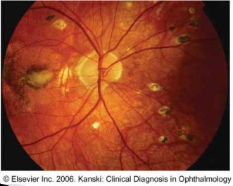
MULTIFOCAL CHOROIDITIS AND PANUVEITIS ( MCP )
Myopic females (30’s to 50’s),bilateral
Vitritis – mild to moderate
Chorioretinal lesions
At the level of the RPE and choriocapillaris
From 50 to 350 m
Lesions become atrophic with varying degrees of pigmentation and scarring
Vision out come
Cystoid macular edema (10-20%)
CNVM in 25-39% of pts

Slide 17
Multiple Evanescent White Dot Syndrome (MEWDS)
First described by Jampol L. M in 1984
Young, healthy women in the second to fourth decades of life
Symptoms:
a viral prodrome
unilateral, acute painless vision loss
an enlarged physiologic blind spot
shimmering photopsias

Slide 18
Multiple Evanescent White Dot Syndrome (MEWDS)
Multiple white spots at the level of the RPE or deep retina
100 and 200 µm in size
Posterior pole
An orange-yellow fovea with granularity
Vitreous inflammation, optic disc edema.

Slide 19
Multiple Evanescent White Dot Syndrome (MEWDS)
FA reveals early punctate hyperfluorescence in a wreath-like pattern and late staining
OCT: Discontinuities in inner segment-outer segment junction
Immune-mediated vascular inflammation that affects various retinal layers, including the choroid, RPE and photoreceptors.2,5

Slide 20
Early identification
MEWDS is generally benign
APMPPE may be associated with systemic vasculitis.
MCP has a chronic recurrent course
responsive to anti-inflammatory therapy.
PIC –a significant risk of choroidal neovascular membrane formation

Slide 21
References
BSCS 2014-2015 Book 12, Retina and Vitreous: 185-193
BCSC 2014-2015 Book 9, Intraocular Inflammation and Uveitis 147-172
Jampol LM, Sieving PA, Pugh D, et al. Multiple evanescent white dot syndrome. I. Clinical findings. Arch Ophthalmol 1984;102:671-4.
Aaberg TM, Campo RV, Joffe L. Recurrences and bilaterality in the multiple evanescent white-dot syndrome. Am J Ophthalmol 1985;100:29-37.
Mamalis N, Daily MJ. Multiple evanescent white dot syndrome. A report of eight cases. Ophthalmology 1987;94:1209-12.
Dreyer R, Gass JDM. Multifocal choroiditis and panuveitis: A syndrome that mimics ocular histoplasmosis. Arch Ophthalmol. Vol 102, Dec 1984:1776-1784.
Dunlop A, Cree I, Hague S, Luthert P, Lightman S. Multifocal choroiditis: Clinicopathologic correlation. Arch Ophthalmol. 1998; 116:801-803
Fung AT, Pal S, Yannuzzi NA, Christos P, Cooney M, Slakter JS, Klancnik JM Jr, Freund KB, Cunningham ET Jr, Yannuzzi LA.Retina. 2014 Jan;34(1):98-107.Multifocal choroiditis without panuveitis: clinical characteristics and progression.
Dunlop A, Cree I, Hague S, Luthert P, Lightman S. Multifocal choroiditis: Clinicopathologic correlation. Arch Ophthalmol. 1998; 116:801-803.)
Thorne J, Wittenberg S, Jabs D, Peters G, Reed T, Kedhar S, Dunn J. Multifocal choroiditis with panuveitis:Incidence of ocular complications and loss of visual acuity. Ophthalmology 2006;113:2310-2316.
Fine HF, Zhitomirsky I, Freund KB, Barile GR, Shirkey BL, Samson CM, Yannuzzi LA. Bevacizumab (avastin) and ranibizumab (lucentis) for choroidal neovascularization in multifocal choroiditis. Retina 2009 Jan:29(1) :8-12.

Slide 22
Thank you!
Notes:
I hope you like the new template created by Dr. fernandaz

Slide 23
MEWDS – Original Description

Slide 24
Multiple Evanescent White Dot Syndrome (MEWDS)
Who usually presents with MEWDS?
Women, 14-47
Is the disease unilateral or bilateral?
Unilateral
Can the disease be recurrent?
Yes, but rarely
What is the visual prognosis?
Excellent, with recovery in 1-2 months
Which of the following is not associated with MEWDS – acute macular neuroretinopathy, Lyme disease, enlarged blind spot?
Lyme disease

Slide 25
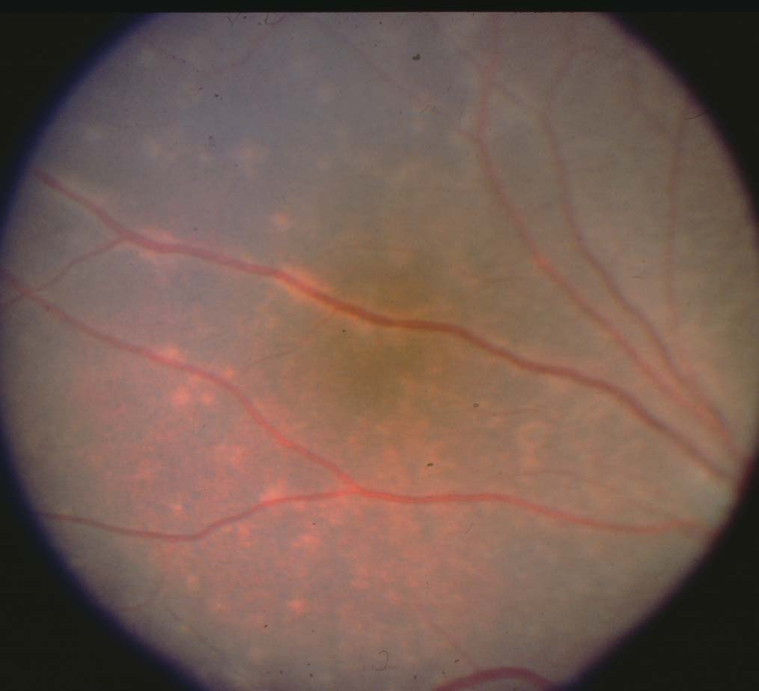

Slide 26
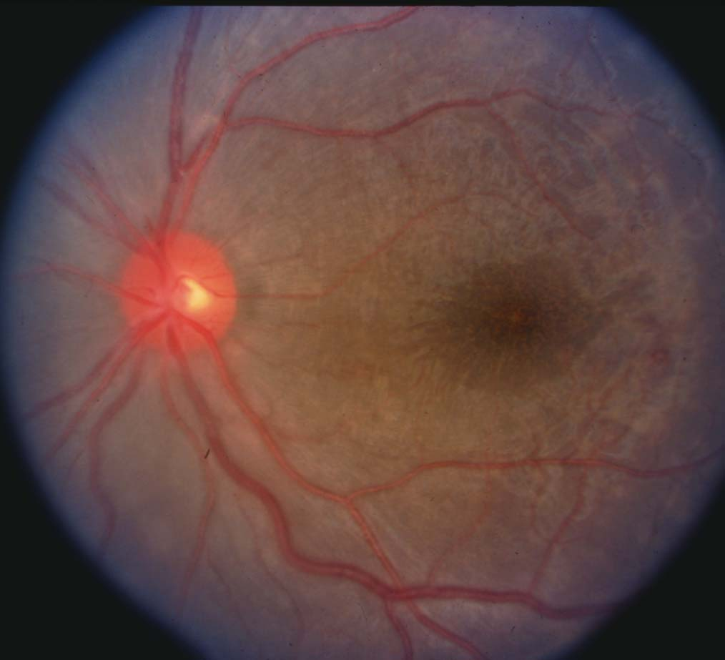

Slide 27
