Slide 1
Grand Rounds
Brett Mueller, D.O., Ph.D.
November 18, 2016

Slide 2
Patient Presentation
CC
Failed vision screening at a pediatrician’s office
HPI
5 yo M presents to clinic for evaluation because of a failed vision screening at his pediatrician's office.
Notes:
She denies any flashes of light and states that she has no visual complaints with OS. The mother denies ever noticing any problems with his vision in the past. And he is a completely healthy individual with no significant PMH.

Slide 3
History (Hx)
POMHx: negative
PMHx: negative
FHx: negative
Meds: none
Allergies: NKDA
Social Hx: Negative
ROS: Noncontributory
Notes:
quiescent

Slide 4
External Exam
 | OD |  | OS
BCVA | 20/20 |  | Count Fingers
Anterior Exam | WNL |  | WNL

Slide 5
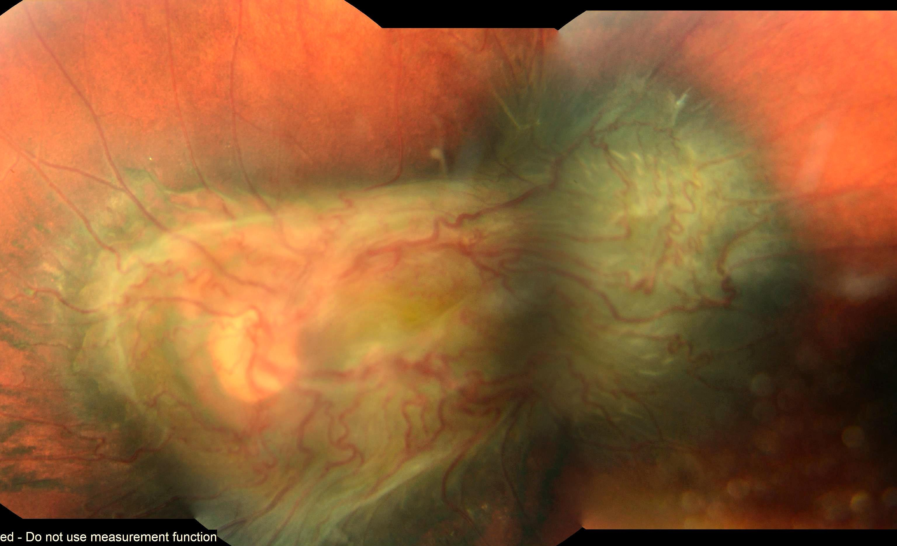
Posterior Segment Exam
Notes:
Demonstrates an enlarged gliotic hyperpigmented mass lesion that is protruding out from the retina and involving the fovea and optic nerve. There is also retinal contraction and vascular tortuosity that is seen in this lesion as well.

Slide 6
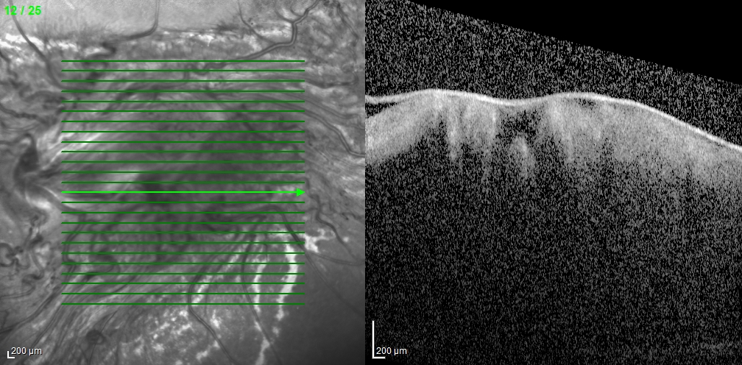
OCT

Slide 7
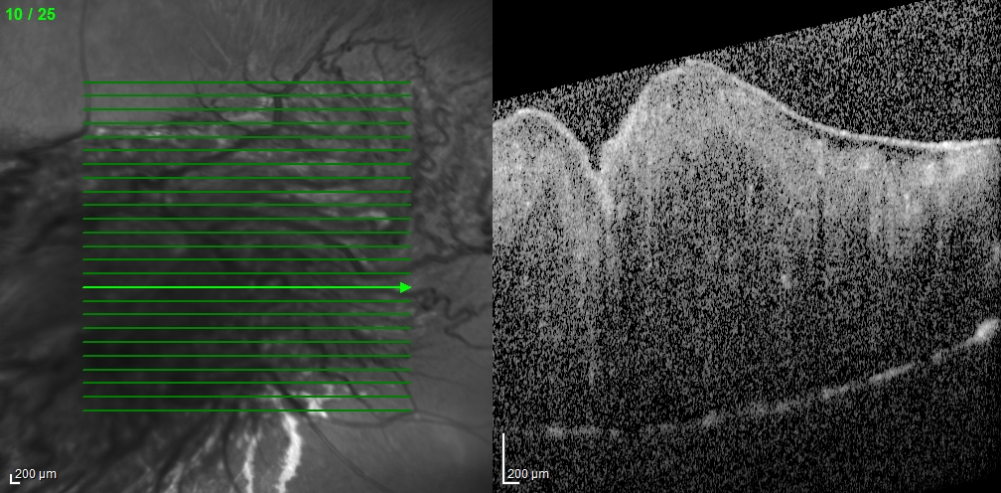
OCT

Slide 8
OCT Angiography
Notes:
BAF

Slide 9
Assessment
5 year-old male that presents with a hyperproliferative lesion causing a distorted retina in the left eye
Differential Diagnosis:
Combined Hamartoma of the Retina and RPE
Choroidal Melanoma
Retinoblastoma

Slide 10
Follow-up
6 months in retina clinic

Slide 11
Combined Hamartoma of the Retina and the RPE
Gass coined the term combined hamartoma of the retina and the RPE in 1973¹
Is a rare benign lesion in the macula, juxtapapillary, or peripheral location that is commonly found in children and consists of an abnormal proliferation of glial cells, vascular tissue and sheets of pigmented epithelial cells
Notes:
Though it was decribed histopathologically earlier, gass was the first to use the term

Slide 12
Combined Hamartoma of the Retina and the RPE
Prevalence of this disease is < 1 in 1,000,000
Font et al. 1989 reviewed 53 patients in the literature between 1952-1988
Shields CL et al. 2008 reviewed 77 patients from their cohort of patients
Notes:
Retina Font
Shields Ophthalmology

Slide 13
General Histopathology
The tumor is described as a disorganized glial tissue intermixed with numerous blood vessels and cords and tubules of proliferative RPE⁵
Notes:
Font RL, Moura RA, Shetlar DJ, Martinez JA, McPherson AR. Combined hamartoma of sensory retina and retinal pigment epithelium. Retina. 1989;9(4):302-11.

Slide 14
General Histopathology
Anita Agarwal. Tumors of the Retinal Pigment Epithelium. Gass’ Atlas of Macular Diseases, Chapter 12, 1065-1097
Notes:
Clinicopathologic correlation of a juxtapapillary CRPE-RH in a 29-year-old man with an 8-week history of blurred vision in his left eye (J). Melanoma was suspected, and the eye was enucleated. Histopathologic examination revealed disorganization of the normal architecture of the optic nerve head and retina associated with hyperplasia of the retinal blood vessels, RPE, and glial tissue (K). Cords and sheets of RPE proliferation extended throughout the tumor and surrounded blood vessels (arrows, K). Note the proliferation of fibrous tissue near the surface of the retina
Histopathology of combined hamartoma of retina. High-power photomicrograph shows tumor to be composed of interlacing cords of retinal pigment epithelial cells and blood vessels within disorganized and thickened neurosensory retina.

Slide 15
Diagnosis
Present between 9.5 – 14.2 months of age with painless decrease in VA and strabismus.
Shields et al. 2008 found the presenting VA to be < 20/200 in 47% of all cases⁴.
Tumor can appear as dusky brown, green, yellow, grey or orange with intrinsic vessels being tortuous and corkscrewed from contraction.
Notes:
Shields CL, Thangappan A, Hartzell K, Valente P, Pirondini C, Shields JA. Combined hamartoma of the retina and retinal pigment epithelium in 77 consecutive patients visual outcome based on macular versus extramacular tumor location. Ophthalmology. 2008 Dec;115(12):2246,2252.e3.
Clinically you see: Change in the vitreoretinal interface where you get retinal traction, fibrosis, gliosis and ERM formation with foveal dragging.

Slide 16
Diagnostic Procedures
OCT: Help to identify the disorganized retina with a distinct ERM with secondary retina folds
FA: Early hypofluorescence due to blockage in the region of hyperpigmentation. In the late phase you will see leakage from dilated tortuous vessels.

Slide 17
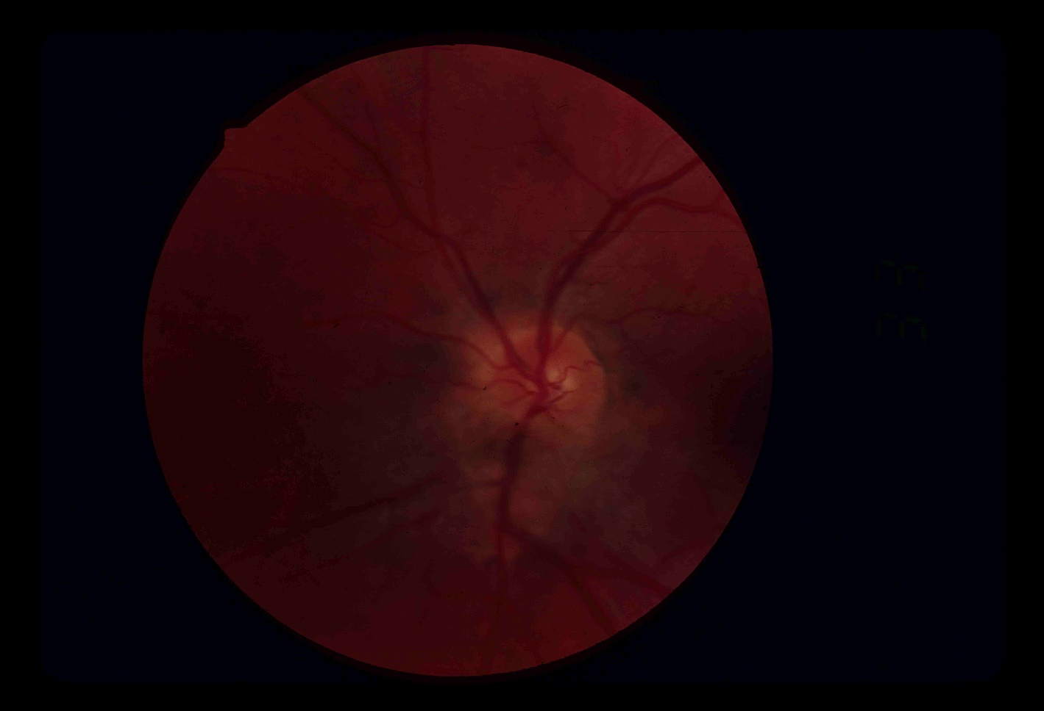
Diagnosis
Notes:
Shields CL, Thangappan A, Hartzell K, Valente P, Pirondini C, Shields JA. Combined hamartoma of the retina and retinal pigment epithelium in 77 consecutive patients visual outcome based on macular versus extramacular tumor location. Ophthalmology. 2008 Dec;115(12):2246,2252.e3.

Slide 18
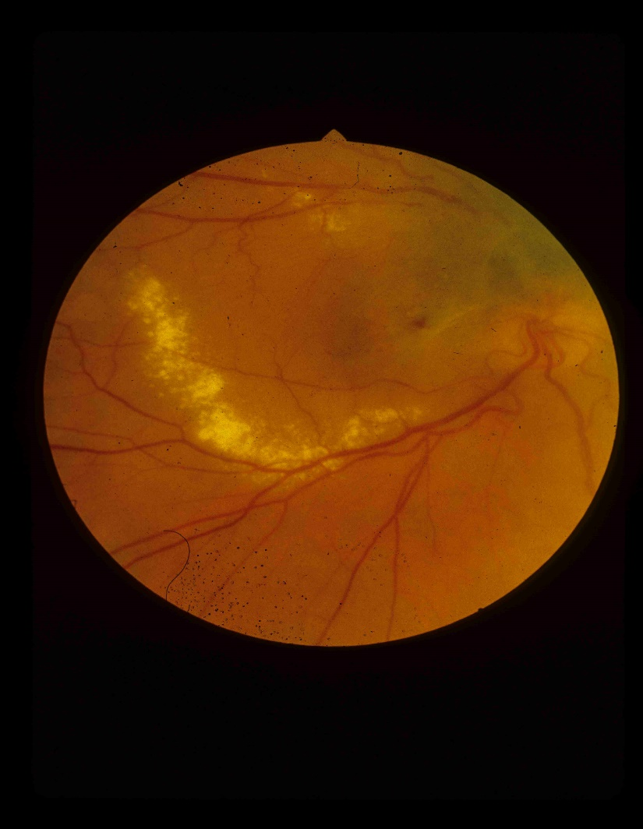
Diagnosis
Notes:
Shields CL, Thangappan A, Hartzell K, Valente P, Pirondini C, Shields JA. Combined hamartoma of the retina and retinal pigment epithelium in 77 consecutive patients visual outcome based on macular versus extramacular tumor location. Ophthalmology. 2008 Dec;115(12):2246,2252.e3.

Slide 19
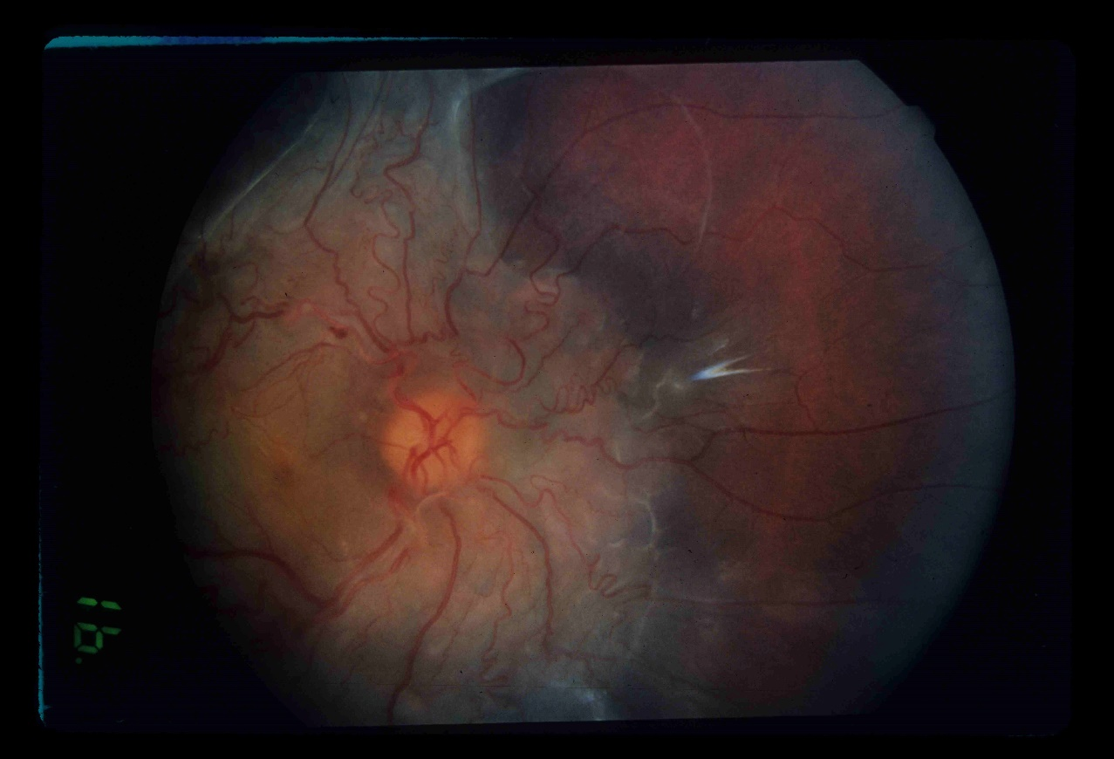
Diagnosis
Notes:
Shields CL, Thangappan A, Hartzell K, Valente P, Pirondini C, Shields JA. Combined hamartoma of the retina and retinal pigment epithelium in 77 consecutive patients visual outcome based on macular versus extramacular tumor location. Ophthalmology. 2008 Dec;115(12):2246,2252.e3.

Slide 20
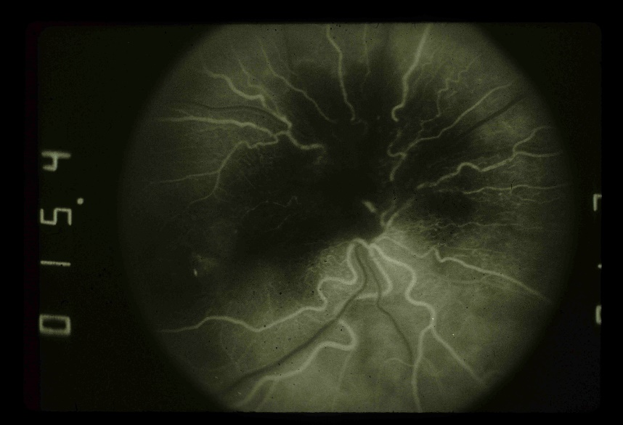
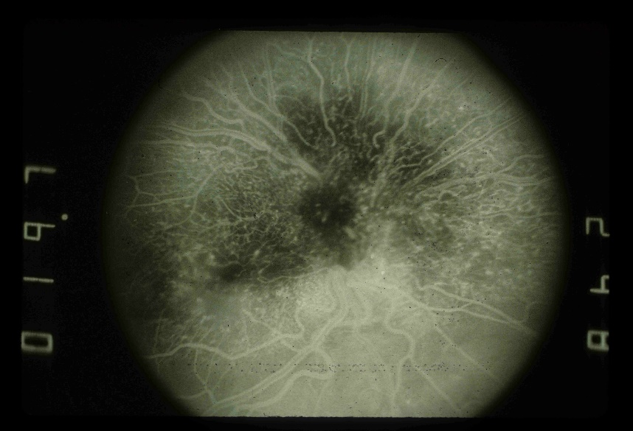
Diagnosis
Notes:
Angiography revealed a capillary angiomatous component of this lesion (E and F, stereo).
G–I: Small hypopigmented combined RPE and retinal hamartoma in a 66-year-old asymptomatic man who was suspected of having ischemic optic neuropathy (G). An epiretinal membrane on the surface of the lesion partly obscured the retinal vessels and the mottled pigmentation within the tumor (G). Angiography revealed evidence of the capillary angiomatous nature of this lesion as well as some dilation of the retinal capillaries in the papillomacular bundle (H and I).

Slide 21
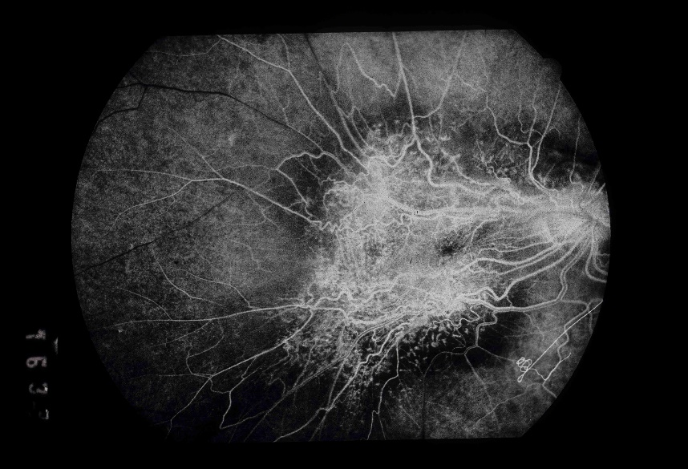
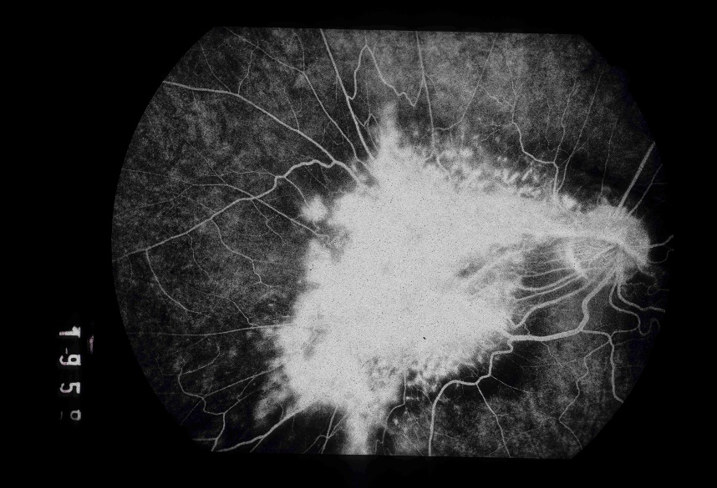
Diagnosis
Notes:
Shields CL, Thangappan A, Hartzell K, Valente P, Pirondini C, Shields JA. Combined hamartoma of the retina and retinal pigment epithelium in 77 consecutive patients visual outcome based on macular versus extramacular tumor location. Ophthalmology. 2008 Dec;115(12):2246,2252.e3.

Slide 22
Combined Hamartoma of the Retina and the RPE
Etiology: believed to be a congenital lesion, but has not been reported at the time of birth and is typically described in infants and young children
Risk Factors: No known risk factors and most patients have no systemic disease, but it is seen mostly in Caucasians^{3,4}, and has been associated with NF1 and NF2⁵⁻⁹.
Notes:
Described in 7 patient in publication 2 in 1973 at the Trans American Ophthalmolo Sociecty

Slide 23
Differential Diagnosis
Choroidal melanoma
Retinoblastoma
Choroidal Nevus
Adenoma or adenocarcinoma of RPE
Melanocytoma
Morning Glory Anomaly
Notes:
Described in 7 patient in publication 2 in 1973 at the Trans American Ophthalmolo Sociecty

Slide 24
Management
General Treatment: amblyopia prevention
Surgical Treatment: Vitrectomy for ERM
Schachat et al. 1984, Retina. Reviewed 60 pts, 3 got surgery and only 1 pt had VA improve from 20/200 to 20/40
Cohn et al. 2009 Retina. Evaluated 11 pts who got a PPV with a membrane peel and showed 6 of 11 pts had a VA improvement
Notes:
Presented at the macular society by Schachat et al (20/200-20/40)
Cohn et al from Beaumant eye institute

Slide 25
Prognosis
Shield et al. 2008 Ophthalmology Demonstrated that 47% of their 77 patient cohort presented with VA < 20/200.
Demonstrated that 60% of macular lesions will continue to have slow gradual visual loss over time.
Notes:
Presented at the macular society

Slide 26
Complications
Reduced VA due to:
Amblyopia
ERM
Retinal holes
Retinoschisis
CNVM
Retinal neovascularization
Retinal hemorrhages
Retinal detachment
Notes:
Presented at the macular society

Slide 27
References
Gass JD. An unusual hamartoma of the pigment epithelium and retina simulating choroidal melanoma and retinoblastoma. Trans Am Ophthalmol Soc. 1973;71:171,83; discussions 184-5.
Gass JD. An unusual hamartoma of the pigment epithelium and retina simulating choroidal melanoma and retinoblastoma. Trans Am Ophthalmol Soc. 1973;71:171,83; discussions 184-5
Schachat AP, Shields JA, Fine SL, et al. Combined hamartomas of the retina and retinal pigment epithelium. Ophthalmology. 1984 Dec;91(12):1609-15.
Shields CL, Thangappan A, Hartzell K, Valente P, Pirondini C, Shields JA. Combined hamartoma of the retina and retinal pigment epithelium in 77 consecutive patients visual outcome based on macular versus extramacular tumor location. Ophthalmology. 2008 Dec;115(12):2246,2252.e3.
Font RL, Moura RA, Shetlar DJ, Martinez JA, McPherson AR. Combined hamartoma of sensory retina and retinal pigment epithelium. Retina. 1989;9(4):302-11.
Meyers SM, Gutman FA, Kaye LD, Rothner AD. Retinal changes associated with neurofibromatosis 2. Trans Am Ophthalmol Soc. 1995;93:245,52; discussion 252-7.
Kaye LD, Rothner AD, Beauchamp GR, Meyers SM, Estes ML. Ocular findings associated with neurofibromatosis type II. Ophthalmology. 1992 Sep;99(9):1424-9.
Destro M, D'Amico DJ, Gragoudas ES, et al. Retinal manifestations of neurofibromatosis. diagnosis and management. Arch Ophthalmol. 1991 May;109(5):662-6.
Grant EA, Trzupek KM, Reiss J, Crow K, Messiaen L, Weleber RG. Combined retinal hamartomas leading to the diagnosis of neurofibromatosis type 2. Ophthalmic Genet. 2008 Sep;29(3):133-8
Kahn D, Goldberg MF, Jednock N. Combined retinal-retina pigment epithelial hamartoma presenting as a vitreous hemorrhage. Retina. 1984 Winter-Spring;4(1):40-3.
Inoue M, Noda K, Ishida S, et al. Successful treatment of subfoveal choroidal neovascularization associated with combined hamartoma of the retina and retinal pigment epithelium. Am J Ophthalmol. 2004 Jul;138(1):155-6.
Helbig H, Niederberger H. Presumed combined hamartoma of the retina and retinal pigment epithelium with preretinal neovascularization. Am J Ophthalmol. 2003 Dec;136(6):1157-9.
http://eyewiki.aao.org/Combined_Hamartoma_of_Retina_and_Retinal_Pigment_Epithelium

