Slide 1
Grand Rounds Retinal vascular disease with unique findings
Niloofar Piri MD
June 16th 2017

Slide 2
Patient Presentation
CC
No visual complaints, was referred to retina clinic to be evaluated for peripheral retinal findings
HPI
57 yo AAF with NTG and Sickle cell disease is referred to be seen in retina clinic for peripheral retinal findings and superonasal retinal lesion OD

Slide 3
History (Hx)
Past Ocular Hx: NTG
Past Medical Hx: Sickle cell disease HbSS( last crisis 5 years prior to presentation), Asthma, Arthritis
Fam Hx: Ischemic heart disease in sister
Meds: Hydroxyurea, folic acid, multivitamins, fluoxetine
Ocular medications: Latanoprost 0.005% qhs OU
Allergies: ASA
Social Hx: nonsmoker, non drinker, denies any drug abuse

Slide 4
External Exam
 | OD |  | OS
VA | 20/20- |  | 20/20
Refraction | Plano +0.25x 95 |  | plano
Pupils | 4→2mm |  | 4→3mm
IOP | 8 mmHg | C Latanoprost qhs OU | 8 mmHg
EOM | full |  | full
pachymetry | 488 |  | 480

Slide 5
Anterior Segment Exam
SLE | OD | OS
External/Lids | Wnl | Wnl
Conj/Sclera | Wnl | Wnl
Cornea | Clear | Clear
Ant Chamber | 0 cell and flare | 0 cell and flare
Iris | Wnl | Wnl
Lens | NS 2+ | NS 2+
Anterior vitreous | Clear | Clear

Slide 6
Posterior Segment Exam

Slide 7
Schisis cavity representing old intraretinal hemorrhage
Black Sunburst lesion

Slide 9
Duane’s Ophthalmology 2006

Slide 11
OCTA
Supf capillary Plexus OD
Supf capillary Plexus OS

Slide 12
Deep plexus OD
Deep plexus OS

Slide 13
Review of perimetry
Nasal cecocentral scotoma OU compatible with temporal foveal thinning

Slide 14
Assessment
57 yo AAF with sickle cell disease (Hb SS) with temporal foveal thinning OU and peripheral findings( schisis cavity, sunburst, iridescent spots , arteriolar occlusion) despite normal visual acuity

Slide 15
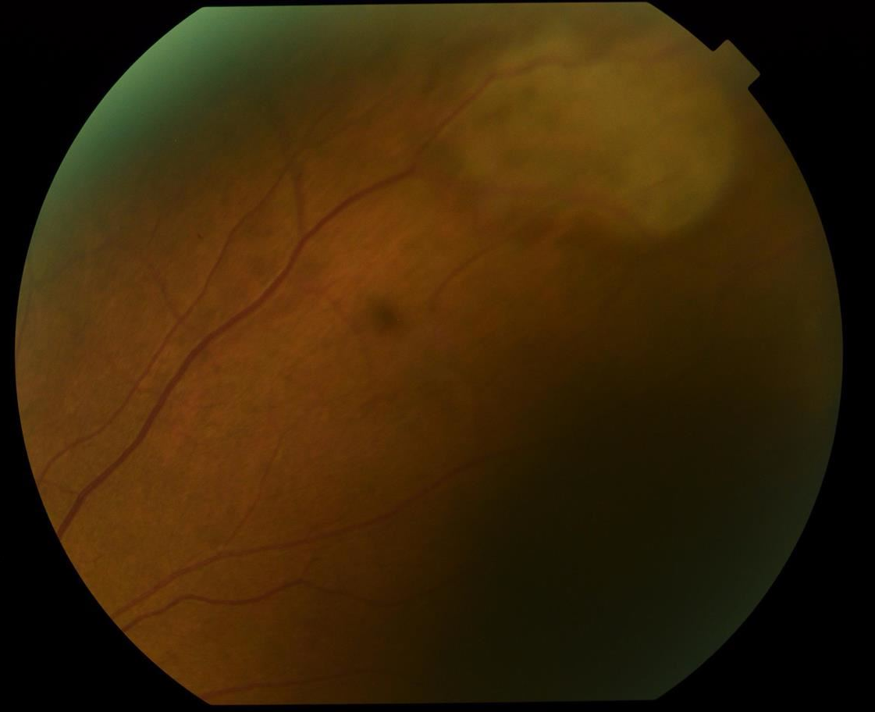
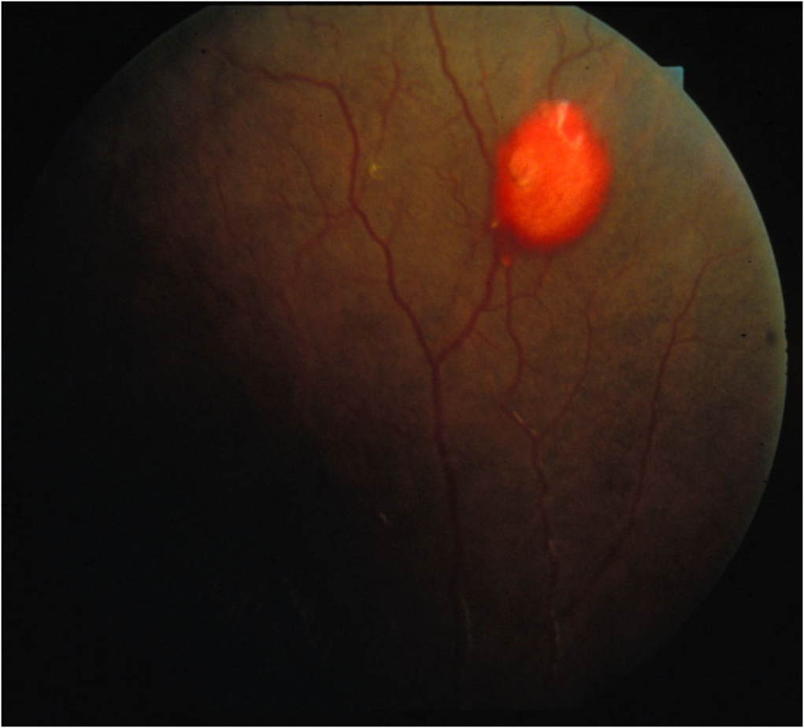
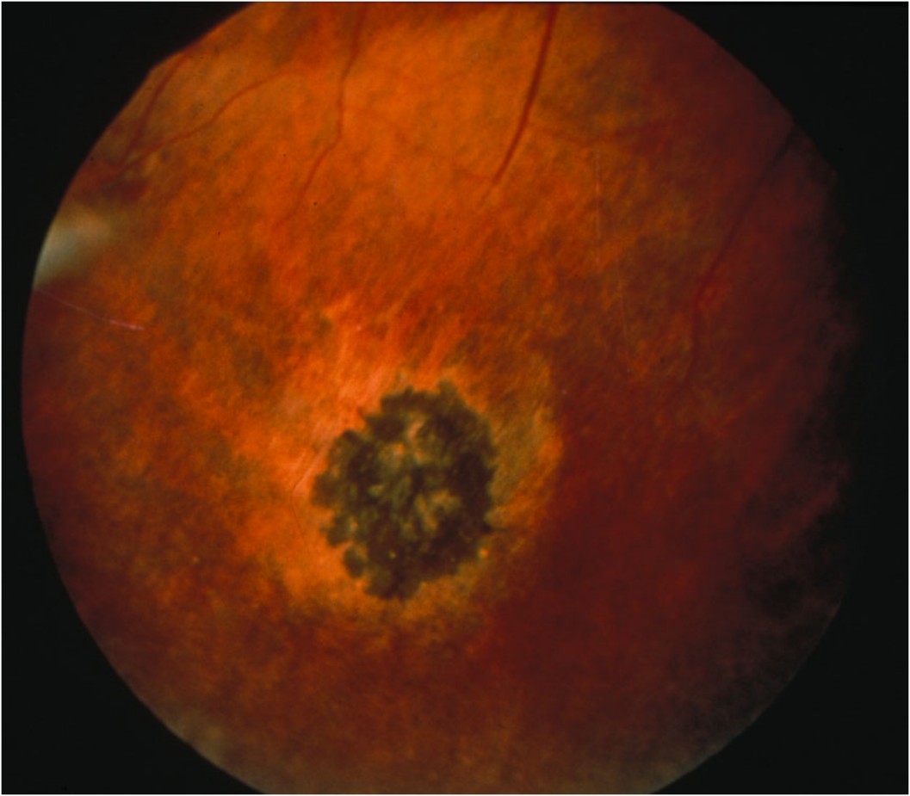
Discussion
Posterior segment findings
Non proliferative
Salmon patch
Black sunburst
Iridescent spots
Schisis cavity
Proliferative

Slide 16
Discussion
Classic severity scale of sickle cell retinopathy was developed by Goldberg (1971). This system encompasses 5 stages of PSR.

Slide 17
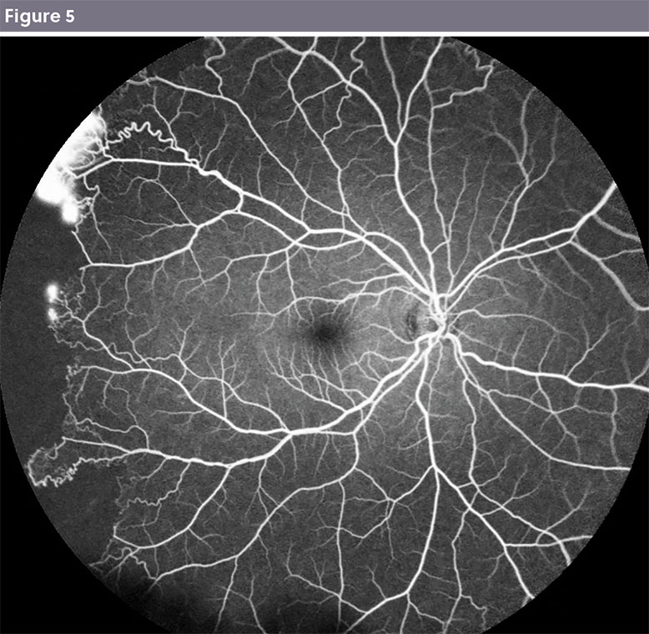
1. Only arterial occlusion noted
2. Classic AV anastomosis
3. classic seafan neovascularization
4. Vitreous hemorrhage
5. Tractional Retinal detachment
Approximately 54% of SC diseas and 18% of SS disease develop stage III or worse in 13 year period.
Steven Cohen (2015), Retina Gallery).

Slide 18
Systemic associations
A recent study in pediatric population demonstrated that following factors significantly correlated with retinopathy
Pain crisis
Male sex
Splenic sequestration
Rosenberg et al. Pediatric sickle cell retinopathy: correlation with clinical factors. J AAPOS 2011; 15:49-53

Slide 19
Recent Imaging Studies
Multiple studies have shown frequent macular thinning.
Temporal thinning has been shown in patients with normal vision and normal FAZ on FA .

Slide 20
Minville et al. Macular Microangiopathy in Sickle Cell Disease Using Optical Coherence Tomography Angiography. AJO 2016

Slide 21
Hood et al. Temporal macular atrophy as a predictor of neovascularization in sickle Cell retinopathy. Ophthalmic Surg Laser Imaging Retina 2016

Slide 22
Temporal macular atrophy had a sensitivity of 27%, specificity of 67%, PPV of 83% and NPV of 13% in identifying neovascularization.
Temporal macular thinning is not sensitive enough to be used as screening tool
It had high PPV and in any case with temporal thinning physician should be alerted for the increased possibility of peripheral neovasculaization

Slide 23
Conclusions
Newer imaging modalities have increased the ability of clinicians to detect subclinical states of sickle cell retinopathy.
It remains to be determined if these early findings are associated with higher rates of visual loss.
However, temporal macular tinning should prompt for more accurate peripheral fundus exam to detect early NV.

Slide 24
References
Hood et al. Temporal macular atrophy as a predictor of neovascularization in sickle cell retinopathy. Ophthalmic Surg Laser Imaging Retina. 2016;47:27-34
Lim Jennifer. Ophthalmic manifestations of sickle cell disease: update of the latest findings. Current Opin ophthalmol 2012,23:533-536.
Scott A. Ophthalmic manifestations of sickle cell disease.2016 SMA
Raeba et al. SD- OCT in patients with sickle cell disease. Br J Ophthalmol 2015’ 99:967-972
Sickle cell retinopathy . Duane ophthalmology 2006
Hemoglobinopathies in : Ryan Retina text book 2017

