Slide 1
Grand Rounds Pupil Check Please?
Sidharth Puri MD, PGY3
July 21, 2017

Slide 2
Patient Presentation
CC
Loss of vision for days/weeks
HPI
57 yo WF w/ pmhx of recurrent supraglottic SCC (first treated by chemoradiation 2015) s/p total laryngectomy, partial pharyngectomy, left neck dissection, left IJ resection on 12/28/2016. Underwent complicated post-operative course

Slide 3
HPI (cont’d)
Patient nonverbal for several weeks post-operatively with significant periorbital and facial edema
January 2017
Worsened agitation, underwent MRI Brain (1/22/17)
“Diffusion restriction involving the bilateral optic nerves extending from the optic canals to near the globes which is concerning for ischemic change.”
1/24/17- “Neck bleeding”
R carotid pseudoaneurysm stented
Repeat imaging indicating left thalamocapsular hemorrhage
February 2017
Seen by Neurosurgery and Stroke Team, with no acute findings on exam other than dilated sluggish pupils and mild R extremity weakness (2/2/2017)
2/13/17 Ophthalmology consulted due to ?vision changes
Patient communication limited to nodding, but revealed to family she has been unable to see for days-weeks

Slide 4
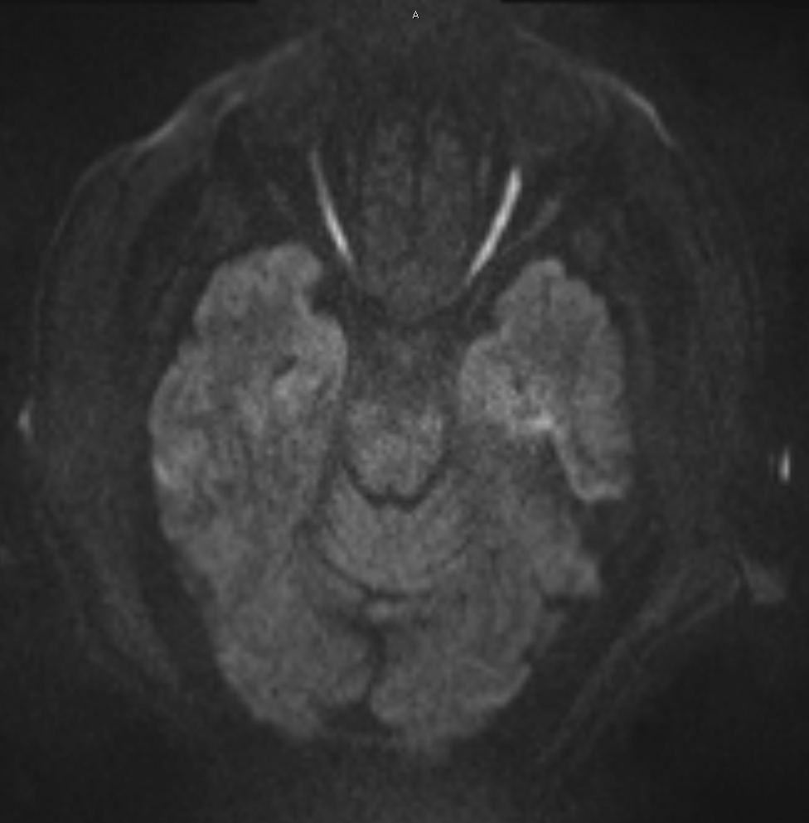
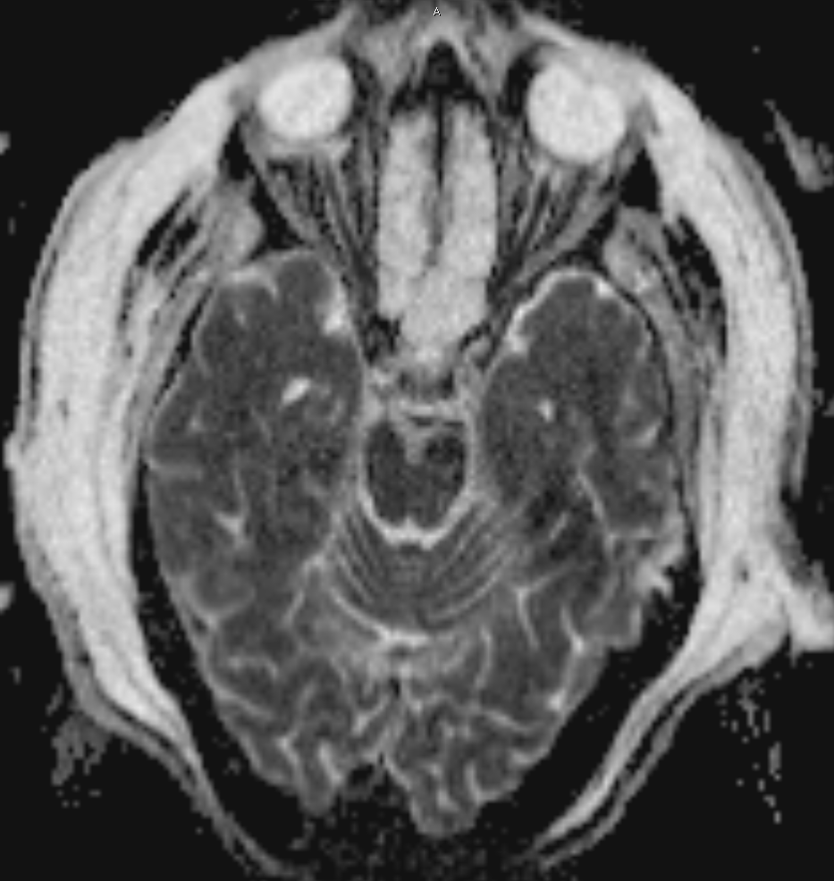
MRI 1/22/17
DWI
ADC

Slide 5
History (Hx)
Past Ocular Hx - None
Past Medical/Surgical Hx- Depression, Supraglottic SCC and as described
Fam Hx -Noncontributory
Meds – Escitalopram, Synthroid, Metoprolol, Ferrous Sulfate, Pepcid, Multi Vitamin
Allergies - NKDA
Social Hx – Former 40 pk year smoker, married

Slide 6
Review of Systems
Negative for Headache, Jaw claudication, Temporal Tenderness, Nausea/Vomiting, Trauma

Slide 7
External Exam
 | OD |  | OS
VA | NLP |  | NLP
Pupils | 5 mm | Fixed, nonreactive | 5 mm
IOP | 14 mmHg |  | 14 mmHg
EOM | Full |  | Full
CVF | UTO |  | UTO

Slide 8
Anterior Segment Exam
SLE | OD | OS
External/Lids | Wnl | Wnl
Conj/Sclera | White and Quiet | White and Quiet
Cornea | Clear | Clear
Ant Chamber | Formed | Formed
Iris | Wnl | Wnl
Lens | 1+ NS | 1+ NS

Slide 9
Posterior Segment Exam
Fundus | OD | OS
Optic Nerve | 4+ diffuse pallor | 4+ diffuse pallor
Macula | Diffuse Whitish-yellow edema involving fovea | Blunted reflex, Milder edematous changes
Vessels | Severe attenuation, sclerotic vessels temp macula and 360 periphery. Intact blood flow prox vessels | Severe attenuation
Periphery | Inferior pallor | wnl

Slide 10
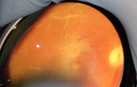
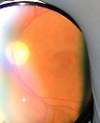
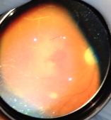
DFE 2/13/17

Slide 11
Differential Diagnosis
Bilateral CRAO
Recurrent/non-sequential BRAO
Bilateral PION
Bilateral Ophthalmic Artery Occlusion
Combined mechanism with Hypoperfusion underlying pathophysiology

Slide 12
Assessment
57 yo WF 2 months s/p total larygnectomy, partial pharygnectomy, left and right neck dissection, left IJ sacrifice for supralarygneal SCC with NLP vision OU and bilateral CRAO

Slide 13
Perioperative Visual Loss
Rare but devastating complication of sx
0.013% - 0.2% incidence (Berg et al 2010)
Highest after cardiac and spinal sx
Leading causes: AION, PION, CRAO, Pituitary Apoplexy, or Cortical Blindness

Slide 14
Postoperative AION
Painless vision loss, disc edema
Occlusion/hypoperfusion of posterior ciliary arteries
Commonly after cardiac sx
In setting of blood loss or hypotension
Endogenous or exogenous vasoconstricting agents may contribute to choroidal and optic nerve ischemia
Hypothermia during CABG may contribute to watershed infarction of optic nerve

Slide 15
Postoperative PION
Less common than AION
Normal ON and fundoscopic exam
Infarction to intraorbital ON, supplied by pial vessels
Commonly after spinal sx in prone position
Prone increases orbital venous pressure and pressure on globe
Anemia, hypotension also implicated

Slide 16
Many documented cases of ION following radical neck dissection
Distention of ophthalmic veins, facial edema, can lead to ION
E.g. venous distention leading to compression of orbital apex -> PION

Slide 17
Postoperative CRAO
Variable vision at presentation
7 of 10 CRAO post spinal sx with NLP vision (Lee et al 2006)
Cherry red spot in macula, white ground glass appearance to retina, attenuated arterioles, APD
Likely due to external ocular compression
Extensive pressure on globe leading to raised IOP above perfusion pressure and retinal ischemia
Emboli also as source
More likely following spinal sx in prone position (headrest prevents ocular perfusion)

Slide 18
Prevention

Slide 19
Management/Treatment
Urgent ophthalmologic evaluation & imaging
Optimize hemodynamics, arterial oxygenation
Unless acutely found, recommend observation
Per AAO, no confirmed benefit for IOP lowering agents, steroids, anti-platelet agents, thrombolysis, hyperbaric oxygen

Slide 20
KEY POINTS
ALWAYS conduct a thorough exam and listen to your patients
Perioperative vision loss is a rare but devastating complication of non-ocular surgery
Various causes range from ischemic optic neuropathy to CRAO
Visual prognosis is severely guarded

Slide 21
References
Berg KT, Harrison, AR, Lee MS. Perioperative visual loss in ocular and nonocular surgery. Clin Ophthalmol. 2010; 4: 531–546.
Newman, NJ. Perioperative Visual Loss After Nonocular Surgeries. Am J Ophthalmol. 2008 Apr; 145(4): 604–610.
Grover VK, Jangra K. Perioperative vision loss: A complication to watch out. J Anaesthesiol Clin Pharmacol. 2012 Jan-Mar; 28(1): 11–16.
Lee LA, Roth S, Posner KL, et al. The American Society of Anesthesiologists Postoperative Visual Loss Registry: analysis of 93 spine surgery cases with postoperative visual loss. Anesthesiology. 2006;105(4):652–659.

Slide 22
Thank You
Dr Sandhu
Dr Pham
Dr Piri
Dr Hadayer

Slide 23
Home of the Innocents Back to School Vision Screening
Saturday July 29, 2017 11AM-2PM
Mandatory for all residents, Any and all attendings and med students welcome!

