Slide 1
Grand Rounds Orbital Mass
Raafay Sophie
September 16, 2016

Slide 2
Patient Presentation
CC
Left eye “protruding out” that was noticed a week ago
HPI
13 y F who was sent to the ED after being seen in outside eye clinic
Painless clear tearing OS started 6 months ago
Complaint of mild diplopia recently
No redness, pain, photophobia, flashes, floaters,

Slide 3
History (Hx)
Past Ocular Hx: Myopia
Past Medical Hx: Unremarkable
Meds: None
Allergies: NKDA
Social Hx: Unremarkable, Vietnamese
Fam Hx:
Paternal grandmother with Breast CA
Maternal grandfather with Lung CA (smoker)

Slide 4
History (Hx)
ROS
Denies any fever, weight loss, headaches, sinusitis like symptoms or respiratory problems.

Slide 5
External Exam
 | OD |  | OS
VAccN | 20/20 |  | 20/25
Refraction | -9.50+1.50x090 |  | -8.00+1.75x080
Pupils | 6→3mm | No rAPD (dilated earlier) | 6→3mm
IOP | 16 mmHg |  | 21 mmHg, no increase w gaze positions
CVF | full |  | full
Red color | 100% |  | 100%
Ishihara plates | 11/11 |  | 11/11

Slide 6
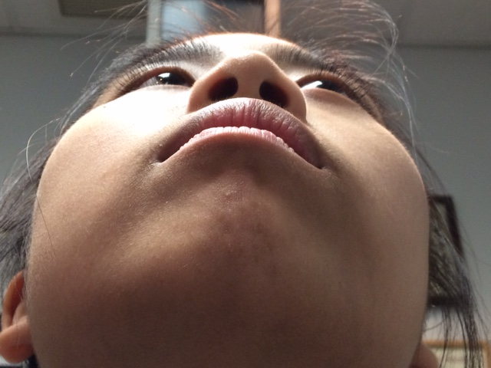
103
18
20.5

Slide 7
Notes:
Proptosis with infero-medial displacement of globe.

Slide 8
-1
-2
0
-1
0
0

Slide 9
Anterior Segment Exam
SLE | OD |  | OS
External/Lids | WNL |  | Soft non-tender mass palpable in supero-temporal lid
Conj/Sclera | White and Quiet |  | White and Quiet
Cornea | Clear |  | Clear
Ant Chamber | Deep and Quiet |  | Deep and Quiet
Iris | WNL |  | WNL
Lens | Clear |  | Clear

Slide 10
Posterior Segment Exam
Fundus | OD |  | OS
Optic Nerve | Pink and sharp |  | Pink and sharp
Macula | WNL |  | WNL
Vessels | WNL |  | WNL
Periphery | WNL |  | WNL
No Lymphadenopathy on Physical Exam

Slide 11
Labs
CBC
CMP
LDH
Uric acid
All within normal limits

Slide 12
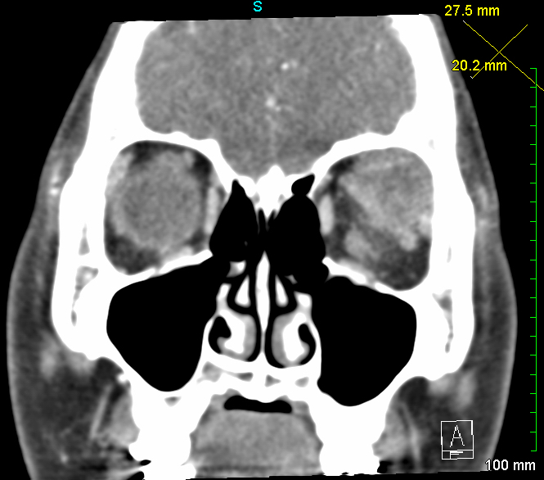
CT
Notes:
well-defined mass intimately associated with the left lacrimal gland. Heterogenous .The mass does not show any necrosis or calcification. No intracranial extension is seen
Axial soft tissue
Coronal soft tissue

Slide 13
CT
Notes:
coronal

Slide 14
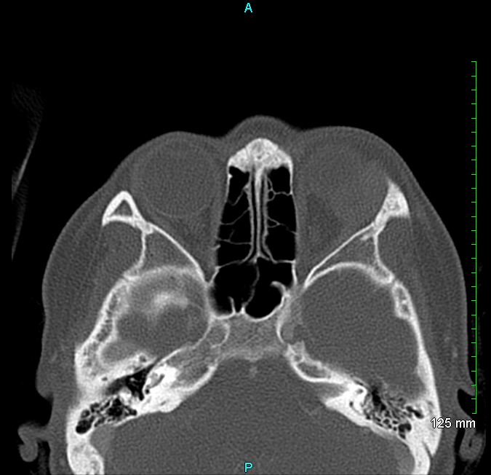
CT
Notes:
Axial Bone window –There is no bony erosion of the adjacent left bony orbit. Perhaps some remodelling

Slide 15
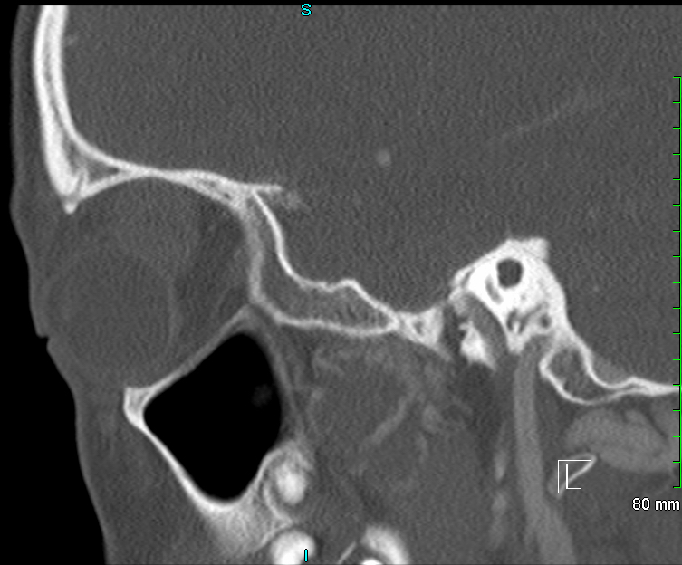
CT
Notes:
Sagital bone window

Slide 16
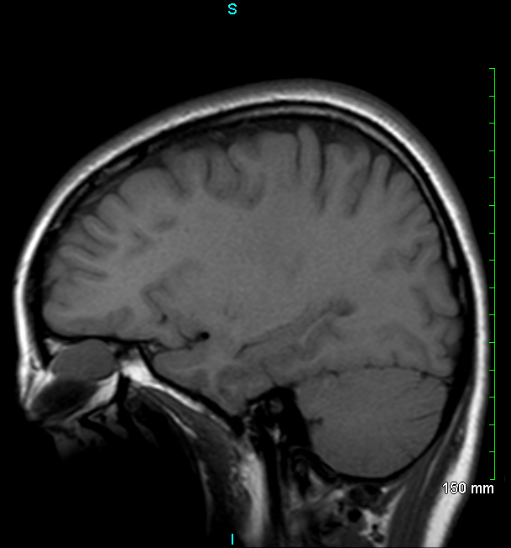
MRI
Notes:
T1 sagital on left
T2 sagitall on right
The lesion appears to be arising from the lacrimal gland. It measures approximately 2 cm x 2 cm.
The lesion is isointense to muscle on T1-weighted images and has thick peripheral enhancement.
It has intermediate T2 signal.

Slide 17
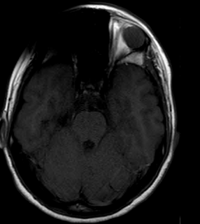
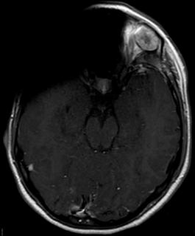
MRI
Notes:
T1 pre axial
Post t1 axial
and has thick peripheral enhancement
There is slight proptosis but no globe deformation.
The surrounding subcutaneous fat and intraorbital fat is normal in signal.
There is remodeling of the lateral and superior orbital wall.

Slide 18
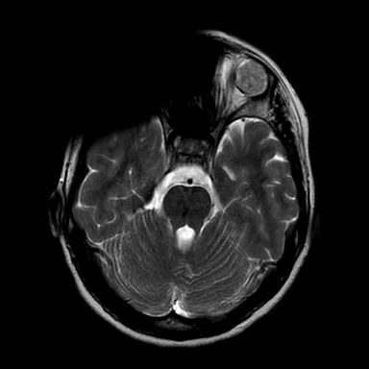
MRI
Notes:
T 2 axial
ADC -apparent diffusion coefficient- The diffusion-weighted images are degraded by braces artifact.
a measure of the magnitude of diffusion (of water molecules)
The extent of tissue cellularity and the presence of intact cell membrane help determine the impedance of water molecule diffusion. This impedance of water molecules diffusion can be quantitatively assessed using the apparent diffusion coefficient (ADC) value

Slide 19
Assessment
Differential Diagnosis
benign mixed tumor
lacrimal gland carcinoma
lymphoproliferative disorder
idiopathic inflammatory pseudotumor
nodular fasciitis
rhabdomyosarcoma
chloroma (myeloid sarcoma)
Notes:
NF- benign^{[3]} soft tissue lesion most commonly found in the superficial fasci
Chloroma- -composed of immature white blood cells^{[2]} called myeloblasts acute myeloid leukemia;

Slide 20
Plan
Proceed with lateral orbitotomy and excision of lesion

Slide 21
Notes:
Lateral orbitotomy approach is required.
a curvilinear incision is made over the lateral orbital wall (frontal and zygomatic bones).
Temporalis fossa is exposed using periosteal elevators.
The periorbital is elevated from the lateral wall and roof of the orbit with a malleable retractor.
The lateral orbital rim is cut , then outfractured
Using a combination of blunt and sharp dissection, the lacrimal gland is mobilized onto an island of free periorbita. Care is taken to avoid the levator and lateral rectus muscles.

Slide 22
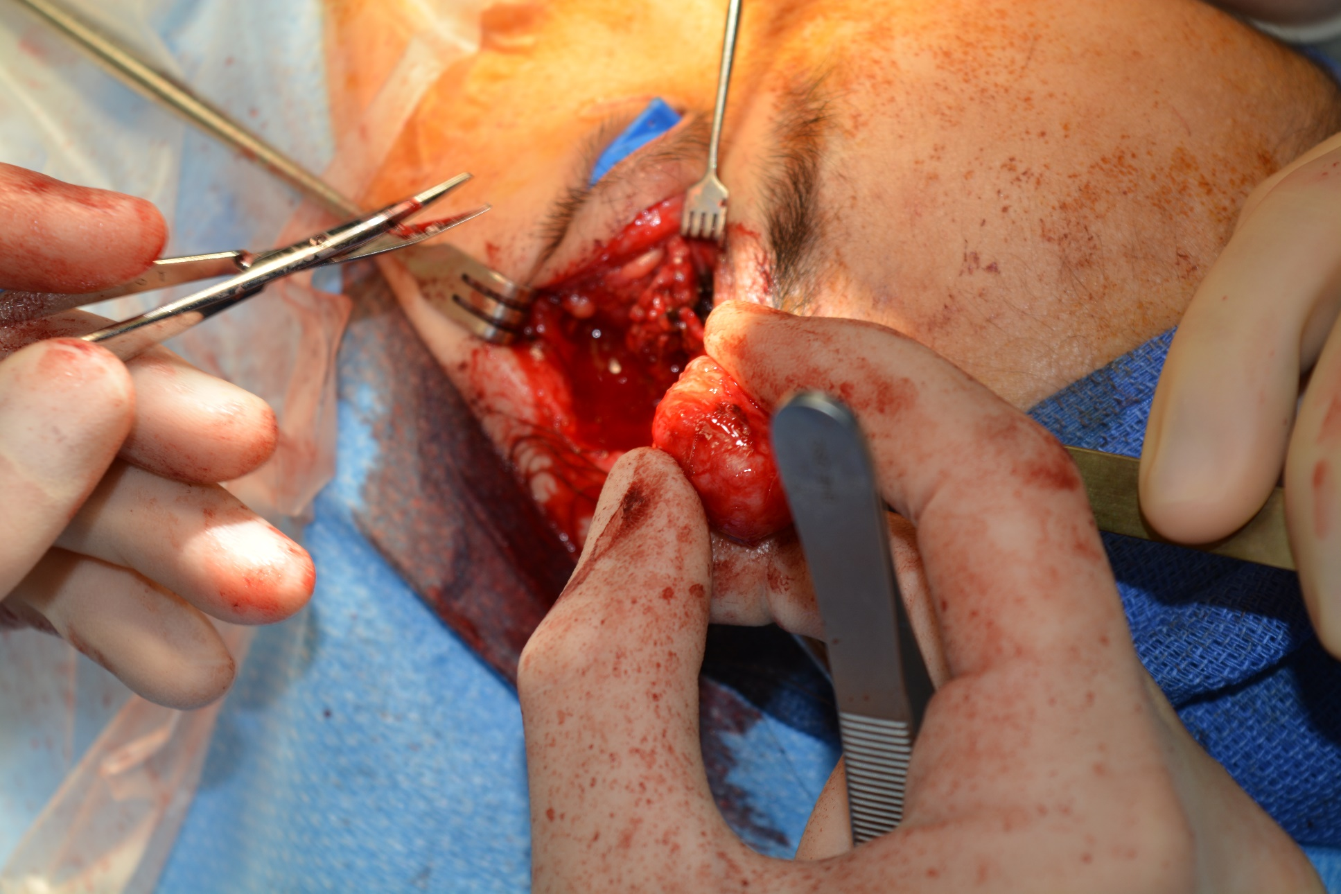
Notes:
Eventually the mass can be freed from the surrounding tissue with the pseudocapsule intact

Slide 23
Notes:
Approx 2.5 cm, nodules and heterogenous tissue with pseudocapsule

Slide 24
Biopsy
Notes:
Pleomorphic adenoma- with epithelial and stromal elements
-epithelial cells forming ductal structures.
Pseudocapsule: partly a fibrous tissue reaction, but partly also surrounding compressed host tissue

Slide 25
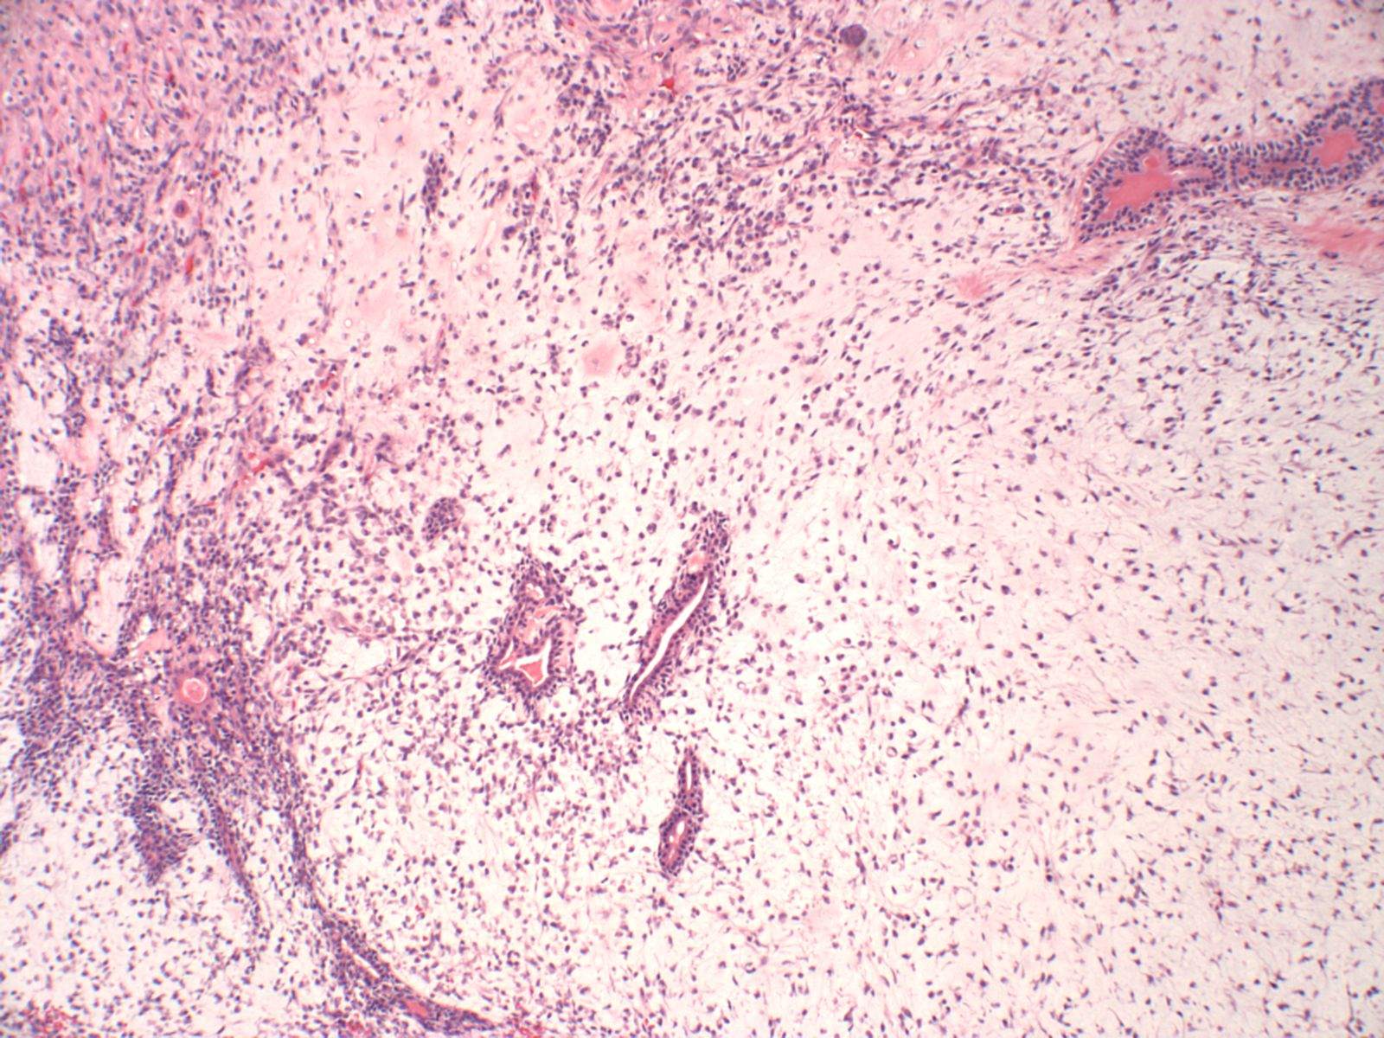
Biopsy
Notes:
Stromal elements

Slide 26
Discussion
Pleomorphic Adenoma
3-5% of all orbital tumors
25 % of all lacrimal gland tumors
50% of epithelial lacrimal gland tumors
Usually occurs in adults during 4th or 5th decade
Slightly affects M>F

Slide 27
Discussion
Most common presentation is progressive downward displacement of the globe
Symptoms are usually present for 12 months or more
Firm lobular mass may be palpated near superolateral rim
Imaging
Usually well-circumscribed, solid lesion
Enlargement of lacrimal fossa with bone remodeling, occasional calcification

Slide 28
Discussion
Also known as Benign Mixed Tumor
Histology:
Varied cellular structure with proliferation of benign
Epithelial cells that form ductal structures
Stroma composed of spindle shaped cells with occasional cartilaginous, mucinous or even osteoid degeneration or metaplasia
Lesions usually circumscribed by pseudocapsule

Slide 29
Discussion
Treatment & Prognosis
Complete removal of tumor with its pseudocapsule
5-year recurrence rate was 32% when capsule was incised for direct biopsy (vs 3%)
In recurrences, risk of malignant degeneration is 10% per decade

Slide 30
Discussion
Adenoid Cystic CA
Rapid onset of growth, may have pain due to perineural infiltration
CT scan shows irregular border, nodularity, along with bone destruction.
Malignant Mixed
Recurrence after removal of benign lesion, sudden growth of previous benign lesion, or rapid denovo growth with pain and aggressive bone destruction
Notes:
adenocarcinoma
(de novo) 5–10% and
mucoepidermoid carcinoma 1–2%

Slide 31
Discussion
12 Cases in the literature to date:
13 year M - Excision
THEODORE E. SANDERS.MIXED TUMOR OF THE LACRIMAL GLAND. Arch Ophthalmol. 1939;21(2):239-260
16 M with exophthalmos since 10 years- excision
Rubin IE. Adenocarcinoma of the lacrimal gland following a mixed tumor of 25 years' duration. Arch Ophthal. May 1947;37(5):686-688.
7 year old M-excision
SD McPherson. Mixed tumor of the lacrimal gland: in a seven-year-old boy. Am J Ophthalmol, 61 (1966), pp. 561–563
16 year old F- excision
Tsunoda S, Yabuno T, Sakaki T, Morimoto T, Moshida T, Hirabayashi M et al. Pleomorphic adenoma of the lacrimal gland manifesting as exophthalmos in adolescence. Neurol Med Chir 1994; 34: 814–816.
6 year old M- excision
Faktorovich EG, Crawford JB, Char DH, Kong C. Benign mixed tumor (pleomorphic adenoma) of the lacrimal gland in a 6-year-old boy. Am J Ophthalmol. Sep 1996;122(3):446-447.
15 year old F- excision
Mercado GJ, Gunduz K, Shields CL, Shields JA, Eagle JA, Eagle RC. Pleomorphic adenoma of the lacrimal gland. Arch Ophthalmol 1998
15 year old- Excision
Mercado GJ, Gunduz K, Shields CL, Shields JA, Eagle RC, Jr. Pleomorphic adenoma of the lacrimal gland in a teenager. Arch Ophthalmol. Jul 1998;116(7):962-963
10 year old F- excision
Cates AC, Manners RM, Rose GE. Pleomorphic adenoma of the lacrimal gland in a 10 year old girl, a case report. Br J Ophthalmol 2002; 86 (2): 249–250
14 year old- FNAC then excision
Fenton S, Sie Go DM, Mourits MP. Pleomorphic adenoma of the lacrimal gland in a teenager, a case report. Eye (Lond). Jan 2004;18(1):77-79.
7 year old M- FNAC then excision
Gupta A, Khandelwal A. Lacrimal gland pleomorphic adenoma: an inconceivable diagnosis in a child. BMJ Case Rep. 2013;2013.
2 more cases- have been referenced to in Book Chapter
Font RL, Gamel JW. Epithelial tumours of the lacrimal gland; an analysis of 265 cases. In: Jakobiec FA (ed). Ocular and Adnexal Tumours. Aesculapius Publishing Co: Birmingham, Ala, 1978, pp 787–805

Slide 32
Conclusions
Pleomorphic Adenoma
3-5% of all orbital tumors
50% of epithelial lacrimal gland tumors
Causes slow progressive displacement of globe without symptoms of pain
CT shows well circumscribed lesion with bone remodeling but no destruction
Excision for treatment (not incisional biopsy!)
Usually, but not exclusively in adults

Slide 33
References
BCSC Orbit Eyelids and Lacrimal System- Chapter 5- Orbital Neoplasms and malformations
THEODORE E. SANDERS.MIXED TUMOR OF THE LACRIMAL GLAND. Arch Ophthalmol. 1939;21(2):239-260
Rubin IE. Adenocarcinoma of the lacrimal gland following a mixed tumor of 25 years' duration. Arch Ophthal. May 1947;37(5):686-688.
SD McPherson. Mixed tumor of the lacrimal gland: in a seven-year-old boy. Am J Ophthalmol, 61 (1966), pp. 561–563
Tsunoda S, Yabuno T, Sakaki T, Morimoto T, Moshida T, Hirabayashi M et al. Pleomorphic adenoma of the lacrimal gland manifesting as exophthalmos in adolescence. Neurol Med Chir 1994; 34: 814–816.
Faktorovich EG, Crawford JB, Char DH, Kong C. Benign mixed tumor (pleomorphic adenoma) of the lacrimal gland in a 6-year-old boy. Am J Ophthalmol. Sep 1996;122(3):446-447.
Mercado GJ, Gunduz K, Shields CL, Shields JA, Eagle JA, Eagle RC. Pleomorphic adenoma of the lacrimal gland. Arch Ophthalmol 1998
Mercado GJ, Gunduz K, Shields CL, Shields JA, Eagle RC, Jr. Pleomorphic adenoma of the lacrimal gland in a teenager. Arch Ophthalmol. Jul 1998;116(7):962-963
Cates AC, Manners RM, Rose GE. Pleomorphic adenoma of the lacrimal gland in a 10 year old girl, a case report. Br J Ophthalmol 2002; 86 (2): 249–250
Fenton S, Sie Go DM, Mourits MP. Pleomorphic adenoma of the lacrimal gland in a teenager, a case report. Eye (Lond). Jan 2004;18(1):77-79.
Gupta A, Khandelwal A. Lacrimal gland pleomorphic adenoma: an inconceivable diagnosis in a child. BMJ Case Rep. 2013;2013.
Font RL, Gamel JW. Epithelial tumours of the lacrimal gland; an analysis of 265 cases. In: Jakobiec FA (ed). Ocular and Adnexal Tumours. Aesculapius Publishing Co: Birmingham, Ala, 1978, pp 787–805

