Slide 1
Grand Rounds Not Broad-Spectrum Enough
Patrick Burchell, MD
January 19, 2018

Slide 2
Patient Presentation
CC:
“Left eye pain and swelling”
HPI:
47 year old white female with a 5 day history of acute onset of left eye pain, swelling, runny nose, and sore throat. Treated with PO Augmentin with no improvement.
Notes:
- As she was also found to be Strep positive at her PCPs office.

Slide 3
Emergency Department
Afebrile, WBC 12.3 (4.5 –11.0)
CT orbits – read as preseptal cellulitis
Admitted and started on IV vancomycin/Zosyn
Ophthalmology consulted following day
Notes:
- WBC normal values

Slide 4
History
Past Ocular History:
Globe repair OD
Traumatic cataract OD status post lens implant
Scleral buckle OD for retinal detachment
Past Medical History:
Migraines, chronic fatigue syndrome, osteoarthritis
Family History:
Negative
Notes:
- Make all points consistent

Slide 5
History
Medications:
Topamax, Flexaril, Cymbalta, magnesium
Allergies:
Tobradex, Voltaren, ibuprofen, timolol, tobramycin
Social History:
Non-smoker
Review of Systems:
+ Pain with EOM, rhinorrhea, diplopia

Slide 6
External Exam
 | OD |  | OS
VA n CC | 20/200 |  | 20/20-1
Color Plates | 9/11 |  | 11/11
Pupils | Non-reactive, surgical | No rAPD | 4→3mm
IOP | 22 mmHg |  | 24 mmHg
EOM | full |  | -3 supra/infraduction -4 Ab/Adduction
CVF | full |  | full

Slide 7
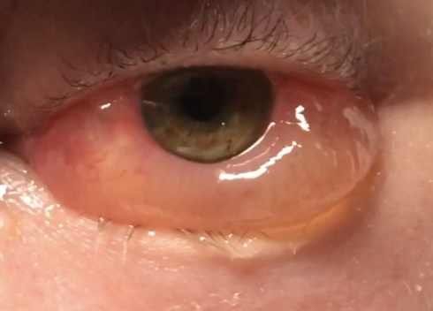
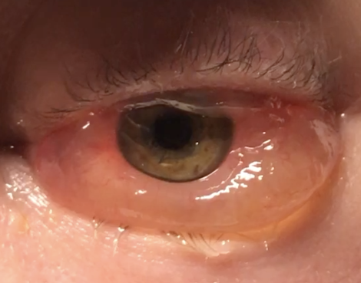
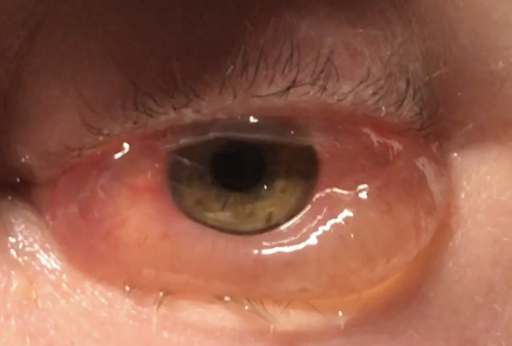
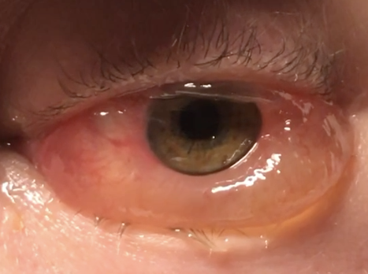
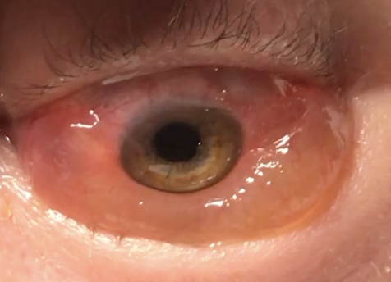
EOM OS
-3
-4
-4
-3

Slide 8
Anterior Segment Exam
PLE or SLE | OD |  | OS
External/Lids | WNL |  | Periorbtial swelling, erythema
Conj/Sclera | WNL |  | 360 chemosis; inferior > superior
Cornea |  | WNL
Ant Chamber |  | WNL
Iris | Oblong |  | WNL
Lens | Pseudophakic |  | WNL

Slide 9
Posterior Segment Exam
Fundus | OD |  | OS
Optic Nerve | 0.4 |  | 0.4
Macula | WNL |  | WNL
Vessels | WNL |  | WNL
Periphery | Laser scars |  | WNL

Slide 10
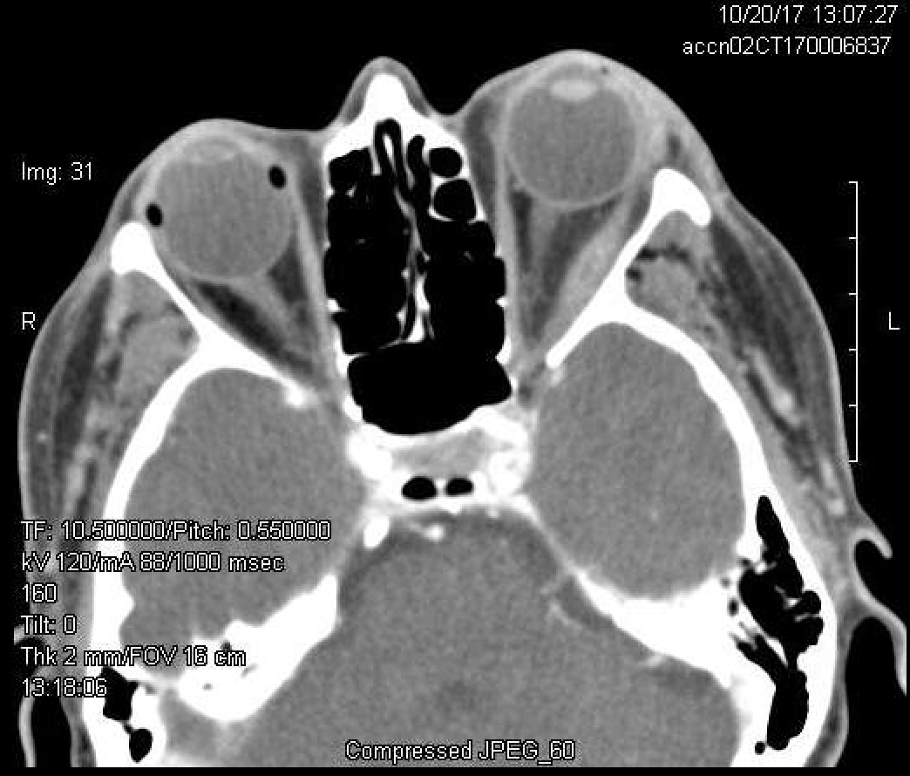
Review of CT Orbits
Axial
Coronal
Notes:
- Of note her sinuses are clear

Slide 11
Assessment
47 year old white female with acute onset of left orbital pain, diffuse chemosis, and periorbital swelling not improving with IV vancomycin/Zosyn, and a CT showing enlargement of her left lateral rectus.
Differential Diagnosis
Orbital cellulitis
Nonspecific orbital inflammation
Thyroid Eye Disease
Neoplasm
Notes:
Orbital cellulitis
She had no history of trauma and sinuses were clear, 90% of cases are from direct extension
Thyroid eye disease usually has more of an insidious onset
Narrow differential
Metastatic disease
Granulomatosis with polyangitis
Lymphoproliferative disease

Slide 12
Recommended MRI Orbits
Axial T1
Axial T1 post contrast with fat suppression
Notes:
Official read was myositic form of orbital pseudotumor

Slide 13
Plan
Diagnosis: Nonspecific Orbital Inflammation
Started on 1 mg/kg of prednisone (60 mg).
ID recommended to continue IV antibiotics until showed improvement with steroids.

Slide 14
2 days after high dose prednisone
-2
-3
-3
-2
OS
Notes:
Significant improvement in pain, EOM, and superior chemosis.
Antibiotics were stopped.
Patient discharged on hospital day 5 with 60 mg of oral prednisone and outpatient follow up.

Slide 15
1 week follow-up
-0
-0
-0
-0
OS
Notes:
Nov 2 (1 week after discharge, 9 days of steroids)
Pain, chemosis, and restriction of EOM had resolved.
Started on slow taper 1 week later.
Developed acute recurrence of pain and diplopia. – she also was not tolerant of the weight gain on steroids
Systemic work up included C-ANCA, P ANCA, ANA, TB, RF, which were all negative
Biopsy recommended to rule out masquerade syndrome.

Slide 16
Biopsy results
Consistent with nonspecific orbital inflammation
Notes:
Biopsy showed focal fibrosis consistent with nonspecific orbital inflammation. Immunostaining was IGG4 negative
chronic inflammatory condition characterized by tissue infiltration with lymphocytes and IgG4-secreting plasma cells, various degrees of fibrosis (scarring) and a usually prompt response to oral steroids.
Polymorphous lymphoid infiltrate with varying degrees of fibrosis
This cellular infiltrate consisted of inflammatory cells, mainly of mature lymphocytes, admixed with plasma cells, neutrophils, eosinophils and occasionally macrophages and histiocytes. Consistent with classical orbital pseudotumour, there was an increase in the amount of connective tissue with variable amounts of tissue oedema and fibrosis.
Currently being treated with rituximab – antibody against CD20 which is on B cells

Slide 17
Nonspecific Orbital Inflammation (NSOI)
First described in 1905 by Dr. Birch-Hirschfeld
Benign inflammatory process of the orbit resulting in a polymorphous lymphoid infiltrate with varying degrees of fibrosis
Other names:
Orbital pseudotumor, idiopathic orbital inflammation, orbital inflammatory syndrome
https://en.wikipedia.org/wiki/Felix_Victor_Birch-Hirschfeld
Notes:
German pathologist
The etiology and pathogenesis of NSOI is currently unknown. Both infectious and immune-mediate etiologies have been implicated.
Purcell and Taulbee^{[11]} reported a case of new onset orbital myositis within two weeks after confirmed streptococcal pharyngitis.

Slide 18
Notes:
Pain and periorbital swelling were the most common clinical feature
Retrospective review of 90 eyes in 65 patients over 10 years at Mass eye and Ear

Slide 19
Presentation
Adults
Typically unilateral and can be associated with systemic immunologic disorders
Pediatrics
1/3 are bilateral
Uveitis, elevated ESR, disc edema, and eosinophilia more common
Notes:
- Like Crohn’s, Lupus, RA, Diabetes, Myasthenia, Ankylosing spondylitis

Slide 20
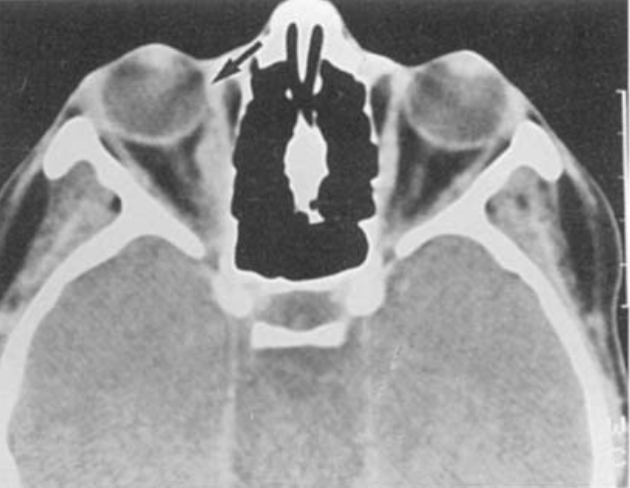
5 typical locations/patterns
Extraocular Muscles (myositis)
Weber et al./ Radiology Clinics of North America 37 (1999) 151-168
Notes:
50% of time involves the tendon unlike in Thyroid eye disease which is tendon sparing
Orbital pain, proptosis, conj edema, diplopia, restriction of EOM

Slide 21
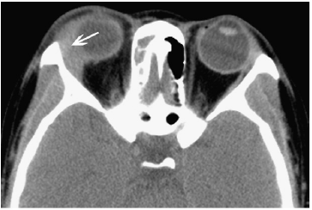
5 typical locations/patterns
Lacrimal Gland (dacryoadenitis)
Notes:
- Local pain, tenderness, and eyelid swelling

Slide 22
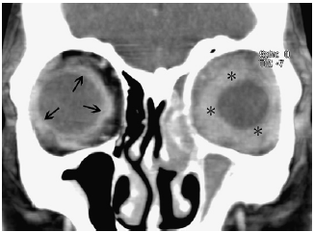
5 typical locations/patterns
Anterior Orbit (scleritis, uveitis)
Notes:
- Orbital pain, swollen eyelid and inflammation

Slide 23
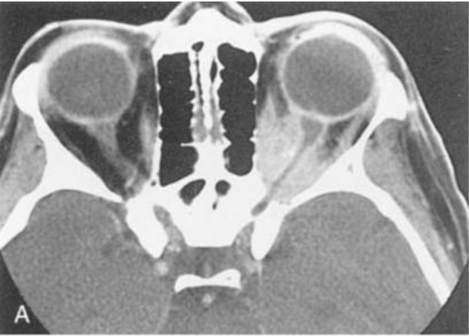
5 typical locations/patterns
Orbital Apex
Weber et al./ Radiology Clinics of North America 37 (1999) 151-168
Notes:
Orbital apex syndrome – occurs due to a lesion anterior to the orbital apex
Most commonly you get dysfunction of oculomotor nerve
Can get compression of optic nerve
Better imaged with MRI as can extend to cavernous sinus

Slide 24
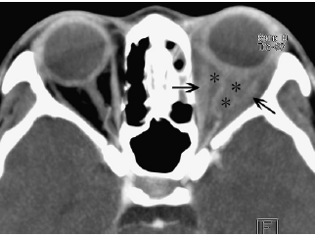
5 typical locations/patterns
Diffuse inflammation throughout orbit

Slide 25
Diagnosis and Treatment
Diagnosis of exclusion
1-1.5 mg/kg per day of prednisone for 1 - 2 weeks with slow taper over 5 – 8 weeks
Persistent or recurrent episodes → biopsy
Case reports showing success with immune-modulating agents like cyclosporine, methotrexate, and infliximab.
Notes:
CBC, CT imaging, trial of antibiotics
Thyroid orbitopathy, sarcoidosis, granulomatosis with polyangitis, neoplasm
Biopsy if people have recurrence of symptoms while tapering or if no improvement of symptoms after 2 weeks
Cyclosporine A – inhibits T cell activation via interference with production of IL-1 and IL-2
Methotrexate – Inhibits dihydrofolate reductase – suppresses B & T cel function
Infliximab – chimeric monoclonal antibody against TNF-alpha

Slide 26
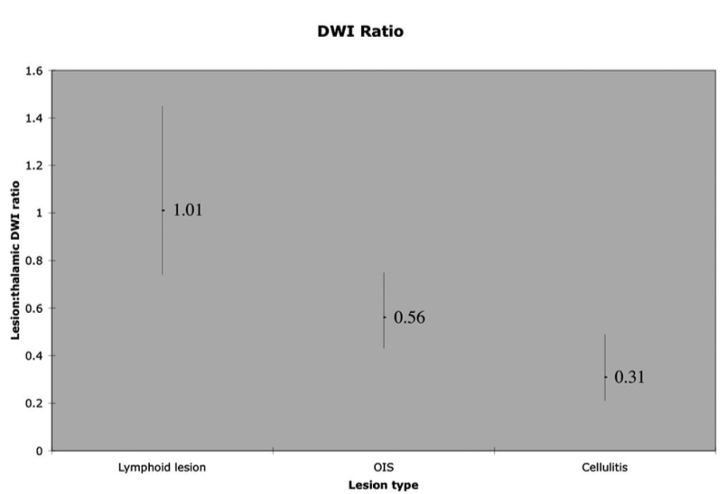
Notes:
DWI – Impedence of water molecule diffusion
ADC (apparent diffusion coefficient) – calculated with computer software using the DWI
- The lower the ADC the greater the impedence
Cellulitis thought to be more of a vascular permeability

Slide 27
Conclusions
Diagnosis of exclusion
Acute onset with rapid progression of pain and periorbital edema
Associated with many rheumatologic disorders
5 typical locations/patterns
Treatment: 1-1.5 mg/kg prednisone
Persistent or recurrent episodes require biopsy

Slide 28
Thank You
Dr. Clark
Dr. Mugavin
Dr. Lowder

Slide 29
References
Orbits, Eyelids, and Lacrimal System, AAO, BCSC Section 7, 2017-2018 (63-66)
Yuen, SJA, Rubin, PAD. Idiopathic Orbital InflammationDistribution, Clinical Features, and Treatment Outcome. Arch Ophthalmol. 2003;121(4):491–499.
AL, Weber et al. Pseudotumor of the orbit. Clinical, pathologic, and radiologic evaluation. Radiologic Clinics of North America. 1999; 37(1): 151-168.
Swamy BN, McCluskey P, Nemet A, et al. Idiopathic orbital inflammatory syndrome: Clinical features and treatment outcomes. The British Journal of Ophthalmology. 2007;91(12):1667-1670.
Ding ZX, Lip G, Chong V. Idiopathic orbital pseudotumor. Clinical Radiology 2011;66:886-892.
Espinoza GM. Orbital Inflammatory Pseudotumors: Etiology, Differential, Diagnosis, and Management. Curr Rheumatol Rep 2010;12:443-447

