Slide 1
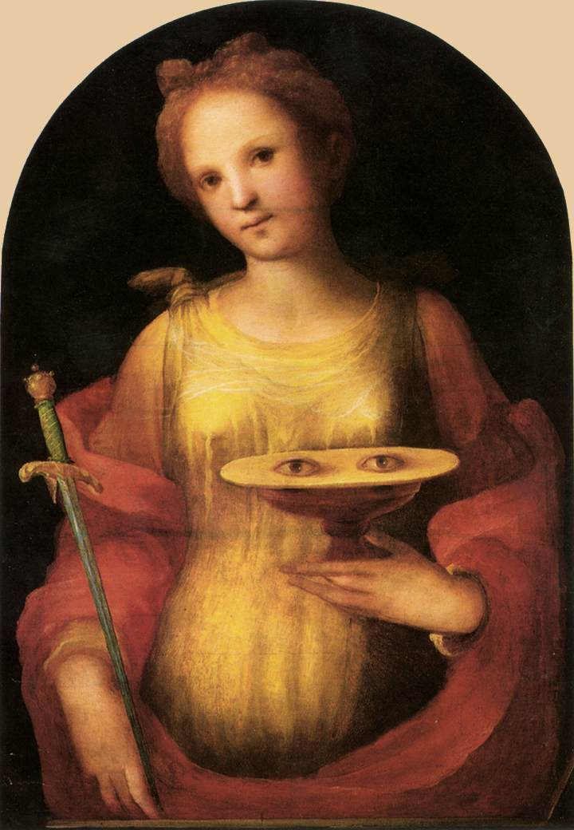
A Case of Attempted Auto-Enucleation
Lara Rosenwasser Newman
University of Louisville Department of Ophthalmology

Slide 2
Patient Presentation
CC:
“Demons in his eyes”
Called by inpatient internal medicine team because patient is trying to pull his eyes out
HPI:
56 year old Caucasian male with paranoid schizophrenia, without his medication for about three weeks, who reportedly took approximately 100 topiramate pills, was convinced there were demons in his eyes, and attempted to gauge/pull his eyes out

Slide 3
History (Hx)
Past Ocular Hx Unknown
Past Medical Hx Paranoid Schizophrenia
Fam Hx Unknown
Meds Previously, topiramate
Allergies NKDA
Social Hx Lives with or near supportive son
ROS Unable to obtain

Slide 4
External Exam
 | OD |  | OS
VA | UTO |  | UTO
Pupils | UTO 2/2 hyphema |  | UTO 2/2 hyphema
IOP | UTO |  | UTO
EOM | UTO |  | UTO
CVF | UTO |  | UTO

Slide 5
Anterior Segment Exam
PLE | OD |  | OS
External/Lids | Mild erythema |  | UL w/ecchymosis, crusted blood on lashes
Conj/Sclera | Conj lacerations? Subconj heme nasal/temporal |  | Conj lacerations? Subconj heme nasal/temporal
Cornea |  | ~WNL
Ant Chamber | Full hyphema |  | Full hyphema
Iris | No view |  | No view
Lens | No view |  | No view
Unable to obtain/no view for posterior segment exam

Slide 6
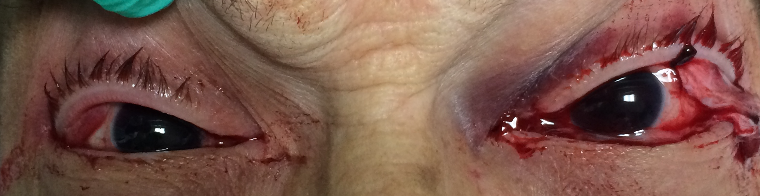
Clinical Photograph

Slide 7
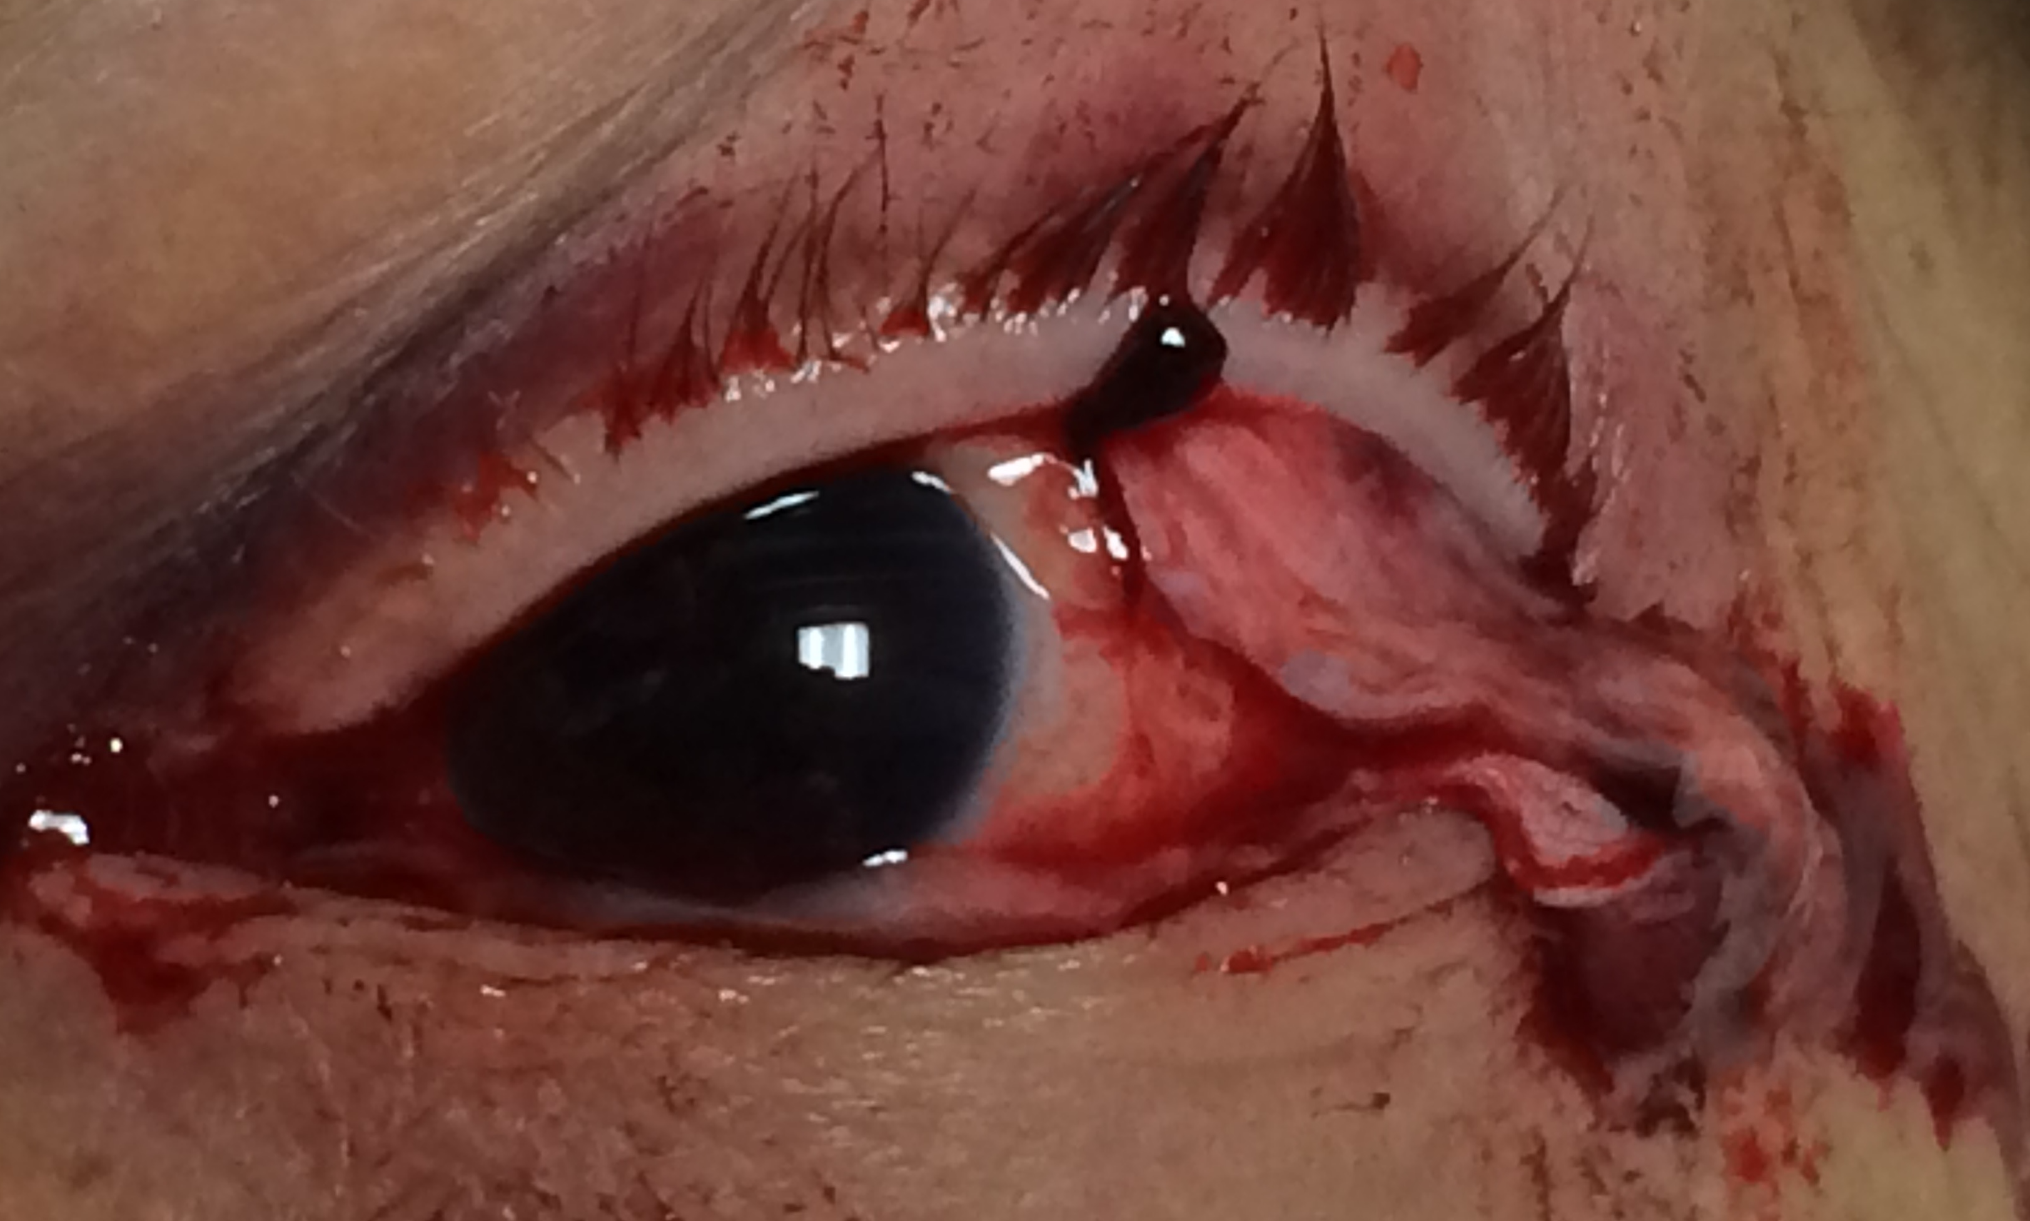
Clinical Photograph OS

Slide 8
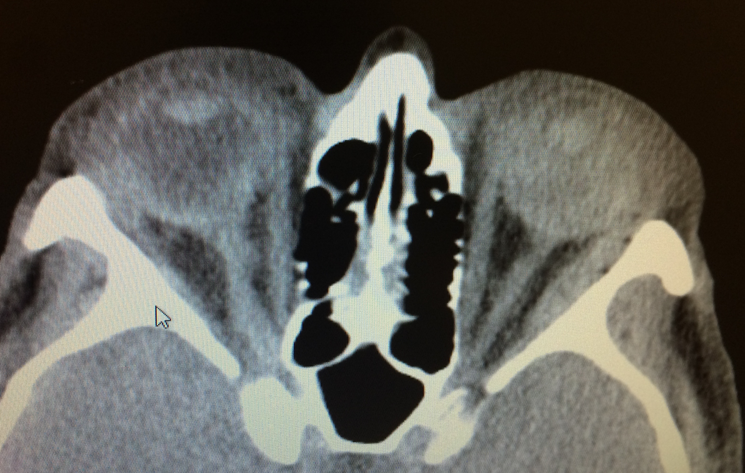
Computed Tomography

Slide 9
CT report
“Although I do not see evidence of orbital wall fracture, there are small pockets of free air within the lateral and superior extraconal space of the left retro-orbital region.”
“Abnormal density within the globes bilaterally, consistent with hemorrhage. I cannot rule out retinal detachment or subchorionic hemorrhage based on this exam. Likewise, I cannot rule out partial dislocation of the left lens.”
“Ophthalmologic examination is highly recommended.”

Slide 10
Assessment/Plan: OR
Consent was obtained from the patient’s son
Patient was taken to the OR for ruptured globe repair OS and exam under anesthesia of OD
Found to have ruptured globes OU

Slide 11
Globe repair
“Conj lac” OS was really lateral rectus, which had been disinserted from its origin at the annulus of Zinn
Necrotic → excised
6 mm scleral rupture near anterior lateral rectus insertion OS
Sutured with 8’0 nylon, conj closed with 8’0 Vicryl, globe formed
OD: hypotonous → 360 peritomy → 5mm scleral rupture under superior rectus
Superior rectus secured (6’0 Vicryl), rupture sutured (8’0) nylon, superior rectus reinserted (6’0 Vicryl), conj closed (8’0 Vicryl)
Hyphema and obvious iris damage OU
Both eyes injected with subconjunctival Kefzol
Given Vigamox QID and erythromycin ointment QID OU

Slide 12
Joint Retina/Cornea Case on OD at 3 weeks
Done for corneal blood staining and retinal detachment
Retina performed peritomy
Cornea specialist removed 7.5 mm host button
AC visualized, clotted hyphema/necrotic tissue removed, temporary keratoprosthesis placed
Retinal detachment repair performed
Scleral buckle, 23 gauge vitrectomy, lensectomy, membrane peel, endolaser, silicone oil with iris plane retention sutures
Temporary keratoprosthesis removed, donor corneal button sutured

Slide 13
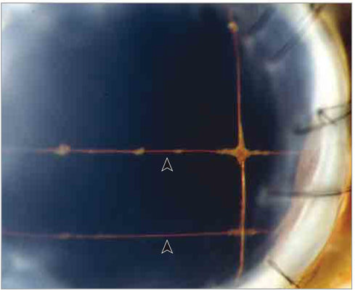
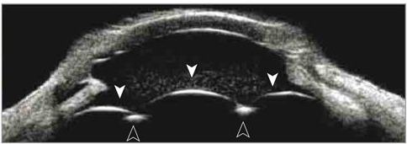
Silicone oil retention sutures
Slitlamp photo and ultrasound biomicroscopy of silicone oil retention sutures (black arrowheads) placed at the iris plane during retinal detachment repair following traumatic aniridia, aphakia, and ruptured globe in a case by Rao et al, JAMA Ophthal 2015.
White arrowheads = silicone oil/aqueous interface
Rao RC, Cohen SR, Mian SI. Silicone Oil Retention Sutures for Retinal Detachment Repair Following Traumatic Aniridia, Aphakia, and Ruptured Globe. JAMA Ophthalmol. 2015 Sep;133(9):e151433.

Slide 14
Retina case OS at 5 weeks
Pre-op dx: retinal detachment with proliferative vitreoretinopathy (PVR), hyphema, and cataract OS
AC washed out, some iridolenticular adhesions broken
Large temporal iridodialysis, lens subluxed posterior/nasal
Fragmatome removed half of lens, half fell to posterior pole
Anterior vitrectomy performed
Extensive PVR seen at ora serrata, extensive scar tissue and bleeding, retina in closed funnel formation with “napkin ring” of PVR around it; anterior and posterior PVR dissected
Retina attached at ora at 2:30; fibrous membrane → cut
Retina flattened with perfluorocarbon
Endophotocoagulation performed
Air fluid exchange performed, silicone oil infused

Slide 15
3 wks p/o OD/ 1 wk p/o OS
Patient was NLP OD and LP OS, IOP 16/11
Anterior segment:
OD: PK clear, sutures in place, iris remnants, aphakic
OS: iris trauma, iridodialysis, aphakic
Silicone oil behind iris OU
Dilated exam:
OD: detached inferiorly, severe recurrent PVR, 80% silicone oil
OS: flat retina (just inferior macula), vitreous hemorrhage inferiorly, 90% silicone oil
Attended a program for the blind
Much more psychiatrically stable on medication

Slide 16
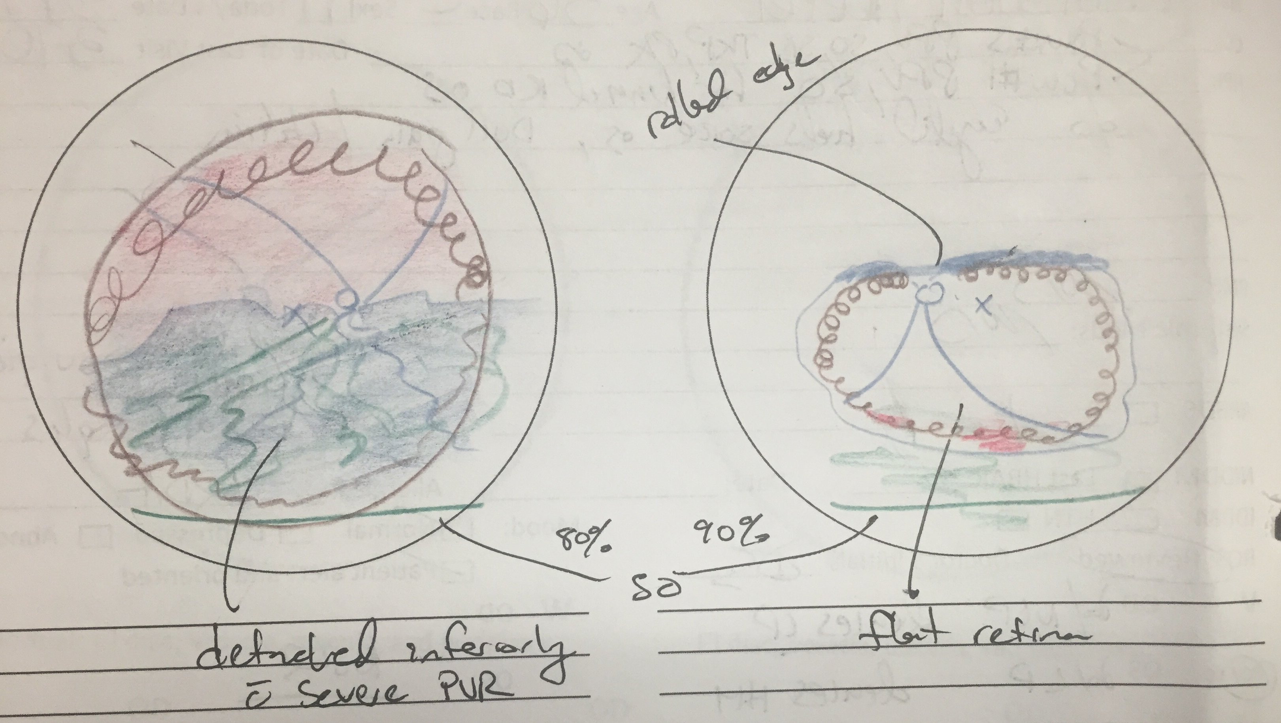
Retinas post-op

Slide 17
Self-inflicted ocular trauma
Saint Lucy of Syracuse, a Christian Martyr
One version of her story is that she removed
her eyes to discourage a suitor
Considered a protector of sight
“Oedipism” = auto-enucleation
Oedipus tore his eyes out or blinded himself
with his mother’s brooch when he found her
dead by suicide
Can cause corneal injury, cataract, ruptured globe, extra-ocular muscle dehiscence, orbital wall fractures, retinal hemorrhage, optic nerve avulsion

Slide 18
In the literature
Attempted auto-enucleation in 2 incarcerated young men with untreated psychosis, Reichstein et al, Saudi J Ophthal 2015 – both schizophrenic
Case 1 pulled out OD “because it was evil,” detached LR at origin at annulus, R floor fx, intact globe
Case 2 transected LR, intact globe w/retinal whitening, subretinal and subhyaloid hemorrhage, c/w partial optic nerve avulsion
Many injuries including ruptured globe, orbital fractures, and choroidal rupture in patients with self-inflicted gunshot wounds (Reddy et al, Jama Ophthal 2014)
23 yr old man, lost job, tried to blind himself with alcohol then razor blade, scleral perf OU, cataract OD (Razavi et al BMC Ophthal 2009)

Slide 19
Literature continued
OCD → eye touching → HM OD due to Descemet’s ruptures and stromal edema, NLP OS due to OAG (Torres et al Gen Hosp Psychiatry 2008)
Delusional parasitosis or Ekbom’s syndrome in a man in his 50s – used hair dryers and heat lamps to “disinfect eyes” → corneal abrasions, skin damage (Meeraj et al BMC Case Rep 2011)
Bilateral endophthalmitis associated w/Munchausen’s (Rao et al, Retin Cases Brief Rep 2015)
Cataracts in 3 autistic kids due to self-inflicted blunt eye trauma (Lee et al, JAAPOS 2016)
7 yr old boy, ruptured globe (full-thickness corneal lac) from Wii remote (Razavi et al JAAPOS 2014)

Slide 20
Conclusions
Many of these injuries cause irreversible vision loss
These patients need psychiatric help!
Counseling
Appropriate medications
Family support
RESTRAINTS!
Supervision of delusional and psychotic patients in hospital
Prompt psychiatric care when these patients present

Slide 21
References
Rao RC, Cohen SR, Mian SI. Silicone Oil Retention Sutures for Retinal Detachment Repair Following Traumatic Aniridia, Aphakia, and Ruptured Globe. JAMA Ophthalmol. 2015 Sep;133(9):e151433. doi: 10.1001/jamaophthalmol.2015.1433. Epub 2015 Sep 10. PubMed PMID: 26356004; PubMed Central PMCID: PMC4784980.
Lee YH, Lenhart PD, Lambert SR. Cataract secondary to self-inflicted blunt trauma in children with autism spectrum disorder. J AAPOS. 2016 May 17. pii: S1091-8531(16)30070-2. doi: 10.1016/j.jaapos.2016.02.013. [Epub ahead of print] PubMed PMID: 27223635.
Reichstein D, Esmaili N, Wells T, Kim JE. Attempted auto-enucleation in two incarcerated young men with psychosis. Saudi J Ophthalmol. 2015 Apr-Jun;29(2):172-4. doi: 10.1016/j.sjopt.2014.09.006. Epub 2014 Sep 27. PubMed PMID: 25892940; PubMed Central PMCID: PMC4398797.
Rao P, Shah AR, Michelotti MM, Anderson B, Abbey AM, Jain N, Stec L, Lowe L, Johnson MW, Williams GA. Bilateral acute endophthalmitis associated with munchausen syndrome. Retin Cases Brief Rep. 2015 Spring;9(2):177-80. doi: 10.1097/ICB.0000000000000132. PubMed PMID: 25799076.
Reddy AK, Baker MS, Sobel RK, Whelan DA, Carter KD, Allen RC. Survivors of self-inflicted gunshot wounds to the head: characterization of ocular injuries and health care costs. JAMA Ophthalmol. 2014 Jun;132(6):730-6. doi: 10.1001/jamaophthalmol.2013.8201. PubMed PMID: 24676273.
Razavi H, Lam G. Wii eye injury: self-inflicted globe rupture and vision loss in a 7-year-old boy from a video game accident. J AAPOS. 2011 Oct;15(5):491-2. doi: 10.1016/j.jaapos.2011.05.022. PubMed PMID: 22108365.
Razavi H, Price N. Self-inflicted penetrating eye injuries using a razor blade: case report. BMC Ophthalmol. 2009 Dec 10;9:14. doi: 10.1186/1471-2415-9-14. PubMed PMID: 20003290; PubMed Central PMCID: PMC2796640.
Torres AR, Domingues Mde S, Shiguematsu AI, Smaira SI. Loss of vision secondary to obsessive-compulsive disorder: a case report. Gen Hosp Psychiatry. 2009 May-Jun;31(3):292-4. doi: 10.1016/j.genhosppsych.2008.08.007. Epub 2008 Oct 7. PubMed PMID: 19410110.
Meraj A, Din AU, Larsen L, Liskow BI. Self inflicted corneal abrasions due to delusional parasitosis. BMJ Case Rep. 2011 Jul 28;2011. pii: bcr0420114106. doi: 10.1136/bcr.04.2011.4106. PubMed PMID: 22689836; PubMed Central PMCID: PMC3149412.
Poulsen EJ, Mannis MJ, Chang SD. Keratitis in methamphetamine abusers. Cornea. 1996 Sep;15(5):477-82. PubMed PMID: 8862924.

