Slide 1
Recurrent Blurry Vision
Mark Mugavin MD, MPH
October 20th, 2017

Slide 2
Patient Presentation
CC painless loss of vision in the right eye.
HPI
43 yo white male presents to Ky Lions Eye with cc of painless blurry vision which has progressively gotten worse over the past 2-3 days. He denies any history of trauma, systemic symptoms, or unusual exposures.

Slide 3
History (Hx)
Past Ocular Hx: Refractive Error, Prior Episode of Idiopathic Vision Loss in Right Eye as an adolescent
Past Medical Hx: Hypertension
Fam Hx: Non-contributory
Meds: Lisinopril 10 mg
Allergies: NKDA
Social Hx: Practicing Physician, Denies alcohol/tobacco/illicit drugs
ROS: Denies fevers, night sweats, numbness/tingling, unusual exposures

Slide 4
External Exam
 | OD |  | OS
VA | 20/70 |  | 20/20
Refraction | -4.50 + 3.00 x 095 |  | -3.25 + 2.25 x 075
Pupils | 4→2mm | 2+RAPD | 4→2mm
IOP | 15 mmHg |  | 14 mmHg
EOM | Full w/o pain or diplopia |  | Full w/o pain or diplopia
CVF | Large paracentral scotoma |  | WNL

Slide 5
Anterior Segment Exam
SLE | OD |  | OS
External/Lids |  | WNL
Conj/Sclera |  | WNL
Cornea |  | WNL
Ant Chamber | Deep and Quiet |  | Deep and Quiet
Iris |  | WNL
Lens | Trace Cortical |  | Trace Cortical

Slide 6
Posterior Segment Exam
Fundus | OD | OS
Vitreous | No vitreous cells | clear
Optic Nerve | 2+ Disc Edema with blurred margins | CDR .2 with pink and sharp margins
Macula | Stellate pattern of Lipid Exudates with associated sub retinal fluid | WNL
Vessels | Grossly WNL | WNL
Periphery | WNL | WNL
Notes:
Vitreous (should be part of posterior segment exam) OD – no vitreous cells OS- clear

Slide 7
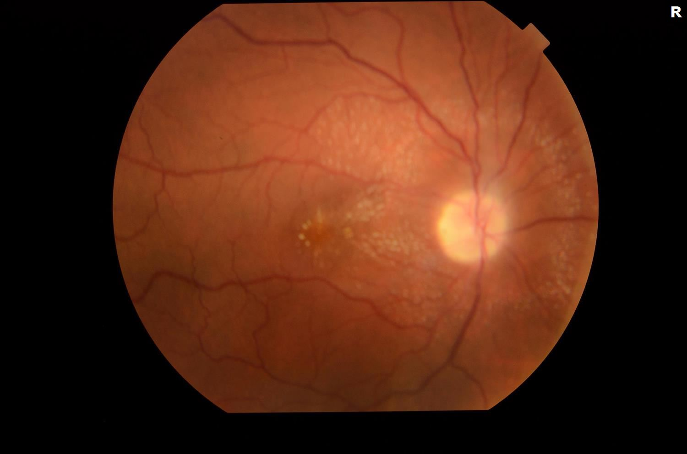
Fig. 1: Color Fundus photo of the right eye demonstrating Optic Disc Edema as well as associated stellate pattern of lipid exudates within the macula. Vessels and Periphery appear grossly wnl. The left eye is not included but is wnl.

Slide 8
Fig 2: SD OCT photo of the right eye demonstrating a neurosensory retinal detachment beneath the fovea.
Fig 3: SD OCT photo of the left eye demonstrating grossly normal retinal architecture.

Slide 9
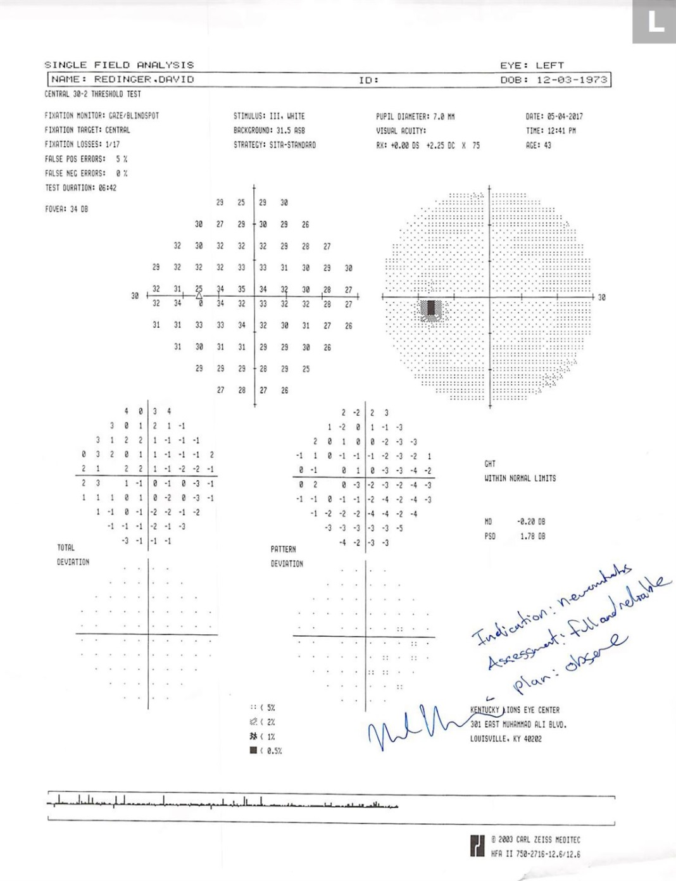
Fig.4 : HVF 24-2
-OD: Generalized Constriction with preservation of the right infero-temporal quadrant -22.01 md, mostly reliable.
-OS: Normal visual field and reliable.

Slide 10
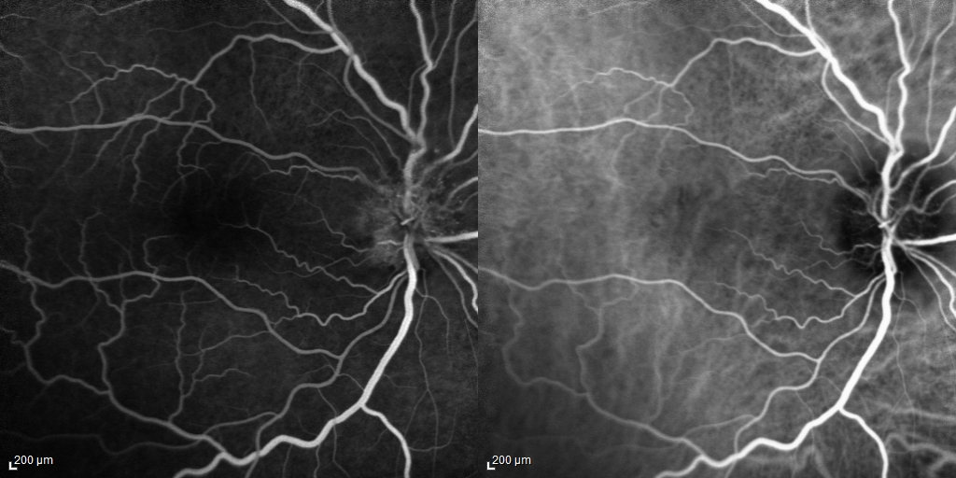
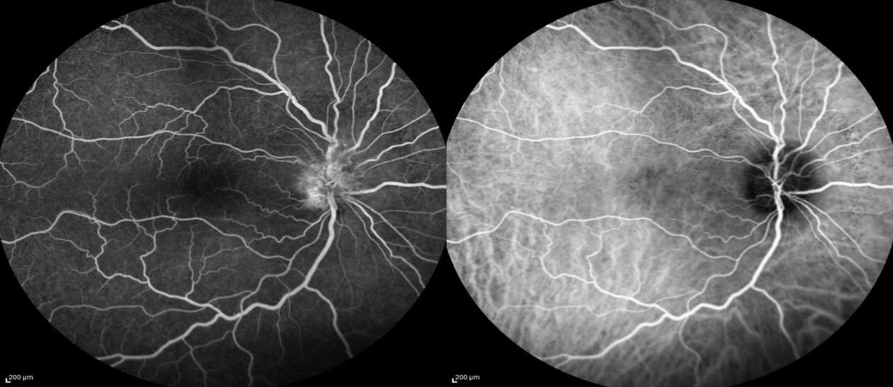
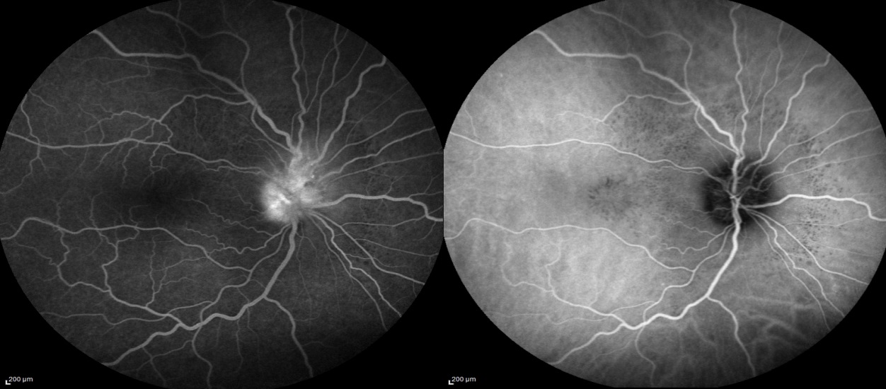
Fig. 5: FA/ICG demonstrating diffuse early peripapillary leakage at the temporal margin of the optic disc. No peripheral signs of abnormal perfusion or inflammation appreciated.

Slide 11
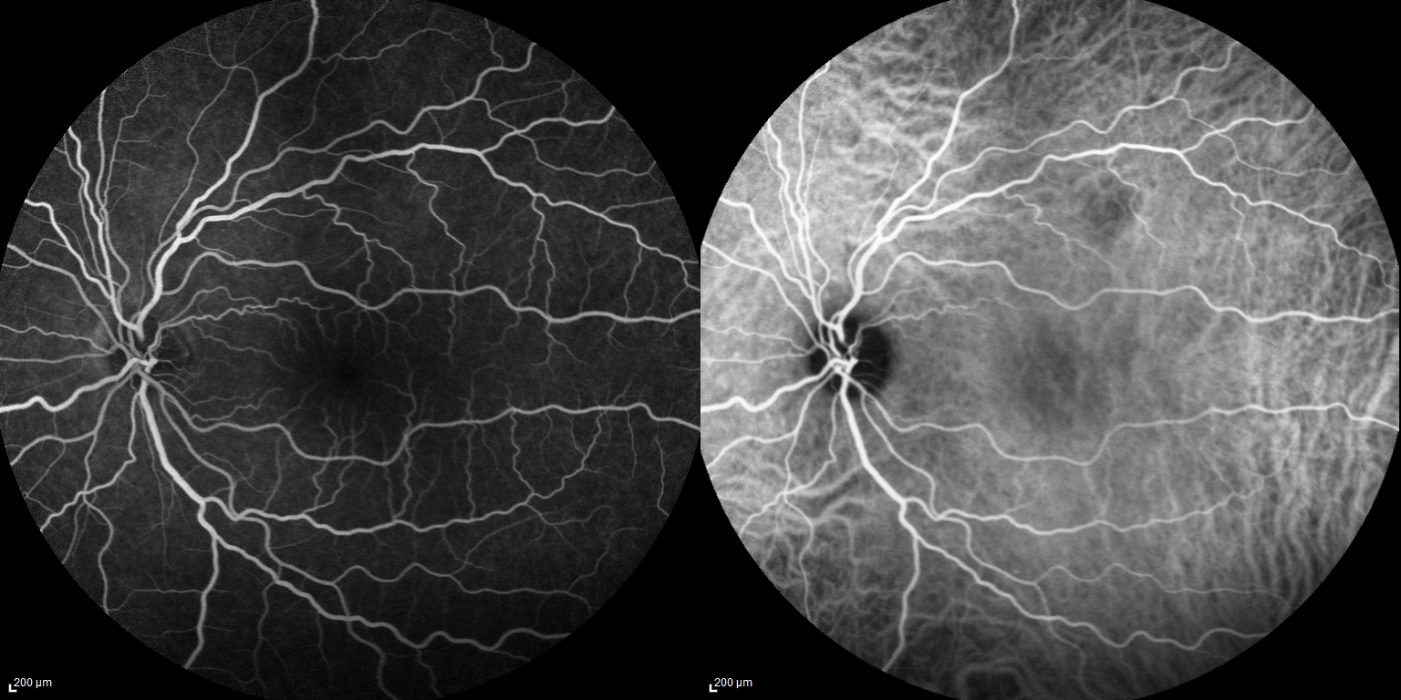
Fig. 6- Late AV phase of the Left Eye included which demonstrates normal findings without breakdown of the blood-retinal brain barrier as seen in the right eye.

Slide 12
Assessment
Diagnosis
Optic disc edema with stellate maculopathy OD
Initial Differential Diagnosis
Neuroretinitis
Infectious vs Idiopathic
Papillitis
Hypertensive Retinopathy

Slide 13
Plan
Obtain an MRI Orbits w/wo contrast
Obtain baseline Chest X-ray
Obtain IgM and IgG titers for Bartonella Hensleae
Start Doxycycline 100 mg po qday, 48 hours later start Prednisone 60 mg po qday

Slide 14
Timeline
5/4/2017
Initial visit with high suspicion for Bartonella Henselae. VA 20/70
Started Doxycycline 100 mg po qday and Prednisone 60 mg day
5/18/2017
IgM and IgG for Bartonella Henselae negative
VA 20/50. Decreased sub-retinal fluid
Stop Doxycycline, initiate Prednisone taper
Obtain MRI brain and orbits plus along with Herpes Virus Panel to seek other etiology

Slide 15
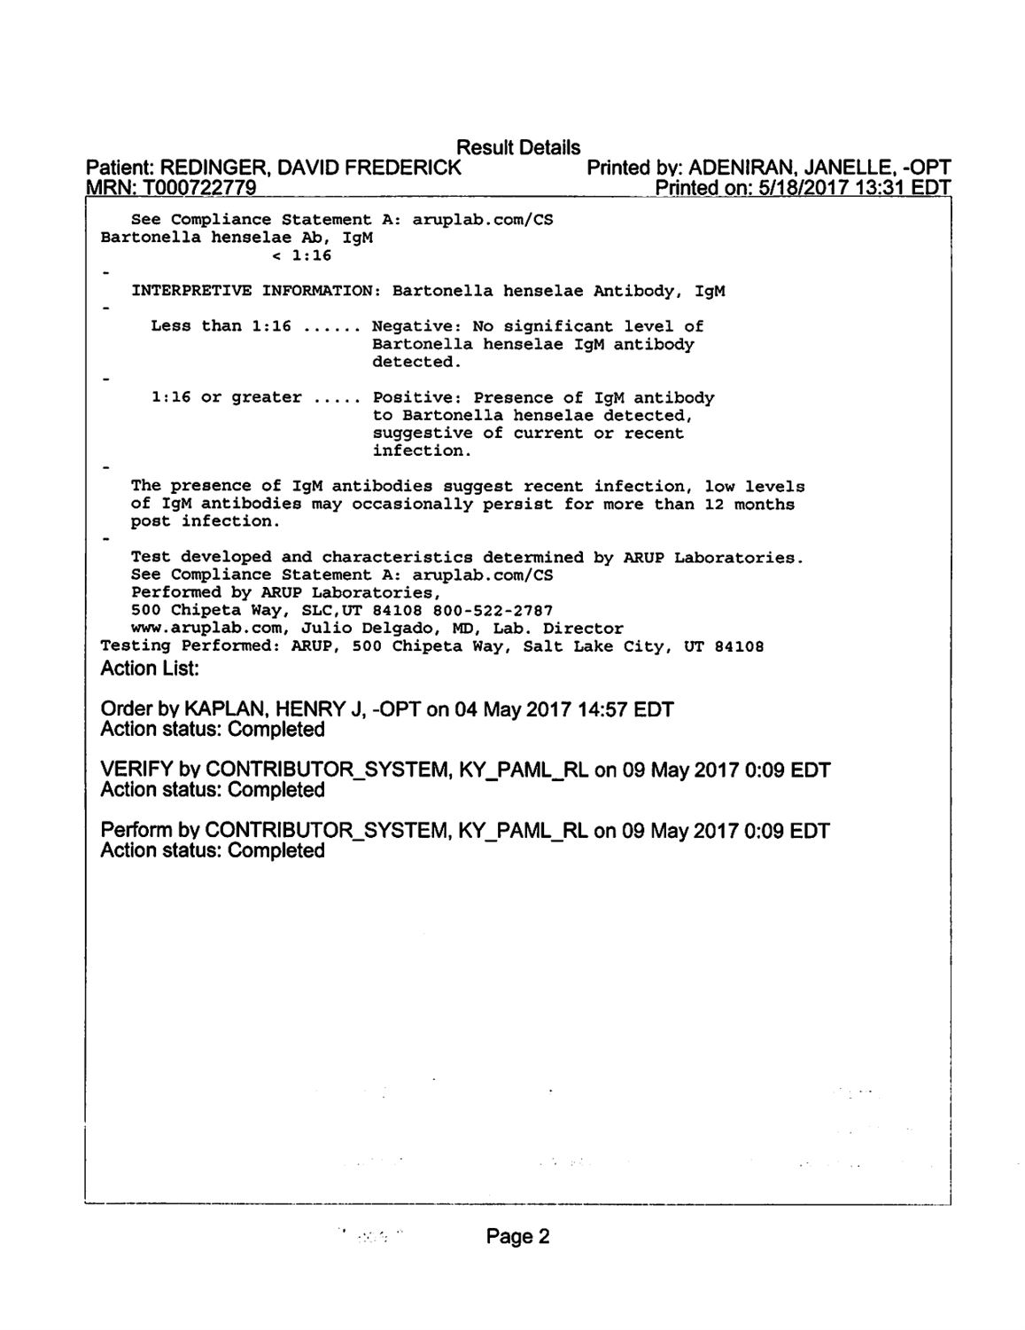

Slide 16
Fig. 7: MRI Brain/Orbits T2 FLAIR Axial Cut
-No signs of optic nerve or sheath enhancement
-No other signs of demyelinating disease

Slide 17
Timeline
6/20/2017
MRI and Herpes Panel: Negative
VA 20/50
Disc edema and Neurosensory Detachment resolved, persistent stellate pattern of hard exudates
7/18/2017
Supero-temporal disc pallor. No edema
VA 20/50. Visual Field Obtained

Slide 18
Repeat Visual Field 2 months later
Persistent constriction throughout with preserved infero-temporal field
(left 2 months out shown next to field from initial presentation)

Slide 19
Timeline
9/19/2017
VA 20/40
Taper Prednisone from 7.5 mg down by 2.5 mg every 2 weeks
OCT demonstrates some distortion of the ellipsoid zone

Slide 20
OCT Retina 4 months later
Fig 8: SD OCT photo showing resolution of the neurosensory detachment and a few focal areas of ellipsoid zone disruption within the parafovea

Slide 21
Neuroretinitis
Risk Factors:
-immunocompromised from Chronic Disease
-health care workers
-immigrants from endemic areas
-HIV/AIDS patients
-exposure to infected cats
Clinical Presentation:
- Painless decrease in central and/or color vision
-Critical to obtain history about exposure to pets, sexual activity, recent travel
Source: #1 BCSC
#2 Purvin et. al
#5 Fateh et. al

Slide 22
Neuroretinitis
Pathophysiology
-Inflammation of the optic disc vasculature with exudation of fluid into the peripapillary retina. Lipid rich component of exudate penetrates the Outer Plexiform Layer to generate classic “star shaped” pattern
Diagnostics
-FA will classically show leakage at the disc and blockage of fluorescence in the area of hard exudates
-OCT can reveal exudates in the Outer Plexiform Layer as well as a neurosensory detachment
-MRI Orbits typically wnl but may show nerve and/or sheath enhancement
Fig. 9: Classic stellate macular exudates in Neuroretinitis (Credit: #5 Fatteh Neuroretinitis)

Slide 23
Literature Review
Purvin et. al published largest review article in the literature regarding Neuroretinitis in Journal of Neuro-Ophthalmology 2011; 31:58-68
Infectious | Non-Infectious
-Most due to bartonella henselae which is a bacteria carried by 40 % of cats at some point in their lifetime | -No classic agent identified
-73% experience systemic symptoms including blister, swollen lymph nodes, fever, headaches | -50% experience flu like illness with upper respiratory symptoms
-Initial VA 20/200 or worse in 50% of patients -Defect typically confined to central visual field -Smaller or absent RAPD | -Initial VA between 20/50 and 20/200 -Visual field defect more diffuse -Large RAPD
Source: #3 Purvin et. al

Slide 24
Literature Review
Infectious | Non-Infectious
-Treatment: Doxycycline 100 mg po qday (adults or Azithromycin 250 mg po qday (kids/adults) | -No clear strategy. -Many rec. high dose oral corticosteroids -Some have advocated for intravitreal steroids and bevacizumab
Outcome: Final VA is 20/40 or better in 93% but some with persistent central visual field defect. | Outcome: Final VA 20/40 or better in 90% although some studies have noted poor outcomes for those with persistent photoreceptor/rpe defects.
Key points
Treat with broad spectrum antibiotics while titers are pending
Consider long term immunosuppressive agent such as azathioprine for idiopathic recurrent
Most patients experience a near full recovery
No relationship between M.S. and Neuroretinitis

Slide 25
Conclusions
Be able to recognize the classic clinical findings of neuroretinitis
Educate your patients on their prognosis for regaining vision

Slide 26
Sources
#1 “Neuroretinitis” Basic and Clinical Science Course Neuro-Ophthalmology 2015-2016 Vol. 5 p 119-120
#2 Purvin, V Sundaram S, “Neuroretinitis: Review of the literature and new observstions” Journal of Neuro-Ophthalmology. 31(1):5—68, Mar 2011
#3 Bhati T, Lee M “Should Patients with Bartonella Neuroretinitis receive treatment?” J Neuro-Ophthalmology 2014;34: 412-416
#4 Chi SL et al. “Clinical characteristics in 53 patients with cat scratch optic neuropathy.” Ophthalmology. 2012. Jan; 119(1):183-7
#5 Fatteh, N “Neuroretinitis” http://eyewiki.aao.org/Neuroretinitis American Academy of Ophthalmology Dec 21st 2014

