Slide 1
Grand Rounds
Brett Mueller, D.O., Ph.D.
August 19, 2016

Slide 2
Patient Presentation
CC
Blurry vision OD
HPI
32 year-old female presents with OD blurriness, and seeing random grey dots for one day.
Notes:
She denies any flashes of light and states that she has no visual complaints with OS

Slide 3
History (Hx)
POMHx: Quiescent Punctate Inner Choroiditis (PIC)
PMHx: Anxiety
FHx: Multiple Sclerosis, hypertension, and diabetes
Meds: Birth Control
Allergies: NKDA
Social Hx: Negative
ROS: Noncontributory
Notes:
quiescent

Slide 4
External Exam
 | OD |  | OS
BCVA | 20/30 |  | 20/30
Refraction | -12.25 + 0.75 x 135 |  | -15.50 + 2.25 x 047
Anterior Exam | WNL No Cells and Flare |  | WNL No Cells and Flare
Notes:
No cells and flares in the AC and anterior vitreous was quiescent

Slide 5
HVF 24-2
OS
OD

Slide 6
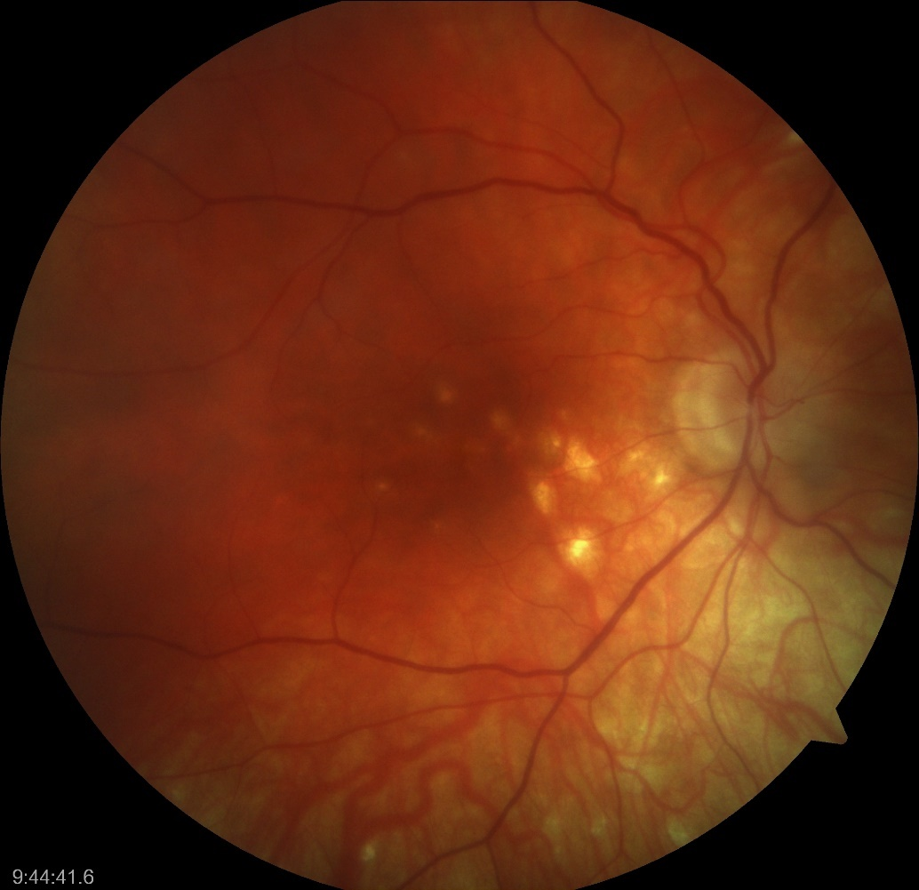
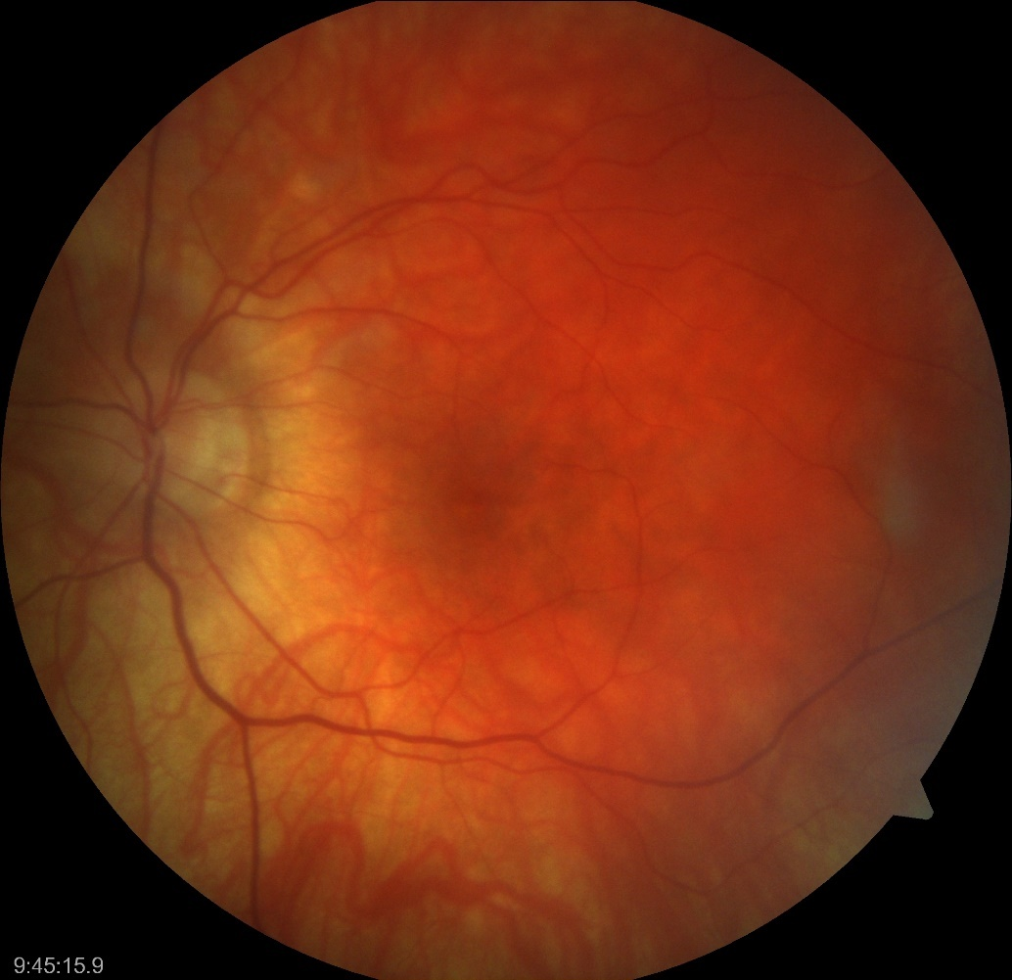
Posterior Segment Exam
OD
OS
PPA with multiple chorioretinal lesions spread throughout the macula and no vitritis
PPA with one chorioretinal lesion outside the macular arcade and no vitritis
Notes:
Blond funduse: hypopigmentary punctate chorior retinal lesions mostly in the paillomacular bundle but some are temporal to the fovea and lesions measuring 100-200ums. Midperiphery is uninvolved

Slide 7
OCT on 7/26/2016
OD
OS
Notes:
Disturbance or irregularity of the RPE layer that could be a scar. Choroidal involvement and inflammation…Boradening of the choroid . RPE elevation..dome shape RPE elevation with subRPE infilitrated which is not clear is fluid but outer retina is more disrupted

Slide 8
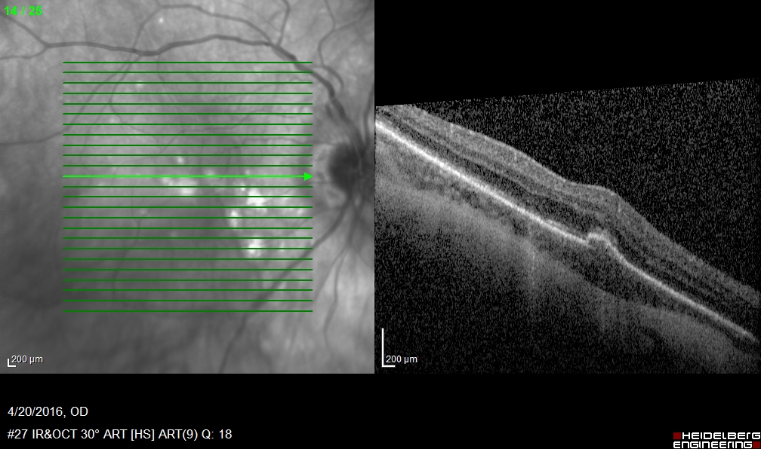
OCT OD
4/20/2016
7/26/2016
Notes:
Disturbance or irregularity of the RPE layer that could be a scar. Choroidal involvement and inflammation…Boradening of the choroid . RPE elevation..dome shape RPE elevation with subRPE infilitrated which is not clear is fluid but outer retina is more disrupted

Slide 9
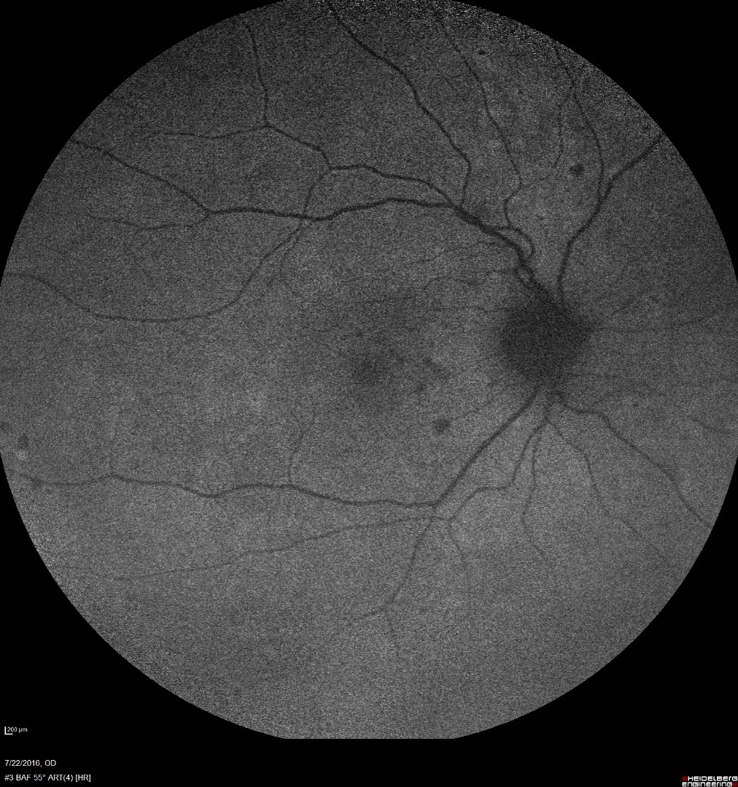
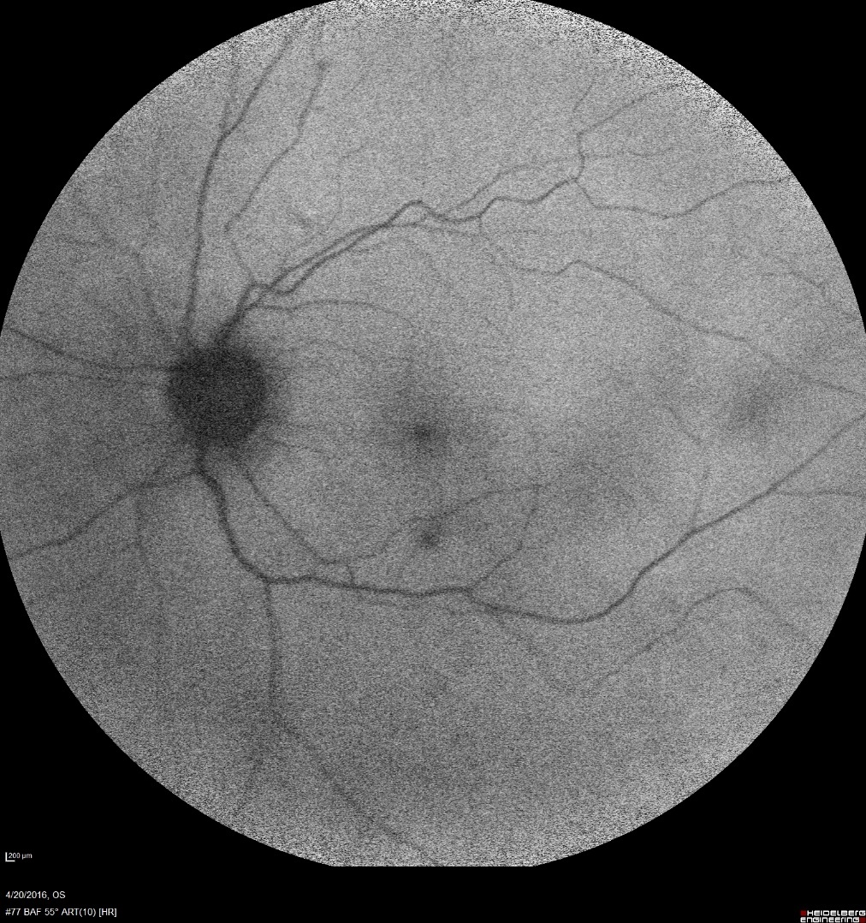
Autofluorescence
Notes:
BAF

Slide 10
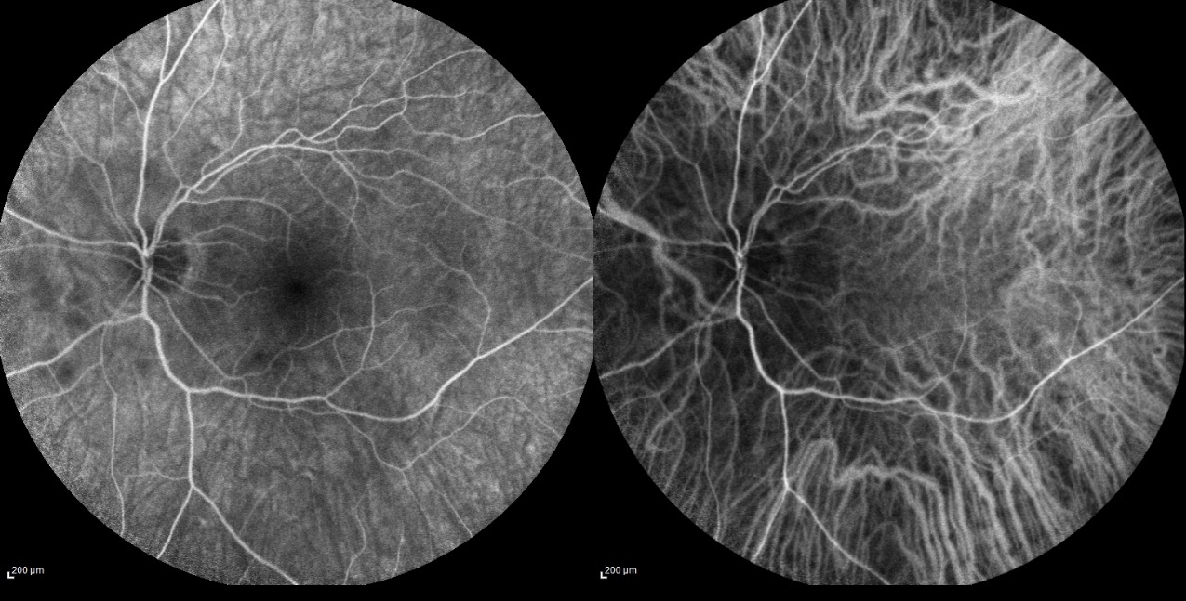
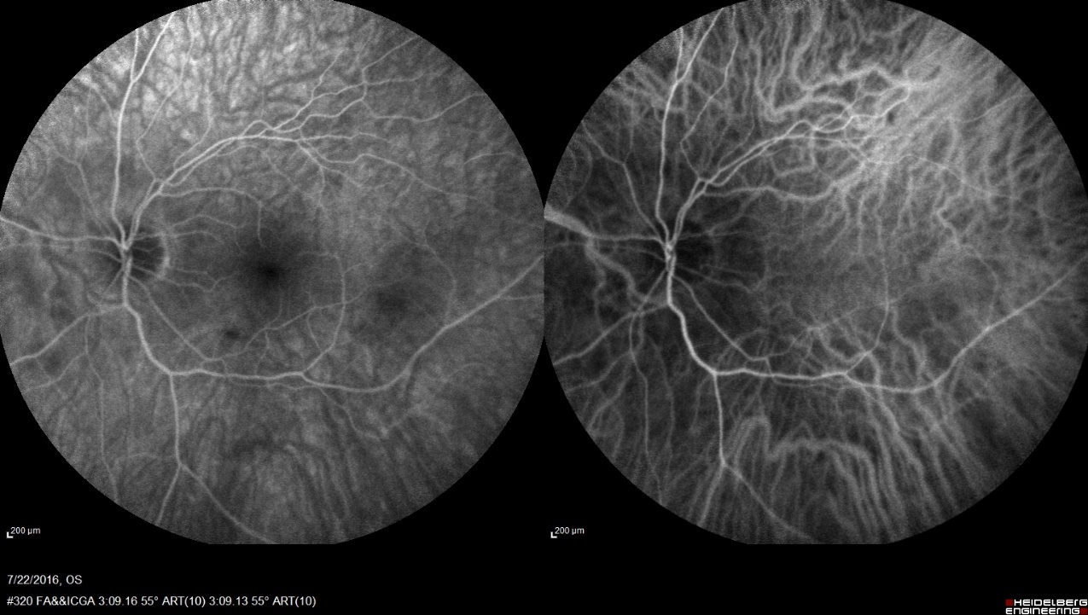
FA/ICG OS
50 Seconds
Recirculation Phase
190 Seconds
Recirculation Phase

Slide 11
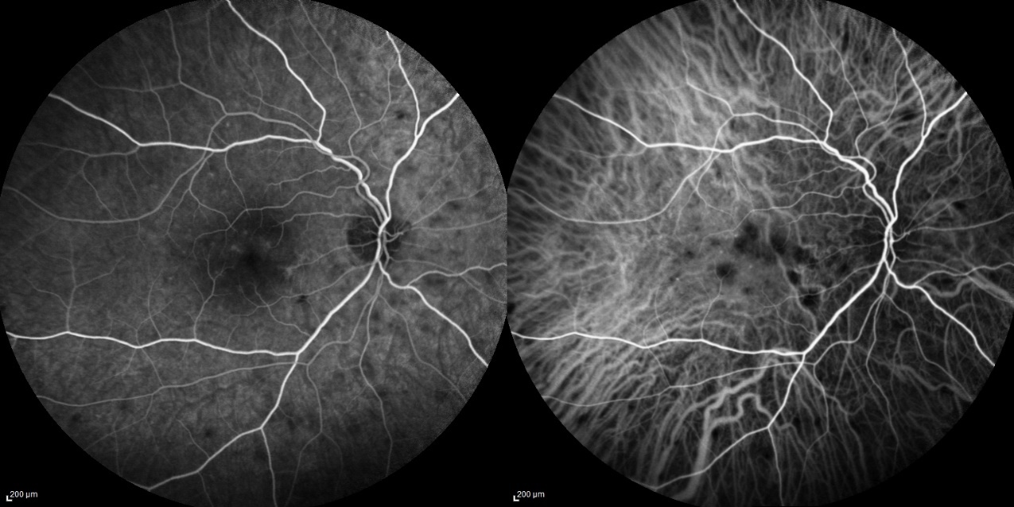
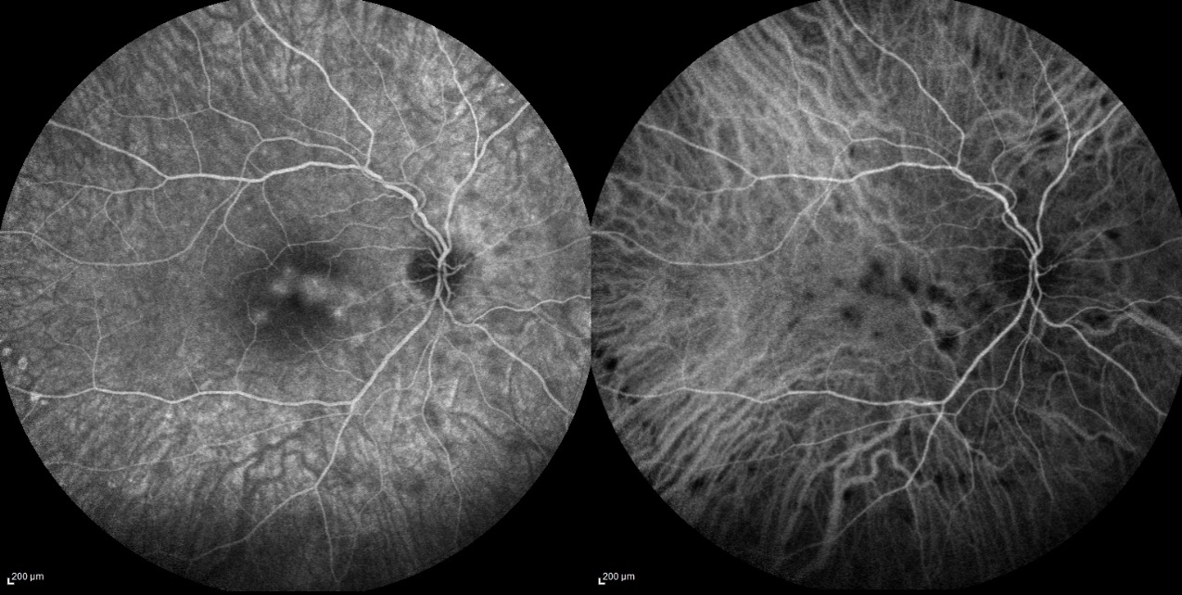
FA/ICG OD
22 Seconds
Venous Phase
190 Seconds
Recirculation Phase

Slide 12
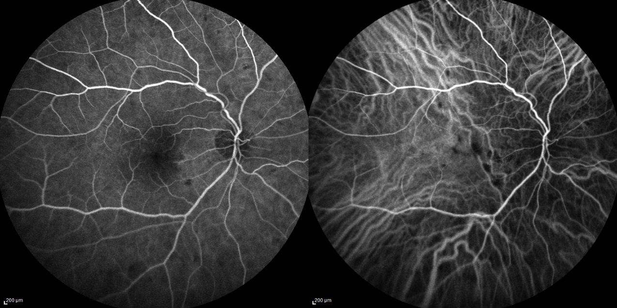
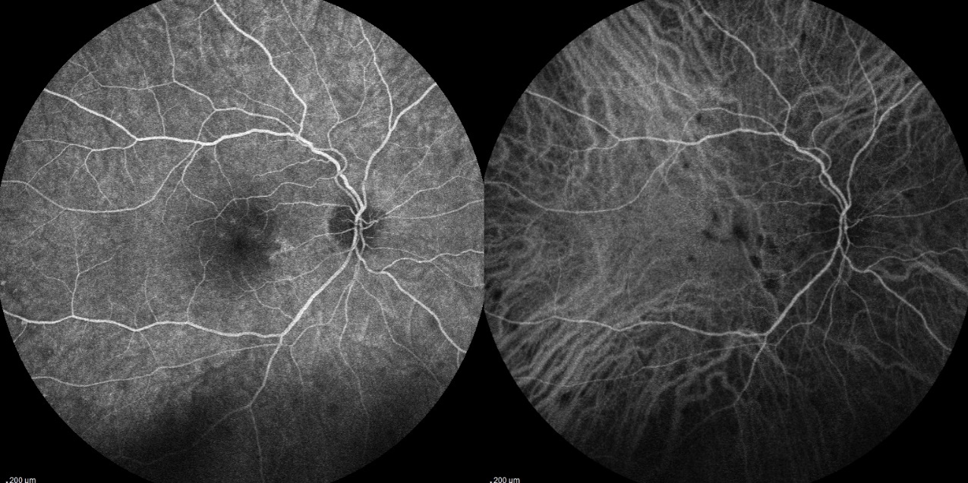
FA/ICG OD 4/20/2016
24 Seconds
Venous Phase
183 Seconds
Recirculation Phase

Slide 13
FA/ICG OD Compare
Recirculation Phase
7/26/2016
Recirculation Phase
4/20/2016

Slide 14
Assessment
32 year-old female that presents with multiple chorioretinal retinal hypopigmented lesions confined to the macula that show leakage on FA and hypofluorescence on ICG
Differential Diagnosis:
Reactivated Punctate Inner Choroiditis (PIC)
Multifocal Choroiditis
Presumed Ocular Histoplasmosis (POHS)
Notes:
How to best describe this???

Slide 15
Plan
Perform an intravitreal injection of triamcinolone 4mg

Slide 16
Follow-up
1 week later patient states that her blurry vision OD has improved

Slide 17
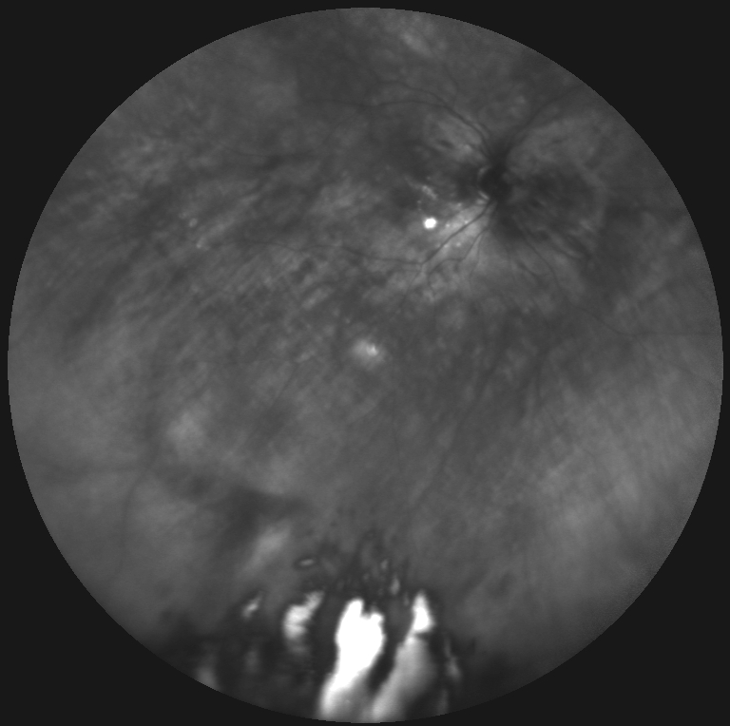
Follow-up

Slide 18
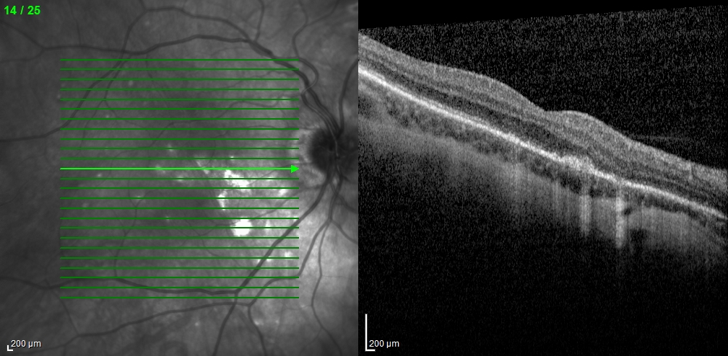
OCT
7/26/2016 OCT
8/1/2016 OCT (Post Treatment)
Notes:
Write down vA

Slide 19
PIC
Defined as an idiopathic inflammatory disorder of the choroid by Watzke et al in 1984
Rare disorder that predominantly occurs in myopic females (90%), usually 18 to 40 years of age
Present with metamorphopsia, paracentral scotomata, photopsias, and asymmetric loss of VA
Notes:
When referred to as a continuum then the term is called multifocal choroiditis and the presence of fibrosis or panuveitis is then described separately, MCP only 28% of pts present with CNVM
Watzke sign and CSR and Watzke

Slide 20
PIC Etiology
Remains unknown, but there are a wide spectrum of theories
Proposed to be a variant of multifocal choroiditis and panuveitis or a form of myopic degeneration
Others also speculate an inflammatory or infectious thrombosis of the choriocapillary layer by an unidentified organism
Notes:
When referred to as a continuum then the term is called multifocal choroiditis and the presence of fibrosis or panuveitis is then described separately, MCP only 28% of pts present with CNVM

Slide 21
PIC Diagnostic Procedures
OCT can demonstrate drusen-like material beneath the RPE with disruption of the overlying outer retina
FA shows early hypofluorescence of inflammatory lesion with late staining/leakage
ICG demonstrates hypofluorescence throughout the posterior pole that corresponds to lesions seen on FA
Notes:
Clinically patients will have an enlarged blind spot. FA is variable and you can see hyperfluorescence as well

Slide 22
Differential Diagnosis
Multifocal choroiditis and panuveitis (MCP)
Subretinal fibrosis and uveitis syndrome (SFUS)
Presumed ocular histoplasmosis (POHS)
Pathologic myopia
Key distinction is that PIC does not have vitritis
Notes:
When referred to as a continuum then the term is called multifocal choroiditis and the presence of fibrosis or panuveitis is then described separately
Reactvation rare or common in PIC
POHS will have smalle chorioretinal lesion

Slide 23
Treatment for PIC
Majority of cases need no treatment unless there is a CNVM or there are inflammatory lesions very close to fixation
Intravitreal injection of 4 mg of triamcinolone or of dexamethasone
If there is a CNVM, anti-VEGF treatment is the preferred therapeutic option
Visual prognosis is typically very good if there is no CNVM (50-75% of eyes having visual acuity of 20/25). If there is a CNVM, visual acuity ranges from 20/80-20/100
Notes:
When referred to as a continuum then the term is called multifocal choroiditis and the presence of fibrosis or panuveitis is then described separately

Slide 24
Zhang X, Zuo C, Li M, Chen H, Huang S, Wen F. Spectral-domain optical coherence tomographic findings at each stage of punctate inner choroidopathy. Ophthalmology. 2013 Dec;120(12):2678-83.
Zhang X, et al., Ophthalmology. 2013
Purpose: To describe natural course of punctate inner choroidopathy using SD-OCT
Design: Prospective observational case series looking at 42 patients (60 eyes)

Slide 25
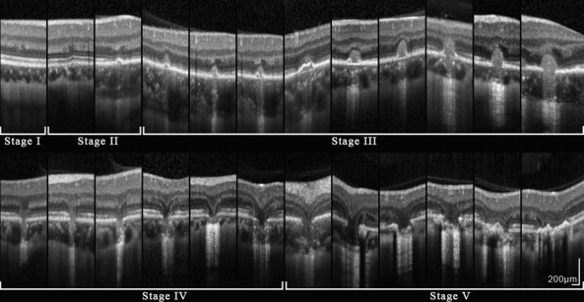
Zhang X, Zuo C, Li M, Chen H, Huang S, Wen F. Spectral-domain optical coherence tomographic findings at each stage of punctate inner choroidopathy. Ophthalmology. 2013 Dec;120(12):2678-83.
Article Review
Stage 1: Normal to slight irregularitis in the outer nuclear layer
Stage 2: Foveal elevation off the RPE with disruption of the inner and outer segments of photoreceptors
Stage 3: Lesion breaks through the RPE, forming a hump-shaped chorioretinal nodule with moderate reflectivity beneath the OPL

Slide 26
Zhang X, Zuo C, Li M, Chen H, Huang S, Wen F. Spectral-domain optical coherence tomographic findings at each stage of punctate inner choroidopathy. Ophthalmology. 2013 Dec;120(12):2678-83.
Article Review
Stage 4: Lesion regressed in a retrograde manner with tissue loss from the photoreceptor layer and inner choroid leaving a V-shaped hernia of the OPL and inner retina into the choroid
Stage 5: Lesion gradually eliminated the photoreceptors around the lesion with RPE proliferation

Slide 27
Conclusions
PIC is thought to be on a similar disease spectrum as multifocal choroiditis and panuveitis & subretinal fibrosis and uveitis syndrome
Typically affects young, myopic females that will complain of metamorphopsia, paracentral scotomata, photopsias, and asymmetric loss of VA
FA demonstrates late staining and ICG demonstrates hypofluorescence

Slide 28
References
Kanski’s Clinical Ophthalmology A systemic Approach, Eighth Edition. Brad Bowling
Retina and Vitritis, BSCS
Uveitis and Intraocular Inflammation, BSCS
http://webeye.ophth.uiowa.edu/eyeforum/atlas/pages/MCP/MFC-OS-lrg.jpg
http://www.atlasrleye.com/index.php/en/atlas/disease/61
http://eyewiki.aao.org/Punctate_Inner_Choroidopathy
Chan WM, Lai TY, Lau TT, Lee VY, Liu DT, Lam DS. Combined photodynamic therapy and intravitreal triamcinolone for choroidal neovascularization secondary to punctate inner choroidopathy or of idiopathic origin: one-year results of a prospective series. Retina. 2008 Jan;28(1):71-80
Mangat SS, Ramasamy B, Prasad S, Walters G, Mohammed M, Mckibbin M. Resolution of choroidal neovascularization secondary to punctate inner choroidopathy (PIC) with intravitreal anti-VEGF agents: a case series. Semin Ophthalmol. 2011 Jan;26(1):1-3.
Vossmerbaeumer U, Spandau UH, V Baltz S, Wickenhaeuser A, Jonas JB. Intravitreal bevacizumab for choroidal neovascularisation secondary to punctate inner choroidopathy. Clin Experiment Ophthalmol. 2008 Apr;36(3):292-4
Zhang X, Zuo C, Li M, Chen H, Huang S, Wen F. Spectral-domain optical coherence tomographic findings at each stage of punctate inner choroidopathy. Ophthalmology. 2013 Dec;120(12):2678-83.
Watzke RC, Packer AJ, Folk JC, Benson WE, Burgess D, Ober RR. Punctate inner choroidopathy. Am J Ophthalmol. 1984 Nov;98(5):572-84.

