Slide 1
Grand Rounds
Brett Mueller, D.O., Ph.D.
June 16, 2017

Slide 2
Patient Presentation
CC
Left sided facial pain
HPI
54 yo WM with significant PMH of lymphoma s/p chemotherapy and radiation in 2009, multiple MIs, CHF, COPD who presents with persistent left facial pain for several months that has progressed over the past week. CT demonstrated an infiltrating lesion from the ethmoid sinuses into the orbit. Primary team concerned for “orbital cellulitis.” He denies any changes in his visual acuity.

Slide 3
History (Hx)
Past Medical Hx:
- Multiple ER visits over the past year for shortness of breath
- Chronic sinusitis being treated by ENT
- CHF, COPD , HTN, B-cell lymphoma
Meds: ASA, statin, flonase, gabapentin, imdur, lisinopril, symbicort, ventolin HFA, torsemide
Allergies: NKDA
Social Hx: 12 drinks per day, one PPD smoker, and uses marijuana/hash daily

Slide 4
Review of Systems
Multiple admissions for unstable angina without a given cause
Sinusitis that has been treated with multiple rounds of antibiotics without resolution
20 pound weight loss over the past 2-3 months with poor appetite, fevers, chills, and night sweats
Increasing lymphadenopathy

Slide 5
External Exam
 | OD |  | OS
VA | 20/20 |  | 20/200
Refraction | -1.00 sphere |  | -1.00 sphere
Pupils | 4→3mm | No rAPD | 4→3mm
IOP | 12 mmHg |  | 15 mmHg
EOM | Full |  | Full (Discomfort with motility)
CVF | Full |  | Full

Slide 6
Anterior Segment Exam
SLE | OD |  | OS
External/Lids | WNL |  | Pertinent Positives: swelling along the parotid glands with palpable lymphadenopathy Pertinent Negatives: erythema, chemosis, or conj injection
Conj/Sclera |  | WNL
Cornea |  | WNL
Ant Chamber |  | WNL
Iris |  | WNL
Lens | 1+ NS |  | 3+ NS with a 4+ PSC

Slide 7
Posterior Segment Exam
Fundus | OD |  | OS
Optic Nerve | Pink and sharp |  | Pink and sharp
Macula | Sharp foveal reflex |  | Sharp foveal reflex
Vessels | WNL |  | WNL
Periphery | WNL |  | WNL

Slide 8
CT Scan 2 months ago
Notes:
Attention is drawn to the maxiallary and ethmoid sinuses where you see hyperdensities along the maxiallary and ethmoid sinuses with some bony erosion. But if you look carefully over to the right orbit, and this was not really picked up on the initial read but when we went back and looked at the images you see this interesting finding where there is this hyperdensty along the inferior orbita with inferior wall bony erosion.

Slide 9
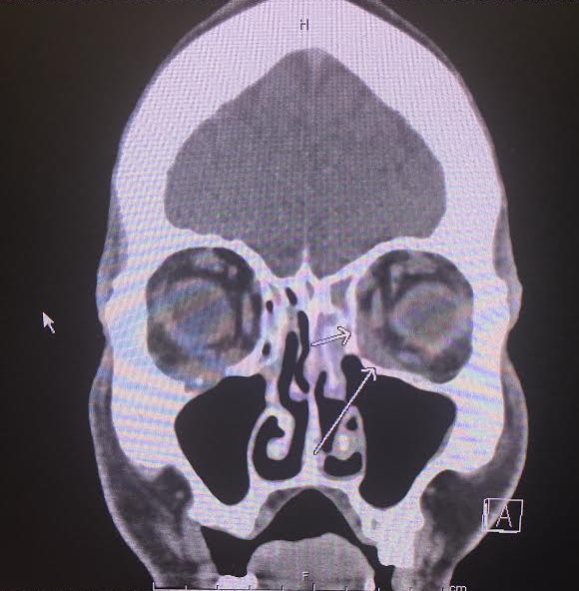
Current CT
Notes:
Coronal:Hyperdensity of the inferior bilateral orbits that is more involved OS than OD. OS you see this hyperdensities involving the medial sinuse that is enchoraching on the medial recturs, and in the right orbit this hyperdensities is involving the inferior recturs and is worse than what we say 2 month ago
Axial cut demonstrates more bony erosion along the left medial orbit

Slide 10
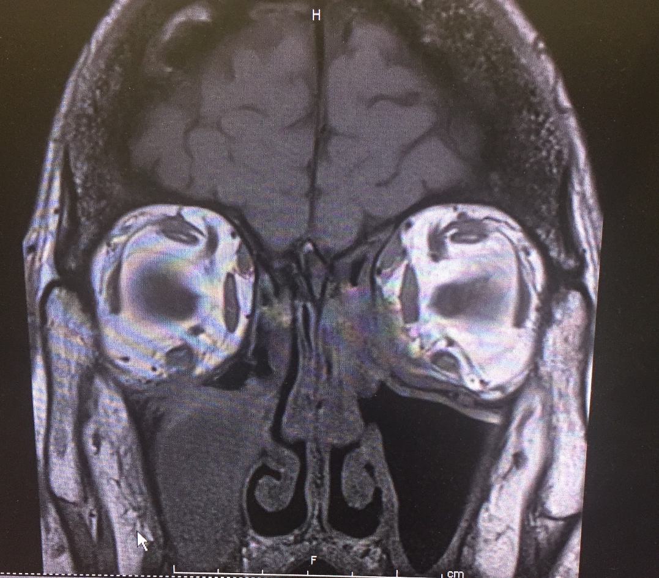
T1 Images
T1 Fat Suppression, post- contrast
T1
Notes:
T1: See an infiltrate in the inf medial orbita on the left which is isointense to mm, along whith what appears to be some enlargement of the MR and SO. In the right orbit you see some IR with appears to be slightly enlarge with an isointense to mm infiltrate that is expanding from the maxiallary sinus into the inferior orbit
T1 fat suppression, post constrat show hyperintensities of the left ethmoid sinus extending into the medial orbti

Slide 11
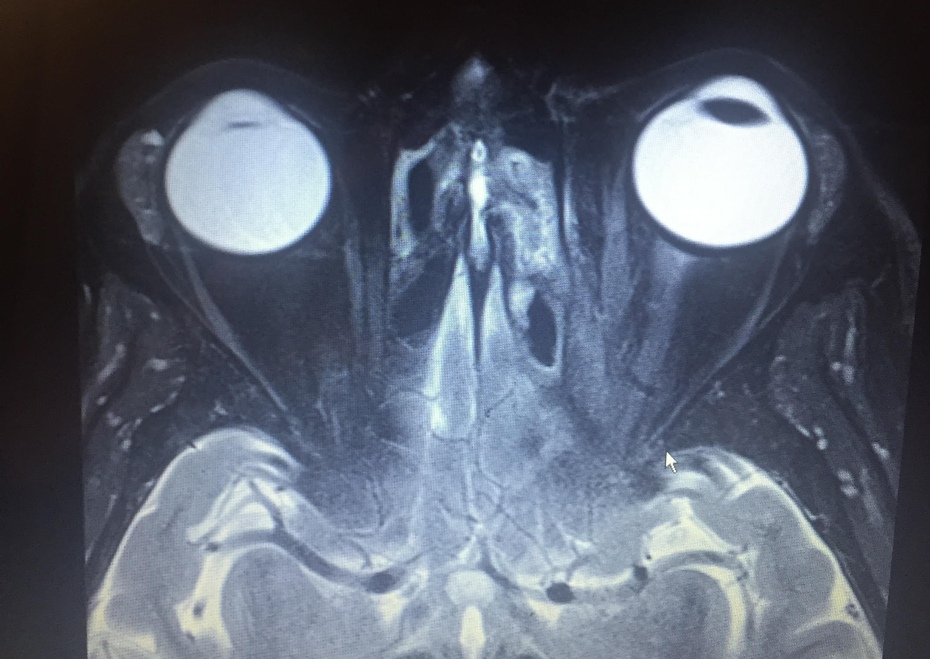
T2 Image
Notes:
Appear to have non specific changes along this axial cut and again seeing this infiltrate along the sinuse and medial left orbit that isointense to EOM

Slide 12
DWI/ADC
Notes:
Hyperintensity that shows Free water restriction of DWI which is concern for malignancy VS abscess VS some inflammatory process with a large cellular infiltracte. ADC is not that helpful but there does appear to be some hypointensity that corresponse
DWI: diffusion weighted imaging
ADC: Apparent diffusion coefficient

Slide 13
Assessment
54 yo WM with a ill-defined iso-intense lesion to EOM on T1 that enhances post contrast and demonstrates a hyper-intensity on DWI that is encroaching from the maxillary and ethmoidal sinuses into the left and right orbits.
Differential Diagnosis
Recurrence of lymphoma
Infectious (Bacterial VS Fungal)
Granulomatosis with polyangiitis
Notes:
lesion (hypointense to ??, always describe hypointense on what scan to what tissue) that is extending from the sinuses into the left orbit w/ lymphadenopathy and recent 20 pound weight loss.

Slide 14
Plan
ENT to take the patient into surgery for a tissue biopsy. Also will start workup to rule out lymphoma and different inflammatory lesions.

Slide 15
Follow-up 2 Days After Surgery
Pathology Results:
Negative for malignant cells
Bacterial and fungal cultures were negative
Demonstrates scattered lymphocytes and stromal elements
After surgery patient complains of decreased visual acuity down to count fingers OS with a new APD and limitation of adduction
Notes:
Pretty nonspecfic

Slide 16
Plan
Oculoplastics service to take the patient for an orbitotomy for a definitive tissue diagnosis

Slide 17
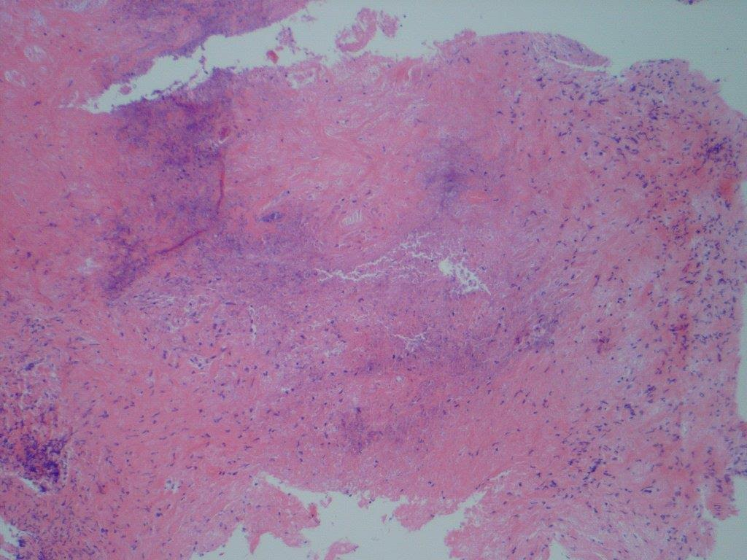
Pathology

Slide 18
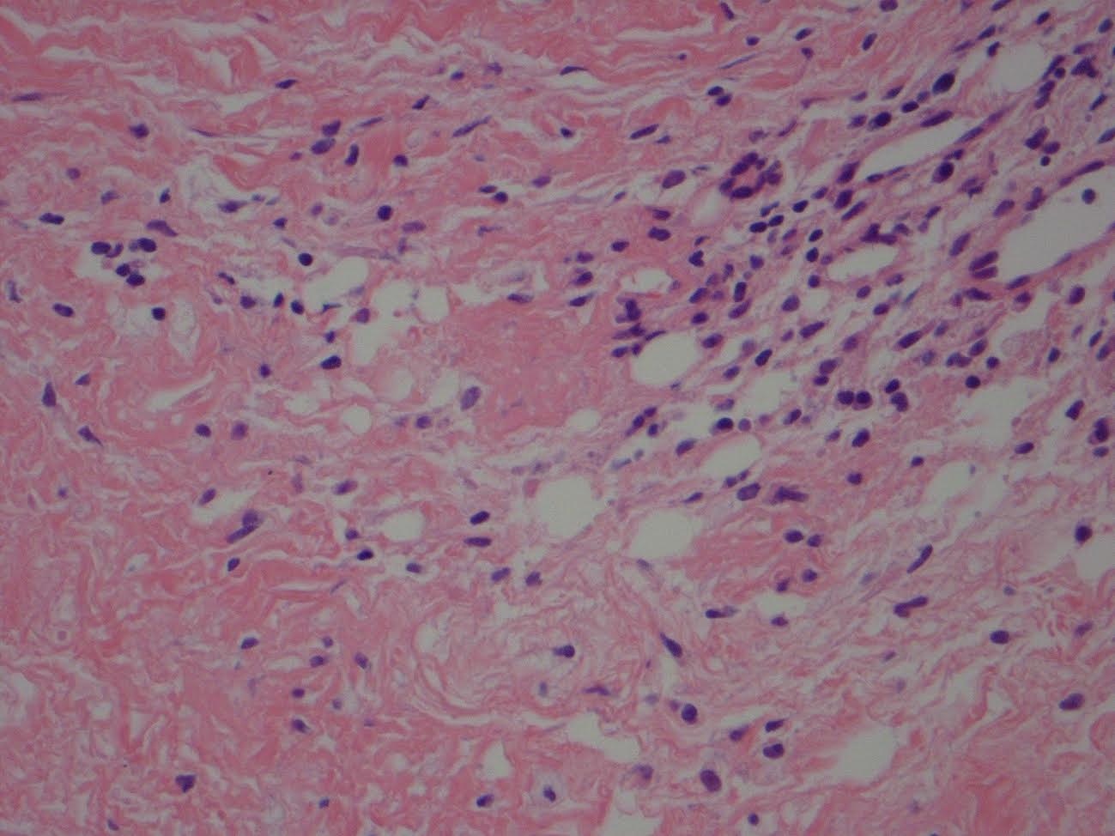
Pathology

Slide 19
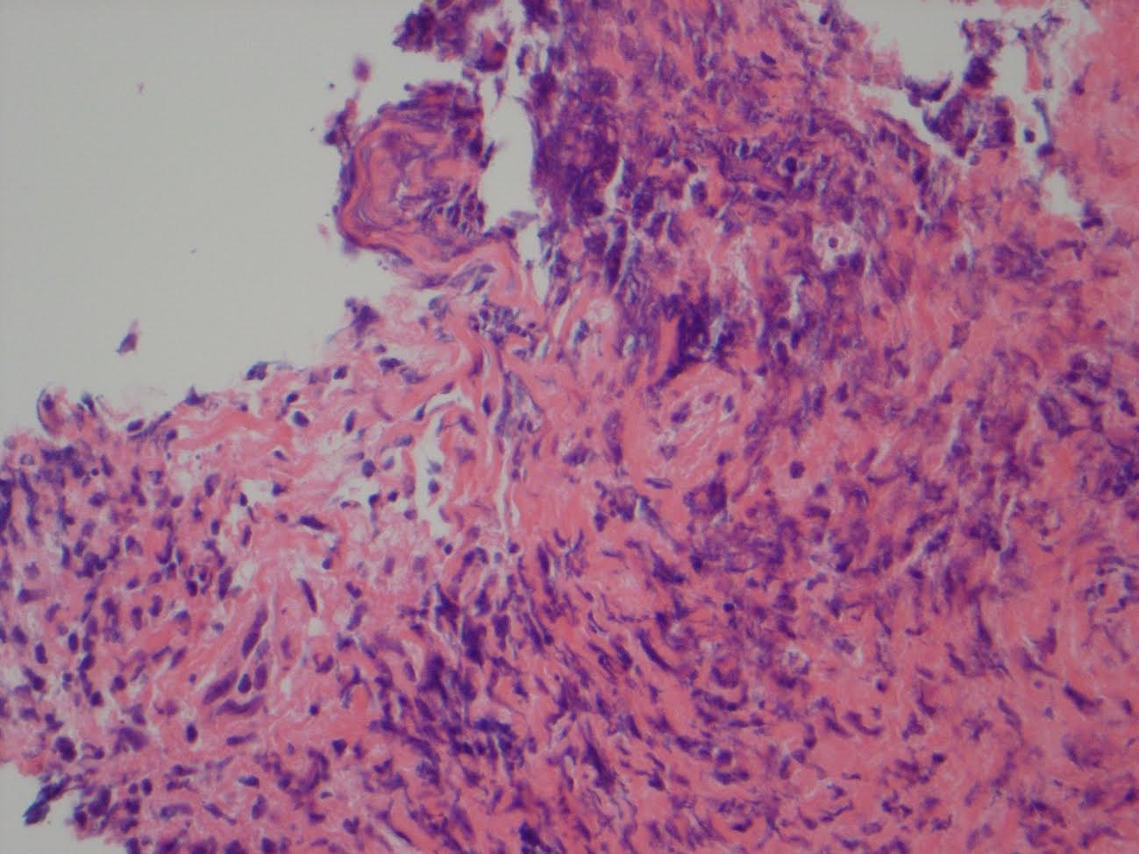
Pathology

Slide 20
Follow-up Results
c-ANCA +
CT of the chest demonstrated multiple cavitary lesions of the lung

Slide 21
Diagnosis
Granulomatosis with polyangiitis (GPA)

Slide 22
Plan
Start the patient on 1mg/kg of oral steroids and send the patient to rheumatology for further management

Slide 23
Follow-up 1 month later
Pt has been started on Rituximab
Still has APD and CF vision at 3 feet, but resolution of his limitation in adduction

Slide 24
Granulomatosis with Polyangiitis
Multisystem autoimmune disorder characterized by the classic triad:
Necrotizing granulomatous vasculitis of the upper and lower respiratory tract
Focal segmental glomerulonephritis
Necrotizing vasculitis of small arteries and veins

Slide 25
Epidemiology
Males affected more often than females, at an average age of 40 years, with peak incidence in the fifth decade.
Caucasians are affected more than African Americans
Incidence in the United States: 4 per 1,000,000.⁶
Prevalence in the United States: 1-5 per 100,000.⁶

Slide 26
Clinical Presentation
Persistent pneumonitis with bilateral nodular and cavitary infiltrates (95%)
Chronic sinusitis (90%)
Renal disease (80%)
Mucosal ulcerations of the nasopharynx (75%)
Notes:
Patients may present with constitutional symptoms, sinusitis associated with bloody nasal discharge, pulmonary symptomatology, and arthritis. Dermatologic involvement is seen in approximately one-half of patients, with purpura involving the lower extremities occurring most frequently; less common are ulcers and subcutaneous nodules. Nervous system involvement may be seen in approximately one-third of patients with peripheral neuropathies, the most common being mononeuritis multiplex; less frequently observed are cranial neuropathies, seizures, stroke syndromes, and cerebral vasculitis.

Slide 27
Clinical Presentation
Skin rashes
Muscle pains
Articular involvement
Mononeuritis or polyneuritis
Fever

Slide 28
Ophthalmic Manifestations
Ocular and orbital involvement is seen in 15% of patients at presentation and up to 50% of patients during the course of the disease.
Orbital involvement usually secondary from contiguous extension of the granulomatous inflammatory process from the paranasal sinuses into the orbit.

Slide 29
Ophthalmic Manifestations
Orbital pseudotumor, orbital cellulitis and dacryocystitis may arise from secondarily infected nasal mucosa.
40% of patients develop scleritis of any type (diffuse anterior or necrotizing disease) w/ or w/o peripheral ulcerative keratitis.
10% of patients can develop anterior, intermediate or posterior uveitis.

Slide 30
Ophthalmic Manifestations
Patients can also develop vaso-occlusive disease, including branch or central retinal artery or vein occlusion.
Also there are reports of patients getting ischemic optic neuropathy.
40% of patients with GPA will suffer some form of vision loss.

Slide 31
Diagnosis
Tissue biopsy is the gold standard
CXR: nodular diffuse or cavitary lesions
Proteinuria or hematuria
Elevated ESR and CRP
+ ANCAs (c-ANCA)
Notes:
ANCAs (anitneutriphil cyctoplasmic antibody) are antibodies directed against cytoplasmic azurophilic granules of neutrophils and monocytes, which are specific markers for a group of related systemic vasculitides that include Wegener granulomatosis, PAN, microscopic polyarteritis nodosa, Churg-Strauss syndrome, and pauci-immunoglomerulonephritis. Two main classes of ANCA have been described based on the immunofluorescence staining pattern on ethanol-fixed neutrophils and the main target antigen. The cytoplasmic pattern, or c-ANCA, is both sensitive and specific for Wegener granulomatosis and is present in up to 95% of patients; proteinase 3 is the most common target antigen. The perinuclear pattern, or p-ANCA, is associated with PAN, microscopic polyarteritis nodosa, relapsing polychondritis, and renal vasculitis. Myeloperoxidase is the most common antigenic target. In contrast to the results found in Wegener granulomatosis, the diagnostic sensitivities of c-ANCA and p-ANCA for PAN are only 5% and 15%, respectively; in patients with microscopic polyarteritis nodosa, p-ANCA (myeloperoxidase) positivity is more common (50%–80%), with a smaller percentage (40%) having the c-ANCA (proteinase 3) marker.

Slide 32
Differential Diagnosis
Infectious
Malignancy
Inflammatory (orbital pseudotumor or IgG4)
Notes:
The distinction of antineutrophil cytoplasmic autoantibody (ANCA)-associated vasculitis (AAV) from other systemic rheumatic diseases is a frequent clinical problem. This includes diseases with similar general clinical features, similar lung and/or renal signs, and/or positive ANCA serologies. This is discussed in detail separately. (See "Overview of and approach to the vasculitides in adults" and "Respiratory tract involvement in granulomatosis with polyangiitis and microscopic polyangiitis" and "Clinical spectrum of antineutrophil cytoplasmic autoantibodies".)
The vasculitis in patients with microscopic polyangiitis (MPA), granulomatosis with polyangiitis (GPA), and eosinophilic granulomatosis with polyangiitis (EGPA, Churg-Strauss) is pathologically indistinguishable. Asthma and eosinophilia may distinguish EGPA from GPA and MPA. (See "Epidemiology, pathogenesis, and pathology of eosinophilic granulomatosis with polyangiitis (Churg-Strauss)".)
MPA may be distinguished from classic polyarteritis nodosa, a vasculitis of medium-sized muscular arteries, by the clinical presentation and ANCA. The cardinal features of classic polyarteritis nodosa include renal infarcts, renal artery stenosis, and visceral microaneurysms, all of which are infrequently observed in MPA. Glomerulonephritis, other manifestations of small-vessel vasculitis, and a positive ANCA are observed in MPA but not classic polyarteritis nodosa [5]. (See "Clinical manifestations and diagnosis of polyarteritis nodosa in adults".)
Whereas nearly three-fourths of patients with MPA have ANCA, classic polyarteritis nodosa is not associated with antibodies to either proteinase 3 (PR3) or myeloperoxidase (MPO). (See "Clinical manifestations and diagnosis of polyarteritis nodosa in adults".)
Anti-glomerular basement membrane (anti-GBM) antibody disease, substantially more rare than AAV, is another disorder that can present with features of a pulmonary-renal syndrome. Furthermore, these diseases can occur together; 10 to 40 percent of patients with anti-GBM antibody disease also form ANCA (mostly MPO rather than PR3), a minority of whom have manifestations compatible with extrarenal and extrapulmonary vasculitis [69-71]. (See "Pathogenesis and diagnosis of anti-GBM antibody (Goodpasture's) disease" and "Clinical spectrum of antineutrophil cytoplasmic autoantibodies", section on 'Anti-GBM autoantibody disease'.)
A number of diseases other than GPA and MPA are also associated with positive ANCA serologies, especially bacteremia (positive anti-PR3 antibodies). Occasionally, serologies are positive for both anti-MPO and anti-PR3; levamisole (often a contaminant in cocaine) should be suspected in this setting. A detailed discussion concerning these disease associations and the clinical and laboratory features that help to distinguish among the different disorders can be found elsewhere. (See "Clinical spectrum of antineutrophil cytoplasmic autoantibodies".)

Slide 33
Differential Diagnosis
Goodpasture’s Syndrome
Other vasculitis
Microscopic polyangiitis
Churg-Strauss
Polyarteritis Nodosa
Notes:
The distinction of antineutrophil cytoplasmic autoantibody (ANCA)-associated vasculitis (AAV) from other systemic rheumatic diseases is a frequent clinical problem. This includes diseases with similar general clinical features, similar lung and/or renal signs, and/or positive ANCA serologies. This is discussed in detail separately. (See "Overview of and approach to the vasculitides in adults" and "Respiratory tract involvement in granulomatosis with polyangiitis and microscopic polyangiitis" and "Clinical spectrum of antineutrophil cytoplasmic autoantibodies".)
The vasculitis in patients with microscopic polyangiitis (MPA), granulomatosis with polyangiitis (GPA), and eosinophilic granulomatosis with polyangiitis (EGPA, Churg-Strauss) is pathologically indistinguishable. Asthma and eosinophilia may distinguish EGPA from GPA and MPA. (See "Epidemiology, pathogenesis, and pathology of eosinophilic granulomatosis with polyangiitis (Churg-Strauss)".)
MPA may be distinguished from classic polyarteritis nodosa, a vasculitis of medium-sized muscular arteries, by the clinical presentation and ANCA. The cardinal features of classic polyarteritis nodosa include renal infarcts, renal artery stenosis, and visceral microaneurysms, all of which are infrequently observed in MPA. Glomerulonephritis, other manifestations of small-vessel vasculitis, and a positive ANCA are observed in MPA but not classic polyarteritis nodosa [5]. (See "Clinical manifestations and diagnosis of polyarteritis nodosa in adults".)
Whereas nearly three-fourths of patients with MPA have ANCA, classic polyarteritis nodosa is not associated with antibodies to either proteinase 3 (PR3) or myeloperoxidase (MPO). (See "Clinical manifestations and diagnosis of polyarteritis nodosa in adults".)
Anti-glomerular basement membrane (anti-GBM) antibody disease, substantially more rare than AAV, is another disorder that can present with features of a pulmonary-renal syndrome. Furthermore, these diseases can occur together; 10 to 40 percent of patients with anti-GBM antibody disease also form ANCA (mostly MPO rather than PR3), a minority of whom have manifestations compatible with extrarenal and extrapulmonary vasculitis [69-71]. (See "Pathogenesis and diagnosis of anti-GBM antibody (Goodpasture's) disease" and "Clinical spectrum of antineutrophil cytoplasmic autoantibodies", section on 'Anti-GBM autoantibody disease'.)
A number of diseases other than GPA and MPA are also associated with positive ANCA serologies, especially bacteremia (positive anti-PR3 antibodies). Occasionally, serologies are positive for both anti-MPO and anti-PR3; levamisole (often a contaminant in cocaine) should be suspected in this setting. A detailed discussion concerning these disease associations and the clinical and laboratory features that help to distinguish among the different disorders can be found elsewhere. (See "Clinical spectrum of antineutrophil cytoplasmic autoantibodies".)

Slide 34
Pathogenesis
Unknown
Similar to PAN and serum sickness suggest some form of a hypersensitivity, possibly to an inhaled infectious or environmental agent
Presence of granulomas and dramatic response to immunosuppressive therapy support an immunologic mechanism
Notes:
Perhaps of the cell-mediated type

Slide 35
Treatment
Combination of oral corticosteroids and immunomodulatory therapy (IMT), specifically cyclophosphamide, and rituximab
Without therapy, the 1 year mortality is 80%
With treatment, 93% of patients treated achieve remission with resolution of ocular manifestations

Slide 36
Literature Review
Purpose: To determine the efficacy of rituximab for the treatment of Granulomatosis with polyangiitis (GPA)
Design: Randomized, double blind, noninferiority trial of rituximab compared to cyclophosphamide for the treatment of GPA. Primary end-point was remission of disease w/o the use of prednisone at 6 months.
Stone JH, Merkel PA, Spiera R, Seo P, Langford CA, Hoffman GS, Kallenberg CG, St Clair EW, Turkiewicz A, Tchao NK, Webber L, Ding L, Sejismundo LP, Mieras K, Weitzenkamp D, Ikle D, Seyfert-Margolis V, Mueller M, Brunetta P, Allen NB, Fervenza FC, Geetha D, Keogh KA, Kissin EY, Monach PA, Peikert T, Stegeman C, Ytterberg SR, Specks U; RAVE-ITN Research Group. Rituximab versus cyclophosphamide for ANCA-associated vasculitis. N Engl J Med. 2010 Jul 15;363(3):221-32. doi: 10.1056/NEJMoa0909905. PubMed PMID: 20647199; PubMed Central PMCID: PMC3137658
Notes:
However, not all patients have a remission with this combination of drugs, and those who do often have disease flares that require repeated treatment. Moreover, side effects of cyclophosphamide, including infertility, cytopenias, infections, bladder injury, and cancer, as well as the multiple adverse effects of lengthy courses of glucocorticoid treatment, are major causes of long-term disease and death

Slide 37
Literature Review
Results: 67% of rituximab group as compared to 42% of the cyclophosphamide group reached their primary end point
Conclusion: Rituximab therapy was not inferior to daily cyclophosphamide
Stone JH, Merkel PA, Spiera R, Seo P, Langford CA, Hoffman GS, Kallenberg CG, St Clair EW, Turkiewicz A, Tchao NK, Webber L, Ding L, Sejismundo LP, Mieras K, Weitzenkamp D, Ikle D, Seyfert-Margolis V, Mueller M, Brunetta P, Allen NB, Fervenza FC, Geetha D, Keogh KA, Kissin EY, Monach PA, Peikert T, Stegeman C, Ytterberg SR, Specks U; RAVE-ITN Research Group. Rituximab versus cyclophosphamide for ANCA-associated vasculitis. N Engl J Med. 2010 Jul 15;363(3):221-32. doi: 10.1056/NEJMoa0909905. PubMed PMID: 20647199; PubMed Central PMCID: PMC3137658
Notes:
However, not all patients have a remission with this combination of drugs, and those who do often have disease flares that require repeated treatment. Moreover, side effects of cyclophosphamide, including infertility, cytopenias, infections, bladder injury, and cancer, as well as the multiple adverse effects of lengthy courses of glucocorticoid treatment, are major causes of long-term disease and death

Slide 38
Conclusions
GPA is a triad of: necrotizing granulomatous vasculitis of the upper and lower respiratory tract, focal segmental glomerulonephritis, and necrotizing vasculitis
This disease has an 80% mortality without treatment
Pathogenesis remains unknown, but likely a mixed b-cell and t-cell dysregulation that is causing this disease

Slide 39
References
Kanski’s Clinical Ophthalmology A systemic Approach, Eighth Edition. Brad Bowling
Retina and Vitritis, BSCS
Oculoplastics, BSCS
https://www.aao.org/bcscsnippetdetail.aspx?id=e805c10e-5182-4a54-90d0-ee5a3111ff4
Robbins and Cotran Pathologic Basis of Desease, 7th Edition
Cecil Medicine 23rd Edition
Stone JH, Merkel PA, Spiera R, Seo P, Langford CA, Hoffman GS, Kallenberg CG, St Clair EW, Turkiewicz A, Tchao NK, Webber L, Ding L, Sejismundo LP, Mieras K, Weitzenkamp D, Ikle D, Seyfert-Margolis V, Mueller M, Brunetta P, Allen NB, Fervenza FC, Geetha D, Keogh KA, Kissin EY, Monach PA, Peikert T, Stegeman C, Ytterberg SR, Specks U; RAVE-ITN Research Group. Rituximab versus cyclophosphamide for ANCA-associated vasculitis. N Engl J Med. 2010 Jul 15;363(3):221-32. doi: 10.1056/NEJMoa0909905. PubMed PMID: 20647199; PubMed Central PMCID: PMC3137658
Up-to-date, looking up Granulomatosis with polyangiitis

