Slide 1
Grand Rounds Masquerading Disease
Niloofar Piri MD
May 19th 2017

Slide 2
Patient Presentation
CC
Right eye redness and mild pain for a month
HP
70 yo Caucasian male presents with right eye redness and mild pain which started a month ago and increased gradually. He presented to the ER a week prior to presentation and was treated with topical antibiotics with diagnosis of conjunctivitis.

Slide 3
History (Hx)
Past Ocular Hx: Chronic moderate low vision secondary to old CRVO OS
Past Medical Hx: HTN, CHF with AICD (defibrillator) placement, Hyperlipidemia
Fam Hx: Unremarkable
Meds: Carvedilol, Lisinopril, Simvastatin
Allergies: NKDA
Social Hx: Current heavy smoker 70 PY
ROS : Generalized weakness, loss of appetite

Slide 4
External Exam
 | OD |  | OS
VA | 20/30 |  | 20/70
Refraction | -0.75+0.50x170 NI |  | +0.50 +0.50 x60 NI
Pupils | Irregular, miotic |  | 3->2 mm
IOP | 16 mmHg |  | 14 mmHg
EOM | full |  | full

Slide 5
Anterior Segment Exam
SLE | OD | OS
External/Lids | Wnl | Wnl
Conj/Sclera | Ciliary Injection 2+/inferonasal conj nodule with sentinel vessel | Wnl
Cornea | Inferonasal pagetoid lesion on endothelium extending from the limbus towards the center/ KPs | Clear
Ant Chamber | Fluffy white material pseudohypopyon | 0 cell and flare
Iris | Inferonasal infiltration/PS | Wnl
Lens | NS2+ | NS1+
Anterior vitreous | poorly visible | Clear

Slide 6
Anterior Segment photos

Slide 10
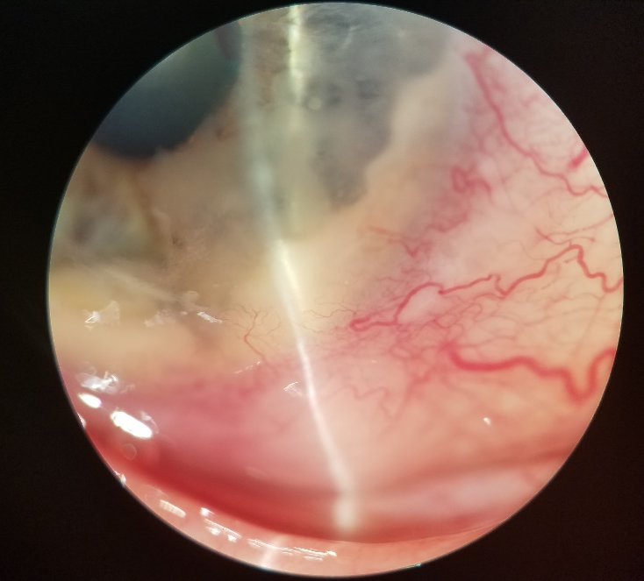
Anterior segment OCT

Slide 14
Differential diagnosis :
- Anterior segment metastasis
Endogenous endophthalmitis

Slide 15
Assessment
70 yo WM with pseudohypopyon, conj nodule and pagetoid corneal lesion and iris infiltrate , heavy smoker with loss of appetite

Slide 16
Plan
The patient was asked about underlying malignancy which was denied. Was not aware of any weight loss; however per chart past W:170 pounds, current 125! Was sent from the clinic directly to radiology for CT with contrast chest , abdomen and pelvis.

Slide 17
CXR

Slide 22
Pathology
H&E

Slide 23
Pathology
Small cell lung cancer
Negative for Napsin A
Positive for CD56
( neuro-edndocrine marker)
Positive for TTF-1 : Lung origin

Slide 24
He was started on chemo ( Cisplatin and Etopside regimen) per oncology service
Started on Pred Forte bid OD and cyclogyl bid OD

Slide 25
1 month follow up
NVG OD/ IOP 27/ 2 cycles of chemo
Started on anti glaucoma drops/ referred to Ocular Oncology service
Continue chemo, control IOP, if no response will recommend EBRT

Slide 27
2 months follow up

Slide 29
Before treatment
2 mo after treatment

Slide 33
Discussion
Uveal metastases are not uncommon in an ocular oncology practice, but occur far more often in the choroid than the iris
Metastasis to the anterior segment of the eye is a rare occurrence accounting for about 7-14% of all intraocular metastasis

Slide 34
Pain and blurred vision are overwhelmingly the most common patient symptoms. The pain was presumably related to secondary glaucoma, iridocyclitis, or scleral invasion from tumor

Slide 35
Both types of lung cancers, non-small cell and small cell, have equal propensity for eye metastases.
In even rarer reported cases in literature, approximately 25% of individuals diagnosed with metastatic carcinoma of the eye, this form of metastasis to the eye was the initial presentation of their cancer. Due to its rarity, this is commonly neglected and diagnosis usually go unnoted leading to poorer outcome for the patient

Slide 36
Metastatic lesion to the eye is a poor prognostic sign for long term survival with the survival rates approximating 7 months.
Early diagnosis is of paramount importance because if left untreated, this condition can lead to significant morbidity.
However, early diagnosis and therapy directed at local tumor control for preservation of vision can improve the patient’s quality of life during the terminal phase of their disease.

Slide 37
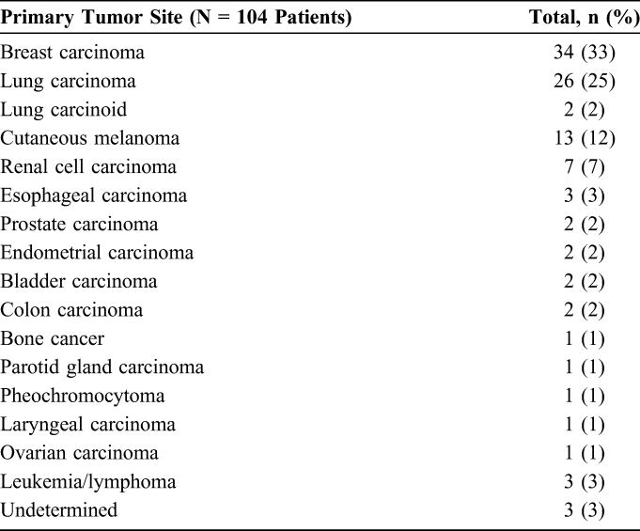
Shields et al. 2014 Cornea

Slide 38
The treatment of uveal metastases, including iris metastases, is palliative. Patients with other systemic involvement should be treated with systemic chemotherapy, while external radiotherapy or brachytherapy are recommended for the treatment of focal metastases

Slide 39
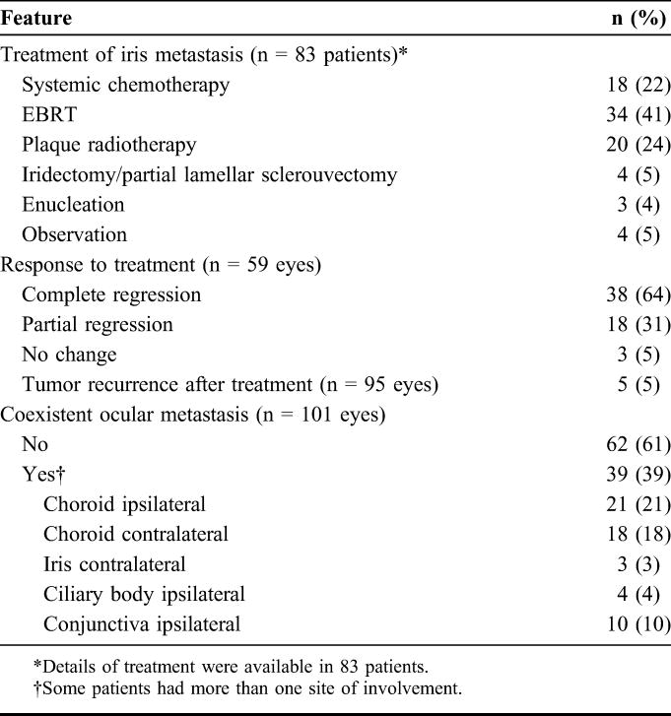
Shields et al. 2014 Cornea

Slide 40
Shields et al. 2014 Cornea

Slide 41
Avastin failed!
Randomized phase II-III study of bevacizumab in combination with chemotherapy in previously untreated extensive small-cell lung cancer: Results from the IFCT-0802 trial ( Ann Oncology 2015)
Conclusions: Bev did not increase the proportion of responder patients at cycle 4. This phase II study failed to demonstrate any signal suggesting an outcome improvement in extensive-SCLC. Consequently this trial will not go further the phase 3 part of the program.

Slide 42
What about intraocular injections?
No studies in the literature !
Only one case report about non-small cell cancer with resolution of the tumor

Slide 43
In summary, iris metastatic tumors can have a variety of presenting signs and symptoms with pain, photophobia, blurred vision, or visible mass and it can manifest before the detection of the primary systemic malignancy.

Slide 44
Occasionally, iris metastasis can masquerade as iridocyclitis with hypopyon or with intractable glaucoma.
A high index of suspicion is warranted for unilateral non-resolving anterior uveitis or glaucoma because there could be an underlying malignancy

Slide 45
Conclusions
It is critical to consider masquerade syndrome in the differential diagnosis of uveitis and to exclude it when appropriate with a diagnostic procedure and appropriate pathological studies

Slide 46
References
Shields CL, Kaliki S, Crabtree GS, Peshatani A, Morton S, Anand RA, et al. Iris metastasis from systemic cancer in 104 patients: The 2014 Jerry A. shields Lecture. Cornea. 2015; 34(1):42
Sen HN, Chan CC, Nussenblatt RB, et al.. Occult primary carcinoma metastatic to the iris. Acta Ophthalmol Scand. 2004;82:746–747
Kesen MR, Edward DP, Ulanski LJ, et al.. Pulmonary metastasis masquerading as anterior uveitis. Arch Ophthalmol. 2008;126:572–574
Woog JJ, Chess J, Albert DM, et al.. Metastatic carcinoma of the iris simulating iridocyclitis. Br J Ophthalmol. 1984;68:167–173.
Harvey BJ, Grossniklaus HE, Traynor MP, et al.. Metastatic lung adenocarcinoma to the iris mimicking Cogan-Reese syndrome. J Glaucoma. 2012;21:567–569.

