Slide 1
Grand Rounds Malignant Diplopia
Juan P. Fernandez de Castro
September 2016

Slide 2
Patient Presentation
CC
Double vision
HPI
63 yo female presents with new onset binocular diplopia, worse on left gaze. First symptoms 2-3 months ago; progressive. Now intolerable, needs to patch one eye.

Slide 3
History (Hx)
Past Ocular Hx Unremarkable
Past Medical Hx Breast Cancer
Fam Hx Unremarkable
Meds Chemo in the past
Allergies None
Social Hx Smoker (20packs-year)

Slide 4
Review of Systems
Headache Intermittent for several months
Cough COPD
No fever
No trauma

Slide 5
External Exam
 | OD |  | OS
BCVA | 20/25 |  | 20/30+
Refraction | +1.50 +1.75 x009 |  | +1.25 +0.25 x166
Pupils | 4→2mm | No rAPD | 4→2mm
IOP | 12 mmHg |  | 13 mmHg
EOM | Full. | No nystagmus | See below.
CVF | full |  | full
0
0
115
0
0
0
0
0
-3
0
0
14
14
0
0

Slide 6
Anterior Segment Exam
PLE or SLE | OD |  | OS
External/Lids |  | WNL
Conj/Sclera |  | WNL
Cornea |  | WNL
Ant Chamber |  | WNL
Iris |  | WNL
Lens | +2 NS |  | +2 NS

Slide 7
Posterior Segment Exam
Fundus | OD |  | OS
Optic Nerve | Sharp, pink C/D 0.3 |  | Sharp, pink C/D 0.3
Macula |  | WNL
Vessels |  | WNL
Periphery |  | WNL

Slide 8
EOM

Slide 9
EOM

Slide 10
Assessment
Differential Diagnosis
Ischemic left 6th CN Palsy
Thyroid eye disease
Myasthenia Gravis
Tumor
Stroke

Slide 11
Back to the headache…
Occipital. Intermittent. No visual symptoms
No jaw claudication, no scalp tenderness
…by the way
“I had an MRI done this week because I have had metastasis of the breast cancer to the skull”

Slide 12
Past Medical History
2001 Left breast cancer.
Mastectomy, +nodes.
Declined Chemo, started on Selective Estrogen Receptor Modulator (Tamoxifen)
2012 Low back pain
Bone scan shows mets to pelvis and spine
Started on antiestrogen (Arimidex)
2013 Severe hip pain, disease progressed
Palliative radiation to pelvis
Started on Chemo (Taxotere, 6 cycles) followed by antiestrogen injection (Faslodex)
2014 Persistent bone mets
Started on antimetabolite (Xeloda)
2015 Headaches
Mets to the skull
Started chemo with weekly Adriamycin
Notes:
Arimidex is an anti estrogen drug that is designed to block estrogen
Xgeva is an antibody, not a bisphosphonate, and it interferes with the activity of the body's bone-destroying cells in a way that is different from bisphosphonates.
Faslodex (fulvestrant) Injection 500 mg anti-estrogen
Originally ER positive and is now "triple negative" and is metastatic to bone.

Slide 13
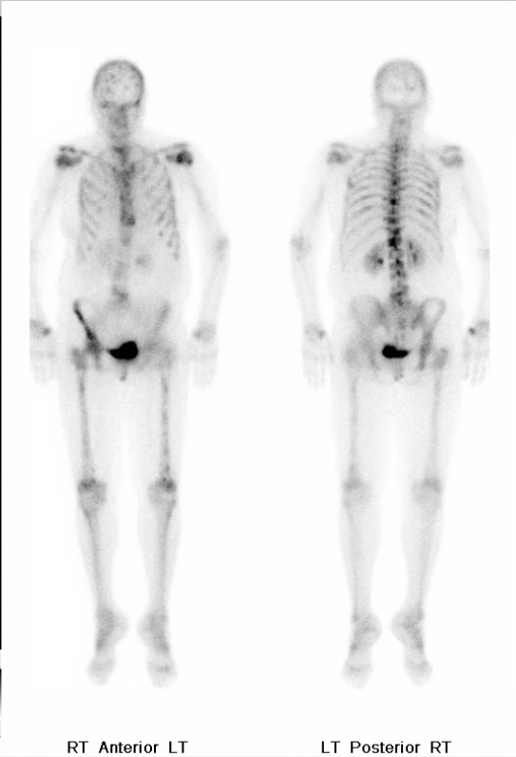
Bone scintigraphy
Notes:
Most notable index lesions are seen in the skull, bilateral femurs, and the bilateral ribs. Largest vertebral metastasis is within L1. There is mottled appearance to the left hip which is unchanged the prior examination and could represent soft tissue
metastases in this location.
There degenerative changes in the bilateral shoulders and knees as well is above on.
IMPRESSION:
1. Progression of diffuse osseous metastatic disease from active breast carcinoma

Slide 14
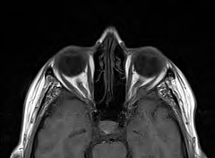
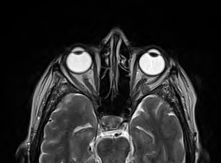
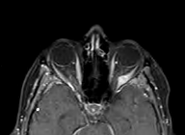
MRI
T1
T2
T1+C
Notes:
T1: isointense to muscle
T2: hyperintense to muscle, hypointense to fat
T1 C+ (GAD): enhancement present but variable

Slide 15
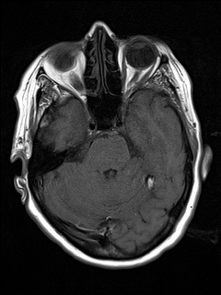
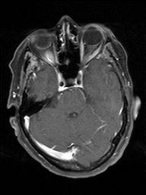
05/27/15
T1
T2
T1+C

Slide 16
Diagnosis
Metastatic breast cancer that was originally ER positive and is now "triple negative" and is metastatic to left lateral rectus muscle and bone.
Triple Negative:
Estrogen receptor
Progesterone receptor
HER2/neu
Notes:
(human epidermal growth factor receptor 2)

Slide 17
Plan
Palliative radiotherapy
Monday to Friday 4 weeks
Radiotherapy aborted before it could be started, due to patient general health decline and severe anemia
Patient died 1 week later

Slide 18
Discussion
Orbital metastasis
2-11% of orbital neoplasms
Uveal metastases outnumber orbital metastases 8:1

Slide 19
Common Tumors to Metastasize to the Orbit
Breast cancer
Bronchogenic cancer
Prostate cancer
Gastrointestinal adenocarcinoma
Thyroid carcinoma
Renal cell carcinoma
Neuroblastoma
Ewing sarcoma
Wilms tumor

Slide 20
Usually unilateral (except neuroblastoma)
In contrast to uveal mets
Primary involvement of extraocular muscles is rare
More common secondary involvement as the tumor grows

Slide 21
Radiographic Features
CT
Variable appearance with morphology ranging from well-defined to diffusely infiltrating
Usually enhancing lesion
Bony destruction
MRI
T1: isointense to muscle
T2: hyperintense to muscle, hypointense to fat
T1 C+ (GAD): enhancement present but variable

Slide 23
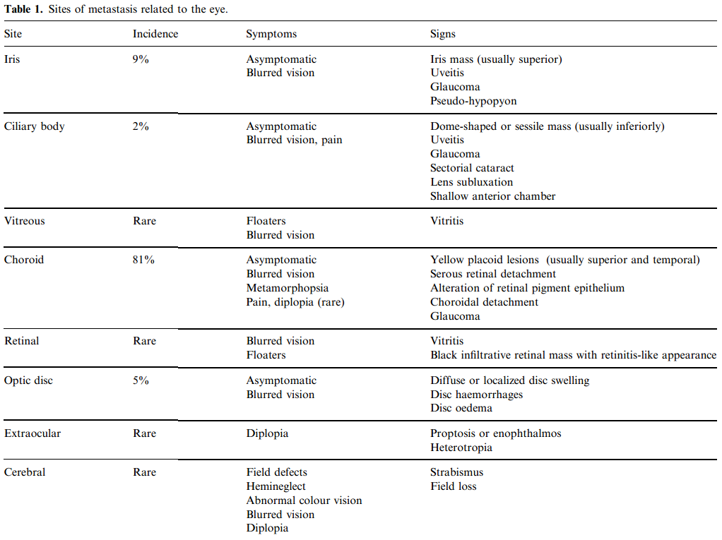

Slide 24
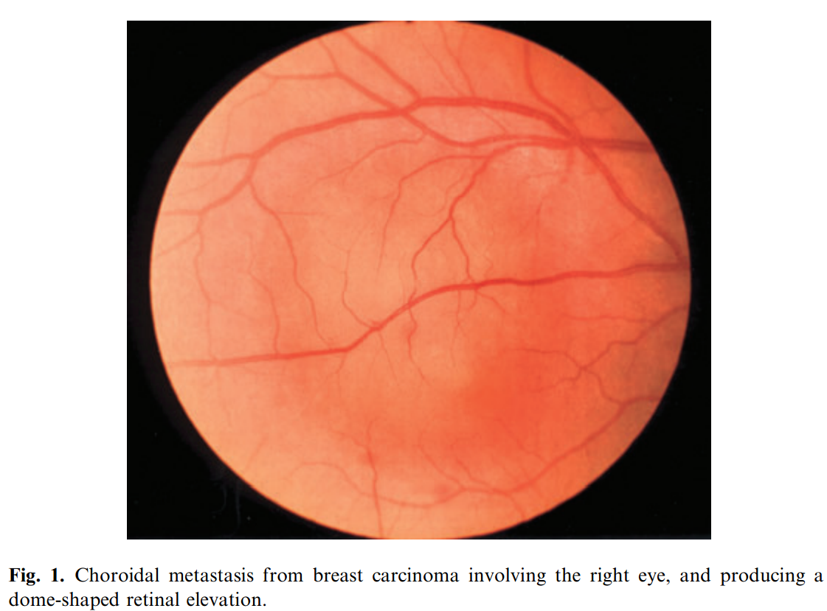

Slide 25
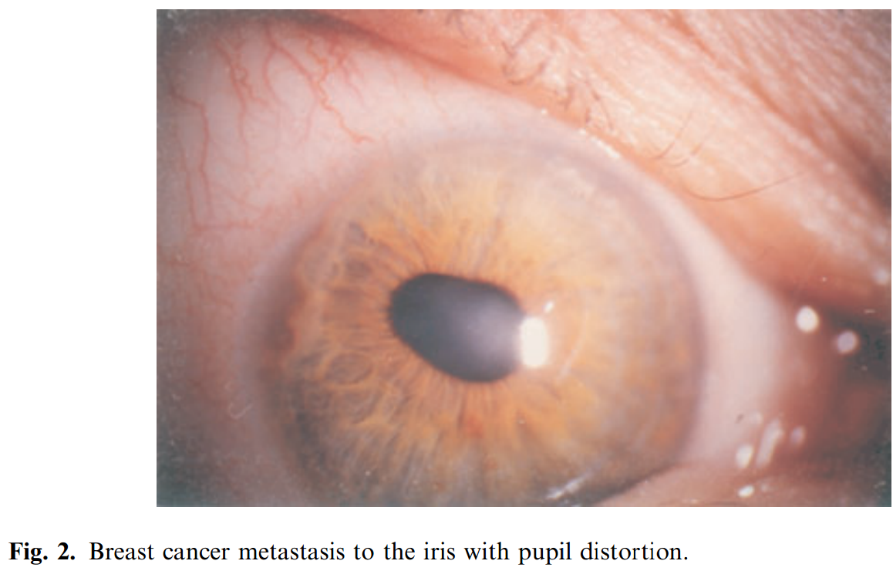

Slide 26
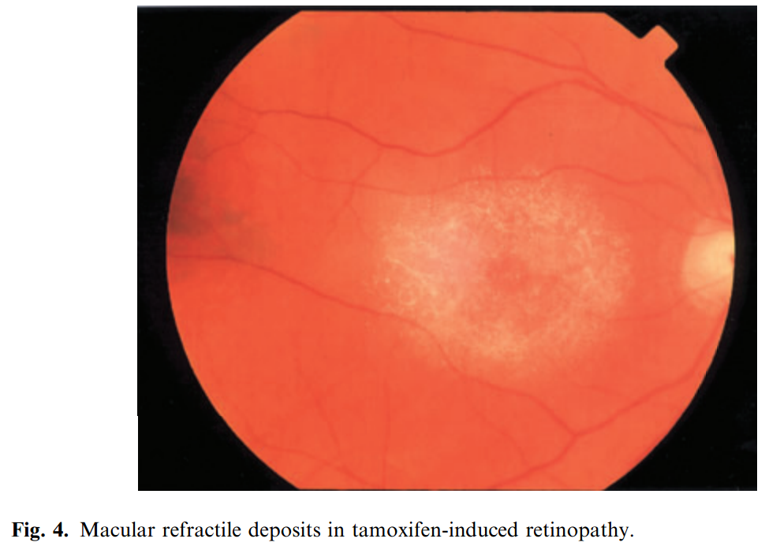

Slide 27
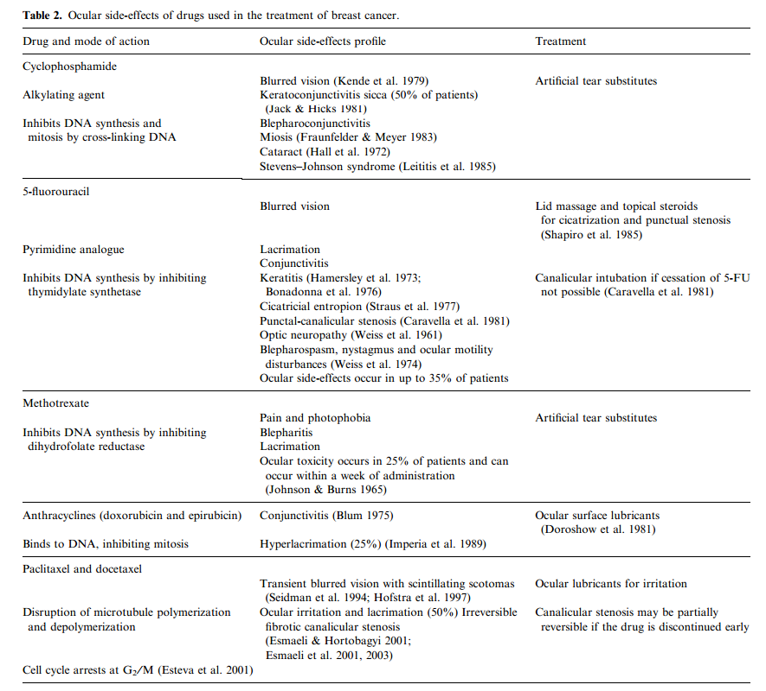

Slide 28
Conclusions
The appearance of eye symptoms in patients with a history of cancer should always be investigated with a consideration of ocular metastatic disease.

Slide 29
References
Panagiotis J. Vlachostergios, Ioannis A. Voutsadakis, and Christos N. Papandreou. Orbital Metastasis of Breast Carcinoma Breast Cancer (Auckl). 2009; 3: 91–97.
Wickremasinghe S, Dansingani KK, Tranos P, et al. Ocular presentations of breast cancer. Acta Ophthalmol Scand. 2007;85: 133–42.
Dieing A, Schulz CO, Schmid P, et al. Orbital metastases in breast cancer: report of two cases and review of the literature. J Cancer Res Clin Oncol. 2004; 130: 745–8
BCSC Pediatric Ophthalmology and Strabismus
BCSC Neuro-Ophthalmology

