Slide 1
Grand Rounds
Raafay Sophie, MD
05/19/2017

Slide 2
Patient Presentation
CC
  Referral for abnormal red light reflex OS
HPI
  2 year old male referred by pediatrician
  Mother had noticed “glare” in the left eye 2-3 months ago
  Eyes had more frequently started to become misaligned
  Occasionally he ran into objects while walking

Slide 3
History (Hx)
  Past Ocular Hx: As per presenting complaint
Past Medical Hx: Asthma
Birth Hx: Born full term by planned C-section, no pregnancy or delivery complications
Fam Hx: No history of ocular tumors, Father with history of colon cancer
Meds: Albuterol inhaler, Budesonide inhaler
Allergies: NKDA
ROS: Unremarkable, meeting age-appropriate milestones

Slide 4
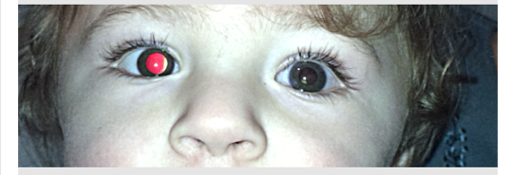
External Exam
 | OD |  | OS
VA | Fixes and follows |  | Fixes and follows
Pupils | 4→2mm |  | 4→3mm, rAPD +ve
IOP | - |  | -
EOM | Full |  | Full, XT
Notes:
In the Brückner test,

Slide 5
Anterior Segment Exam
PLE | OD |  | OS
External/Lids | WNL |  | WNL
Conj/Sclera | White and Quiet |  | White and Quiet
Cornea | Clear |  | Clear
Ant Chamber | Deep and Formed |  | Deep and Formed
Iris | WNL |  | WNL
Lens | clear |  | Leukocoria/Xanthocoria

Slide 6
Posterior Segment Exam
Fundus | OD |  | OS
Optic Nerve | Pink and sharp |  | Total Retinal Detachment- difficult to examine
Macula | Sharp foveal reflex
Vessels | WNL
Periphery | WNL

Slide 7
Assessment
DDx:
Retinoblastoma
Coats Disease
Persistent Hyperplastic Primary Vitreous (PHPV)
Toxocariasis
Familial Exudative Vitreoretinopathy (FEVR)
Notes:
2 yr old with leukocoria and TRD

Slide 8
Plan
Take to OR for Examination Under Anestheia
  Retcam
  FA
  B-scan
  UBM

Slide 9
EUA
IOP (mmHg)
  OD 12
  OS 18
Horizontal Corneal Diameter (mm)
  OD 12
  OS 12
Retinoscopy
  OD plano
  OS unable to perform

Slide 10
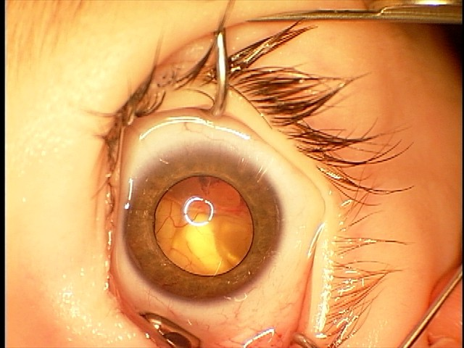
OS
Notes:
Extensive 360 NVI, lens clear, cornea clear, AC formed

Slide 11
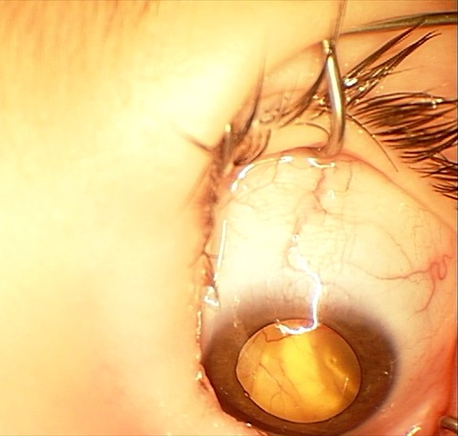
OS

Slide 12
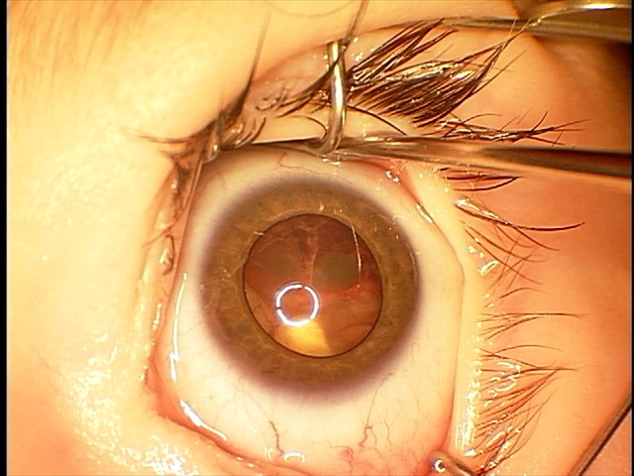
OS

Slide 13
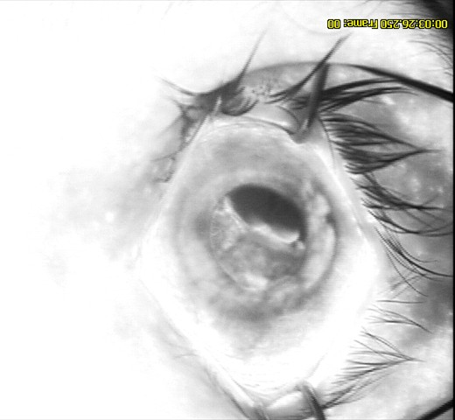
OS

Slide 14
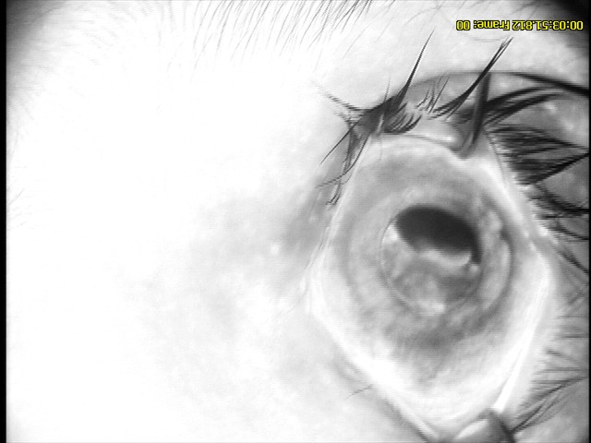
OS

Slide 15
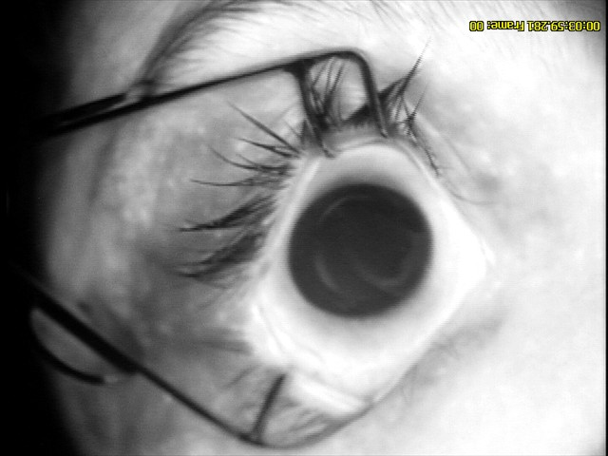
OS

Slide 16
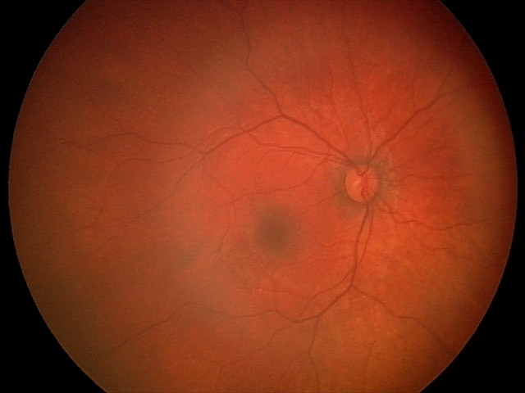
EUA

Slide 17
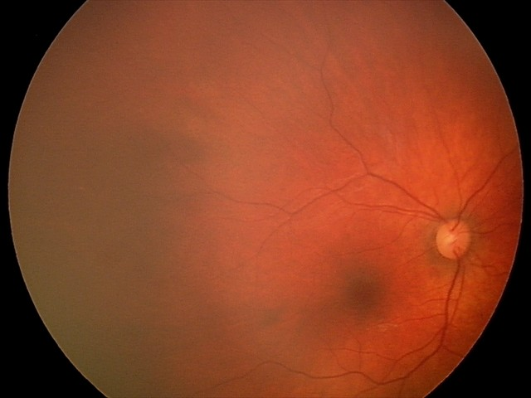
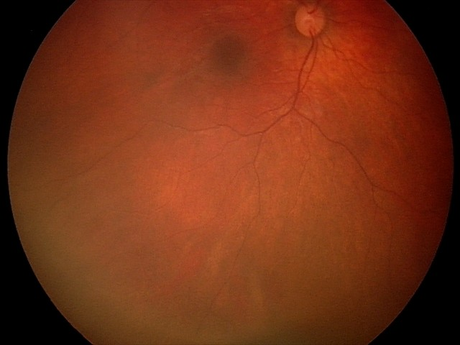
EUA
Notes:
SOME MILD NON-PERFUSION, No NV

Slide 18
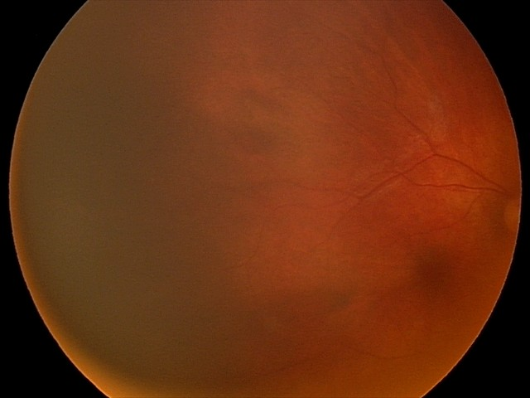
EUA

Slide 19
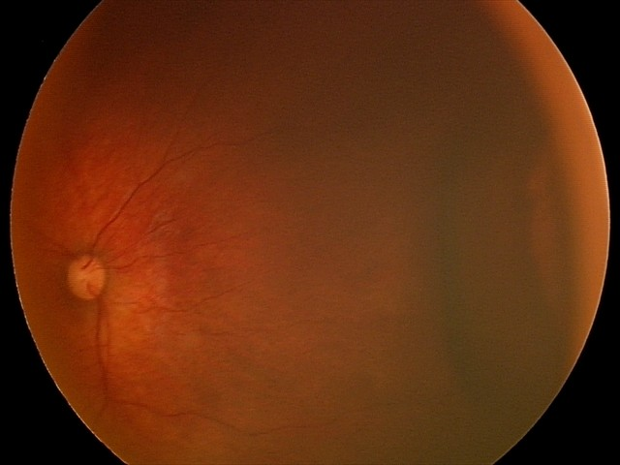
EUA

Slide 20
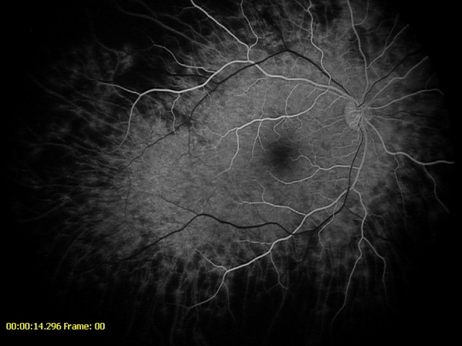
EUA

Slide 21
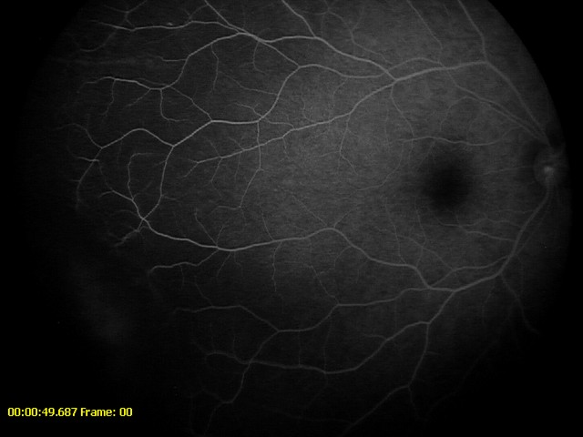
EUA
Notes:
One hyperfluorescent spot, Non perfusion peripheral mild

Slide 22
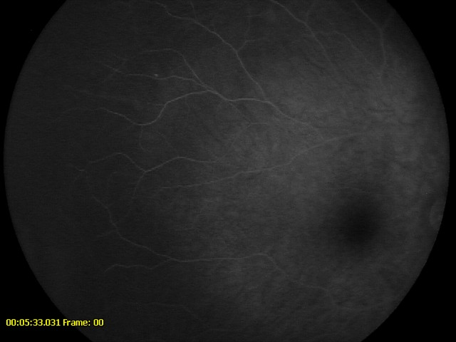
EUA

Slide 23
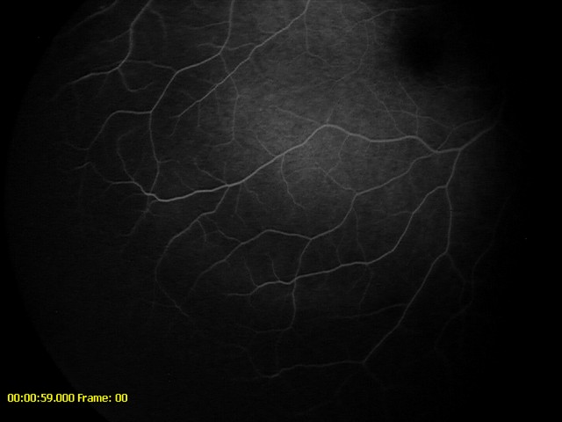
EUA

Slide 24
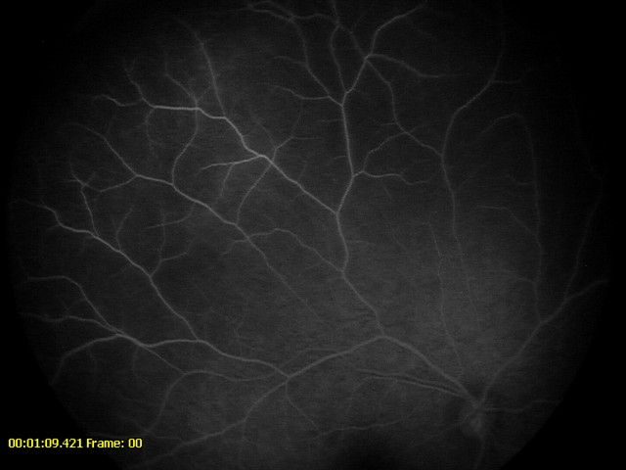
EUA

Slide 25
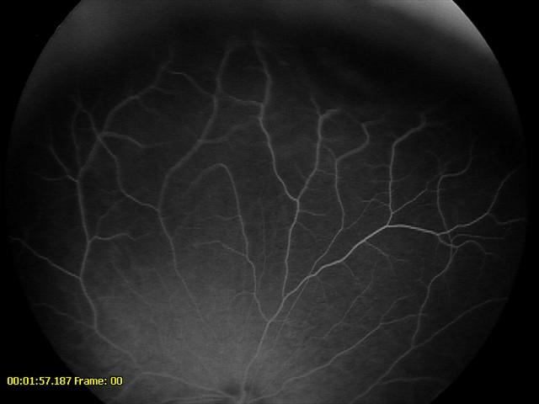
EUA

Slide 26
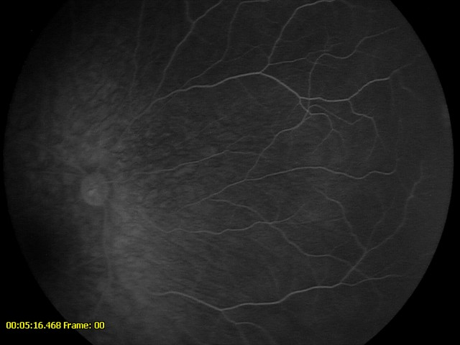
EUA

Slide 27
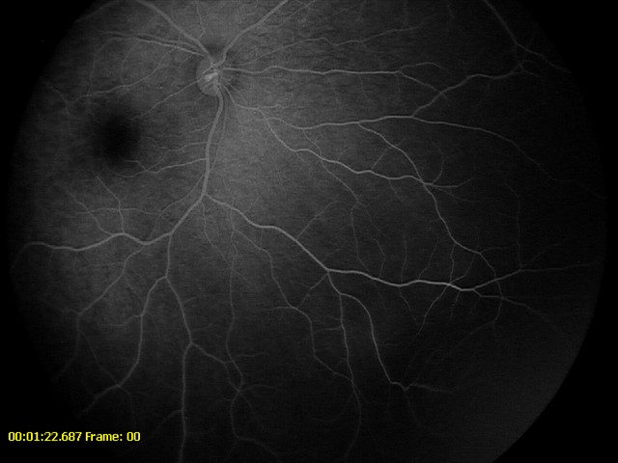
EUA

Slide 28
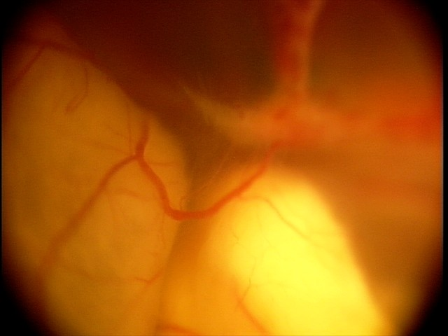
EUA
Notes:
ERD with retina. Vessel coursing over retina ,can be seen throughout its course and is not dipping in.

Slide 29
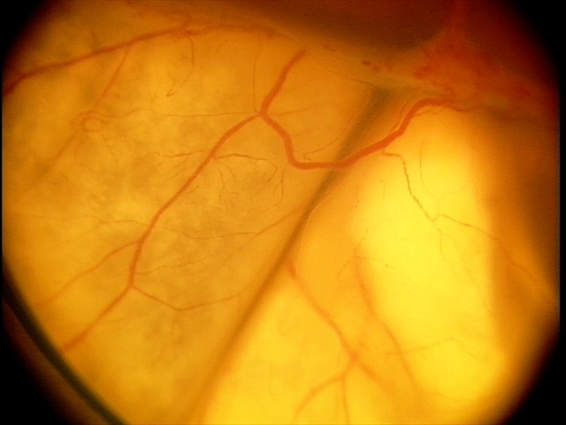
EUA
Notes:
Peripheral telangiectasia, Substance under retina appears yellowish.

Slide 30
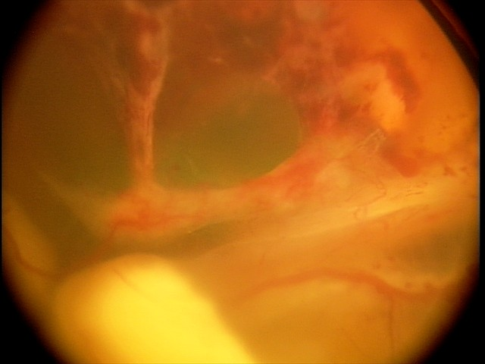
EUA
Notes:
Superior abnormal vessel w heme

Slide 31
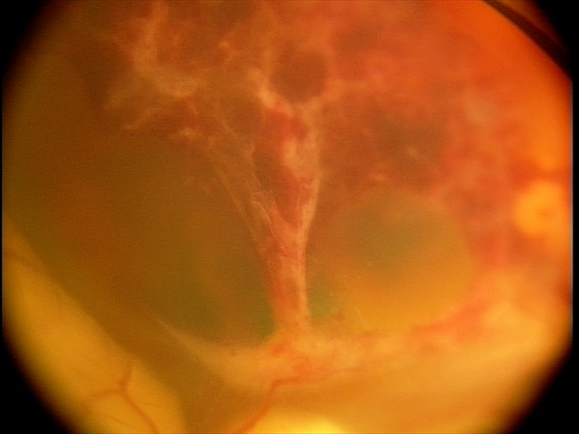
EUA

Slide 32
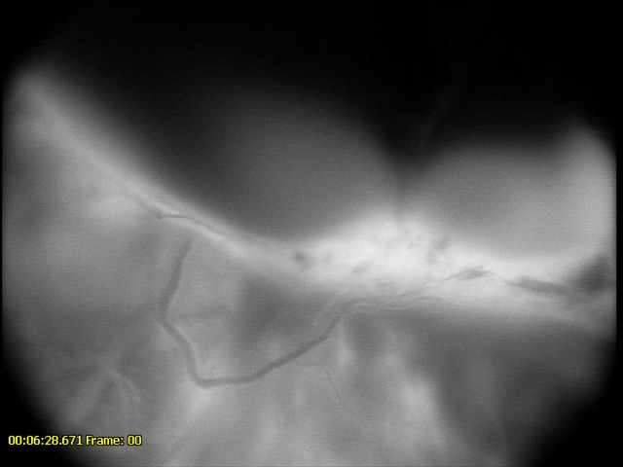
EUA
Notes:
FA of the RD

Slide 33
U/S
Total RD with underlying heme/exudate
Some linear calcification suggestive of RPE metaplasia

Slide 34
EUA
Blood drawn for FEVR testing
  Negative for deletion/duplication for CAPN5, COL2A1, FZD4, KIF11, LRP5, NDP, TSPAN12,VCAN and ZNF408 genes

Slide 35
Diagnosis and Plan
Stage 5 Coats
Pt at high risk for developing painful blind eye.
Enucleation recommended, referred to Oculoplastics

Slide 36
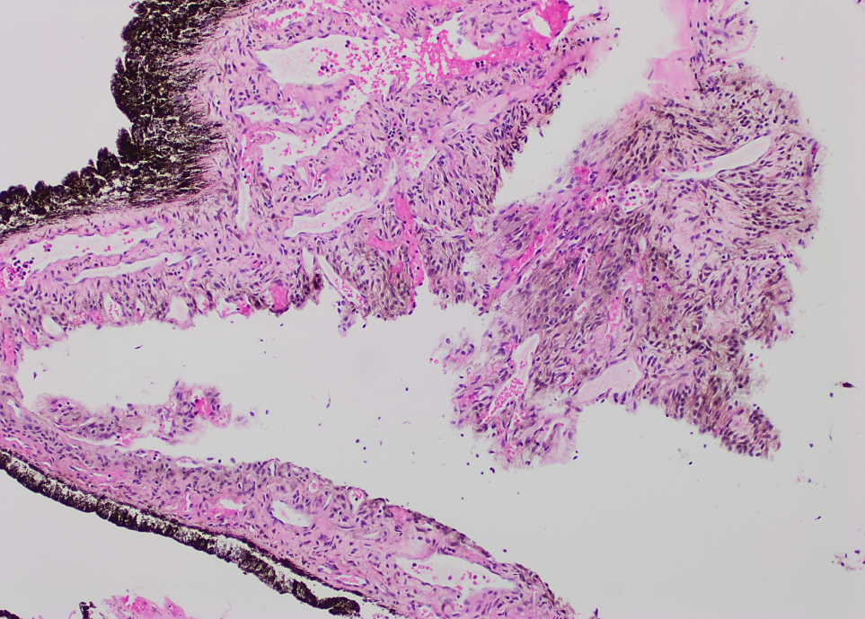
Notes:
Pigmented Retinal lining. Too many vessels. Neovascularization. Brown areas are hemosiderin indicative of bleeding

Slide 37
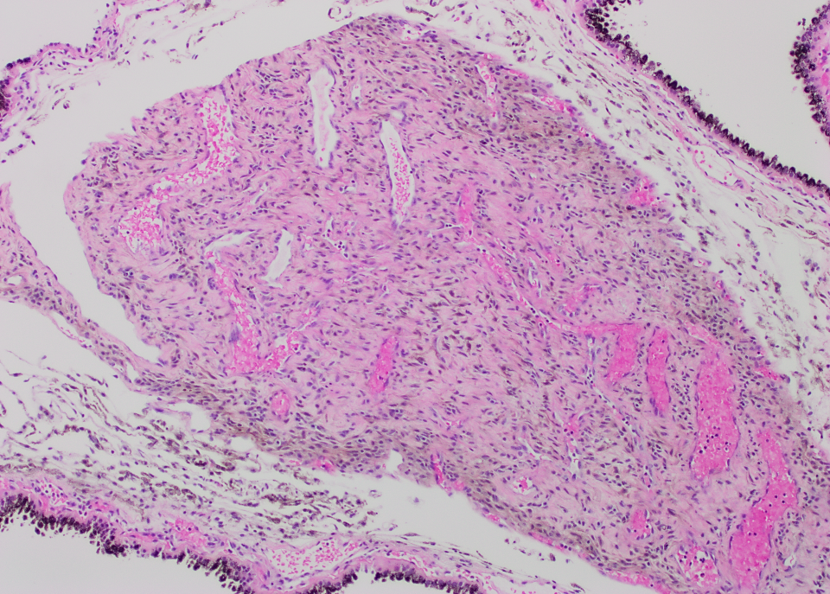
Notes:
Too many vessels in fibrin- telengiectatic vessels

Slide 38
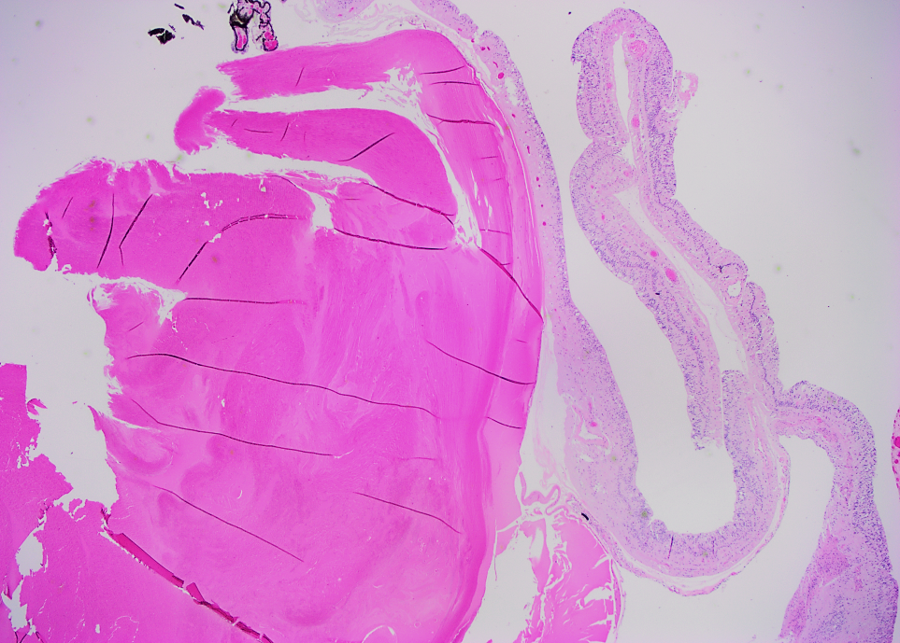
Notes:
Exudative material- blood and fibrin material. Bright pink is lens

Slide 39
Coats Disease
Idiopathic retinal telangiectasia associated with intraretinal exudation and frequent exudative retinal detachment without signs of appreciable retinal or vitreal traction

Slide 40
Clinical Presentation
Common presentation
  Decreased vision
  Strabismus
  Leukocoria
Important to rule out imitators, especially Retinoblastoma

Slide 41
Features | Retinoblastoma | Coats Disease
Family History | 10% of patients | Sporadic
Mean Age of onset | 1.5 years | 5 years
Gender | Male=Female | 75% are males
Laterality | Unilateral or Bilateral | 95 % are Unilateral
Genetics | Mutation in RB1 on chromosome 13q14 | ± Somatic mutation on NDP gene on chromosome Xp11.4
Notes:
^{B/L:}
^{Retinoblastoma}
^{Retinopathy of prematurity}
Familial exudative vitreoretinopathy
^{Incontinentia pigmenti}
astrocytic ham­artoma
Autosomal dominant facioscapulohumeral muscular dystrophy (Hallermann-Streiff syndrome)

Slide 42
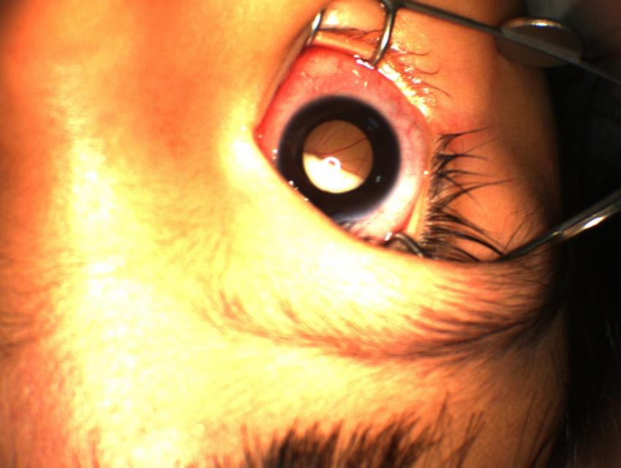
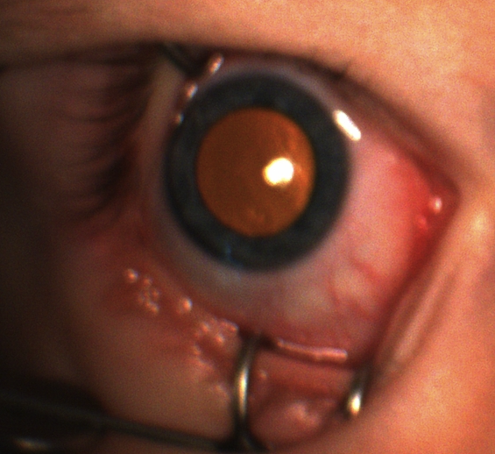
COLOR OF THE REFLEX
LEUKOCORIA
XANTHOCORIA
Notes:
RB: leukocoria

Slide 43
Anterior Chamber
Retinoblastoma
Coats Disease
J Pediatr Ophthalmol Strabismus. 2001 Sep-Oct;38(5):262-6; quiz 302-3.
Differentiation of coats' disease and retinoblastoma.
Shields JA1, Shields CL.
Notes:
RB: Rare white cells with hypopyon
Coats: Rare cholesterol crystals

Slide 44
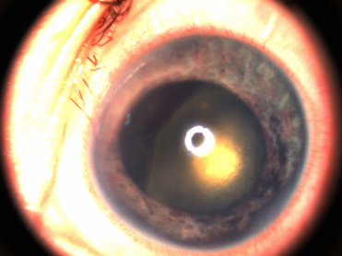
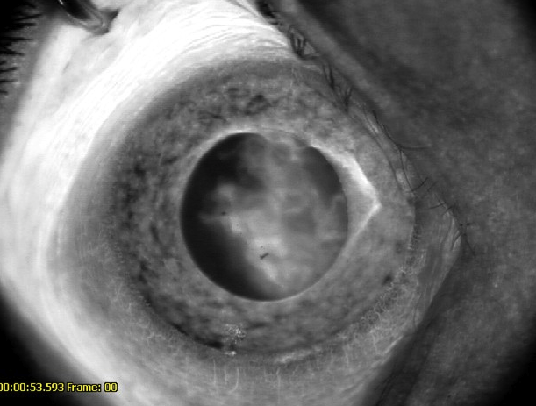
NVI
Retinoblastoma: 17 %
Coats Disease: 8 %
Notes:
RB: Rare white cells with hypopyon
Coats: Rare cholesterol crystals

Slide 45
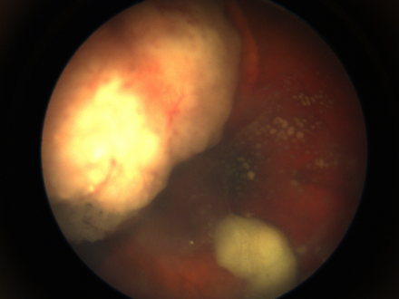
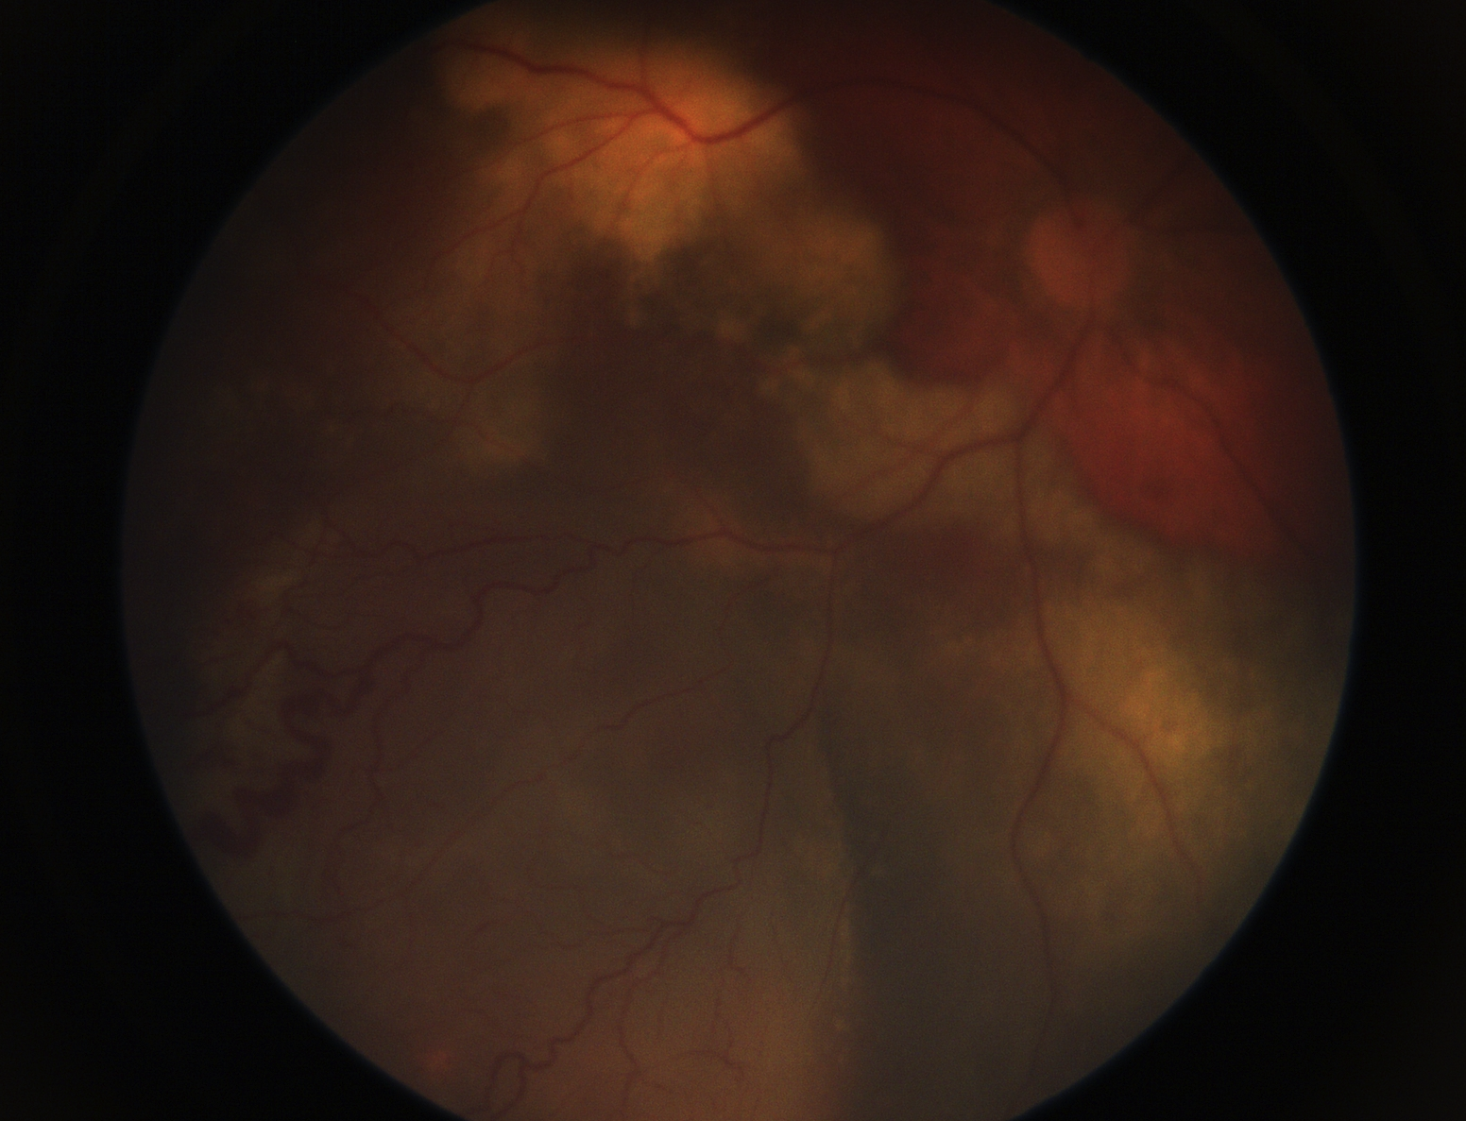
Retinoblastoma
Coats Disease
Notes:
RB: White fluffy seeds in vitreous
Coats: clear vitreous

Slide 46
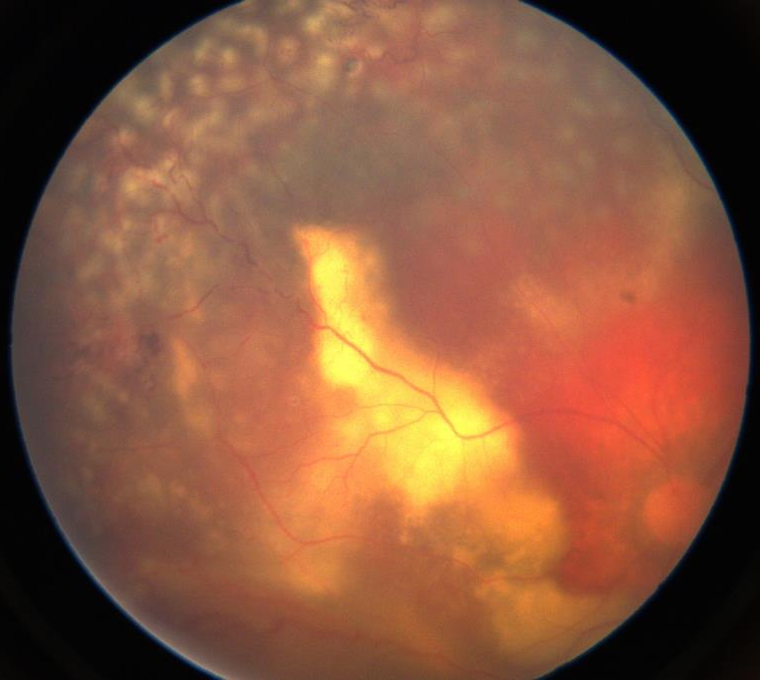
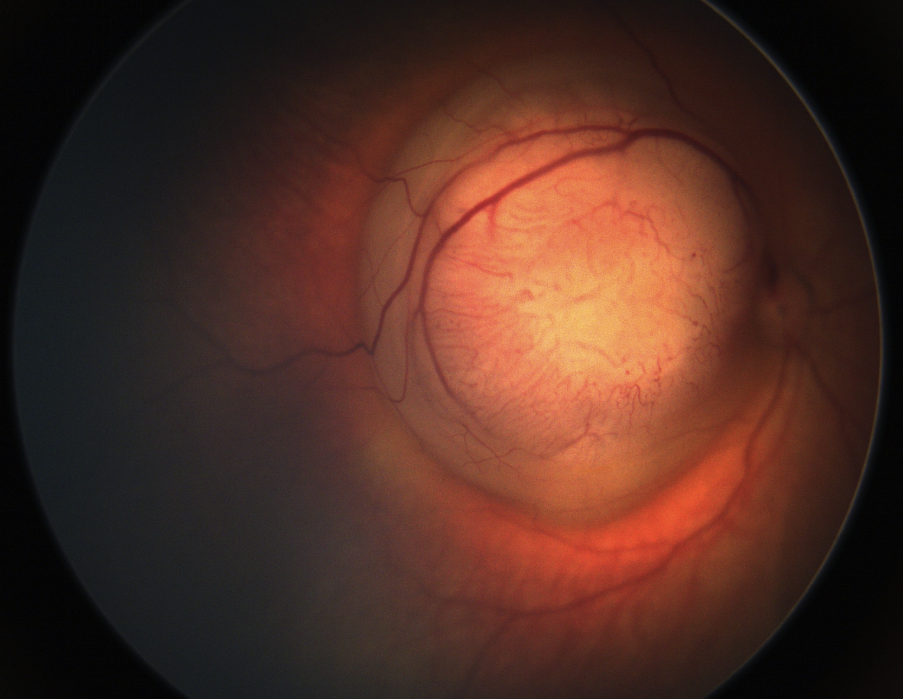
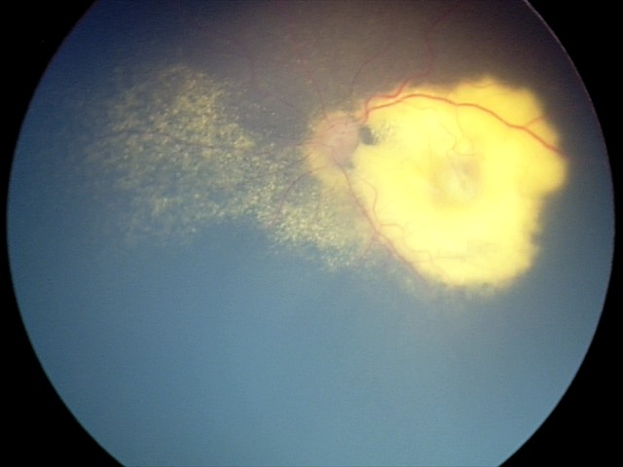
Retinoblastoma
Coats Disease
Notes:
RB: Mass, but no exudation
Coats: No mass, may present as subretinal gliotic nodule. Exudation

Slide 47
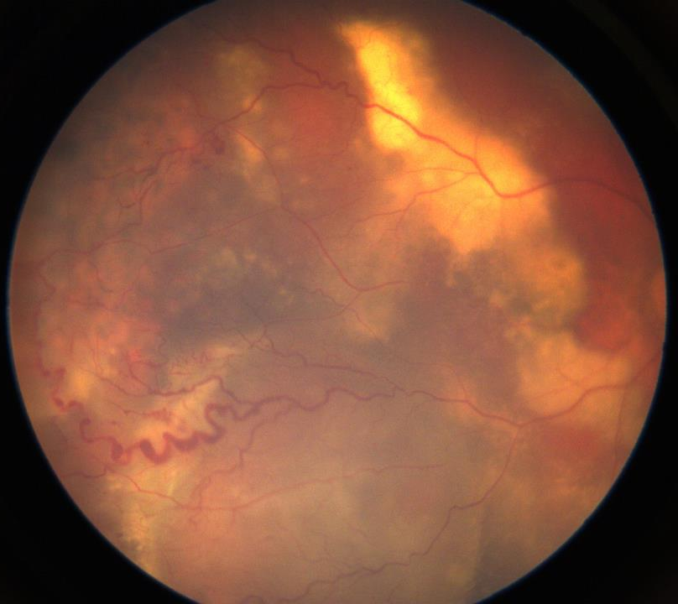
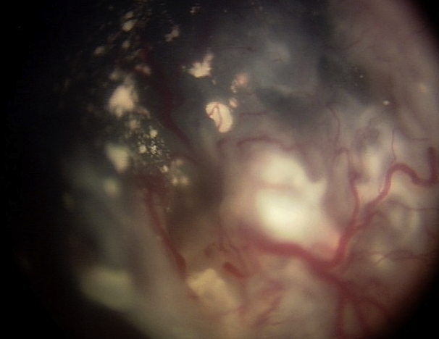
Retinoblastoma
Coats Disease
Notes:
RB:. Subretinal with faint whire free floating seeds. Dilated feeding artery and tortuous draining vein. Dips down and disappears into the tumour
Coats:. Subretinal fluid golden yellow with cholesterol. Can see the vessel in its entire course. Irregular dilation with telangiectasia

Slide 48
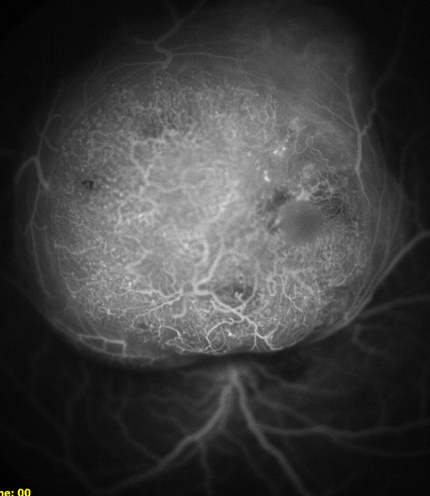
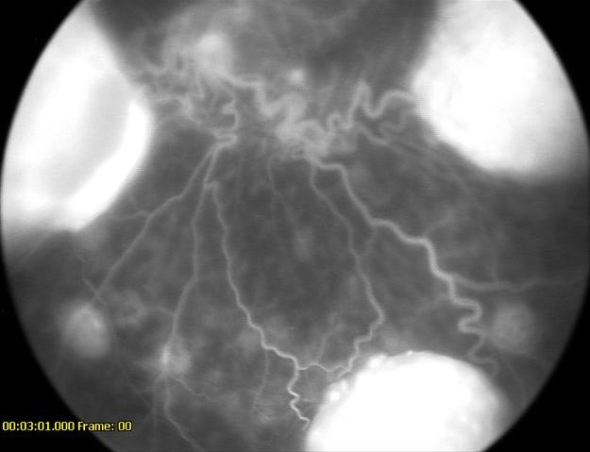
Retinoblastoma
Notes:
RB:
Early arterial filling within tumor with leakage on venous phase. Late phase demonstrates intense well-circumscribed, hyperfluorescence of tumor

Slide 49
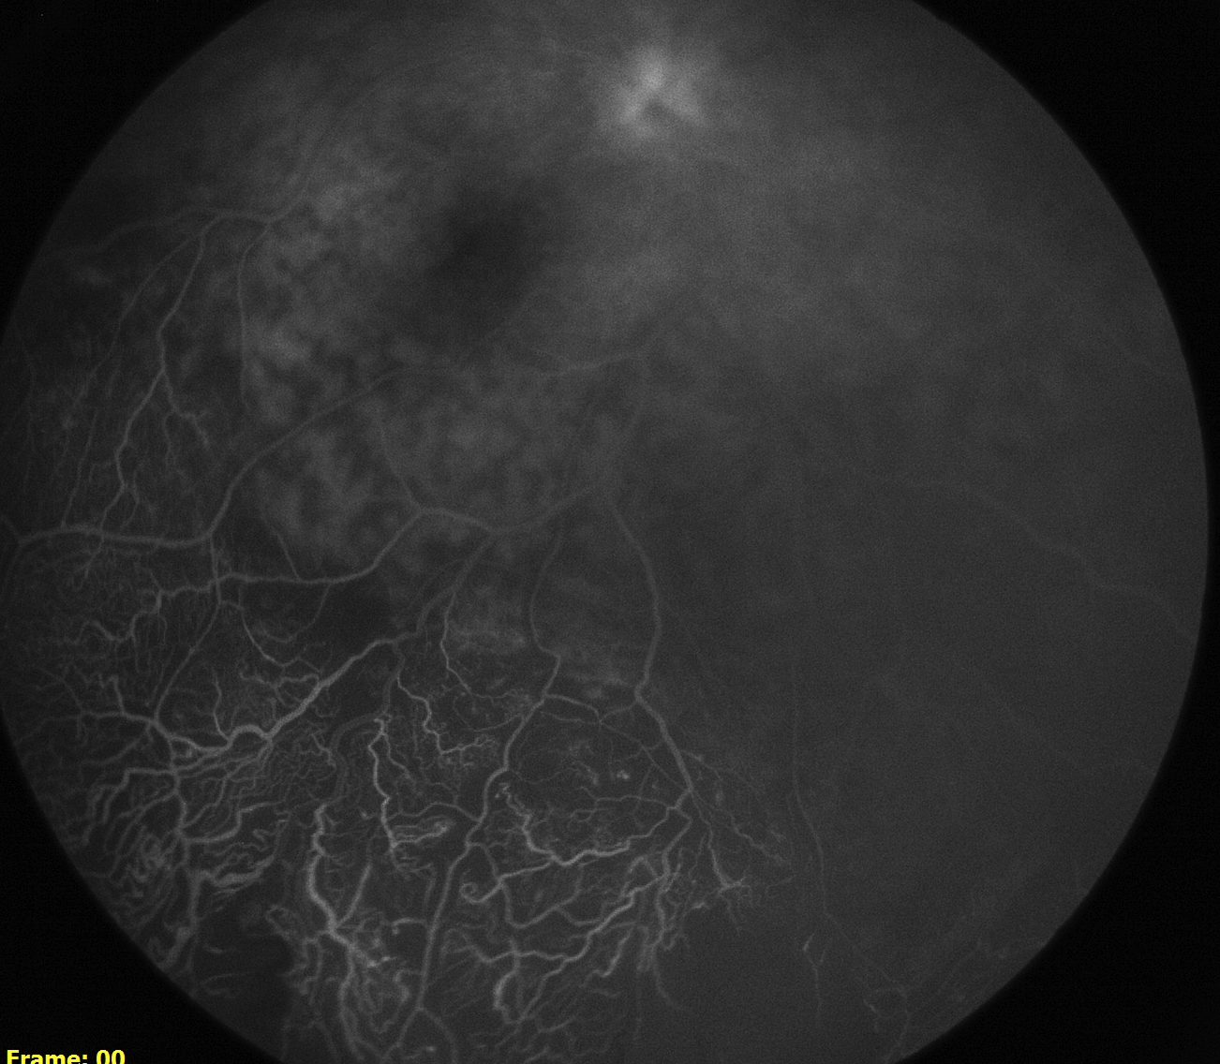
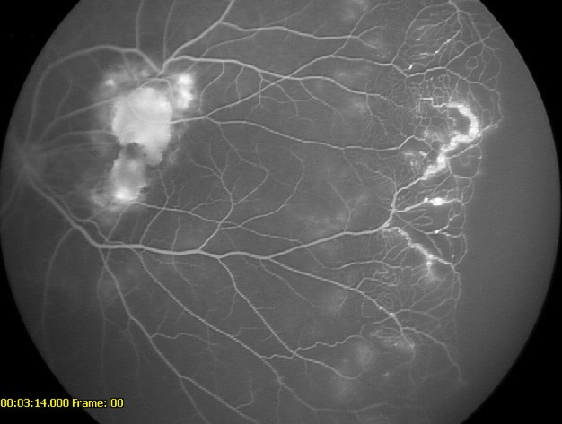
Coats Disease
Notes:
Coats:
Early arterial and venous phase demonstrate areas of nonperfusion and arterial and venular telengiectasia with light bulbs. Late phase shows leakage of dye

Slide 50
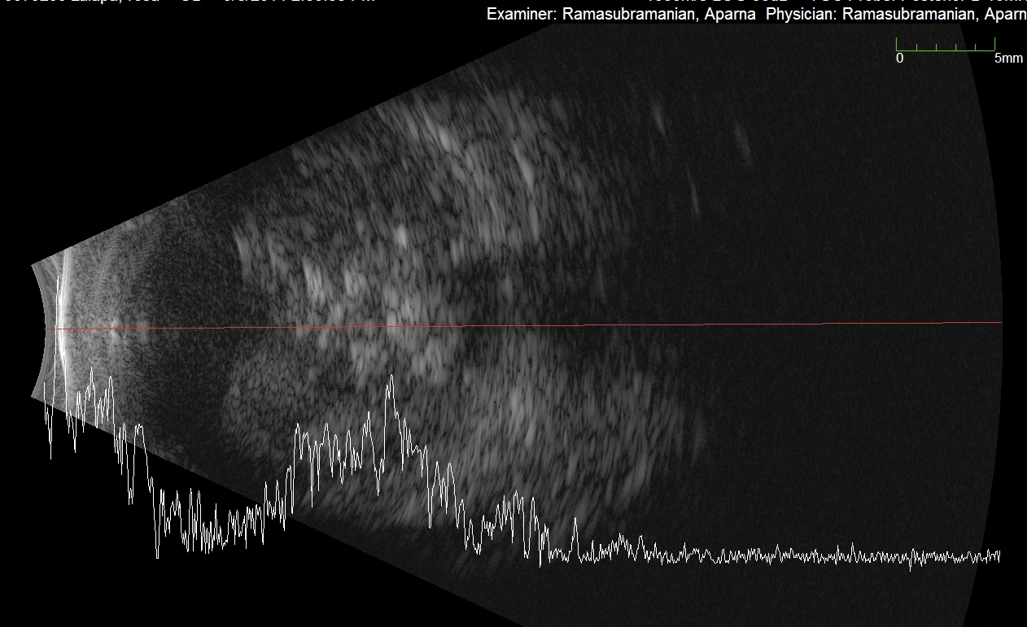
Retinoblastoma
Notes:
RB:
Solid retinal mass with intratumoral calcifications (high intesity echoes)
Retinal detachment

Slide 51
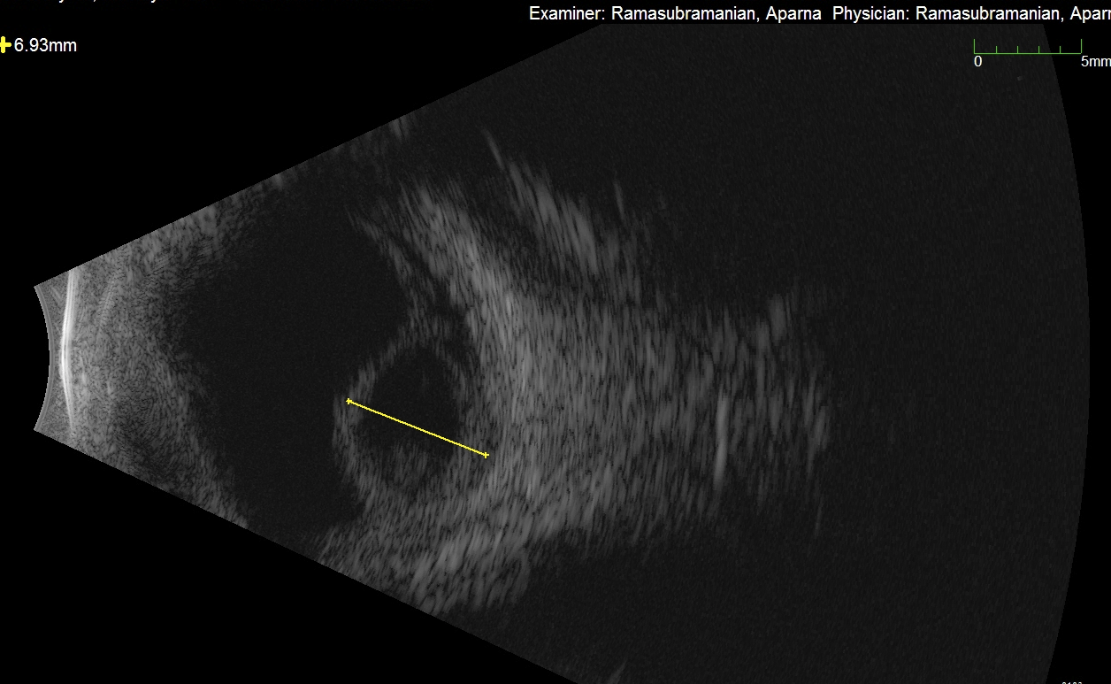
Coats Disease
Notes:
Coats:
Retinal detachment, subretinal opacities due to cholesterlosis
Rarely, linear calcification at level of RPE

Slide 52
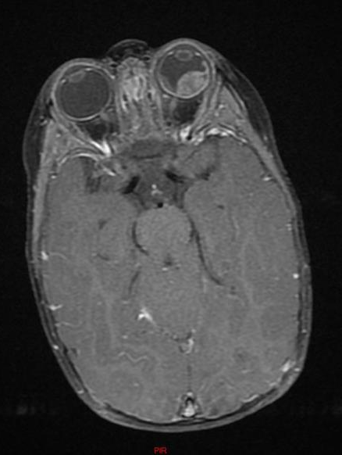
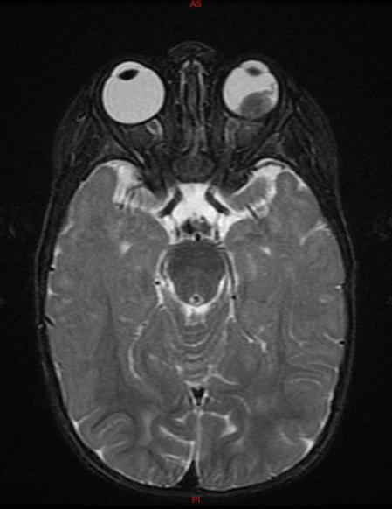
Retinoblastoma
Notes:
RB
T1- isotense or slighlty hyperintense to vitreous
T2-hypointense to vitreous

Slide 53
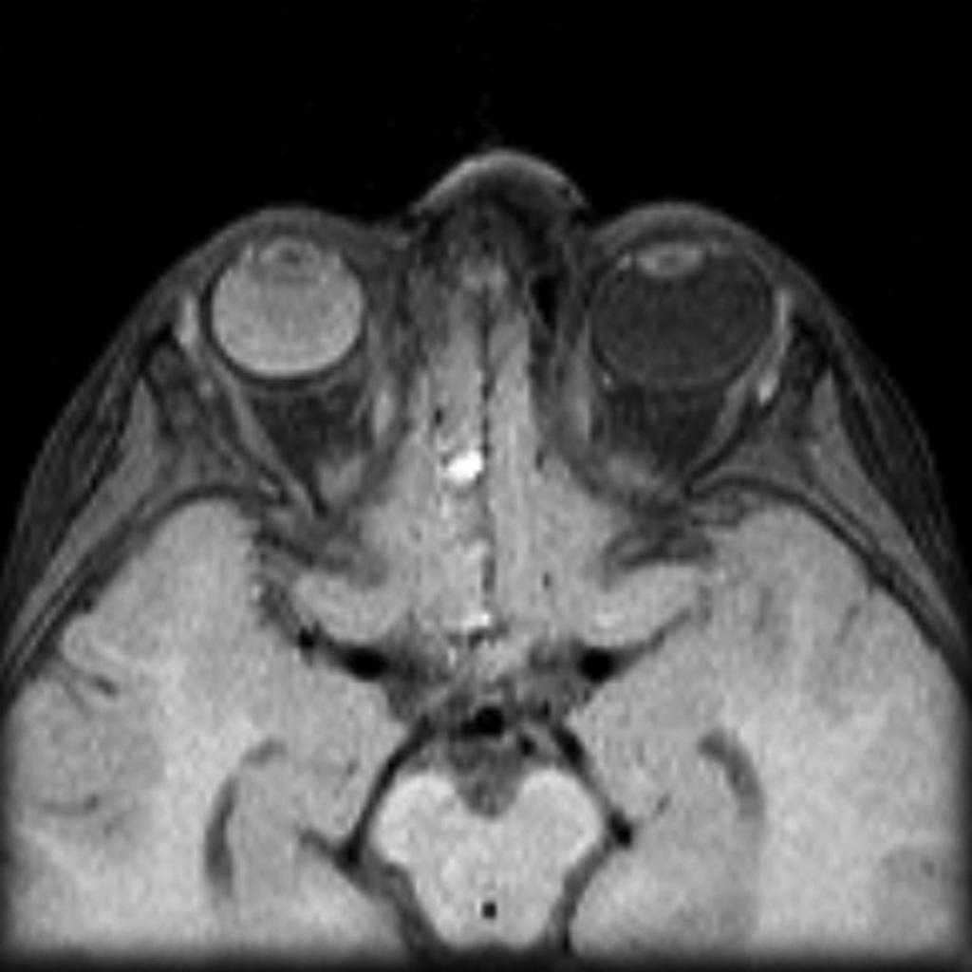
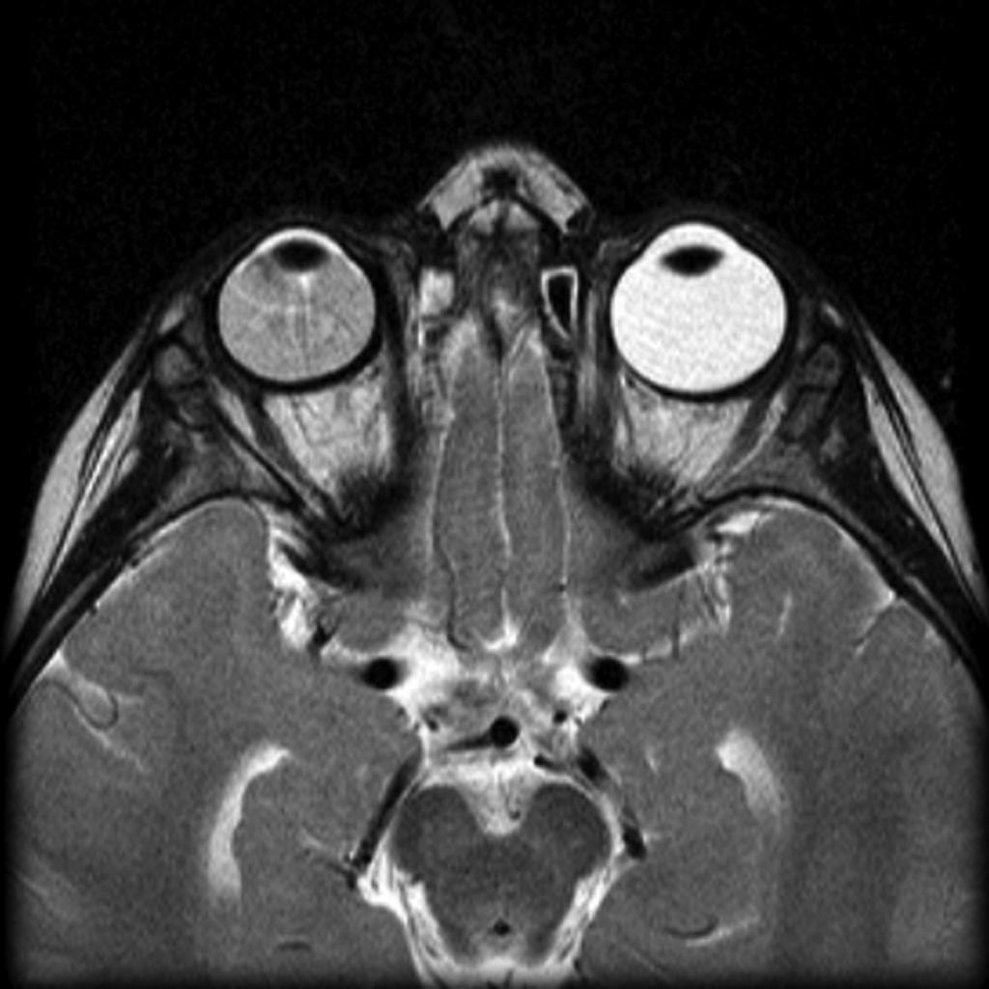
Coats Disease
Case courtesy of Dr Michael Sargent, Radiopaedia.org, rID: 6089
Notes:
Coats:
T1 and T2- hyperintense to vitreous due to exudates

Slide 54
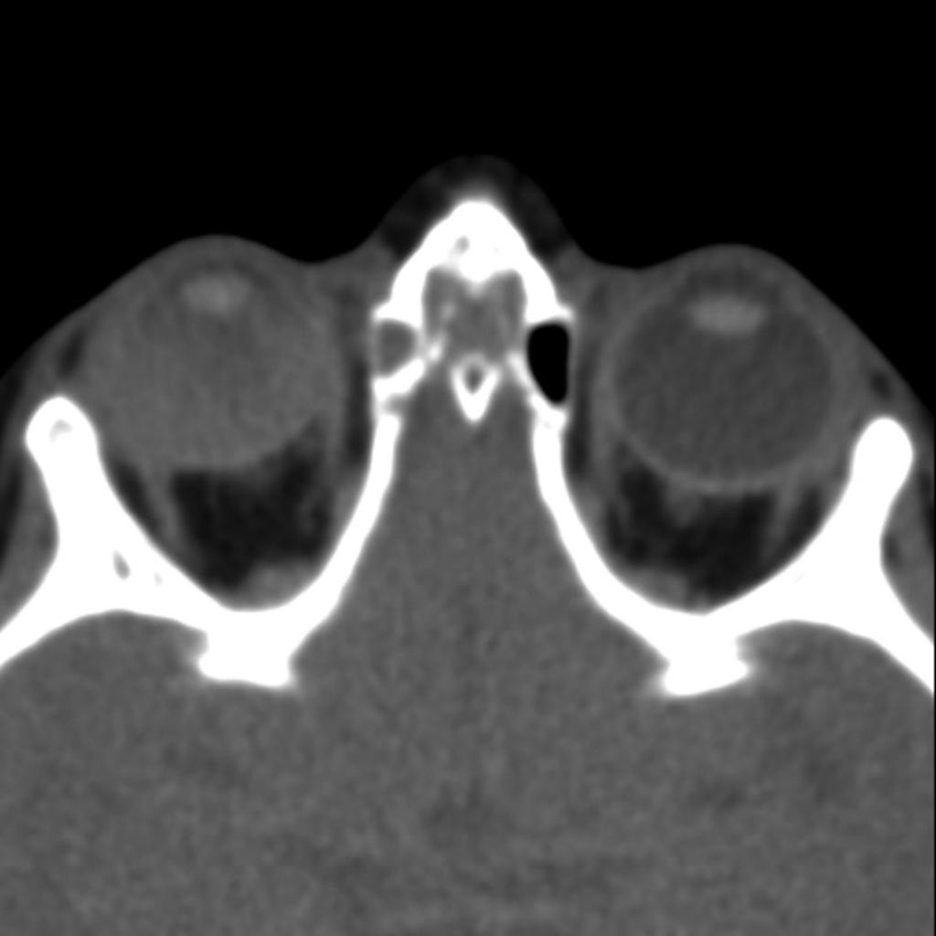

Retinoblastoma
Coats Disease
Case courtesy of A.Prof Frank Gaillard, Radiopaedia.org, rID: 9764
Case courtesy of Dr Michael Sargent, Radiopaedia.org, rID: 6089
Notes:
RB: Hyperattenuated intraocular mass with calcifaction
Coats: Retinal detachment with hyperattenuating subretinal exudates. No calcification

Slide 55
Coats Disease
Stage | VA 20/200 or worse
Stage 1. Retinal telangiectasia only | 0%
Stage 2. Telangiectasia and exudation | 30-66%
Stage 3. Exudative retinal detachment
A. Subtotal detachment | 70
B. Total detachment | 94
Stage 4. Total detachment and glaucoma | 100
Stage 5. Advanced end-stage disease (pre-pthisis) | 100
Shields JA, Shields CL, Honavar SG, Demirci H, Cater J. Classification and management of Coats disease: The 2000 Proctor Lecture. Am J Ophthalmol 2001;131:572-583.
Notes:
150 patients (158 eyes) in the series, Stage 2. foveal or extra foveal involvement
Stage 1 or 2
Goal is prevention of retinal detachment by laser photoablation or cryotherapy
Stage 3 (or 4)
Cryotherpay plus intravitreal therapy (e.g., intravitreal triamcinolone or anti-vascular endothelial growth factor agents)
before or at the time of ablation
Vitreoretinal surgery for total retinal detachment or significant epiretinal membrane
Stage 4
Role of cyclodiode treatment?
Stage 4 or 5
Enucleation for blind painful eye

Slide 56
Conclusions
Coats is an idiopathic retinal telangiectasia associated with intraretinal exudation and frequent exudative retinal detachment
Important to differentiate from Retinoblastoma:
  A good clinical history and exam, complemented by appropriate imaging will prevent in misdiagnosis and mismanagement.

Slide 57
References
Shields JA, Shields CL, Honavar SG, Demirci H. Clinical variations and complications of Coats’ disease in 150 cases: The 2000 Sanford Gifford Memorial Lecture. Am J Ophthalmol 2001;131:561-571.
Shields JA, Shields CL, Honavar SG, Demirci H, Cater J. Classification and management of Coats disease: The 2000 Proctor Lecture. Am J Ophthalmol 2001;131:572-583.
Ghorbanian S1, Jaulim A, Chatziralli IP. Diagnosis and treatment of coats' disease: a review of the literature. Ophthalmologica. 2012;227(4):175-82.
Shields JA1, Shields CL. Differentiation of coats' disease and retinoblastoma.J Pediatr Ophthalmol Strabismus. 2001 Sep-Oct;38(5):262-6; quiz 302-3.

