Slide 1
Lessons in Ophthalmology Advocacy from Frankfort to D.C.
Mark Mugavin, MD, MPH
July 24, 2017

Slide 2
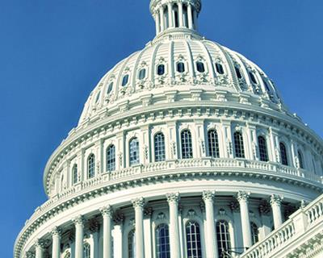
What is Advocacy?
Voice for our patients
Protect our profession
Safeguard public health
Ensure access to care
Speed access to innovative treatments

Slide 3
KAEPS Lobbying Day
March 8,2017 approximately 20 Ophthalmologists from across the Commonwealth met with state legislators to advocate for healthcare policy bills
University of Louisville DOVS
Dr. Charles Barr
Dr. Tala Kassm
Dr. Mark Mugavin
Event organizers (KAEPS)
Director Jamie Ennis Bloyd
President Dr. Frank Burns

Slide 4
Key Legislative Efforts
SENATE BILL 4
Establishes panel of three medical professionals chaired by lawyer to review cases of medical error or neglect
Findings admissible as evidence but plaintiff can still proceed with case if no wrongdoing found
GOALS
Reduce backlog of frivolous lawsuits
Create more provider friendly environment for the state

Slide 5
Kentucky State Senator Julie Adams District 36 and her constituents

Slide 6
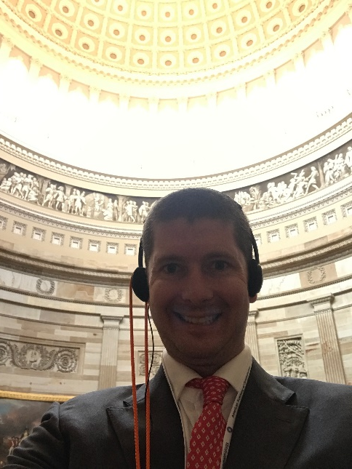
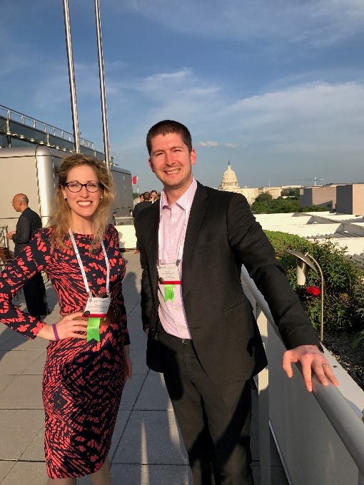
Mid-Year Forum
Washington D.C.
April 26-29

Slide 7
Advocacy Ambassador Program
Collaboration between:
American Academy of Ophthalmology
State Ophthalmology Societies
Ophthalmic Subspecialty & Specialized Interest Societies
Training Programs

Slide 8
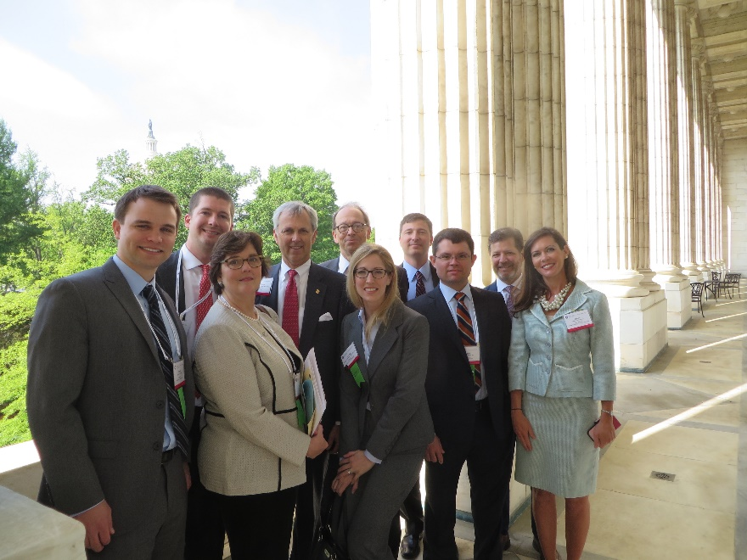
Goals: Advocacy Ambassador Program
Learn about current legislative issues
Meet with legislators
Network with colleagues
Learn about the impact of state ophthalmology societies

Slide 9
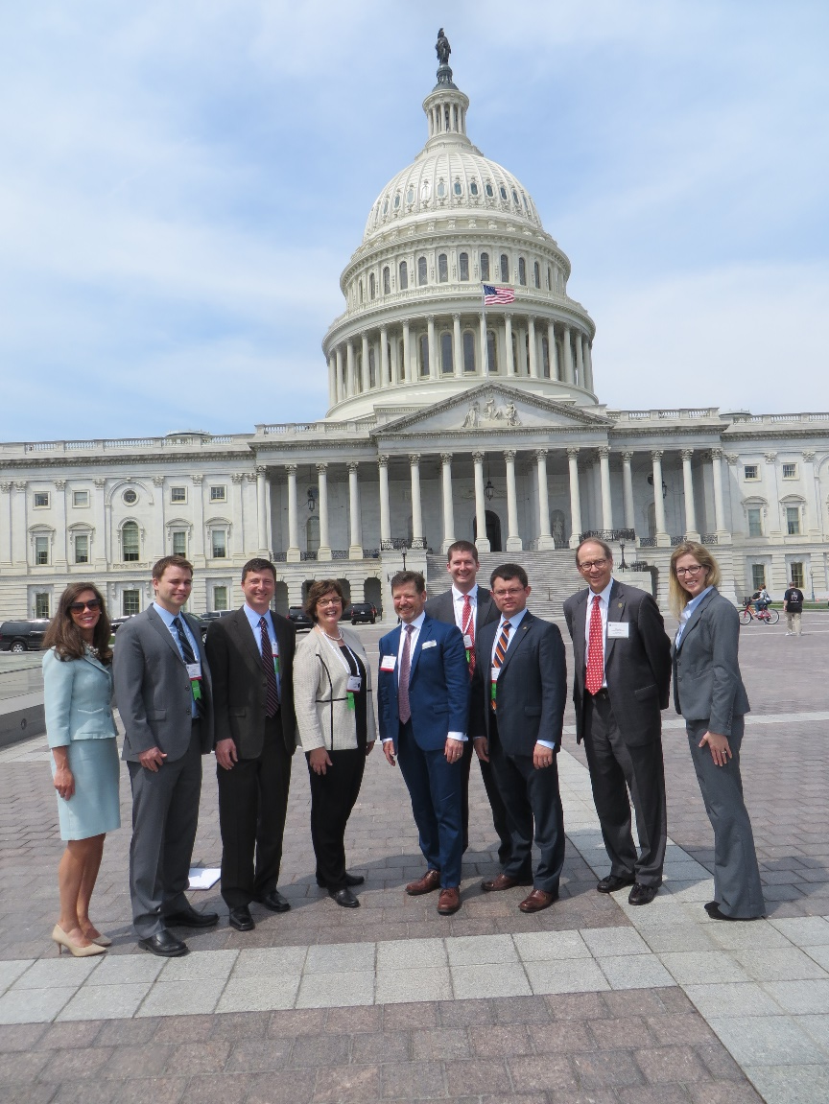
Midyear Forum 2017
Congressional Advocacy Day
Politics, Policy & Practice Management Sessions
L.E.A.P. Forward for Advocacy Ambassadors
Council Meetings

Slide 10
What issues were discussed?
Regulatory & Penalty Relief from Onerous Medicare Quality Reporting Requirements
The Academy is pressing HHS & CMS to provide physicians with relief from regulatory burdens & payments penalties in 2018

Slide 11
https://www.aao.org/practice-management/regulatory/mips/quality-reporting-measures?tid=8b6cd48a-0064-4135-b1d8-c930a0776dbf

Slide 12
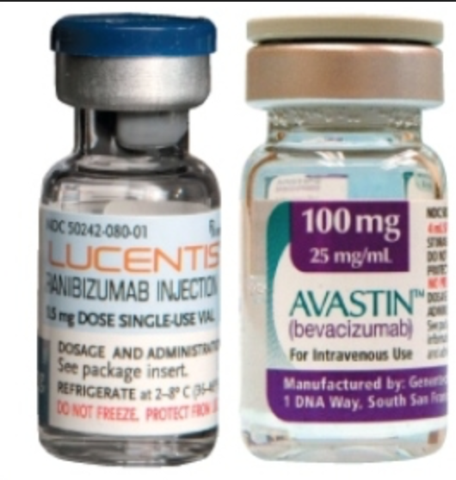
What issues were discussed?
FDA Implementation of Drug Quality & Security Act Threatens Timely Access to Compounded & Repackaged Drugs
Ophthalmologists want access to safe and effective compounded drugs.
Timely access to compounded and repackaged drugs for office use is critical for the treatment of a variety of blinding eye diseases.
Support the Stewart-Carter letter urging the FDA to reconsider its prescription requirement policy for traditional compounding pharmacies.

Slide 13
What issues were discussed?
Prescription Drug Pricing
Need for greater transparency of drug costs and pricing
Lobbied members to co-sponsor
H.R. 759 “Lower Drug Costs through Competition Act”
S. 297 “The Increasing Competition in Pharmaceuticals Act”

Slide 14
What issues were discussed?
National Institute of Health
Lobby Congress to support increased funding to NIH by $2 billion for fiscal year 2017 and 2018
Ask for continued funding of $800 million for National Eye Institute
UofL Dept. of Ophthalmology NEI Studies:
-CATT AMD Treatment trial
-Ocular Hypertension Treatment Trial
-Utilizing Telemedicine for detection of ROP

Slide 15
Our Representatives
U.S Congressmen Andy Barr of 6th Congressional District

Slide 16
Our Representatives
U.S. Congressmen John Yarmuth of 3rd District

Slide 17
Our Representatives
U.S. Senator Dr. Rand Paul

Slide 18
Early Results
Congress finalized an omnibus appropriations bill for the remainder of FY2017
Includes $2 billion increase for NIH
Six House members have signed the Roe Regulatory Relief letter

Slide 19
Early Results

Slide 20
Early Results
815 page Fee Schedule from CMS just released July 2017. https://www.aao.org/advocacy/medicare-fee-schedule/2018

Slide 21
Lessons Learned
There are powerful and well funded forces influencing policy decisions that are in direct opposition of what you might think is common sense for practicing quality medicine.
Advocacy is easier than you think; it just takes a conscious effort and appreciation of its impact.
Our elected officials truly enjoy hearing the physicians’ perspective.

