Slide 1
Corneal Ulcers in Methamphetamine Use
Lara Rosenwasser Newman MD
August 19, 2016

Slide 2
Patient Presentation
CC:
Decreased vision OD
HPI:
22 year old Caucasian female, known Hep C +, heroin abuser, presents with pain, redness, photophobia, and decreased vision OD

Slide 3
Extended HPI
No history of contact lens use, or freshwater exposure
No past ocular history other than refractive error
Outside hospital noted hypopyon, periorbital edema, chemosis, central corneal ulceration, purulent discharge
They gave 1 g Vancomycin IV, 380 mg Gentamicin IV

Slide 4
History (Hx)
Past Ocular Hx: refractive error
Past Medical Hx: Hep C, IV drug use
Fam Hx: non-contributory
Meds: none
Allergies: none
Social Hx: history of sexual, physical, and emotional abuse in past, substance abuse “anything”
ROS: negative

Slide 5
External Exam
 | OD |  | OS
VA near sc | LP |  | 20/20
Pupils | No view | No rAPD | 4→2mm
IOP | 14 mmHg |  | 14 mmHg

Slide 6
Anterior Segment Exam
PLE or SLE | OD |  | OS
External/Lids | WNL |  | WNL
Conj/Sclera | Very injected (4+) |  | Clear/white
Cornea | Large central ulcer surrounded by dense infiltrate |  | Clear
Ant Chamber | hypopyon |  | Deep & quiet
Iris | Difficult to assess |  | WNL
Lens | Difficult to assess |  | clear

Slide 7
Posterior Segment Exam
Fundus | OD |  | OS
Optic Nerve | UTA |  | C/D 0.2, pink & sharp
Macula | UTA |  | WNL
Vessels | UTA |  | WNL
Periphery | UTA |  | WNL
UTA = unable to assess

Slide 8
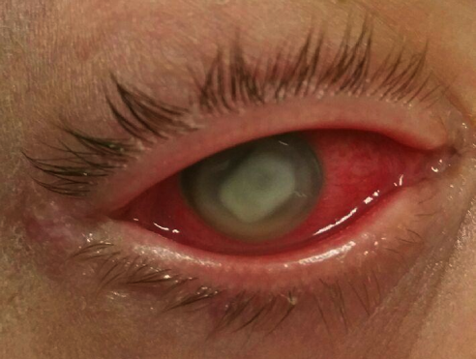
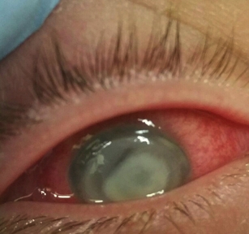
Clinical photos OD

Slide 9
Assessment
Corneal ulcer with hypopyon OD
Differential Diagnosis:
Bacterial vs fungal ulcer/keratitis
Mechanism: patient eventually admits to repeatedly scratching/picking at her eye while using methamphetamine

Slide 10
Plan
Admitted for administration of:
Fortified vancomycin q1h
Fortified tobramycin q1h
Natamycin q1h
Medicine team on board for management of anticipated withdrawal symptoms

Slide 11
Clinical Course
Rare coagulase-negative staphylococcus on culture
Was in-house 6 days, medicine managed opioid withdrawal, discharge with careful medication instructions to continue drops and not scratch eye
Then disappeared for 2 months

Slide 12
Reappears 2 months later
States she poured tap water in her left eye when it was itchy, continued to rub it and pick at it while high
Admits to both methamphetamines and IV heroin
Only used fortified gtts and natamycin occasionally
Exam: HM OU, complete opacification/pannus OD, OS with large corneal ulcer, corneal melting, descemetocele, scleral extension of infection
Started on IV Ceftriaxone and Vancomycin due to concern for endophthalmitis; also concern for impending perforation

Slide 13
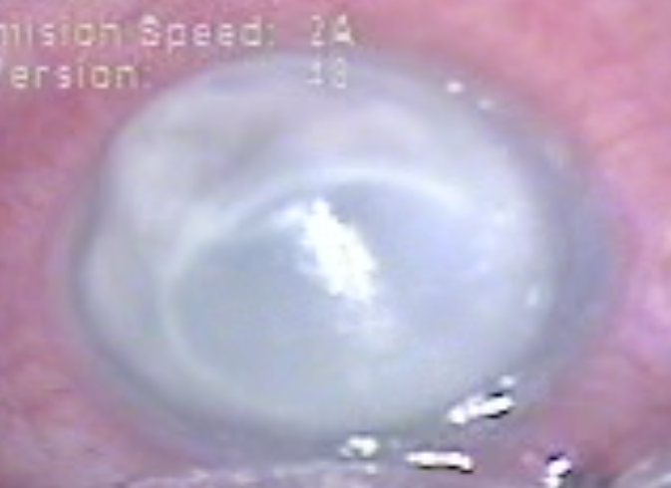
OS on 2nd presentation

Slide 14
Hospital Course #2
Admitted by family medicine with ophthalmology consult
Ultimately perforated OS, went to OR for PK
9.0 mm trephine for host, 9.5 mm for donor
Retina fellow present, gave intravitreal ceftazidime and vancomycin
Also received subconjunctival Kefzol and Vancomycin

Slide 15
Hospital Course #2 Continued
Seen by psychiatry who felt she had a “grief reaction”
Sent home on gabapentin 300 mg TID, Vigamox q3h OS, prednisolone acetate 1% q4h OS, fortified vancomycin q3h OS
Patient and husband due to “living far away/homelessness” agreed to stay in Louisville in a homeless shelter
Eye culture OS ultimately returned positive for preliminary Candida albicans, & Candida glabrata (torulopsis)

Slide 16
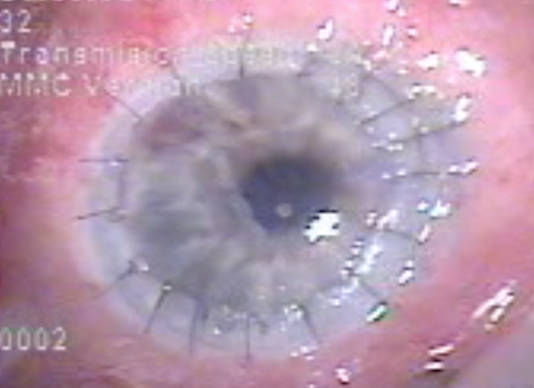
Post-op OS

Slide 17
Post-op Course
1 week post-discharge (10 days post-PK) came to office
Only knew of being on prednisolone QID
OD LP, OS CF@2’, PH 20/200, PK OS, loose suture, no hypopyon
Disappeared AGAIN for 3 weeks, no-showed office appt
Appeared at ER 2 days after no-showing, OD NLP, OS CF
Unclear frequency of fortified antibiotics, should have run out
OD: diffuse corneal scarring
OS: Corneal ulceration PK at graft-host junction 2-10 o’clock, 2 loose sutures, corneal melting at 3 o’clock, hypopyon
Loose sutures removed, started on fortified vancomycin and tobramycin q1h OS, cyclopentolate 1% OS BID

Slide 18
5 weeks post-PK
Came to 1 week follow-up appt
PK OS with “corneal ulcer (total)”
B-scan OS with inflammatory cells
Cultures from 1 week prior at ER negative for bacteria or fungus, 4+ WBCs present
Continued Vanc and Tobra, started natamycin OS
Also given Ciprofloxacin 500 mg BID po x 7 days

Slide 19
3 months post-PK
Non-compliant with drops and LP OU
Corneal melting OU
Still with ulcer OS
Rx Vig q3h and Nata q1h
Cultures taken OS

Slide 20
Most recent updates
Was scheduled for PK OD
Has now no-showed surgery twice

Slide 21
Discussion: Corneal Injuries in Methamphetamine Use*
Poulsen, Mannis & Cheng reported 4 cases of severe corneal ulceration in methamphetamine abusers in 1996 (Cornea)
Case 1: Capnocytophaga keratitis and liquefactive necrosis
Methamphetamine inhalation only, also cigarette smoker
Case 2: ulcer → ant uveitis w/hypopyon → descemetocele → perf → glue → re-perf → PK
grew Candida albicans and P. acnes
Admitted to rubbing and “picking” at eye constantly for around 1 month prior to presentation
Meth use by IV and inhalation
*Excluding meth lab explosion burn injuries

Slide 22
Corneal Injuries in Meth Use
Case 3: Pseudomonas corneal abscess, ulcer, hypopyon
PK → ulcer recurred (Staph aureus & Strep viridans) → repeat PK
Other eye previously enucleated for panendophthalmitis w/uveal prolapse through perf
Long history IV meth
Case 4: infiltrate, hypopyon, edema, corneal opacification, post synechiae →conj flap, PK, CE/IOL, pupilloplasty
Grp D Strep aka Enterococcus
Same eye 19 months prior had ulcer requiring PK
Graft failed due to infection w/Morganella morganii
Meth use – inhalation only

Slide 23
4 categories of factors:
1) Direct pharmacologic and physical effects
Potent vasoconstrictor → decreased ocular perfusion, vasculitis
Elevates pain threshold → may disrupt normal blink
Users are hyperstimulated → fixate on FBS, rub/scratch
Drug is base often sold as HCl salt → chemical burn
May damage nerves via effects on dopamine & serotonin receptors

Slide 24
4 categories of factors:
2) Toxic effects of cutting agents
Lidocaine & procaine predispose to corneal ulcers (anesthetics)
Strychnine and bicarbonate → chemical burns
Quinine → photophobia, scotomas, retinal edema, optic atrophy
Caffeine, ephedrine, phenylpropanolamine → incr vasospasm

Slide 25
4 categories of factors:
3) Effects related to route of admin (smoking, inhalation, IV)
Risk of drug-to-hand-to-eye exposure
IVDU → embolization, infection
Inhalation/snorting can lead to amaurosis fugax, retinal vasculitis
Smoking → irritation, damage to corneal epithelium
IVDU = Intravenous drug use

Slide 26
4 categories of factors:
4) Caustic contaminants in final product related to manufacturing
Corrosives such as sodium hydroxide or sulfuric acid
Solvents such as acetone and benzene
Metals such as mercury and red phosphorus
Salts such as sodium cyanide

Slide 27
Conclusions
This type of injury can cause irreversible vision loss
Admitting patients for eye drops – where’s the limit?
These patients need psychiatric help!
Counseling
Appropriate medications
Drug rehab
Family support
RESTRAINTS!
Supervision of delusional and psychotic patients in hospital
Prompt psychiatric care when these patients present

Slide 28
References
Poulsen EJ, Mannis MJ, Chang SD. Keratitis in methamphetamine abusers. Cornea. 1996 Sep;15(5):477-82. PubMed PMID: 8862924.

Slide 29
THANK YOU!

