Slide 1
Grand Rounds Conference Headache and Diplopia
Reema Syed
December 16, 2016

Slide 2
Subjective
CC
Left-sided headache for 2 weeks
Double vision for 2 days
HPI
24 yr/o female with worsening achy left frontal and retro-orbital pain x 2 wks
New onset binocular oblique diplopia that resolves with covering either eye.
Pertinent negatives: trauma, nausea/vomiting, pain with eye movements

Slide 3
History
Past Medical History: Fibrous dysplasia of frontal and ethmoid sinuses
Medications: oral contraceptives, Hydrocodone/Acetaminophen
Allergies: Penicillin
Family History: non-contributory
ROS: negative

Slide 4
Exam
OD OS
BCVA: 20/20 20/20-2
Pupils: tr RAPD OS
IOP (mmHg): 12 10
EOM:
Color vision: 6/6 5/6
Anterior Segment: WNL WNL
0
0
-2
-3
0
0
-1
-3
0
0
-2
-3

Slide 5
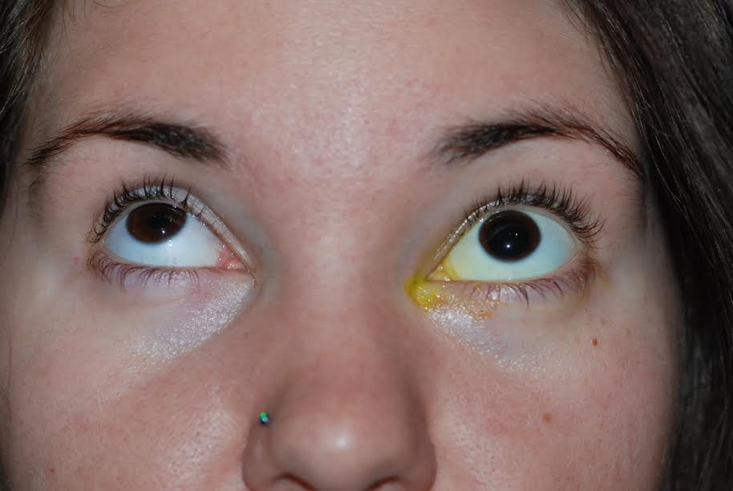
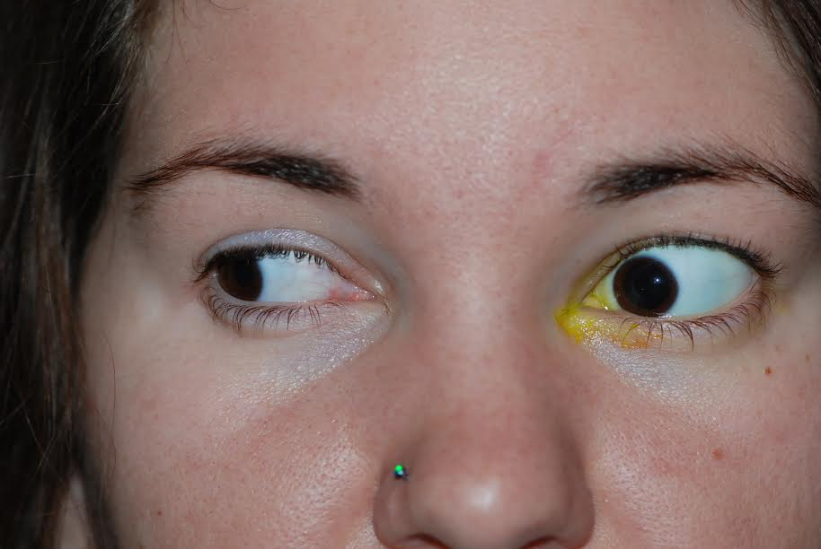
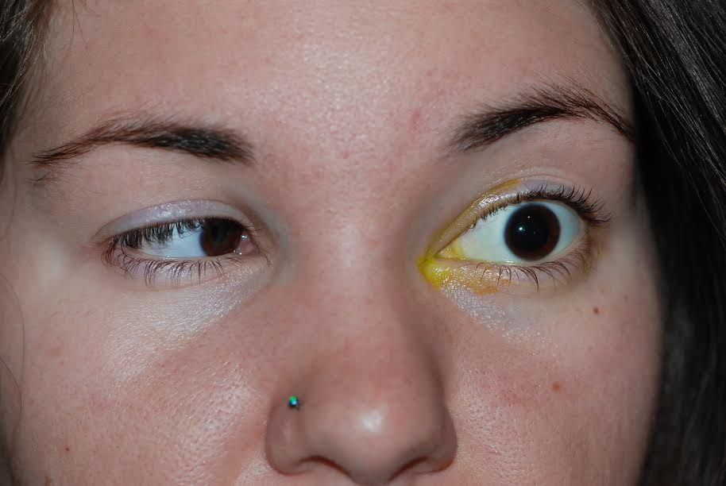
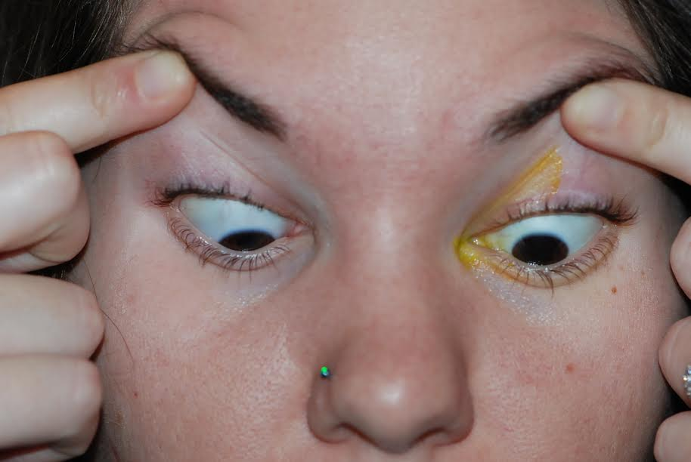
Primary gaze: Esotropia 16 PD, Left hypertropia 12 PD
Differential IOP: 10 mmHg primary gaze, 24 mmHg upgaze, 20 mmHg abduction

Slide 6
Dilated Fundus Exam
OD: WNL
OS: grade 2 disc edema

Slide 7
Assessment
24 year female with left retro-orbital pain, mechanical strabismus with possible left optic neuropathy OS
DDx:
Fibrous dysplasia with growth or secondary malignant transformation
Plan:
MRI brain and orbits

Slide 8
Follow-up
Patient presented 2 days later with loss of vision to CF@ 2ft OS, 2+ RAPD, increased optic disc edema
Started on Prednisone 60 mg qday

Slide 9
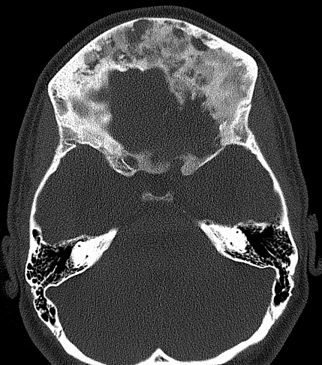
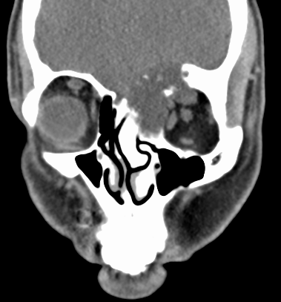
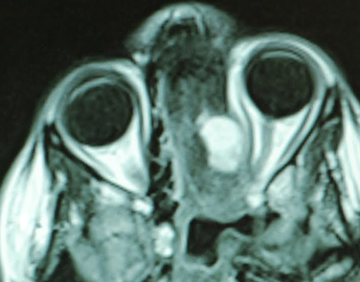
Follow-up
Normal brain parenchyma
Groundglass appearance of frontal bones, frontal sinuses and left ethmoid air cells, compatible with fibrous dysplasia.
T1 with Gadolinium: enhancing mass encroaching on and crowding left orbital apex

Slide 10
Follow-up
Combined approach with neurosurgery
Craniotomy with left orbital decompression
Debulking of fibrous dysplasia
Removal of cystic structure along optic canal
Orbital roof left unrepaired to allow for decompression

Slide 11
Pathology
Fibrous dysplasia with secondary aneurysmal bone cyst
Notes:
cellular fibrous stroma surrounding irregular trabeculae of woven bone, arranged in a “Chinese characters” pattern

Slide 12
Follow-up
Staged strabismus surgery:
Left inferior rectus recession (6mm)
Developed >50 PD left hypotropia due to scarring and 8PD Esotropia
Left superior rectus resection (8mm) + medial rectus recession (4 mm on adjustable suture)

Slide 13
6 month follow-up
BCVA 20/25 OS
Residual left hypotropia, left upper lid ptosis
Planned right superior rectus recession

Slide 14
Fibrous Dysplasia
Benign disorder of bone - normal bone is replaced by fibrous tissue with islands of immature woven bone.
2.5% of primary bone tumors in the first 3 decades of life
Most commonly affects long bones of the extremities or the craniofacial skeleton.
Notes:
It represents 2.5% of primary bone tumours and occurs predominantly in the first 3 decades of life
mutation at the α-subunit of the G-protein receptor results in an increase of cAMP, causing hyperproliferation of abnormal osteoblasts

Slide 15
Fibrous Dysplasia
Three forms:
monostotic (single skeletal site): 75%
polyostotic (multiple sites): 20-25%
McCune Albright Syndrome (polyostotic fibrous dysplasia with endocrine dysfunction and café au lait spots): 3%
Notes:
Equal prevalence in males and females although Mc Cune Albright syndrome more commonly affects females
Precious puberty is the most frequent hyperfunctioning endocrinopathy; others include acromegaly, hyperthyroidism, diabetes, hyperparatuitarism, hypercalcemia, and adrenal disorders.

Slide 16
Pathophysiology
Activating somatic mutation of a gene on chromosome 20, encoding stimulatory G protein.
Triggers an arrest of typical bone maturation.
Functionally impaired osteoblasts that produce spicules of poorly organized bone.

Slide 17
Signs and Symptoms
Pain, swelling and disfigurement
Headache, proptosis, nasal obstruction, extraocular muscle palsies, trigeminal neuralgia and epiphora.
Most common neurologic complications: visual impairment and hearing loss

Slide 18
Prognosis
Generally considered a benign, pediatric disease that becomes dormant by adulthood
Malignant transformation (incidence of 0.4% to 6.7%): osteosarcoma, fibrosarcoma and chondrosarcoma
Benign but locally aggressive aneurysmal bone cysts (rare case reports)
Notes:
cause weakening of the bony structure, and expansion can cause pain, swelling, deformity, neurological symptoms and pathological fracture

Slide 19
Thank you

