Slide 1
Grand Rounds
An Unusual Uveitis
Nicole Clements Jody
August 18, 2017

Slide 2
Patient Presentation
CC
  Blurry vision
HPI
  70-year-old white male presents with blurry vision of the right eye which is made worse with activity

Slide 3
Patient Presentation
May: Noticed pain, redness and light sensitivity
June: Optometry – pressure 26, corneal edema, iris heterochromia, possible angle closure glaucoma
Same day: Glaucoma – AC cell, open angle, “red cells covering white cells” on gonioscopy
Same day: Retina – 2+ AC cell, vitreous haze
  Durezol and cyclopentolate
  Lab work up

Slide 4
Patient Presentation
June - July: Switched to pred forte, then tapered
August: Presented with hyphema
  Valtrex 2 weeks, pred forte, cyclopentolate
October: Presented to UW with blurry vision and pain

Slide 5
History (Hx)
Past Ocular Hx
- Dry AMD
Past Medical Hx
- Lymphoma, in remission
- Hypertension
- Hyperlipidemia
- COPD
- Prostatic hypertrophy
Meds
- Pred forte every 2-3 hours
- Tropicamaide
- Amlodipine
- Hydrochlorothiazide
Allergies
- NKDA
Social Hx
- Lives with wife and three children
- Former smoker quit 20 years prior
- Works in mechanical maintenance
ROS
- Noncontributory

Slide 6
External Exam
 | OD |  | OS
VA | 20/100 -1 |  | 20/20 -3
Refraction | +3.00 -1.75 x 120 |  | +1.50 Sphere
Pupils | 3 | No rAPD | 4
IOP | 15 mmHg |  | 15 mmHg
EOM | full |  | full
CVF | full |  | full
Notes:
2+ diopter hyperopic shift

Slide 7
Anterior Segment Exam
PLE or SLE | OD |  | OS
External/Lids | WNL |  | WNL
Conj/Sclera | 1+ injection, 1+ episcleral vessels |  | White and quiet
Cornea | Diffuse fine KP |  | Clear
Ant Chamber | 4+ pigmented and non-pigmented cell, 3+ flare, hyphema |  | Deep and quiet
Iris | Oval pupil, irregular fixed folds, diffuse thickening, inferonasal blood on iris |  | Round and reactive
Lens | 2+ NS, 2+ cortical, 2+ diffuse PSC. Pigment on AC |  | 1+ NS
Vitreous | Cells, 3+ haze |  | Normal

Slide 8
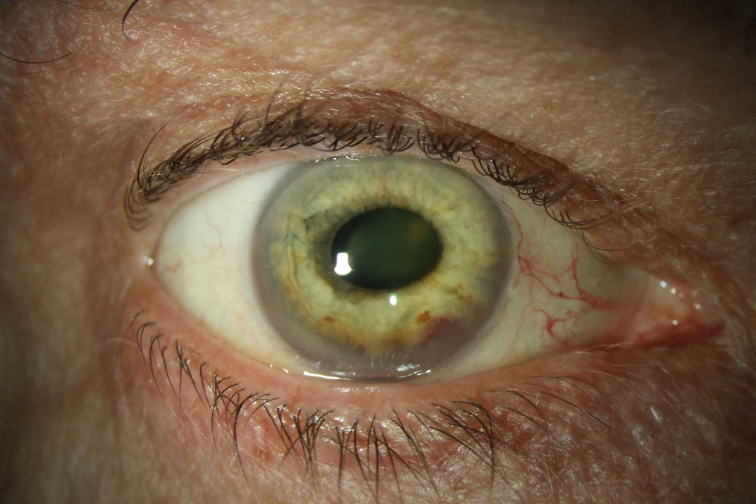
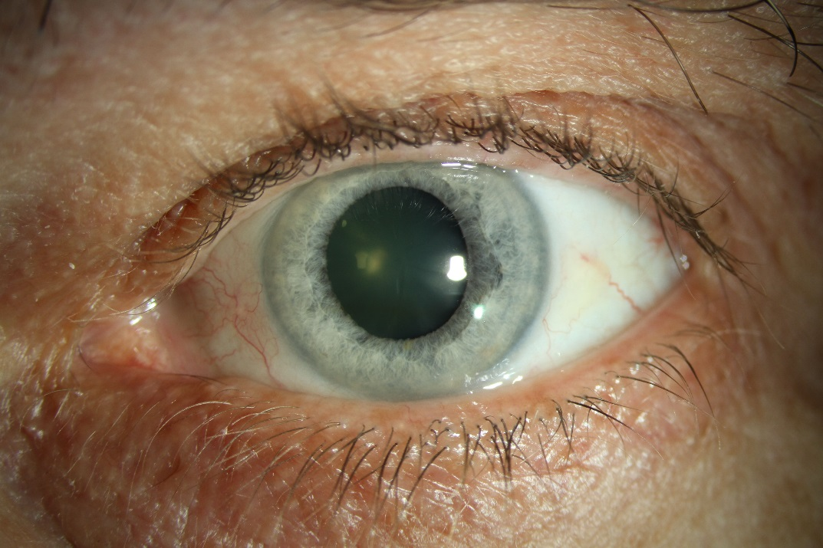
Anterior photos

Slide 9
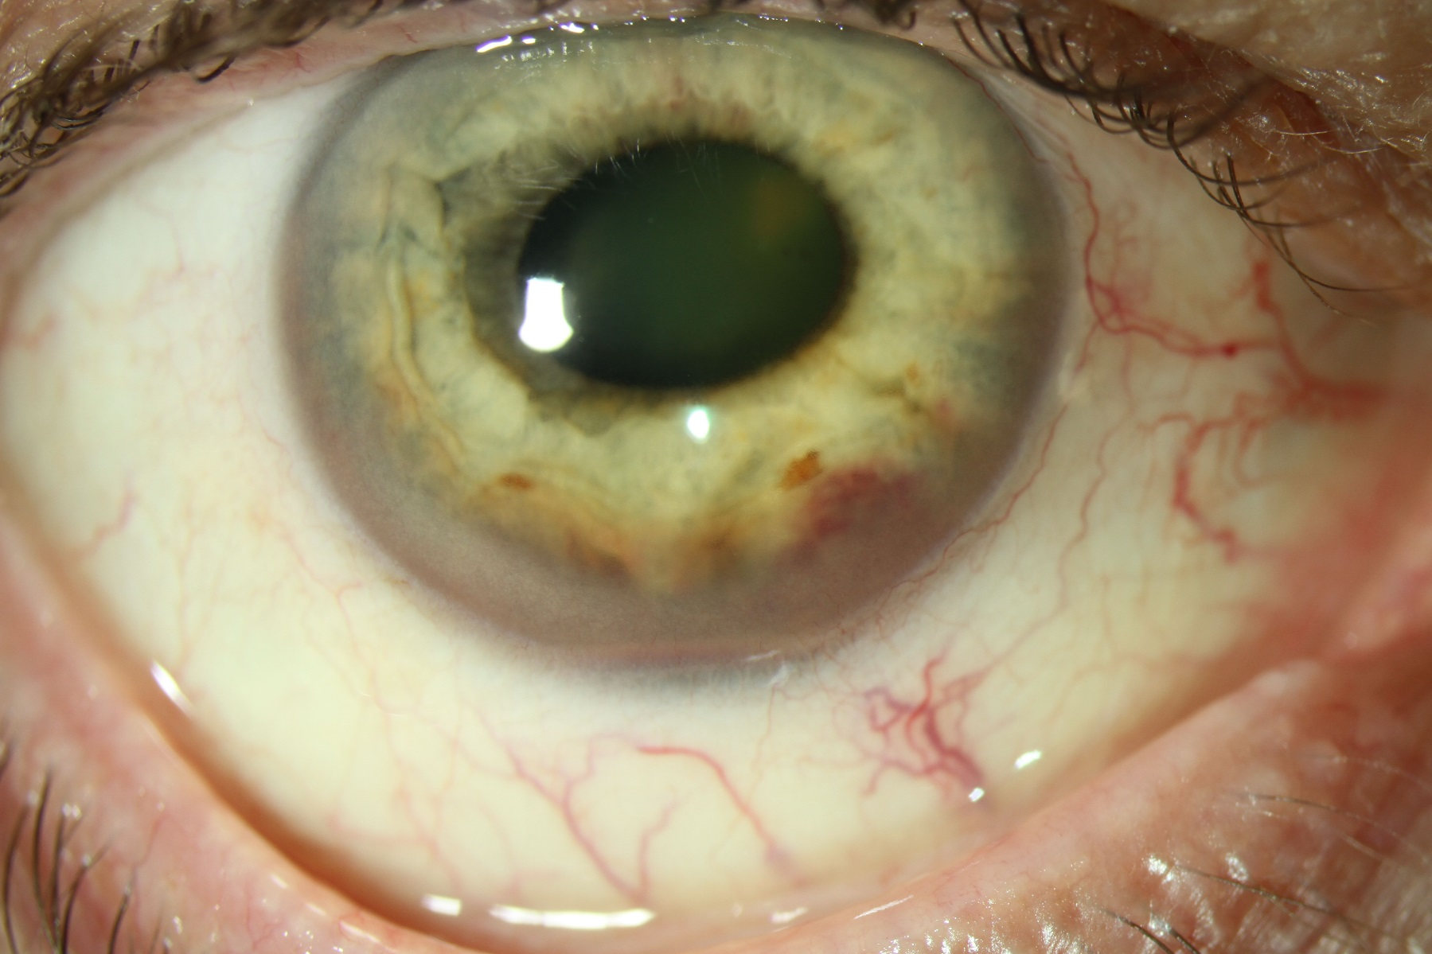
Anterior photos

Slide 10
Posterior Segment Exam
Fundus | OD |  | OS
Optic Nerve | Hazy |  | Normal
Macula | Poor view |  | Punctate RPE atrophy, drusen with pigment mottling
Vessels | Poor view |  | Normal
Periphery | Inferior heaped-up white mass |  | Normal

Slide 11
Other Exam Findings
AS OCT: Nasal ciliary body thickening
Gonioscopy: billowing and irregularities of iris periphery, engorged blood in Schlems canal inferiorly
Labs:
  Leukopenia with normal platelets and Hgb
  Borderline T spot
  HLAB27 positive
  Lyme, syphilis negative
  Lysozyme, ACE normal
Notes:
T spot: tuberculosis
Lysozyme: sarcoid
ACE: Sarcoid

Slide 12
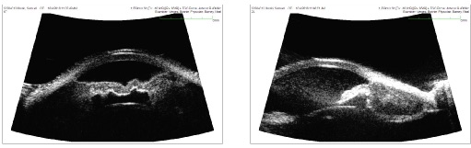
Ultrasound

Slide 13
Assessment
70-year-old man with a history of lymphoma presents with steroid-resistant uveitis and iris irregularity with heterochromia
Differential Diagnosis
  Uveitis
    Infectious vs HLA-B27
  Fuchs’ heterochromic iridocyclitis
  Uveitis-Glaucoma-Hyphema syndrome
  Iris carcinoma
  Sarcoidosis
  Recurrent lymphoma

Slide 14
Additional History
Diagnosed with stage 4 mantle cell lymphoma in 8/2014
  Presented with hepatosplenomegaly
Treated with chemotherapy 1/2015 and stem cell transplant in 2/2015
  Last chemotherapy 1.5 years prior
In remission for 3 months prior to presentation

Slide 15
Plan
Proceed with iris biopsy
  Sector iridectomy 11-1

Slide 16
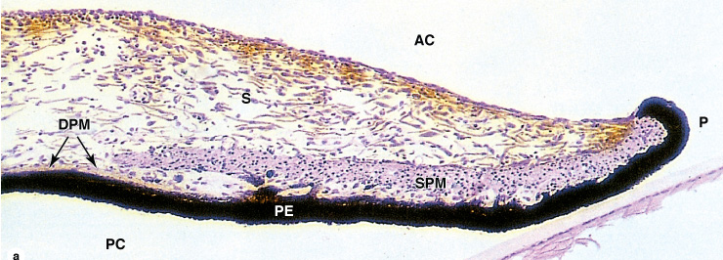
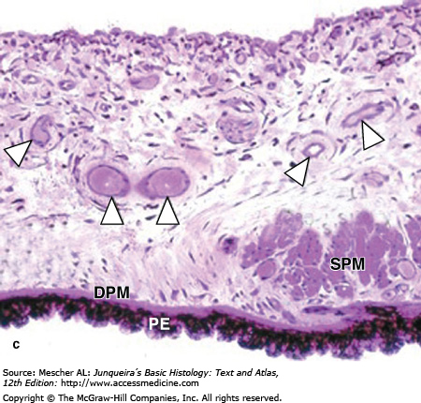
Iris H&E

Slide 17
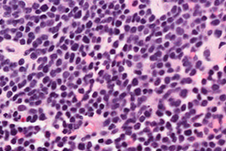
Iris Biopsy – H&E
Notes:
Dense cellular infiltration of small blue cells
Scant cytoplasm, irregular nuclei, inconspicuous nucleoli – indicates lymphocytes
No irregular architecture, No follicles

Slide 18
Immunohistochemistry Stains
 | CD 20 | CD 3 | CD 5 | Cyclin D1 | CD10
Follicular | + | - | - | - | +
Marginal | + | - | - | - | -
Mantle | + | - | + | + | -
CLL/SLL | + | - | + | - | -
Diffuse large B cell | + | - | - | - | +

Slide 19
Iris Biopsy – CD20

Slide 20
Iris Biopsy – CD3

Slide 21
Iris Biopsy – CD5

Slide 22
Iris Biopsy – Cyclin D1

Slide 23
Immunohistochemistry Stains
 | CD 20 | CD 3 | CD 5 | Cyclin D1 | CD10
Follicular | + | - | - | - | +
Marginal | + | - | - | - | -
Mantle | + | - | + | + | -
CLL/SLL | + | - | + | - | -
Diffuse large B cell | + | - | - | - | +

Slide 24
Plan
Look for other recurrent lesions
  Axillae
  Anterior-superior mediastinum
  Retroperitoneum
  Bilateral inguinal regions
  Iliac crest
  Spleen
Follow up with oncology
  Rituximab and bendamustine, 3 cycles

Slide 25
Follow up
1 week:
  Treated with prednisolone for inflammation
  VA 20/200
1 month: inflammation resolved, less iris thickening and heterochromia
  VA is HM with a dense cataract
2 months: off prednisolone, completed two rounds of chemo
  VA is HM
4 months: Cataract surgery
  VA 20/70
6 months: heterochromia resolved
  VA 20/25

Slide 26
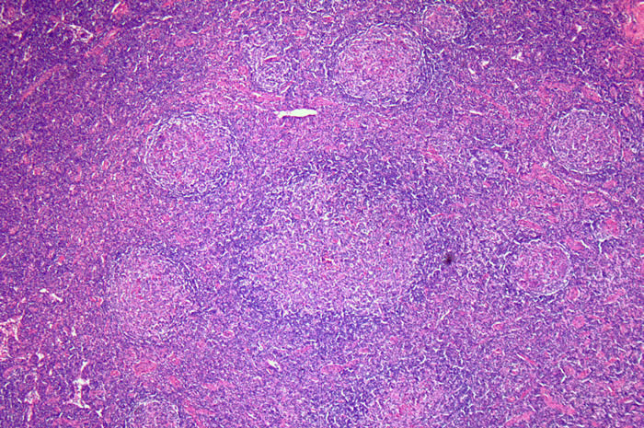
Mantle Cell Lymphoma
Arises from peripheral B-cells of the mantle zone of lymphoid follicles
Pathophysiology: t(11;14)(q13;q32) with overexpression of cyclin D1
Notes:
Dis regulation of the cell cycle

Slide 27
Mantle Cell Lymphoma
3-6% of non-Hodgkin lymphoma
  Follicular, marginal zone, chronic lymphocytic/small lymphocytic, diffuse large B cell, MALT, Burkitt
Incidence: 0.5 per 100,000
  Male:female ratio 3:1
  Average age 68
Presentation: generalized lymphadenopathy
  Extranodal involvement
  Splenomegaly, bone marrow, GI
Diagnosis: excisional biopsy of lymph node
Prognosis: 3-6 years
  High rate of multiple relapses
Treatment: Chemotherapy, autologous stem cell transplant, radiation
Notes:
Is considered an aggressive form of lymphoma with presentation at stage 4

Slide 28
Intraocular Lymphoma
Primary
  Vitreoretinal or uveal
  Most commonly diffuse large B cell, low-grade extranodal marginal zone B-cell lymphomas
Secondary
  Affects uvea, choroid most often
  Diffuse large B cell
  Ocular involvement in 7% of patients who die with systemic lymphoma
Notes:
Uveal can be further subclassified into choroidal, ciliary body, or iris

Slide 29
Literature Review
Larkin et al. reviewed intravitreal injections for intraocular lymphoma
  Across Oregon, Massachusetts, Michigan, Illinois, Ohio, Maryland, Canada, Germany, Australia, Brazil
34 patients who suffered from vitreoretinal lymphoma and were treated with intravitreal injection of rituximab
  Rituximab is a mouse-human chimeric monoclonal antibody that targets the CD20 protein
Notes:
Out of Oregon
Done by retinal surgeons who want to achieve control locally while avoiding systemic toxicity

Slide 30
Literature Review
Indications for treatment: new diagnosis (68.8%), progressive disease (29.9%), maintenance therapy (2.1%)
48 eyes received injection
  18 rituximab only
  30 rituximab and methotrexate
19 were only treated with intravitreal injections

Slide 31
Literature Review
Results
  31 with complete remission – 10 were treated with injection alone
    7 developed recurrent disease
  11 with partial remission – 2 were treated with injection alone
  4 with no response
  2 could not be evaluated, already clinically free of lymphoma (maintenance, diagnostic vitrectomy cleared)
Complications in 15 eyes
  Cataract (9), elevated IOP (2), granulomatous anterior uveitis (1), vitreous hemorrhage (1), rhegmatogenous retinal detachment (1)
  methotrexate-related keratopathy (2), blood-brain barrier disruption-associated maculopathy (2), secondary lymphomatous glaucoma (1), choroidal neovascular membrane at the site of an old chorioretinal scar (1), lymphomatous exudative retinal detachment (1)

Slide 32
Notes:
Out of Nebraska

Slide 33
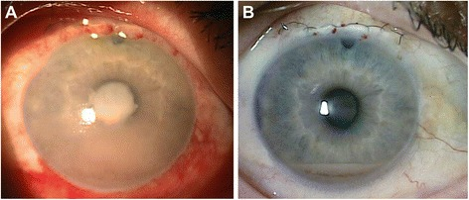
Intravitreal chemotherapy
58-year-old with MCL relapse, hypopion, NVI
Paracentesis with +CD20, +CD5, +Cyclin D1, -CD10, -CD3
Intravitreal injections of methotrexate and rituximab, and ranibizumab for NVI
Systemic ibrutinib

Slide 34
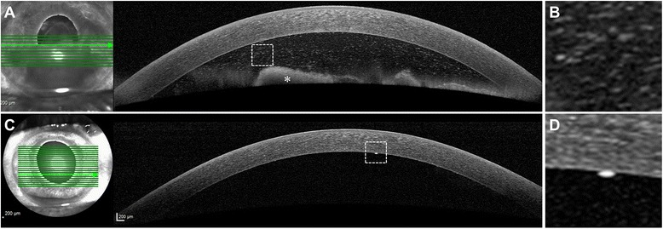
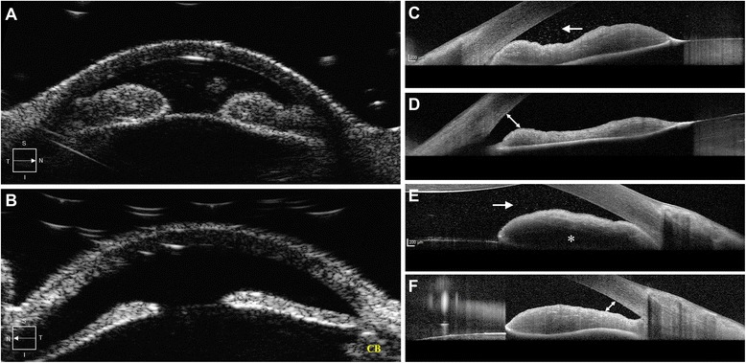
Intravitreal chemotherapy
Notes:
Resolution of anterior chamber inflammation
Thinning of the iris
Opening of the angle
However it is unclear whether these changes were from the injection or the local therapy

Slide 35
Summary
Iris lymphoma can be primary or secondary, is rare, and often is initially diagnosed as anterior uveitis
Patients often present after failure of steroid treatment, with hypopion/pseudohypopion and iris thickening
Treatment includes systemic therapy including chemotherapy and stem cell transplant, as well as local radiation therapy
Intravitreal injections of rituximab is a possible targeted therapy for intraocular lymphoma

Slide 36
Acknowledgements
Dr. Heather Potter
Dr. Neal Barney
University of Wisconsin Department of Ophthalmology and Visual Sciences

Slide 37
References
Rao IS. Role of immunohistochemistry in lymphoma. Indian Journal of Medical and Paediatric Oncology : Official Journal of Indian Society of Medical & Paediatric Oncology. 2010;31(4):145-147.
Gauthier, Angela C. et al. “Anterior Chamber Non-Hodgkin Lymphoma of the Iris Masquerading as Uveitis-Glaucoma-Hyphema Syndrome.” Ocular Oncology and Pathology 2.4 (2016): 230–233.
Mashayekhi A, Shields CL, Shields JA. Iris involvement by lymphoma: a review of 13 cases. Clin Experiment Ophthalmol. 2013;41:19–26
Reid, J. P., et al. (2014). "Intraocular mantle cell lymphoma of the iris." Optom Vis Sci. 91(4 Suppl 1): S25-29.
Larkin KL, Saboo US, Comer GM, et al. Use of intravitreal rituximab for treatment of vitreoretinal lymphoma. British Journal of Ophthalmology 2014;98:99-103.
Coupland, S. E. and Damato, B. (2008), Understanding intraocular lymphomas. Clinical & Experimental Ophthalmology, 36: 564–578.

