Slide 1
Conjunctival Lesion – An Ocular Manifestation of a Dermatological Condition
Mehreen Adhi, MD
August 18, 2017

Slide 2
Patient Presentation
Chief Complaint:
“My eye is irritated”
HPI:
60 year old white male admitted on 5/20/2017 for severe flank pain secondary to spontaneous perinephric hematoma s/p coil embolization of arteriovevous malformation by interventional radiology
5/23/2017: sudden onset of fever, chills, altered mental status tachycardia and worsening leukocytosis (WBC: 19 →24) concerning for sepsis, started on empiric intravenous Vancomycin and Ceftriaxone

Slide 3
Patient Presentation
HPI (continued):
Infectious workup negative except positive serum cryptococcal antigen
Started on anti-fungals for suspected recurrence of cryptococcal meningitis (previous history of cryptococcal ?meningitis ?line infection in 2014)
5/28/2017: “pink left eye”, started on ofloxacin gtts by primary team and Ophthalmology was consulted for the same
Poor historian, altered mental status, family unreliable and not readily available

Slide 4
Patient Presentation
Review of Systems:
Left flank pain

Slide 5
Patient Presentation
Past Ocular History:
Unremarkable
Past Medical/Surgical History:
End-stage renal disease on intermittent hemodialysis (amphotericin toxicity)
Cryptococcal infection: ?meningitis, line infection
Granulomatous polyangitis
Family History:
Unremarkable
Medications:
Prednisone 10mg QD, Fluconazole 200mg QD (non-compliant)
Allergies:
No known drug allergies

Slide 6
External Exam
 | OD |  | OS
Best-corrected VA | 20/30-2 |  | 20/25-2
Pupils | 3→2mm | No rAPD | 3→2mm
IOP | 13 mmHg |  | 15 mmHg
EOM | Grossly full (unreliable) |  | Grossly full (unreliable)
CVF | Grossly full (unreliable) |  | Grossly full (unreliable)

Slide 7
Anterior Segment Exam
SLE | OD |  | OS
External/Lids | WNL |  | WNL
Conj/Sclera | White and quiet |  | Diffuse 1+ injection; three lesions; largest one on the temporal conjunctiva, two smaller ones at the inferior and nasal limbus; raised, whitish, undefined borders, non-pigmented
Cornea | Clear |  | Clear
Ant Chamber | Deep and quiet |  | Deep and quiet
Iris | WNL |  | WNL
Lens | NS |  | NS
Vitreous | Clear |  | Clear

Slide 8
Posterior Segment Exam
Dilated Fundus Exam | OD |  | OS
Optic Nerve | pink and sharp |  | pink and sharp
Macula | Good foveal reflex |  | Good foveal reflex
Vessels | WNL |  | WNL
Periphery | WNL |  | WNL

Slide 9
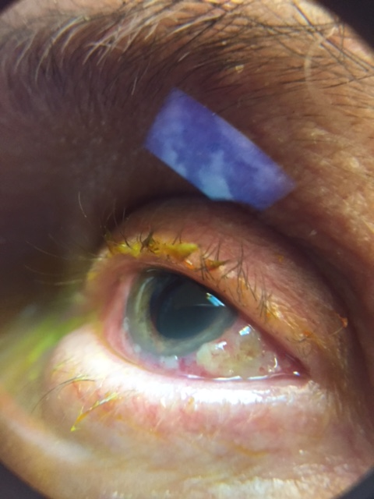
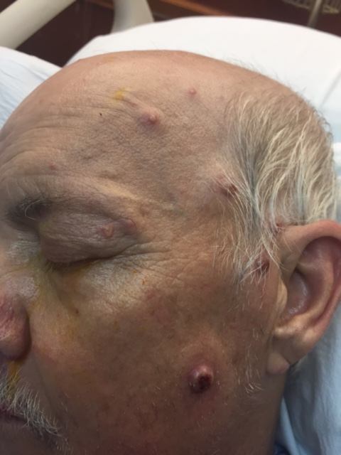
Clinical Photos
Skin Lesions: Raised, firm-hard, non-tender nodular lesions on face, forehead and dorsum of hands

Slide 10
Assessment and Plan
60 year old white male with fever, chills leukocytosis, altered mental status, tachycardia. Exam significant for new conjunctival/limbal lesions and non-tender, raised hard skin nodules. No response to empiric antibiotics/antifungals
Ofloxacin gtts continued, plan to obtain biopsy of the conjunctival lesions, dermatology consult

Slide 11
Clinical Photos
Skin Lesions: Now larger, pustular, violaceous papules, severely tender

Slide 12
Assessment and Plan
Viral, bacterial (aerobic/anaerobic) cultures and gram stain of the conjunctival lesions – all came back negative
Started on Pred acetate 1% ophthalmic solution Q2H OS
Punch biopsy of a skin lesion on dorsum of hands obtained

Slide 13
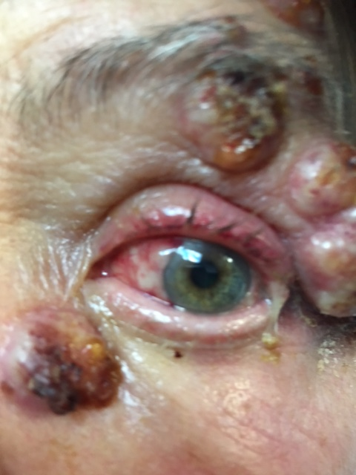
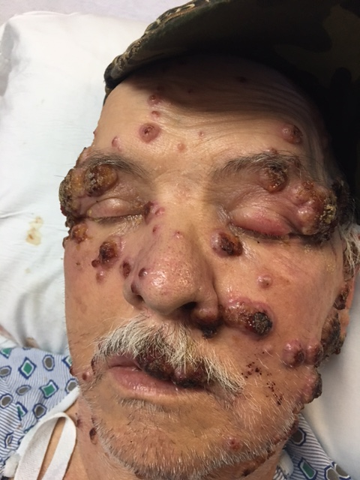
Clinical Photos

Slide 14
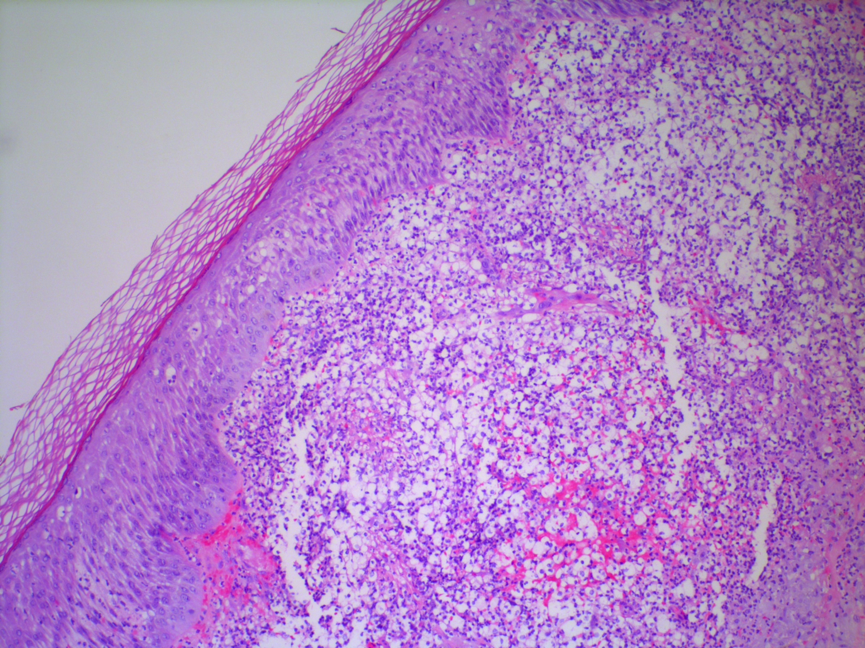
Pathology

Slide 15
Pathology

Slide 16
Pathology

Slide 17
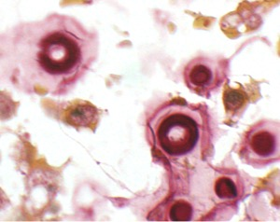
Pathology

Slide 18
Assessment and Plan
Pathology of the skin biopsy consistent with acute febrile neutrophilic dermatosis (Sweet’s syndrome; Gumm-Button disease)
Started on systemic steroids

Slide 19
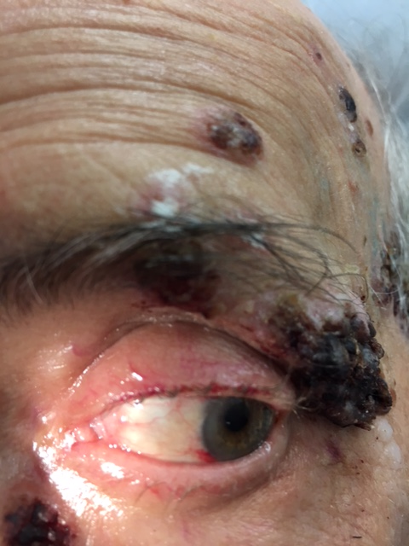
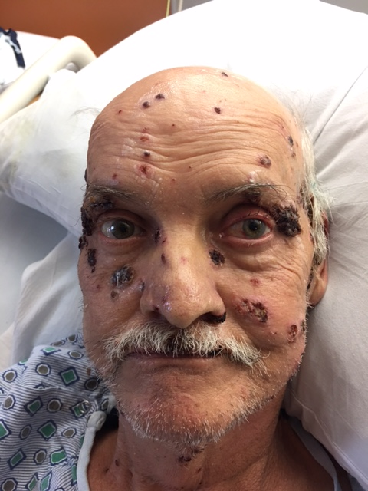
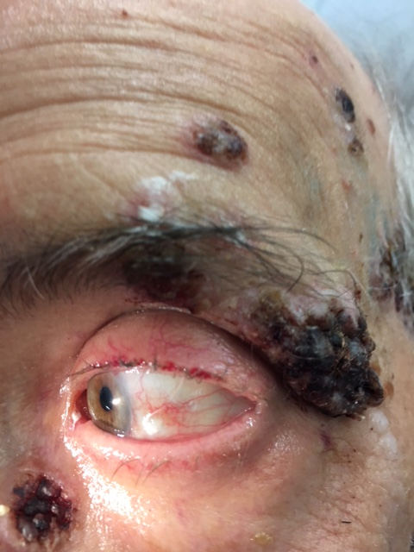
Clinical Photos

Slide 20
Sweet’s Syndrome
Described by Dr. Robert D Sweet
Abrupt appearance of asymmetrical painful, edematous and inflamed papules, plaques and nodules exhibiting a brightly erythematous or violaceous color
Fever > 38 degrees Celsius, leukocytosis and neutrophilic infiltration of eyes, central nervous system and other internal organ may occur
Oral ulcers, bullae, vesicles, gingival hyperplasia, ulcerative periodontitis and tongue swelling; rarely, nectrotizing fascitis

Slide 21
Sweet’s Syndrome
Major Criteria
- Abrupt onset of painful erythematous plaques or nodules
- Histopathologic evidence of a dense neutrophilic infiltrate without evidence of leukocytoclastic vasculitis
Minor Criteria
- Pyrexia >38°C
- Association with underlying hematologic or visceral malignancy, inflammatory disease or pregnancy or preceded by upper respiratory infection, gastrointestinal infection, or vaccination
- Excellent response to systemic steroids
- Abnormal laboratory values including leukocytosis and increased inflammatory markers

Slide 22
Sweet’s Syndrome
Classified as:
- Classical Sweet syndrome
- Malignancy associated Sweet syndrome
- Drug-induced Sweet syndrome

Slide 23
Sweet’s Syndrome
Ocular inflammation is a common extracutaneous manifestation
17 to 72 percent of patients with the classical variant of Sweet’s syndrome
Conjunctivitis, episcleritis, scleritis, limbal nodules, peripheral ulcerative keratitis, iritis, glaucoma, dacryoadenitis and choroiditis
Systemic steroids are the first-line treatment

Slide 24
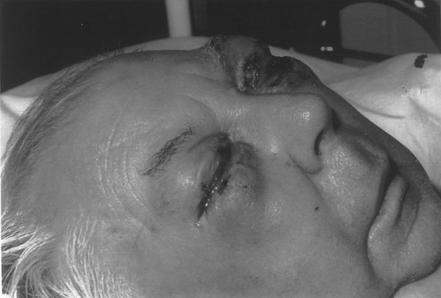
72-year-old man who developed bilateral periocular swelling overnight, treated for probable Herpes Zoster cellulitis with secondary bacterial infection without response
CT demonstrated only preseptal ocular and facial swelling, pathology clinched the diagnosis
Excellent response to systemic steroids

Slide 25
47-year-old man who developed facial lesions associated with conjunctival nodules
Diagnosis established on biopsy of skin and conjunctival lesions
Excellent response to systemic steroids

Slide 26
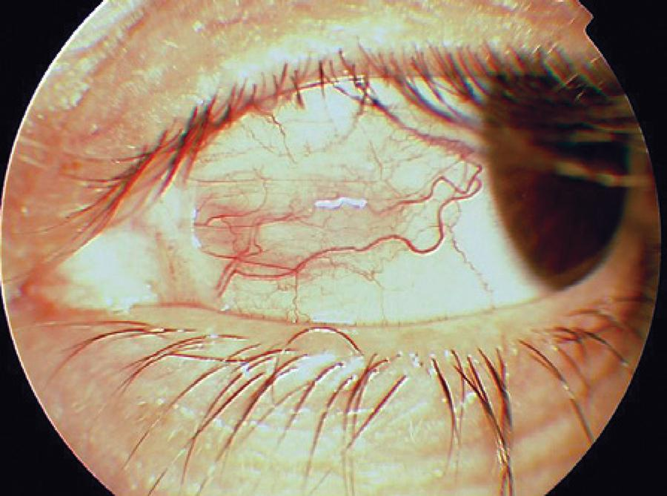
46-year-old woman with classic skin lesions diagnosed with Sweet Syndrome and treated with systemic steroids
5 months after skin lesions resolved, she developed nodular scleritis and peripheral ulcerative keratitis in the absence of active skin lesions
Excellent response to systemic steroids

Slide 27
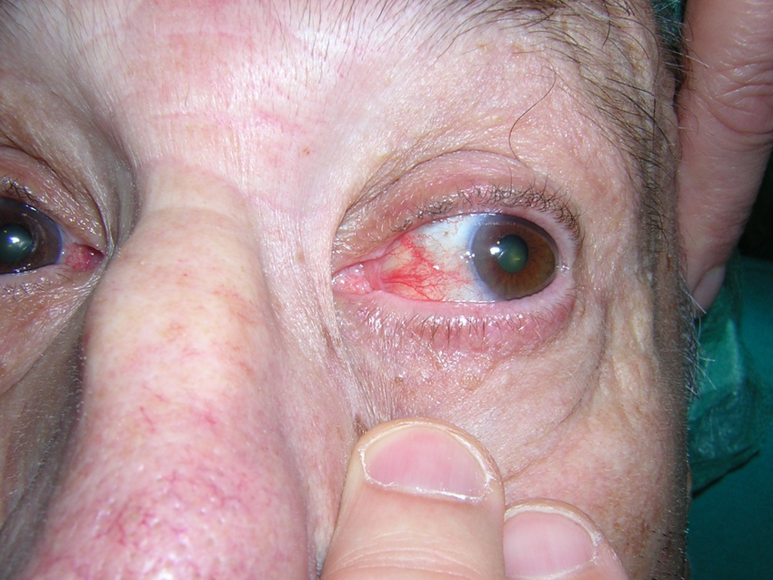
Sweet’s Syndrome

Slide 28
Conclusion
Ocular involvement is not uncommon in Sweet’s syndrome and may be the presenting sign of the disease or occur concurrently with the skin lesions; conjunctival/limbal lesions are the most common ocular manifestation
Constellation of fever, chills, leukocytosis and skin lesions
Systemic steroids are the first-line treatment

Slide 29
Acknowlegdements
Drs. Breaux and Sophie
Dr. Kaplan
Dr. Nowacki (Norton Pathology)

Slide 30
References
Cohen PR. Sweet’s Syndrome - a comprehensive review of an acute febrile neutrophilic dermatosis. Orphanet J Rare Dis. 2007
Gottlieb CC, et al. Ocular involvement in acute febrile neutrophilic dermatosis (Sweet syndrome): new cases and review of the literature. Surv Ophthalmol. 2008 May-Jun
Anwar S, et al. Bilateral periocular swelling in Sweet’s syndrome. Eye 2004
Zhuang Y, et al. Bilateral conjunctival nodules in Sweet’s syndrome. Journal of clinical and experimental ophthalmology 2011
Bilgin AB, et al. An uncommon ocular manifestation of Sweet syndrome: peripheral ulcerative keratitis and nodular scleritis. Arq. Bras. Oftalmol. vol.78 no.1 São Paulo Jan./Feb. 2015

Slide 31
Thank you

