Slide 1
Grand Rounds
Endogenous Endophthalmitis
Raafay Sophie
18th Aug 2017

Slide 2
Patient Presentation
CC
  Pain/pressure, blurry vision and seeing spots in right eye
HPI
  51 y F who woke at 5 am with right eye pain, photophobia and some “pressure” feeling.
  She had blurry vision and complained of “seeing spots”.
  Denied flashes, any discharge, headache or pain on eye movement
Notes:
She was seen in the ER and sent the same day to KLEC

Slide 3
History (Hx)
Past Ocular Hx: Macular Degeneration
Past Medical Hx: Hepatits C (treated)
Meds: None
Social Hx:
Smoker - 1 pack/day for 30 years
no recent IV drug use (last use at 14 years of age)
ROS: Had some flu like symptoms a week ago. No other systemic complaints. No hx of recent travel.
Notes:
Fam Hx none
Allergies: Morphine

Slide 4
Exam
External | OD | OS
VAsc | 20/40 pH NI | 20/20
Pupils | 2 mm,unreactive, rRAPD -ve | 4→3mm
IOP | 22 mmHg | 17mmHg
EOM | full | full
SLE | OD | OS
External/Lids | WNL | WNL
Conj/Sclera | Ciliary Flush | White and Quiet
Cornea | Fine KP, Descemet Folds | Clear
Ant Chamber | 2+ Flare, 3+ Cell | Deep and Quiet
Iris | Posterior synechiae | WNL
Lens | Not well visualized | Trace NS
Notes:
B-Scan OD: Flat Retina, no vitreous opacities.
Posterior exam wnl OS,

Slide 5
Assessment
Acute anterior Uveitis OD
  Started on Pred Forte 1% Q2h, Cyclopentolate 1% BID.
  Because of very acute onset, scheduled to be seen in the next Uveitis Clinic (2 days later)
  Instructed to call if increased pain or further loss of vision.

Slide 6
Progress
2 days later she presented to ER with altered mental status.
Family reported a rapid decline in vision the night before.
On exam she had a fever (101.3ºF), right red eye with surrounding periorbital swelling, no other systemic findings.
Labs drawn, started on broad spectrum IV antibiotics - Ophthalmology consulted

Slide 7
Labs
WBC 30.8 (74.0 % neutrophils)
CRP 161.8, ESR 34
Glucose 185
Total Protein 7.7, Albumin 3.4
Na 129, Cl 96
Urine Tox negative
Blood Cultures pending
Notes:
Lactic Acid 1.4, Thyroid profile wnl
Hb 13.6
Plt 189
Na 129, Cl 96, K 3.6, CO2 23.6, AG 9.4

Slide 8
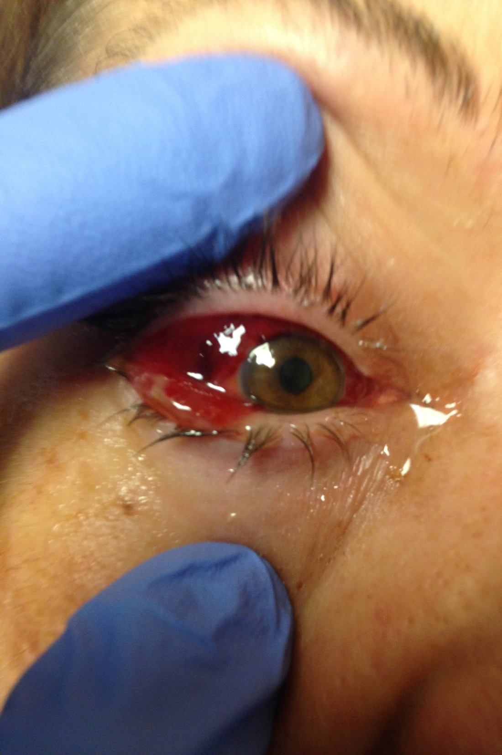
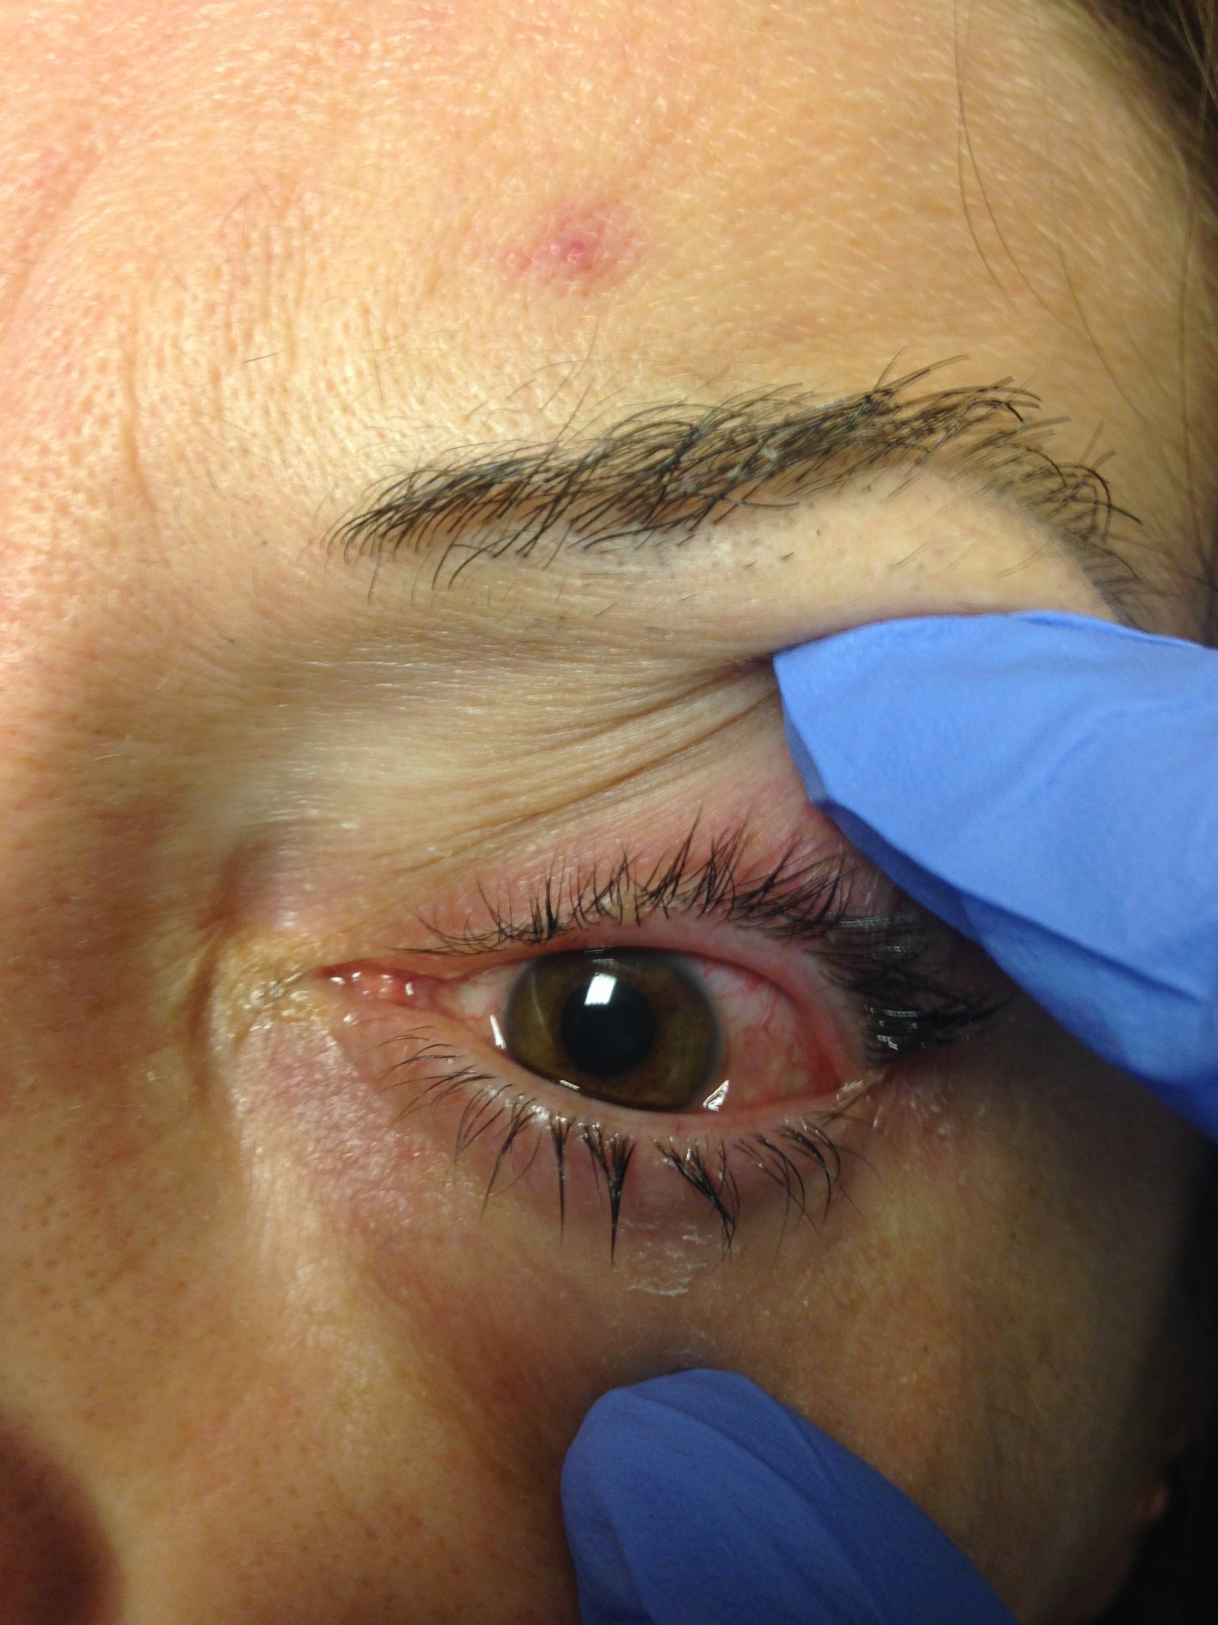
Notes:
VA UTO
Pupils 3/ 4 no rAPD
IOP 18/ 17
EOM full
OD
Upper lid erythema and edema, 360 chemosis
OS: 1= injection

Slide 9
Posterior Segment Exam
B-Scan OD:
Significant vitreous strands and membranes adhering to posterior pole and periphery.
No Retinal Detachment

Slide 10
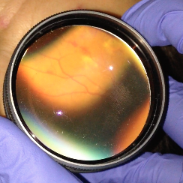
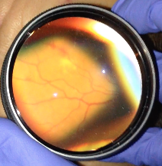
Posterior Segment Exam OS
Notes:
OS: Numerous blot heme surrounding macula up to arcades, some with central whitening (roth spots). Heme adjacent to retinal vessels suggestive of vasculitis.

Slide 11
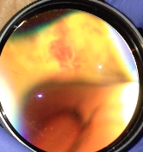
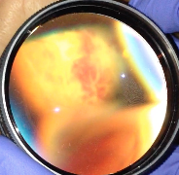
Posterior Segment Exam OS
Notes:
Inf periphery raised whitish retina compatible with retinitis

Slide 12
Assessment/Plan
DDx:
Endogenous endophthalmitis
Panophthalmitis
Vasculitis
Plan
CT orbits/MRI orbits,
Echo, CMV, EBV, Syphillis, HIV, TB, ANA, ANCA, RF, pan culture x3
Neurology consult to evaluate for meningitis.
Continue with IV antibiotics, Pred Forte QID OU, Vigamox OU TID.
Notes:
Ceftriaxone and vancomycin.

Slide 13
Progress
Blood Culture: positive for Pneumococcus
MRI orbits:
  “probable myositis of superior rectus” as suggested by “mild thickening”, no florid orbital cellulitis seen.
  “abnormality of right globe - areas of linear signal abnormality in an unusual and unfamiliar pattern”
Notes:
(pansensitive)

Slide 14
Day 1
Patients mental status improved next day
VA sc : HM OD, 20/100 OS
SLE:
  OD: 360 chemosis, Descemet folds, 4+ cell/flare, 0.5 mm hypopyon.
  OS: +2 injection, 3+ cell/ flare
DFE:
  OD: no view
  OS: unchanged
Tap and inject OD ( Vancomycin / ceftazidime)
Notes:
PF OU q2h and Topical fortified Vancomycin and Ceftazidime q2h OU.

Slide 15
Progress
Labs:
  Lyme, RPR, ANA,EBV, CMV, HIV negative
  RF 30
  Vitreous Culture OD: Pneumoccocus (pan-sensitive to ceftriaxone, levofloxacin, PCN, Bactrim)

Slide 16
Day 2
Patients Vision OS deteriorating
VA sc : HM OD, 20/200 OS
SLE:
  OD: 360 chemosis, descemet folds, 4+ cell/flare, 0.3 mm hypopyon.
  OS: +2 injection, 3-4+ cell/ flare
DFE:
  OD: no view
  OS: unchanged
Tap and inject OS( Vancomycin / ceftazidime)

Slide 17
Day 3-8
Patient remained stable with subjective improvement in pain OU.
VA sc :
  OD: HM
  OS: 20/200 improving to 20/70
Vitreous Culture OS: negative
LP: high WBC with low glucose, but culture negative
Echo: no vegetations
CXR: normal
Sputum culture: negative
Notes:
Discharged by ID with IV cefttriaxone.

Slide 18
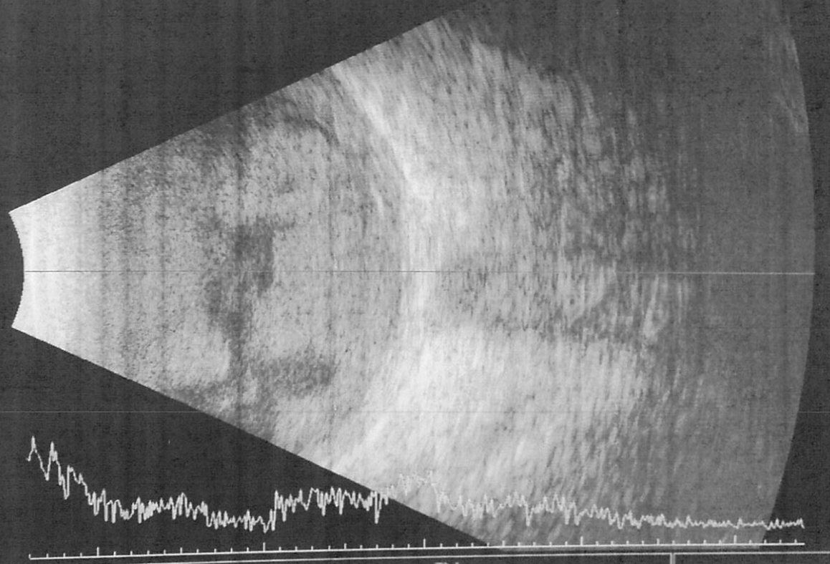
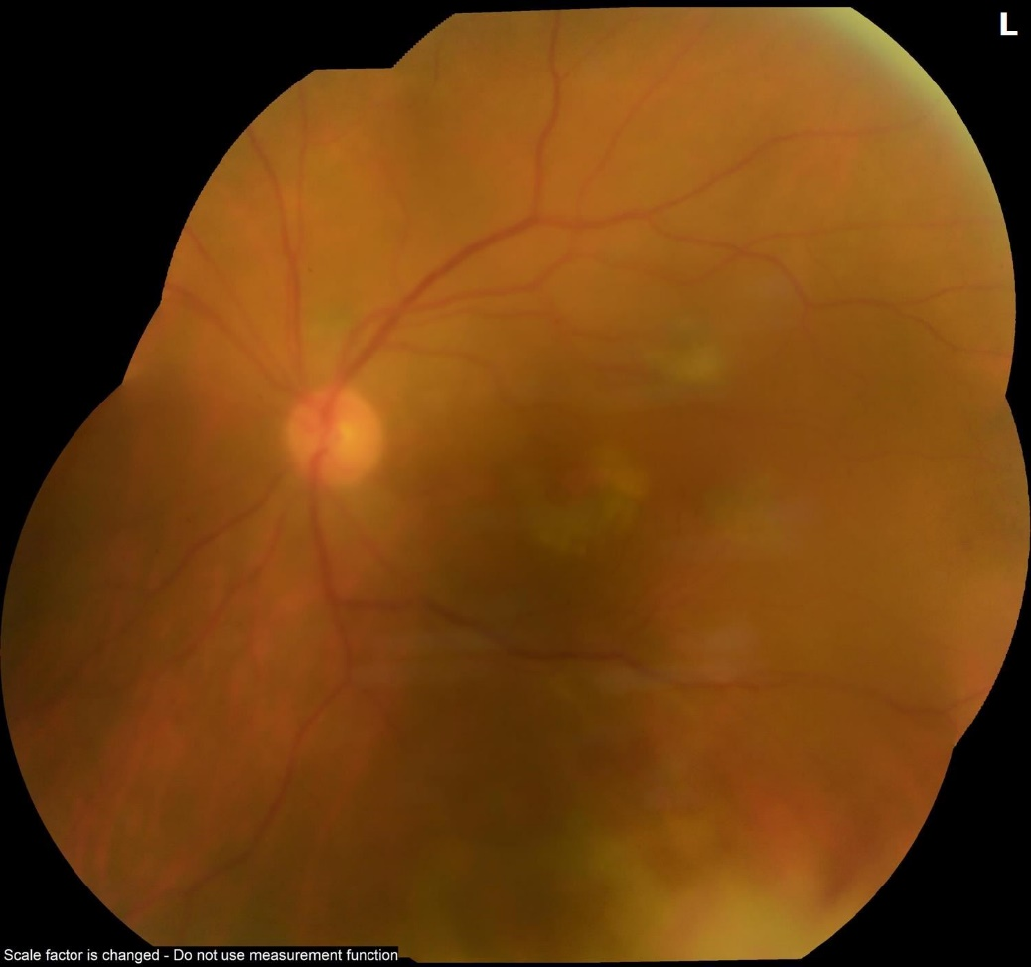
Day 10- seen in clinic
OD
BCVA- LP
3+ cell and Flare, PAS
OS
BCVA- 20/60
Tr cell and flare
Notes:
4+ Vitreous Debris OD,
2+ Vitritis OS with some infiltrate and heme inferiorly
Plan for PPV

Slide 19
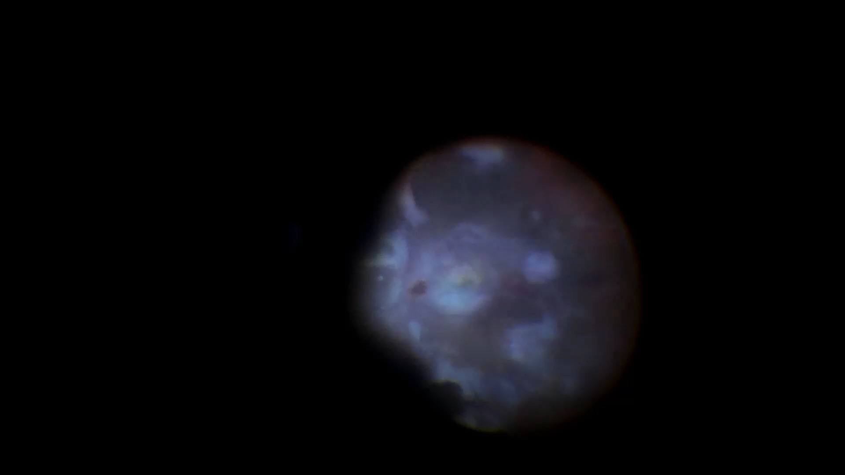
Notes:
PAS synechiolysis with BSS and healon- 23 G. Anterior vitrectomy, then lensecotmy to improve the view. Post vitrectomy and post hyaloid removed. Endophthlamitis had damaged retina severely: Hemorrhage on optic dics, vessels sclerosed, heavy infiltrate, pre and sub retinal in the macula area. Large retina defect superiorly when infiltrate was removed. As much of vitreous infiltrate removed and fluid gas exchange, then endophotocoagulation done around superior breaks and any potential post breaks.. 20% C3F8 . She underwent a second surgery 1 month later for preretinal fibrosis removal and IOL imploancation.

Slide 20
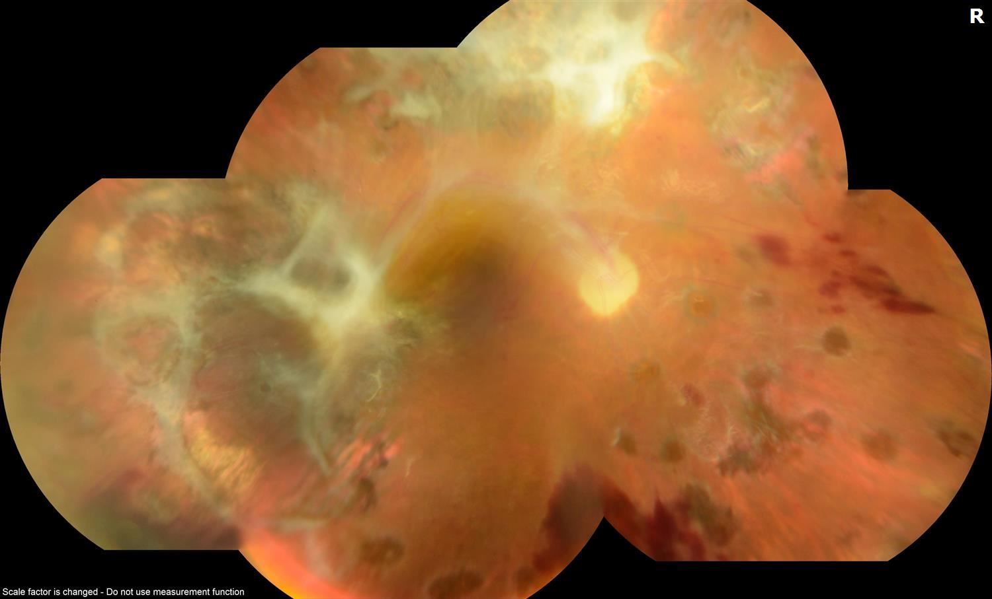
Last Visit ( Month 6)
OD: BCVA CF

Slide 21
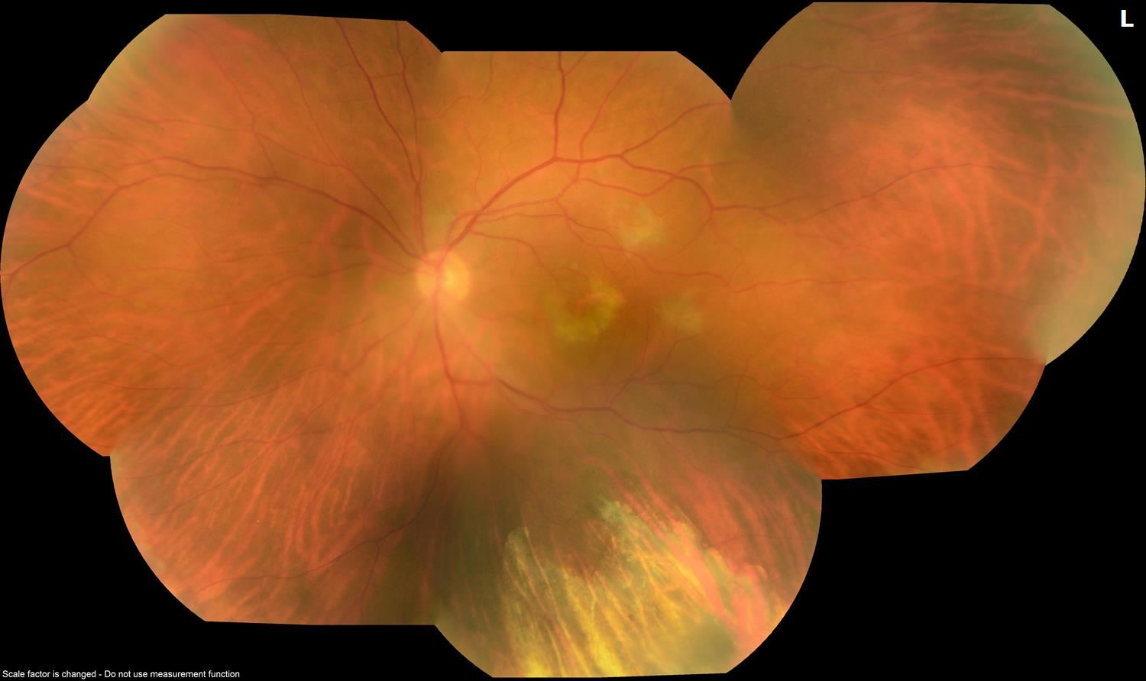
Last Visit ( Month 6)
OS: BCVA 20/25

Slide 22
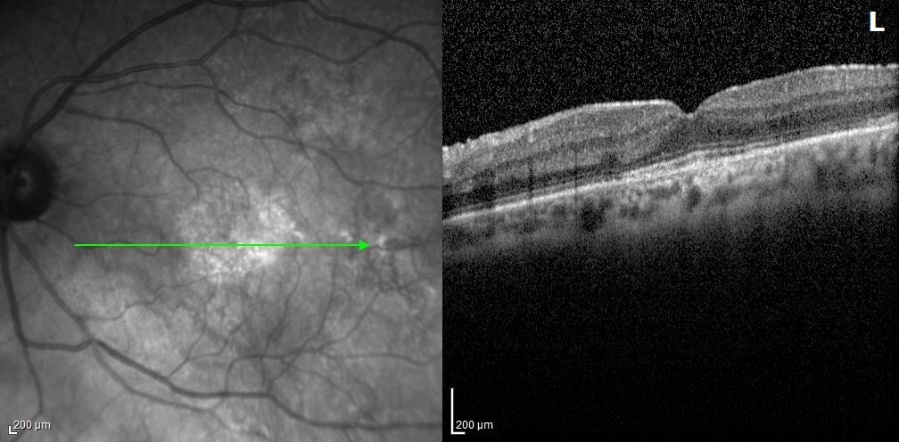
OS

Slide 23
Endophthalmitis
Endophthalmitis: inflammation of internal ocular spaces - clinical practice this is synonymous with intraocular infection.
Exogenous - breach of external ocular barrier
  incidence rate of 0.07-0.32 %
  70% coagulase negative staphylococci
Endogenous - breach blood-ocular barrier
  2-8% of all cases of endophthalmitis

Slide 24
Endogenous Endophthalmitis
Associated with underlying medical conditions such as diabetes, cardiac disease, immunosuppression, IVDA and malignancy in up to 90% of patients
May present with systemic infections such as liver abscess, meningitis, endocarditis or UTI - it can also occur in isolation

Slide 25
Pathophysiology
The organism invades through the blood stream in cases of bacteremia, usually through the posterior segment vasculature.
After crossing blood ocular barrier, microbial proliferation and the resulting inflammatory response cause damage to retinal and choroidal tissue, invading the vitreous cavity and anterior chamber
Notes:
Direct inoculation through optic nerve in cases of CNS infection is possible

Slide 26
Clinical Features
Decreased vision
Pain
Photophobia
Floaters
Eyelid edema
Conjunctival injection
AC inflammation with hypopyon
Absent red reflex, vitreous cells and haze
Notes:
Hallmark is involvement of vitreous

Slide 27
Diagnosis
Culture and Histology
  Vitreous aspiration (44% yield*)
  Vitrectomy (92% yield*)
Real-time PCR of AC and Vitreous samples is promising but does not provide antibiotic susceptibility.
Blood Cultures should be drawn, and systemic workup done as indicated.
*Lingappan A, Wykoff CC, Albini TA, Miller D, Pathengay A, Davis JL, Flynn HW., Jr Endogenous fungal endophthalmitis: causative organisms, management strategies, and visual acuity outcomes. Am J Ophthalmol. 2012;153(1):162–166.

Slide 28
Pathogens
Gram positive infections more common in Europe and the US
  In US, 40% associated with endocarditis (Staph or Strep)
Gram negative cases more common in Asia
  60 % of cases associated with liver abscess caused by Klebsiella Pneumonia
Notes:
Fungal is also common in asia 11.1 to 17.54 %

Slide 29
Treatment
Systemic Antibiotics
Intravitreal Antibiotic Injections
  Vancomycin (1 mg/0.1 ml) + Ceftazidime (2.25 mg/0.1 ml)
Pars Plana Vitrectomy – diagnostic and therapeutic - usually in sight threatening or unresponsive cases.
Role of steroids is controversial
Notes:
(amikacin 0.4 mg/0.1 ml out of favor due to risk of retinal toxicity)

Slide 30
Mean age 51 year ( SD±23, range 2 days -91 years)
Sixty percent had predisposing condition (diabetes most common)
Extraocular focus in 64% of cases identified. Most common liver, lung and endocardium.
Notes:
75 local cases. 1986-2012

Slide 31
Clinical features (data from 75 local cases):
  Blurred vision ( 89%)
  Pain (48%)
  No view of fundus( 40%)
  Hypopyon (35%)
  Vitritis (33%)
  Anterior chamber inflammation (32%)
  Fever (37%)
  Influenza-like symptoms (20%)

Slide 32
In 26% of all cases, there was a delayed or missed diagnosis.
Mean duration of delay was 3.2 days.
Most common misdiagnosis was uveitis
Microorganisms:
54 % Gram positive (18% strep, 10% staph)
46 % Gram negative (27% Klebsiella)
Notes:
Most commonly vitreous taken- 59% positive, AC plus vitrectomy in 21%, 41% in PPV. PCR used in 9 cases- 2 to exclude fungal/viral. 7 to identify organism.

Slide 33
Treatment:
36 % systemic antibiotics +intravitreal injection
20 % systemic antibiotics +intravitreal injection + PPV
11% systemic antibiotics only
10% intravitreal antibiotics and vitrectomy
10% intravitreal antibiotics
Visual Prognosis:
44% had VA worse than 20/200
31% achieved 20/200 or better
24% required enucleation or evisceration
2 deaths reported
Notes:
2% PPV only

Slide 34
Summary
Endogenous Endophthalmitis is a rare but often devastating ocular and systemic disorder.
High clinical suspicion in patients with risk factors
Blood and Ocular cultures (±PCR), and systemic workup is indicated
Early administration of both intraocular and systemic antibiotics should be mainstay of treatment, PPV at clinician discretion

Slide 35
Acknowledgment
Dr. Sidharth Puri
Dr. Amir Hadayer
Dr. Janelle Adeniran
Dr. Charles C. Barr

Slide 36
References
BCSC Section 12- Retina
Jackson TL, Eykyn SJ, Graham EM, Stanford MR. Endogenous bacterial endophthalmitis: a 17-year prospective series and review of 267 reported cases. Surv Ophthalmol 2003;48:403-23.
Jackson TL, Paraskevopoulos T, Georgalas I. Systematic review of 342 cases of endogenous bacterial endophthalmitis. Surv Ophthalmol 2014;59:627-35.
Sadiq MA, Hassan M, Agarwal A, et al. Endogenous endophthalmitis: diagnosis, management, and prognosis. J Ophthalmic Inflamm Infect 2015;5:32.
Lingappan A, Wykoff CC, Albini TA, Miller D, Pathengay A, Davis JL, Flynn HW., Jr Endogenous fungal endophthalmitis: causative organisms, management strategies, and visual acuity outcomes. Am J Ophthalmol. 2012;153(1):162–166

