Slide 1
Grand Rounds A Case of Hypertension and Intraocular Hemorrhage
Sidharth Puri MD, PGY2
November 18, 2016

Slide 2
Patient Presentation
CC
Blurred vision left eye
HPI
72 y/o African American female presents to ER with acute onset blurred vision OS.
Occasional floaters in past. Never experienced such symptoms before. Has not seen a doctor in years.

Slide 3
History (Hx)
Past Ocular Hx - Old corneal scar OS
Past Medical Hx- HTN, Arthritis
Fam Hx -Noncontributory
Meds - Multi-vitamin
Allergies - NKDA
Social Hx - <1 pk daily, occasional alcohol use, no illicit drugs

Slide 4
Review of Systems
Negative for Headache, Jaw claudication, Temporal Tenderness, Nausea/Vomiting, Trauma

Slide 5
External Exam
 | OD |  | OS
VA | 20/30 |  | CF @ 4’
Pupils | 4→3mm | No rAPD | 4→3mm
IOP | 14 mmHg |  | 14 mmHg
EOM | Full |  | Full
CVF | Full |  | Full
BP in ER 220/140

Slide 6
Anterior Segment Exam
SLE | OD | OS
External/Lids | Wnl | Wnl
Conj/Sclera | White and Quiet | White and Quiet
Cornea | Clear | Old Peripheral Stromal Scar
Ant Chamber | D&Q | D&Q
Iris | Wnl, no rubiosis | Wnl, no rubiosis
Lens | 2+ NS | 2+ NS

Slide 7
Posterior Segment Exam
Fundus | OD | OS
Optic Nerve | c/d 0.3 Pink and sharp | c/d 0.3 (poor view due to VH)
Macula | WNL | Vertical streak of subILM/preretinal hemorrhage
Vessels | WNL | Poor view due to VH
Periphery | WNL | VH extending to periphery, no tear or hole appreciated
B SCAN- Retina flat and attached OS

Slide 8
Differential Diagnosis
RVO
HTN Retinopathy
Retinal Arterial Macroaneurysm
Diabetic Retinopathy

Slide 9
Assessment
72 y/o African American female with pmhx of HTN presenting with HTN emergency, decreased VA OS secondary to subILM/preretinal hemorrhage, vitreous hemorrhage

Slide 10
Plan
Observe, admit to ICU for blood pressure control and follow closely

Slide 11
Back to Clinic
Patient is seen in PCC (now on metoprolol)
VA OS HM with dense VH
(B scan-flat, attached retina)
Referred to Retina for evaluation
Seen 3 weeks later, VA OS 20/300

Slide 12
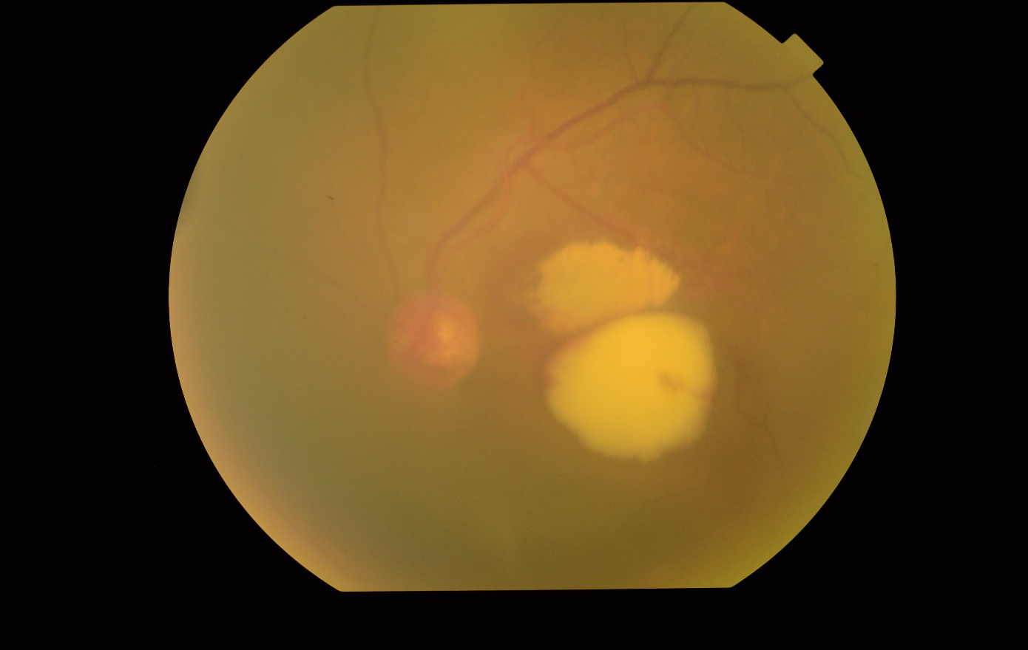
DFE 8/2016

Slide 14
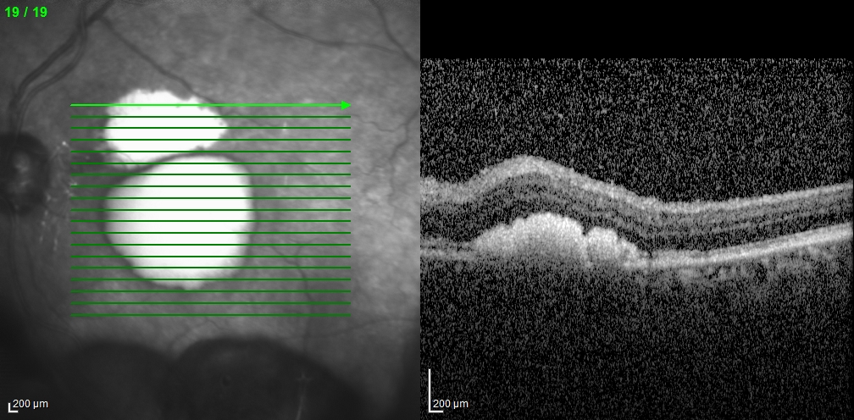
OCT OS 8/2016

Slide 15
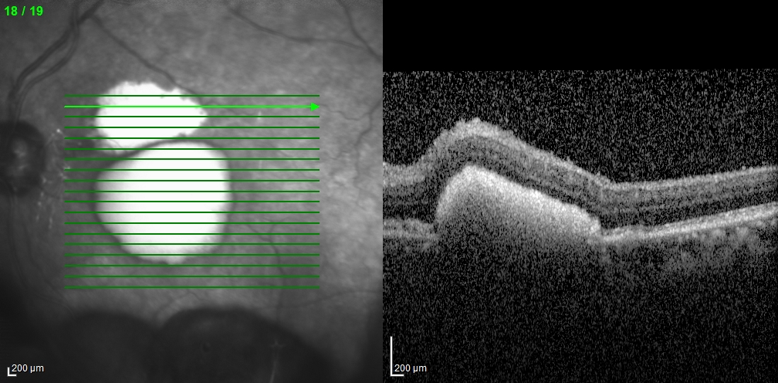

Slide 16
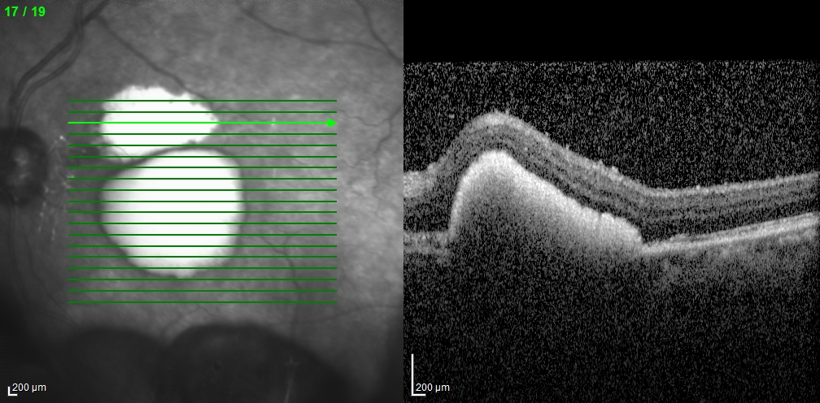

Slide 17
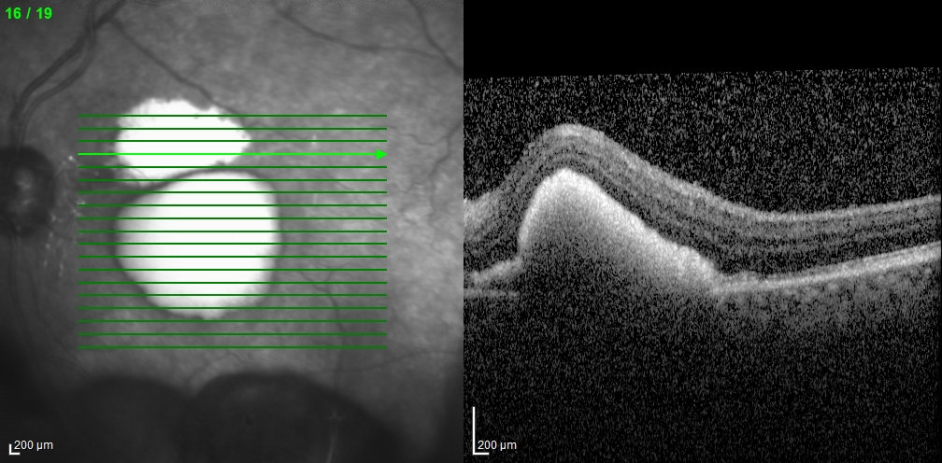

Slide 18
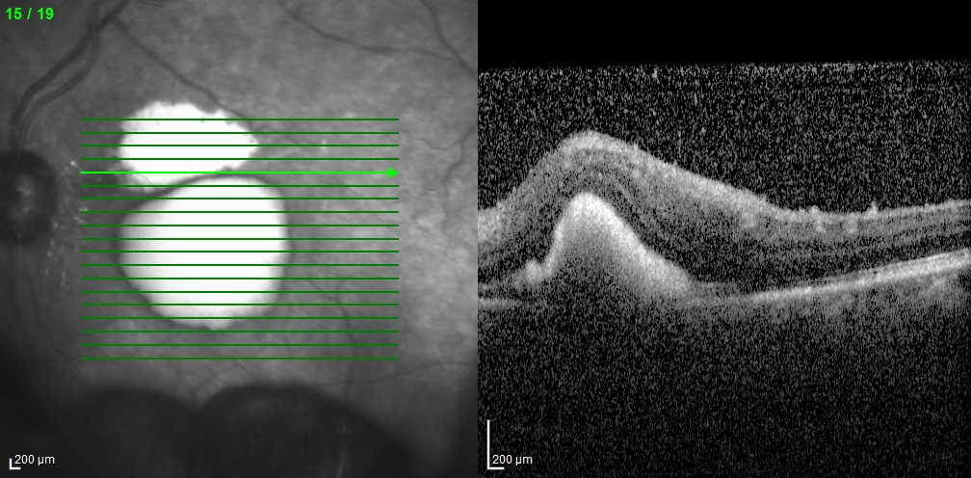

Slide 19
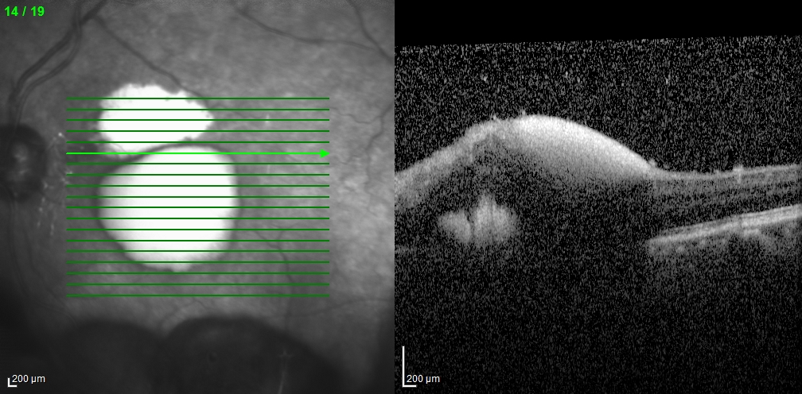

Slide 20
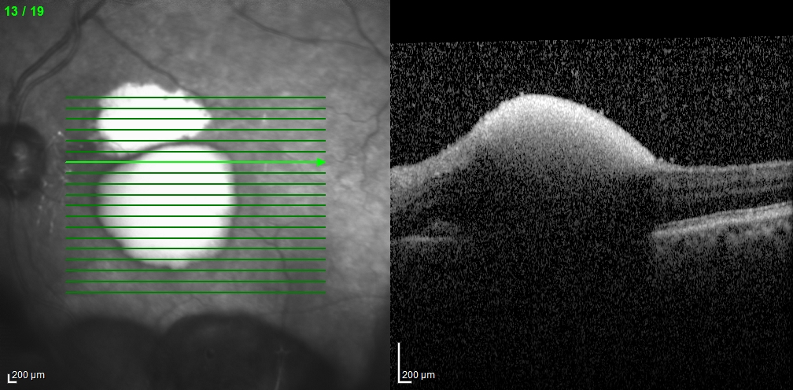

Slide 21
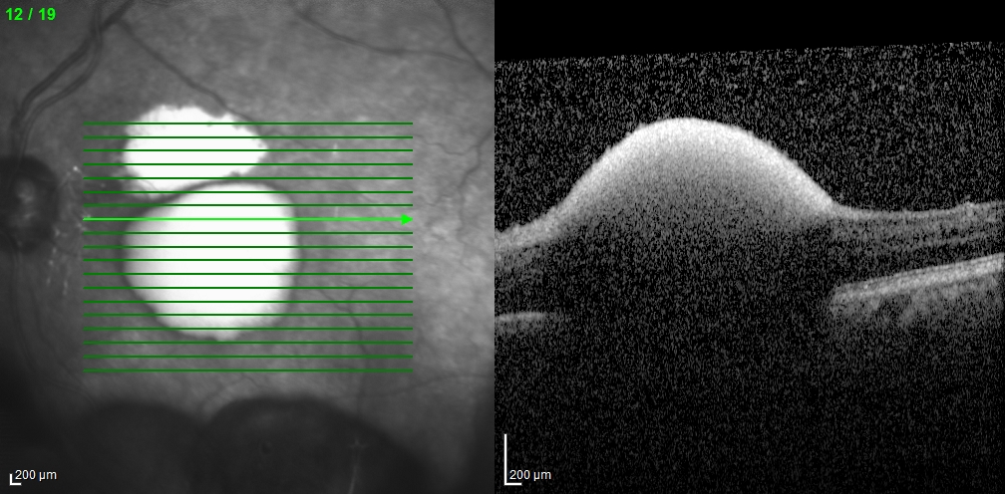

Slide 22
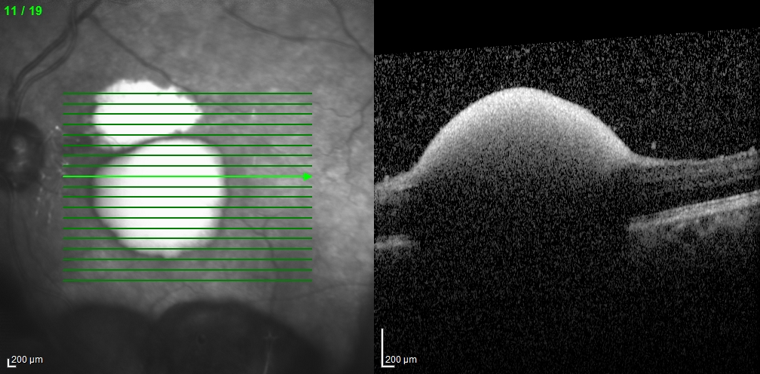

Slide 23
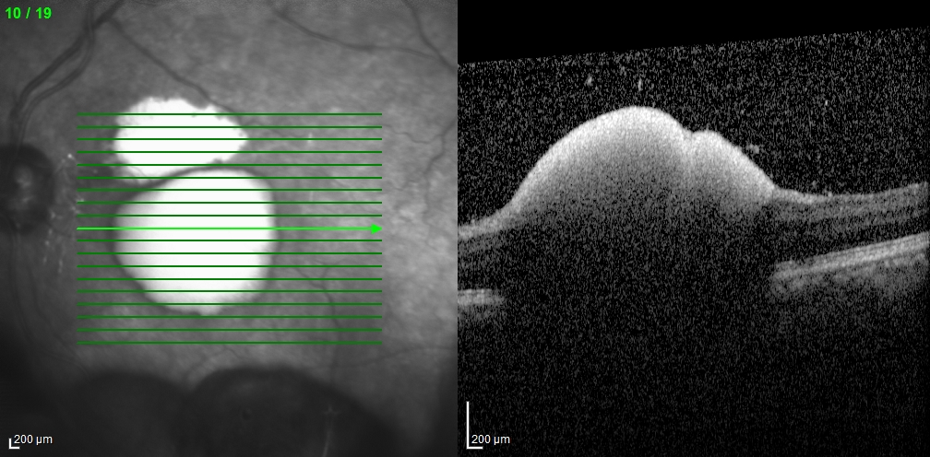

Slide 24
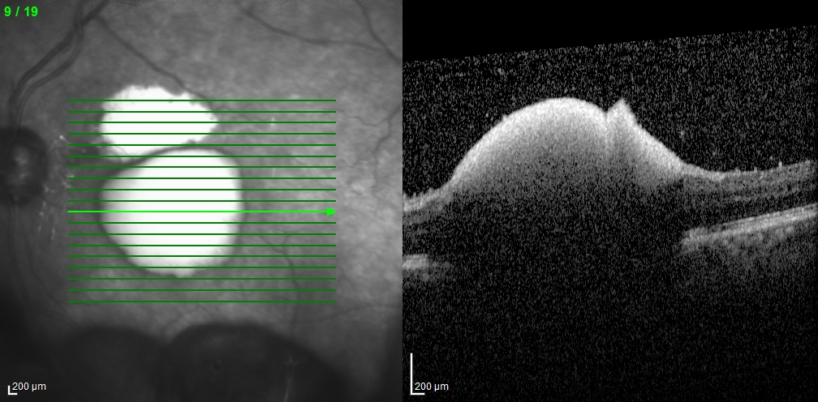

Slide 25
FA/ICG OS Early

Slide 26
FA/ICG OS Late

Slide 27
Retinal Arterial Macroaneurysms
Acquired, focal dilations of retinal arterial branches
Hemorrhagic or Exudative
Prevalence
May occur 1:9000 Eyes (Xu et al 2007)
Risk Factors
Female gender, Age >60, Hypertension
Natural Course
May involute spontaneously
Decrease VA due to edema, exudate, or hemorrhage involving macula
Diagnosis aided by angiography

Slide 28
Management
OBSERVATION
Laser Photocoagulation
Directly to or around leaking aneurysm (Humayun et al. 1998).
Intravitreal anti-VEGF
Bevacuzimab (Pichi F et al 2013)
Vitrectomy
Hemorrhagic, ruptured MA (Zhao et al 2000)
Nd:YAG
Photodisruption to ILM or Posterior Hyaloid (Dahreddine et al 2011)

Slide 29
Overall visual prognosis was good.
Individually chosen therapies were effective and efficient (laser, vitrectomy
w/ or w/o tPA, observe)
If subfoveal hemorrhage caused a macular hole, the VA outcome was limited.
Koinzer S, et al. Br J Ophthalmol 2015;99:1345–1353. doi:10.1136/bjophthalmol-2014-305884

Slide 30
Return 9/2016
VA OS 20/100

Slide 31
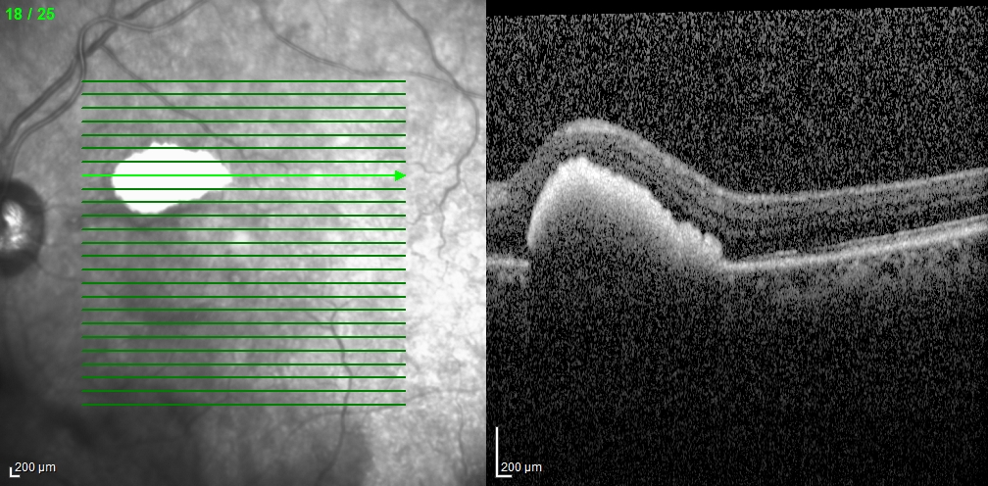
OCT OS 9/2016

Slide 32
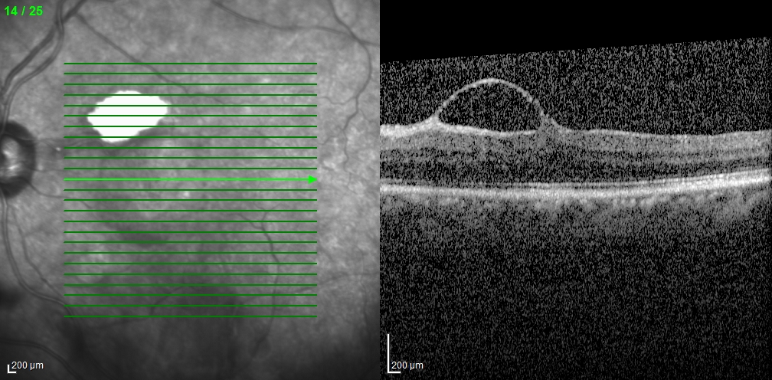

Slide 33
Return 10/2016
BCVA 20/60 OS

Slide 34
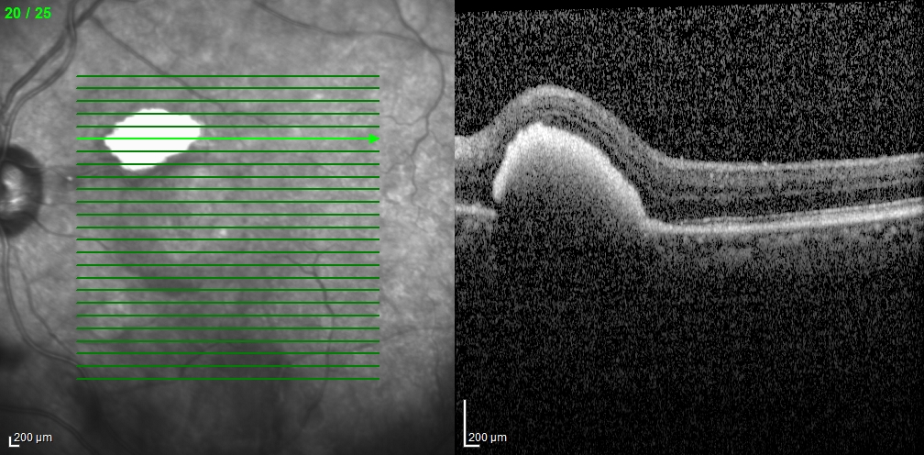
OCT OS 10/2016

Slide 36
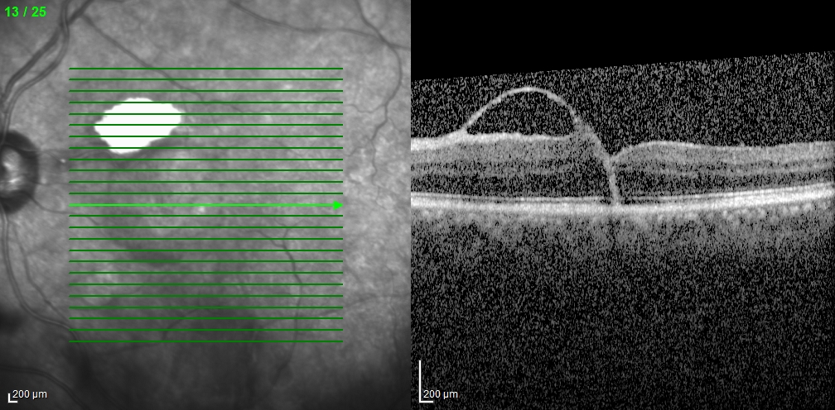

Slide 37
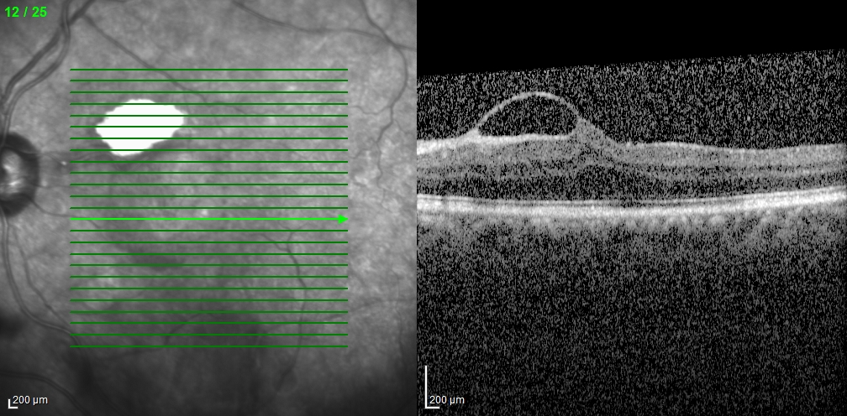

Slide 38
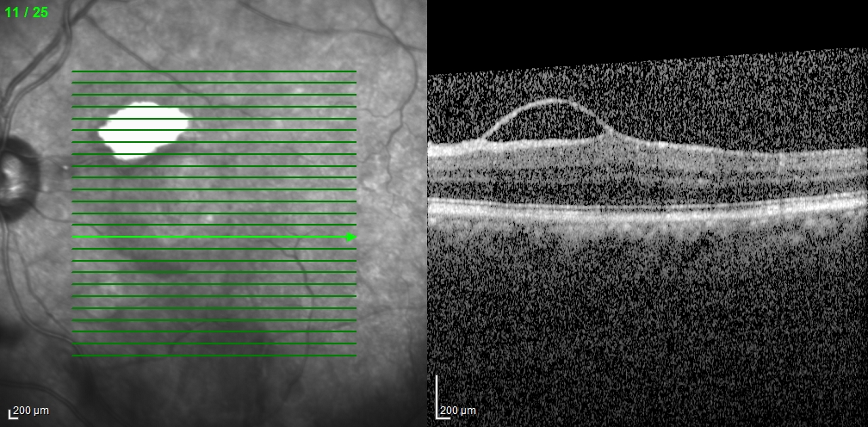

Slide 39
KEY POINTS
Macroaneurysms associated with HTN, female, age >60
Diagnosis with angiography
Management is variable – observe, laser photocoagulation, anti-VEGF, vitrectomy
Future studies?
Prospective study to explore photocoagulation vs anti-VEGF vs observation

Slide 40
References
BCSC- Retina and Vitreous
Koinzer S, Heckmann J, Tode J, Roider J. Long-term, therapy-related visual outcome of 49 cases with retinal arterial macroaneurysm: a case series and literature review. Br J Ophthalmol. 2015 Oct;99(10):1345-53
Cahuzac A, Scemama C, Mauget-Faÿsse M, Sahel JA, Wolff B. Retinal arterial macroaneurysms: clinical, angiographic, and tomographic description and therapeutic management of a series of 14 cases. Eur J Ophthalmol. 2016 Jan-Feb;26(1):36-43.
Xu L, Wang Y & Jonas JB: Frequency of retinal macroaneurysms in adult Chinese: the Beijing Eye Study. Br J Ophthalmol. 2007. 91: 840–841.
Humayun M, Lewis H, Flynn HW Jr, Sternberg P Jr & Blumenkranz MS: Management of submacular hemorrhage associated with retinal arterial macroaneurysms. Am J Ophthalmol . 1998.126:358–361.
Pichi F, Morara M, Torrazza C, et al. Intravitreal bevacizumab for macular complications from retinal arterial macroaneurysms. Am J Ophthalmol 2013;155:287–294.e1.
Zhao P, Hayashi H, Oshima K, et al. Vitrectomy for macular haemorrhage associated with retinal arterial macroaneurysm. Ophthalmology 2000;107:613–17.
Dahreddine M, Eldirani H, Mutsinzi E, et al. [Retinal arterial macroaneurysm complicated by premacular haemorrhage: treatment by YAG laser disruption]. J Fr Ophtalmol 2011;34:131.e1–5.

Slide 41
Thank You
Drs Newman, Piri, Hadayer, Adeniran, Wang, and Sigford

