Slide 1
Grand Rounds A Systemic Diagnosis of an Orbital Finding
Tala Kassm DO
August 19th, 2016

Slide 2
Patient Presentation
Chief Complaint
“I see two of everything.”
HPI
63 year old white male presents with 3 – 4 months of vertical binocular diplopia.
Denies eye pain but notes some mild tenderness along left brow.
Denies a history of weight loss, night sweats, loss of appetite or fever.

Slide 3
History (Hx)
Past Ocular Hx: none
Past Medical Hx: hypertension, anxiety, depression
Family Hx: Diabetes mellitus, hypertension
Medications: Simvastatin, omeprazole, metoprolol, losartan, clonazepam, lamotrigine
Allergies: NKDA
Social Hx: denies tobacco, alcohol or drug use
ROS: Denies bloody urine or difficulty urinating

Slide 4
External Exam
 | OD |  | OS
VA cc D | 20/25 |  | 20/25
Refraction | +2.50-0.25x145 |  | +3.50-0.75x111
Pupils | 4→3mm | No rAPD | 4→3mm
IOP | 14 mmHg |  | 18 mmHg
EOM | Full |  | 12 PD hypotropia
CVF | Full |  | Full
-2
-2
-1
0
0
0

Slide 5
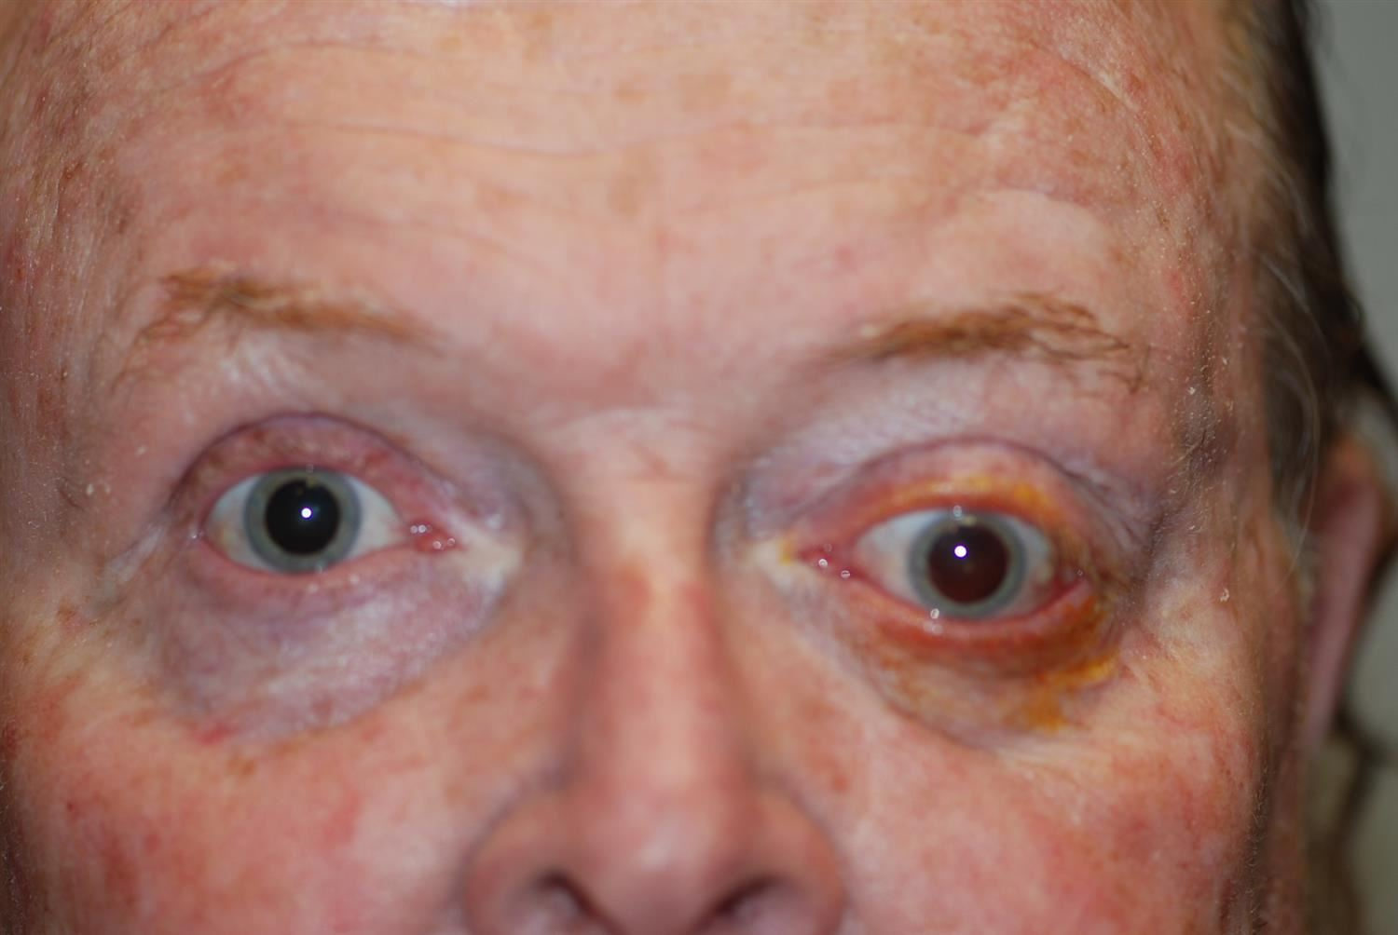
Clinical Exam
SLE | OD |  | OS
External/Lids | WNL |  | Hypoglobus Proptosis Lag ophthalmos Fullness in superior temporal region of orbit
Conj/Sclera | White and quiet |  | Mild injection inferiorly
Cornea | Clear |  | SPK diffusely
Ant Chamber | Deep and quiet |  | Deep and quiet
Iris | WNL |  | WNL
Lens | 2+ NS |  | 2+ NS
DFE | Unremarkable |  | Unremarkable
106
18
25
Notes:
Fullness of upper brow temporally, hypoglobus, proptosis

Slide 6
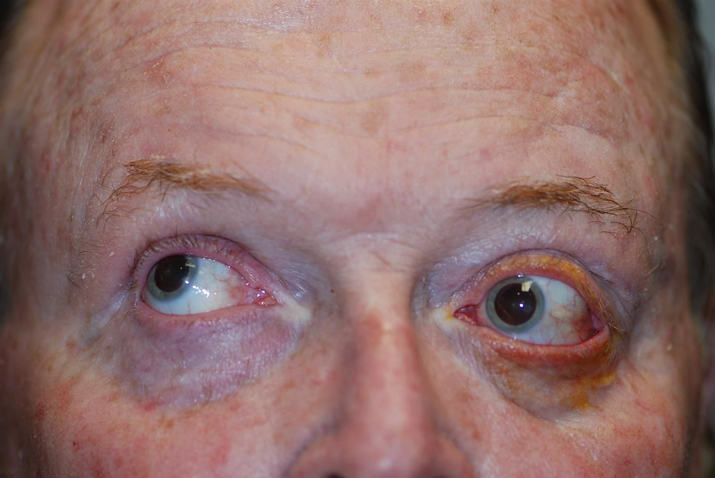
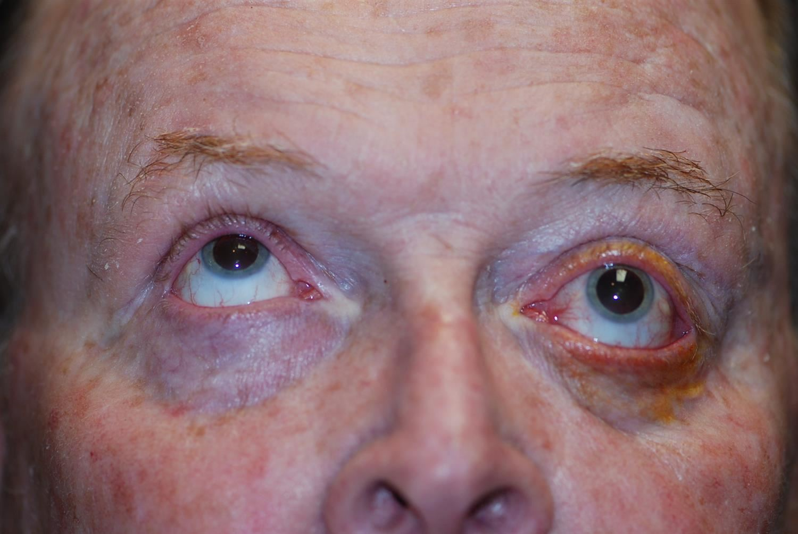
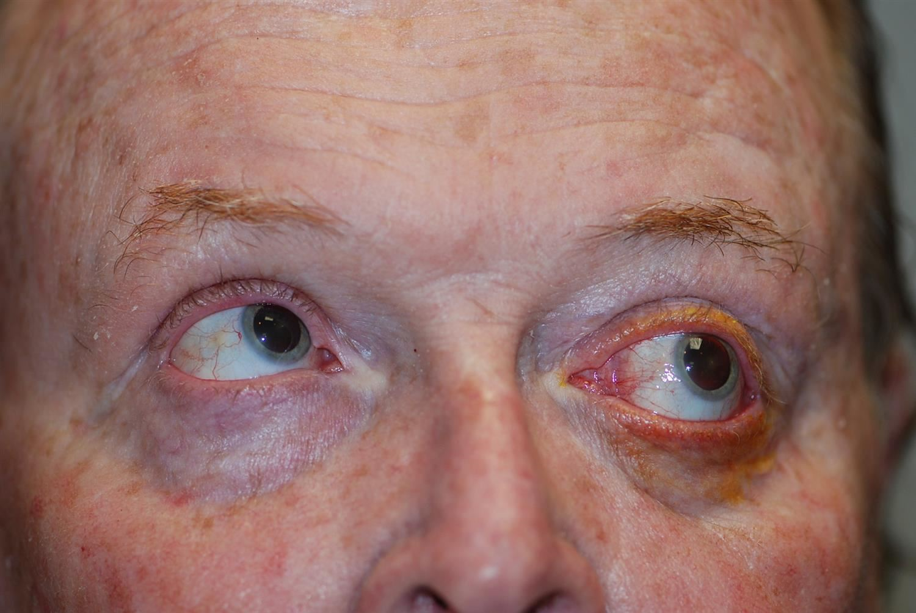
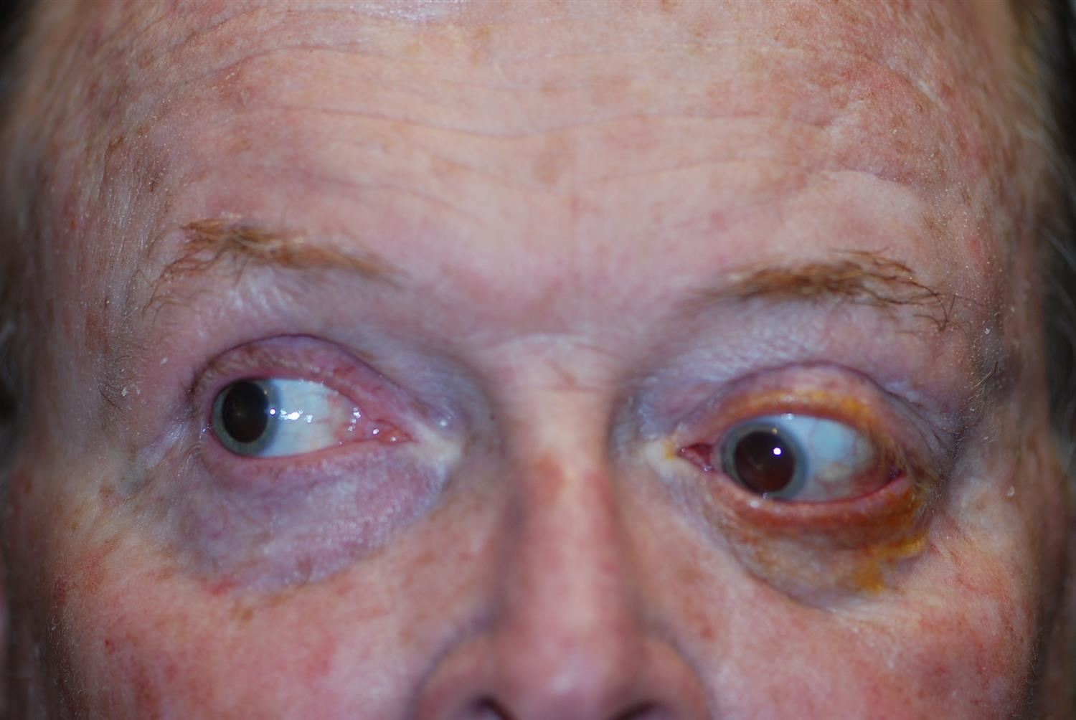
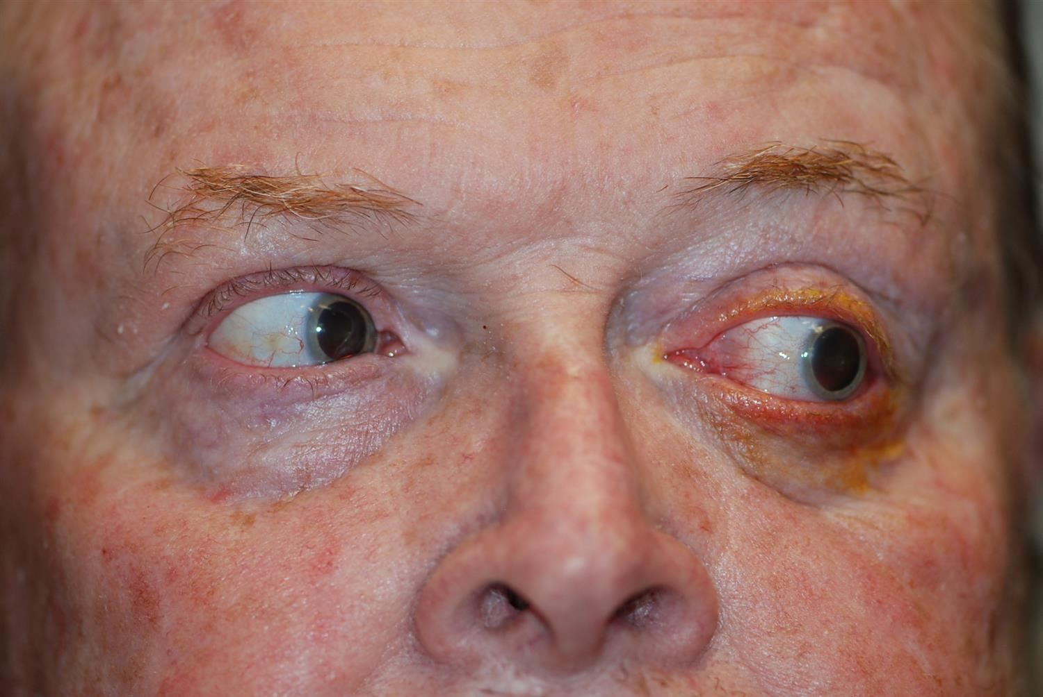
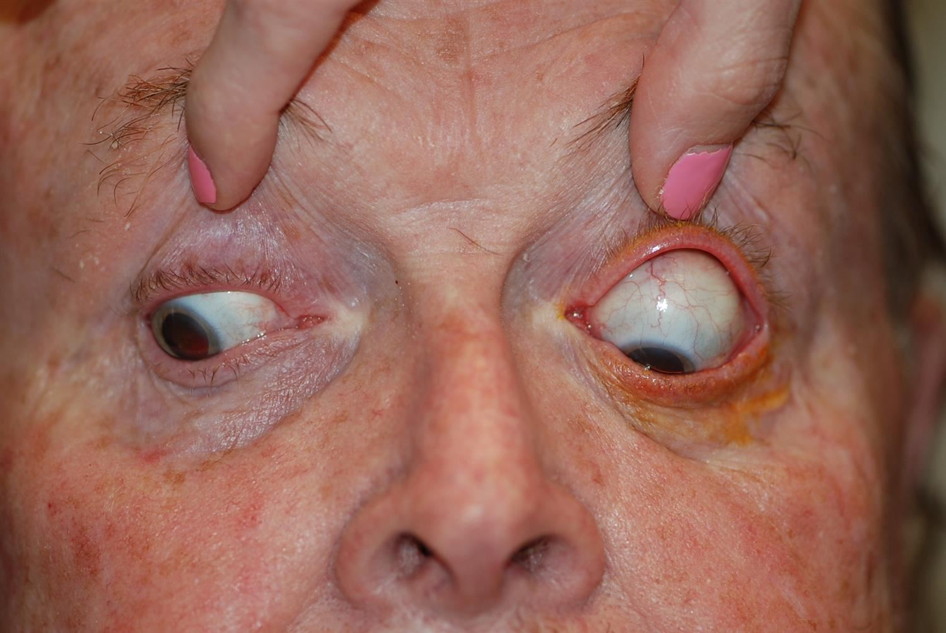
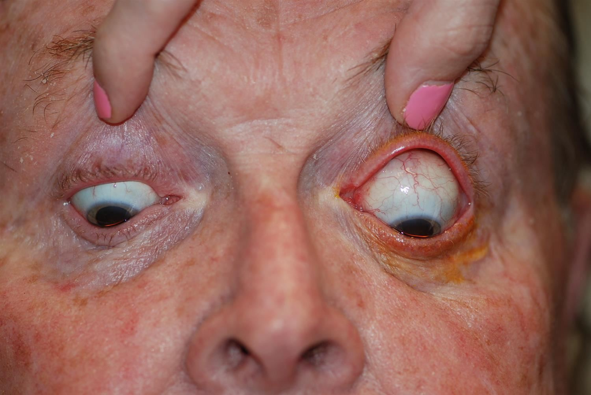
Clinical Photos

Slide 7
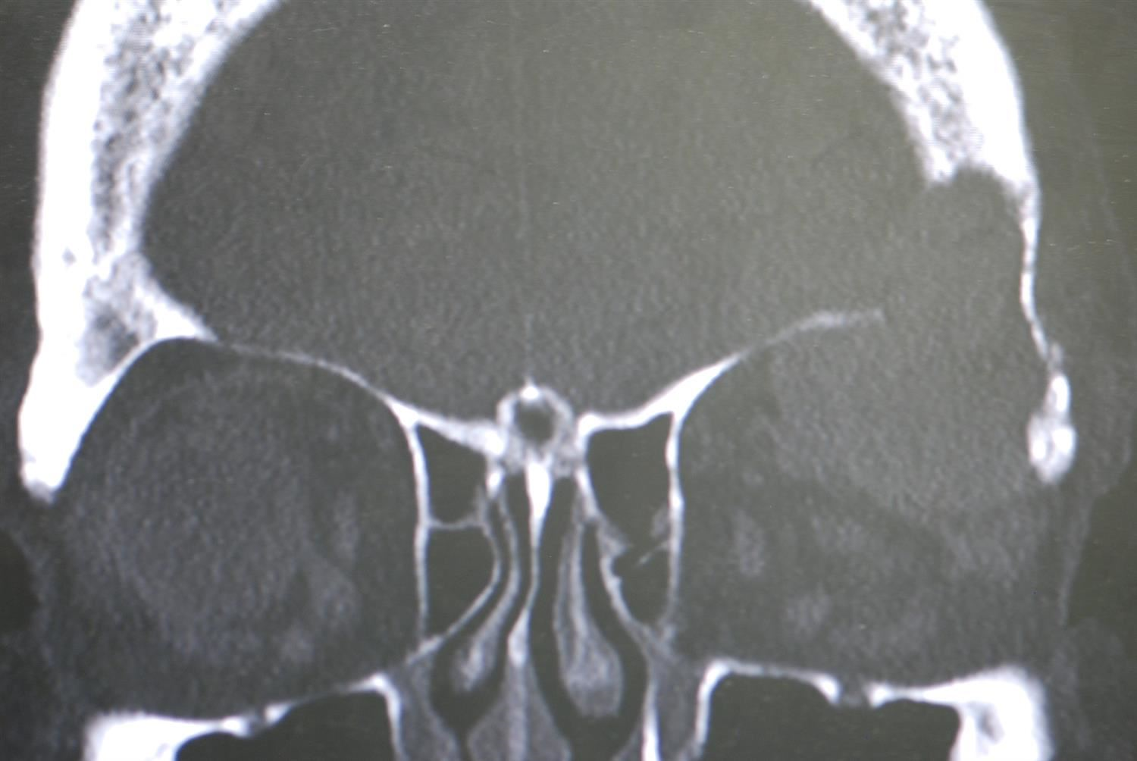
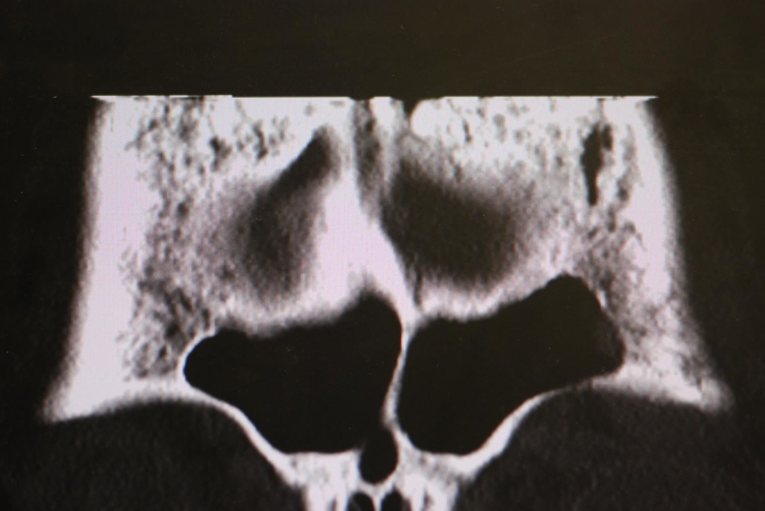
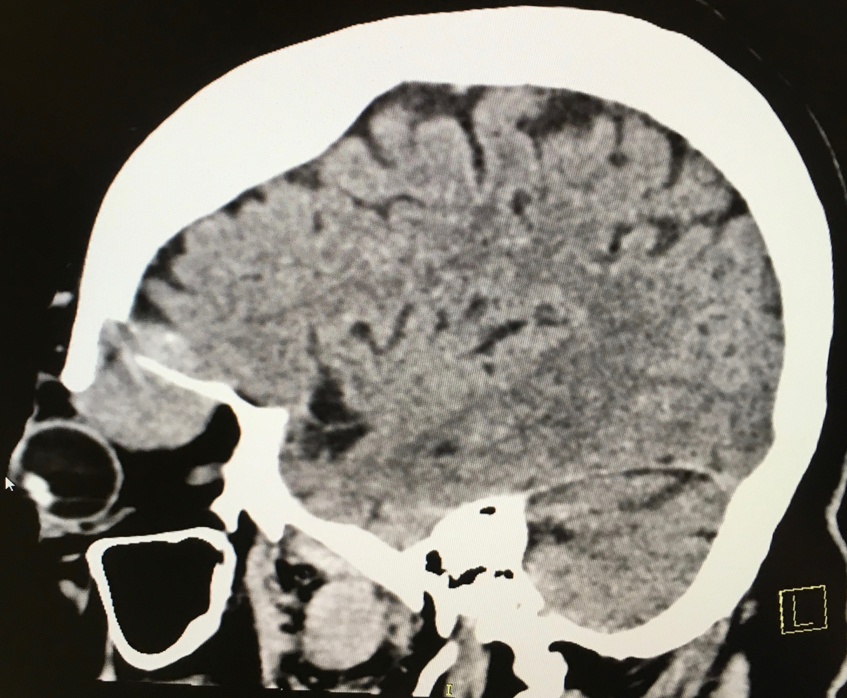
CT Scan
Notes:
Coronal, axial, sagittal
Mass in the superolateral extraconal space of left orbit, displacing lateral and medial rectus muscles and globe. Extends into left frontal sinus and extra dural space adjacent to the left frontal lobe in association with cortical destruction of base of skull without definitive evidence for extension into brain parenchyma.
Destruction of left superolateral orbital wall with extension of mass into soft tissues
Other bony destruction/lesions of skull, differential includes multiple myeloma, lymphoma, metastatic disease

Slide 8
Assessment
63 year old white male presents with 3 months of vertical diplopia and proptosis on left side.
Mass lesion of the superior temporal aspect of left orbit.
Differential includes:
Lacrimal gland tumor
Adenoid cystic carcinoma
Metastatic disease
Prostate
Primary lymphoma
Multiple myeloma
Notes:
Also primary adenocarcinmoas, mucoepidermoid carcinomas, squamos carcinomas

Slide 9
Plan
Orbitotomy with biopsy of mass lesion
Follow up with primary care for prostate evaluation and further systemic work up
Routine labs

Slide 10
Labs
CMP
Protein total 8.8 (High)
Calcium 8.7 (N)
Remainder was unremarkable
CBC
Unremarkable
Notes:
RBC (4.32-5.72) HGB: 13.5-17.5 HCT: 38.8- 50.0

Slide 11
Pathology Results
IgG Kappa Plasma Cell Neoplasm
CD138 Positive
MUM1: Positive
CD20: Negative
Kappa ISH: Positive
Lambda ISH: Negative
CD56: Positive
Notes:
CD56: diffusely, seen with plasma cells, neuroendrocine lesions.

Slide 12
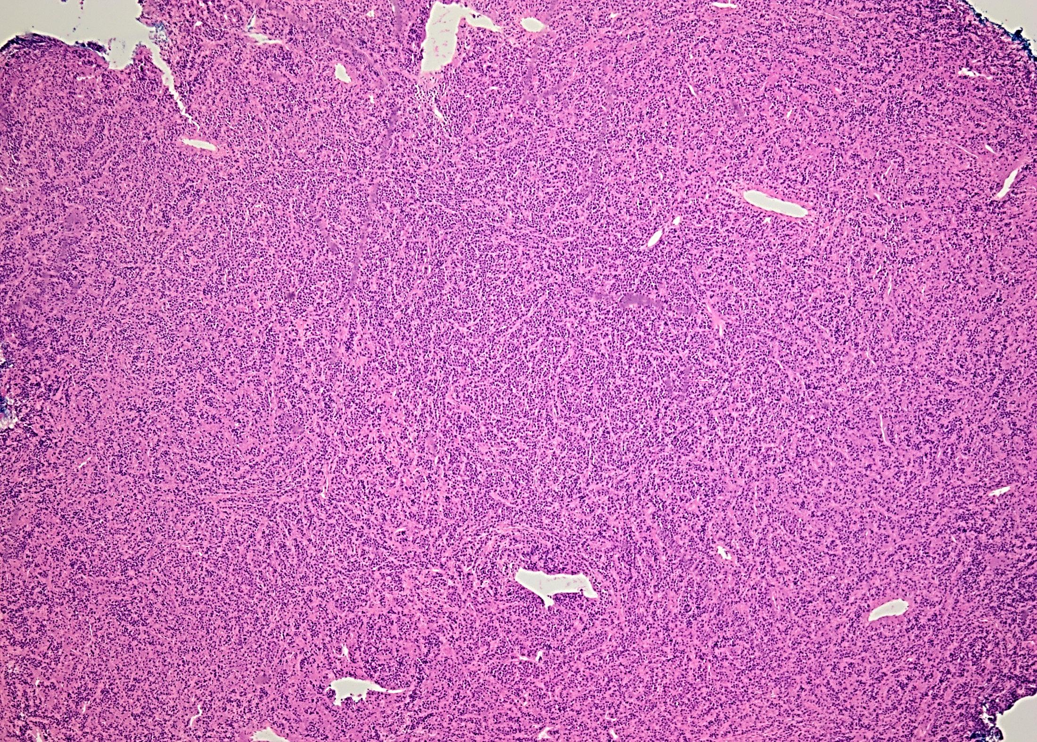
Notes:
4x – diffuse sheets of monotonous cells

Slide 13
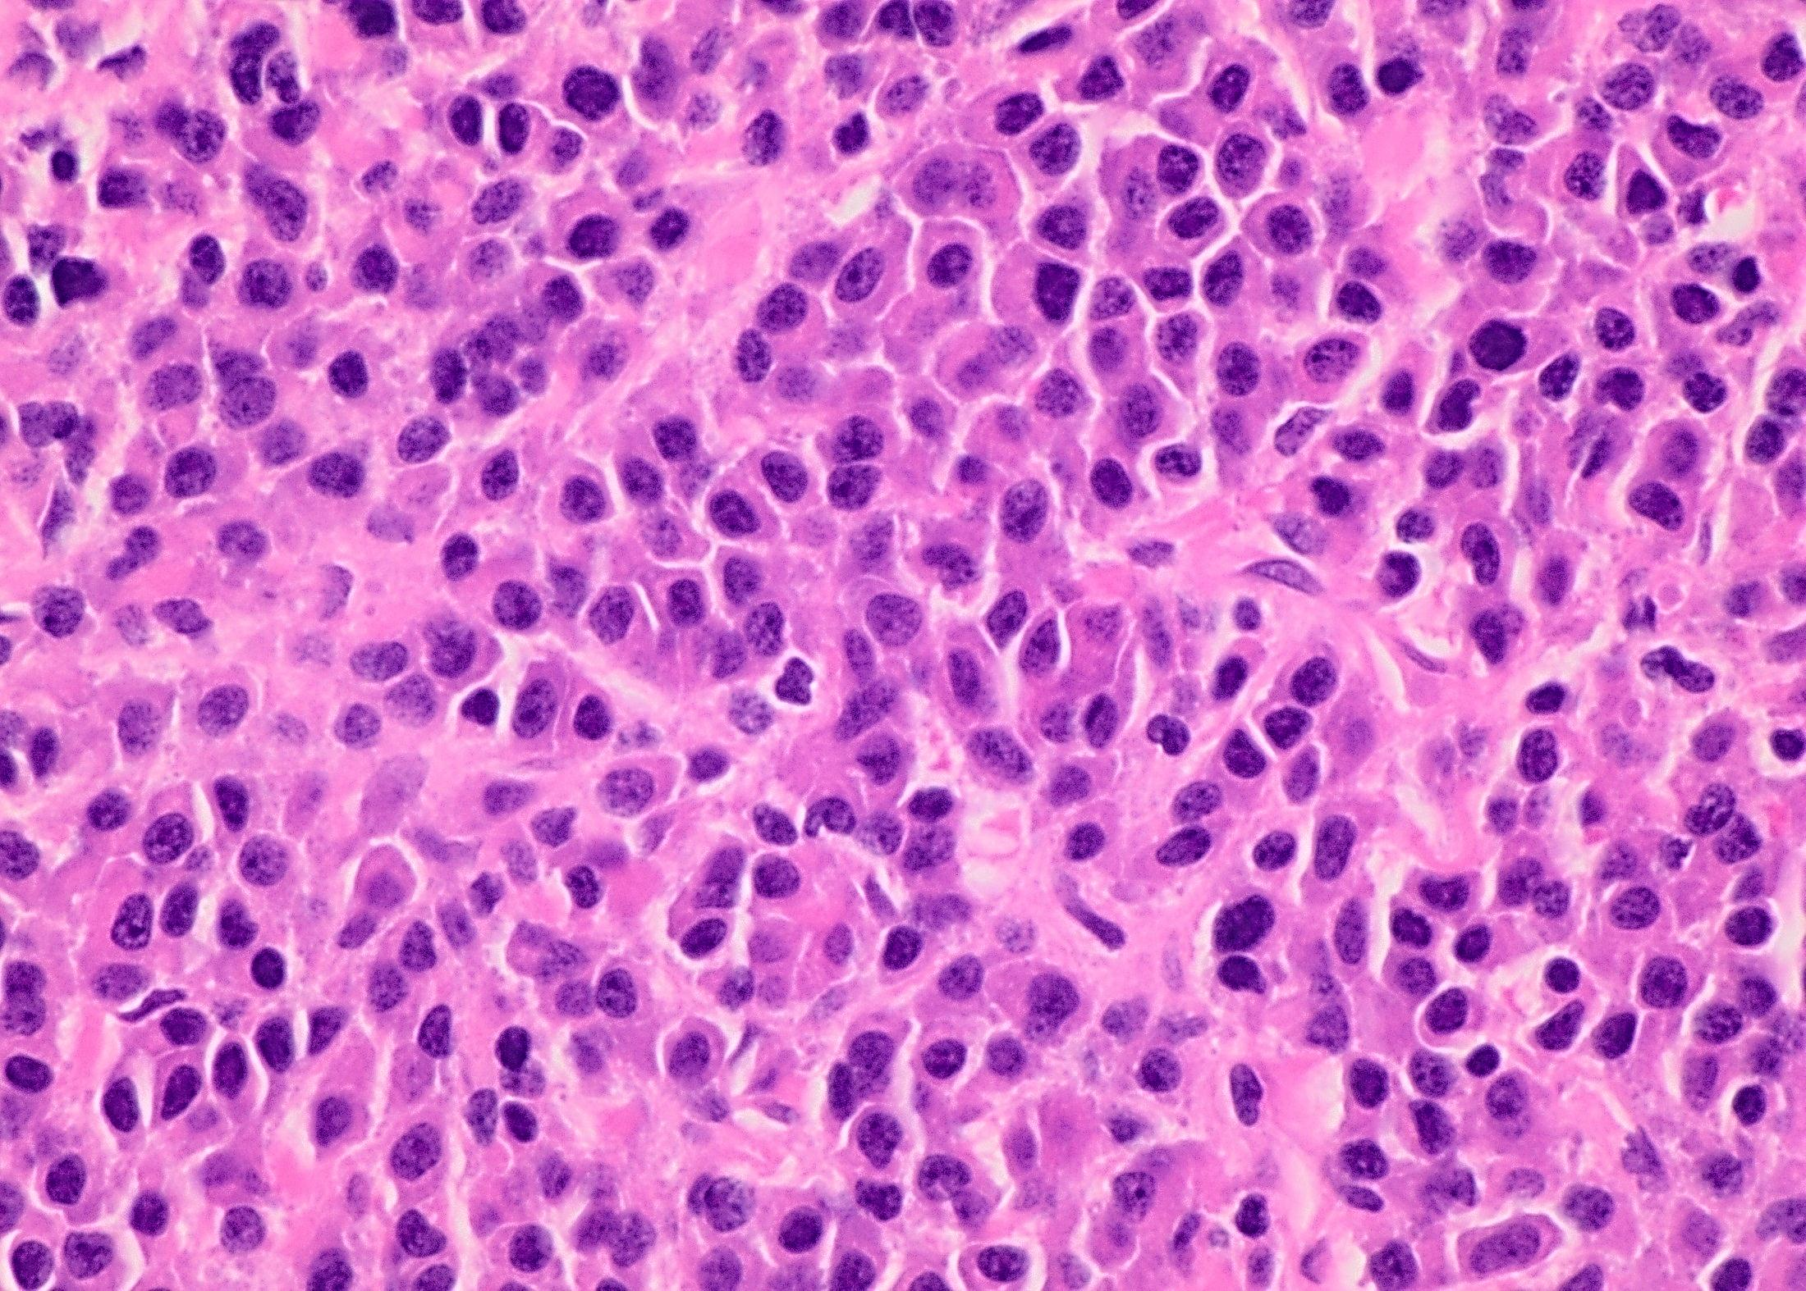
Notes:
60x – plasmacytoid appearance = eccentric nuclei (pushed to one side of the cell), abundant eosinophilic cytoplasm
Characteristic cheets and clusters of mature plasma cells, eccentric nuclei

Slide 14
Plan
Pathology findings consistent with a diagnosis of plasmacytoma
Systemic workup needed to rule out multiple myeloma, waldenstrom macroglobulinemia and lymphoma
PET Scan

Slide 15
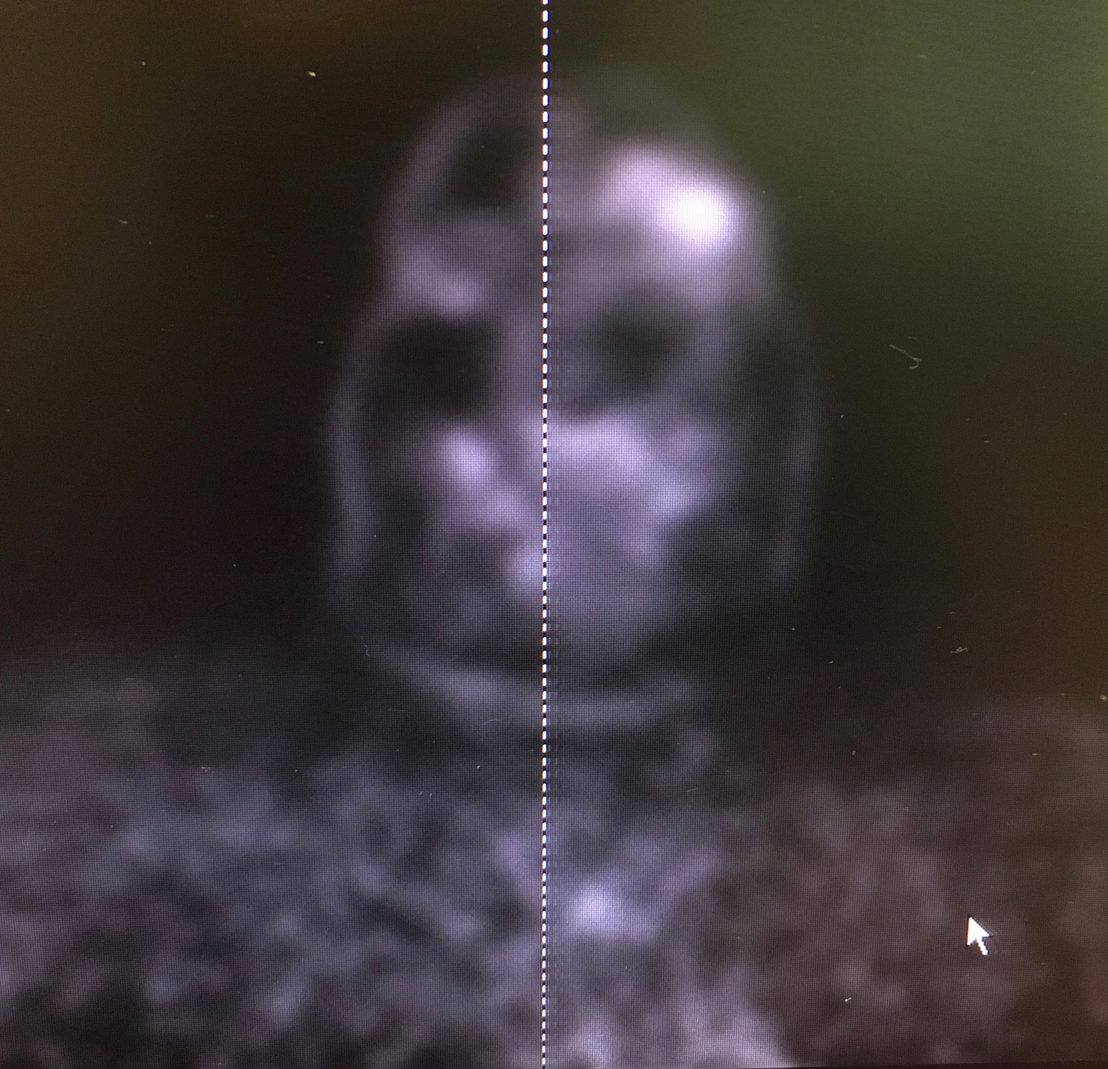
PET Scan
Hypermetabolic left periorbital mass
Lytic lesion extending into intracranial compartment over left orbitofrontal region
Small “punched out” bone
lesion in left superior frontal
calvarium
Small volume hypermetabolic
lucent lesion in manubrium
Findings most consistent with
manifestations of multiple myeloma
Further lab workup:
Kappa FL Chain 236.2 (H)
Lambda FL Chain 5.50 (L)

Slide 16
Multiple Myeloma
Bone marrow-based multifocal plasma cell neoplasm that destroys skeletal, renal and neurological function.
Characterized by multiple osteolytic lesions
Common presenting signs and symptoms include
Bone pain
Fatigue
Normocytic-normochromic anemia
Renal insufficiency
Notes:
Bence jones protein obstructing distal and collecting tubules,
Hypercalcemia: boney destruction, increased osteoclast activity

Slide 17
Multiple Myeloma
Second most common blood cancer (10%)
Age range of 40 to 70 years
African Americans affected more than whites
Male to female 1.4:1
Incidence in the United States of 4.4 cases per 100,000 persons per year
Notes:
After non-Hodgkin lymphoma
Majority of patients older than 65, only 1% younger than 40. uncommon in children.
Bone pain of axial skeleton

Slide 18
Lab Values
Diagnostic lab findings of monoclonal hypergammaglobulinemia
Production of excess monoclonal and free light chain proteins
Most common type of heavy chain is IgG
Light chain: kappa or lambda
May also find:
Hypercalcemia, anemia
Elevated alkaline phosphatase
Hyperuricemia
Elevated erythrocyte sedimentation rate
Notes:
Light chain: bence jone protein seen in urine
Bone marrow dysfunction: pancytopenia

Slide 19
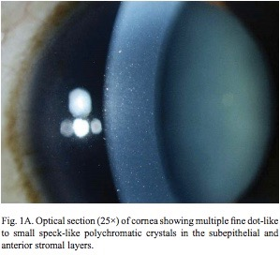
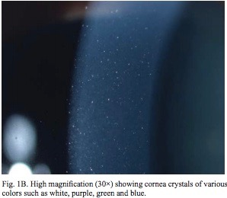
Multiple Myeloma
Common ocular findings:
Copper or crystal deposition in cornea
Ciliary body cysts
Retinopathy of viscosity
Retinal hemorrhages or cotton-wool spots
Exudative macular detachment
Orbital involvement is rare
Frequently the first manifestation of MM
Proptosis is the initial presenting symptom
Majority affect superotemporal quadrant
Notes:
Viscosity: elevated serum immunoglobulins -> CRVO
Eye findings are either ocular, orbital or neuro-ophthalmic. Tissue infiltration by plasma cells and hematological abnormalities due to increased blood viscosity
Also seen as first recurrence of disease thought to be in remission

Slide 20
Treatment
Systemic involvement
Best treated with chemotherapy
Oral melphalan and prednisone
Bortezomib
Possibly with adjunctive radiotherapy
Isolated orbital lesions
Respond well to local irradiation
2-40 Gy range
Mean survival roughly 30 months
Notes:
Melphalan: alkylating agent
Proteasome inhibitor (proteasome – cellular complex that breaks down proteins (proteins normally break down cancer cells, are destroyed too quickly
Autologous stem cell transplant
GY: gray units

Slide 21
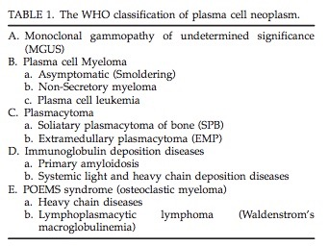
Plasma Cell Neoplasm of the Orbit
In the setting of multiple myeloma
As a solitary mass
Extramedullary plasmacytoma (EMP)
Solitary plasmacytoma of bone (SPB)
Notes:
SPB: 50% will develop MM. EMP: derived from soft tissue, relatively benign with better prognosis.
Abnormal proliferations of a single clone of highly specialized B-lymphocytes that produce a specific immunoglobulin
Plasma cell dyscrasias – paraproteinemias- low grade lymphoplasmacytic lymphomas
Expansion of a single clone of immunoglobulin-secreting, terminally differentiated, end-stage B-cells
-multiple myeloma and waldenstrom macroglobulinemia – two common forms. Monoclonal gammopathy of undetermined significance (MGUS).
-unlike leukemia – proliferation of terminally differentiated B-lymphocytes, or plasma cells, secreting immunoglobulin or immunoglobulin fragments

Slide 22
Retrospectively reviewed literature of multiple myeloma (MM) patients with orbital involvement
Goal: to clarify and summarize the presenting characteristics of orbital involvement in MM.
Reviewed 52 cases in total, some with diagnosis of SBP or EMP
Orbital involvement of MM is rare – 34 reported cases from 1972 to 2009

Slide 23
Characteristics of Orbital Multiple Myeloma
Roughly two-thirds (65%) already carried a diagnosis of MM.
Average time from initial MM diagnosis to orbital presentation was over one year (17.6 months).
Most common finding of proptosis (81% of patients).
Average of 5 months from symptom onset to presentation
Unilateral involvement in 88%
IgG subtype in 51% and Kappa light chain elevated in 38%
Survival with orbital involvement was 23, 28 and 26 months for MM, EMP, SBP

Slide 24
Conclusions
Orbital involvement in multiple myeloma is rare.
May be the presenting symptom of MM.
Most commonly occurs in the superotemporal quadrant.
When found as an isolated orbital lesion, responds well to radiation.

Slide 25
References
Allen CE. Kent CJ. Rubin PAD. Jakobiec FA. Other Lymphocytic Disease Processes. Albert & Jakobiec’s Principles and Practices of Ophthalmology. 238: 3061-71. 2000.
Burkat, Cat. Van Buren, J.J. Lucarelli, MJ. Characteristics of Orbital Multiple Myeloma: A Case Report and Literature Review. Survey Of Ophthalmology. 2009-11-1. 54.6: 697-704. 2009.
Cavo M, Galieni P, Gobbi M, Baldrati L, Leardini L, Baccarani M, Tura S. Nonsecretory multiple myeloma. Presenting findings, clinical course and prognosis. Acta Haematol. 1985;74:27-30.
Allen CE. Kent CJ. Rubin PAD. Jakobiec FA. Hematologic Disorders. Albert & Jakobiec’s Principles and Practices of Ophthalmology. 346:4803-4820. 2000.
Fung S, Selva D, Leibovitch I, Hsuan J, Crompton J. Ophthalmic manifestations of multiple myeloma. Ophthalmologica. 2005;219:43-48.
Hamburger HA. Orbital Involvement in multiple myeloma. A new angiographic presentation. J Clin Neuro-ophthalmol. 1984;4:25-29.
Allen CE. Kent CJ. Rubin PAD. Jakobiec FA. Orbital Pathology. Albert & Jakobiec’s Principles and Practices of Ophthalmology. 276:3753-3795. 2000.

Slide 26
Thank You

Slide 27
Plasmacytoma
Two types: either arise from bone (SBP) or soft tissue (EMP)
SBP closely related to MM, majority progress to MM within three years
More frequent than EMP
Arises from medullary bone of axial skeleton
Bony erosion more common than in EMP
Poor outcome predictor

Slide 28
Plasmacytoma
EMP
Comprises 3% of malignant plasma cell tumors
Majority are located in head and neck (80%)
Typically affect upper respiratory tract then gastrointestinal tract
M:F 3:1
Age of presentation 6th to 7th decade
Rare to present as primary orbital plasmacytoma
May mimic lacrimal gland tumor
Relatively benign with better prognosis

Slide 29
Plasmacytoma
Diagnostic criteria for EMP
No M protein in serum or urine
Normal bone marrow
Normal skeletal survey
No related organ or tissue impairment
Extramedullary tumor of clonal plasma cells

