Slide 1
Corneal endothelial decompensation secondary to retained intracameral foreign body
Grand Rounds
Lara Rosenwasser Newman
April 21, 2017

Slide 2
Patient Presentation
CC
  Blurred vision OD s/p MVA
  Consult for “air in globe on CT”
HPI
  64 yo F s/p MVA p/w blurred vision OD
  Denied pain OD
  History that many glass particles hit patient in face during MVA

Slide 3
History (Hx)
Past Ocular Hx: neg
Past Medical Hx: HTN, “thyroid condition”
Fam Hx: non-contributory
Meds: Synthroid, lovastatin
Allergies: NKDA
Social Hx: non-smoker, no EtOH
ROS: broken ankle, about to go to OR for external fixation

Slide 4
External Exam
 | OD |  | OS
VA | 20/25+1 |  | 20/20
Refraction | (not performed) |  | (at ER)
Pupils | 3→2mm | No rAPD | 2→1mm
IOP | 18 mmHg |  | 12 mmHg
EOM | full |  | full

Slide 5
Anterior Segment Exam
SLE | OD |  | OS
External/Lids | 2+ edema UL Palpable FB subcutaneous at brow |  | WNL
Conj/Sclera | 1+ injection |  | Clear/white
Cornea | Small 3-4 mm full thickness laceration (Siedel negative) |  | clear
Ant Chamber | Formed, Hyphema |  | formed
Iris | Traumatic iris defect |  | WNL
Lens | Clear (limited view/non-dilated pupil) |  | clear

Slide 6
Posterior Segment Exam
Fundus | OD |  | OS
Optic Nerve | UTA | WNL | Pink/sharp
Macula | UTA |  | WNL
Vessels | UTA |  | Normal caliber
Periphery | UTA |  | Small flame hem. inf. to inf. arcade
OD not dilated due to suspicion for open globe/foreign body

Slide 7
CT Imaging
“FINDINGS:
  A prominent radiopaque foreign body in the right eyelid
  Soft tissue swelling and subcutaneous emphysema
  Two small bubbles of gas are in the right anterior chamber
A radiopaque foreign body in the inferior anterior chamber

Slide 8
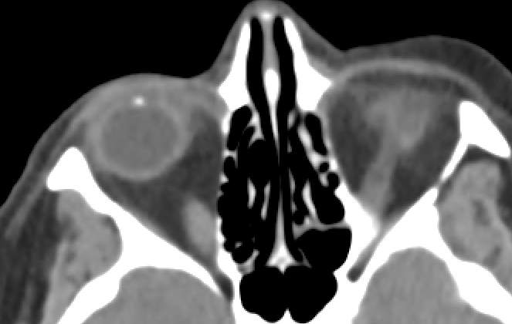
CT Imaging

Slide 9
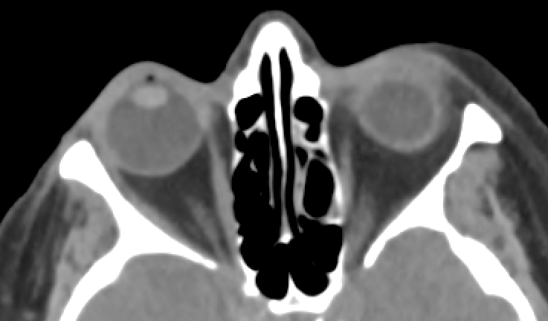
CT Imaging

Slide 10
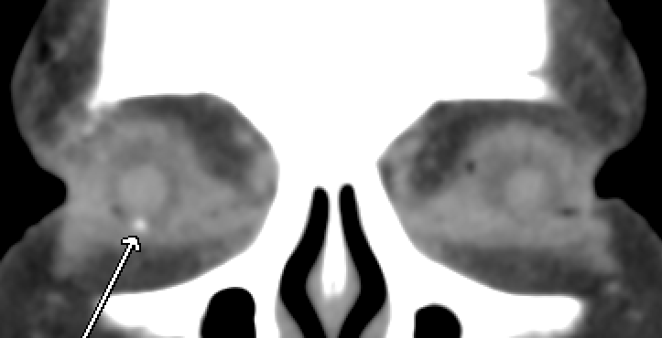
CT Imaging

Slide 11
Assessment & Plan
Full thickness corneal laceration with intraocular foreign body (evidence: iris laceration, FB and air in AC on CT)
Plan: Exploration/primary repair

Slide 12
Globe exploration OD in OR
Anterior chamber formed and deep
2 mm full thickness corneal laceration without leakage
No foreign body was found (clinically or on U/S)
At this time the decision was made to let the wound heal without suturing

Slide 13
In-hospital follow-up
VA: 20/20 OD
IOP: 16 OD
No rAPD
Ant seg exam OD: small iris laceration, small hyphema in AC over iris defect, stable vs prior
Pt placed on Vigamox and PF
Instructed to follow up in 1-3 days after discharge in clinic

Slide 14
Patient lost to follow-up until…
2 months and 4 days later...

Slide 15
Patient Re-Presentation
CC
  Decreased vision, OD>OS

Slide 16
External Exam
 | OD |  | OS
VA | HM cc, NI on manifest |  | 20/100 cc, M 20/30
Refraction | -6.00 sph NI |  | -6.75 +0.75 x150
Pupils | Round. Brisk. | No rAPD | Round. Brisk.
IOP | 12 mmHg |  | 12 mmHg
EOM | Full, orthotropic |  | Full, orthotropic
CVF | Full |  | Full

Slide 17
Anterior Segment Exam
SLE | OD |  | OS
External/Lids | Foreign body RUL |  | Normal ocular adnexa
Conj/Sclera | Clear/white |  | Clear/white
Cornea | Corneal edema, (inferiorly) Descemet folds, healed lac |  | clear
Ant Chamber | Glass FB in inf. angle |  | Deep & quiet
Iris | Iris defect |  | WNL
Lens | 3+ NS |  | clear

Slide 18
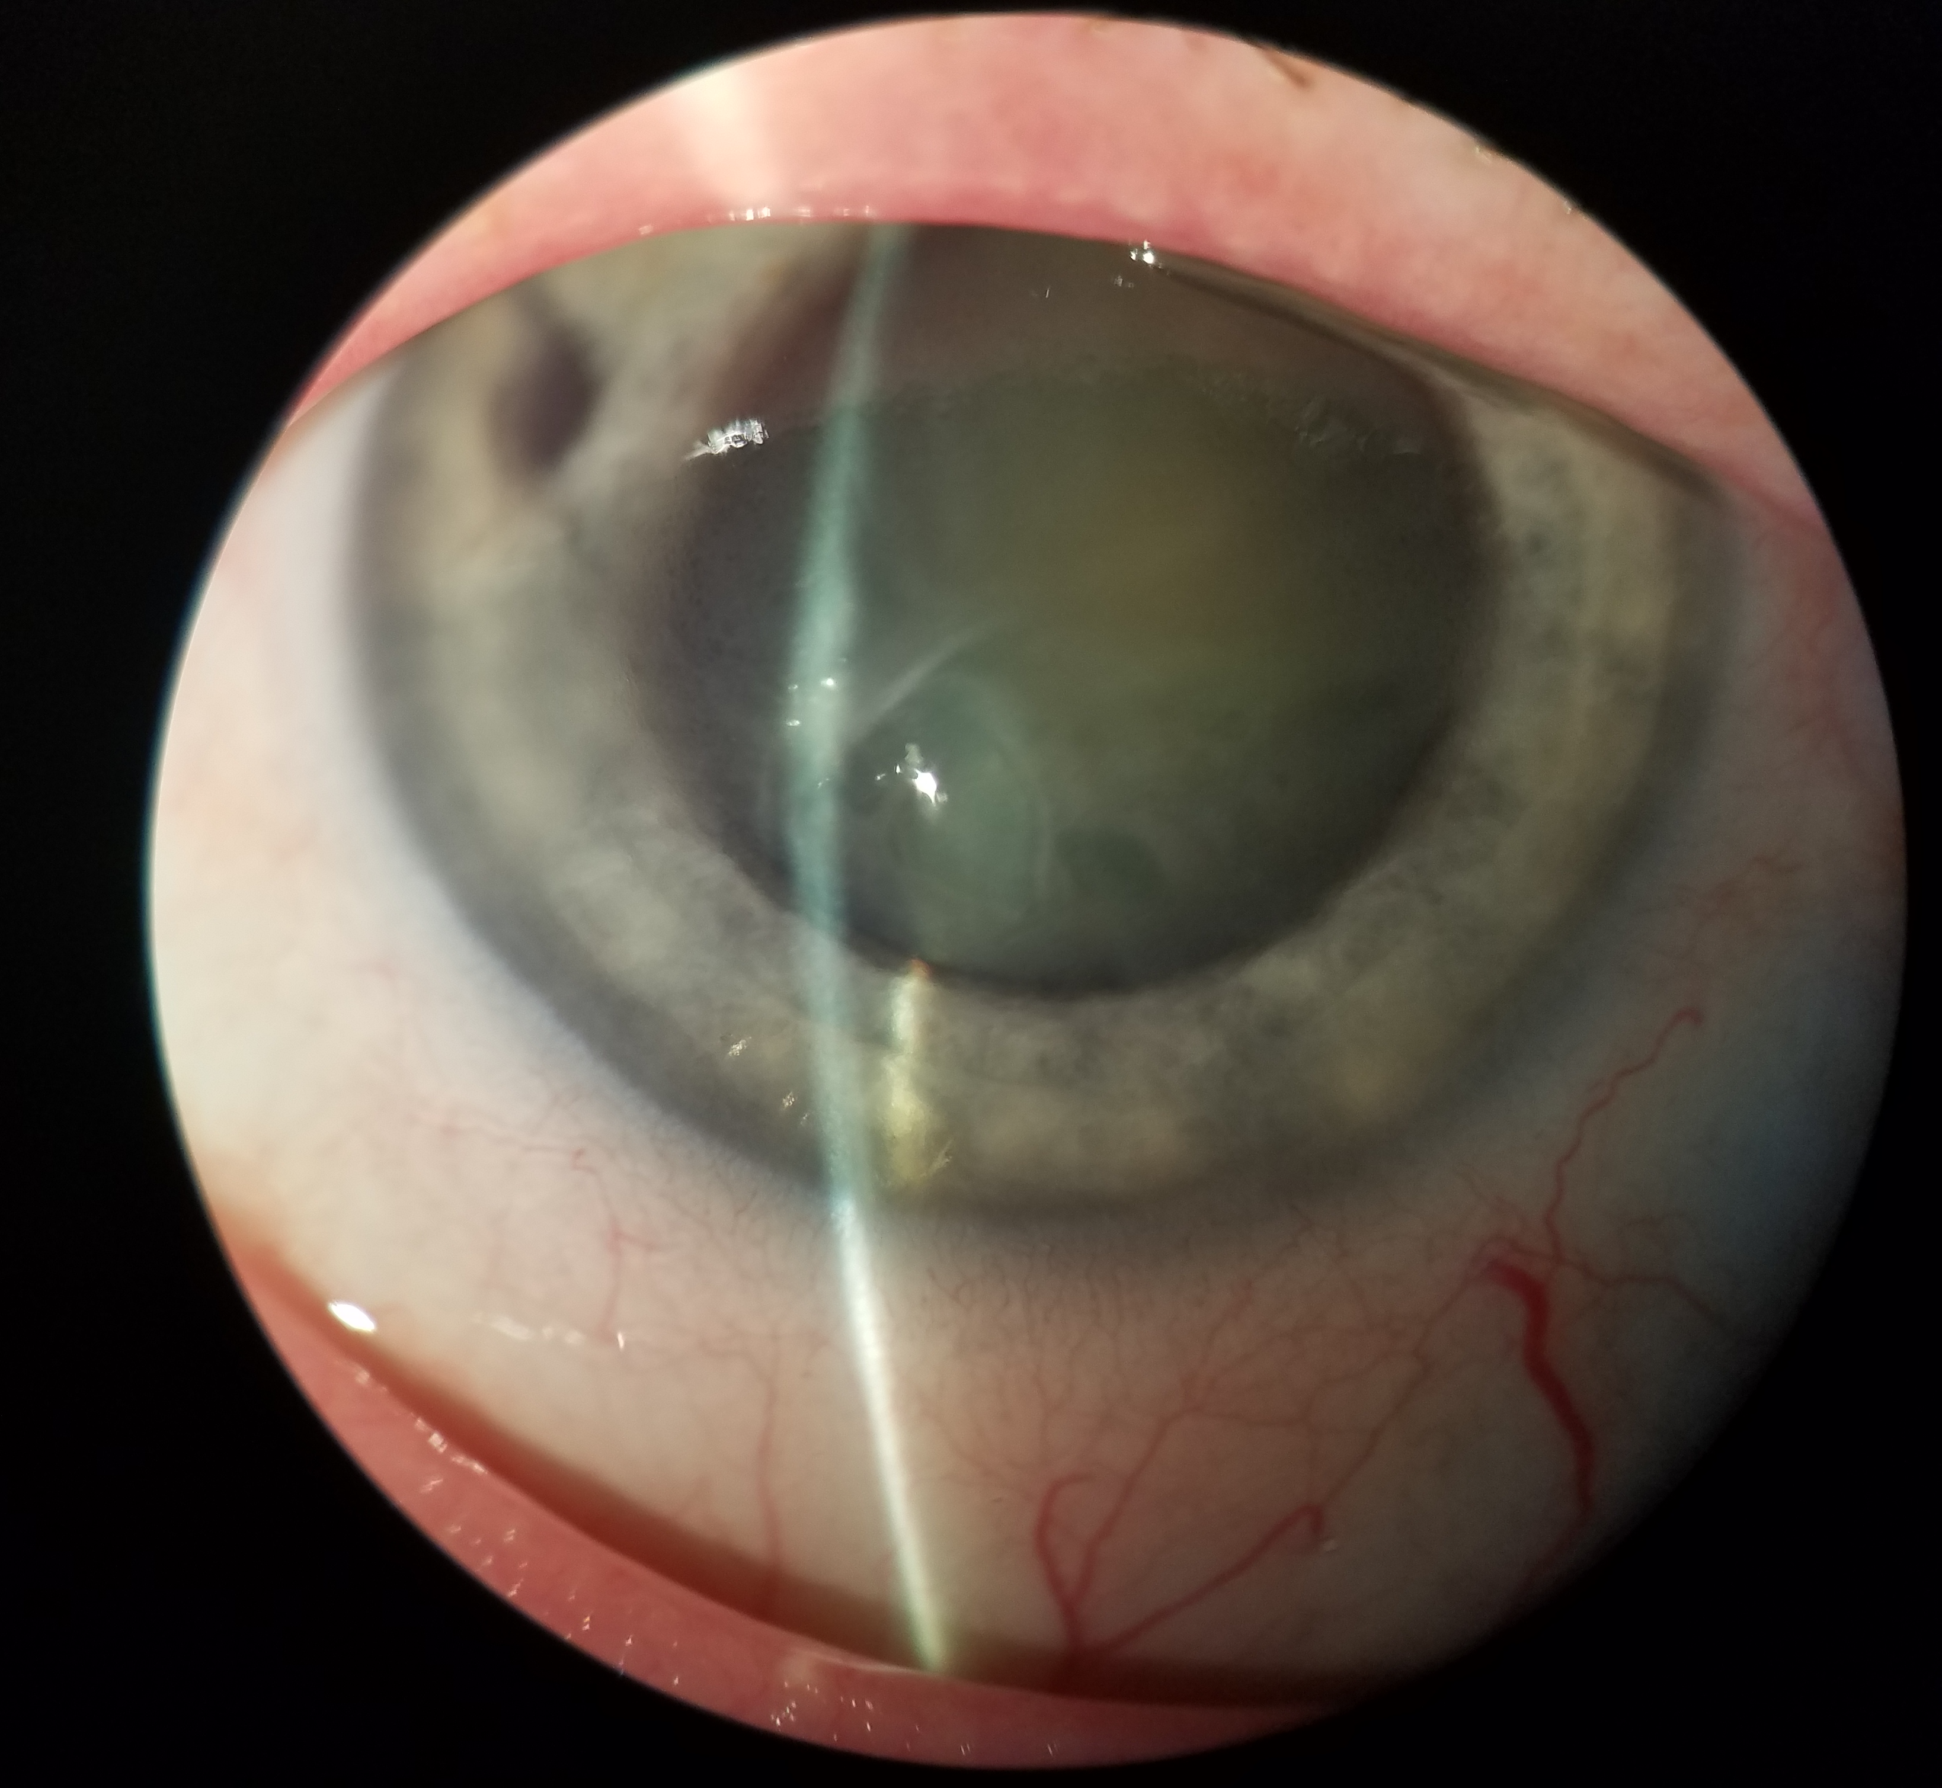
Anterior segment exam

Slide 19
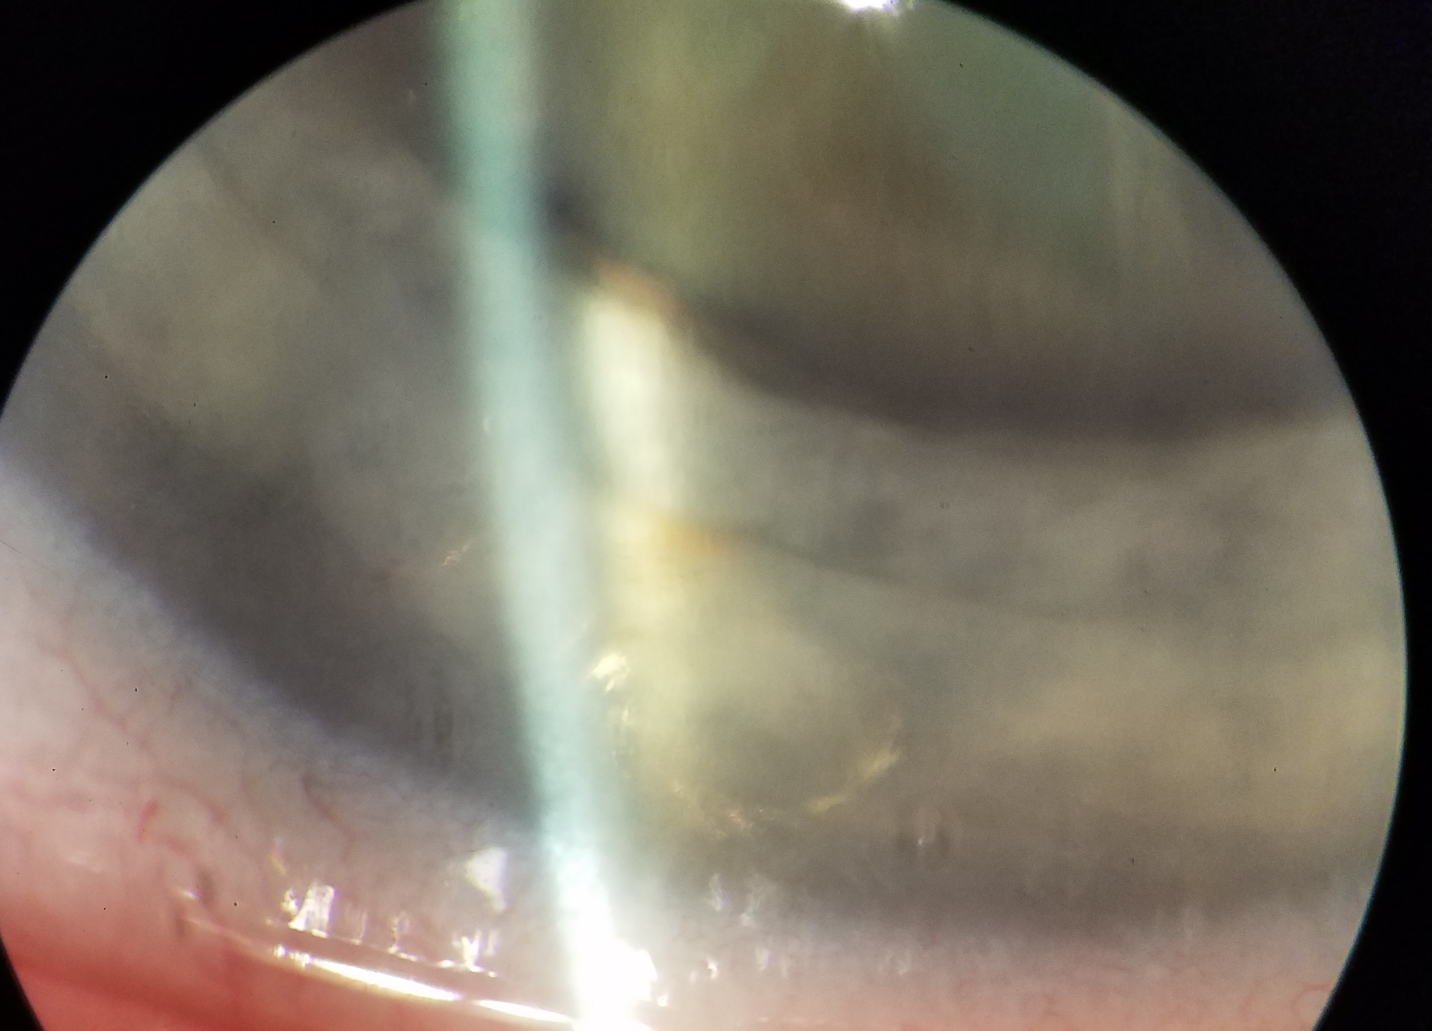
Anterior segment exam

Slide 20
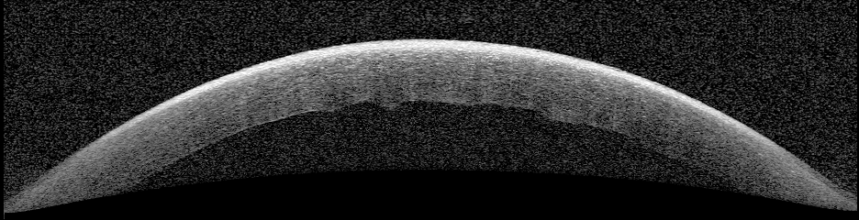
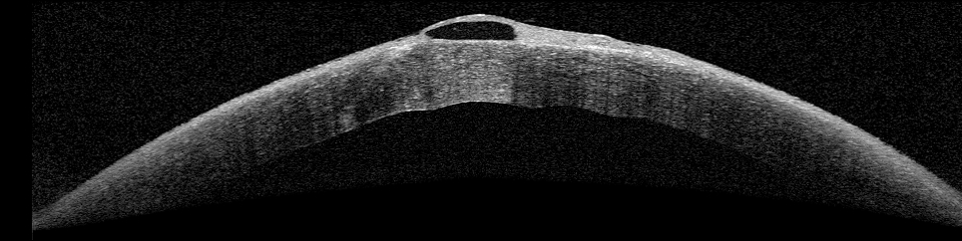

Slide 21

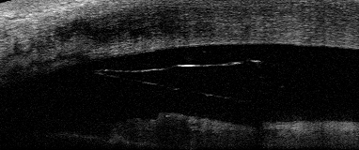
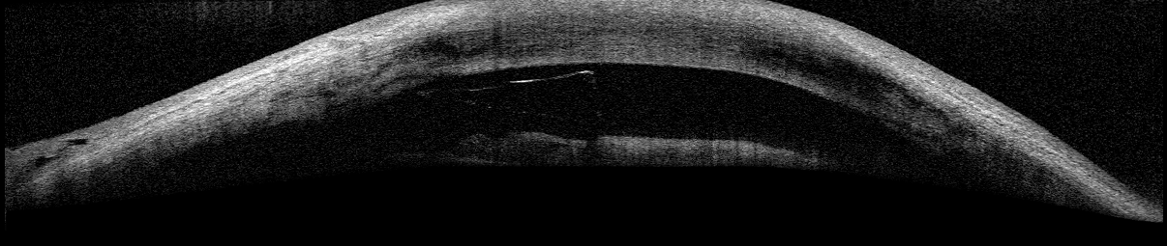

Slide 22
Assessment & Plan
Assessment:
  Corneal decompensation due to retained glass foreign body in anterior chamber
Plan: Surgical removal of the foreign body in the OR

Slide 23
POW #4
Still some residual corneal edema
  Even on treatment with Muro
Will follow up in 3 months
May need transplant

Slide 24
Jpn J Ophthalmol
2010
39 yo M, had MVA 8 yrs prior
Eyeglasses broke, multiple fragments removed from conj, none seen in AC initially but had corneal laceration which was sutured, and glass IOFB seen in AC on immediate follow-up
Presented 8 yrs later w/CF VA and bullous keratopathy
Glass extracted, bullous keratopathy persisted; pt underwent PK

Slide 25
Jpn J Ophthalmol
2010
UBM

Slide 26
Discussion
IOFB constitute 18%-41% of open globe injuries
Intraocular foreign bodies are usually detected at the first visit
The perforating injuries associated with IOFBs range from self-sealing wounds to severe corneoscleral or scleral lacerations

Slide 27
Accurate detection and localization of intraocular foreign bodies is a critical component of ophthalmological assessment and surgical planning to minimize intra- and post-operative complications

Slide 28
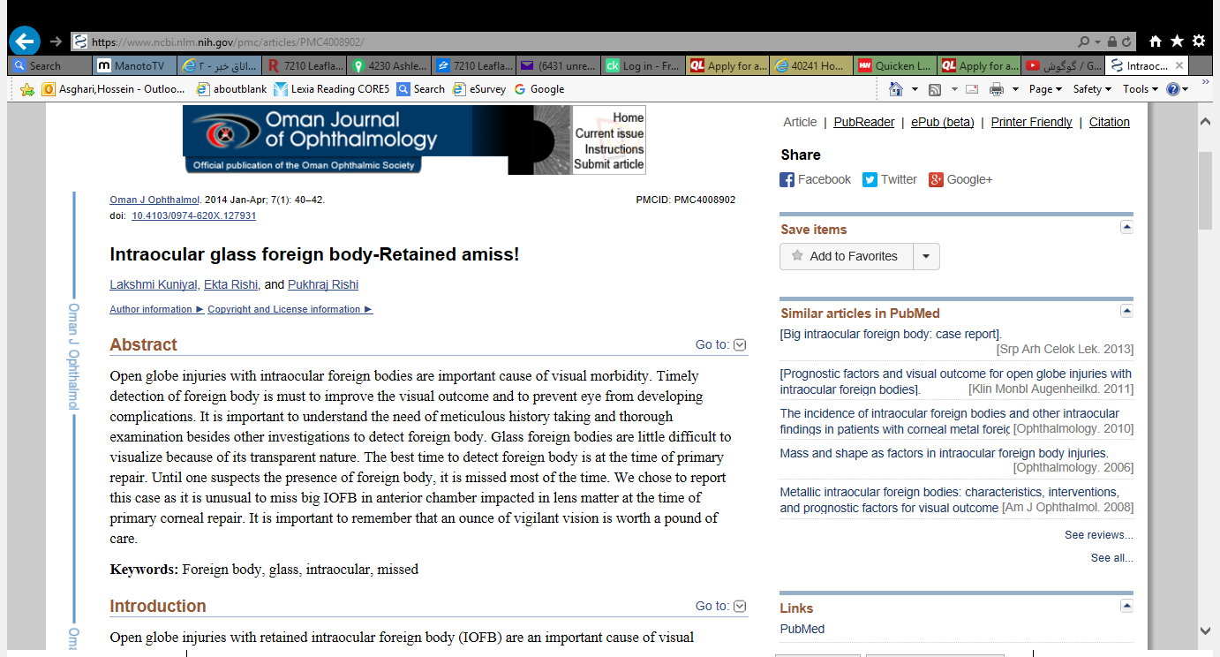
Take home message
1- Glass foreign body is difficult to visualize because of its transparent nature.
2- The best time to detect foreign body is at the time of primary repair.
3- Although it is inert and can be tolerated inside the eye, needs to be removed from anterior chamber to prevent endothelial cell damage.
4- Until one highly suspects the presence of foreign body, it is missed most of the time¹.

Slide 29
References
Gor DM, Kirsch CF, Leen J, Turbin R, Von Hagen S. Radiologic differentiation of intraocular glass: evaluation of imaging techniques, glass types, size, and effect of intraocular hemorrhage. AJR Am J Roentgenol. 2001 Nov;177(5):1199-203. PubMed PMID: 11641202.
Jastaneiah SS. Long-term corneal complication of retained anterior chamber-angle foreign body. Saudi J Ophthalmol. 2010 Jul;24(3):105-8. doi: 10.1016/j.sjopt.2010.04.002. Epub 2010 Apr 13. PubMed PMID: 23960885; PubMed Central PMCID: PMC3729341.
Kuniyal L, Rishi E, Rishi P. Intraocular glass foreign body-Retained amiss! Oman J Ophthalmol. 2014 Jan;7(1):40-2. doi: 10.4103/0974-620X.127931. PubMed PMID: 24799804; PubMed Central PMCID: PMC4008902.
Li Q, Wang N, Qing G. Glass fragment in the anterior chamber caused corneal endothelial dysfunction eight years after penetrating trauma. Jpn J Ophthalmol. 2010 Jul;54(4):358-9. doi: 10.1007/s10384-010-0820-2. Epub 2010 Aug 11. PubMed PMID: 20700807.

Slide 30
Globe exploration OD in OR
Excerpt from procedure narrative: “A deep chamber was found and a central, 2 mm full thickness corneal laceration was identified. Seidel negative. Moderate pressure was applied to the eye and wound remained water tight. No tissue prolapse or vitreous seen in wound. An ultrasound was performed and no foreign body was identified. At this time the decision was made to let the wound heal without suturing.”
Findings: “Penetrating wound OD, with iris involvement and traumatic cataract. Self sealed”

Slide 31
(Ophtho) OR Trip #2 (OD)
Paracentesis performed with supersharp blade
Pupil constricted with pilocarpine
Viscoat injected into AC
Keratome used to make 2.75 mm temporal clear corneal wound
Epithelium debrided to obtain clear view
Drysdale inserted through paracentesis to lift FB while spatula used to gape temporal wound
FB floated out with Viscoat
Incision was sutured, Vigamox and BCL placed
Incision made over right brow, three 5-mm pieces of glass were removed, skin closed with 6’0 Vicryl

Slide 32
2010
Pt initially presented in 1984 at age 13 w/corneal ulcer, glass IOFB from exploded light bulb 2 months prior
P/w “reduced vision, scar at the area of a full thickness self sealed corneal laceration with corneal infiltrates, anterior chamber FB residing in the angle inferiorly, and inferior corneal edema”
“Ultrasound A scan reported a single high spike around 5 o’clock anteriorly. No acoustic shadowing or reverberations as would be expected in metallic foreign body (Fig. 2).”

Slide 33
Plan at that time
“The child was admitted to treat the corneal ulcer… by debridement and topical fortified antibiotics.”
“Surgical removal of the FB was not recommended for reasons related to the FB material being inert, location, encapsulation, and the fact that the cornea was infected at the time of admission.”
UCVA was 20/80 at that time

Slide 34
20 years later…
P/w decreased VA and photophobia x 9 mo assoc w/inf corneal edema
Had been treated for stromal keratitis w/no improvement
Surgical removal of glass anterior chamber FB was performed; pt 20/30 at last follow-up

Slide 35
33 yo man w/glass AC FB

Slide 37
Implanted 1.5, 1.0, and 0.5 mm pieces of glass into pig eyes
Used U/S, axial CT, helical CT, MRI, before/after blood placed in AC
Detection rates: 57.1% for helical CT, 41.3% for axial CT, 11.1 for MRI
  Helical CT was most sensitive method tested
  Easiest to detect in AC
  Most difficult to detect embedded in cornea
  Larger the piece, easier to find (96.2% for 1.5 mm to 48.3% at 0.5 mm)

Slide 38
Anterior chamber
Posterior chamber

Slide 39
CT: higher H → more detectable
Hounsfield units: range 80 H – 550 H
  green beer bottle, 550 H
  brown beer bottle, 539 H
  40-W fluorescent bulb, 285 H
  100-W incandescent bulb, 260 H
  windshield glass, 175 H
  window plateglass, 140 H
  spectacle glass, 80 H
Detection rates:
  green beer bottle glass at 90.3%
  brown beer bottle glass at 86.1%
  windshield glass at 70.8%
  plateglass at 75.0%
  100-W incandes-cent bulb glass at 83.3%
  40-W fluorescent bulb glass at 76.4%
  spectacle glass (the least detectable) at 43.1%
  (n = 504, p < 0.0001) (Fig. 5)

Slide 41
Conclusions
Corneal decompensation following glass IOFBs is a reported sequella of trauma
  Relatively uncommon
Can be found on radiologic evaluation and/or clinical evaluation
Critical to look for other signs suspicious for intraocular foreign body or penetrating ocular injury
Removal of any foreign body in the anterior chamber recommended as soon as possible providing there are not undue surgical risks (to avoid future endothelial damage)

