Slide 1
Differential Diagnosis of an Orbital Mass
Andrea Breaux
June 15, 2017

Slide 2
Patient Presentation
CC
“Blurry and double vision”
HPI
91 yo AAF having problems with balance and equilibrium, dizziness and double vision, primarily worse in down gaze. She also complained of headaches in the front part of her head and sides of her head.

Slide 3
History (Hx)
Past Ocular Hx: Bell’s palsy, hemifacial spasm, pseudophakia OU
Past Medical Hx: Breast cancer (bilateral s/p mastectomy), DM, thyroid disease
Fam Hx: DM, cancer, heart disease
Meds: Numerous
Allergies: None
Social Hx: Non-smoker, no alcohol use
ROS: Vision change, headache, fatigue, dizziness

Slide 4
External Exam
 | OD |  | OS
VA | 20/40 |  | 20/40
Refraction | -1.25 +1.00 x 025 |  | -2.00 +0.50 x 120
Pupils | 2mm |  | 2mm
IOP | 18 mmHg |  | 18 mmHg
EOM | -3 to -4 limitation in infraduction, -1 abduction |  | Restriction in supraduction, hemifacial spasm
CVF | full |  | full

Slide 5
Anterior Segment Exam
PLE or SLE | OD |  | OS
External/Lids | Firm, irregularly shaped, non-tender mass under RLL |  | Ptosis
Conj/Sclera | Trace injection, nodular appearing area of raised conj temporally in inferior fornix |  | White/quiet
Cornea | Clear |  | Clear
Ant Chamber | Deep |  | Deep
Iris | WNL |  | WNL
Lens | PCIOL |  | PCIOL

Slide 6
Posterior Segment Exam
Fundus | OD |  | OS
Optic Nerve | Sharp/pink |  | Sharp/pink
Macula | WNL |  | WNL
Vessels | Normal caliber |  | Normal Caliber
Periphery | WNL |  | WNL

Slide 7
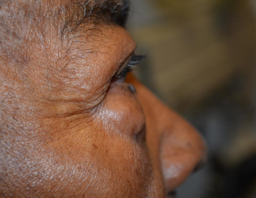
Clinical Photos

Slide 8
Workup
Orbital Mass Workup
Concern for primary or malignant lesion
MRI brain with and without contrast of brain and orbit
Coordination with primary care physician about initiation of metastatic workup.

Slide 9
Follow up
2 week follow up – symptoms unchanged.
Primary care doctor confirmed no known history of metastatic disease.
MRI showed large anterior orbital mass that was molding to structures and isointense to mucous membranes on T1 and hyperintense with contrast on T2.

Slide 10
Assessment/Plan
91 yo AAF with known history of bilateral breast cancer in the 1960’s and 70’s, but no other known malignancy.
Differential Diagnosis
Metastatic disease
Lymphoma
Sarcoma
Infection
Plan: Proceed with anterior orbitotomy with mass biopsy with frozen tissue/fresh tissue sections per lymphoma protocol.

Slide 11
Imaging
T1 Coronal Pre-contrast

Slide 12
Imaging
T1 Coronal Post Contrast
Notes:
6 x 2 x2 tumor around 7 o’clock. 2 seeds. Sectoral cataract.

Slide 13
Imaging
T1 Axial Post Contrast
Notes:
6 x 2 x2 tumor around 7 o’clock. 2 seeds. Sectoral cataract.

Slide 14
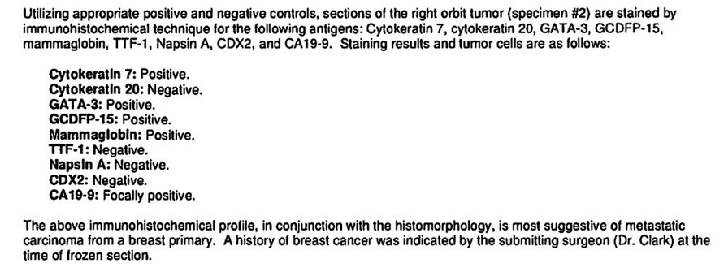
Pathology
Notes:
CK 7 and 20 for epithelial cancers
GATA-3 urothelial and breast Ca
GCDFP-15 marker of apocrine differentiation, including apocrine carcinoma of breast
Mammaglobin breast tissue
TTF-1 Lung cancer
Napsin A- pulmonary adenocarcinoma
CDX2 for adenocarcinomas, typically GI
CA19-9 for pancreatic cancer

Slide 15
Pathology – H&E low power

Slide 16
H&E 40x

Slide 17
ER staining

Slide 18
PR staining

Slide 19
HER2 Staining

Slide 20
Special Stains
CK 7 and CK 20 | Epithelial cancers
GATA-3 | Urothelial and Breast cancers
GCDFP-15 | Apocrine differentiation, including breast
Mammaglobin | Breast tissue
TTF-1 | Pulmonary cancers
Napsin-A | Pulmonary Adenocarcinoma
CDX2 | Adenocarcinomas, typically GI
Ca 19-9 | Pancreatic cancer

Slide 21
Discussion
Extraocular orbital metastasis account for 2-11% of all orbital neoplasms.
Most commonly: breast, pulmonary, prostate, GI.
Distant metastasis of breast cancer are relatively common, but spread to head and neck is not quite as common.

Slide 22
Discussion
Gondim et al reviewed a set of patients and found that only 88% had a known history of breast carcinoma.
They also found that time between primary diagnosis to head and neck metastasis ranged from 1 to 33 years.
The most common site of metastasis in this study was neck lymph nodes, followed by orbital soft tissue.

Slide 23
Discussion
Presenting symptom can be quite variable…
Gaze-evoked amaurosis
Acute fungal rhinosinusitis
Parasthesias or pain
Spontaneous Retrobulbar Hemorrhage
Conjunctival Chemosis

Slide 24
Discussion
The majority of orbital breast metastases are lobular carcinomas.
Lobular carcinomas are more likely to spread due to lack of intracellular cohesiveness and absence of E-cadherin.
Special staining protocols are very helpful in diagnosis of these metastases.

Slide 25
Discussion
Breast cancer is much rarer in men, however there are cases of males with orbital breast cancer metastasis.
Case study of 66 yo WM who presented with headaches and intermittent diplopia who had been diagnosed with breast carcinoma 12 and 5 years prior. Found to have mass in superomedial right orbit near superior oblique.
Only four prior case reports of this in males.

Slide 26
Discussion
Enophthalmos due to infiltration and retraction is commonly seen in breast carcinoma metastasis.
Extraocular muscles tend to be the main site of breast cancer orbital metastases.
Symptoms associated with this are what we would expect: diplopia, pain with eye movement, eye movement limitation.

Slide 27
Discussion
In almost 40% of patients who are symptomatic from orbital metastases (excluding breast metastasis), orbital symptoms occur well before local symptoms manifest and are thus the first indication of advanced malignancy.
MRI remarkable for T1 isointense to muscle,T2 hyperintense to muscle and hypointense to fat, and T1 plus contrast with enhancement present but variable.

Slide 28
Differential Dx
Primary orbital malignancy
Rhabdomyosarcoma, lymphoma, lacrimal gland
Extraocular extension of intraocular tumor
Uveal melanomas or metastases
Tumors of the optic nerve
Glioma, meningioma
Orbital vascular lesion
Infection
Thyroid eye disease
Inflammatory or granulomatous disease
Sarcoid, granulomatosis with polyangiitis, orbital pseudotumor

Slide 29
Summary
91 yo AAF with remote history of bilateral breast cancer, had undergone bilateral mastectomy and lymphadenectomy in the 1960’s and 1970’s.
Presented with double vision and headaches.
Found to have distant metastasis consistent with breast cancer.

Slide 30
Summary
Breast cancer is one of the most common cancers to metastasize to the orbit.
Can present in a variety of ways, but typically present with pain and diplopia.
The presence of ocular metastasis is a bad prognostic indicator. Survival can range from 0-64 months with average of 5 months.
We must be vigilant to pursue a thorough workup in patients with new orbital complaints, especially those with a history of cancer.

Slide 31
References
Ratanatharathorn V., Powers W. E., Grimm J., et al. Eye metastasis from carcinoma of the breast: diagnosis, radiation treatment and results. Cancer Treatment Reviews. 1991;18(4):261–276. doi: 10.1016/0305-7372(91)90017-T.
Tabai, M., Hazboun, I. M., Sakuma, E. T. I., Sampaio, M. H., & Sakano, E. (2016). Orbital Metastasis of Breast Cancer Mimicking Invasive Fungal Rhinosinusitis. Case Reports in Otolaryngology, 2016, 2913241. http://doi.org/10.1155/2016/2913241
Gondim, D.D., Chernock, R., El-Mofty, S. et al. Head and Neck Pathol (2016). doi:10.1007/s12105-016-0768-8
Patel M., Lefebvre D.R., Lee, G, N., Brachtel, E., Rizzo J., Freitag, S K. Gaze-Evoked Amaurosis From Orbital Breast Carcinoma Metastasis. Ophthalmic Plastic & Reconstructive Surgery: July/August 2013 - Volume 29 - Issue 4 - p e98–e101doi: 10.1097/IOP.0b013e31827defc7
Wang, Y., Mettu, P., Maltry, A. et al. Ophthalmol Ther (2017). doi:10.1007/s40123-017-0093-7
Frederick A. Jakobiec; Anna M. Stagner; Natalie Homer; Michael K. Yoon. Periocular Breast Carcinoma Metastases: Predominant Origin From the Lobular Variant. Ophthalmic Plastic and Reconstructive Surgery. DOI: 10.1097/IOP.0000000000000793
Wickremasinghe S, Dansingani KK, Tranos P, et al. Ocular presentations of breast cancer. Acta Ophthalmol Scand. 2007;85: 133–42.
Dieing A, Schulz CO, Schmid P, et al. Orbital metastases in breast cancer: report of two cases and review of the literature. J Cancer Res Clin Oncol. 2004; 130: 745–8

