Slide 1
Grand Rounds
CMV Retinitis
Niloofar Piri MD
September 16th 2016

Slide 2
Patient Presentation
CC
  Shadow in upper part of visual field with the left eye
HPI
  40 yo Caucasian female presents with blurred vision in superonasal visual field in the left eye that was noticed for the past week. She has been experiencing flashes of light in the left eye for the past 3 weeks. She has had some cold/flu symptoms for a month.

Slide 3
History (Hx)
Past Ocular Hx: Unremarkable
Past Medical Hx: HIV+ ( 23 years)
Fam Hx: Unremarkable
Meds: None
Allergies: Penicillin( rash), Codeine( rash)
Social Hx: Her husband passed away from end stage AIDS two years ago after which the patient was depressed, gave up and stopped taking her HAART neither followed up with infectious disease/ 3 healthy children
ROS : cough+/ blurred vision OS

Slide 4
External Exam
 | OD |  | OS
VA | 20/20 |  | 20/60⁻²
Refraction | Plano +0.25x120 |  | -1.25+0.5 x60
Pupils | 4→2mm | 1+ rAPD OS | 4→3mm
IOP | 16 mmHg |  | 14 mmHg
EOM | full |  | full
CVF | full |  | Superior nasal field loss

Slide 5
Anterior Segment Exam
SLE | OD | OS
External/Lids | Wnl | Wnl
Conj/Sclera | Wnl | Wnl
Cornea | Clear | Fine diffuse stellate KPs
Ant Chamber | 0 cell and flare | 1+ cell and flare
Iris | Wnl | Wnl
Lens | Clear | Clear
Anterior vitreous | Clear | 2+ cell

Slide 6
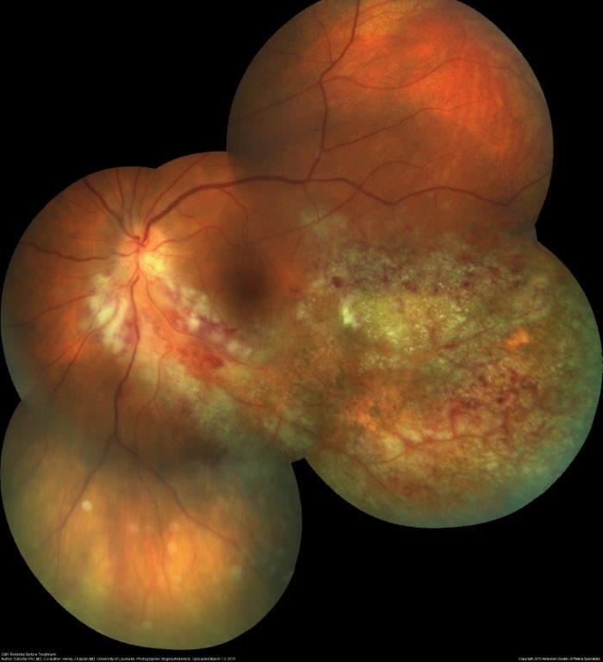
Posterior Segment Exam

Slide 7

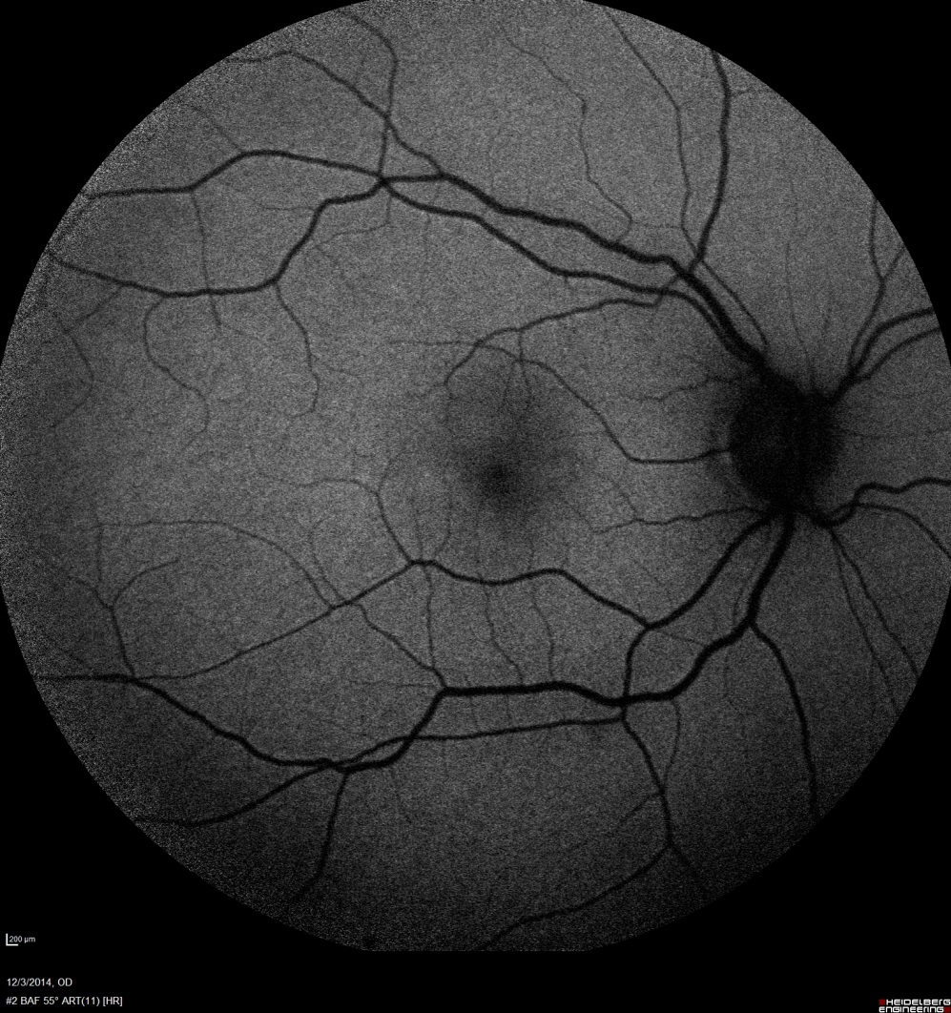
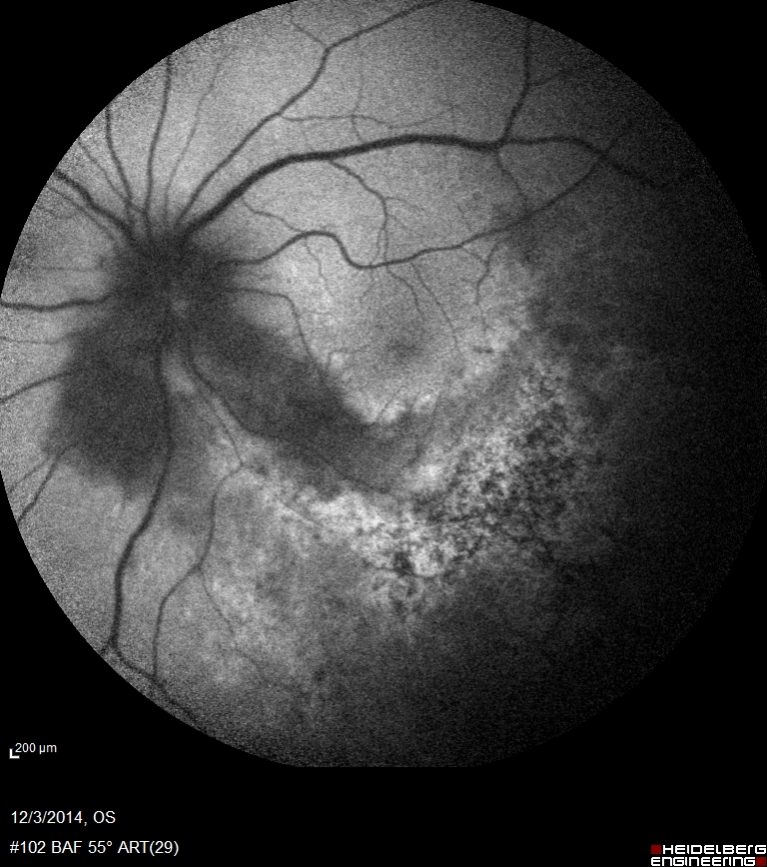

Slide 8
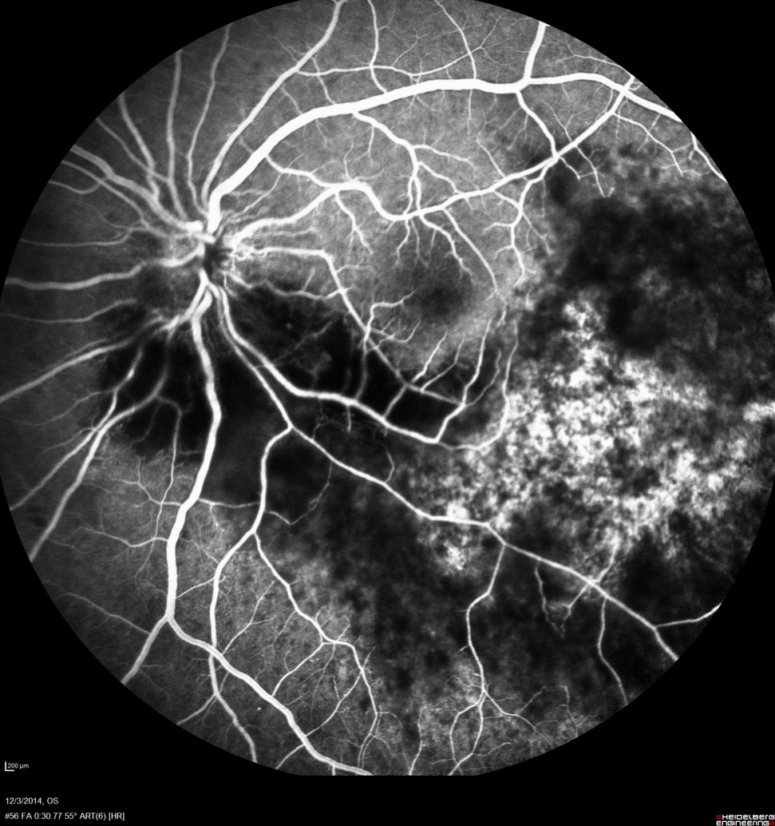
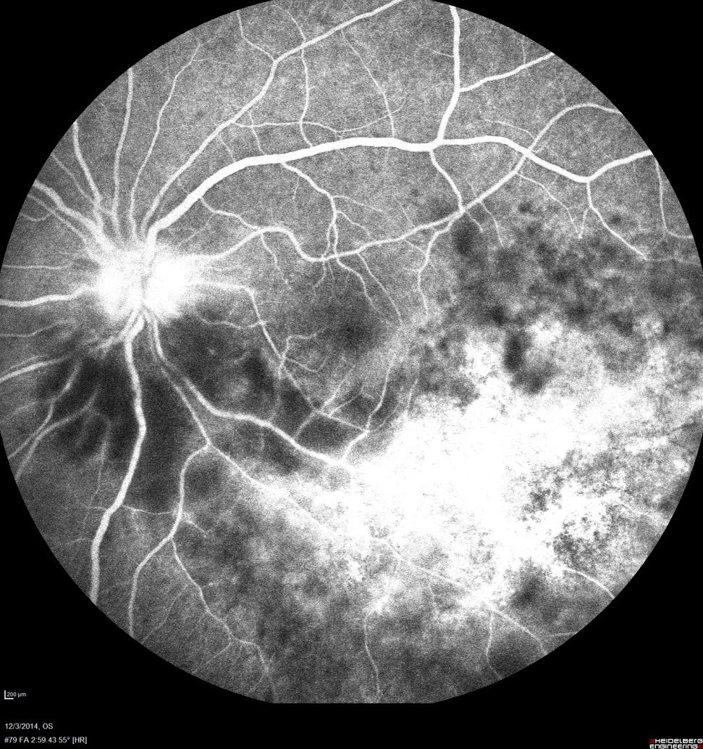

Slide 9
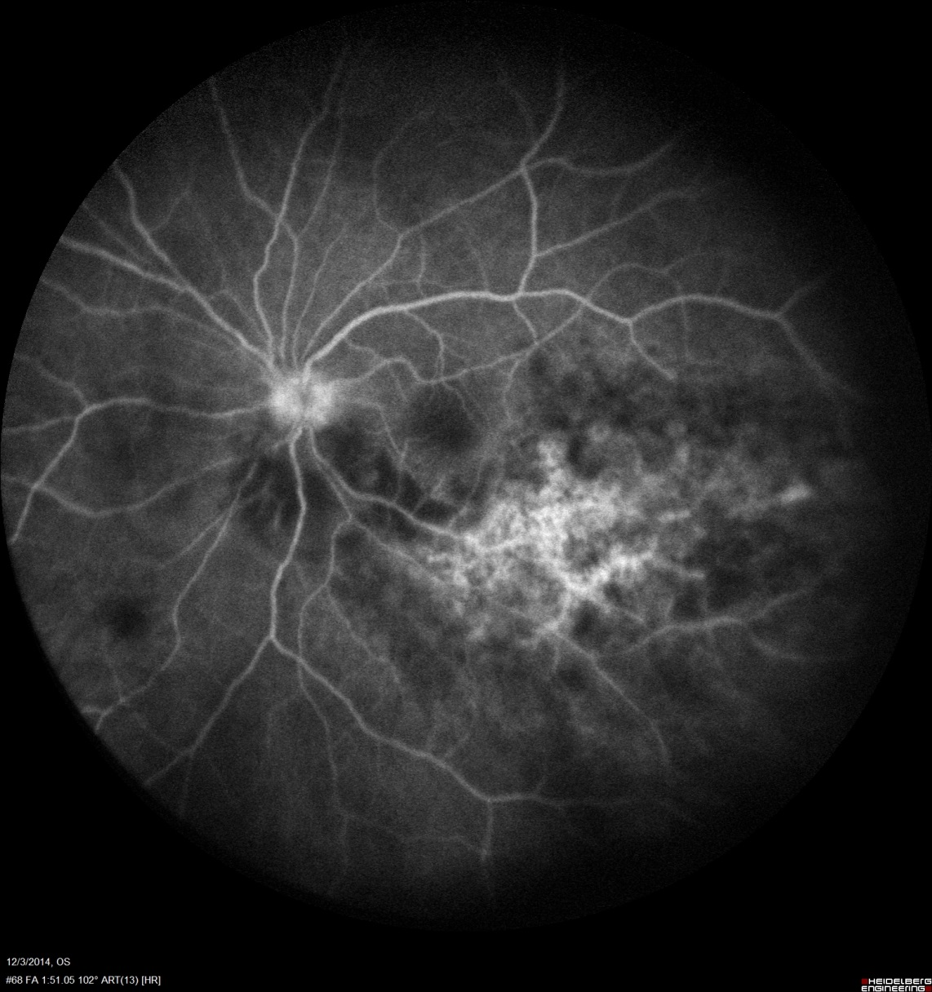

Slide 10
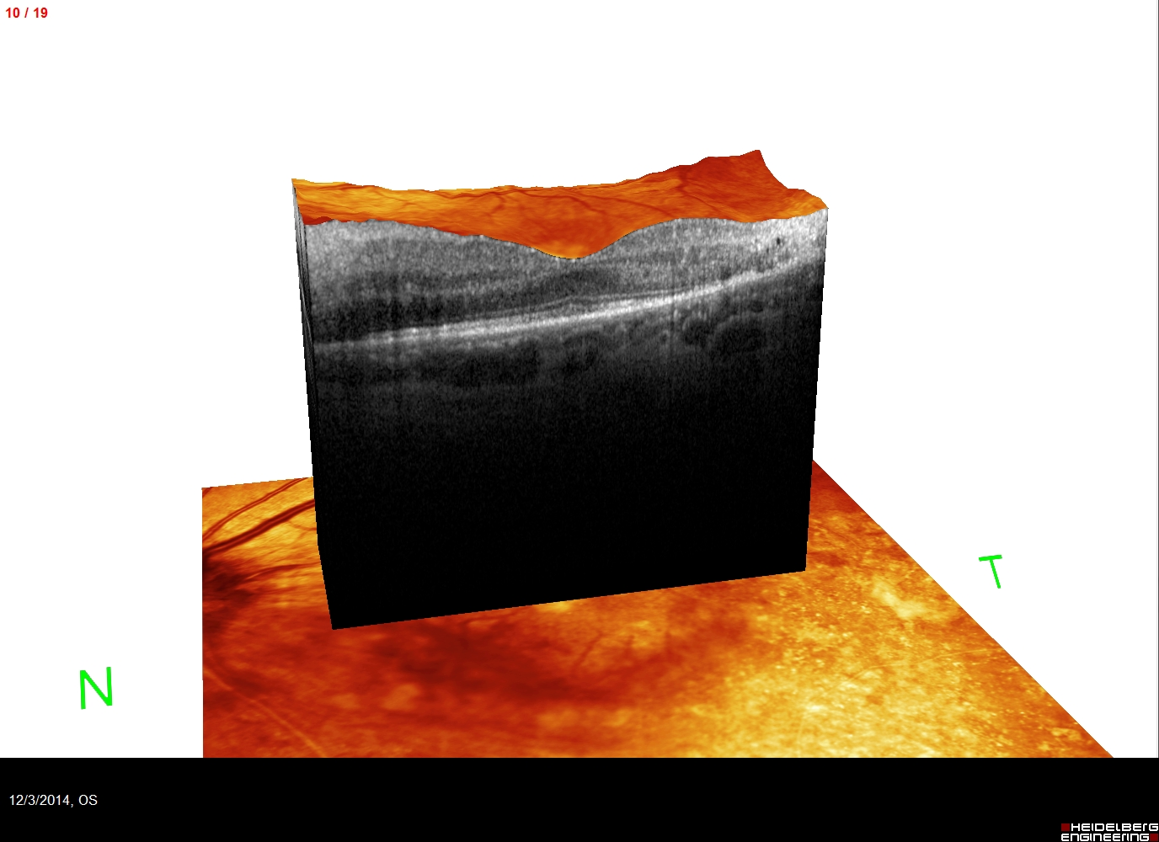

Slide 11
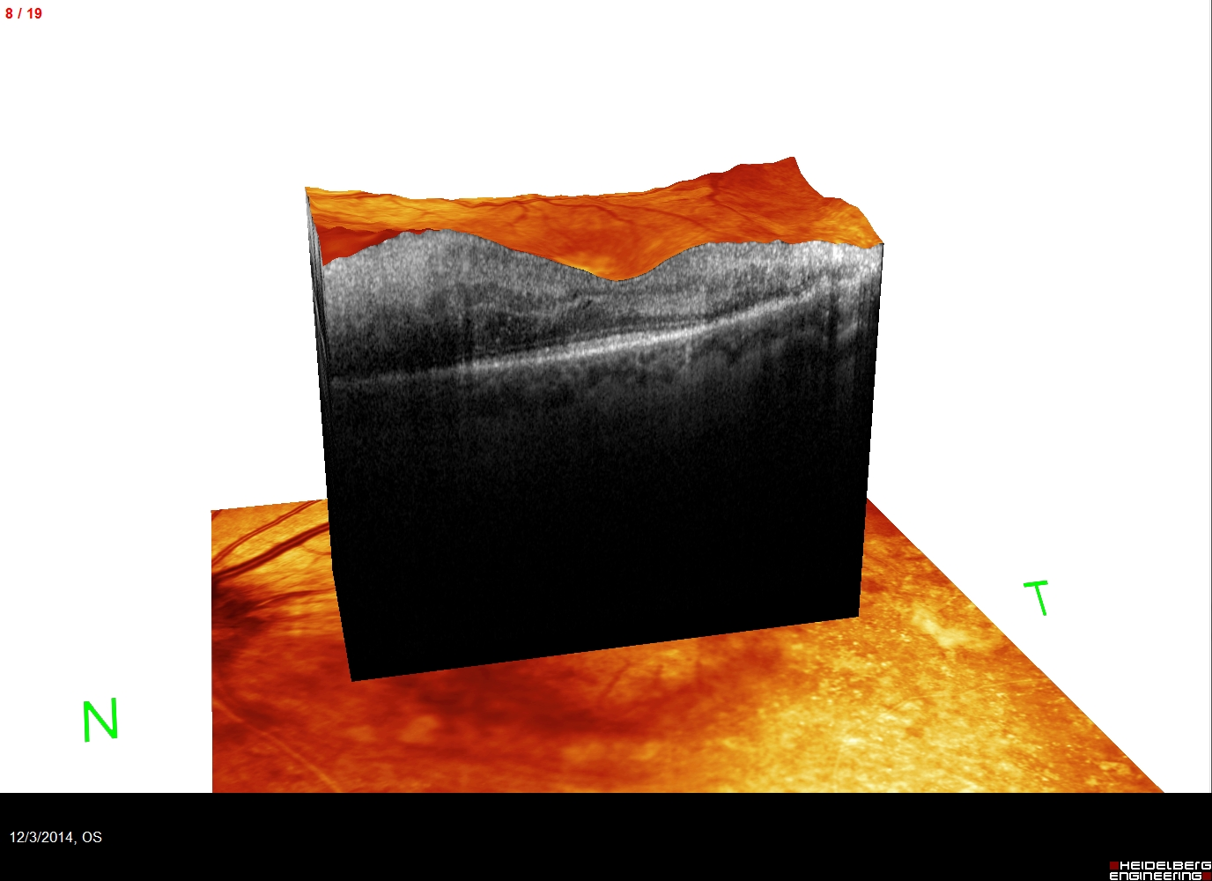

Slide 12
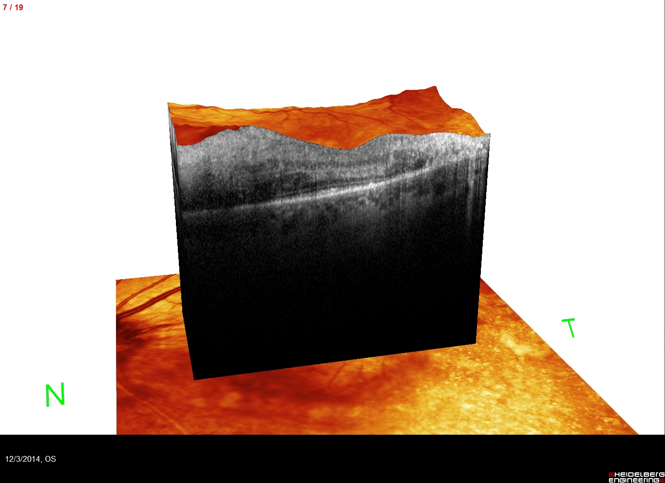

Slide 13
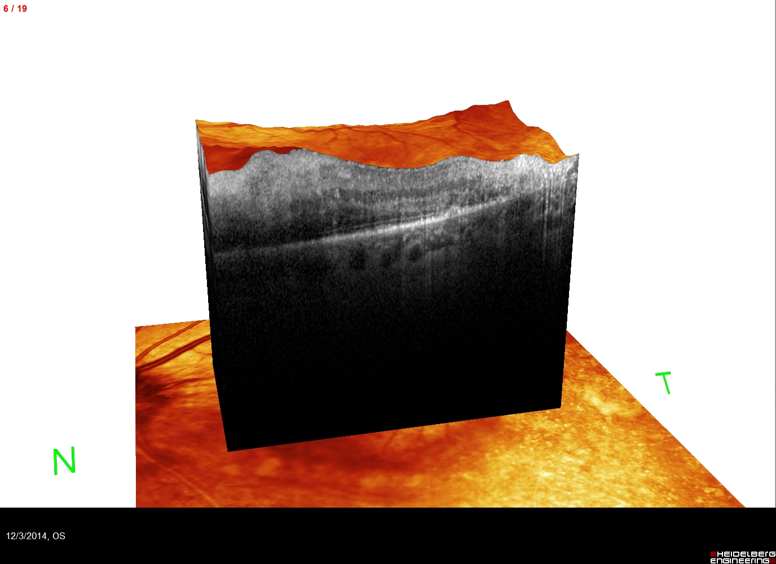

Slide 14
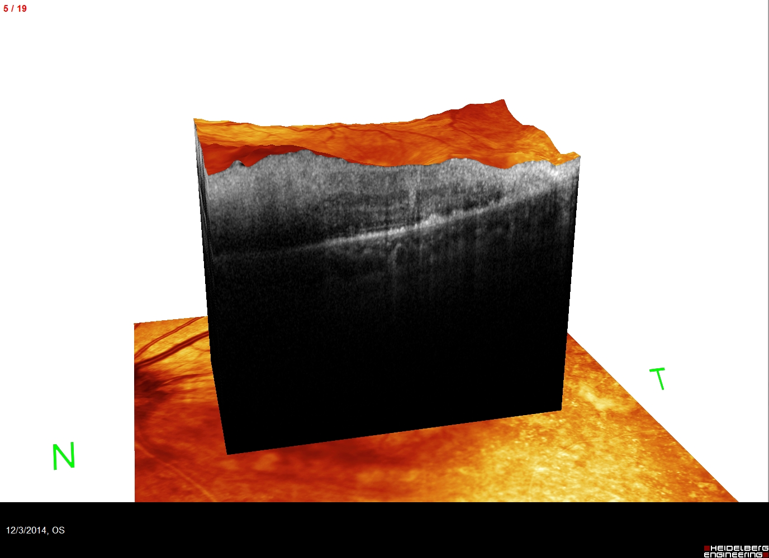

Slide 15
Differential diagnosis
- CMV retinitis
  Progressive outer retinal necrosis (PORN)
  toxoplasmosis,
  syphilis,
  tuberculosis
  Acute retinal necrosis syndrome (ARN)

Slide 16
Assessment
40 yo Caucasian female with PMH of HIV infection for 23 years who has been off ART for the past 2 years presented with left VF defect secondary to CMV retinitis.

Slide 17
Plan
The patient was referred to infectious disease service, she was admitted the same day and was started on IV Gancyclovir for 3 days and transitioned to PO Valgancyclovir 900 bid, started on HAART at the same time.

Slide 18
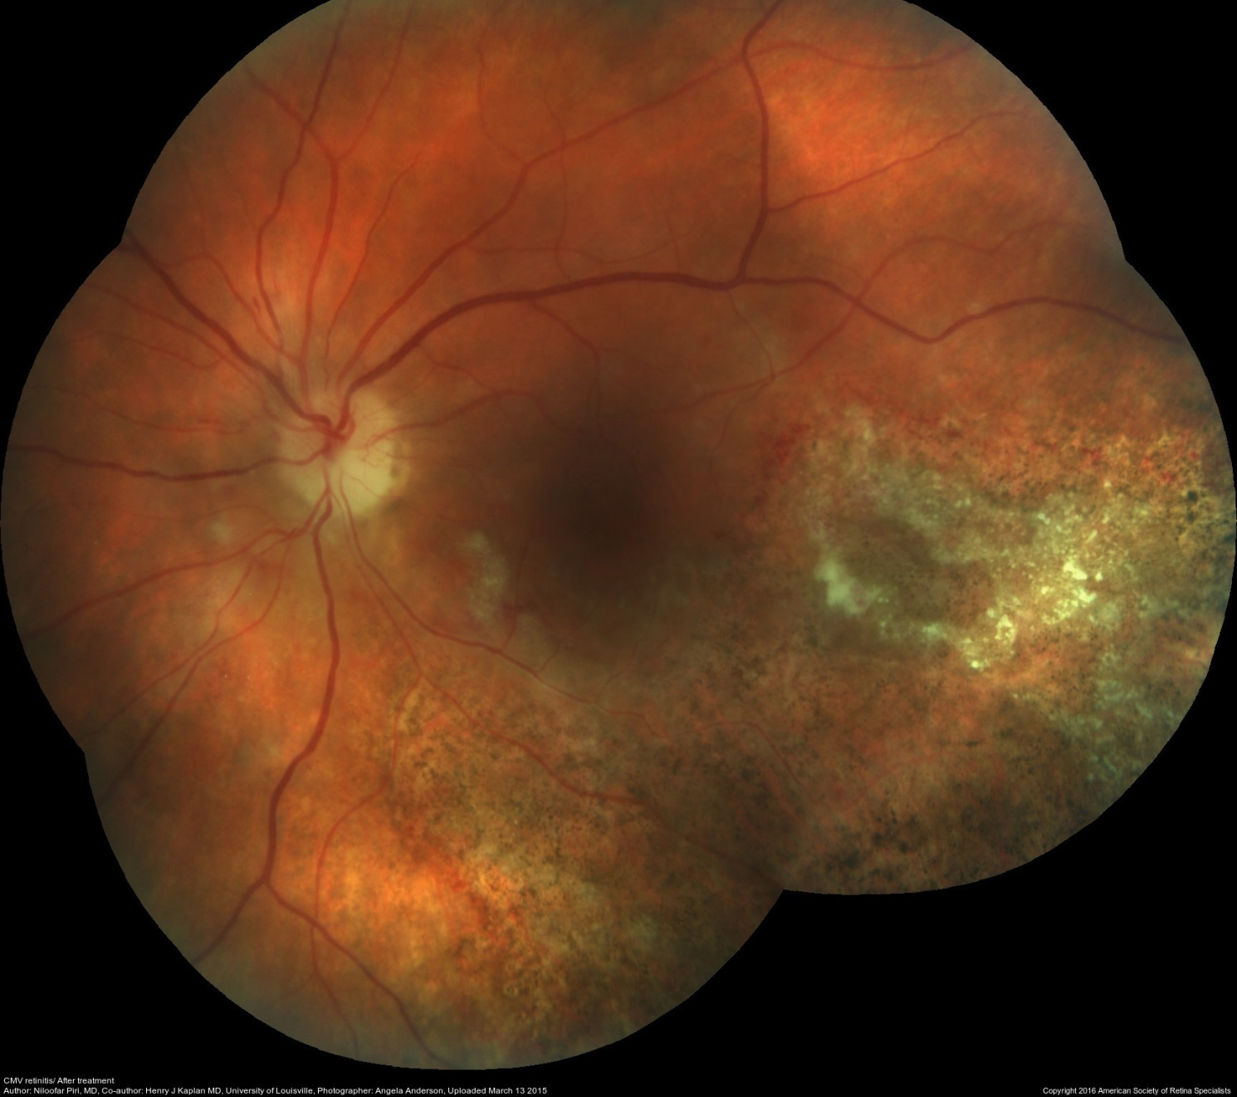
1 month follow up

Slide 19

Before treatment 20/60
After treatment 20/60

Slide 20
Discussion
The treatment of CMV retinitis:
Treatment may be systemic, local, or a combination of the two. There are currently five medications approved by the US Food and Drug Administration (FDA) for the treatment of CMV retinitis: ganciclovir, valganciclovir, cidofovir, foscarnet. Fomivirsen, the first antisense drug with a relatively long duration of action, is no longer available in the United States.

Slide 21
Discussion
Once the CD4+ T lymphocyte count has dropped below 50 cells/µL, a patient with AIDS has a 30% lifetime risk of developing CMV retinitis

Slide 22
Treatment decisions are frequently based on the location of retinitis as defined by Holland et al.
Zone 1, considered immediately sight-threatening, encompasses the retina two disc diameters from the fovea (3,000 microns) and one disc diameter from the nerve (1,500 microns), whereas zone 2 extends from this border anteriorly to the equator, and zone 3 extends to the ora serrata.

Slide 25
The development of valganciclovir, an oral prodrug of ganciclovir, has contributed to significant advancement in the treatment of CMVR.
Due to increased oral bioavailability over ganciclovir, it has become the mainstay of treatment of CMV retinitis in the AIDS patient for induction and maintenance therapy.
In 2002, the Valganciclovir Study Group demonstrated equivalently low rates of CMVR progression, similar to previous trials, in patients randomly assigned to either oral valganciclovir (900 mg twice daily) or intravenous ganciclovir (5 mg/kg twice daily), 10% versus 9.9% after 4 weeks of induction therapy

Slide 26
With the increasing utilization of intravitreal drug delivery in the management of vitreoretinal disease, one important and timely question is related to the role of intravitreal antiviral therapy either as monotherapy or in combination with systemic antiviral for CMV retinitis.

Slide 27

Jabs et al. reported results from 250 patients treated for AIDS related CMVR with systemic versus intravitreal therapy( 2013).
These results demonstrated a 50% reduction in mortality, a 90% reduction in new visceral disease, and an 80% reduction in fellow eye involvement when treating with a systemic agent.
When compared to systemic regimens, intravitreal therapy alone demonstrated three-times-greater risk of retinitis progression (hazard ratio [HR] = 3.4) and five-times-greater risk of visual field loss (HR = 5.5).

Slide 28
Although progression to foveal involvement is a concern in patients with zone 1 disease not involving the fovea, the benefit of intravitreal antiviral therapy is not clear.
Because of the benefit to mortality and systemic morbidity, the use of systemic antiviral is important, however, with infectious disease consultation given the side effects of antiviral medications that require monitoring.

Slide 29
For patients with recurrent disease or concerns for drug resistance, intravitreal antiviral therapy may still overcome “relative” drug resistance and should be considered.

Slide 30
What’s new?
The disease progresses even 2 years after treatment !!

Slide 33
Conclusions
Early diagnosis and treatment is essential to prevent profound visual loss.
CMV retinitis needs to be treated systemically

Slide 34
References
Pearce WA, Yeh S, Fine HF. Management of Cytomegalovirus Retinitis in HIV and Non-HIV Patients. Ophthalmic Surg Lasers Imaging Retina. 2016 Feb;47(2):103-7.
22. Holland GN, Vaudaux JD, Shiramizu KM, Yu F, Goldenberg DT, Gupta A, et al. Characteristics of untreated AIDS-related cytomegalovirus retinitis. II. Findings in the era of highly active antiretroviral therapy (1997 to 2000) Am J Ophthalmol. 2008;145:12–22
Holland GN, Buhles WW Jr, Mastre B, Kaplan HJ. A controlled retrospective study of ganciclovir treatment for cytomegalovirus retinopathy. Use of a standardized system for the assessment of disease outcome. UCLA CMV Retinopathy. Study Group. Arch Ophthalmol. 1989;107(12):1759–1766.
Martin D, Sierra-Madero J, Walmsley S, Wolitz R, Macey K, Georgiou P, Robinson C, Stempien M. A controlled trial of valganciclovir as induction therapy for cytomegalovirus retinitis. N Engl J Med. 2002;346(15):1119–1126. doi:10.1056/NEJMoa011759
Jabs DA, Ahuja A, Van Natta M, Dunn JP, Yeh SStudies of the Ocular Complications of AIDS Research Group. Comparison of treatment regimens for cytomegalovirus retinitis in patients with AIDS in the era of highly active antiretroviral therapy. Ophthalmology. 2013;120(6):1262–1270. doi:10.1016/j.ophtha.2012.11.023
Al-Dhibi HA, Al-Mahmood AM, Arevalo JF.A systematic approach to emergencies in uveitis. Middle East Afr J Ophthalmol. 2014 Jul-Sep;21(3):251-8

