Slide 1
Grand Rounds
Raafay Sophie, MD
11/18/2016

Slide 2
Patient Presentation
CC
Painful Red Right eye
HPI
70 y White Female seen in the ED at night, with acute pain in right eye that stared around 8 hours ago
Had called her Ophthalmologist earlier and had been instructed to come to clinic the same day, but had initially deferred due to improvement in pain
Pain was suddenly exacerbated later in evening when she bent down to play with her dog.

Slide 3
Patient Presentation
HPI
Some “flashes of light” when she blinked
Eye had been “watering” on and off
Was starting to have a headache with associated nausea and had vomited x1
Vision was “about the same”
No new floaters
No discharge
No photophobia.

Slide 4
History (Hx)
Past Ocular Hx: Low Tension Glaucoma.
Hx of combined (Trab+Phaco) OU 10 years ago
currently not on drops
Past Medical Hx: HTN, Asthma, DM, Hypothyroidism
Meds: ASA, Metformin, Synthroid, Lisinopril, Lipitor, Albuterol inhaler
Allergies: PCN, Latex, Antihistamines
Social Hx: no smoking or alcohol.
Fam Hx: non-contributory
ROS: No fever, palpitations, Shortness of breath

Slide 5
External Exam
 | ODccN |  | OSccN
VA | 20/400 |  | 20/400
Pupils | 4→3mm, irregular | No rAPD | 4→2mm
IOP | 7,6 mmHg |  | 11,12mmHg
EOM | full |  | full
CVF

Slide 7
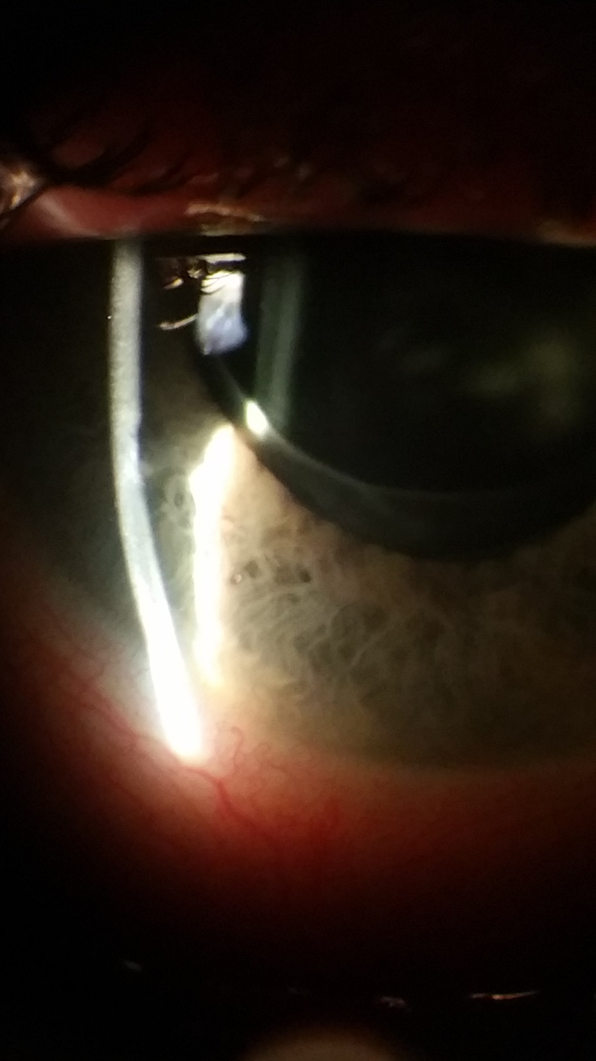

Slide 8
Anterior Segment Exam
PLE or SLE | OD |  | OS
External/Lids |  | WNL
Conj/Sclera | Diffuse chemosis with +2 injection. white bleb superiorly |  | Superior bleb
Cornea | Clear, Siedel negative |  | Clear
Ant Chamber | Shallow, +1 cell and flare, <5% hyphema with trace diffuse RBCs |  | Deep and Quiet
Iris | Bowed forward slightly but not touching cornea No NVI |  | PI@12
Lens | PCIOL |  | PCIOL

Slide 10
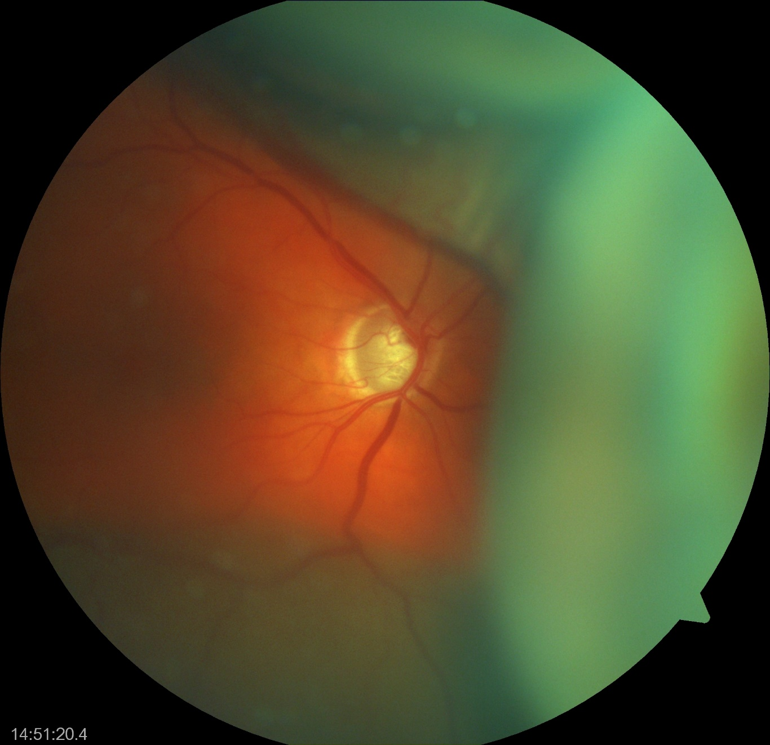

Slide 12
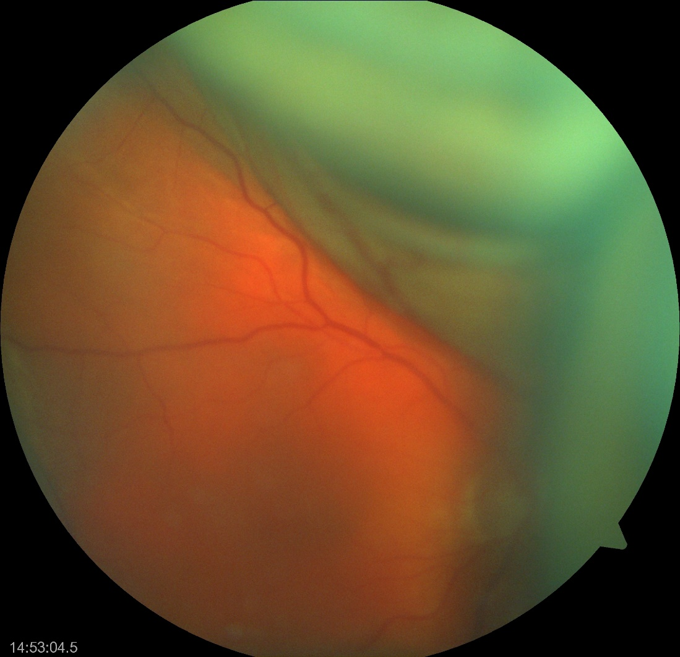

Slide 13
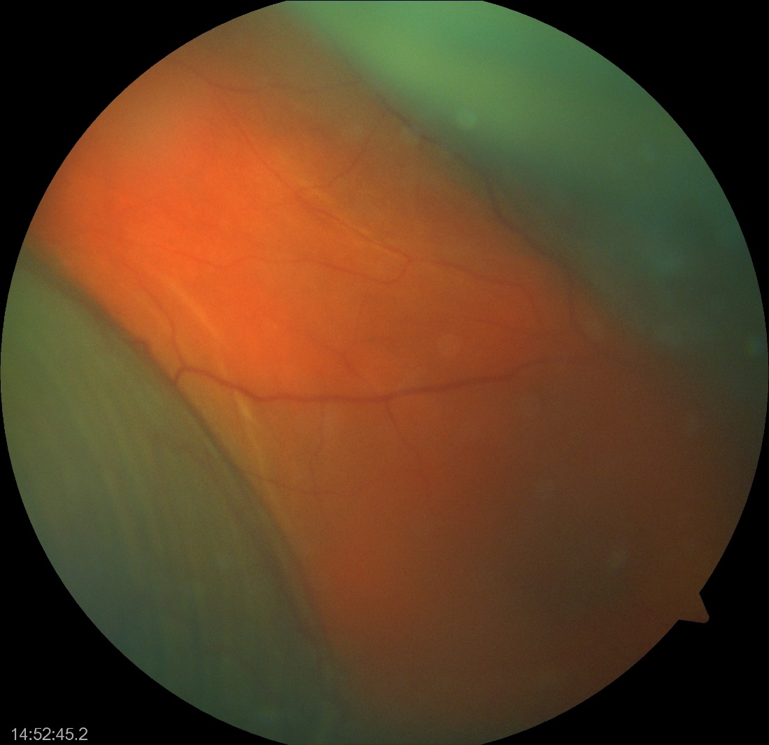
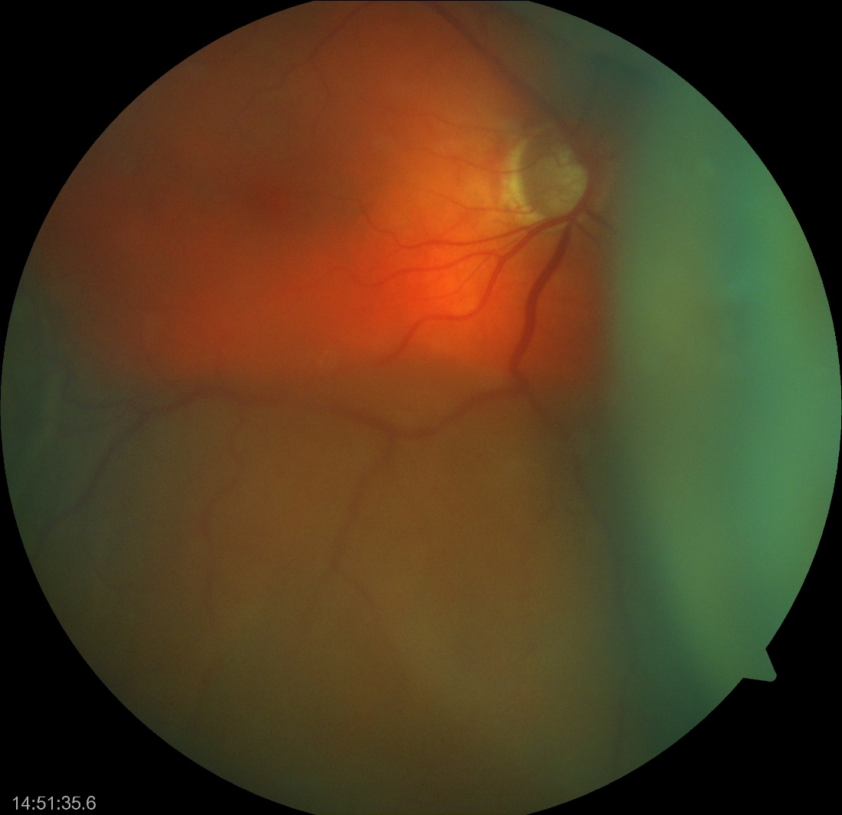

Slide 15
OS

Slide 16
Posterior Segment Exam
Fundus | OD |  | OS
Optic Nerve | C/D 0.9, sharp border | WNL | C/D 0.8
Macula |  | WNL
Vessels |  | WNL
Periphery | Dome shaped dark choroidal elevation (no central retinal apposition) |  | WNL

Slide 17
Notes:
elevated choroidal detachments with a dome-shaped appearance

Slide 18
Assessment
DDx:
Suprachoroidal Hemorrhage
Suprachoroidal effusion/serous choroidal detachment
Blebitis
Rhegmatogenous Retinal detachment

Slide 19
Plan
Started on
Pred Forte QID
Cyclopentolate 1% TID
Prophylactic Vigamox Q2h WA
PO Tylenol and Zofran PRN
Instructed not to touch eye and keep eye shield on at night
F/up next day in General Clinic and then referred to Retina Clinic

Slide 20
F/up
Retina Clinic:
Suprachoroidal hemorrhage (with no central retinal apposition)
Unknown etiology
VAcc 20/HM and 20/200
Stopped Vigamox
Stopped ASA
PF QID + Atropine 1% BID
Subsequently monitored with bi-weekly checkups

Slide 21
Day 52 VAcc 20/200

Slide 23
Month 11 VAcc 20/200

Slide 25
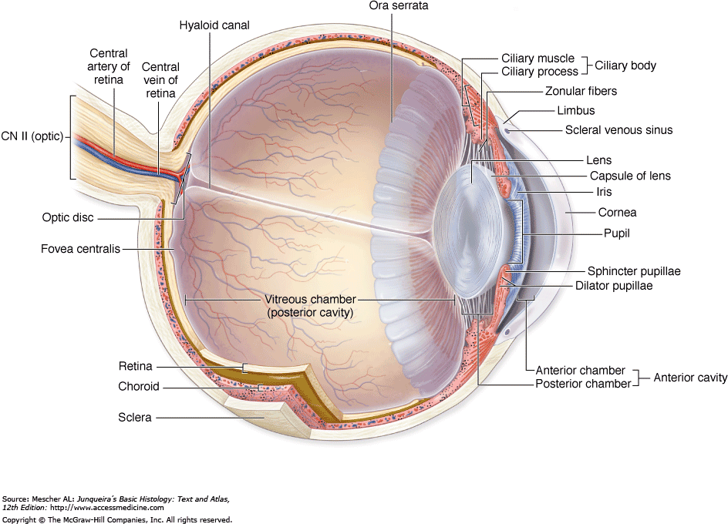
-accumulation of blood in the space between the choroid and sclera (ie, suprachoroidal space) -is a distinct entity from a choroidal detachment in which serous fluid (rather than blood) pools in the suprachoroidal space. -First case report of choroidal hemorrhage in the setting of ophthalmic surgery was in 1760, by Baron de Wetzel.
Suprachoroidal Hemmorhage (SCH)
Expulsive Suprachoroidal Hemorrhage: usually associated with substantial bleeding that leads to the eviction of intraocular contents through the surgical wound, usually with a poor visual prognosis.
Delayed Suprachoroidal Hemorrhage: Closed wound prevents the extrusion of intraocular contents. Have a better visual prognosis.
Notes:
is a rare but potentially devastating complication of ocular surgery.
Anterior boundary scleral spur and posterior boundary in OD. suprachoroidal space normally contains approximately 10 mL of fluid
RARE. Varying incident rate. Old CE 0.2%, PHACO 0.03% to 0.06%. Glaucoma 0.15- 2.0%

Slide 26
Discussion
Proposed Mechanism:
engorgement of the choriocapillaris
serous effusion into the suprachoroidal space, occurring mainly in the posterior pole
stretching and tearing of the vessels and attachments at the base of the ciliary body as the effusion enlarges
resultant massive extravasation of blood arising from torn ciliary body vessels, which leads to SCH (and expulsion of intraocular contents through the surgical wound)
Notes:
The long
posterior ciliary arteries appear especially vulnerable
to rupture during separation of the choroid from
the sclera—from ciliochoroidal effusion—because
their connections between the scleral exit and the
outer choroid are short

Slide 27
Discussion
Risk factors include
Systemic conditions: advanced age, atherosclerosis, hypertension, blood dyscrasias
Ocular conditions: including glaucoma, aphakia/pseudophakia, choroidal arteriolar sclerosis, myopia, choroiditis, recent intraocular surgery, SCH in fellow eye
Notes:
Loss of scleral rigidity and/or choroidal vascular fragility
Weakening of long posterior ciliary artery

Slide 28
Discussion
Perioperative conditions:
Valsalva maneuver, precipitous drop in IOP, retrobulbar anesthesia without epinephrine, vitreous loss, intraoperative systemic hypertension,
tube shunts vs trabeculectomy
Postoperative conditions:
hypotony, systemic thrombolytic agents, and postoperative trauma.
Glaucoma surgery: White race, post operative hypotony, anticoagulants and aphakia/anterior chamber lens

Slide 29
Discussion
Clinical Presentation:
Severe ocular pain (from stretching ciliary nerves in the posterior segment)
± Headache and Nausea/ Vomitting
Decreased vision
IOP may be low, normal or high

Slide 30
Discussion
Clinical Presentation :
Shallowing of the anterior chamber
May have vitreous prolapse into the anterior chamber in aphakic and pseudophakic eyes
May have a loss of red reflex
Exhibit classically dark dome-shaped choroidal elevations that do not transillluminate well (can be confirmed by B-scan ultrasound).
Notes:
(from stretching ciliary nerves in the posterior segment)

Slide 31
Discussion
Treatment:
Topical and oral steroids to control inflammation.
Analgesics (except aspirin and NSAIDs) and cycloplegic agents control the pain.
Manage IOP- Topical and oral antiglaucoma medications.
Notes:
On A-scan evaluation, a steeply rising,
double-peaked wide spike is seen, characteristic of choroidal
detachment, with lower reflective spikes in the
suprachoroidal space, indicating clotted hemorrhage

Slide 32
Discussion
Secondary surgical management remains controversial.
No consensus exists about whether the surgical drainage of the Suprachoroidal space is appropriate. Indications for surgery may include:
retinal detachment
central retinal apposition
vitreous incarceration into a surgical wound or a breakthrough vitreous hemorrhage
increased IOP
retained lens material during cataract surgery
intractable eye pain.

Slide 33
Discussion
SCH with associated retinal detachment
evidence suggests that patients may be followed for progression, because the majority may experience spontaneous regression.
Delayed SCH with central retinal apposition
Treatment strategies range from close follow up without intervention to surgical drainage and vitrectomy 10 to 14 days after the event

Slide 34
Conclusions
Suprachoroidal Hemorrhage is a rare but potentially devastating complication of ocular surgery.
Expulsive Suprachoroidal Hemorrhage vs Delayed Suprachoroidal Hemorrhage
Treatment goals: control IOP, inflammation and pain
Surgical management: no current consensus

Slide 35
References
Chu TG, Green RL. Suprachoroidal hemorrhage. Surv Ophthalmol. 1999;43:471-486.
Chu TG, Cano MR, Green RL. Massive suprachoroidal hemorrhage with central retinal apposition: a clinical and echographic study. Arch Ophthalmol.1991;109:1575-1581.
Berrocal JA. Adhesion of the retina secondary to large choroidal detachment as a cause of failure in retinal detachment surgery. Mod Probl Ophthalmol. 1979;20:51-52.
Reynolds MG, Haimovici R, Flynn HW Jr, et al. Suprachoroidal hemorrhage: clinical features and results of secondary surgical management. Ophthalmology. 1993;100:460-465.
Scott IU, Flynn HW Jr, Schiffman J, et al. Visual acuity outcomes among patients with appositional suprachoroidal hemorrhage. Ophthalmology. 1997;104:2039-2046
Tuli SS1, WuDunn D, Ciulla TA, Cantor LB. Delayed suprachoroidal hemorrhage after glaucoma filtration procedures. Ophthalmology. 2001 Oct;108(10):1808-11.

