Slide 1
Grand Rounds A Case of Monocular Glaucoma
Tala Kassm, DO
October 21, 2016

Slide 2
Patient Presentation
Chief Complaint
“My eye pressure is high in my right eye and my vision is blurry.”
HPI
53 year old WM referred to glaucoma clinic by an outside optometrist with a 4 day history of blurry vision and associated eye pain OD.

Slide 3
Patient Presentation
More history
At initial presentation:
Vision: 20/50 OD, 20/20 OS
IOP: 43 mmHg OD, 16 mmHg OS
Trace cell in the AC, no KP’s
Diagnosed as glaucomatocyclitic crisis
Started on Durezol TID OD and timolol BID OD and oral Diamox 250 mg daily
Four days later:
IOP of 42 mmHg, VA of 20/200 OD
Given additional oral Diamox and sent to us

Slide 4
History
Past Ocular History
Pseudophakic OU
Trauma OD 3 years ago: hit by nail off of saw bit
Subsequent traumatic cataract OD, removed 4/2015
Review of systems
Headache intermittently
Denies nausea or vomiting
Notes:
Evaluated by optometrist, didn’t require FB removal or surgery. Had “bleeding inside the eye” that resolved.
PMH: hypertension, on lisinopril, metoprolol, diamox 250 mg daily, current daily smoker, occasional alcohol
PMH, FH, Meds, Allergies, Soc HX

Slide 5
External Exam
 | OD |  | OS
VA | 20/60 PH: 20/20 |  | 20/20
Current Rx | plano |  | plano
Pupils | 4→3mm | No rAPD | 4→3mm
IOP | 35 mmHg |  | 16 mmHg
EOM | full |  | full
CVF | full |  | full

Slide 6
Anterior Segment Exam
SLE | OD |  | OS
External/Lids |  | WNL
Conj/Sclera | 2+ injection, diffuse |  | White and quiet
Cornea | Clear, no KP’s, no scar |  | Clear
Ant Chamber | Deep and quiet |  | Deep and quiet
Iris | WNL, no heterochromia |  | WNL
Lens | PCIOL |  | PCIOL
Gonio | D45r1+ No PAS, no angle recession |  | D45r1+ No PAS, no angle recession
D: deep
45: angular approach of iris
R: regular peripheral iris
1+ pigment of trabecular meshwork
PAS: peripheral anterior synechiae
Spaeth grading system
Notes:
No transillumination defects
No debris in TM

Slide 7
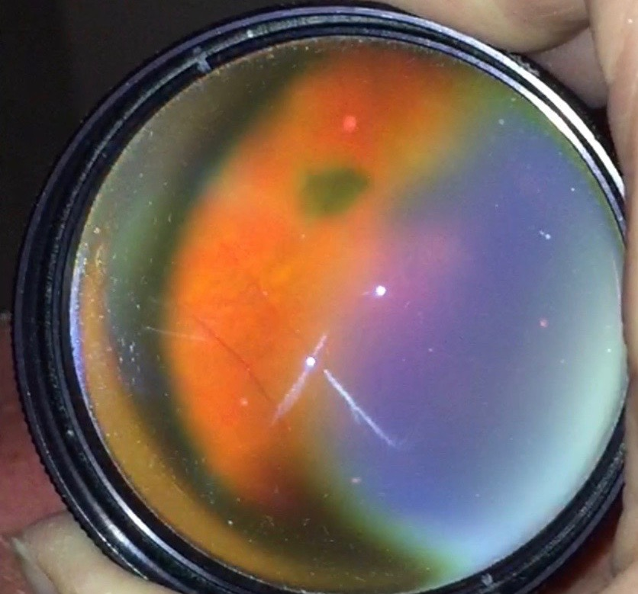
Posterior Segment Exam
Fundus | OD |  | OS
Optic Nerve | c/d: 0.7, no heme |  | c/d: 0.5
Macula |  | WNL
Vessels |  | WNL
Periphery | Small dark IOFB in vitreous. No holes or tears 360 degrees |  | WNL

Slide 8
Assessment
53 year old WM with a 5 day history of elevated IOP, pain and blurry VA OD.
Remote history of injury to eye by metal FB
IOFB seen in vitreous now on exam
Concern for metal toxicity due to foreign body
Notes:
What sounded like metal of metal on metal saw
On our exam he didn’t have inflammation but per the notes, he presented initially with some

Slide 9
Plan
Started on Simbrinza OD TID
In addition to timolol BID, Durezol once daily
Sent for retinal evaluation
Retinal evaluation same day, observe for 1 week
1 week later: VA 20/25, IOP of 23 OD
Scheduled 23 gauge pars plana vitrectomy with foreign body removal OD
Notes:
Brinzolamide and brimonidine

Slide 10
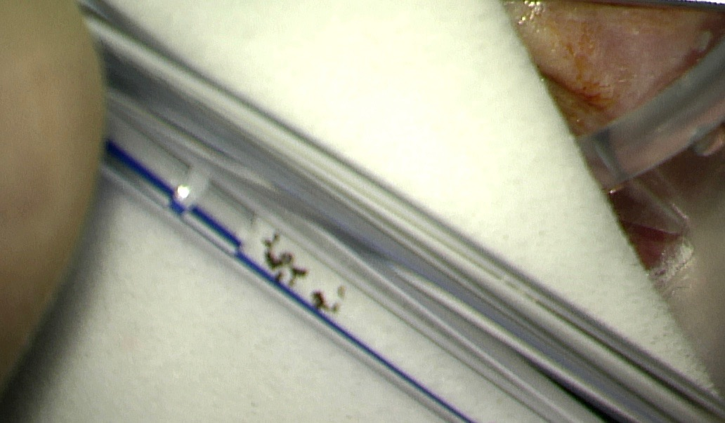
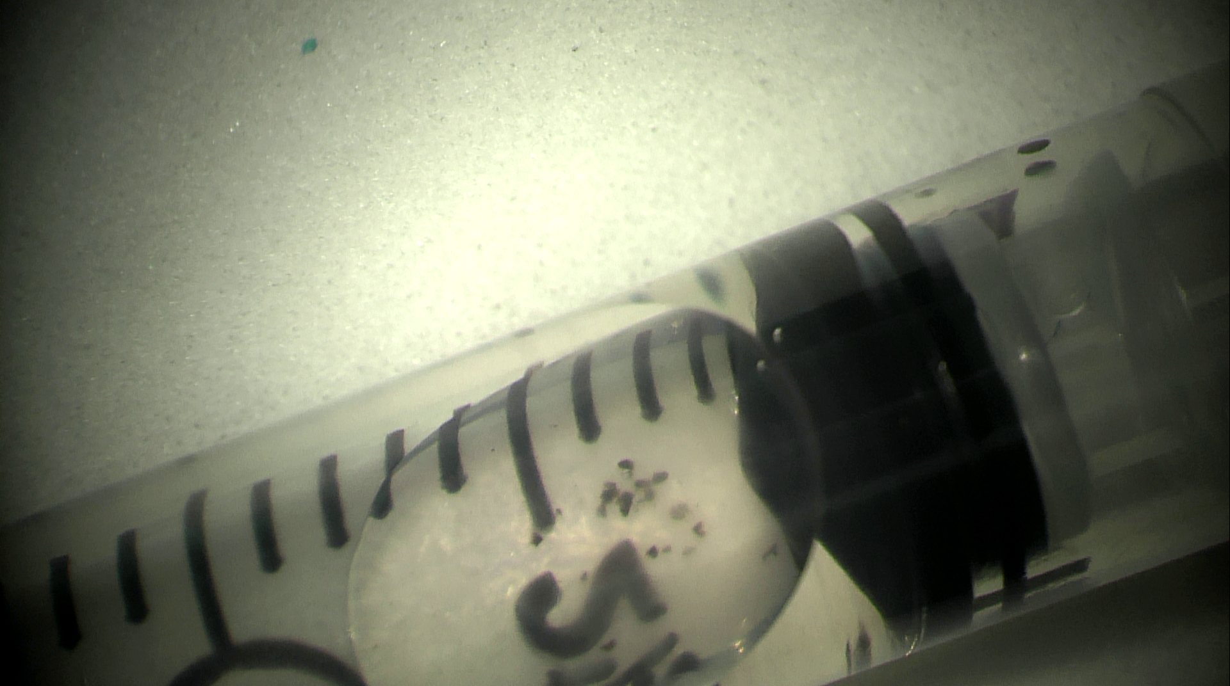
Surgery
Foreign body was removed while performing anterior vitrectomy.

Slide 11
Surgery
No retinal tears or detachment seen during scleral depression at time of surgery.
The foreign body material was sent to lab for further identification.
Pathology report returned as unidentified black foreign body material.

Slide 12
Follow Up
1 week follow up for right eye:
VA of 20/30
IOP of 20
Still on Simbrinza TID, timolol BID, PF QID
AC quiet
Inferior rhegmatogenous retinal detachment with horseshoe tear at 9 o’clock
Plan: return to OR for scleral buckle, 25 gauge vitrectomy, endolaser and SF6
Notes:
SF6: sulfur hexafluoride

Slide 13
Follow up
Retinal detachment was successfully repaired
At follow up visits, IOP ranged from 20-25 mmHg
Still on Simbrinza TID, timolol BID, Diamox 250 mg BID and PF TID.
Trace to no inflammation
Travatan added to his regimen

Slide 14
So… What was the diagnosis?
Open Angle Glaucoma Secondary to Intraocular Metal
Metallosis
No signs on exam
No obvious debris in TM on gonioscopy
Only reported with copper and iron
Fibrosclerosis of TM
Indirect metal toxicity (not physically blocking the angle)
Inflammation incited by a metallic foreign body
Could be incited as metal degraded over time
Consistent with friability upon removal and delayed onset
Possible encapsulation
Unilateral Open Angle Glaucoma
Possible glaucomatocyclic crisis, Fuchs heterochromic iridocyclitis, pseudoexfoliation, etc.
Unlikely given history and lack of other findings that support these diagnoses
Notes:
No reports of different metals causing toxicity
Glaucomatocyclitic: corneal edema, KP’s, minimal pain to none, ciliary flush, rare to see cupping.
No reports of metal causing inflammation without metallosis
Fuchs: heterochromia, iris atrophy, KP’s, doesn’t respond to steroids
Pseudoex: no fibrillar deposit, bilateral, older population, transillumination defects

Slide 15
Intraocular Foreign Bodies
Up to 40% of eyes with an open-globe injury contain at least one IOFB.
Most commonly affect young men
While shooting a shotgun or BB gun
Hammering
Witnessing an explosion
Using a machine tool
Can lead to severe vision loss due to:
Endophthalmitis
Retinal detachment
Metallosis
Notes:
Rarely do metal on metal injuries cause infection – due to heat and speed of missile?

Slide 16
Intraocular Foreign Bodies
Majority are small, sharp projectiles produced in hammering stone or metal.
90% are metallic
55-80% of those are magnetic
Most frequently enter the eye through:
Cornea 65%
Sclera 25%
Limbus 10%
Most frequently lodged in the vitreous (65%)
Lemley CA. Wirostko WJ. Mieler WF. McCabe CM. Dieckert JP. Intraocular Foreign Bodies. Alber &Jakobiec’s Principles & Practice of Ophthalmology. 2008; 377:5137-5145.

Slide 17
Siderosis Bulbi
Due to retained iron IOFB’s
Onset and degree of destruction depends on iron content of material
Characterized histopathologically by accumulation of iron in metabolically active cells
Most commonly involved tissues:
RPE
Corneal epithelium
Lens epithelium
Pupillary constrictor muscles
Trabecular meshwork
Pars plana
Notes:
Creates free radicals
May be a latent period… time for metal to diffuse into tissues and cause toxicity

Slide 18
Siderosis Bulbi
Clinical signs:
Mydriasis
Iris heterochromia
Reduced visual acuity
Corneal deposits
Dark brown deposits under the anterior lens capsule
Cataract
Optic nerve atrophy
Retinal pigmentary change
Notes:
Pupillary dilation: one of the first signs, due to precepitation of iron in sphincter and dilator muscles
nyctalopia, RAPD, iridocyclitis
Anterior subcapsular cataract

Slide 19
Siderosis Bulbi
ERG abnormalities are common
May occur before a decline in visual acuity
Changes may be progressive and irreversible
Despite foreign body removal
Glaucoma induced by:
Physical obstruction of trabecular meshwork
By metallic particles directly
By macrophages with phagocytosed material
Ciliary body changes
Trabecular fibrosclerosis
Notes:
Classic ERG findings: initial super normal signal followed by a progressive decline in b-wave amplitude. Implicit time usually remains normal.
ERG may be followed if not sure about removing foreign body
Glaucoma is typically a late finding
Sclerosis and narrowing of schlemm canal

Slide 20
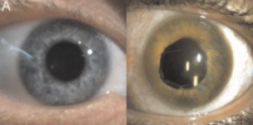
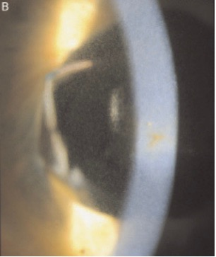
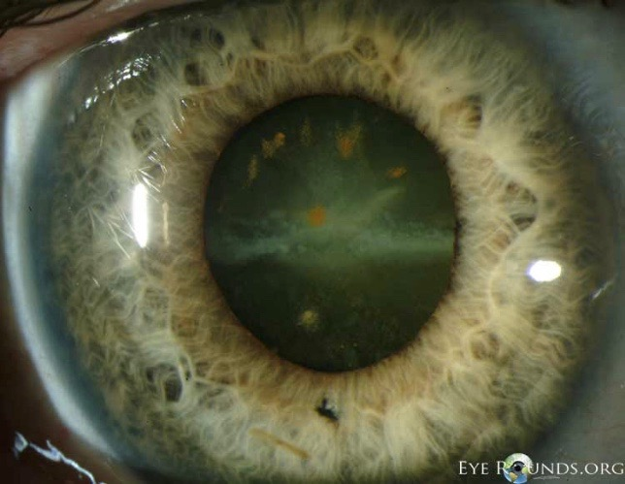
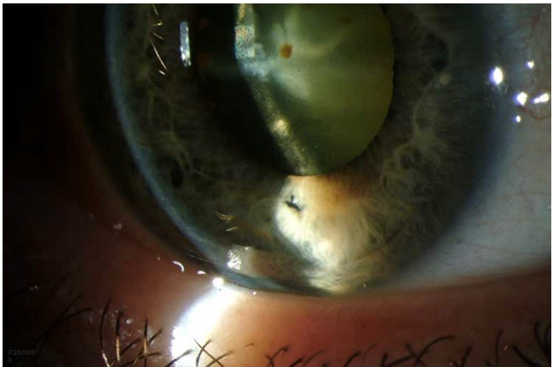
Notes:
Iris hterochromia, normal iris OD. Cornea haze with central rust colored stellate pigmentation. Cornea edema as well, diffuse mid stromal puncate opacities.
Rust colored anterior sub capsular deposits of lens. Injury to cornea and iris inferiorly.

Slide 21
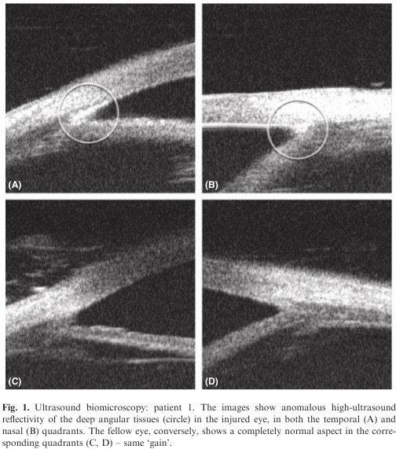
Notes:
Case of 11yo boy, bullet fragment, sclera repair, iofb overlooked. 2 mo later traumatic cataract + uveitis, IOP of 30 (glaucoma). Underwent Vtx, phaco. Glaucoma surg 1 mo later
27 y/o hammering metal. Diagnosed 3 months later, removed. Glaucoma surgery 4 mo later (7 mo total)
Anomalous high reflectivity in the deep angular layers thought to be due to direct metallic particles or fibrotic reaction
Histologically proven siderosis of TM from glaucoma surgery.
2010. ACTA
This is really cool, but I really want more details about the glaucoma in the patients that developed it. For example, it doesn’t seem like broken down metal would cause an acute rise in IOP. The above pictures seem like this would take time and cause a chronic slow rise in IOP. I am just speculating, but did any of the papers describe details concerning this?

Slide 22
Chalcosis
Due to retained copper IOFB
Damage and vision loss depends on concentration of copper
Pure copper
Severe, rapid panophthalmitis leading to phthisis
Containing 85% of copper
Deposits in Descemet’s membrane, vitreous cavity and ILM
Alloys containing less than 85% of copper
Typically do not cause vision loss
Notes:
Necessitates immediate removal
Kayser-Fleischer ring
Greenish refractile deposits in ILM
Anterior subcapsular sunflower cataract
Greenish discoloration of iris and vitreous

Slide 23
Metallosis due to IOFB
Four classes of steel used in the manufacturing of tools:
Standard alloy
Contains iron, carbon, manganese
Magnetic and corrodible
Used in machinery and automotive parts
Stainless
Chromium and nickel makes them resistant to corrosion
Used in relation to food and hospital setting
Tool
Tungsten, chromium, vandanium, molybdenum
Resistant to abrasion and deformation
Often used for shaping of other materials
Manganese
Contain 12% manganese
Jaws of crushers and grinders
Ballantyne JF. Siderosis Bulbi. Brit. J. Ophthal. (1954) 38, 727.
Notes:
Consider stainless steel or aluminum (when no evidence of siderosis)
Two cases – one of stainless steel tacs and one of metal pieces on retina 20+ years later no ocular toxicity documented

Slide 24
Conclusions
Obtain a detailed history in any case of trauma
CT scan is the gold standard for identifying metallic IOFB
Symptoms of retained IOFB depends on the composition of the material
Can potentially be asymptomatic for years
Siderosis bulbi has multiple ocular findings
Can monitor with ERG

Slide 25
References
Weiss MJ. Hofeldt AJ. Behrens M. Fisher K. Ocular Siderosis. Diagnosis and Management. Retina. 1997; 17(2):105-8.
Ballantyne JF. Siderosis Bulbi. Brit. J. Ophthal. (1954) 38, 727.
Zhu L. Shen P. Lu H. Du C. Shen J. Gu Y. Ocular Trauma Score in Siderosis Bulbi with Retained Intraocular Foreign Body. Medicine. 2015; 94(39): 1-4.
Ding J. Yoganathan P. Fernando-Sieminski S. Resolution of siderosis glaucoma from chronic intraocular foreign body without glaucoma surgery. Can J Ophthalmol. 2015; 50(5):e82-5.
Sangermani C. Mora P. Mancini C. Vecchi M. Gandolfi S. Ultrasound Biomicroscopy in two cases of ocular siderosis with secondary glaucoma. Acta Ophthalmologica. 2010; e1-e2.
McGimpsey SJ. Rankin SJA. Clinical Case Notes: Presentation of intraocular foreign body 25 years after the event. Clinical and Experimental Ophthalmology. 2005; 33: 665-674.
Tingey D. Shingleton BJ. Glaucoma Associated with Ocular Trauma. Ophthalmology. 10.17, 1084-1089.e1
Lemley CA. Wirostko WJ. Mieler WF. McCabe CM. Dieckert JP. Intraocular Foreign Bodies. Alber &Jakobiec’s Principles & Practice of Ophthalmology. 2008; 377:5137-5145.
Ho TT. MacCumber M. Intraocular Foreign Bodies. Alber &Jakobiec’s Principles & Practice of Ophthalmology. 2008; 187: 2375-2386.

Slide 26
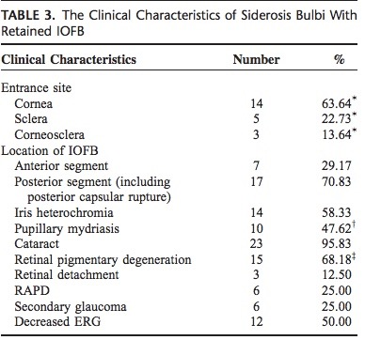
Siderosis
Retrospective review of 24 cases of siderosis bulbi in China, 2007-2013
To investigate the clinical characteristics and visual outcomes
Notes:
OTS: score based on variables: vision, endophthalmitis, rupture, perforating or penetrating injury, RD, APD. Prognostic model to determine visual outcome in ocular injuries
Where were the foreign bodies in these eyes? And was there a relationship between where the FB was and whether glaucoma developed?

