Slide 1
Grand Rounds
“A case of white dots”
Raafay Sophie, MD
January 19, 2018

Slide 2
Patient Presentation
CC
  Seeing “white floaters” with decreased vision in the right eye x 10 days.
HPI
  20 y Hispanic F presents with
  Decreased vision, white floaters, increased photophobia OD
  Denies flashes, associated headache, tearing, discharge, pain on eye movement

Slide 3
History (Hx)
Past Ocular Hx: Idiopathic intracranial hypertension
Past Medical Hx: None
Fam Hx: None
Meds: Diamox 250 mg PO BID
Allergies: NKDA
Social Hx: No smoking/alcohol/drugs, mother of two
ROS: Denies recent infection, travel, joint pains, skin rash or fever

Slide 4
External Exam
 | OD | OS
BCVA | 20/50 | 20/20
Refraction | -1.50 Sph | -1.00 Sph
Pupils | 4→3mm, No rAPD | 4→3mm, No rAPD
IOP | 18 mmHg | 17 mmHg
EOM | full | full
CVF | full | full
Ishihara | 11/11 | 11/11
Red Desaturation | none | none

Slide 5
Anterior Segment Exam
SLE | OD | OS
External/Lids | WNL | WNL
Conj/Sclera | White and quiet | White and quiet
Cornea | Clear | Clear
Ant Chamber | Deep and quiet | Deep and quiet
Iris | WNL | WNL
Lens | Clear | Clear

Slide 6
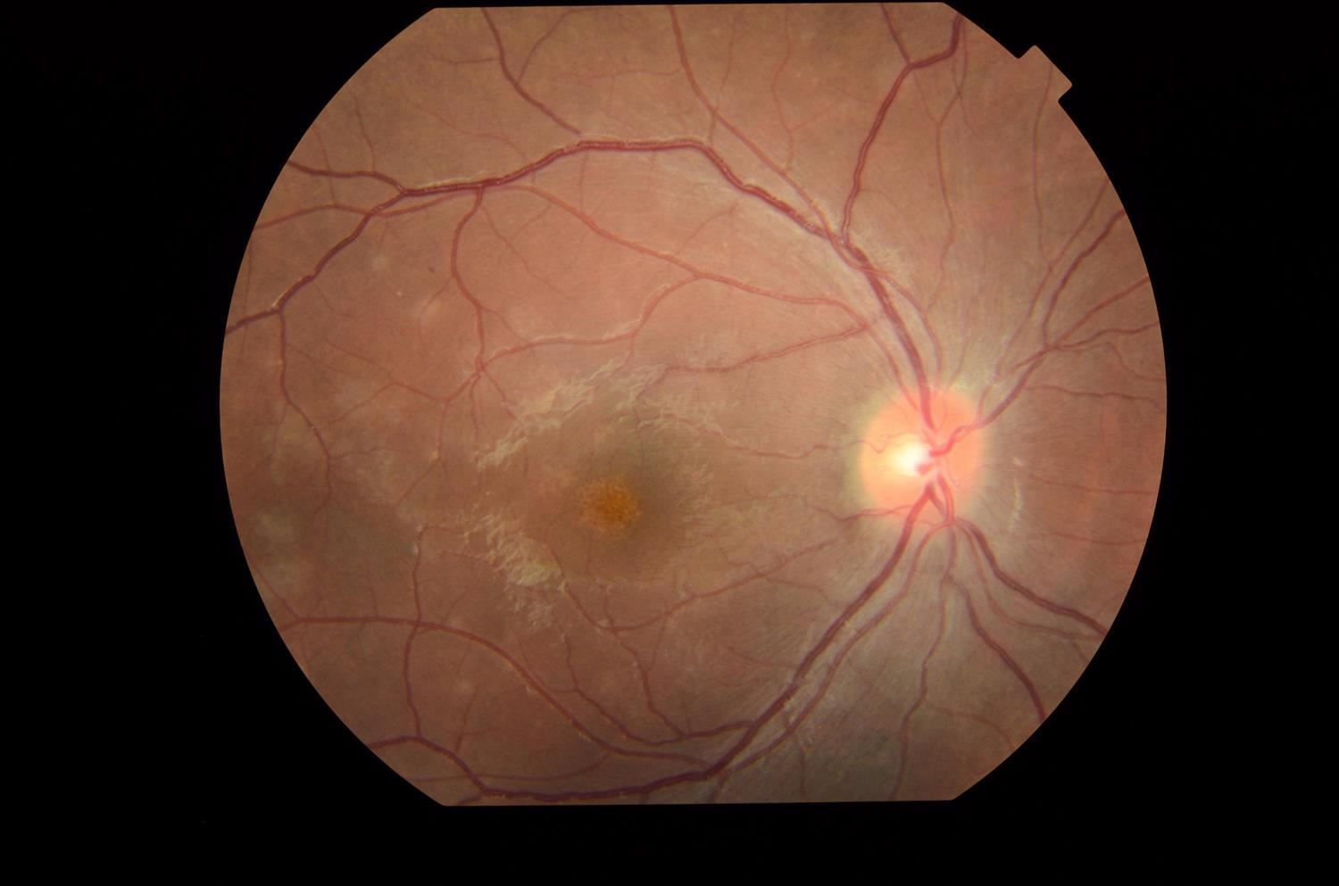
OD
Notes:
Optic Nerve
c/d 0.2, pink and sharp,
Mild elevation inferotemporal
Macula
Foveal/Parafoveal multiple fine yellow/orange granular focal dots
Vessels normal caliber
Subretinal hypopigmented dots (100-200 µm

Slide 7
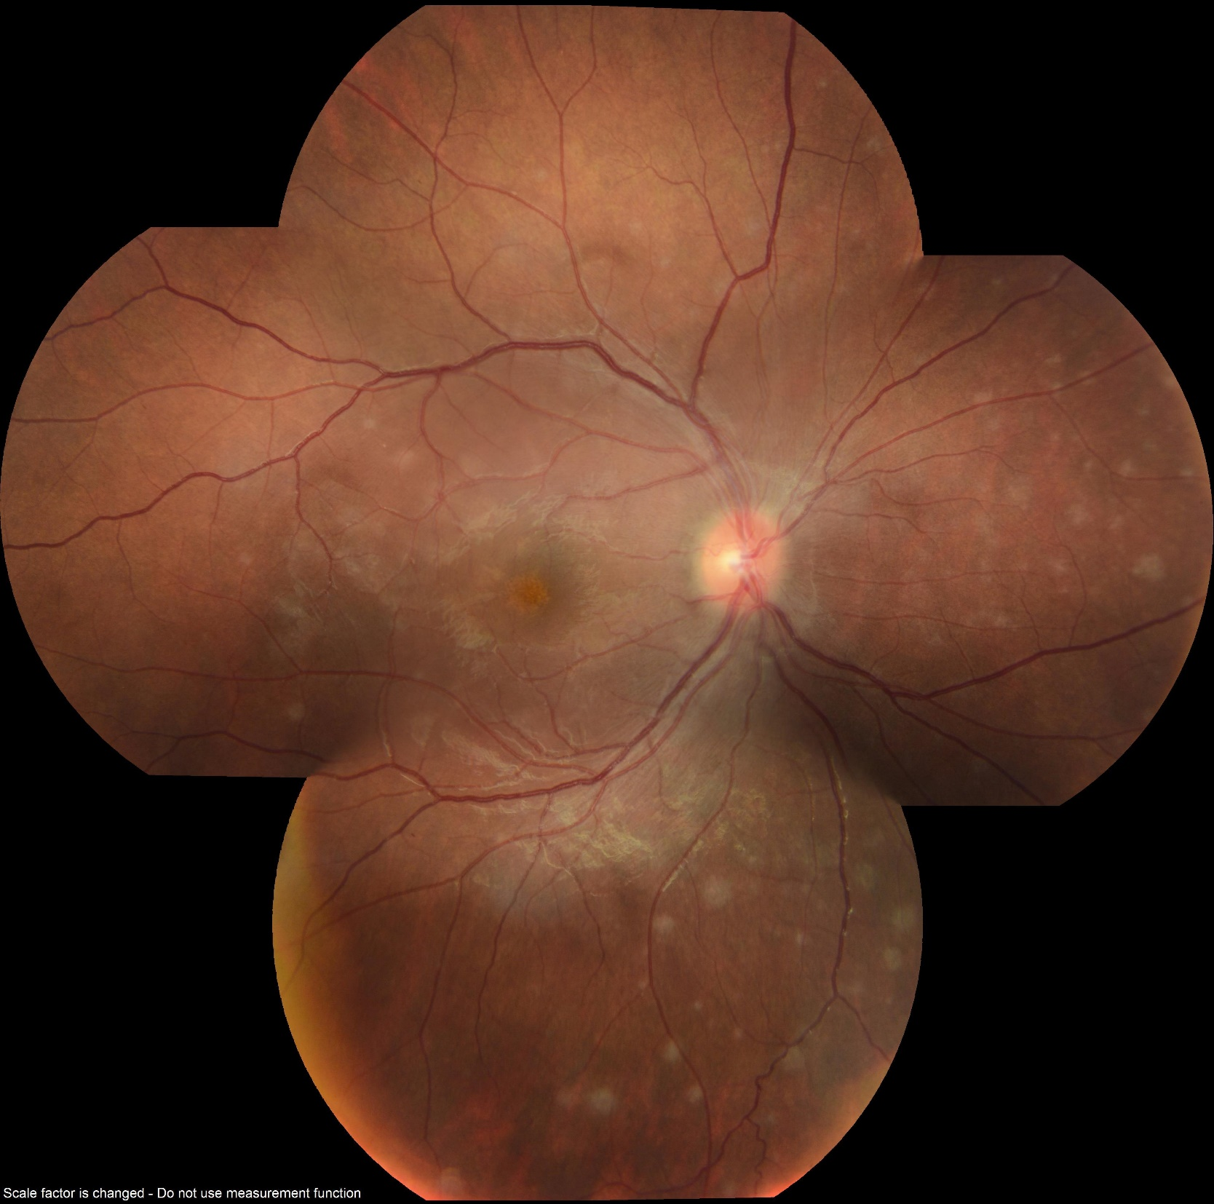
Notes:
Periphery
Subretinal hypopigmented dots (100-200 µm) around arcades

Slide 8
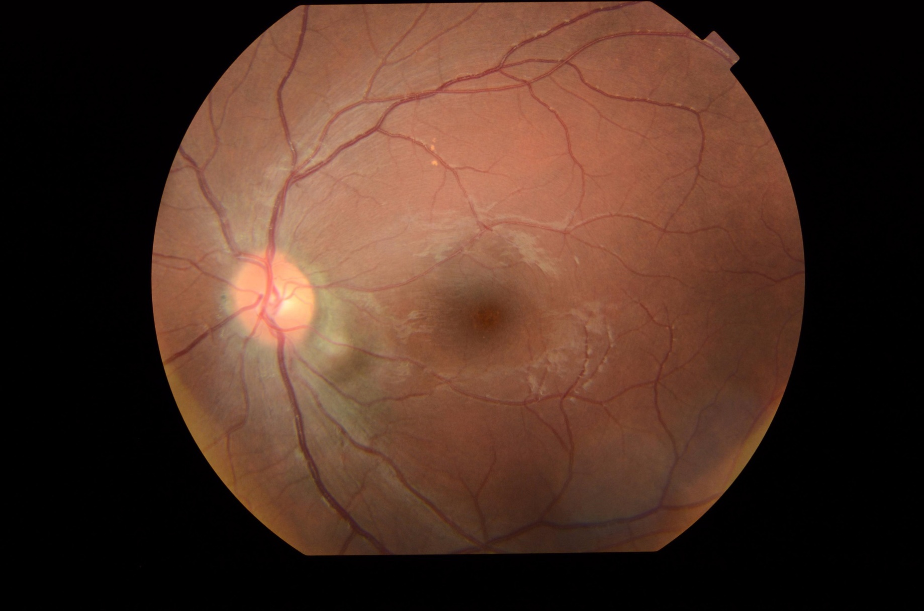
OS
Notes:
c/d 0.2, pink and sharp, Elevation inferotemporal

Slide 9
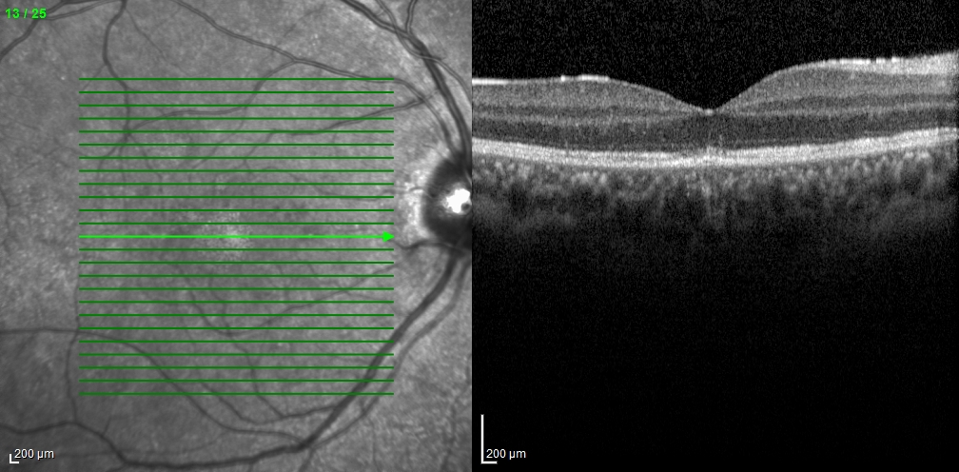
OCT OD
Notes:
OCT showed focal disruption in the EZ and outer PR area

Slide 10
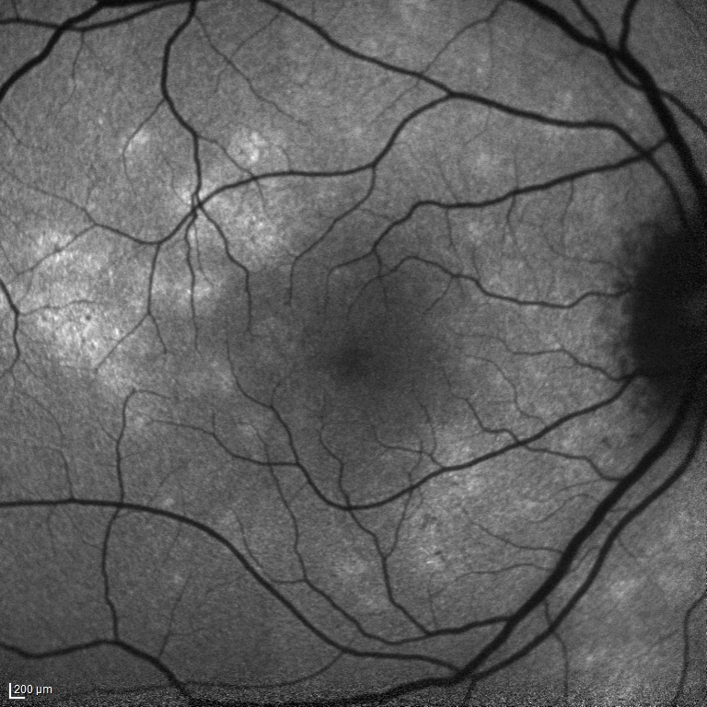
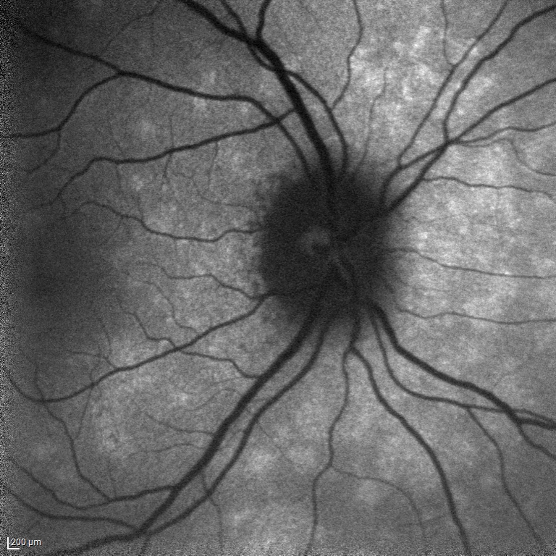
AF OD
Notes:
Hyper autofluorescent areas corresponding to the wds

Slide 11
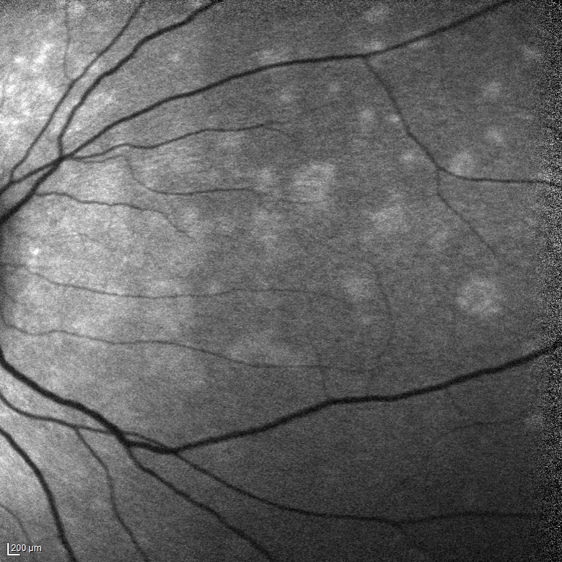
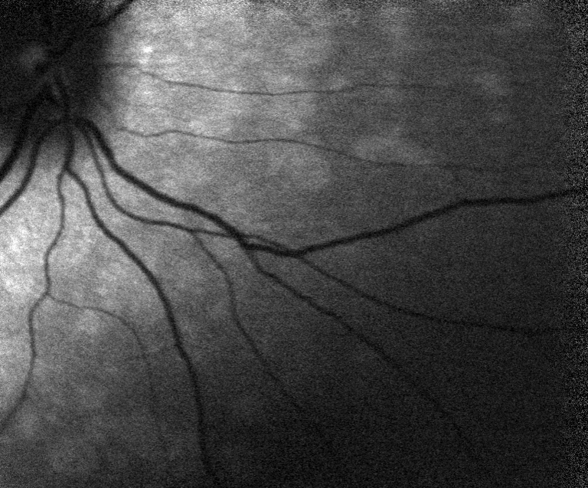
AF OD
Notes:
FA/ICG pt did not want to get done

Slide 12
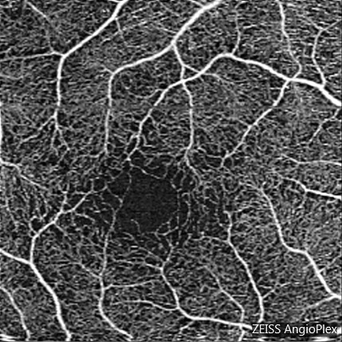
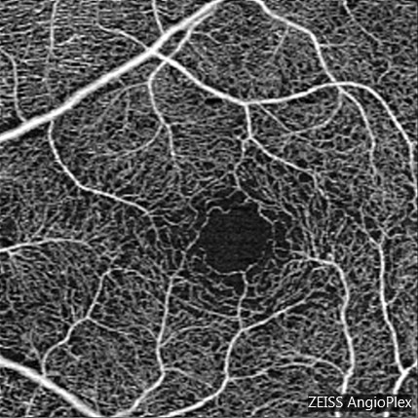
OCT A
OD
OS
Notes:
Macula shows enlarged and irregular FAZ with increased perifoveal intracapillary spaces.

Slide 13
OD
OS
Notes:
OCTA of choriocapillary shows hypoperufion at the fovea. The corresponding Bscan shows some outer PR disruption with some mild posterior shadowing that may contribute to the hyporeflective signal we see at the choriocapilaris but is not sufficient to totally explain the hyporeflective area.

Slide 14
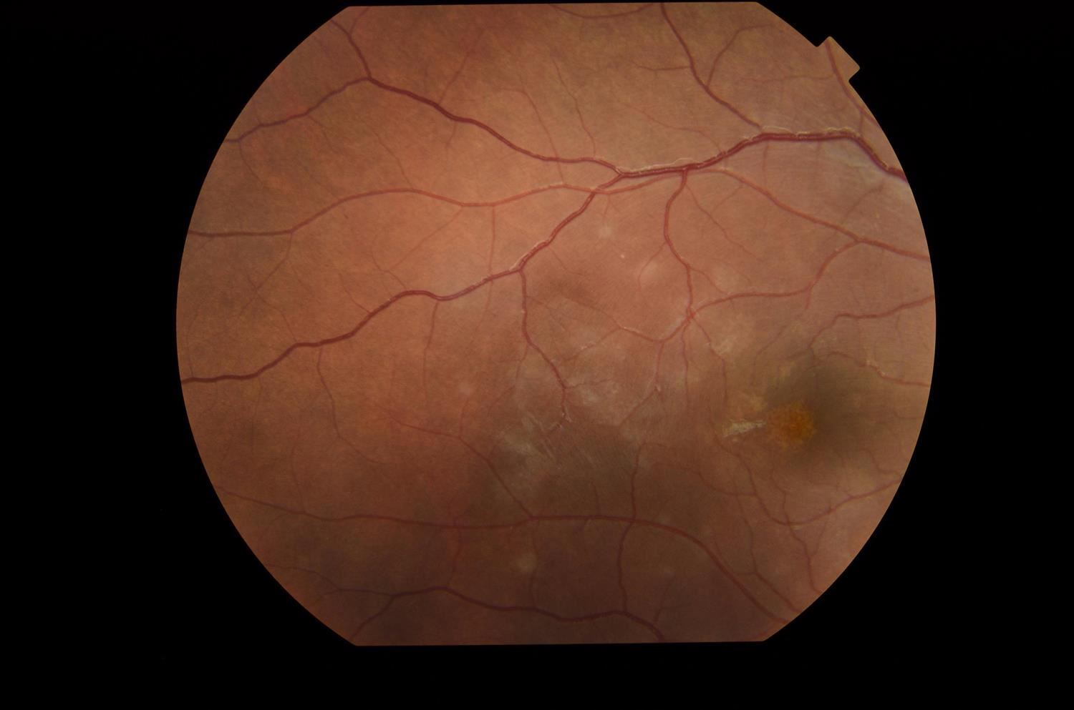
OD White dot

Slide 15
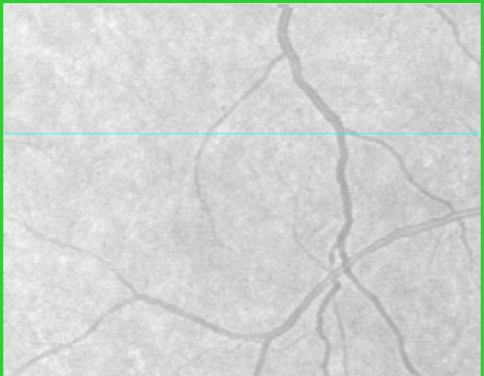
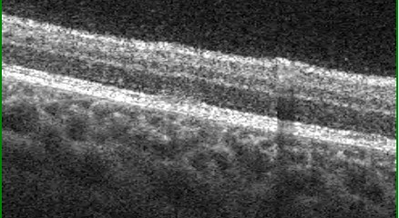
OD White dot

Slide 16
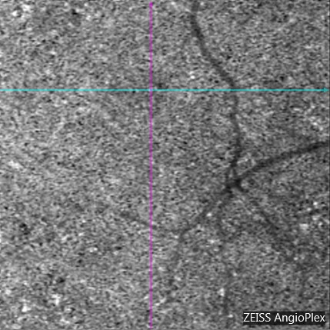
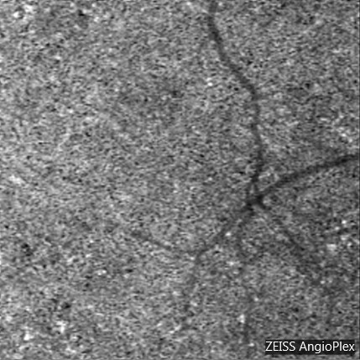
OD White dot
Notes:
Perhaps some hypoperfusion in the choriocapillary but nothing definite.

Slide 17
Assessment
  Multiple evanescent white dot syndrome (MEWDS)
  Differential Diagnosis
  Sarcoidosis
  Multifocal choroiditis
  Acute posterior multifocal placoid pigment epitheliopathy (APMPPE)

Slide 18
Plan
CXR, CBC, FTA/ABS, CMP, Urine analysis, B2 globulin, Quantiferon TB, EBV IgG and IgM,
Return in 1 week with results
Notes:
Patient did not return for 1 week appointment saying she was unable to come from Clarksville, Tennessee due to her children needing care, but that her vision had gotten better. Tried contacting her several times since then, but her phone has been disconnected.
Labs faxed over Quantiferon negative, EBV IGG positive, IGM negative

Slide 19
MEWDS
Originally described in 1984 by Lee Jampol
An acute, multifocal, usually unilateral retinopathy affecting young adults.
  Mean age 26.8 years
  Female preponderance (75 %)
Postulated to be an immune dysregulation in response to a virus

Slide 20
MEWDS
Symptoms:
  blurred vision
  photopsias,
  temporal scotoma (occasional)
  Visual field testing often shows an enlarged blind spot.
  May relate flu-like symptoms prior to presentation

Slide 21
MEWDS
Signs
Multiple white dots in deep retina or RPE
  mostly concentrated in the paramacular area, usually sparing the fovea
  less prominent but more numerous outside vascular arcades
The macula usually shows granular orange or yellow dots, distinct from the larger white dots
Vitreal cells, retinal venous sheathing, and blurring of the disc margins are often seen.
Notes:
The white spots disappear completely after a number of weeks or months.
They may be replaced by mild pigment mottling, or sometimes, scattered chorioretinal scarring resembling multifocal choroiditis

Slide 22
MEWDS
Testing
FA
early and late hyperfluorescence of dots in a wreath like pattern
late staining of the optic disk
Notes:
findings include early and late hyperfluorescence of the
white dots in a wreath-like pattern; diffuse, but patchy, late
staining at the level of the RPE and retina; and disc capillary
leakage

Slide 23
MEWDS
Testing
ICG
Intermediate/ late hypofluorescence of spots.
  Lesions are more numerous than seen clinically or on FA.
FAF
Hyper autofluorescent areas corresponding to the white dots.
  More numerous than clinically seen. Overtime may persist or fade.
small areas of hypoautofluorescence around the disk and posterior pole

Slide 24
MEWDS
Testing
OCT
Spots:
Disruption/signal attenuation of Ellipsoid Zone (EZ)

Slide 25
MEWDS
Granularity of the macula
FA: hyperfluorescence throughout the angiogram.
ICGA: intermediate/ late hypofluorescence.
FAF: shows pinpoint areas of increased or decreased autofluorescence.
OCT: Disruption/signal attenuation of EZ

Slide 26
Prognosis/Treatment
The natural course of MEWDS is excellent and often no intervention is required
VA ranges from 20/20 to 20/300, after an average of about 6 weeks almost always returns to normal
Rare instances of late CNV have also been noted that have been treated with anti-VEGF therapy
Rarely can be bilateral or recurrent

Slide 27
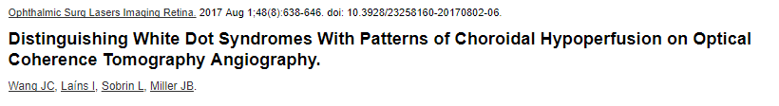
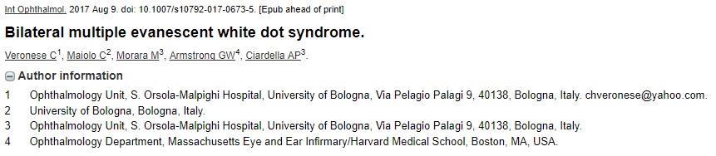
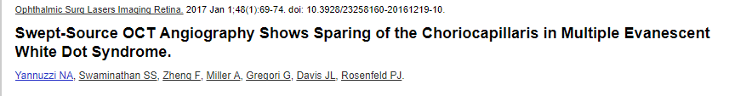
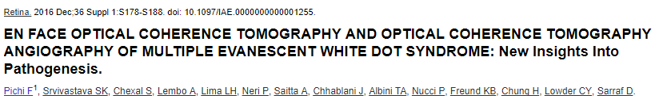
OCTA in MEWDS?

Slide 28
In POHS and MEWDS, areas of choroidal hypoperfusion correlated well with clinically observed pathology, but in APMPPE and BCR, they were more widespread

Slide 29
OCTA
areas of photoreceptor slab black-out corresponding to areas of EZ disruption
light areas of flow void or flow disturbance in the choriocapillaris.

Slide 30
SS-OCTA images show that choriocapillaris flow appears to be preserved in the early stages of disease, but SS-OCTA may not be sensitive enough to detect small changes in flow.
Notes:
2 patients imaged

Slide 31
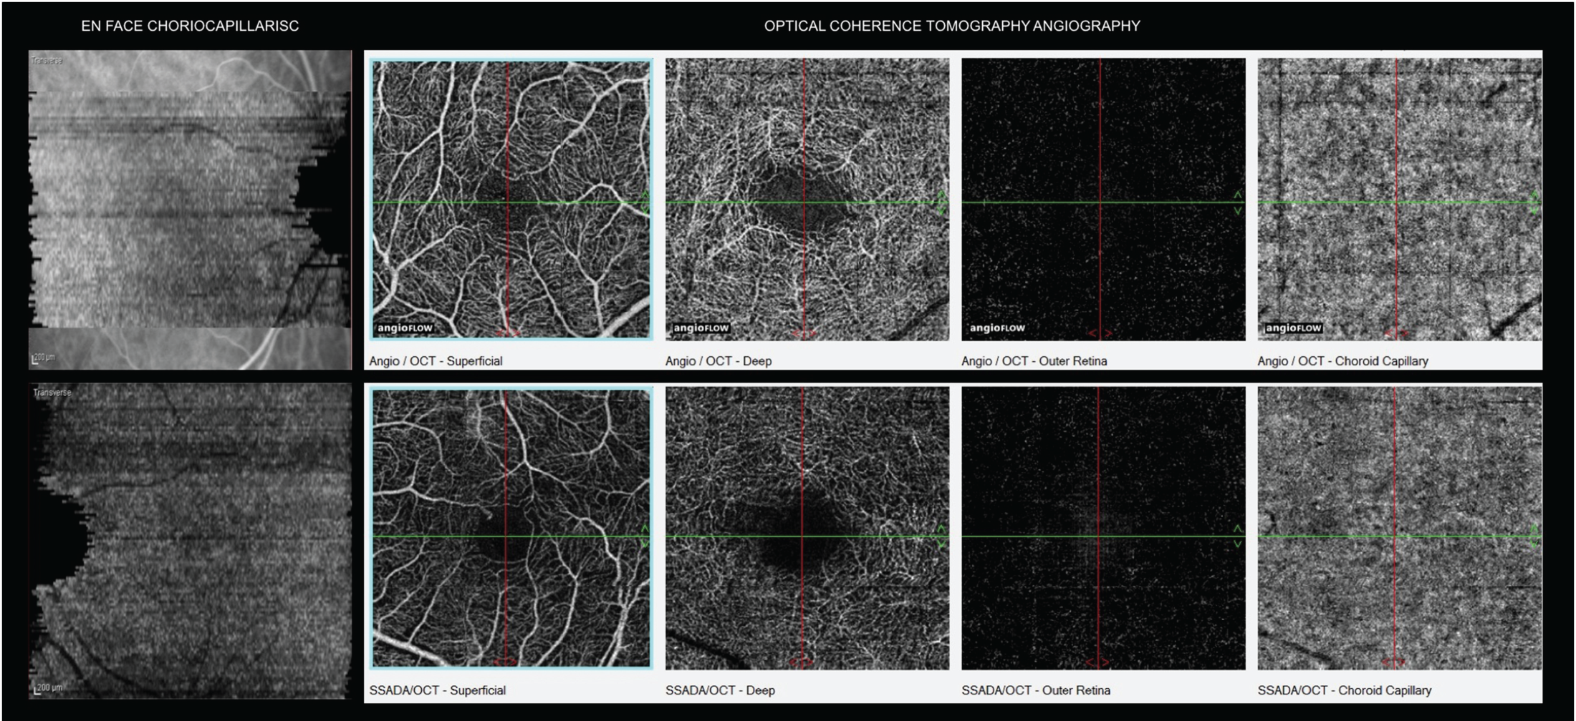
29 eyes with MEWDS- At the fovea, the superficial and deep retinal capillary networks and the choroidal vasculature were comparable to capillary networks reported in healthy, control eyes

Slide 32
Summary
MEWDS is an acute, multifocal, usually unilateral retinopathy affecting predominantly young women
Changes occur as a result of inflammation at the RPE and outer photoreceptor level, likely with some hypoperfusion of the underlying choriocapillaris
Excellent prognosis with majority regaining vision in 4-6 weeks

Slide 33
References
Jampol LM , Sieving PA , Pugh D , e al. Multiple evanescent white dot syndrome. I. Clinical findings . Arch Ophthalmol. 1984 ; 102 : 671 – 674.
BCSC Intraocular Inflammation and Uveitis (2015-2016)
Retina, Ryan, 5th edition- Section 4, Ch76 “White Spot Syndromes and Related Diseases”
Gass’ Atlas of Macular Diseases,5th Edition, Ch11

Slide 34
Acknowledgements
Henry Kaplan, MD
Mehreen Adhi, MD

