Slide 1
A Case of Myopic Foveoschisis
Mehreen Adhi, MD
May 19, 2017

Slide 2
Patient Presentation
Chief Complaint:
“I see floaters in both eyes and I am unable to see as well as I used to”
HPI:
54 year old African American female presented to the retina clinic for a second opinion
She had complaints of chronic floaters in both eyes and a difficult time seeing small print
No flashes of light
New prescription for glasses ~6 months ago

Slide 3
Patient Presentation
Review of Systems:
Unremarkable

Slide 4
Patient Presentation
Past Ocular History:
High myopia
Ocular hypertension
Past Medical/Surgical History:
Hypertension
Family History:
Glaucoma (mother)
Medications:
Lisinopril
Allergies:
Codeine

Slide 5
External Exam
 | OD |  | OS
Best-corrected VA | 20/30+1 |  | 20/25-2
Refraction | -6.25 +0.75 x 175 |  | -7.50+2.00 x 175
Pupils | 4→2mm | No rAPD | 4→2mm
IOP | 24 mmHg |  | 25 mmHg
EOM | Full |  | Full
CVF | Full |  | Full

Slide 6
Anterior Segment Exam
SLE | OD |  | OS
External/Lids | WNL |  | WNL
Conj/Sclera | White and quiet |  | White and quiet
Cornea | Clear |  | Clear
Ant Chamber | Deep and quiet |  | Deep and quiet
Iris | WNL |  | WNL
Lens | 1+NS |  | 1+NS
Vitreous | Clear |  | Clear

Slide 7
Posterior Segment Exam
Dilated Fundus Exam | OD |  | OS
Optic Nerve | pink and sharp; tilted |  | pink and sharp; tilted
Macula | petalloid appearance |  | petalloid appearance
Vessels | WNL |  | WNL
Periphery | WNL |  | WNL

Slide 8
Color Fundus Photographs

Slide 9
Optical Coherence Tomography

Slide 10
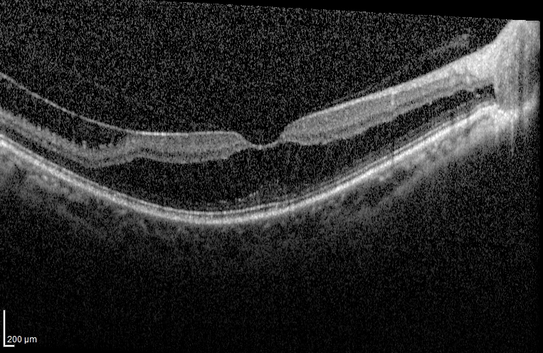
Optical Coherence Tomography

Slide 11
Optical Coherence Tomography

Slide 12
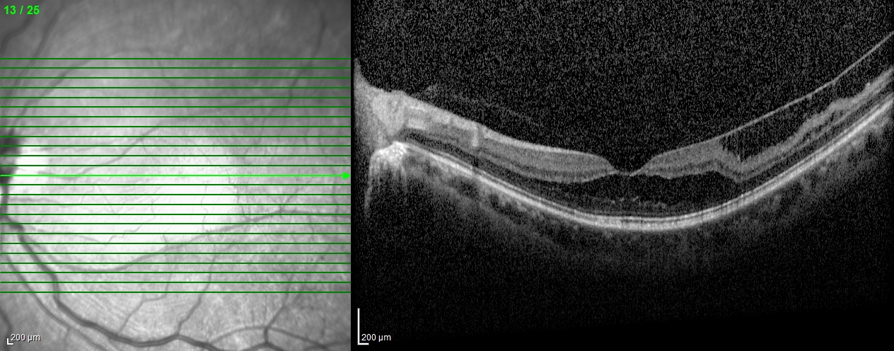
Optical Coherence Tomography

Slide 13
Assessment and Plan
54 year old African American female with chronic floaters and recent decrease in vision OU secondary to high myopia complicated by vitreomacular traction and foveoschisis OU

Slide 14
2014; 20/30-2
2015; 20/30+1
2016; 20/30

Slide 15
2014; 20/25
2015; 20/25-1
2016; 20/25-1

Slide 16
Assessment and Plan
54 year old African American female with chronic floaters and recent decrease in vision OU secondary to high myopia complicated by vitreomacular traction and foveoschisis OU
Has maintained stable best-corrected vision and is being observed in the retina clinic for the past ~2 years

Slide 17
Foveoschisis
Foveoschisis also known as intraretinal splitting or cleavage is well known complication of high myopia
8% to 34% of eyes with high myopia
On slit-lamp biomicroscopy foveoschisis can rarely have a stellate foveal appearance
The term “foveal retinoschisis” was coined by Takano and Kishi based on optical coherence tomography in 1999

Slide 18
Showed two patterns of intraretinal splitting on OCT: outer retinal schisis and inner retinal schisis
In outer retinal schisis, which is more common, the retina is split into a thicker inner layer and a thinner outer layer
Inner retinal schisis is defined as splitting of the retina such that it is divided into a thinner inner layer and a thicker outer layer

Slide 20
Foveoschisis
The natural course and evolution of myopic foveoschisis is not well documented as most patients are asymptomatic
It may result in the formation of an lamellar macular hole or full-thickness macular hole
Traction exerted by the posterior hyaloid, epi retinal membrane and/or epimacular structure is a likely mechanism
Presence of foveal detachment and/or epimacular structure appear to be significant risk factors

Slide 21
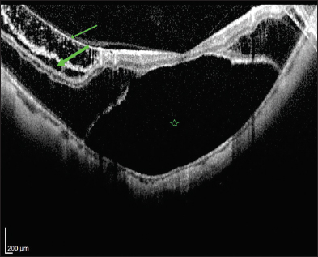
Foveoschisis

Slide 22
Foveoschisis
Pars plana vitrectomy is reported to be an effective approach in the management of the disease
Peeling of inner limiting membrane is controversial
Linked to increased incidence of postoperative macular hole formation although other studies have shown that this complication may occur even if no inner limiting membrane peeling is carried out

Slide 23
Modified surgical technique, the parafoveal multiple curvelinear internal limiting membrane peeling
20 eyes of 20 consecutive patients
Postoperative OCT showed that full-thickness macular holes did not developed in any case at 12 months

Slide 24
OCT and clinical findings indistingishable from myopic foveoschisis
Similar management
Surgical outcomes very similar to myopic foveoschisis

Slide 25
Conclusion
Fovoeschisis is a common complication of high myopia and spectral-domain OCT is crucial to establish the diagnosis
When symptoms develops, presence of foveal detachment and/or epimacular structure appear to be significant risk factors for progression to macular hole formation
Pars plana vitrectomy with or without membrane peeling is an effective approach in the management of the disease

Slide 26
References
Wu PC, Chen YH, Chen CH, et al. Factors associated with foveoschisis and foveal detachment without macular hole in high myopia. Eye. 2009;23:356-361.
Paba T, Ohno-Matsui K, Futagami S, et al. Prevalence and characteristics of foveal retinal detachment without macular hole in high myopia. Am J Ophthalmol. 2003;135:338-342.
Panozzo G, Mercanti A. Optical coherence tomography findings in myopic traction maculopathy. Arch Ophthalmol. 2004;122:1455-1460.
Benhamou N, Massin P, Haouchine B, Erginay A, Gaudric A. Macular retinoschisis in highly myopic eyes. Am J Ophthalmol 2002; 133: 794–800
Duker JS, Kaiser PK, Binder S, et al. The International Vitreomacular Traction Study Group classification of vitreomacular adhesion, traction, and macular hole. Ophthalmology 2013; 120: 2611–2619

Slide 27
Thank you

