Slide 1
Grand Rounds Iris Melanoma
Andrea Breaux
December 16, 2016

Slide 2
Patient Presentation
CC
“Spot on my right eye”
HPI
60 yo WM presents with lesion on his right eye. Was getting evaluation for LASIK and was told there is a spot he needed to have “checked out”. Had not noticed it previously.

Slide 3
History (Hx)
Past Ocular Hx: Unremarkable
Past Medical Hx: Skin cancer, hypertension
Fam Hx: Cancer
Meds: anti-hypertensive, omeprazole
Allergies: None
Social Hx: Non-contributory
ROS: Negative for pain, negative for visual changes

Slide 4
External Exam
 | OD |  | OS
VA | 20/20 |  | 20/20
Refraction | -1.50 +1.75 x 170 Add: +2.50 |  | -0.75 +1.25 x 177 Add: +2.50
Pupils | 5mm |  | 5mm
IOP | 15 mmHg |  | 16 mmHg
EOM | full |  | full
CVF | full |  | full

Slide 5
Anterior Segment Exam
PLE or SLE | OD |  | OS
External/Lids | WNL |  | WNL
Conj/Sclera | White/quiet |  | White/quiet
Cornea | Clear |  | Clear
Ant Chamber | Deep |  | Deep
Iris | 6 x 2 x 2 pigmented lesion in periphery at 7 o’clock. 2 seeds iris stroma at 6 o’clock. |  | WNL
Lens | Sectoral cataract at 7 o’clock. Posterior iris shadow. No obvious ciliary body shadow. |  | Clear

Slide 6
Clinical Photos

Slide 7
Clinical Photos
Notes:
6 x 2 x2 tumor around 7 o’clock. 2 seeds. Sectoral cataract.

Slide 8
Gonioscopy
OD: Peripheral pigmented lesion. 2 Iris stromal seeds next to lesion. No angle seeding.

Slide 9
Anterior Segment OCT

Slide 10
B scan

Slide 11
Posterior Segment Exam
Fundus | OD |  | OS
Optic Nerve | CD 0.3 | WNL | CD 0.3
Macula | WNL |  | WNL
Vessels | Normal caliber |  | Normal Caliber
Periphery | WNL |  | WNL

Slide 12
Assessment
60 yo WM with no significant POH presents with incidental finding of peculiar pigmented iris lesion and sectoral cataract on routine evaluation for LASIK.
Differential Diagnosis
Benign nevus
Iris freckle
Iris foreign body
Iris pigment epithelial cyst
Extension of posterior tumor
Metastasis
Melanoma

Slide 13
Pathology
“Oval cells, varying degree of pigmentation, and single nucleolus in many of the cells with indistinct cytoplasm, consistent with spindle B-type cell which is diagnostic of a spindle melanoma of the iris.”

Slide 14
Pathology

Slide 15
Pathology

Slide 16
Cytogenetics
Type IB tumor
Percent Metastasis Free at 3 years 83%
Percent Metastasis Free at 5 years 79%
Notes:
This was from DecisionDx-UM. It is a gene expression assay for uveal melanomas that uses RT-PCR to determine the expression of a panel of 15 genes (3 control) in the supplied tumor tissue. The classification is then calculated from the gene expression results and comparing these results to a training set of patients with known outcomes.
Class 1A
Class 1B
Class 2

Slide 17
Discussion
How do iris melanomas behave in comparison to posterior uveal melanomas?
How do we analyze the sample and why are the cytogenetic results relevant?
Which pigmented iris lesions are likely to progress to melanomas?
How do we manage an iris melanoma?

Slide 18
Discussion
Most iris melanomas have a favorable prognosis, with mortality rate as low as 1%-4%.
Main risk factor for metastatic death is angle invasion, which can present with intractable elevation in intraocular pressure.

Slide 19
Discussion
Harbour et al analyzed 20 iris melanomas using a 15 gene assay commonly used on posterior uveal melanomas to stratify them into Class 1 (low risk) or Class 2 (high risk) and found that one third of the iris melanomas they analyzed had Class 2 gene expression profile
After a median follow-up of 24 months, no patients had developed detectable metastatic disease. By comparison, >30% of patients with a class 2 posterior uveal melanoma will have developed detectable metastasis.
Notes:
Which suggests that the less aggressive behavior of iris melanomas cannot simply be explained on the basis of them having less advanced genetic alterations.
Class 1 = low metastatic risk
Class 2 = high metastatic risk

Slide 20
Analyzing The Specimen
Cytogenetics and histopathology play an important role in diagnosis and predicting behavior.
Cytogenetic testing from FNAB of 17 iris melanomas demonstrated partial or complete monosomy 3.
In analysis of 500 cases of uveal melanoma it was found that those with complete monosomy 3 had a worse prognosis at 3 years than those with partial monosomy or disomy 3.
Notes:
Shields studies on evaluating chromosome 3 anomalies
Relevance of chromosome 3 monosomy has important prognostic predictor was evaluated as far back as 1996

Slide 21
Histopathology
Iris melanomas are composed of spindle cells, epithelioid cells, or a combination of both.
Nevi exhibit an accumulation of branching dendritic cells or spindle cells, usually with melanin granules in the cytoplasm. Nuclei usually have indistinct nucleoli.

Slide 22
Evaluating the Lesion
ABCDEF – Factors that predict an iris nevus is more likely to develop into a melanoma
Age- < 40 years old
Blood- hyphema
Clock Hour- inferior
Diffuse- involving iris surface
Ectropion uveae
Feathery margins
Shields et al Iris Nevus Growth Into Melanoma: Analysis of 1611 Consecutive Eyes. 2013 Ophthalmology
Notes:
Shields et al analysis of 1611 iris nevi looking at risk factors for growth into iris melanoma. Growth into melanoma occurred in 8% over 15 years.

Slide 23
Management Options
Local resection (iridectomy or iridocyclectomy)
Enucleation
Plaque radiotherapy
Notes:
Local resection good for small, localized tumors with no seeding
Enucleation for extensive tumors with a lot of seeding or severely elevated IOP
Plaque radiotherapy for tumors where fellow eye has poor vision, smaller tumor with seeds, patient preference,

Slide 24
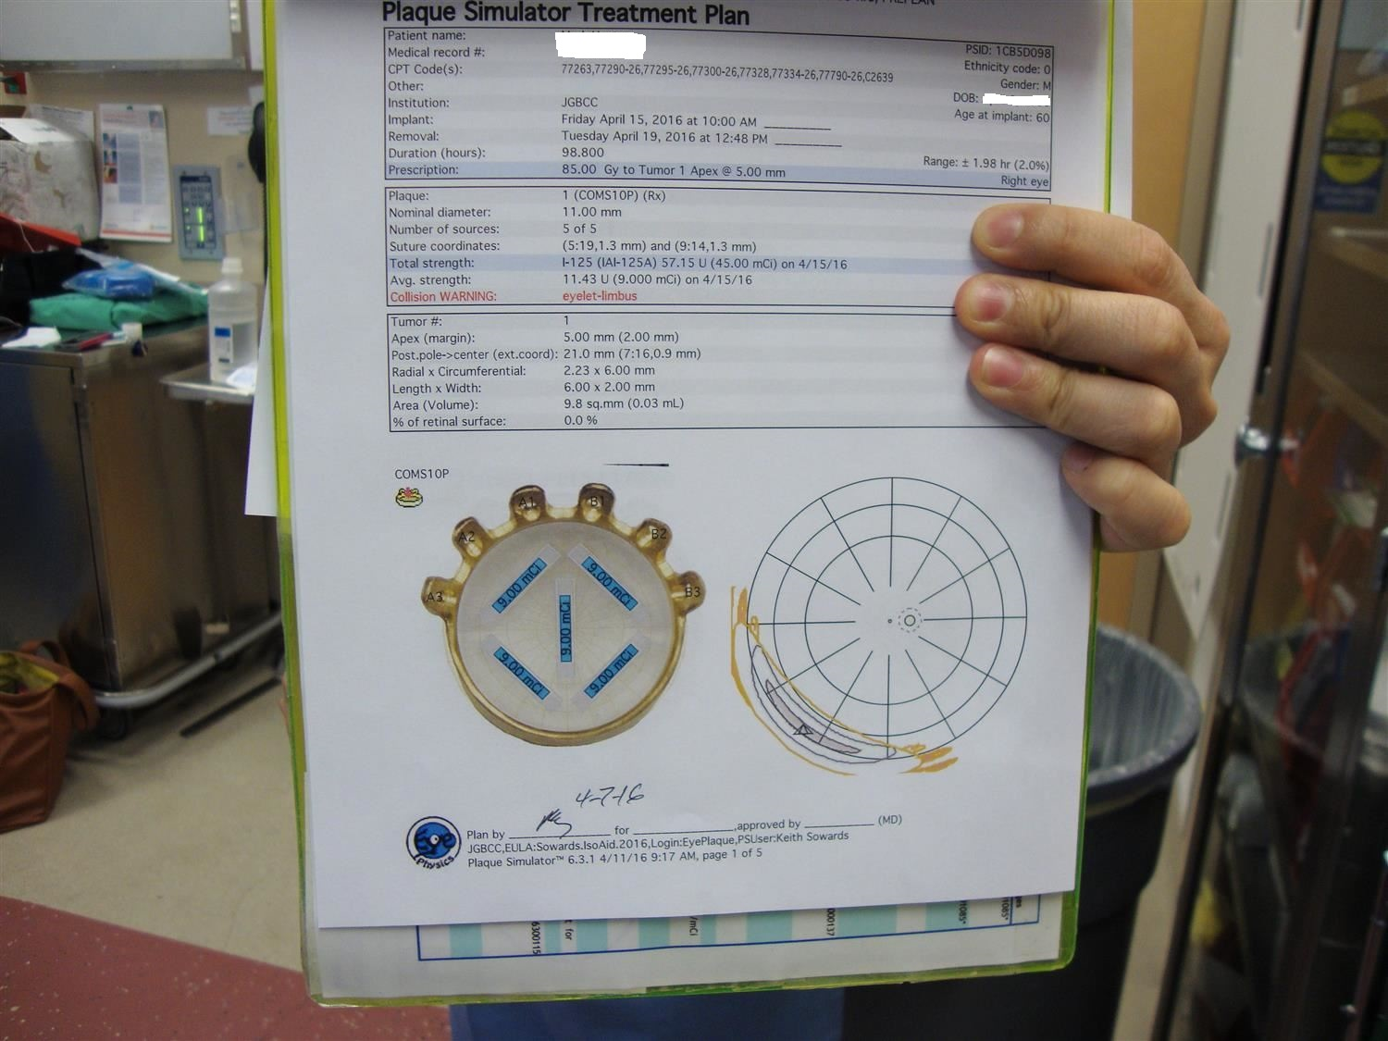
Plan
Fine needle aspiration followed by plaque brachytherapy

Slide 25
Operative Photos

Slide 26
Operative Photos

Slide 27
Operative Photos
Notes:
Plaque stayed on for 4.1 days

Slide 28
Anterior Segment OCT 5 months later
Notes:
VA 20/70
IOP 15
Pigmented lesion still present but with diffuse pigment nasal to it
Sectoral cataract larger with NS 2+ developing
No seed on gonio
OCT with regression

Slide 29
Conclusions
Certain features of iris nevi can provide helpful clinical clues that lesion is progressing to a melanoma.
Iris melanomas behave differently than posterior uveal melanomas but this is not fully explained by cytogenetics alone
FNA, histopathology, and size all play an important role in prognosis
Plaque brachytherapy is a good option when local resection is not possible

Slide 30
References
Shields, Carol L. et al. “Prognosis of Uveal Melanoma in 500 Cases Using Genetic Testing of Fine-Needle Aspiration Biopsy Specimens.” Ophthalmology , Volume 118 , Issue 2 , 396 - 401
Shields, Carol L. et al. “Iris Melanoma Management with Iodine-125 Plaque Radiotherapy in 144 Patients: Impact of Melanoma-Related Glaucoma on Outcomes” Ophthalmology , Volume 120 , Issue 1 , 55 – 61
Harbour, J. William et al. “Gene Expressing Profiling of Iris Melanomas.”Ophthalmology 120.1 (2013): 213–213.e3
Shields, Carl L. et al. “Cytogenetic testing of iris melanoma using fine needle aspiration biopsy in 17 patients.” Retina 2011 Mar;31(3):574-80.
Shields, Carol L. et al. “Iris Nevus Growth into Melanoma: Analysis of 1611 Consecutive Eyes.” Ophthalmology , Volume 120 , Issue 4 , 766 – 772
The Collaborative Ocular Melanoma Study Group. “The COMS Randomized Trial of Iodine 125 Brachytherapy for Choroidal Melanoma, III: Initial Mortality Findings” COMS Report No. 18. Arch Ophthalmol. 2001;119(7):969-982
BCSC Ophthalmic Pathology and Intraocular Tumors Ch 12 and 17

