Slide 1
GRAND ROUNDS Anterior Segment OCT Imaging in a case of Acute Anterior Uveitis
Mehreen Adhi, MD
October 21, 2016

Slide 2
Patient Presentation
Chief Complaint:
“My left eye hurts really bad and I cannot see anything out of it”
HPI:
55 year old diabetic white gentleman presented to the retina clinic in August 2016 at the Robley Rex VA Medical Center with pain, photophobia and blurring of vision OS for 5 days.
He was vacationing in Las Vegas when symptoms came on suddenly
He had Cyclopentolate from one of his previous flare ups that he started using before presenting
Per patient, his left eye had “flared up” at least 3 times in the past

Slide 3
Patient Presentation
HPI (continued…):
First episode: June 2013 – resolved with topical steroids
Second episode: March 2014 – resolved with topical steroids
- systemic work up done at this time
Third episode: December 2015 – resolved with topical steroids

Slide 4
Patient Presentation
Review of Systems:
General: no fever, fatigue, weight loss
Cardiovascular: unremarkable
Respiratory: no flu-like symptoms, sinusitis, hemoptysis, shortness of breath
Gastrointestinal: h/o chronic diarrhea
Genitourinary: unremarkable
Neurological: unremarkable
Musculoskeletal: h/o intermittent back pain
Integumentary: no rash or skin lesions

Slide 5
Patient Presentation
Review of Systems:
General: no fever, fatigue, weight loss
Cardiovascular: unremarkable
Respiratory: no flu-like symptoms, sinusitis, hemoptysis, shortness of breath
Gastrointestinal: h/o chronic diarrhea
Genitourinary: unremarkable
Neurological: unremarkable
Musculoskeletal: h/o intermittent back pain
Integumentary: no rash or skin lesions

Slide 6
Patient Presentation
Past Ocular History:
No h/o trauma to either eye; no h/o similar episodes in OD
Mild non-proliferative diabetic retinopathy OU
Glaucoma suspect OU: based on cup/disc ratio
Nuclear sclerotic cataract OU
Past Medical History:
Diabetes (insulin dependent)
Past Surgical History / Family History:
Unremarkable
Social History:
Former smoker; occasional/social alcohol use; no recreational drugs
Medications:
Long-acting insulin (Glargine) and pre-prandial insulin sliding scale
Allergies:
No known drug allergies

Slide 7
External Exam
 | OD |  | OS
Best-corrected VA | 20/20 |  | 20/200
Refraction | -1.00 +0.75 x 178 |  | -1.50 sphere
Pupils | 3→2mm | No rAPD | 5mm→unreactive
IOP | 18 mmHg |  | 20 mmHg
EOM | Full |  | Full
CVF | Full |  | Full

Slide 8
Anterior Segment Exam
SLE | OD |  | OS
External/Lids | WNL |  | WNL
Conj/Sclera | White and quiet |  | 2+ diffuse conjunctival injection
Cornea | Clear; no KPs |  | Stromal edema; no KPs
Ant Chamber | Deep and quiet |  | Deep; 2-3+ flare
Iris | WNL |  | Post synechiae from ~4:30 to 9:00 o’clock
Lens | 1+NS; 1+CC |  | 360 degrees fibrin membrane overlying the anterior aspect of the lens
Gonio | D35rf1+; No PAS |  | D35rf1+; No PAS; fibrin inferiorly

Slide 9
Posterior Segment Exam
Fundus | OD |  | OS
Optic Nerve | Pink and sharp; C/D 0.7 |  | No view
Macula | Few MAs |  | No view
Vessels | WNL |  | No view
Periphery | WNL |  | No view
B-scan:
Vitreous clear;
Retina flat

Slide 10
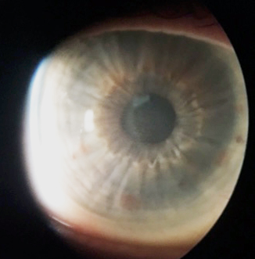
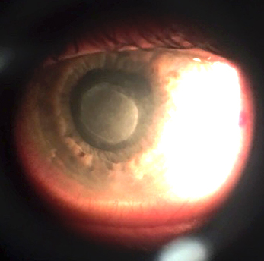
Clinical Photos
OD
OS

Slide 11
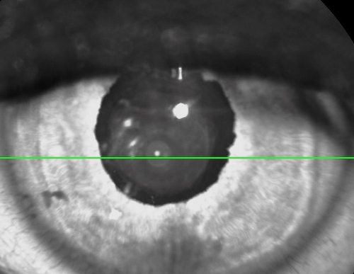
Anterior Segment OCT

Slide 12
Anterior Segment OCT
386 um
282 um

Slide 13
Systemic workup
RPR | Non-reactive
FTA-ABS | Negative
Quantiferon TB | Negative
CBC | WNL
ESR | WNL
HLA-B27 | Negative
ANA | Negative
Lyme | Negative
ACE | Negative
RF | Negative
CXR | WNL
C-scope and biopsy | Gross and biopsy WNL

Slide 14
Assessment
55 year old diabetic white gentleman with a 5 day history of blurred vision, photophobia and pain in the left eye; exam significant for 2-3+ anterior chamber flare with a 360 degrees fibrin membrane overlying the anterior aspect of the lens OS
Recurrent Acute Non-granulomatous Acute Uveitis OS

Slide 15
Plan and Follow up
Pred acetate ophthalmic solution Q1H OS
Medrol dose pack PO
Cyclopentolate ophthalmic solution TID OS
Alphagan ophthalmic solution BID OS
Follow up 2 days later: sub-tenon Triescence OS
Follow up 3 weeks later….

Slide 16
External Exam
 | OD |  | OS
Best-corrected VA | 20/20 |  | 20/20
Refraction | -1.00 +0.75 x 178 |  | -1.50 sphere
Pupils | 3→2mm | No rAPD | 5mm→unreactive
IOP | 13 mmHg |  | 14 mmHg
EOM | Full |  | Full
CVF | Full |  | Full

Slide 17
Anterior Segment Exam
SLE | OD |  | OS
External/Lids | WNL |  | WNL
Conj/Sclera | White and quiet |  | Sub-tenon Triesence
Cornea | Clear; no KPs |  | Clear; no KPs
Ant Chamber | Deep and quiet |  | Deep and quiet; no cell or flare
Iris | WNL |  | Post synechiae at ~4:00 and 5:00 o’clock
Lens | 1+NS; 1+CC |  | 1+ NS; 1+CC; fibrin membrane previously present on anterior aspect of lens no more visible

Slide 18
Posterior Segment Exam
Fundus | OD |  | OS
Optic Nerve | Pink and sharp; C/D 0.7 |  | Pink and sharp; C/D 0.7
Macula | Few MAs |  | Few MAs
Vessels | WNL |  | WNL
Periphery | WNL |  | WNL

Slide 19
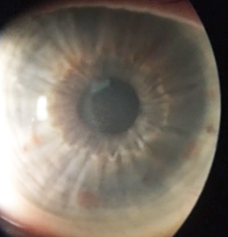
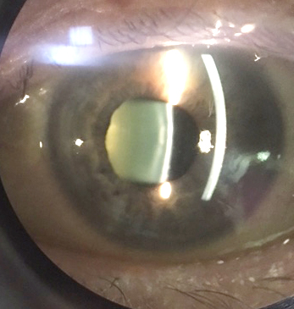
Clinical Photos
OD
OS

Slide 20
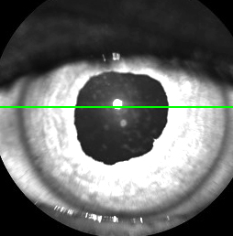
Anterior Segment OCT

Slide 21
Anterior Segment OCT

Slide 22
Discussion
Anterior segment optical coherence tomography (AS-OCT) allows the visualization of various features of the anterior segment
In-vivo cross-sectional imaging of the anterior segment from AS-OCT is particularly useful in the presence of corneal opacity and ocular inflammation
Non-invasive ancillary test for assessment of features of anterior uveitis, its complications, and response to treatment

Slide 23
Discussion
Corneal thickness/edema
Healthy subject
Acute anterior uveitis

Slide 24
Discussion
Corneal thickness/edema
Healthy subject
Acute anterior uveitis

Slide 25
Discussion
Anterior segment optical coherence tomography in acute anterior uveitis
Cristiana Agra, Lydianne Agra, Jeanine Dantas, Tiago Eugênio Faria e Arantes, João Lins de Andrade Neto
Arq. Bras. Oftalmol. Feb 2014; 77:1

Slide 26
Discussion
Keratic precipitates

Slide 27
Discussion
Fibrin membrane

Slide 28
Discussion
Inflammatory cells in the anterior chamber

Slide 29
Discussion
High-speed optical coherence tomography for imaging anterior chamber inflammatory reaction in uveitis: clinical correlation and grading.
Agarwal A, Ashokkumar D, Jacob S, et al
Am J Ophthalmol 2009 Mar;147(3):413-416.e3.

Slide 30
Discussion
Automated Analysis of Anterior Chamber Inflammation by Spectral-Domain Optical Coherence Tomography.
Sharma S, Lowder CY, Baynes K, et al
Ophthalmology 2015 Jul;122(7):1464-70

Slide 31
Conclusions
Anterior segment optical coherence tomography (AS-OCT) may be a useful non-invasive ancillary test in patients with anterior uveitis
Features such as corneal thickness/edema, keratic precipitates, fibrin deposition and anterior chamber inflammation may be useful parameters to assess treatment response

Slide 32
Acknowledgements
Shorye Payne MD
Mary and Tammy
Drs. Syed, Fernandez, Kassm, Breaux, Piri, Mueller

Slide 33
References
Cristiana Agra, Lydianne Agra, Jeanine Dantas, Tiago Eugênio Faria e Arantes, João Lins de Andrade Neto. Anterior segment optical coherence tomography in acute anterior uveitis. Arq. Bras. Oftalmol. Feb 2014; 77:1
Agarwal A, Ashokkumar D, Jacob S, et al. High-speed optical coherence tomography for imaging anterior chamber inflammatory reaction in uveitis: clinical correlation and grading. Am J Ophthalmol. 2009;147:413–416. e413.
Sharma S, Lowder CY, Vasanji A, Baynes K, Kaiser PK, et al. Automated Analysis of Anterior Chamber Inflammation by Spectral-Domain Optical Coherence Tomography. Ophthalmology 2015 Jul;122(7):1464-70.
Regatieri CV, Alwassia A, Zhang JY, et al. Use of Optical Coherence Tomography in the Diagnosis and Management of Uveitis. Int Ophthalmol Clin 2012 Fall; 52(4): 33-34
Lowder CY, Li Y, Perez VL, DH Anterior Chamber Cell Grading with High-Speed Optical Coherence Tomography. Invest Ophthalmol Vis Sci. 2004;45 E-Abstract 3372.

Slide 34
Thank you

