Slide 1
Grand Rounds Management of Retinoblastoma
Tala Kassm, DO
July 21, 2017

Slide 2
Patient Presentation
Chief Complaint
Evaluation of retinoblastoma
HPI
3 year old white female presents for evaluation and treatment of retinoblastoma of right eye.
Patient was sent from University of Kentucky. She had undergone no previous treatment.

Slide 3
Patient Presentation
Patient noted to have leukocoria on a picture taken by a friend and was sent to UK - seen by retina service there who then referred to Dr. Rama.

Slide 4
History (Hx)
Past Ocular Hx
unremarkable
Past Medical Hx
none
Fam Hx
no family history of retinoblastoma
Meds
none
Allergies
NKDA
Social Hx
lives with parents
ROS
noncontributory

Slide 5
External Exam
 | OD |  | OS
VA | Fix and follows |  | Fix and follow
Refraction | +0.50 sph |  | +0.50 sph
Pupils | 4→3mm | No rAPD | 4→3mm
IOP | 14 mmHg |  | 12 mmHg
Horizontal corneal diameter (mm) | 12 |  | 12
Anterior segment | Unremarkable |  | Unremarkable

Slide 6
Posterior Segment Exam
Fundus | OD |  | OS
Optic Nerve | Pink and sharp |  | WNL
Macula | Vitreous seeding localized over macula; mild subretinal fluid |  | WNL
Vessels | unremarkable |  | WNL
Periphery | Nasal retinoblastoma tumor 10 x 10 x 6 mm Vitreous seeds inferiorly and overlying macula |  | WNL

Slide 7
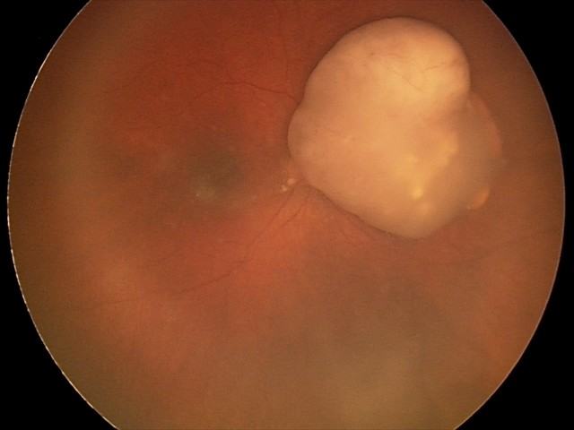
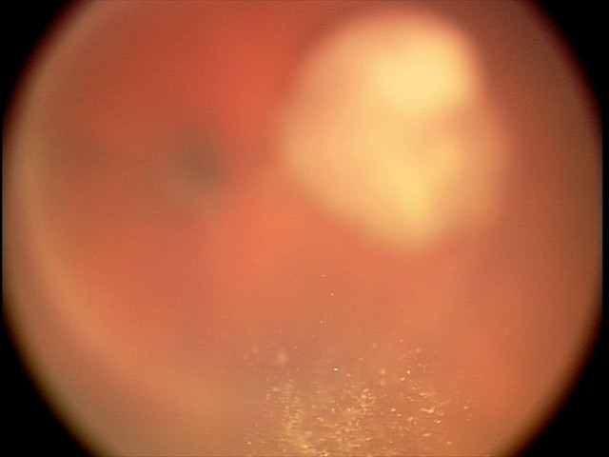
Fundus Photo: September
Notes:
ICRB group D

Slide 8
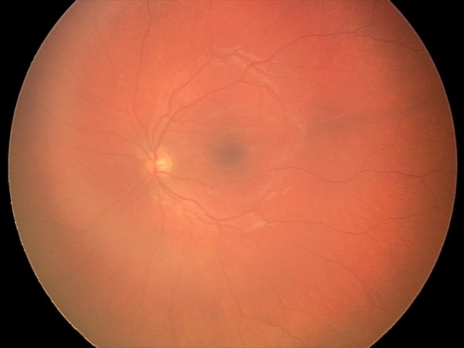
Fundus Photo - OS

Slide 9
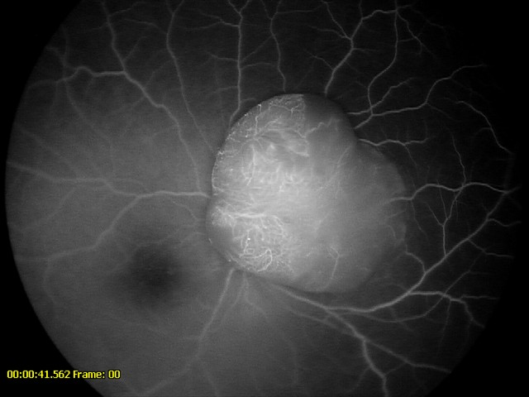
Fluorescein angiography
Notes:
Leakage seen at the tumor
FA helpful for tumor recurrence

Slide 10
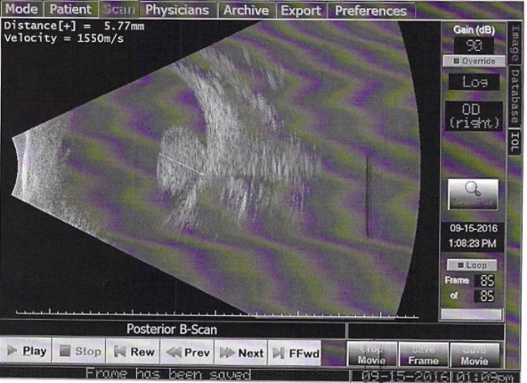
Ultrasound
No obvious optic nerve or scleral invasion seen.
Notes:
Ulrasound – calcification
No obvious optic nerve or scleral invasion

Slide 11
Assessment
3 year old girl presents with unilateral retinoblastoma of right eye with vitreous seeds.
Stage ICRB Group D
Brain MRI negative for any additional tumors or abnormalities
Notes:
International classification of retinoblastoma
Describes tumor as favorable (group A) to unfavorable (group E) according to the anticipated prognostic response to chemoreduction and focal therapy
Doesn’t categorize extra-ocular cases

Slide 12
Plan
Chemoinduction cryotherapy done at 3 o’ clock meridian
Typically would do transpupillary thermotherapy (TTT) over lesion
Decided not to due to vitreous seeds
Plan for intra-arterial chemotherapy with 5 mg of melphalan
Obtain genetic testing
Notes:
Cryo done at initial visit to anterior area
Avoided TTT due to vitreous seeds
Alkylates and cross links DNA – inhibits nucleic acid and protein synthesis

Slide 13
Course
Pt underwent a total of 4 sessions of monthly intra-arterial chemotherapy with 5 mg of melphalan
Fourth round was given with 1 mg of topotecan as well due to persistent vitreous seeds
Tumor started to show regression after first session
Notes:
Topotecan: binds to topoisomerase I-Dna complex, preventing religation of single strand breaks

Slide 14
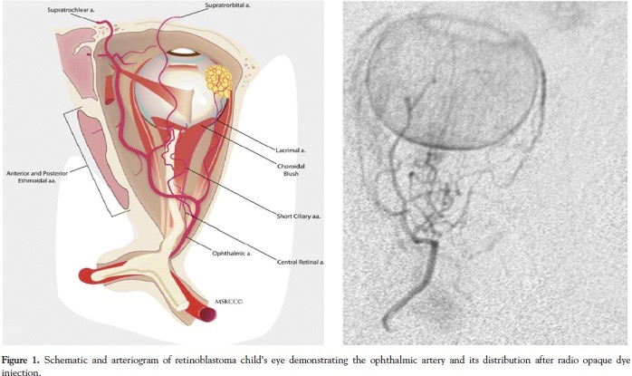
Intra-arterial Chemotherapy
Notes:
Delivers one tenth the systemic dose and ten times the concentration to the eye
Angiogram
Choroidal blush

Slide 15
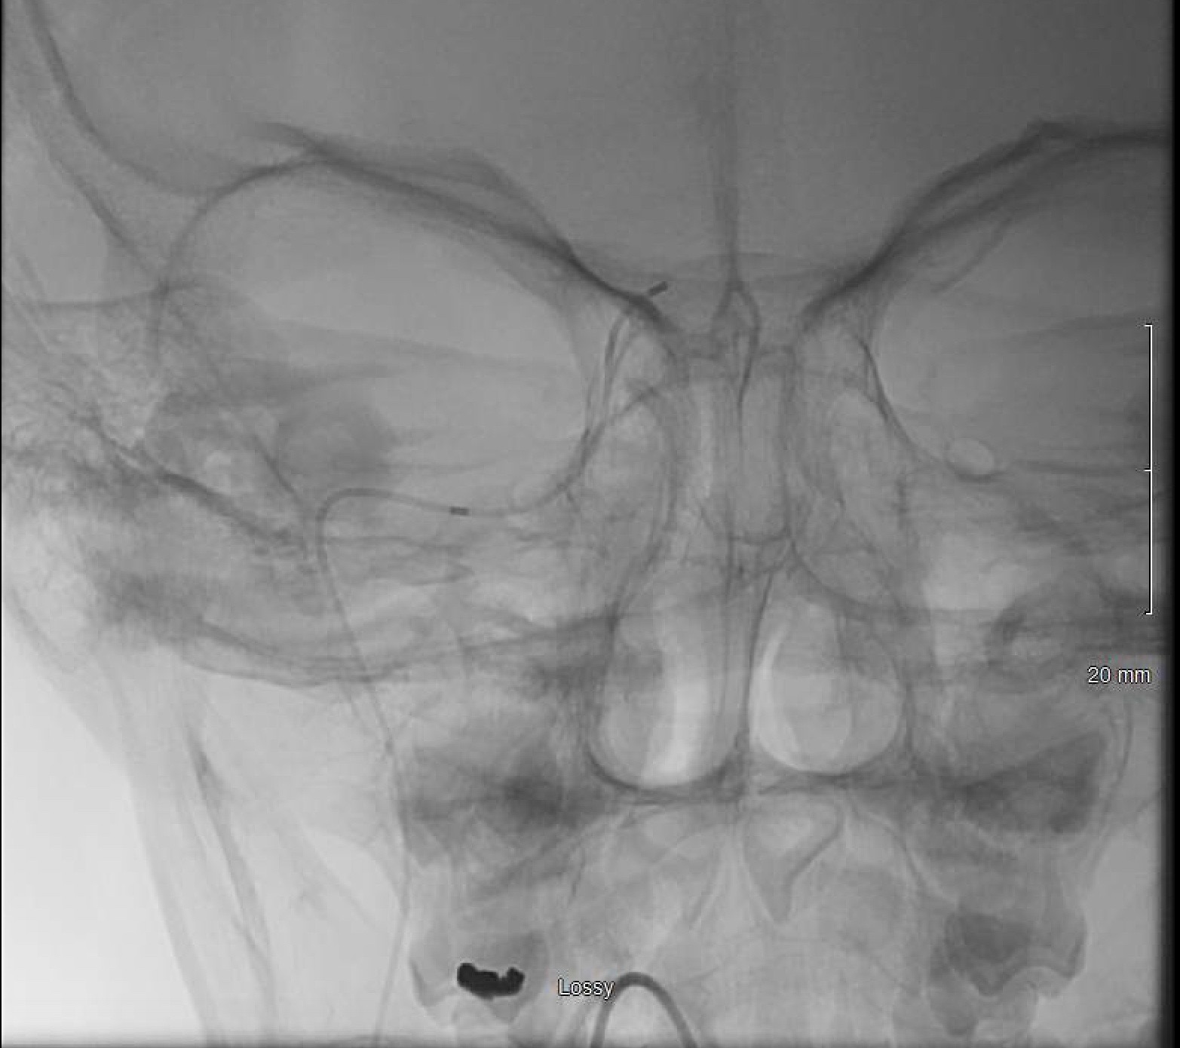
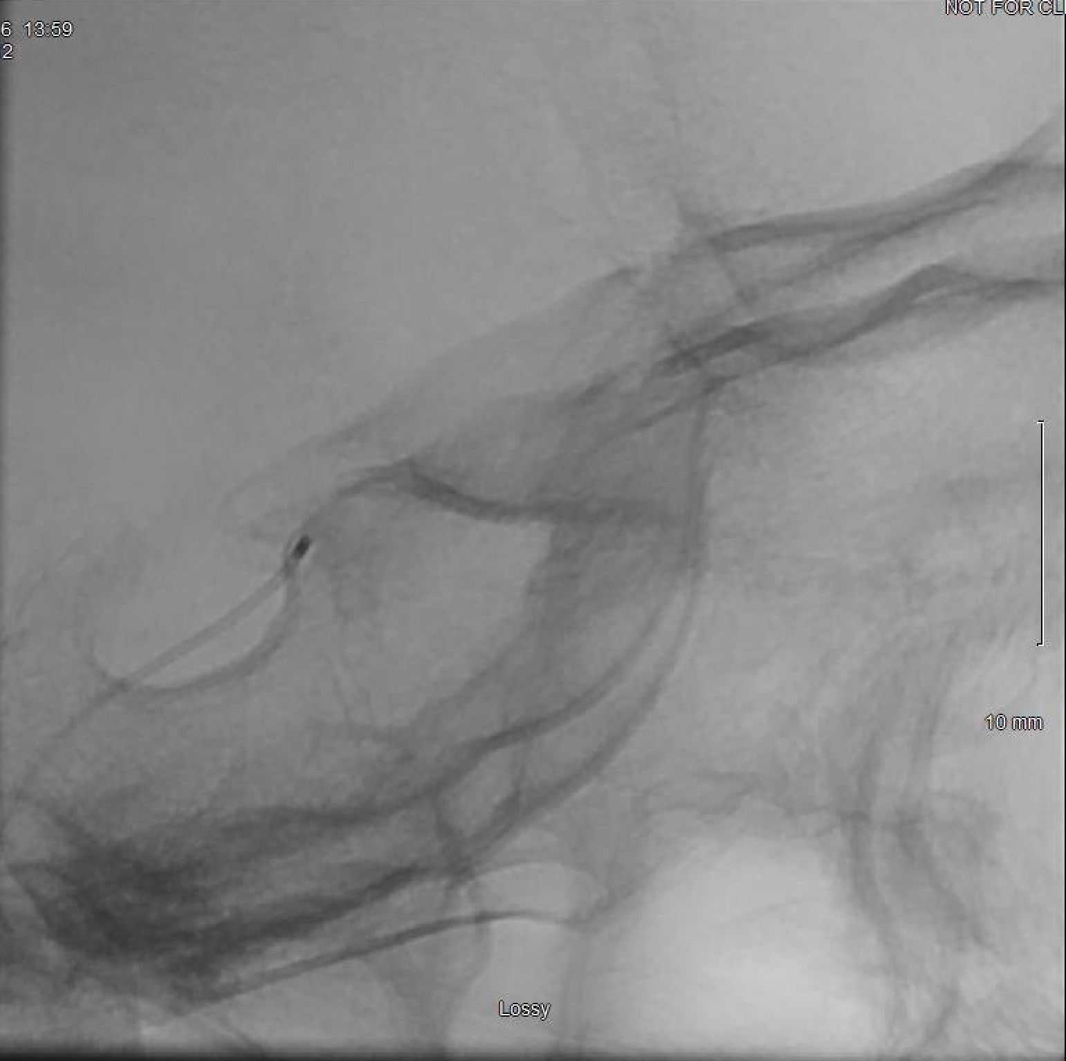
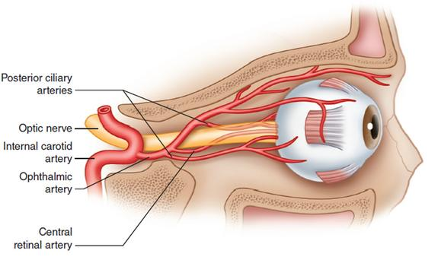
Intra-arterial Chemotherapy
Notes:
Coronal; sagittal

Slide 16
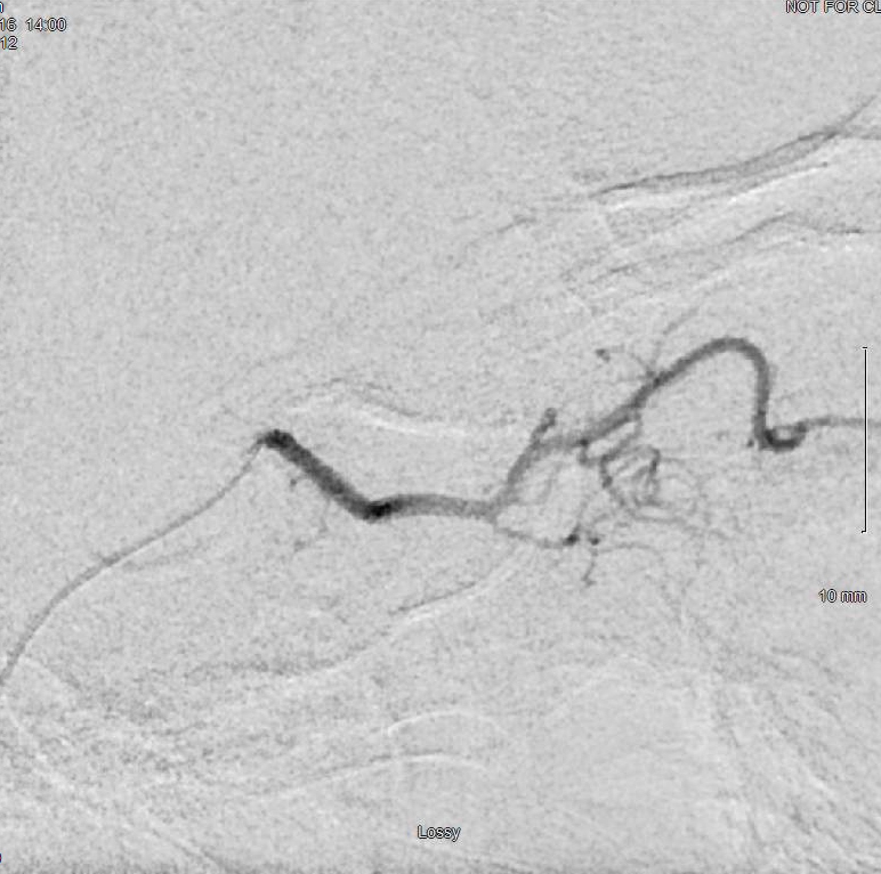
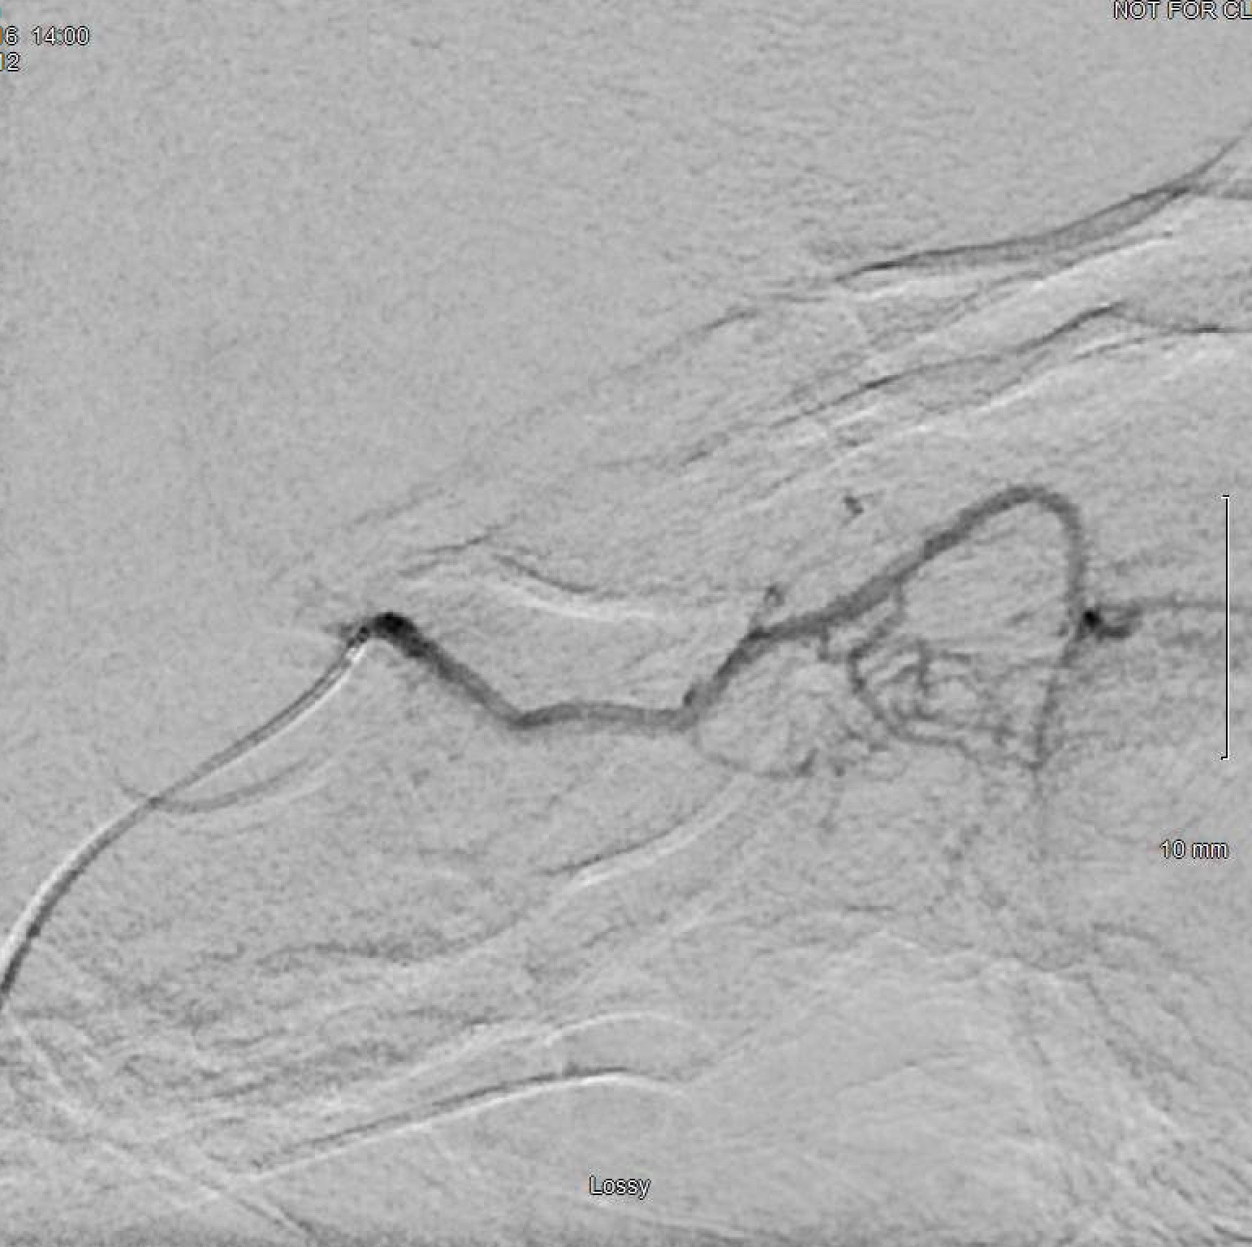
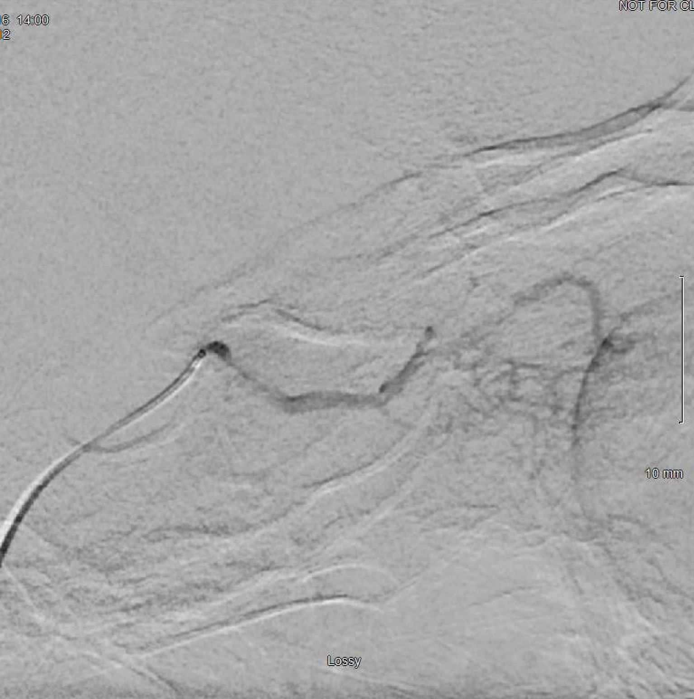
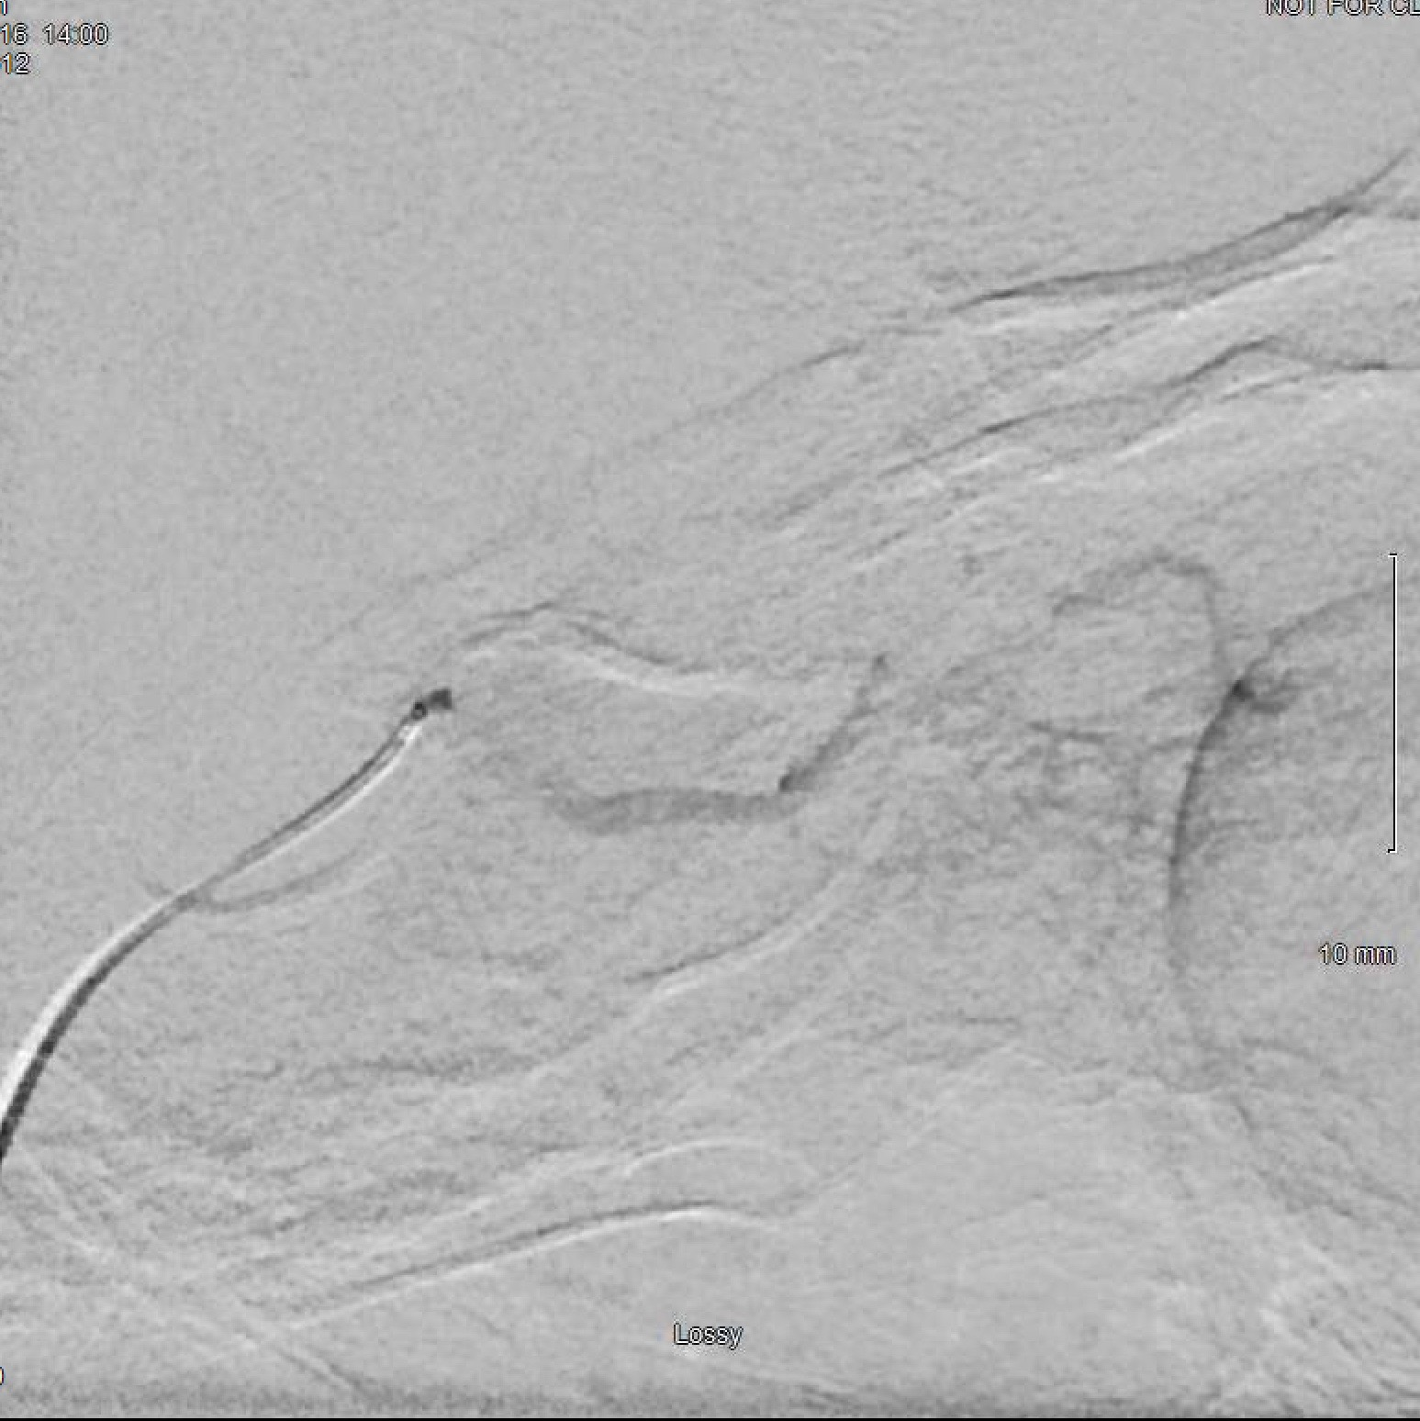
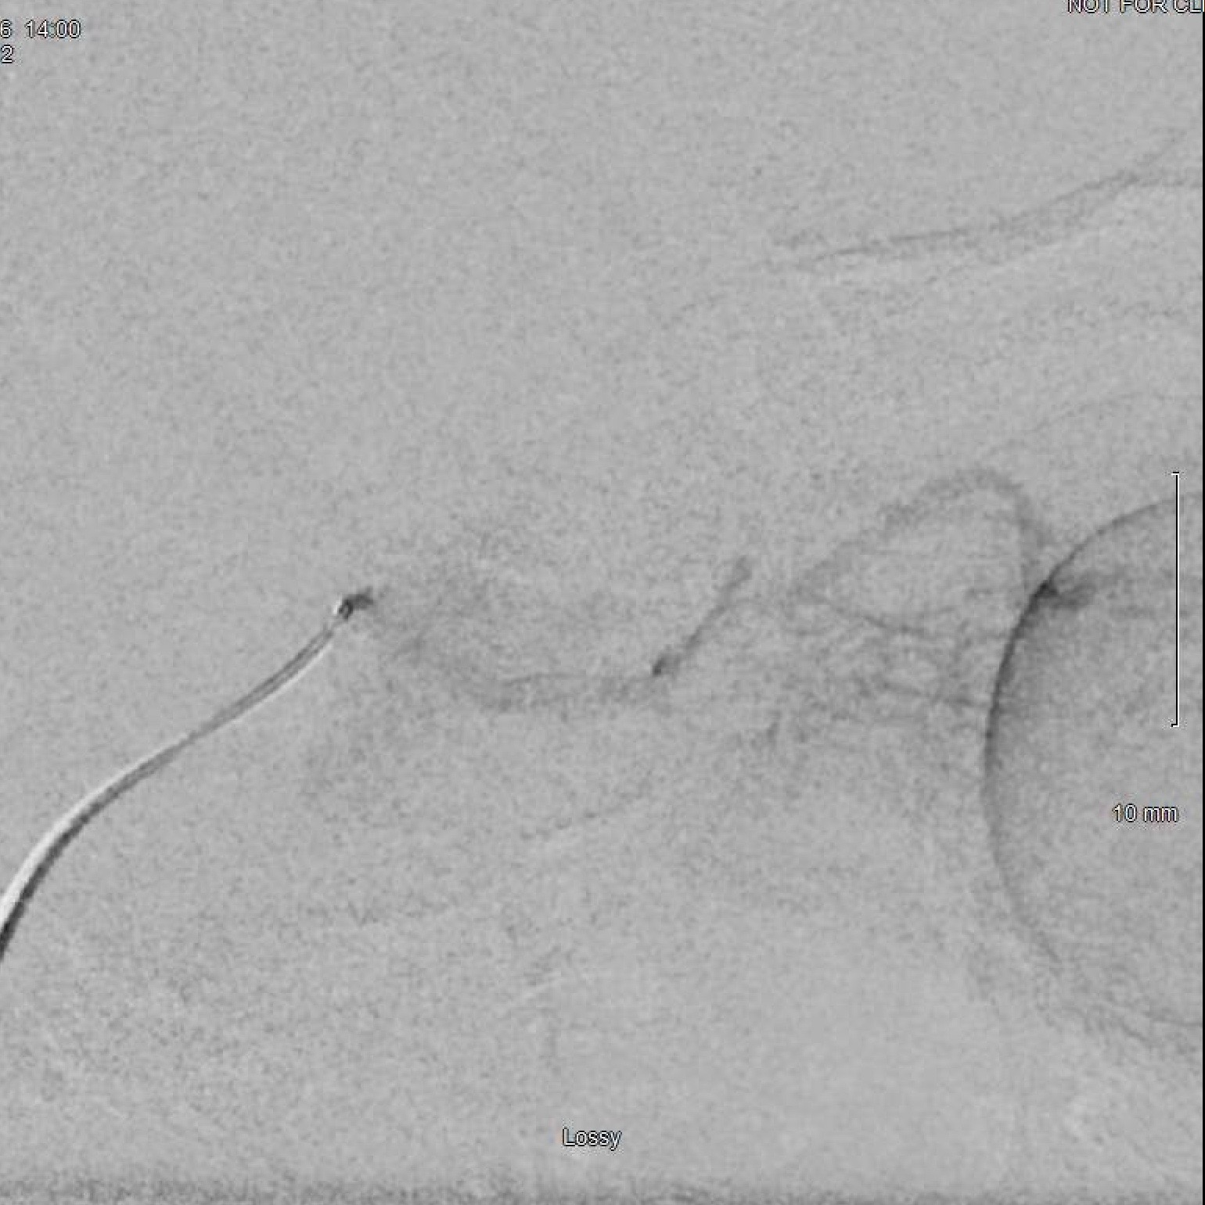
Intra-arterial Chemotherapy

Slide 17
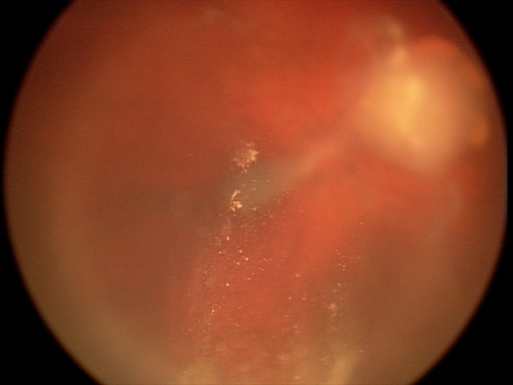
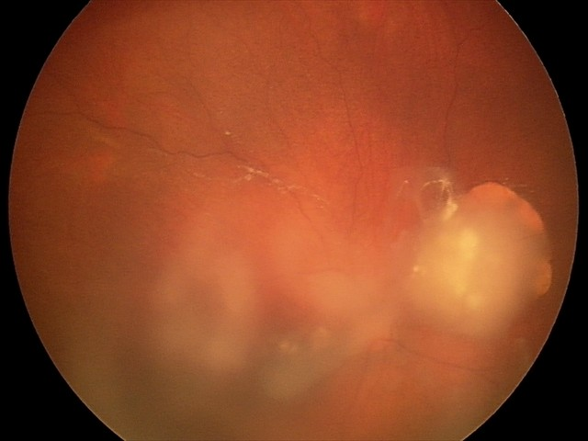
Follow Up: October (1 month)
After one round of IAC
Notes:
10/21/16

Slide 18
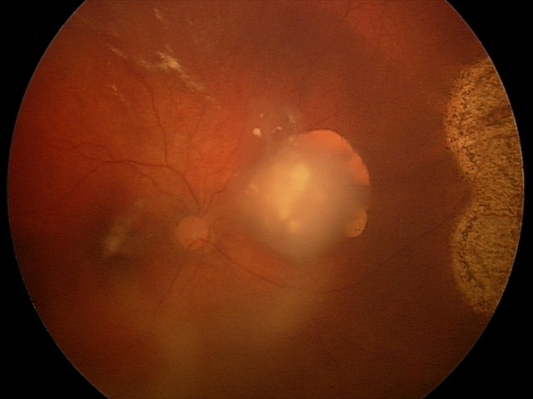
Follow Up: November (2 months)
After second round
Notes:
11/18/16
Vitreous seeds tend to move around

Slide 19
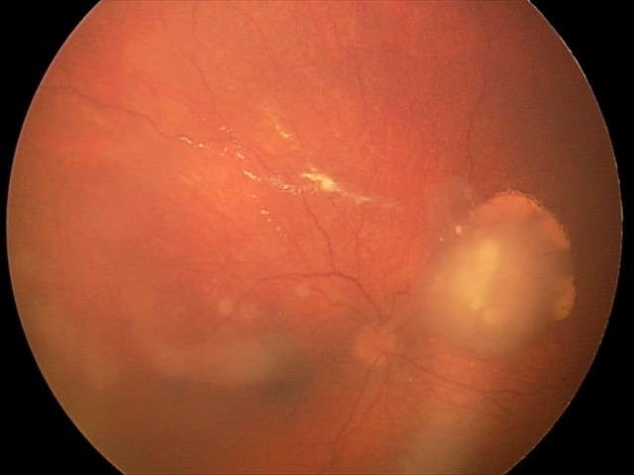
Follow Up: December (3 months)
After third round
Active seeds still seen
Fourth round given with 1 mg of topotecan
Notes:
12/16/18
Topotecan: binds to topoisomerase I-Dna complex, preventing religation of single strand breaks

Slide 20
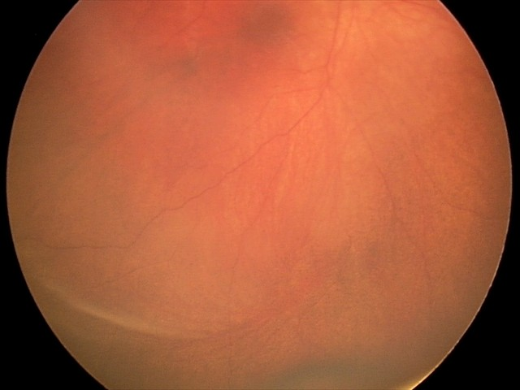
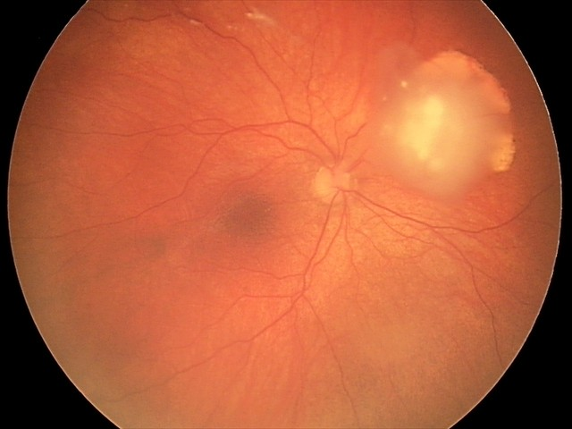
Follow Up: January (4 months)
75% Calcified
No treatment given

Slide 21
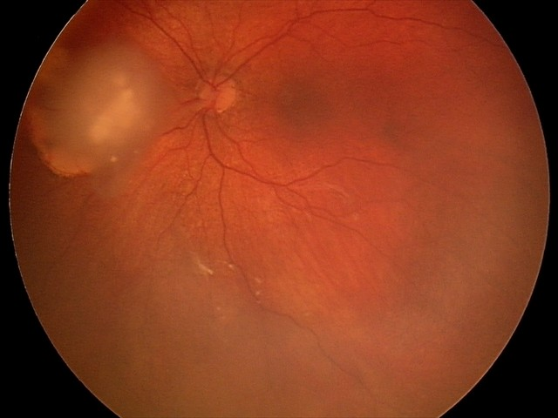
Follow Up: February (5 months)
Observation

Slide 22
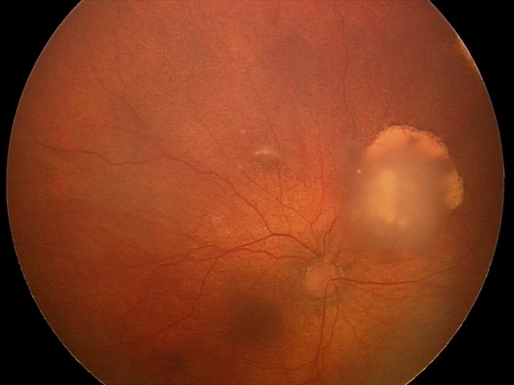
Follow Up: March (6 months)
Ninety-five percent calcified
Notes:
Observation

Slide 23
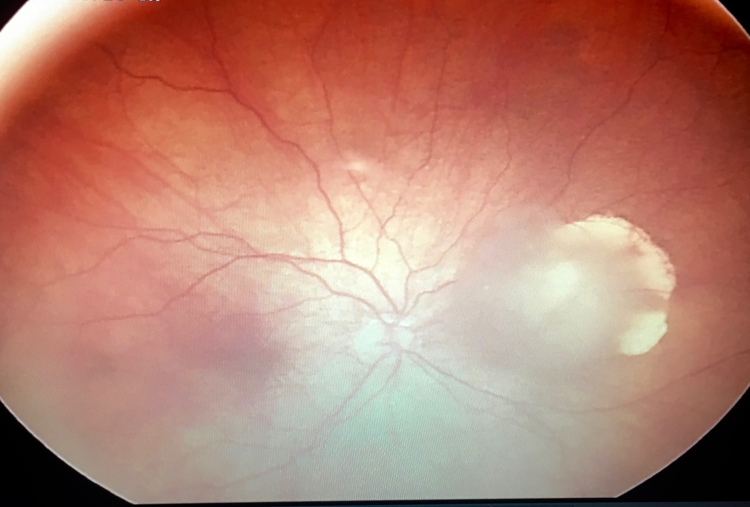
Follow Up: June
9 months later

Slide 24
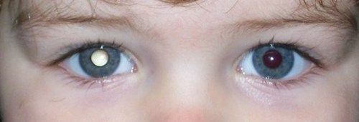
Retinoblastoma
Most common intraocular tumor of childhood
1:14,000 to 1:20,000 live births
Typically diagnosed in first year of life
Familial and bilateral cases
Between ages 1 and 3 years
In sporadic unilateral cases
Onset after 5 is rare
Most common initial sign: leukocoria
Notes:
Other presenting signs and symptoms
Strabismus (25%) – ET or XT
Vitreous hemorrhage
Hyphema
Ocular or periocular inflammation
Glaucoma
Proptosis
Pseudohypopyon
Differential for leukocoria: RB, PFV, ROP, cataract, coloboma of choroid or optic disc, uveitis, larval granulomatosis (toxocariasis), congenital retinal fold, coats disease, organizing vitreous hemorrhage, retinal dysplasia, corneal opacity, FEVR, high myopia/anisometropia, myenlinated nerve fiber, norrie disease, retinal detachment, photographic artifact.

Slide 25
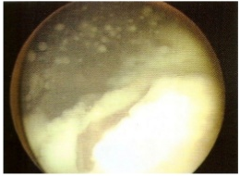
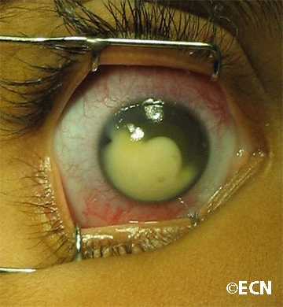
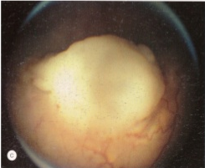
Retinoblastoma
Endophytic
Neuroblastic tumor
Similar to neuroblastoma and medulloblastoma
Diagnosis typically made by ophthalmoscopic appearance
Endophytic growth
Associated with vitreous seeding
Exophytic tumor growth
Can have signs of both types
of growth
Exophytic
Notes:
Endophytic: white to cream-colored mass, breaks through internal limiting membrane.
Vitreous seeding: individual cells or fragments of tumor tissue become separated from main mass. Can be few and localized or diffuse and extensive – resembling endophthalmitis → malignant cells enter AC-> pseudohypopyon
Exophytic- yellow-white, in subretinal space- overlying retinal vessels inc caliber and tortuosity. Associated w/ subretinal fluid accumulation-> can mimic exudative RD → suggestive of coats disease
- RB cells can implant on previously uninvolved retinal tissue and grow -> creates impression of multicentric tumor

Slide 26
Genetics
Retinoblastoma gene (RB1) on q14 band of chromosome 13
Codes for pRB protein – functions as a tumor suppressor gene
Sixty percent of cases occur from somatic nonhereditary mutations of both alleles of RB1 in a retinal cell
Other 40%
A mutation in 1 of 2 alleles of RB1 is inherited from an affected parent (10%)
Spontaneously occurs in 1 of the gametes
Notes:
Normal gene suppresses tumor production – only need one normal gene.
1 abnormal gene is unstable so leads to second gene becoming mutated
Somatic: results in unifocal and unilateral tumors
Second somatic mutation occurs in 1 or more retinal cells – results in multicentric and usually bilateral tumor formation

Slide 27
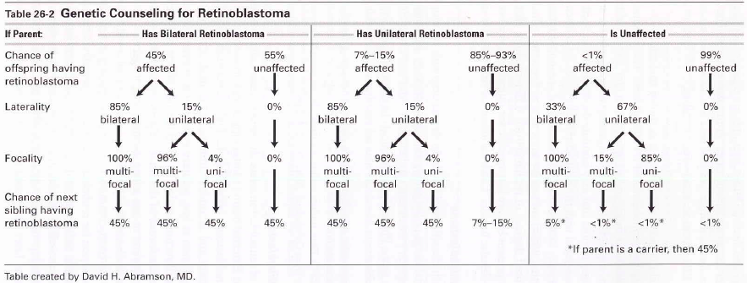
Genetic Counseling
Both parents and all of siblings of patient should be examined
A fundus lesion may be seen
Likely a spontaneously regressed retinoblastoma or retinocytoma
Notes:
Occurs in about 1% of cases

Slide 28
Management
External beam radiation
Rarely done now
Primary enucleation
Advanced unilateral RB, low likelihood of vision recovery
Obtain long segment of ON
Primary systemic chemotherapy (chemoreduction)
Rarely successful when used alone
Used as adjuvant with local therapy
Local therapy
Cryotherapy, laser photocoagulation, thermotherapy, plaque radiotherapy
Intra-arterial chemotherapy with melphalan
Via ophthalmic artery
Intravitreal melphalan for vitreous seeds
Notes:
EBR: high rate of secondary tumors, craniofacial deformities
IAC: used as primary therapy, advanced disease, bilateral cases and eyes who have previously failed conventional management (EBR and systemic chemo)
Chemotherapy: vincristine, carboplatin, epipodophyllotoxin (etoposide or teniposide), cyclosporine

Slide 29
Prospective clinical trial
Twenty eight eyes of 23 newly diagnosed retinoblastoma patients
Cannulation of ophthalmic artery via femoral artery
Chemotherapy of melphalan alone, +topotecan, or +carboplatin, or all three
Outcome measures: patient survival, eye survival, systemic toxicity
Notes:
2010 New York
Chemotherapy:
Systemic → bone marrow suppression
Long term: hearing loss
External beam radiation: secondary cancers

Slide 30
Superselective Ophthalmic Artery Chemotherapy
Follow up for over 3 years
All children survived
One of 28 enucleated
Adverse ophthalmic finding: transient lid/forehead edema, loss of nasal lashes
No deaths, strokes, blood transfusions
Prevented the need for primary radiation, systemic chemotherapy or enucleation
Safe to perform repeat cannulation in very young
Notes:
Age range of 3 months to 88 months
Enucleation due to disease progression, not complications of chemo
25 of 28 were group V of Reese-Ellsworth classification – meaning they had vitreous seeds and previously all eyes with vitreous seeds were enucleated so this prevented all but one from enucleation

Slide 31
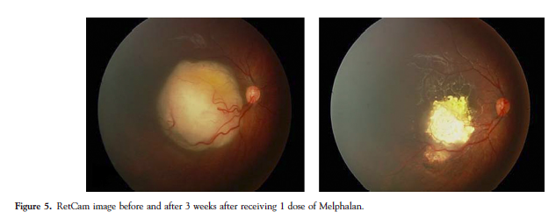
Ophthalmic Artery Chemotherapy
Results

Slide 32
There is a spectrum of vitreous seed appearance and response to intravitreal melphalan
Proposed a classification scheme to distinguish different types
Evaluate clinical response
Establish and define clinical characteristics of each seed classification
Notes:
Vitreous seeds are the primary reason for treatment failure and loss of the eye
Previously globe salvage rates w/ vitreous seeds was 10-47%

Slide 33
Intravitreal Melphalan
Looked at 87 eyes with 475 intravitreal melphalan injections
Classification system guides identification of each seed type
Provides powerful information regarding distinct clinical characteristics and response to intravitreal melphalan

Slide 34
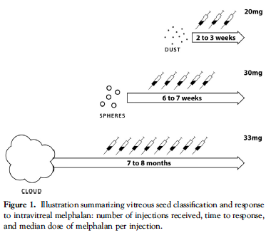
Vitreous Seeds Classification

Slide 35
Intravitreal Melphalan
A-B. Dust before and after 3 injections; C-D. dust and spheres after 6 injections

Slide 36
Intravitreal Melphalan
Notes:
Previously globe salvage rates w/ vitreous seeds was 10-47%

Slide 37
Conclusions
Treatment for retinoblastoma has made tremendous advancements
External beam radiation therapy is no longer necessary
Local therapy can be done via ophthalmic artery chemotherapy and intravitreal injections with great results and minimal side effects
Avoiding enucleation and minimizing systemic chemotherapy is possible even in advanced cases now.

Slide 38
References
Soliman SE, Eldomiaty W, Goweida MB, Dowidar A. Clinical Presentation of Retinoblastoma in Alexandria: A Step Toward Earlier Diagnosis. Saudi J Ophthalmol. 2017;31(2):80-85.
Soliman SE, Racher H, Zhang C, MaDonald H, Gallie BL. Genetics and Molecular Diagnostics in Retinoblastoma – an Update. Asia-Pacific Journal of Ophthalmology. 2017;6(2): 197-207.
BCSC Pediatric Ophthalmology and Strabismus 354-361.
Abramson DH, Dunkel IJ, Brodie SE, Marr B, Gobin YP. Superselective Ophthalmic Artery Chemotherapy as Primary Treatment for Retinoblastoma (Chemosurgery). Ophthalmology 2010; 117:1623-1629.
BCSC Ophthalmic Pathology and Intraocular Tumors 178-181.
Francis JH, Abramson DH, Gaillard MC, Marr BP, Beck-Popovic M, Munier FL. The Classification of Vitreous Seeds in Retinoblastoma and Response to Intravitreal Melphalan. Ophthalmology 2015;122:1173-1179.
Muen WJ, Kingston JE, Robertson F, Brew S, Sagoo MS, Reddy MA. Efficacy and Complications of Super-selective Intra-ophthalmic Artery Melphalan for the Treatment of Refractory Retinoblastoma. Ophthalmology 2012;119:611-616.

Slide 39
Evaluation
Pre treatment evaluation includes
Imaging of head and orbits – third tumor
Evaluate extraocular extension
MRI and ultrasound are preferred
High risk of secondary tumor
Avoid aspiration of ocular fluids for diagnostic testing
Can disseminate malignant cells
Notes:
CT may facilitate by demonstrating intraocular calcification but need to avoid risk of radiation. Risk of secondary tumors is high
Trilateral RB: primitive neuroectodermal tumor of pineal gland or parasellar region. 0.5% in unilateral; 5-15% bilateral. Rate reduced in pt w/ chemoreduction therapy
Extraocular: common in under developed countries due to delay in diagnosis – optic nerve involvement, orbital invasion, CNS involvement, distant mets.
Nonocular tumors: higher if received external beam radiation and in germline mutations. Most common secondary tumor: osteogenic sarcoma of skull and long bones. Also soft tissue sarcomas, cutaneous melanoma, breast CA, lung, brain tumors, hodgkin lymphoma

Slide 40
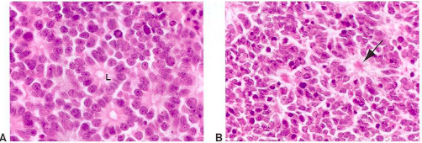
Pathology
Characteristic feature of retinoblastoma: Flexner-Wintersteiner rosette
Highly organized
Created by expression of retinal differentiation
Flexner-Wintersteiner
Homer Wright rosette
Notes:
Doesn’t occur in other neuroblastic tumors Vs. Homer Wright rosette seen in other neuroblastic tumors
Homer-wright- neurofibrillary tangle in center of structure
Often outgrows blood supply and develops necrosis, calcification often seen in area of necrosis

Slide 41
Classification
International intraocular retinoblastoma classification (IIRC or ICRB)
Describes tumor as favorable (group A) to unfavorable (group E) according to the anticipated prognostic response to chemoreduction and focal therapy
Doesn’t categorize extra-ocular cases
TNMH cancer staging
Reese-Ellsworth Grading

Slide 42
Classification
International Classification of retinoblastoma (ICRB)
Group A: small intraretinal tumors (<3 mm) away from foveola and disc
Group B: tumors > 3 mm, macular or juxtapapillary location, or with subretinal fluid
Group C: Tumor with focal subretinal or vitreous seeding within 3 mm of tumor
Group D: Tumor with diffuse subretinal or vitreous seeding > 3 mm from tumor
Group E: Extensive retinoblastoma occupying >50% of the globe with or without neovascular glaucoma, hemorrhage, extension of tumor to optic nerve or anterior chamber
Notes:
Eye wiki

