Slide 1
Grand Rounds Surgical Management of Strabismus due to Cranial Nerve 3 Palsy
Tala Kassm, DO
December 15, 2017

Slide 2
Patient Presentation
Chief Complaint
“I have double vision and I can’t focus.”
HPI
36 year old WF presents to clinic for double vision. Double vision is improved when one eye is closed, images are side by side. Patient wearing a patch over left eye. Having difficulty reading and watching TV.
Symptoms began after a hemorrhagic stroke of the brainstem five months ago.

Slide 3
Patient Presentation
More history
History of brainstem arteriovenous malformation diagnosed and treated 20 years ago with stereotactic radiosurgery
Now recent history of hemorrhagic brainstem stroke related to AVM.
Patient subsequently developed obstructive hydrocephalus and required a shunt placement.
Per the patient’s mother, both eyes deviated initially after the stroke with some improvement of right eye only.

Slide 4
History (Hx)
Past Ocular Hx
lazy eye as a child (doesn’t recall which eye)
muscle surgery as a child, OU
Past Medical Hx
Brainstem AVM s/p stereotactic radiosurgery
Hemorrhagic brainstem stroke and secondary obstructive hydrocephalus s/p shunt placement and removal
Seizures
Fam Hx
Mother: thyroid disease
Meds
Amlodipine
Allergies
Dilantin
Social Hx
Denies tobacco or alcohol use
ROS
denies headaches or dizziness

Slide 5
External Exam
 | OD |  | OS
VA | 20/50 |  | 20/60
Refraction | - 6.00+1.75x63 |  | -6.00+3.00x60
Pupils | 4mm sluggish | No rAPD | 7mm no reaction
IOP | 12 mmHg |  | 14 mmHg
EOM | See below | XT 64 PD | See below
CVF | Full |  | Full
Lids | Palpebral fissure 12 mm |  | Palpebral fissure 10 mm, mild ptosis

Slide 6
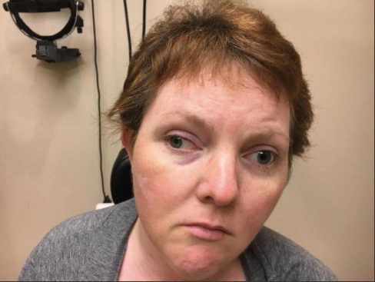
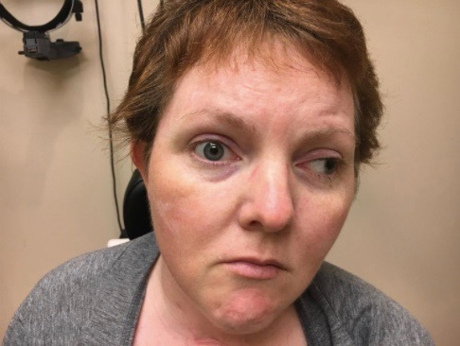
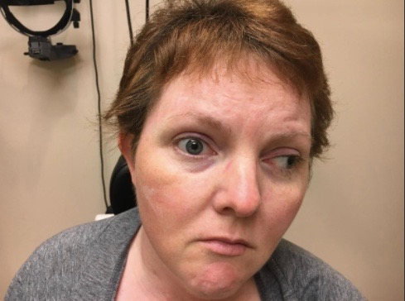
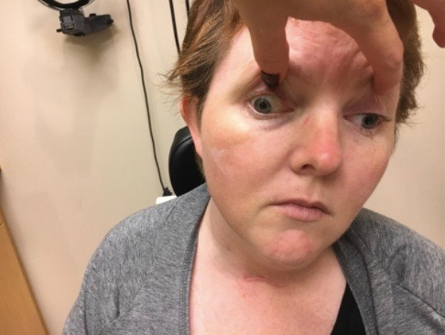
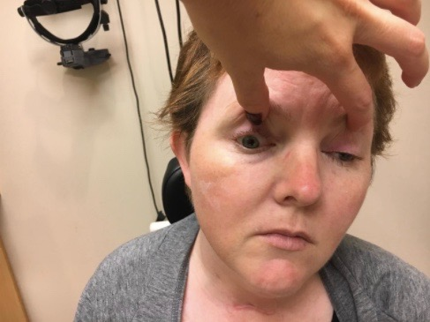
Clinical Photos
- 4
- 4
OD
OS
- 0.5
- 4
- 4
-1
- 4
- 4
Notes:
XT of 64 PD

Slide 7
Assessment
36 year old WF with binocular double vision for five months since a hemorrhagic stroke of the brainstem.
Patient diagnosed with a bilateral CN 3 palsy, pupil involving, worse OS than OD

Slide 8
Plan
Recheck in 2 months
If stable, will plan for LR transposition OU
2 months later, exam is unchanged.
Patient agrees to proceed with surgery.

Slide 9
Lateral Rectus Transposition
Notes:
Lateral rectus is divided 15 mm back. Reattached 1-2 mm posterior to insertion of medial rectus

Slide 10
Lateral Transposition

Slide 11
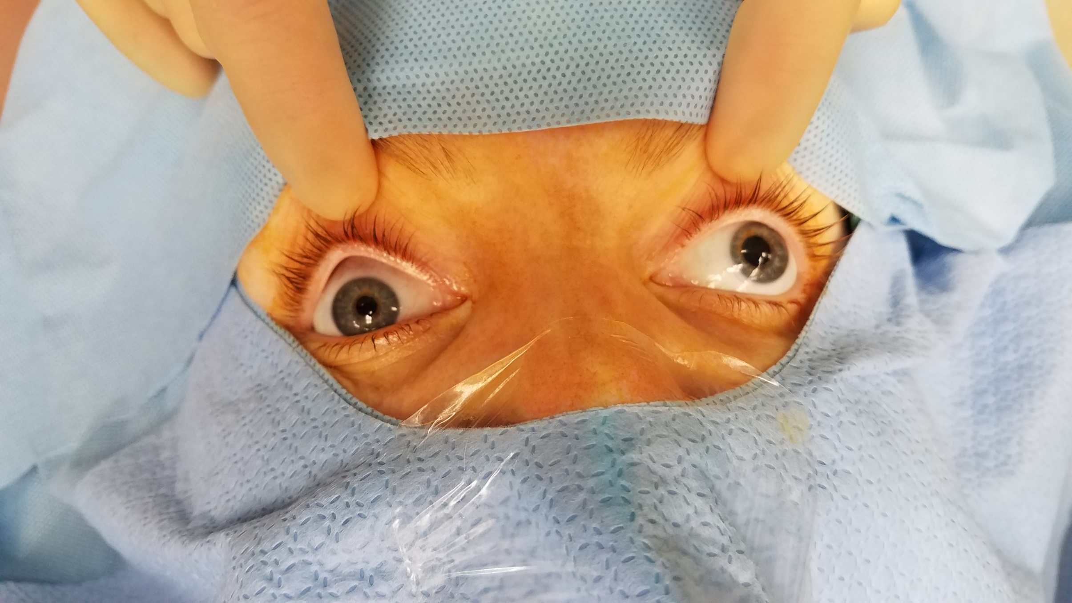
Pre Op

Slide 12
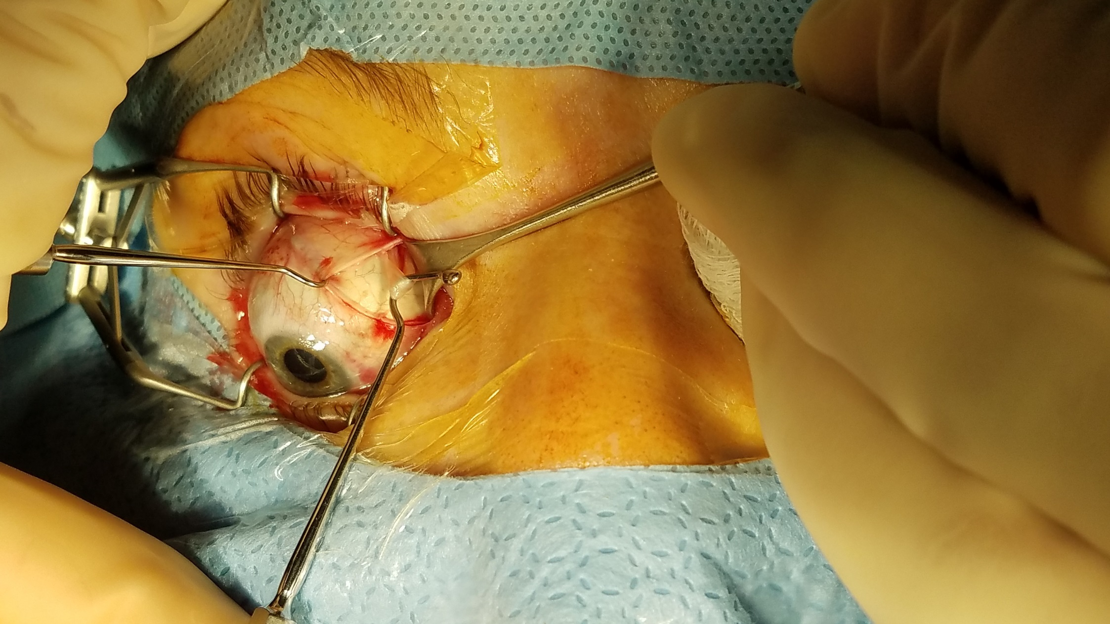
Superior Oblique Tenotomy OD
Notes:
SO tenotomy OD
Decrease abduction and move muscle out of the way.

Slide 13
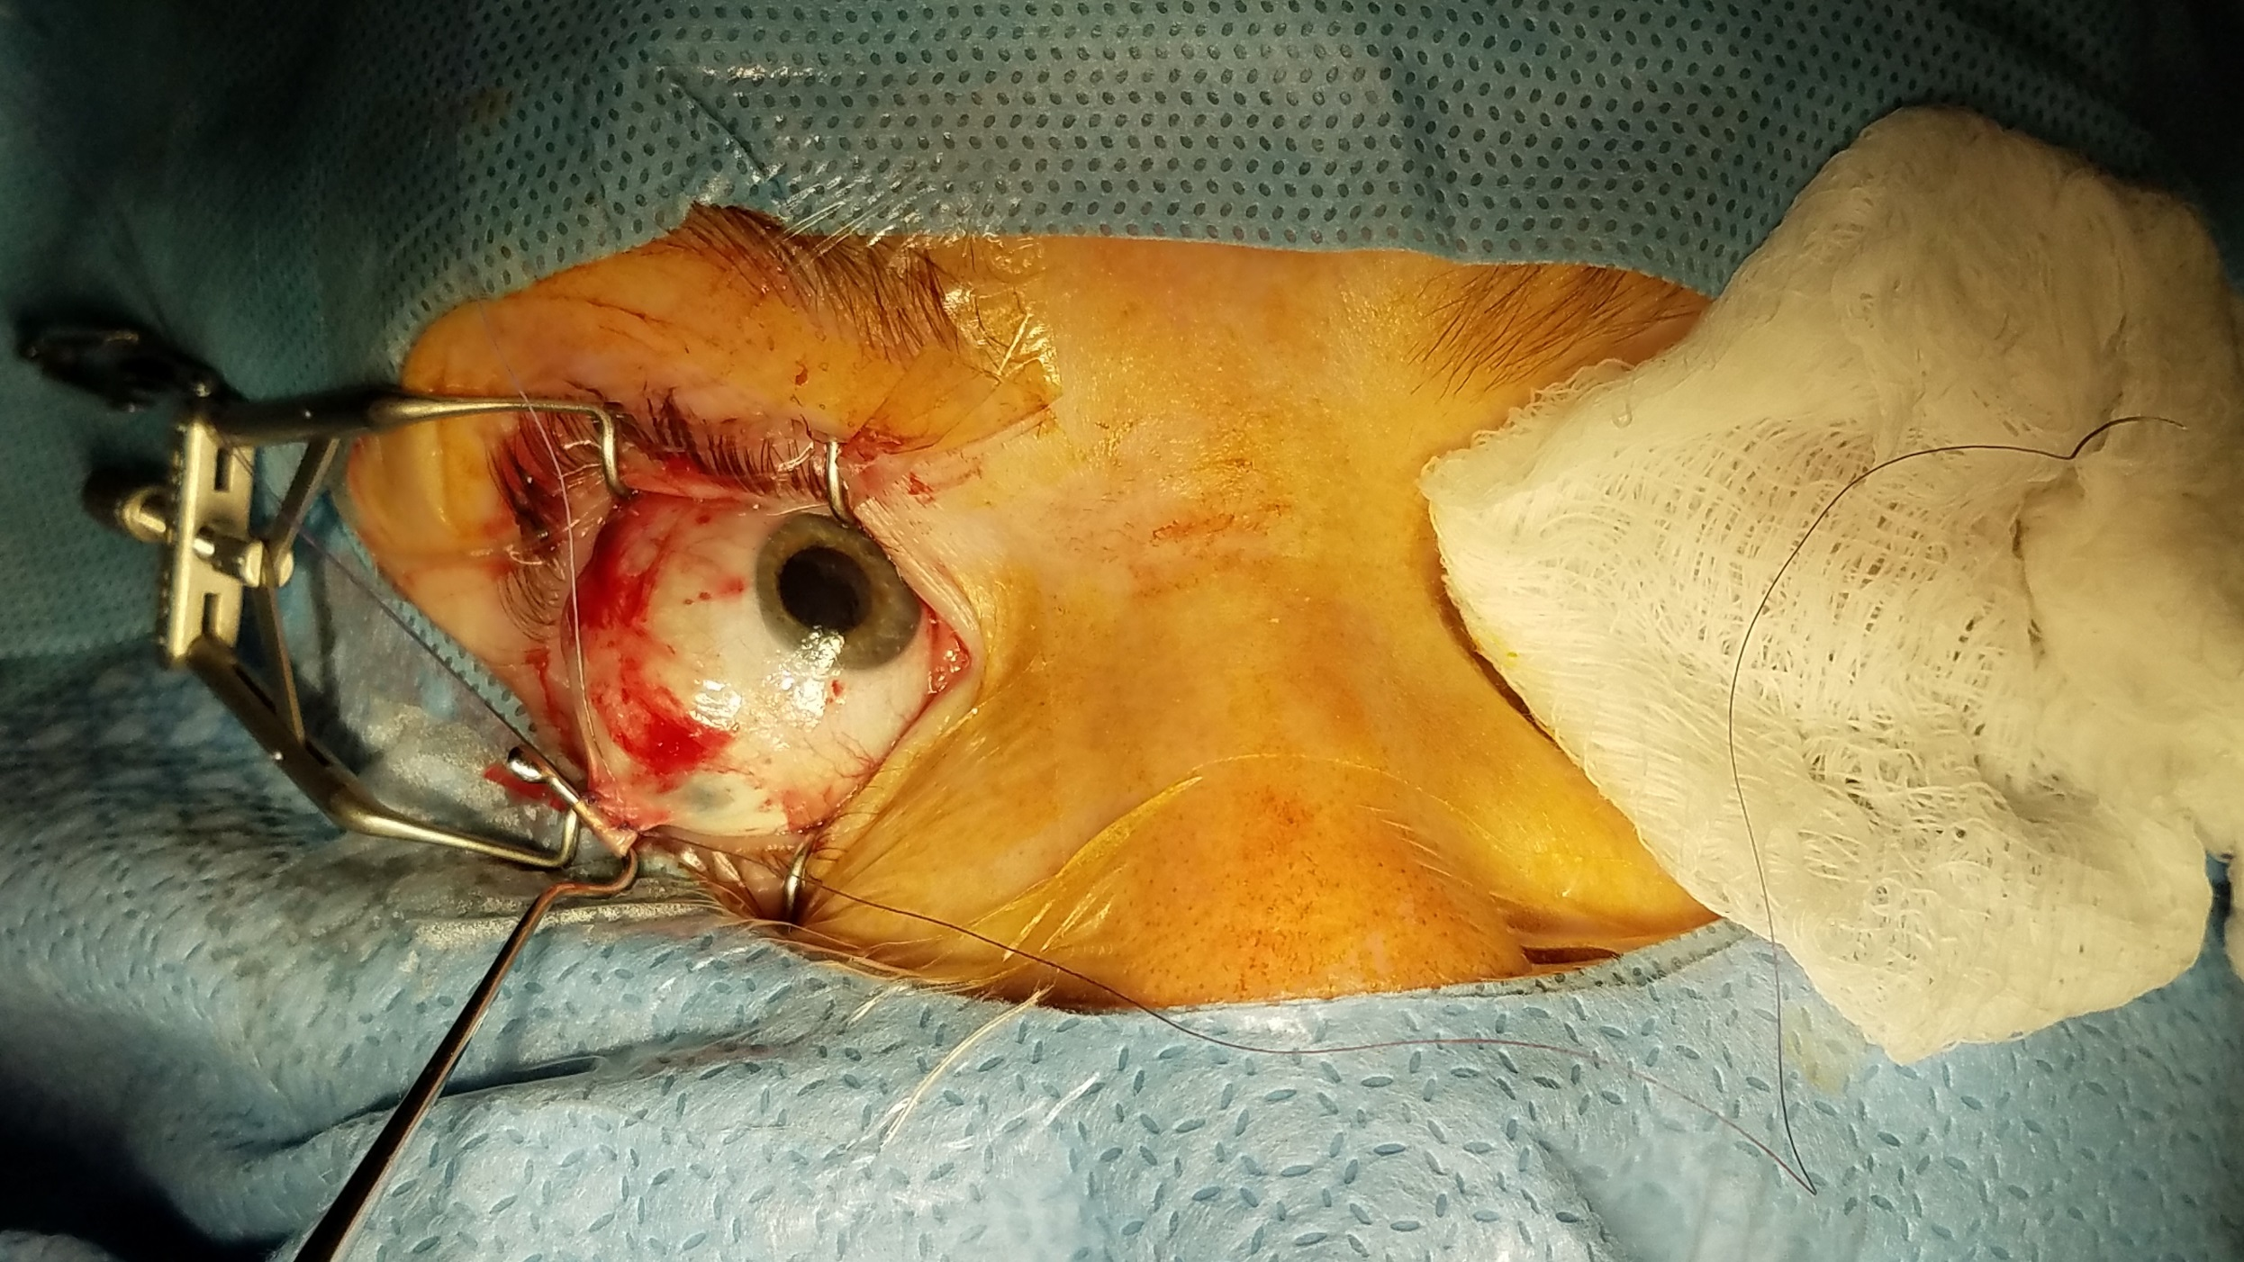
Lateral Rectus on Two Separate Sutures
Notes:
LR on two separate sutures

Slide 14
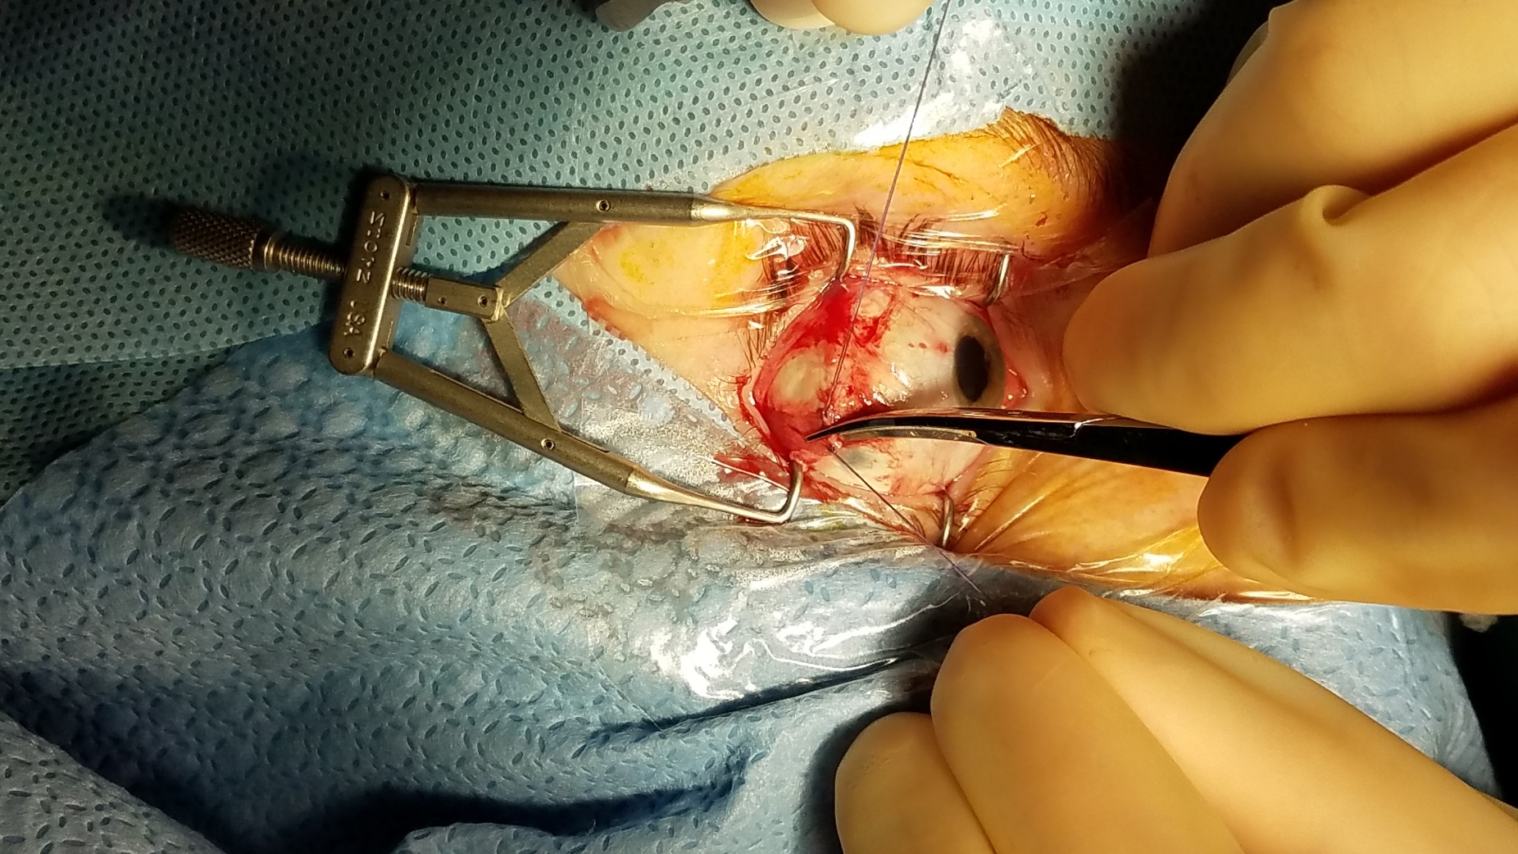
Splitting Lateral Rectus
Notes:
Splitting LR

Slide 15
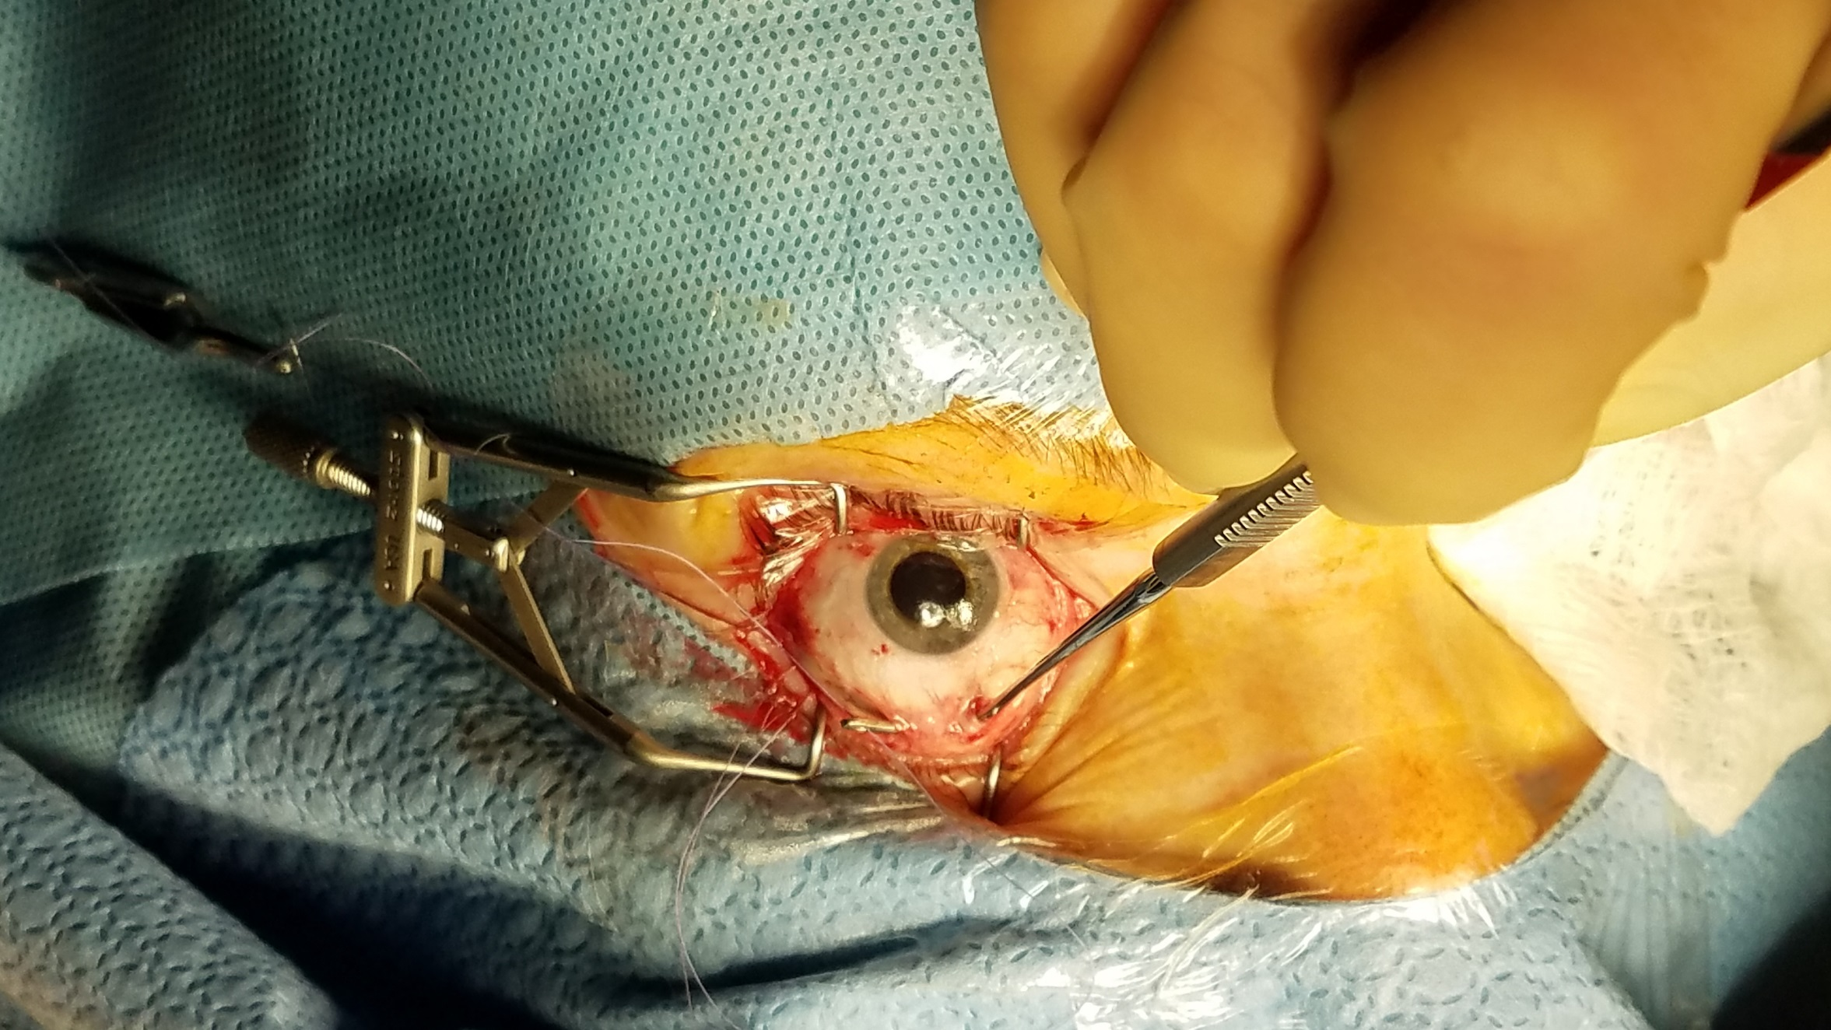
Bringing lower half from under inferior rectus
Notes:
Bringing lower half from under the IR

Slide 16
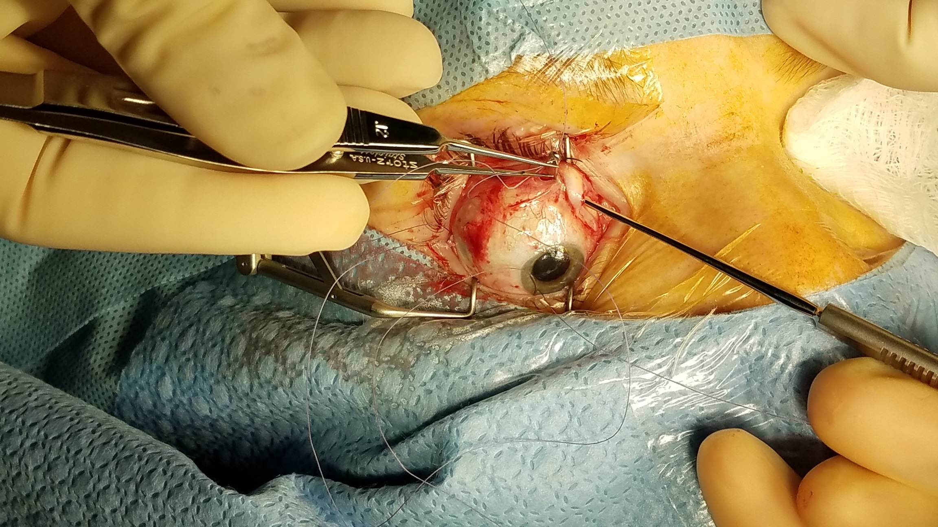
Superior half from under superior rectus
Notes:
Superior half from under SR – Gass Hook

Slide 17
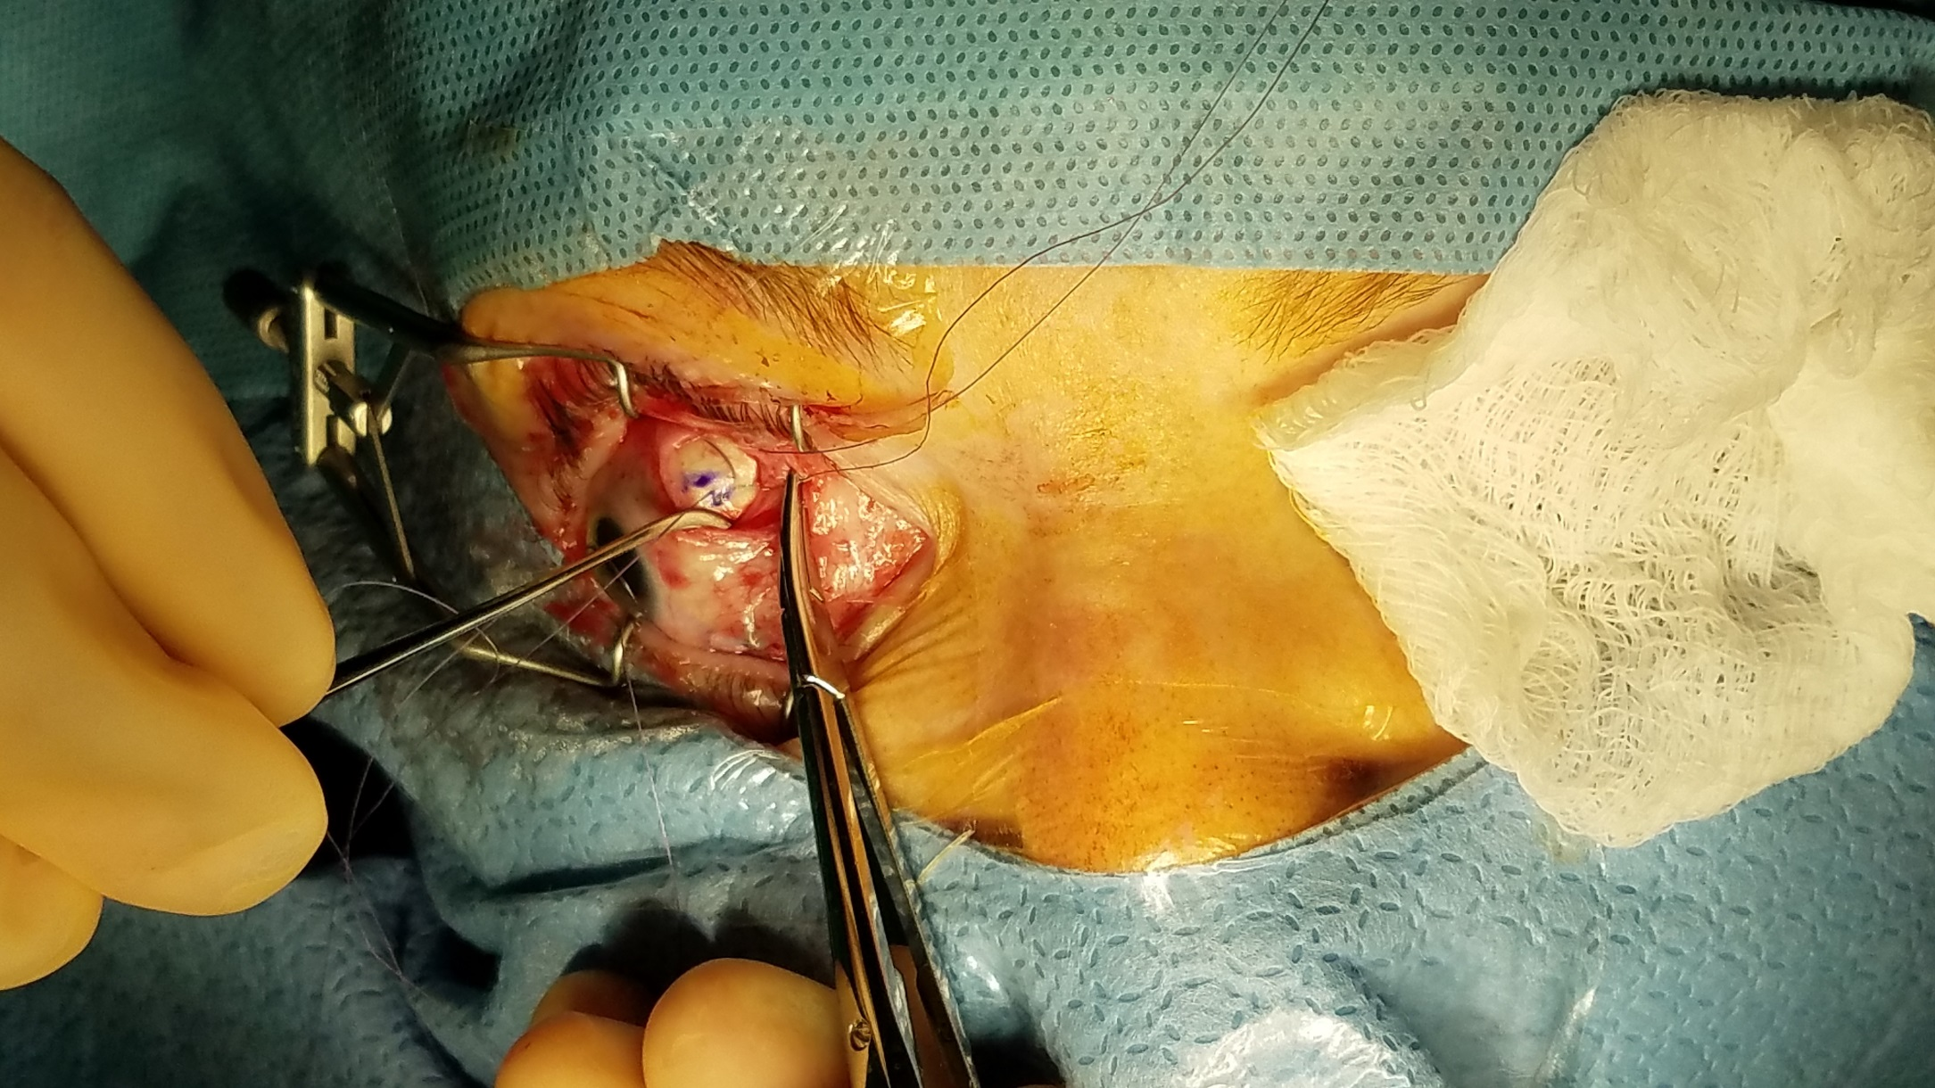
Suturing superior half
Notes:
Suturing superior half

Slide 18
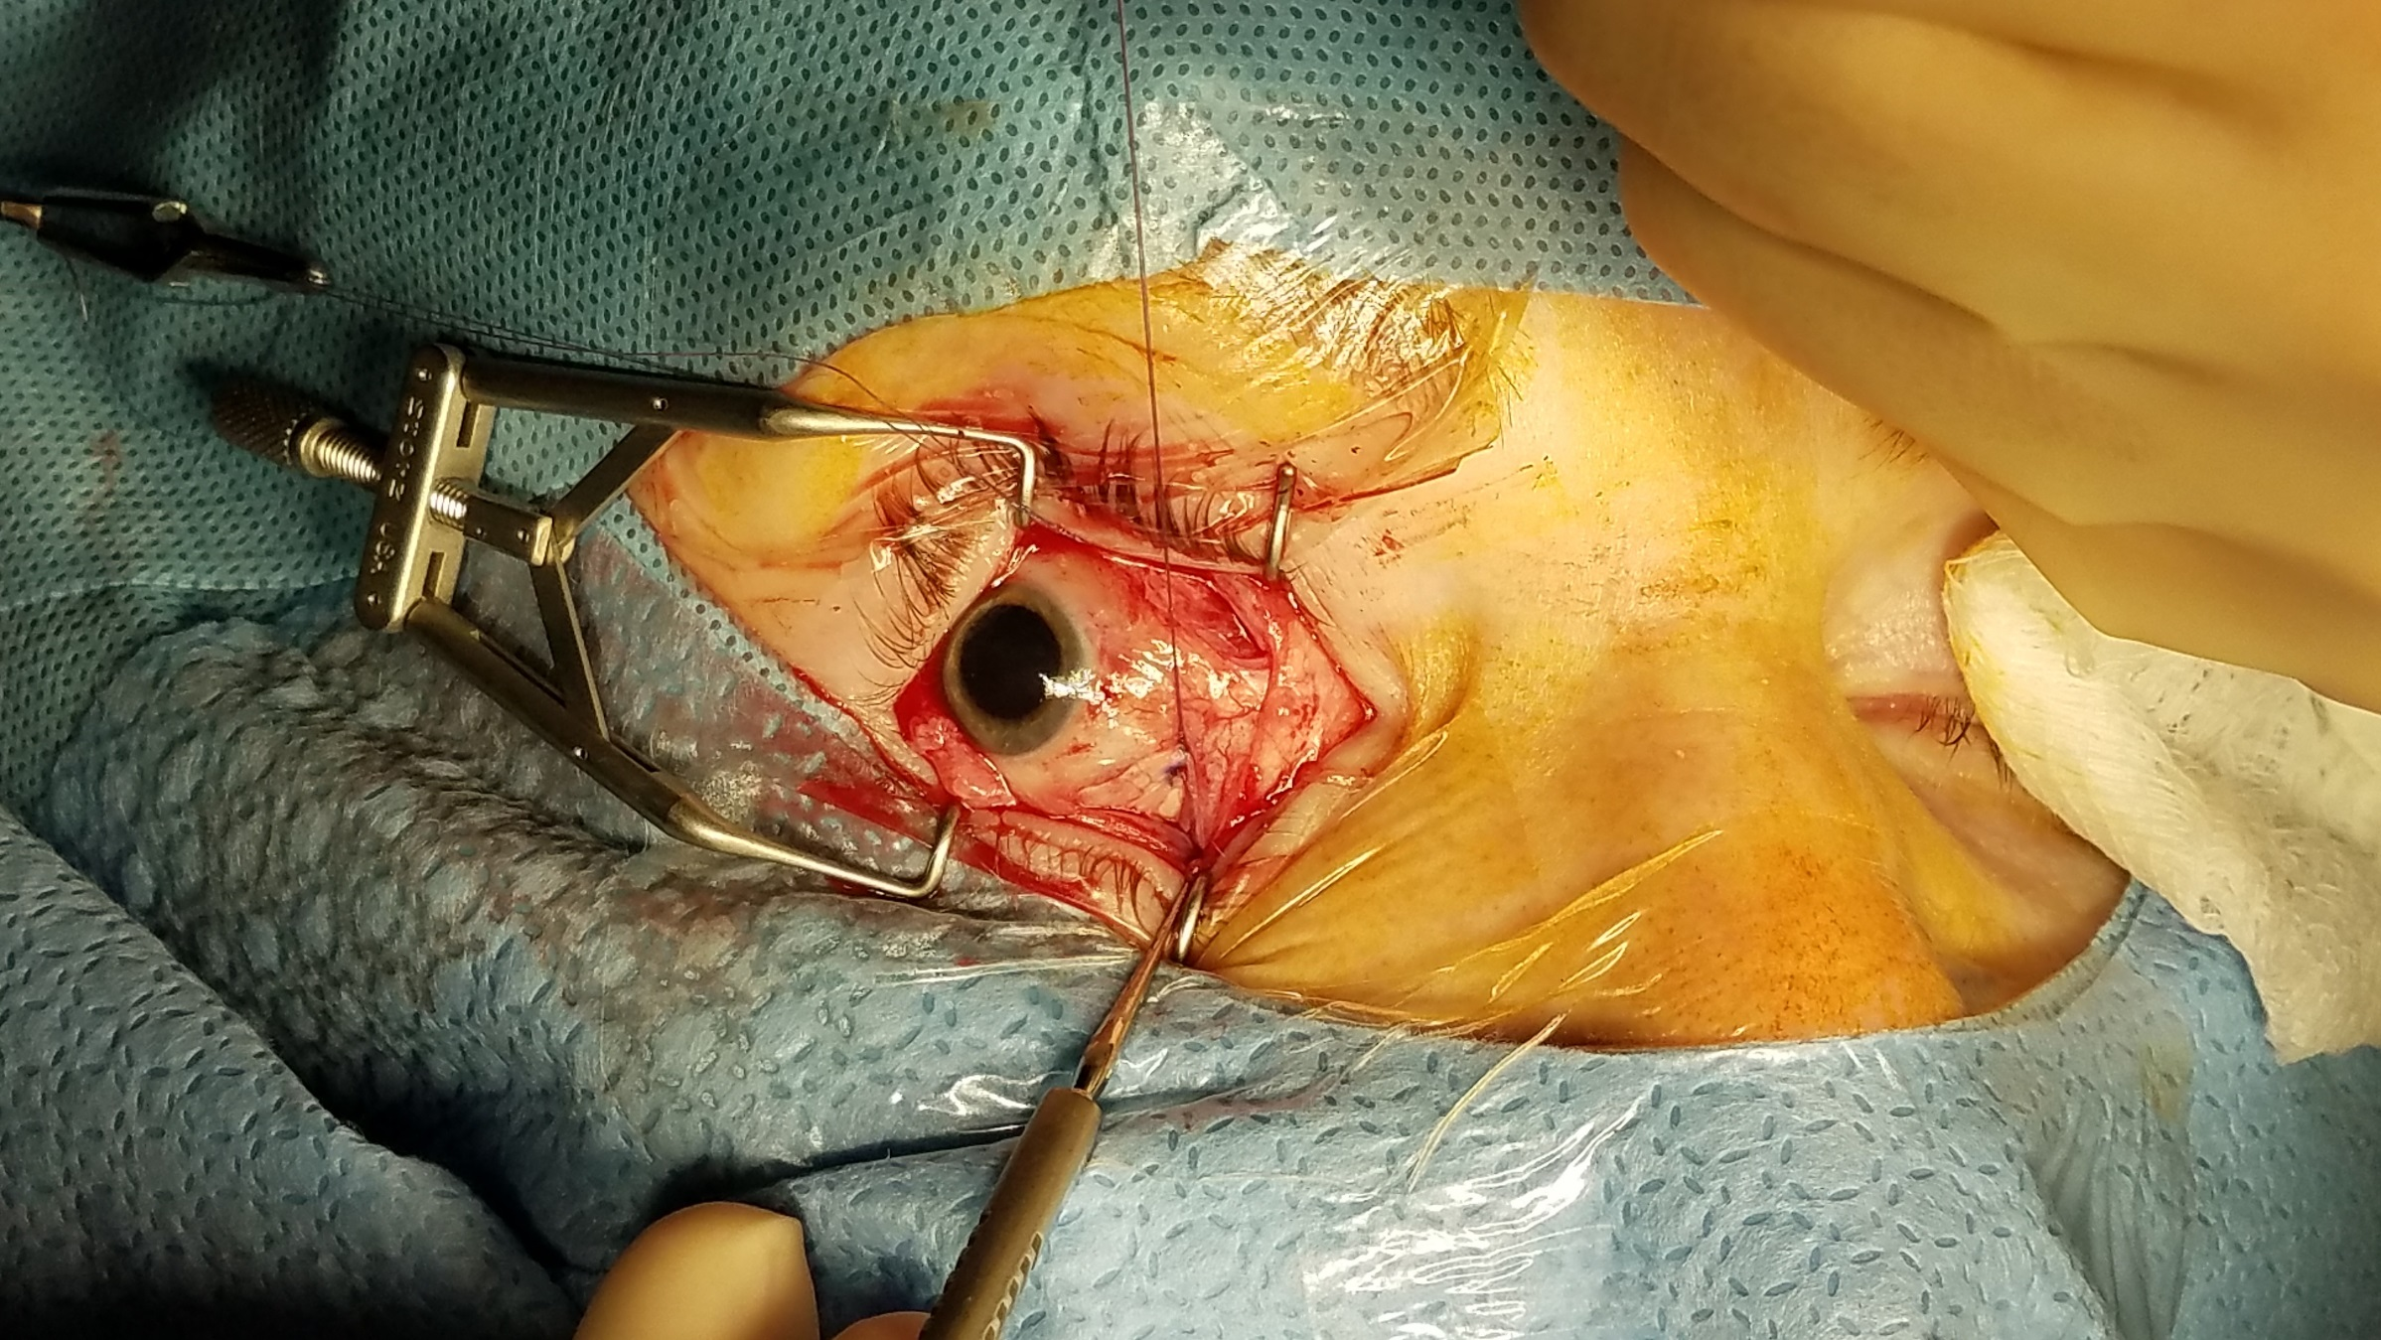
Suturing Inferior Half
Notes:
Suturing inferior half

Slide 19
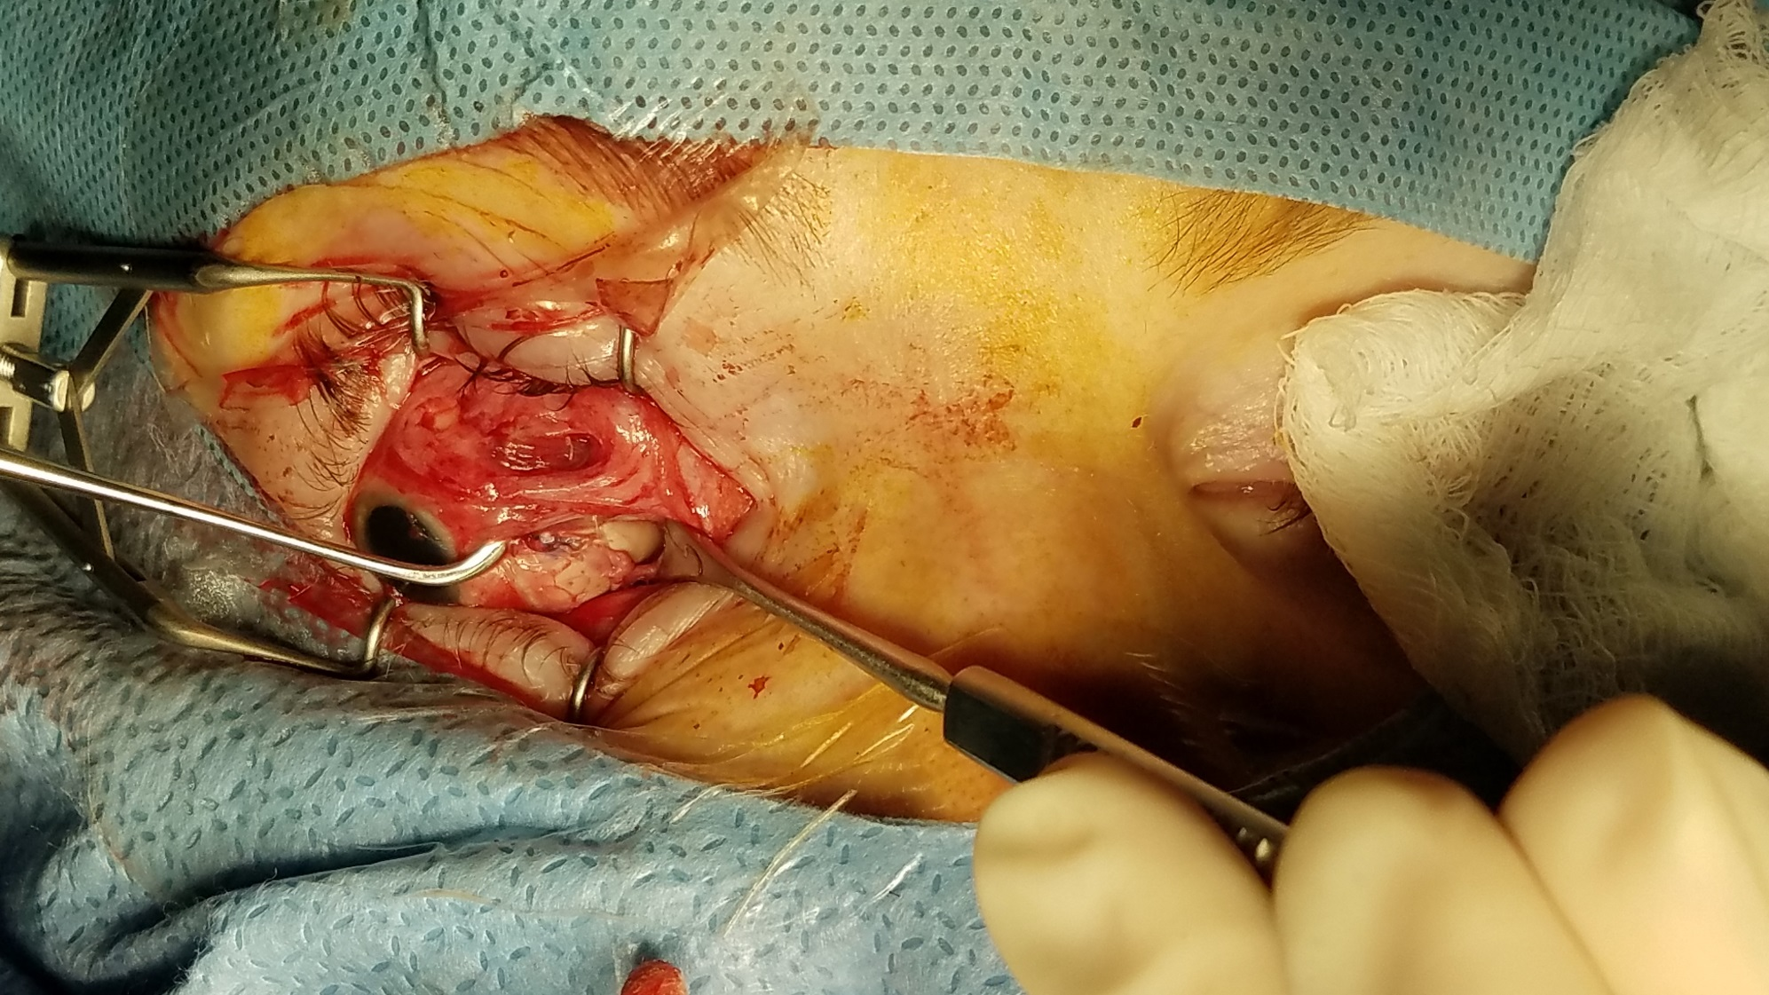
Notes:
Two halves of lateral rectus and medial rectus

Slide 20
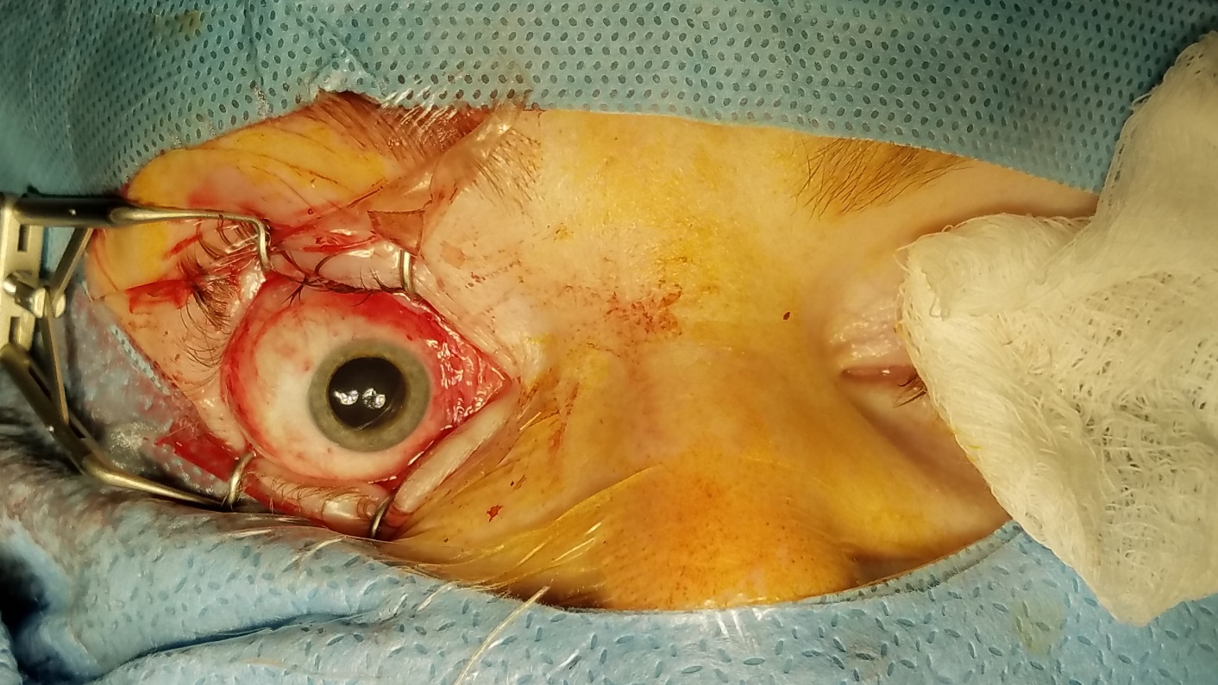
Before
After

Slide 21
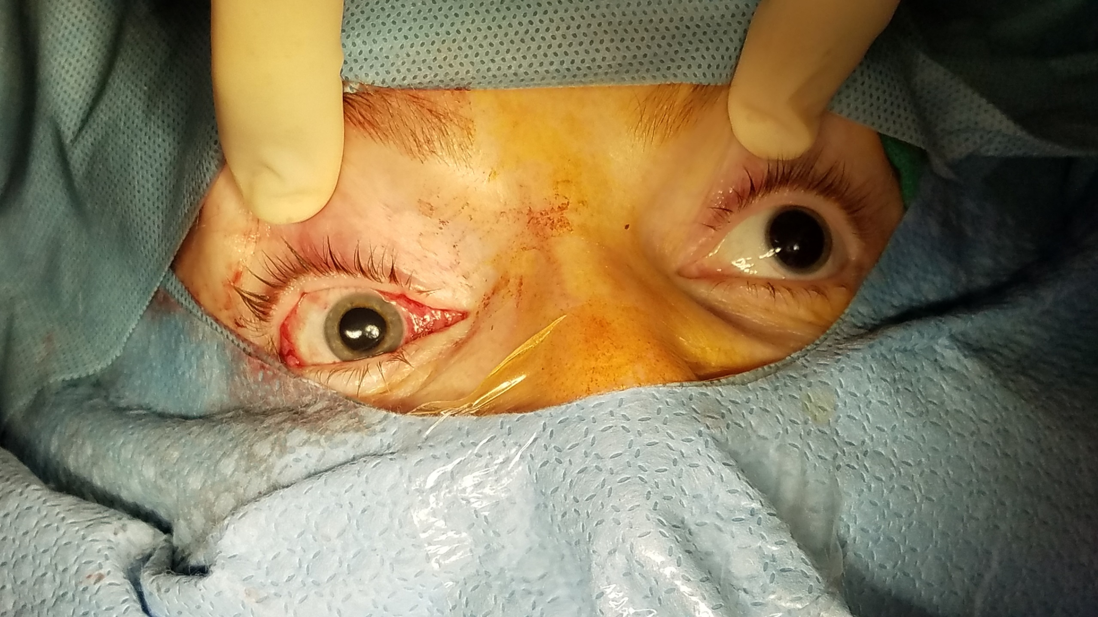
Alignment already improved

Slide 22
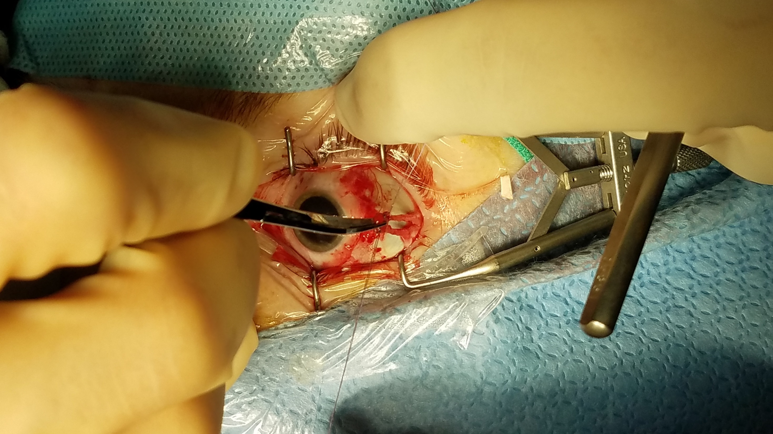

Slide 23
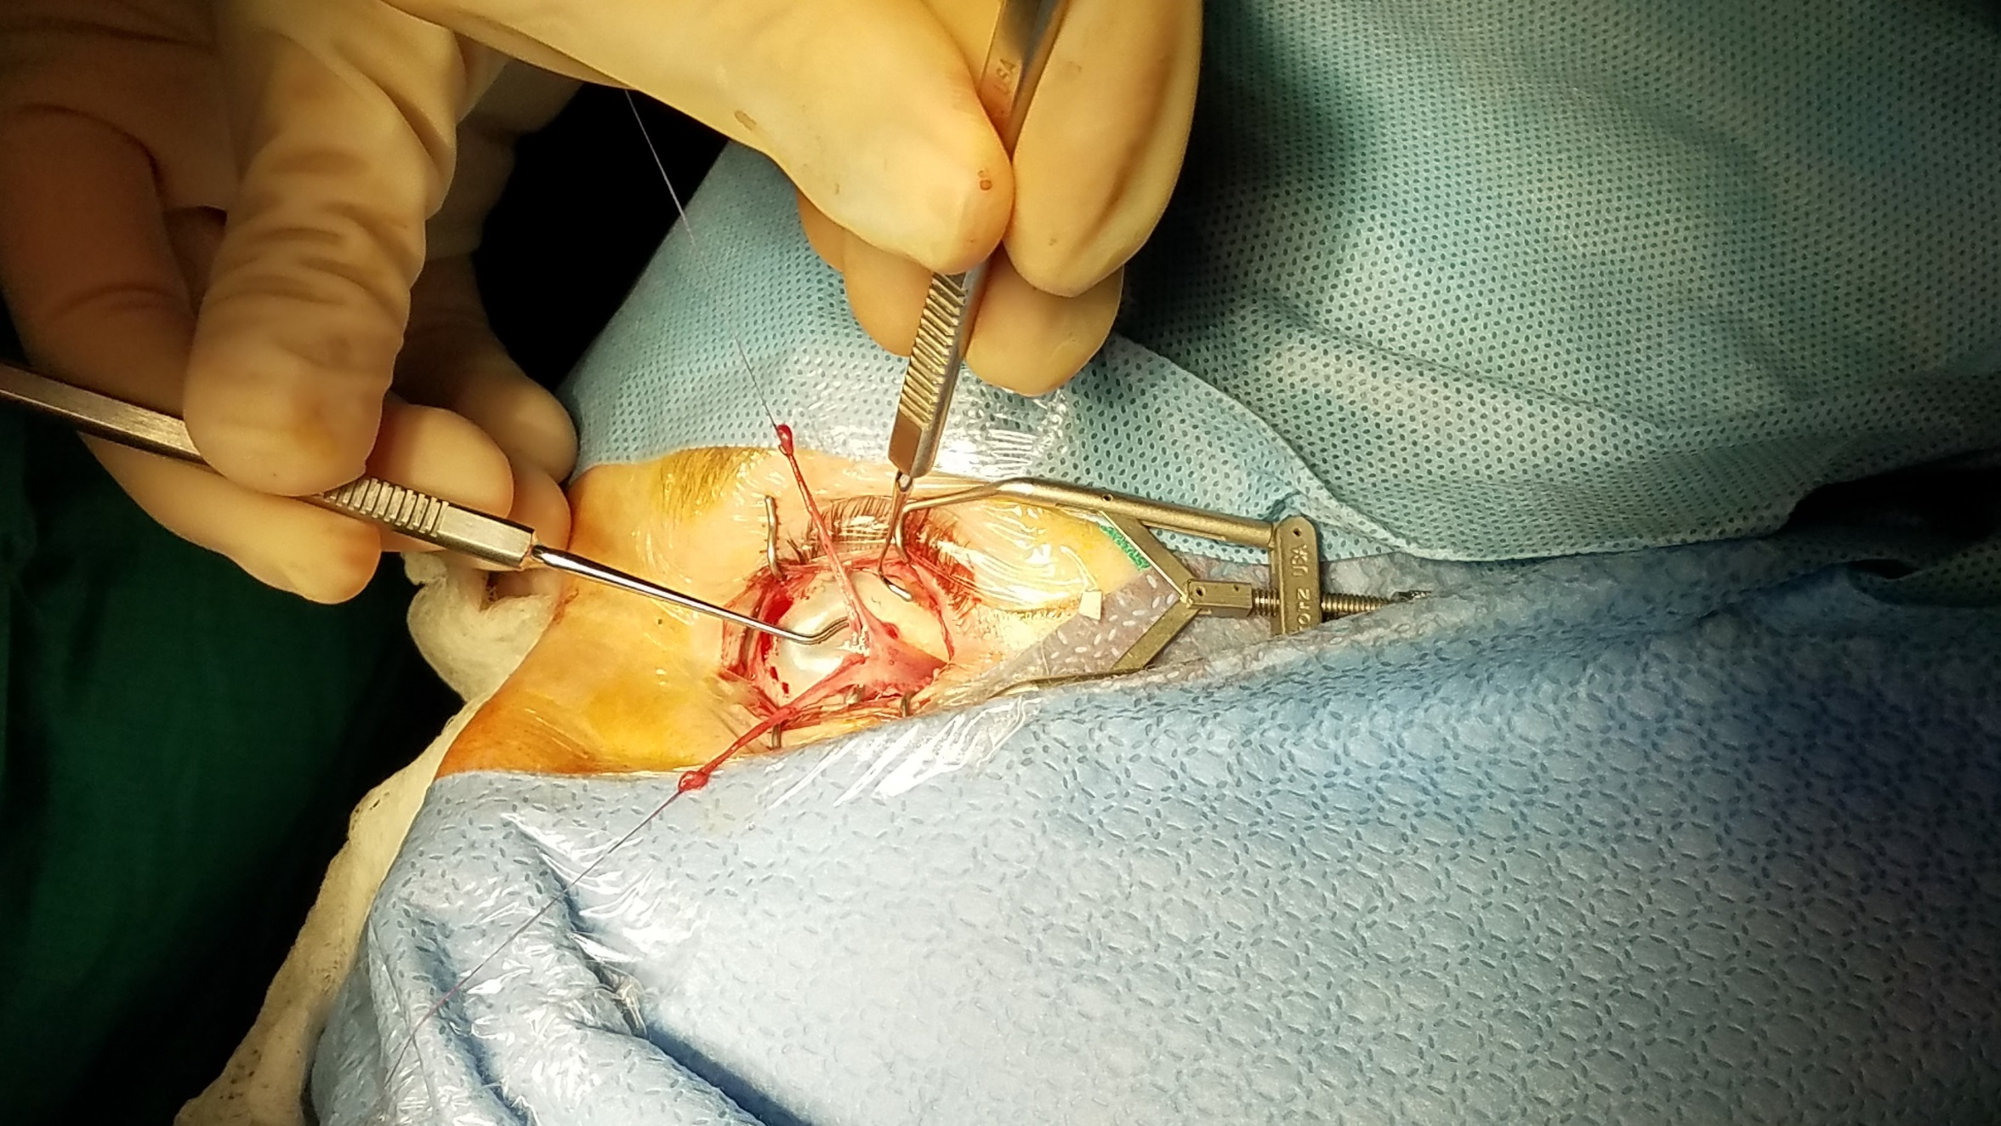

Slide 24
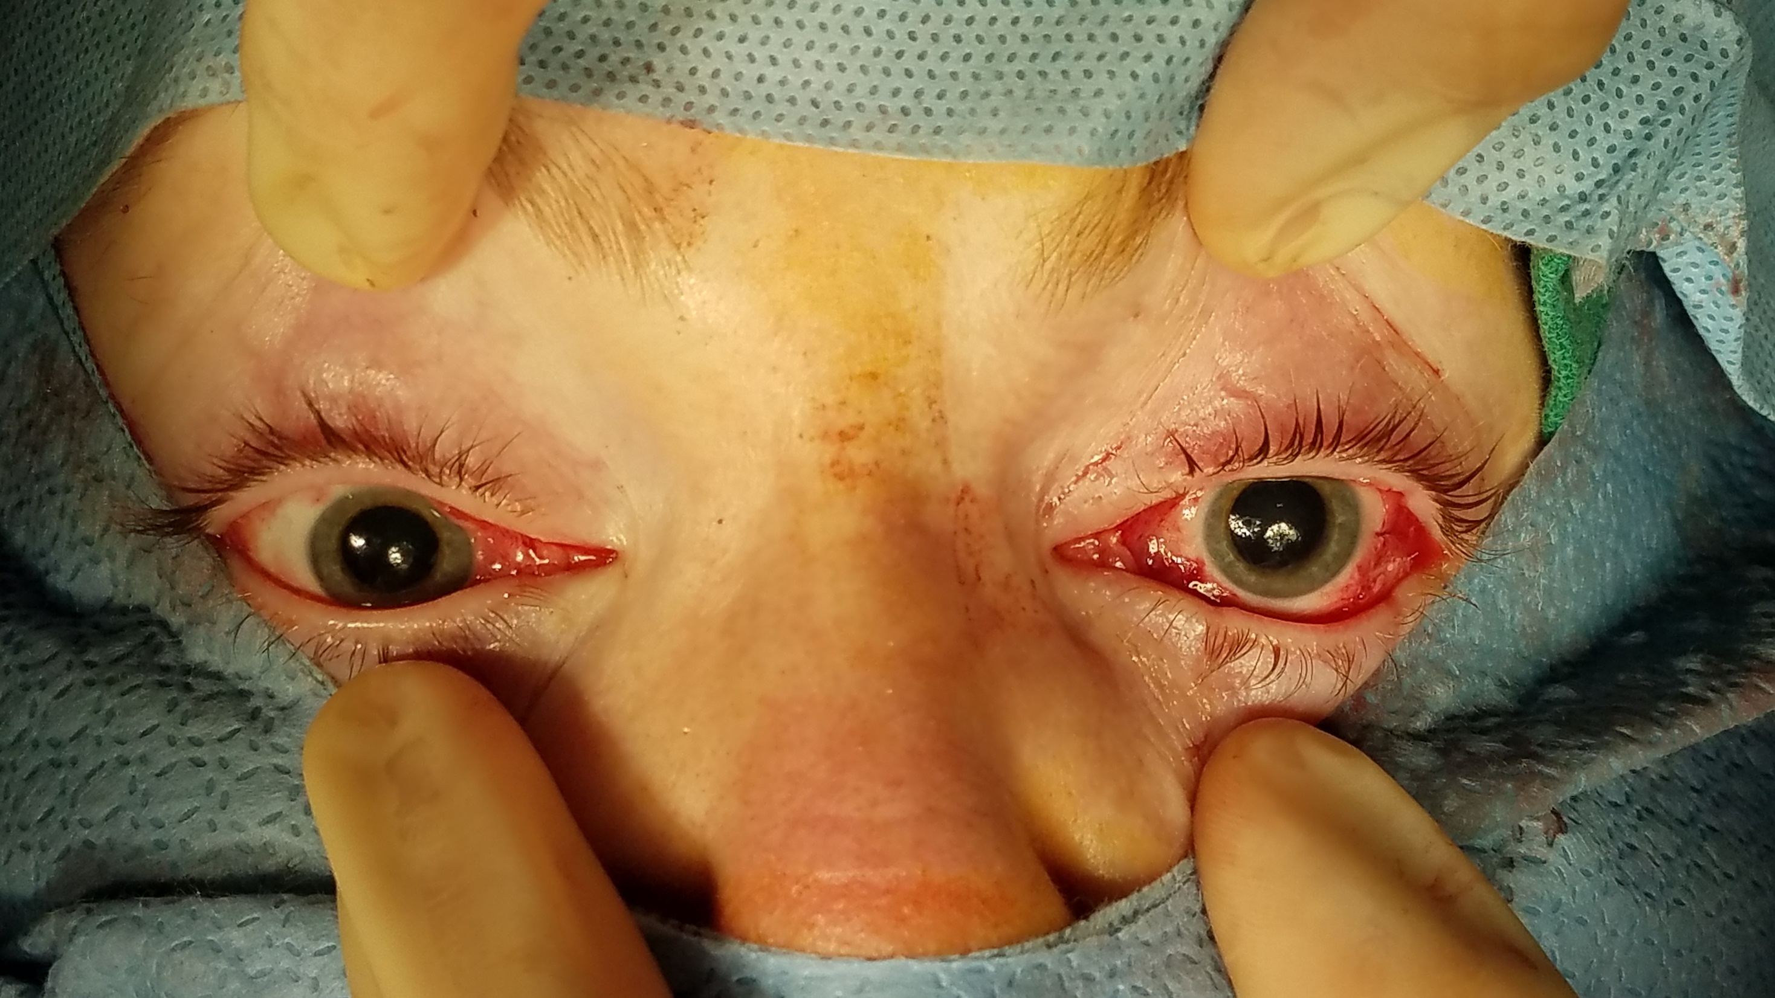
After

Slide 25
Before
After

Slide 26
Surgery
SO tenotomy OU
IO myectomy
Nasal transposition of LR OU

Slide 27
Post Op
Post op: XT 12 PD, right hypotropia 14 PD

Slide 28
Discussion
Third nerve palsy
Cranial nerve dysfunction affecting the superior, medial and inferior rectus as well as inferior oblique, levator muscle, pupillary sphincter and ciliary muscle
Most isolated unilateral third nerve palsies due to microvascular etiologies
Rule of thumb that ischemic damage will improve or even resolve by 3 months
Notes:
May also be due to brainstem lesions
Less commonly aneurysm, tumor, inflammation, infection, trauma, vasculitis
Partial versus complete
Compressive verses ischemic
Pupil involving versus pupil sparing

Slide 29
When it doesn’t resolve
Patient is left with disfiguring strabismus and potentially disabling diplopia
Only lateral rectus and superior oblique muscles still functioning – “down and out”
Limited options for surgical repair
Strategies aimed at fixating globe in primary position with extremely limited motility
Notes:
Ptosis ranging from mild to full eyelid ptosis

Slide 30
Surgical Management
Orbital fixation
Using orbital fascia or fascia lata graft
Superior oblique transposition
Large angle recession of lateral rectus
Leads to proptosis of globe
Lateral rectus transposition to superonasal globe
Required a second and third surgery
Induced torsion and vertical deviation
Notes:
SO – 1 to 3.5 mm anterior anterior to medial insertion of superior rectus
Goal of surgery: orthotropia in primary position

Slide 31
Surgical Management of Strabismus Secondary to 3rd Nerve Palsy
Difficult and highly invasive
Need for complex calculations
Introduction of a foreign body into the orbit
Less useful in a child with a growing orbit
Long surgical time
Need for additional extraocular muscle surgery
May lose their effect over time

Slide 32
Surgical Management
1991 Kaufmann:
Splitting of lateral rectus muscle, transposition to superior nasal and inferior nasal globe
Retroequatorial location near vortex veins
Gokyigit’s (2013) modification:
Transposing split muscle anterior to vortex veins and 2mm posterior to medial rectus muscle
Further modification Hunter (2014):
The above technique using adjustable sutures

Slide 33
Evaluate ocular alignment after Y splitting of lateral rectus muscle with reattachment near medial rectus in patients with complete oculomotor nerve palsy
12 eyes of 10 patients
Mean age of 31.7 years (range 6-66 years)
Pre operative horizontal deviation was 73.7 +/- 8.9 PD
Notes:
Single center, prospective, cohort
Final deviation of 1 to 10 prism diopters was considered successful
Pre operative deviations greater than 45 PD

Slide 34
Results
After the surgery: 11.8+/-1.0 PD
Additional surgery was performed in 4 out of 10 patients
On final visit, horizontal deviation was 8.5+/-1.3 PD
No intraoperative complications
No orbital hemorrhage or damage to vortex veins
No serious post operative complications
No retinal detachments seen in this group
No clinical signs of optic nerve compression
Notes:
Medial rectus resection, medial rectus tucking, lateral rectus recession to other eye
Intraoperative hirshberg testing
9 patients had successful results
Overall 3.7 PD improvement of vertical alignment
Able to achieve ortho only in primary position
Previously reported to result in retinal detachment due to increased choroidal vortex vein pressure

Slide 35
Retrospective chart review
Six patients with third nerve palsy who underwent nasal transposition of the split lateral rectus with adjustable sutures
Looked at outcomes of horizontal and vertical alignment post operatively
Evaluate anatomical changes post operatively with magnetic resonance imaging
Identify associated complications

Slide 36
Results
Four patients underwent surgery successfully
Three patients were ortho post op
Median pre op horizontal deviation of 68 PD and post op horizontal deviation of 1 PD
All four underwent intraoperative adjustment of LR muscle
Adjustable sutures allow for addressing vertical deviation as well

Slide 37
Results
Imaging confirms that the split LR muscle tethers to the globe
Complication:
One patient with transient choroidal effusion
As seen with the prior study, case selection is important
LR contracture, previous strabismus surgery can complicate surgery
Inadequate splitting of LR, extensive scarring
Notes:
Lasted for three days post op, no intervention required, no permanent effect on vision

Slide 38
Pre and Post Op
Notes:
Axial first then coronal

Slide 39
Imaging of Lateral Rectus
Notes:
5 months after surgery
15 months after surgery

Slide 40
Conclusions
Cranial nerve 3 palsy may lead to disfiguring strabismus that is difficult to treat
Goal is to achieve ortho in primary position
Lateral transposition with Y splitting is a viable option
Placing muscle halves preequatorial greatly enhances results
Single muscle surgery
Low risk of complications
Adjustable sutures may facilitate addressing vertical deviation

Slide 41
References
Taylor JN. Transplantation of the lateral rectus muscle to the medial side of the globe in third nerve palsy.Aust N Z J Ophthalmol. 1993;21(4):282.
Mora J. An adjustable medial orbital wall suture for third nerve palsy. Clin Experiment Ophthalmol. 2004;32(5):460-461.
Gottlob I, Catalano RA, Reinecke RD. Surgical management of oculomotor nerve palsy. Am J Ophthalmol. 1991;111(1):71-76.
Taylor JN. Surgical management of oculomotor nerve palsy with lateral rectus transplantation to the medial side of globe.Aust N Z J Ophthalmol 1989;17(1):27-31.
BSCS Neuro Ophthalmology 228-232
Gokyigit B, Akar S, Satana B, Demirok A, Yilmaz OF. Medial transposition of a split lateral rectus muscle for complete oculomotor nerve palsy. J AAPOS. 2013;17(4):402-410.
Shah A, Prabhu S, Sadiq M, Mantagos I, Hunter D, Dagi L. Adjustable Nasal Transposition of Split Lateral Rectus Muscle for Third Nerve Palsy. JAMA Ophthalmol. 2014; 132(8): 963-969.

