Slide 1
Grand Rounds A Unique Case of Acute Optic Neuropathy
Josh Gross, MD
September 15, 2017
Notes:
Good morning, my name is Josh Gross. I am a first year ophthalmology resident here at Louisville. I would like to present to you a unique case of acute optic neuropathy

Slide 2
No commercial disclosure

Slide 3
Patient Presentation
CC
Vision loss right eye 1 month ago
HPI
59 yo AAF previously admitted to Norton’s for work-up for painless vision loss OD. Subsequently treated for presumed GCA. Now presents to clinic 1 month later for f/u with no visual complaints.
Notes:
This is a patient with a CC of vision loss in her right eye 1 month ago
She is a 59yo AAF who woke up 1 month earlier with “black scribble” across her vision in the right eye.
Admitted at Norton with elevated ESR/CRP and concerns for GCA, started in 1g IV Solu-medrol and bilateral temp artery bx’s negative.
OD VA returned to b-line 2 days after CCS.
Ophtho not consulted during admission.
DC’d with 60mg Pred x 14 days.

Slide 4
History (Hx)
Past Ocular Hx: none
Past Medical Hx: HTN, HLD
Fam Hx: HTN, CA, CVA, MI
Meds: Lipitor, Amlodipine, Carvedilol, ASA 81mg, Lisinopril 20mg, Ferrous sulfate, Loratadine
Allergies: NKDA
Social Hx: non-smoker, non-EtOH
ROS: negative
Notes:
She has no past ocular history
PMHx for HTN and HLD, for which she was taking medication
She had no allergies, and did not smoke or drink alcohol
ROS was negative

Slide 5
Physical Exam
 | OD |  | OS
BCVA | 20/20-2 |  | 20/30+3
Refraction | -1.00 sphere |  | -1.00 sphere
Pupils | 4→3mm | No rAPD | 4→3mm
IOP | 19 mmHg |  | 18 mmHg
EOM | Full |  | Full
CVF | Full |  | Full
AC | 0 cell or flare |  | 0 cell or flare
Notes:
Say: ANTERIOR SEGMENT EXAM WAS NORMAL

Slide 6
Physical Exam
Fundus | OD |  | OS
Optic Nerve | Pink with sharp margins, c/d 0.3 |  | Pink with blurred margins, c/d 0.3
Macula | No hemorrhage, fluid, or edema |  | 1 disc diameter of whitish patch of retinitis with indistinct borders superotemporal to the disc
Vessels | Normal caliber, no venous sheathing |  | Normal caliber, no venous sheathing
Periphery | No holes or tears, attached 360 degrees |  | ½ disc diameter of whitish patch of retinitis with indistinct borders inferonasal to the disc
Notes:
Whitish patch of retinitis with indistinct borders

Slide 7
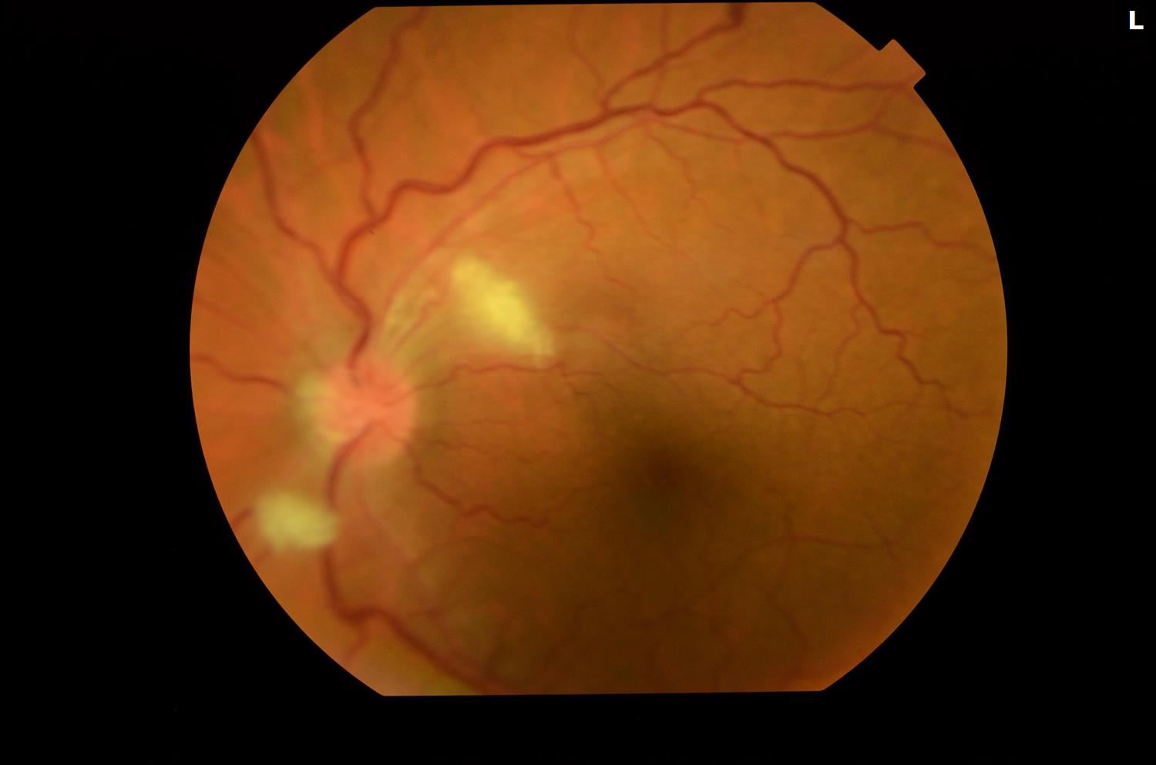
Fundus Photo OS
Notes:
Color fundus photo of the left eye remarkable for White patch of retinitis superotemporal to the disc that is approximately 1 DD with indistinct borders, with a similar patch of retinitis ½ DD inferonasal to the disc

Slide 8
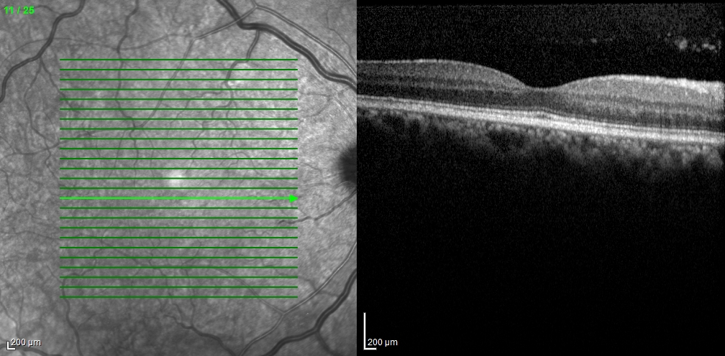
OCT OD
Notes:
OD: OCT of the right eye remarkable for hyperreflective spots in the vitreous which likely is vitritis

Slide 9
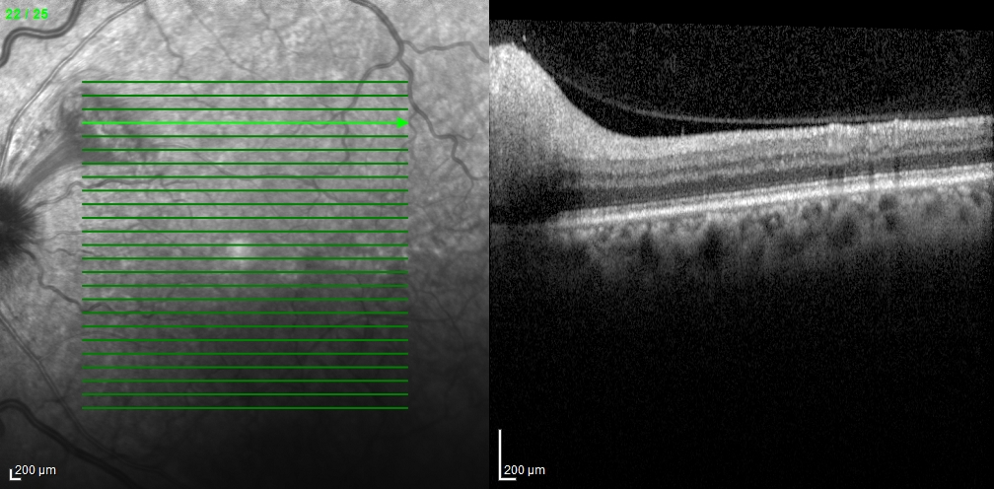
OCT OS
Notes:
OS: OCT of the left superior macula was remarkable for significant swelling of the inner retina layer which is shown by the hyperreflective signal and correlated with the retinitis patch seen clinically, with shadowing of outer retina layers. (some vitritis as well)

Slide 10
Assessment/Plan
59yo AAF previously treated for GCA in the right eye with likely vitritis of the right eye and two retinitis patches with overlying vitritis in the left eye with no systemic signs or symptoms
DDX: Posterior Uveitis
1. Infectious – syphilis, TB, lyme, toxoplasmosis
2. Non-infectious – sarcoidosis, multiple sclerosis, systemic lupus erythematous
Plan
Infectious work-up ordered, pt to follow up with results
Notes:
Assessment: with no systemic signs or symptoms

Slide 11
New Presentation
CC
New onset loss of central VA OD
HPI
59yo AAF history of sudden VA loss OD, who noticed several days ago her central VA was becoming dark, which has worsened to no central VA
Notes:
However, the patient developed new symptoms before her follow up with new onset, sudden and painless central vision loss OD that had gradually worsened over several days

Slide 12
Physical Exam
 | OD |  | OS
BCVA | CF @ 5ft peripherally |  | 20/30
Refraction | -1.00 sphere |  | -1.00 sphere
Pupils | 4→3mm, + RAPD |  | 4→3mm
IOP | 15 mmHg |  | 18 mmHg
EOM | Full |  | Full
CVF | Full |  | full

Slide 13
Physical Exam
Fundus | OD |  | OS
Optic Nerve | Pink with sharp margins, C/D 0.3 |  | Pink with sharp margins, C/D 0.3
Macula | No hemorrhage, fluid, or edema |  | Resolving retinitis with more discrete borders and decreased swelling
Vessels | Normal caliber, no venous sheathing |  | Normal caliber, no venous sheathing
Periphery | No holes or tears, attached 360 degrees |  | Resolving retinitis with more discrete borders and decreased swelling
Notes:
Anterior segment exam was unchanged from last visit
Fundus exam of the left eye demonstrated resolving retinitis

Slide 14
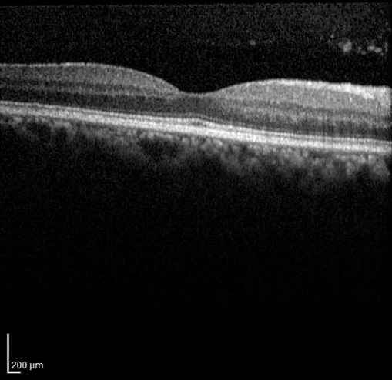
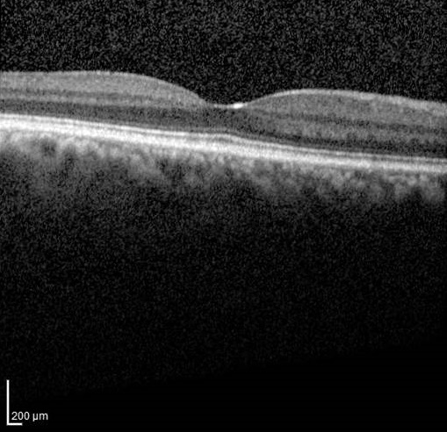
OCT OD
Before
Current
Notes:
OCT of both eyes were taken, and on the left the patient’s prior OCT of the right eye, and on the right is the OCT taken on this visit of the same eye, remarkable for resolution of the hyperreflective vitreous spots [which was likely vitritis]

Slide 15
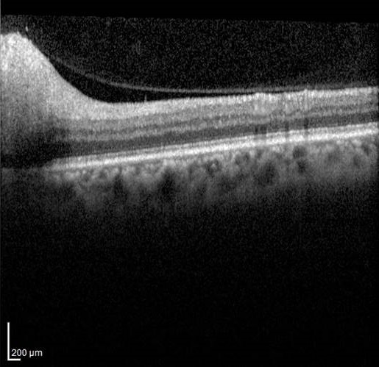
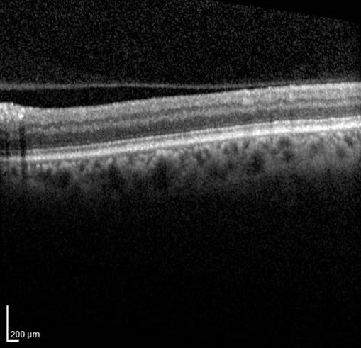
OCT OS
Before
Current
Notes:
On the left is the prior OCT of the left eye from the patients initial encounter, to compare to the OCT of the same eye from this visit which shows decreased swelling of the inner retina

Slide 16
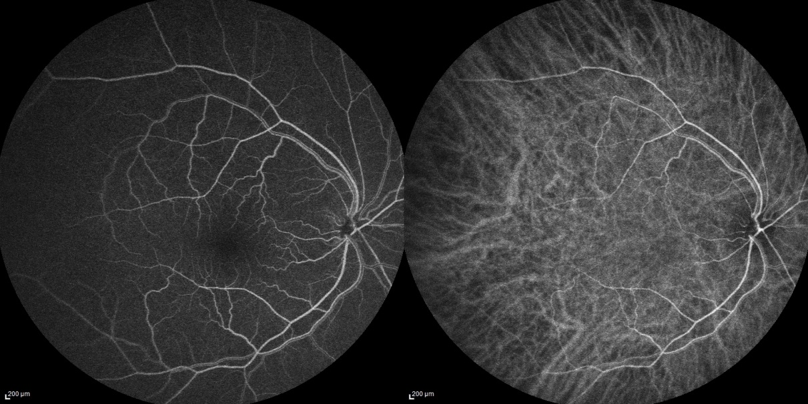
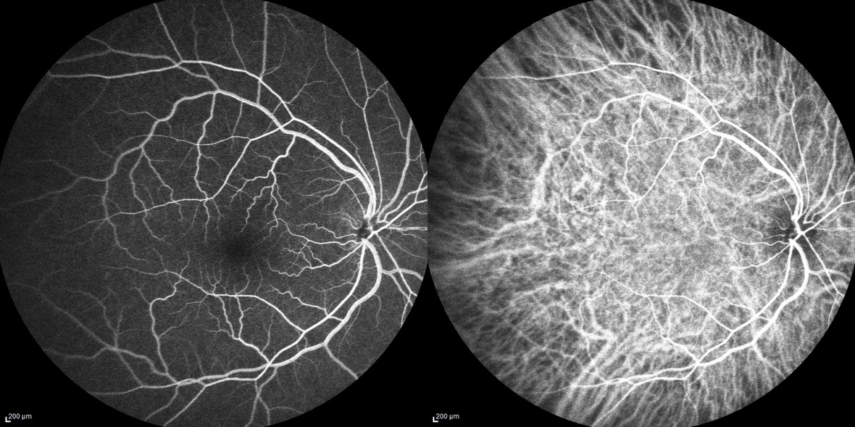
FA/ICG OD
Notes:
Late and early FA and ICG of the right eye, unremarkable for any findings

Slide 17
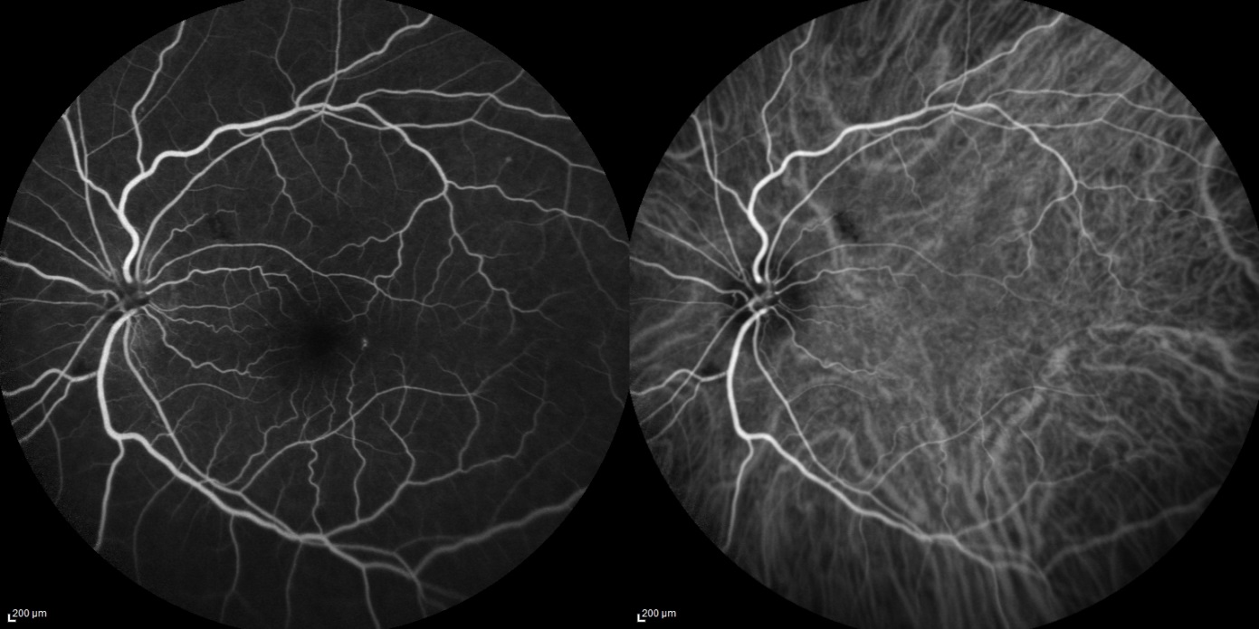
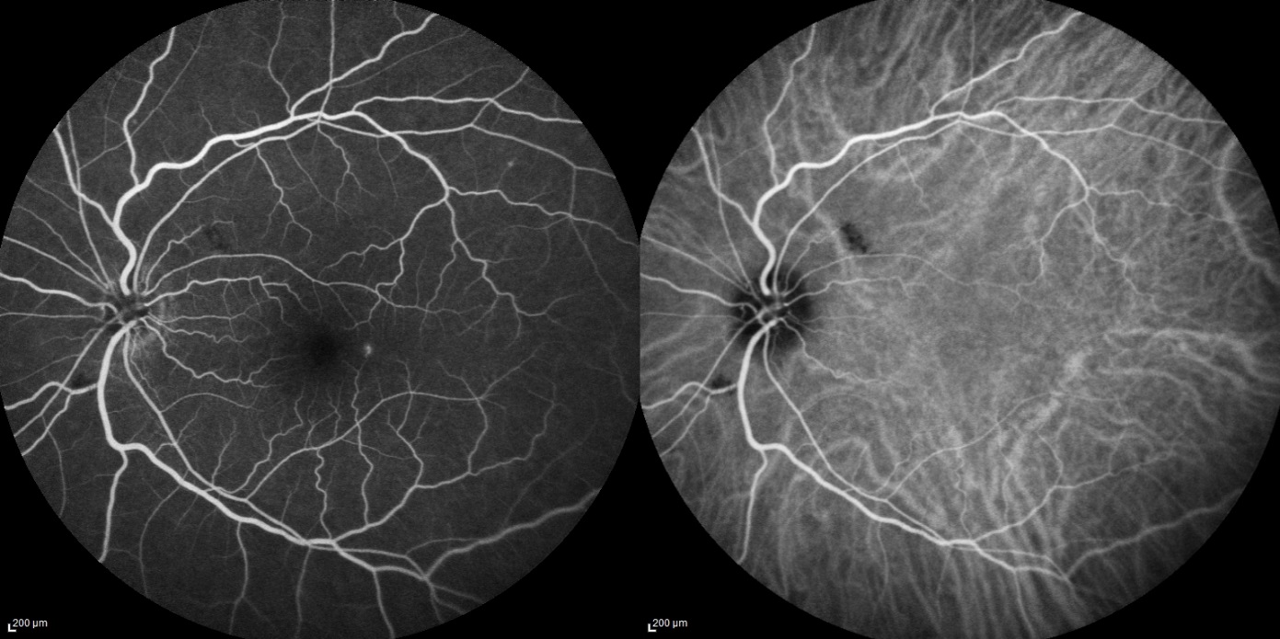
FA/ICG OS
Notes:
FA and ICG study of the left eye, remarkable for blockage superotemporal and inferonasal to the disc, corresponding to the lesions seen on her fundus exam
ONLY MENTION IF ASKED:
Early @ 0:40 = remarkable for increased fluorescence temporal to the fovea, and blockage on both images that corresponds to the previously described whitish preretinal lesions superotemporal and inferonasal to the disc
Late @ 3:48 = remarkable for slightly increased leakage of the hyperfluorescent spot temporal to the fovea

Slide 18
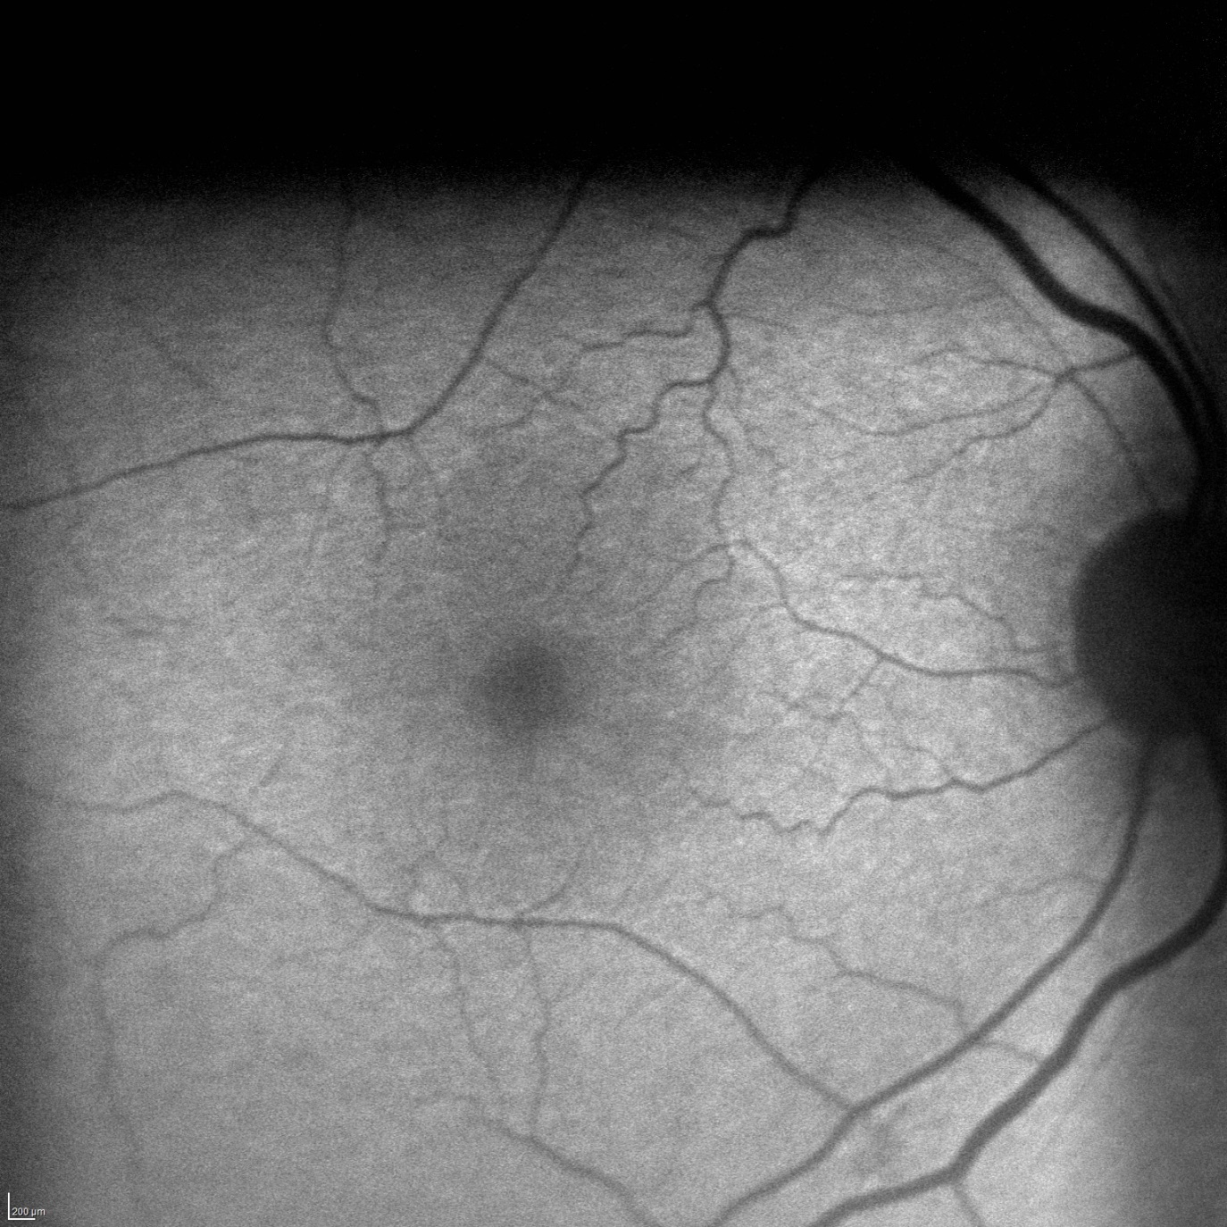
Fundus Autofluorescence OD
Notes:
The fundus autofluorescence of the right eye was unremarkable

Slide 19
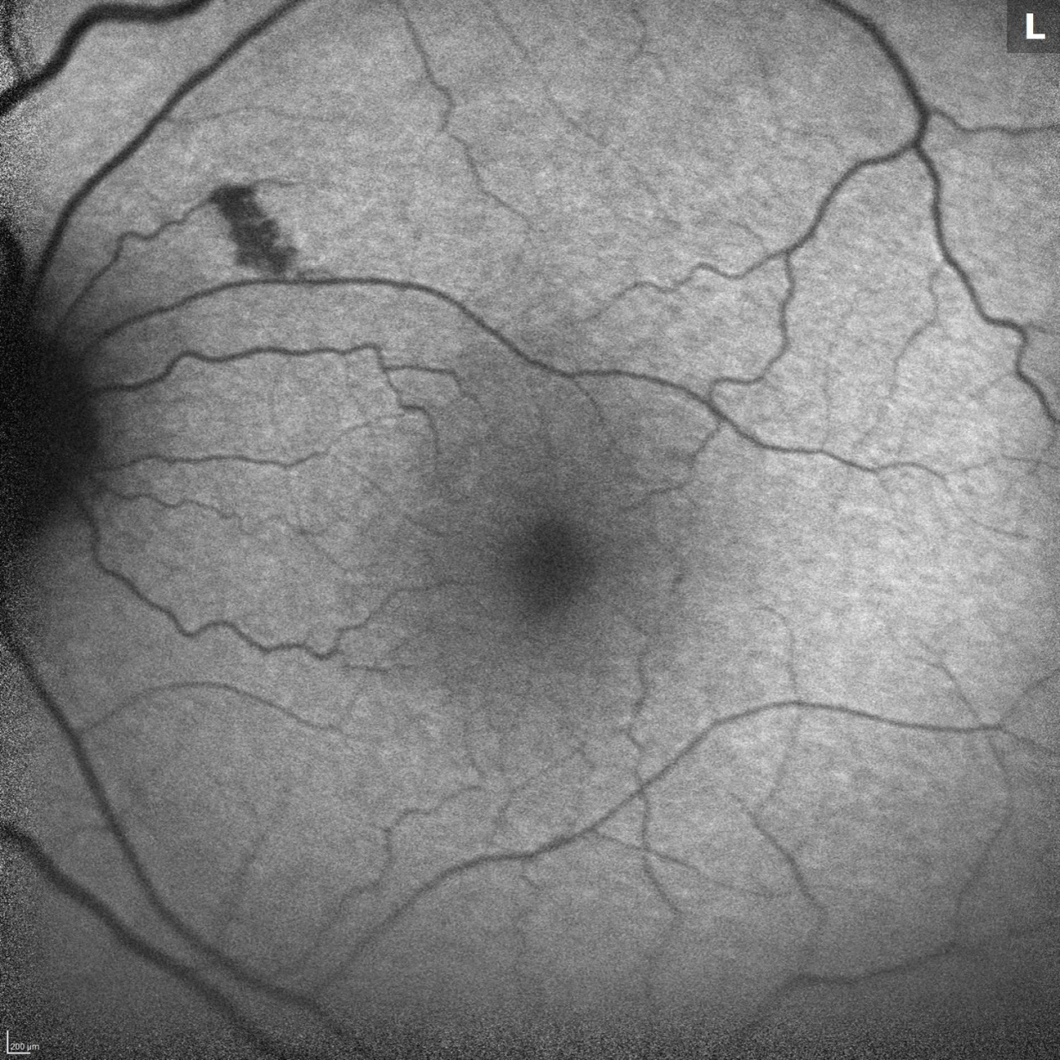
Fundus Autofluorescence OS
Notes:
And here is the fundus autofluoresence study of the left eye, remarkable for a hypofluorescent area superotemporal to the optic disc corresponding to the patch of retinitis

Slide 20
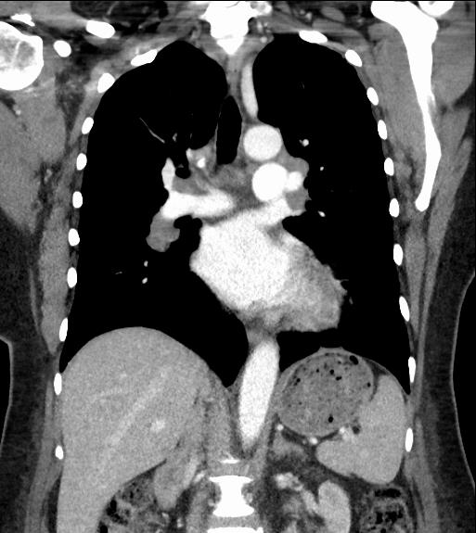
Chest Computed Tomography
Notes:
Additionally, the patient had a follow up chest CT performed in between encounters (for groundglass changes in the upper lobes seen on CT angiography of the neck done on her admission for GCA) that showed : Mediastinal and bilateral hilar adenopathy, mild groundglass infiltrate in the right upper lobes, and nonspecific right lower lobe nodules

Slide 21
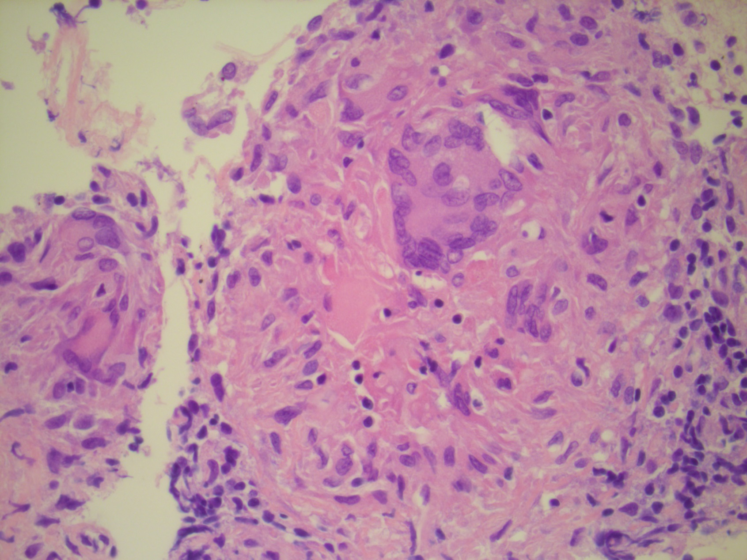
Transbronchial Lymph Node Biopsy
Notes:
She also had a Transbronchial US guided subcarinal LN biopsy done to follow up her chest CT that demonstrated palisading epithelioid histiocytes with adjacent multinucleated giant cells; additional staining was neg for bacteria, fungi, or malignancy
Also, Flow Cytometry of the BAL was negative [also failed to reveal a monoclonal B cell population]
(epithelioid gramulomas in a background of lymphocytes, columnar cells, and macrophages)

Slide 22
Final Diagnosis
Sarcoidosis

Slide 23
Plan
Send to University Hospital for admission and expedited work-up and initiation of IV corticosteroids for suspected optic neuropathy secondary to sarcoidosis

Slide 24
ULH Admission
Infectious work-up negative
Started 1g IV Solu-medrol x 3 days, VA OD markedly improved to 20/20 @ near on day 2
MRI Brain/orbits
Notes:
V B12 defiency, RF, Lyme, ANA, Syphilis, Hep panel, HIV, Quantiferon = neg
AST & ALT = slightly high
ESR = 35 (high)
ACE < 10 (lowish)

Slide 25
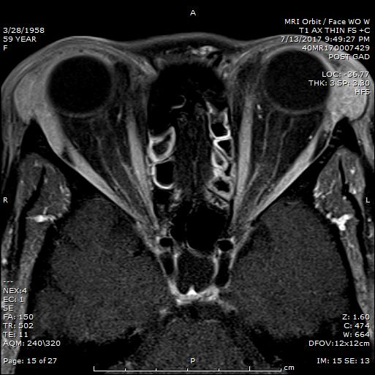
MRI orbits
Notes:
Axial view of the patient’s T1 weighted MRI of the orbits showing bilateral ON sheath AND lacrimal gland hyperintensity
T1 = fat is bright, fluid is dark
T2 = fat is intermediate bright, fluid is bright

Slide 26
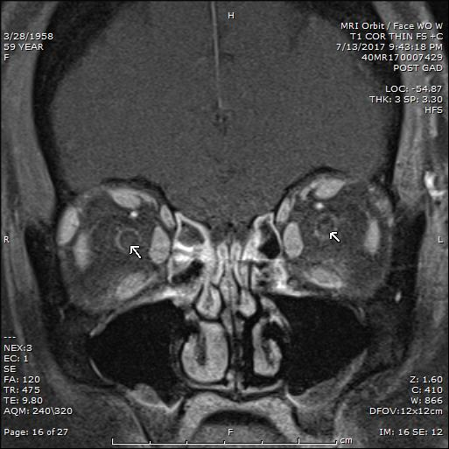
MRI Orbits
Notes:
Coronal view, again, of the patient’s T1 weighted MRI of the orbits showing bilateral ON sheath and lacrimal gland hyperintensity
T1 = fat is bright, fluid is dark
T2 = fat is intermediate bright, fluid is bright

Slide 27
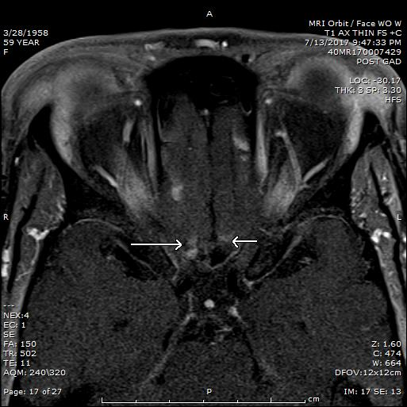
MRI Brain
Notes:
Axial view of the patient’s T1 weighted MRI of the brain showing hyperintensity in the bilateral gyrus recti (arrow)
T1 = fat is bright, fluid is dark
T2 = fat is intermediate bright, fluid is bright

Slide 28
1 Month Follow up
VA right eye improved to 20/20
No rapd or optic disc pallor
Vitritis resolved
DX - Neurosarcoidosis
Notes:
the patient saw neuro-ophthalmology for 1 month f/u and her vision was 20/20 OD with no rapd or optic disc pallor. VF OU were normal
She saw a neuro-immunologist who started her on pulse IV steroids [with plans to follow her progression with ophthalmic exam and MRI]

Slide 29
Neurosarcoidosis
Occurs in 5-16% of patients with sarcoidosis
Neuro-ophthalmic symptoms are the presenting clinical manifestation in 1% of sarcoidosis cases
Most common in women of African descent between ages of 20-40
Notes:
INTRO: Sarcoidosis is a multi-systemic granulomatous disorder of unknown etiology; epidemiologic studies have demonstrated an increased incidence of sarcoidosis with various environmental exposures (that include infections such as mycobacterium and Proprionibacterium acnes, pesticides, mold, fire-fighting, metal dusts, and naval ship-service. Additionally other factors such as race, genetic polymorphisms, host immune status, and geography seem to be important.)
African Americans (35-80/100K) = 0.05 – 0.14%
Northern Europeans (15-20/100K) = 0.02 – 0.1 %
3rd-5th decade of life
Women 30% increased risk
The most common ocular manifestations of sarcoidosis include conjunctival granulomas, lacrimal gland involvement, and all forms of uveitis
Patients of African descent are at most risk for sarcoidosis, as are women.
African americans generally experience more acute and severe ocular disease course, whereas Europeans have a more asymptomatic and chronic course

Slide 30
Clinical Presentation
Cranial neuropathy most common: 50-70%
Optic disc pallor (55%), optic disc edema (29%), periphlebitis (14%), ON granuloma (10%)
Leptomeningeal +/- cerebral parenchymal involvement common
Notes:
Neurosaroidosis most commonly presents as a cranial neuropathy, with the facial nerve being involved most commonly, but the optic nerve is also involved 1/3 to ½ of the time [CN 7 involved 50% of time, CN 2 involved ½ to 1/3 of the time]
optic disc pallor is the most common sign (55%), followed by optic disc edema (29%), periphlebitis (14%) and optic disc granulomas (10%)
Leptomeingeal and/or cerebral parenchymal involvement is common
Lumbar puncture most commonly shows increased protein and pleocytosis, with decreased glucose
Less common neuro-ophthalmic manifestations reported include hearing loss, abducens nerve palsy, oculomotor nerve palsy, optic tract involvement, Horner’s syndrome and tonic pupil [32,37,38].
These manifestations may occur as a consequence either from direct inflammation, compression or infiltration along any level of the visual pathway, whether afferent of efferent.
Other causes for neuro-ophthalmic involvement include secondary mechanisms from ischemic complications of retinal or choroidal inflammation and glaucoma, disc granulomas, meningeal inflammation within the optic nerve sheath itself leading to an optic perineuritis or as a consequence of hydro- cephalus

Slide 31
Diagnosis: Zajicek’s Criteria
Definitive: histologic confirmation of affected neural tissue
Probable: 1) evidence of neurological involvement on imaging (MRI) and tissue confirmation of systemic sarcoidosis
Possible: characteristic neurological involvement seen in the absence of any tissue diagnosis or diagnosis of sarcoidosis
Notes:
Neurosarcoidosis is diagnosed based from Zajicek’s Criteria, which is broken down into 3 categories:
Definitive is the gold standard and requires histological confirmation of the affected neural tissue
Probable diagnosis requires evidence of neurological involvement on imaging and systemic tissue confirmation
And a Possible diagnosis is the least certain, and is defined as characteristic neurological involvement seen without tissue diagnosis
Our patient had a probable diagnosis with evidence of ON sheath and cerebral parenchymal involvement on MRI and a positive subcarinal LN bx
- in setting of ocular manifestations of neurosarcoidosis a definitive dx is not possible, as a bx of the ON would be inappropriate and could lead to permanent VA loss.

Slide 32
Systemic Complications
Hydrocephalus
Seizures
Hypothalamic-pituitary dysfunction
Peripheral neuropathy, trigeminal neuralgia
Neurovascular complications
Fatigue, weight gain
Depression, cognitive changes
Notes:
Systemic complications of neurosarcoidosis include hydrocephalus, seizures, hypothalamic-pituitary dysfunction, neurovascular dysfunction, and cognitive changes

Slide 33
Treatment
1st Line: Corticosteroids
2nd Line: Hydroxychloroquine, Methotrexate, Azathioprine, Mycophenolate, cyclophosphamide
3rd Line: Infliximab, Adalimumab, Rituximab
Notes:
Neurosarcoidosis often requires immunosuppresion treatment, esp in setting of brain/SC involvement
Given lack of controlled trials, tx guidelines are largely based on anecdotal evidence and small case series
1st line treatment consists of corticosteroids where:
-Mild-moderate cases are treated with 20-40mg PO daily
-Severe cases are treated with 3-5 days of IV steroids, then 60mg PO taper over 6-12 months
READ from slide 2nd & 3rd line treatments
XTRA INFO:
Factors to consider in choosing a specific therapy include length of anticiapted treatment, severity of clinical manifestation
-mild: facial palsy
-moderate: cranial neuropathies involving 2/8, myopathy, neuropathy, dural meningeal involvement
-severe: brain & SC lesions, leptomeningeal involvement, hydrocephalus
Whole brain Radiation therapy - generally reserved for CNS involvement who fail medical therapy, and whereas it may stop disease progression, it will not likely restore function

Slide 34
Prognosis
Natural history poorly defined
Optic neuritis carries poorer prognosis
Fritz et al. reported on 1088 neurosarcoid pts with multiple neurological presentations
27% complete remission
32% incomplete remission
24% stable
6% deteriorated
5% death
Notes:
There is limited available information on the prognosis in patients with neurosarcoidosis.
The natural history is poorly defined, and spontaneous remission has occurred, although optic neuritis carries a poorer prognosis. However, Unilateral involvement has been shown to demonstrate more favorable outcomes
Fritz et al. reported on over 1000 patients with neurosarcoidosis, and as you can see about 1/3 of patients had complete remission, ¼ had incomplete remission or were stable, 6% deteriorate, and 5% of patients died.
(between 1965 and 2015. CN 7 & 2 was the most common presenting feature; systemic review and meta-analysis study)
Monitoring: Visual acuity and color vision +/- MRI

Slide 35
Conclusions
Optic neuropathy is a common clinical presentation
Diagnosis made by history/physical exam, MRI, and tissue biopsy
Corticosteroids are the mainstay of treatment, although immunosuppressive drugs and biological agents are effective in treating severe cases of the brain and spinal cord involvement
Notes:
In conclusion…
Although neurosarcoidosis is rare, optic neuropathy is a common clinical presentation
Diagnosis is made by history and PE, MRI, and tissue biopsy
CCS are the mainstay of treatment; although immunosuppressive drugs and biological agents are effective in treating severe cases of brain and SC

Slide 36
References
Tavee JO, Stern BJ. Neurosarcoidosis. Clin Chest Med.2015 Dec;36(4):643-56
Agnihotri SP, Singhal T, Stern BJ, Cho TA. Neurosarcoidosis. Semin Neurol. 2014 Sep;34(4):386-94.
Kefella H, Luther D, Hainline C. Ophthalmic and neuro-ophthalmic manifestations of sarcoidosis. Curr Opin Ophthalmol. 2017 Jul 28. Epub ahead of print.
Fritz D, van de Beek D, Brouwer MC. Clinical features, treatment, and outcome in neurosarcoidosis: systemic review and meta-analysis. BMC Neurol. 2016 Nov 15;16(1):220.
Cohen Aubart F, et al. Long-term outcomes of refractory neurosarcoidosis treated with infliximab. J Neurol. 2017 May;264(5):891-897.

Slide 37
Thank you
Dr. Pham
Dr. Sigford
Dr. Mueller
Dr. Mugavin
Dr. Piri

Slide 38
18 patients with histologically proven sarcoidosis
Neuro involvement: meningeal (16), cerebral (10), SC (6), ON (5)
Median follow-up: 20 months
All pts treated with Infliximab (3-7.5 mg/kg) and CCS (18), low-dose MTX (15), azathioprine (2), mycophenolate (1)
RESULTS
At 6 months after infliximab initiation
6 pts with complete remission (33%)
10 pt with partial remission (56%)
2 with stable disease (11%)
Of 8 pts with toxic side effects, 7 of these were infectious events
CONSLUSION: Infliximab is an efficacious treatment of refractory neurosarcoidosis, however, relapses frequently occurred during follow-up
Notes:
Cohen Aubart F, et al. Long-term outcomes of refractory neurosarcoidosis treated with infliximab. J Neurol. 2017 May;264(5):891-897.
This was a retrospective review of 18 patients with neurosarcoidosis treated with infliximab between 2009 and 2015.
Complete remission was defined as a neurological-related extra-pulmonary physician organ severity tool (ePOST) score of 0. The ePOST score is the sum of 17 extra-pulmonary organ activity scores ranging from 0 to 6 (from no activity to maximal activity)

Slide 39
Conjunctival Bx
Pichler M, et al. Neurology 2015
440 pts at Mayo Clinic with blind conjunctival bx for concern for neuro-sarcoid
3% of patients had + conj bx consisent with sarcoidosis, 1% of positive bx were diagnosed with other neurological disease; 14% of negative bx ultimately dx’d with neuro-sarcoidosis
With high pre-test probability, conj bx may still have a diagnostic role
Notes:
Conjunctival bx has been described as a potentially useful and minimally invasive study that demonstrates findings consistent with sarcoidosis in up to 55% of cases even in the absence of conj lesions, and bilateral bx is recommended bc abnormalities can often be seen only on one side.
However, a recent retrospective study by Pichler et al. found an insufficient yield to recommend conj bx.

